Slide 1
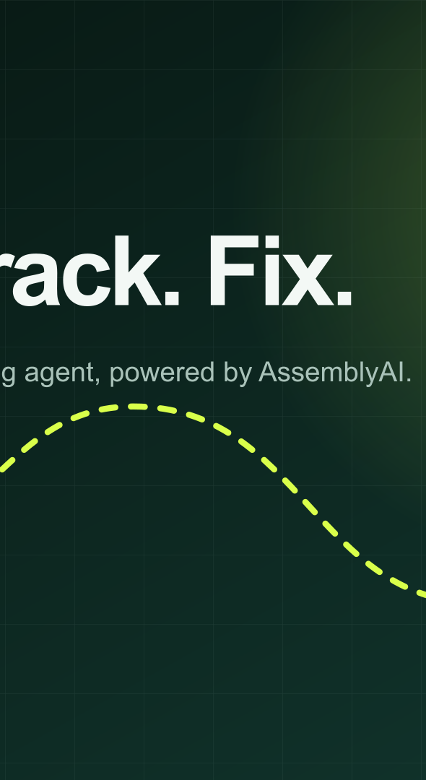
FixSA Voice
Speak. Track. Prove.
A voice-first civic issue reporting agent with resident-verified outcomes
ASSEMBLYAI VOICE AGENT HACKATHON / VALO SYSTEMS
Notes:
FixSA Voice hackathon deck. Product and visual assets by VALO Systems.

Slide 2
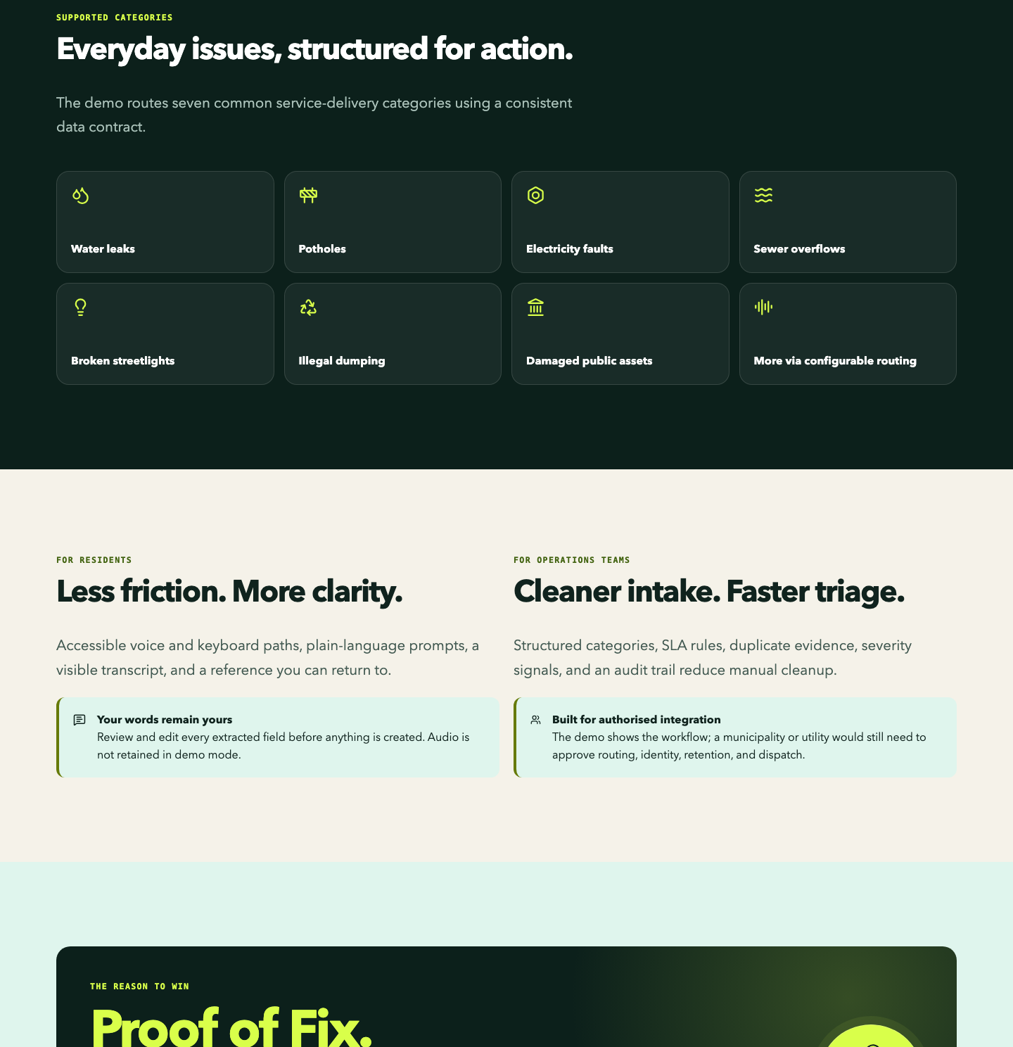
FIXSA VOICE 02
Residents tell stories. Service systems expect fields
Forms push the translation burden onto the person reporting the problem. Missing context and duplicate reports slow triage, while status remains opaque.
FixSA listens first, then structures only what the workflow needs.
Notes:
Source: live FixSA Voice deployment captured 18 September 2026 at https://fixsa.valosystems.co.za/.

Slide 3
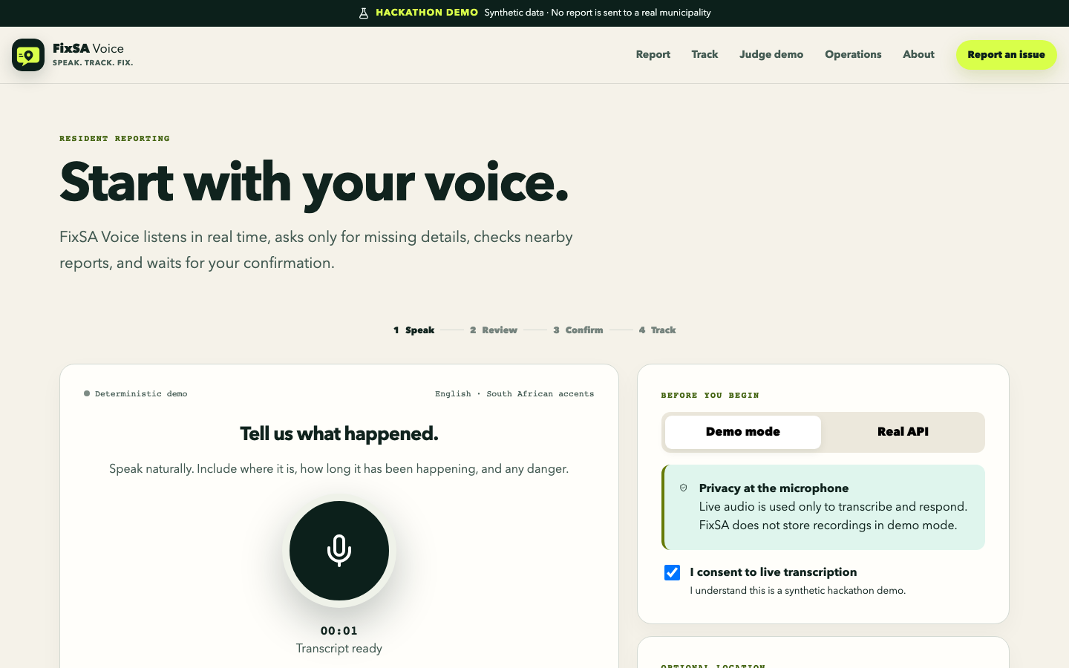
FIXSA VOICE 03
One conversation becomes a trackable work order
Speak naturally
FixSA collects the missing location, duration and hazard detail during the conversation.
Review before action
The resident sees the structured record and confirms the complete read-back before creation or merge.
Notes:
Source: live hosted deterministic voice journey captured at https://fixsa.valosystems.co.za/report?scenario=water.

Slide 4
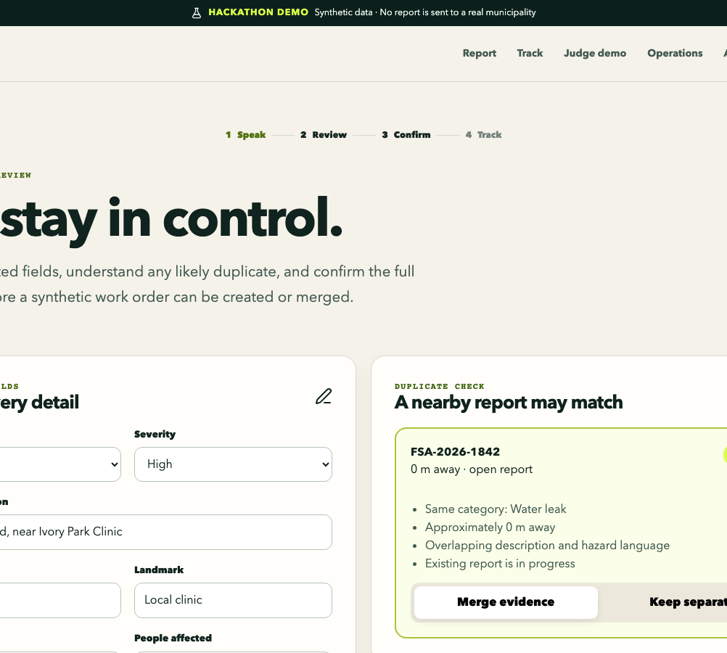
FIXSA VOICE 04
AssemblyAI is the interaction layer
Realtime transcript events keep the conversation visible. Spoken replies handle turn-taking. JSON-schema tool calls move validated data into the civic workflow.
The permanent key never reaches the browser
Laravel exchanges the server-only credential for a short-lived Voice Agent token. The browser receives only the temporary session token.
Notes:
AssemblyAI sources: https://www.assemblyai.com/docs/voice-agents/voice-agent-api/browser-integration and https://www.assemblyai.com/docs/voice-agents/voice-agent-api/tools/client-side-tools. Hosted application capture from the FixSA Voice deployment.

Slide 5
FIXSA VOICE 05
Nine tools share one guarded contract
CLASSIFY
CONFIRM
ACT
classify_service_issue
search_nearby_reports
confirm_report_details
attach_evidence
create_service_request
merge_with_existing_report
FOLLOW THROUGH
get_report_status
verify_resolution
update_report_status
Create and merge fail closed until the resident confirms the full read-back.
Notes:
Tool names match the implemented FixSA Voice agent contract in src/lib/voice-agent-config.ts.

Slide 6
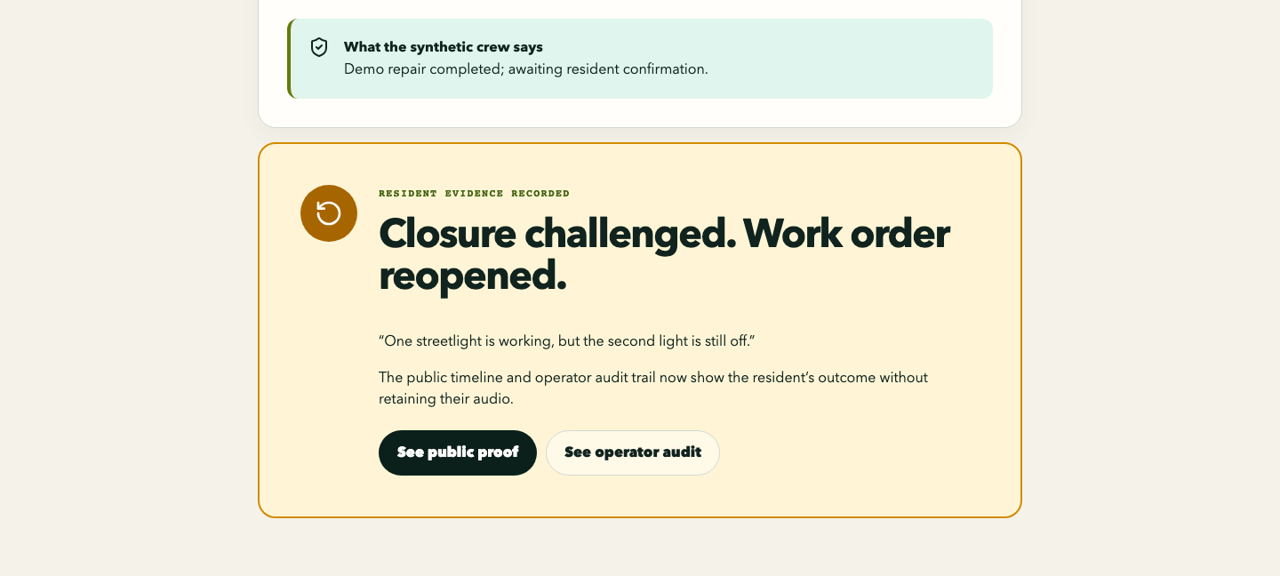
FIXSA VOICE 06
Proof of Fix closes the accountability loop
A status change to resolved is only a claim. The resident confirms the repair, reports a partial result, or disputes the closure.
Partial or failed work reopens automatically
The public timeline and operator audit both record the resident outcome without retaining audio.
Notes:
Source: live hosted Proof of Fix journey for synthetic reference FSA-2026-1811.

Slide 7
FIXSA VOICE 07
Safety and privacy are workflow states
Consent before capture
Audio stays ephemeral by default. Public views use allowlisted fields and rounded location coordinates.
Danger stops ordinary automation
FixSA tells the resident to move to safety and contact the appropriate official service. It never fabricates an emergency number.
Notes:
Source: hosted electricity danger scenario. The page contains synthetic data and no emergency-service number.

Slide 8
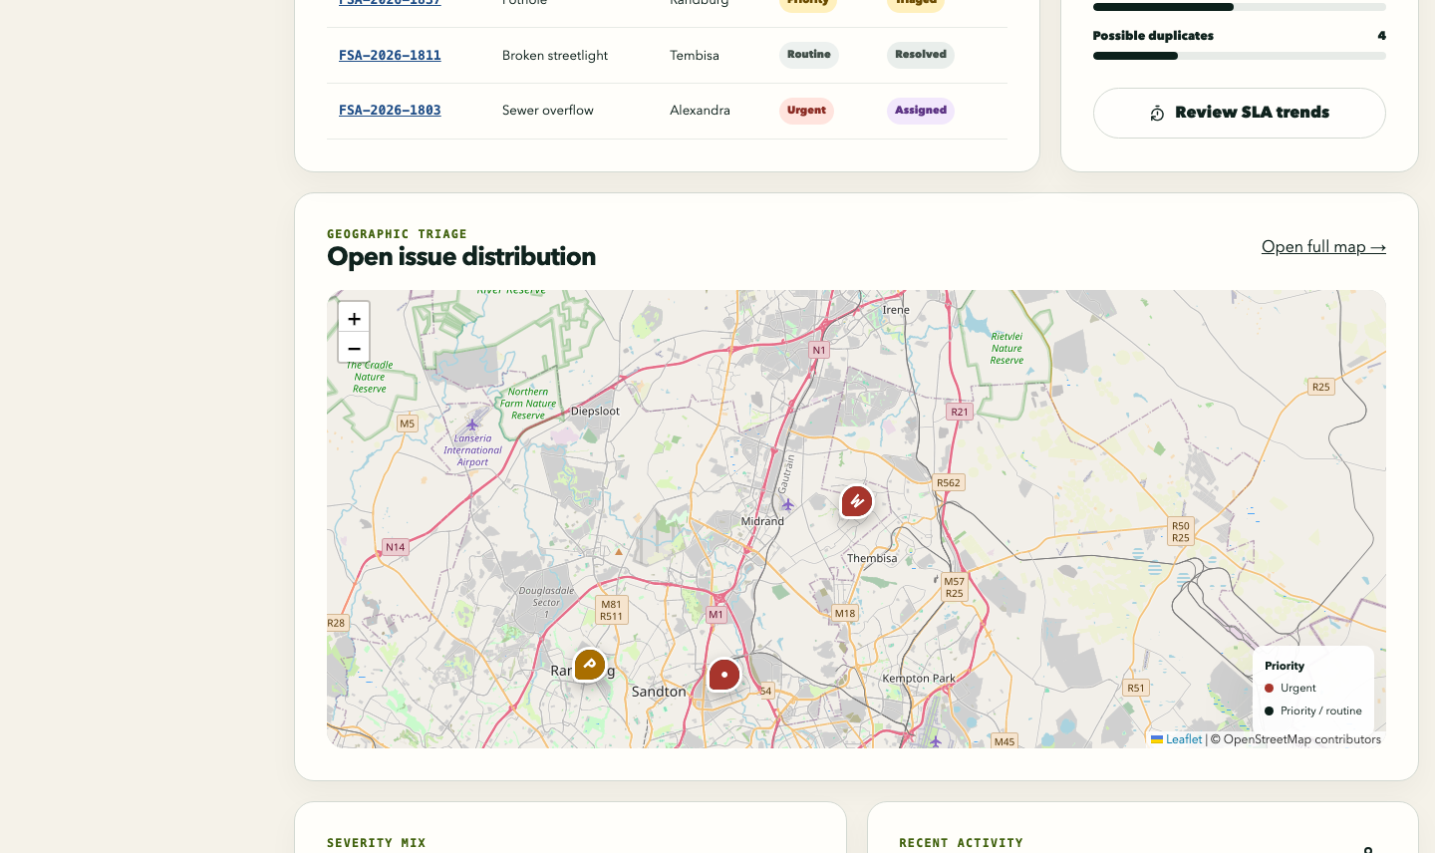
FIXSA VOICE 08
One evidence trail serves residents and operations
Residents
Accessible voice and keyboard intake
Clear read-back and explicit consent
Public status and Proof of Fix
Operations
Cleaner records, duplicate context and a visible SLA history
Notes:
Source: hosted synthetic operations dashboard. The interface is a judge preview; production operator endpoints require Sanctum authentication.

Slide 9
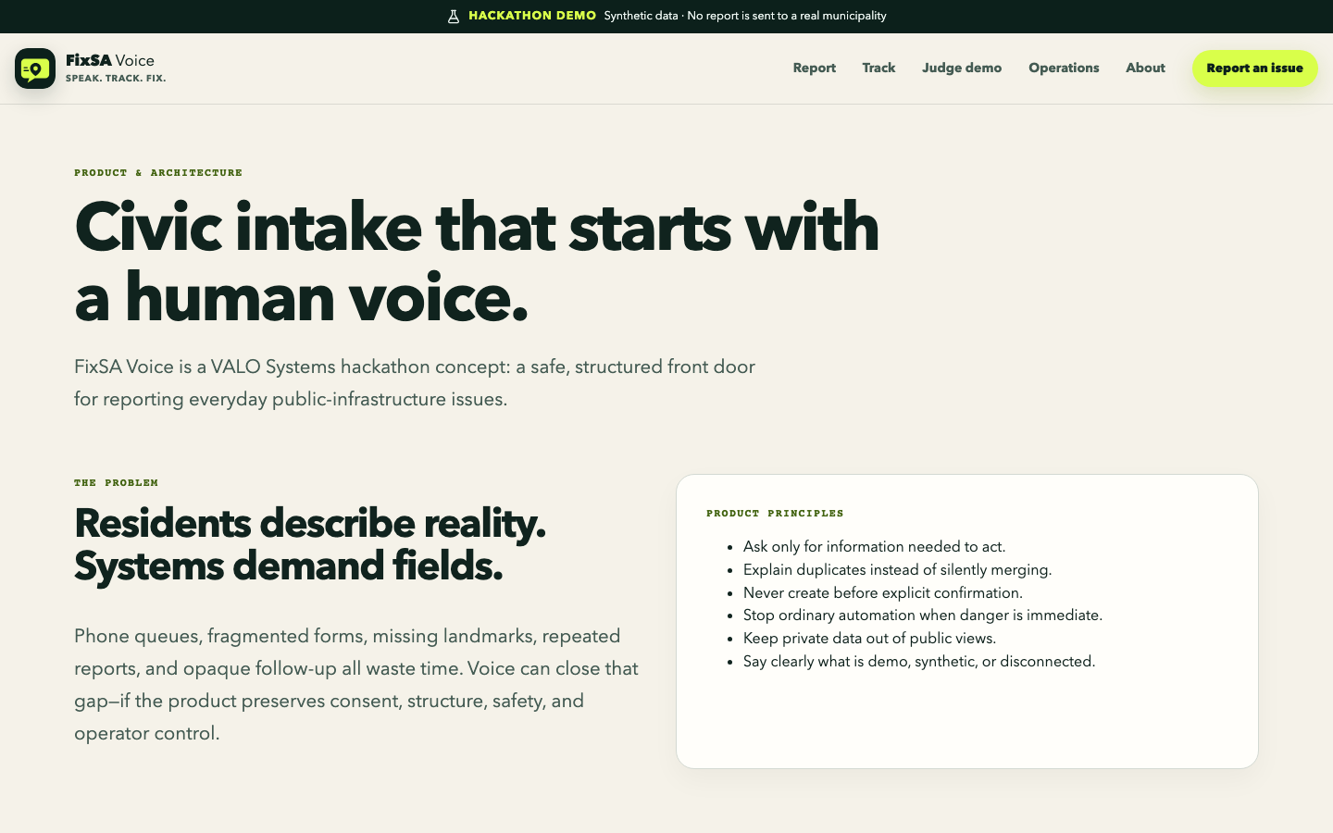
FIXSA VOICE 09
Reliable demo path, production-ready data path
Static Next.js frontend
cPanel serves the prebuilt interface over HTTPS.
Laravel 13 and MariaDB
ULIDs, indexed public references, transactions, idempotency and immutable audit events support clean handoff to authorised systems.
Server-only AssemblyAI key
Notes:
Architecture source: repository docs/architecture.md and docs/database-design.md. Deployment health: https://api.fixsa.valosystems.co.za/api/v1/health.

Slide 10
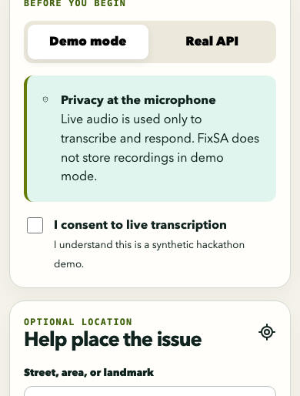
FIXSA VOICE 10
What works now, what remains synthetic
Working now
Synthetic by design
Real AssemblyAI Voice Agent token flow
Validated civic tools
Laravel and MariaDB persistence
Hosted responsive journeys
People, locations and metrics
Operator preview actions
Municipal dispatch and integrations
Next: authorised work-order integration, verified identity, geocoding and evidence-led language expansion.
Notes:
The deck preserves the product boundary described in README.md and the hosted demo banner. All displayed operational data is synthetic.

Slide 11
FIXSA VOICE 11
Judging evidence is visible and testable
Technology
Originality
Trust
Delivery
Real Voice Agent token exchange
Nine structured tools
Server-only credential
Explainable deduplication
Resident Proof of Fix
Automatic reopen
Consent-first voice
Public/private split
Immediate-danger stop
24 unit tests
13 API tests
40 local browser runs
Hosted acceptance confirms HTTPS, MariaDB health, CORS, redacted public tracking, 401 operator protection and temporary Voice Agent tokens.
Notes:
Test evidence: docs/final-verification.md. Latest local verification: 24 Vitest tests, 13 Laravel tests with 70 assertions, and 40 Playwright runs.

Slide 12
Speak. Track. Prove.
Try the resident Proof of Fix journey
fixsa.valosystems.co.za/verify?ref=FSA-2026-1811
github.com/SibusisoMashita/fixsa-voice
A VALO Systems concept / Synthetic hackathon data
Notes:
Live application: https://fixsa.valosystems.co.za. Public repository: https://github.com/SibusisoMashita/fixsa-voice.

