Slide 1
Artificial Neural Networks
ECE 398BD
Instructor: Shobha Vasudevan

Slide 2

Computers are smart?
Calculate
Input
Output
Modern computers: get inputs, do some calculations, output results
Can they do something smart?
Yes!

Slide 3
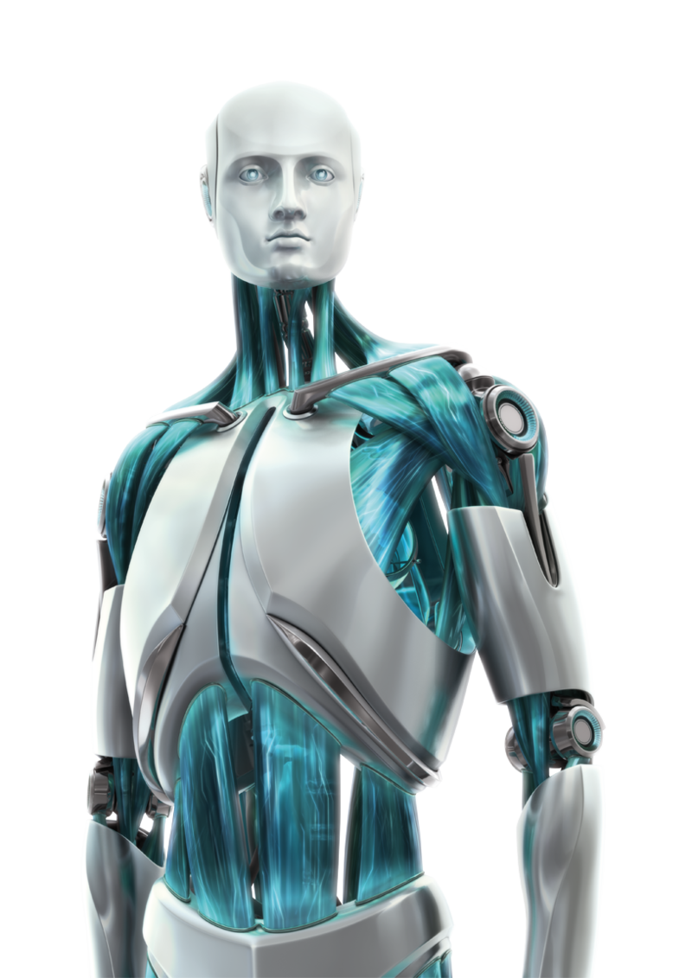
Smart computers
Robots: combination of Artificial Intelligence: Computer Vision, Speech Recognition, etc.
How do they “think” like we do?
A good way is to simulate human brains
Picture from quorrischarmyn.com

Slide 4
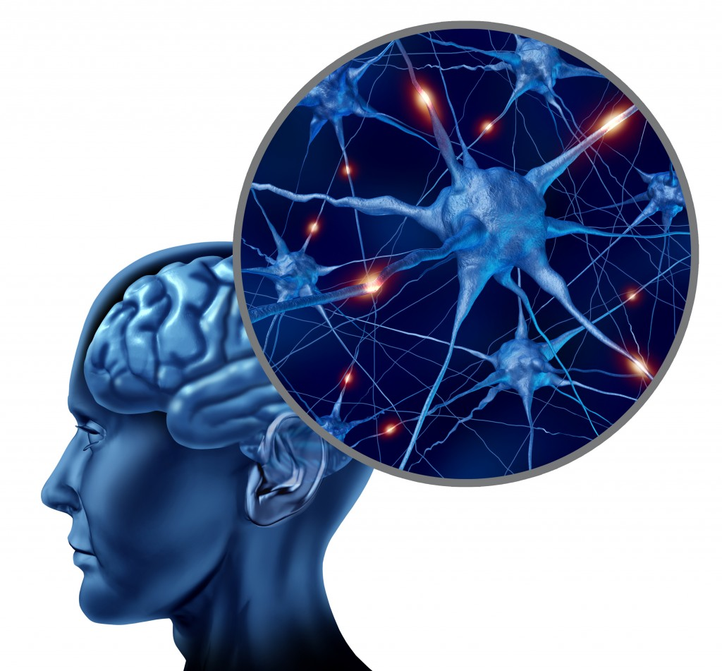
Brains and Neurons
Human brain contains billions of neurons
Neurons are the basic elements that make the brain work
Picture from phys.org

Slide 5
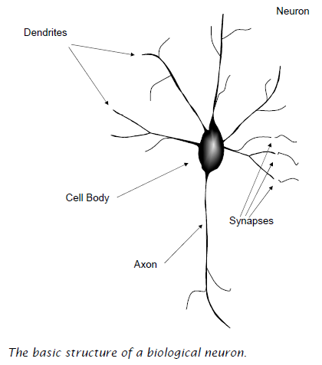
Neurons
Neurons pass messages between each other
Dendrites: receive messages from other neurons
Axon: sends messages to other neurons
Cell body: processes incoming messages and produce outgoing messages
Synapses: connections between dendrites and axons
Neural Computing

Slide 6
Neurons
Neurons form networks
Passing through messages are our thoughts
Scientists believe that the efficiency (“strength”) of synapses is what is modified when we learn
Neural Computing

Slide 7
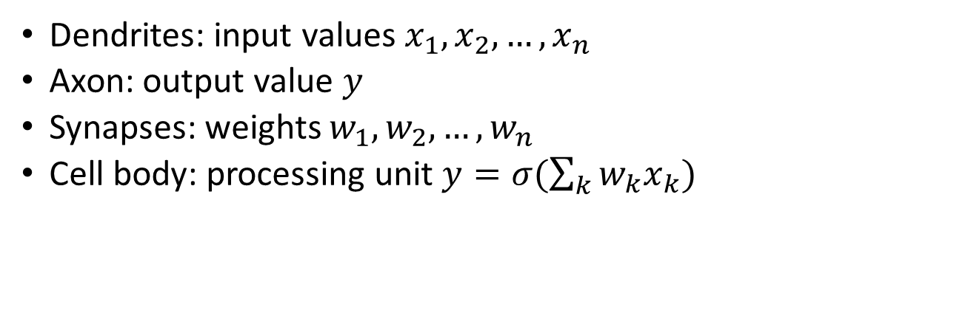
Artificial Neurons
Dendrites: input values $x_{1}, x_{2}, …, x_{n}$
Axon: output value $y$
Synapses: weights $w_{1}, w_{2}, …, w_{n}$
Cell body: processing unit $y=σ(\sum_{k}{w_{k}x_{k}})$
Neural Computing
Basheer, I. A., & Hajmeer, M. (2000).

Slide 8
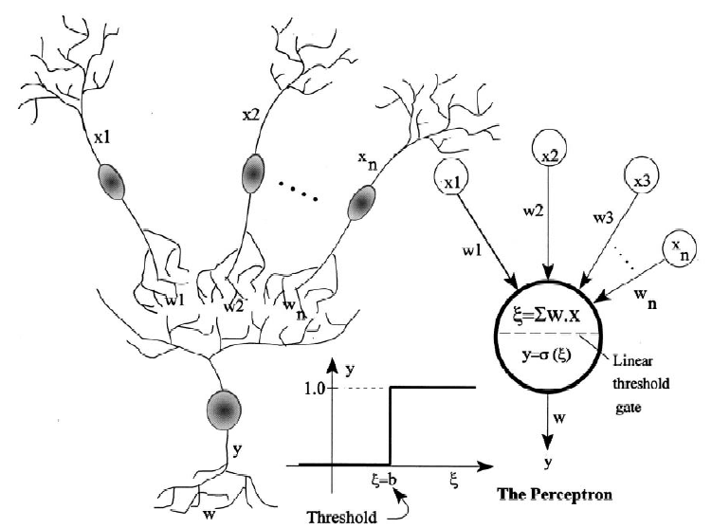
Artificial Neurons
A simulation of biological neurons
Artificial Neurons form Artificial Neural Networks
Basheer, I. A., & Hajmeer, M. (2000).

Slide 9
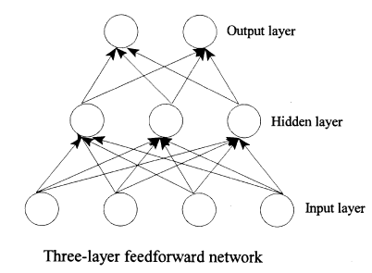
Artificial Neural Networks (ANNs)
Basic structure of 3-layer feedforward network:
One input layer, one hidden layer, and one output layer
Each layer is formed by many processing units
Full weighted connections between adjacent layers (but not within layers)
Threshold function is only applied on hidden layer
Basheer, I. A., & Hajmeer, M. (2000).

Slide 10
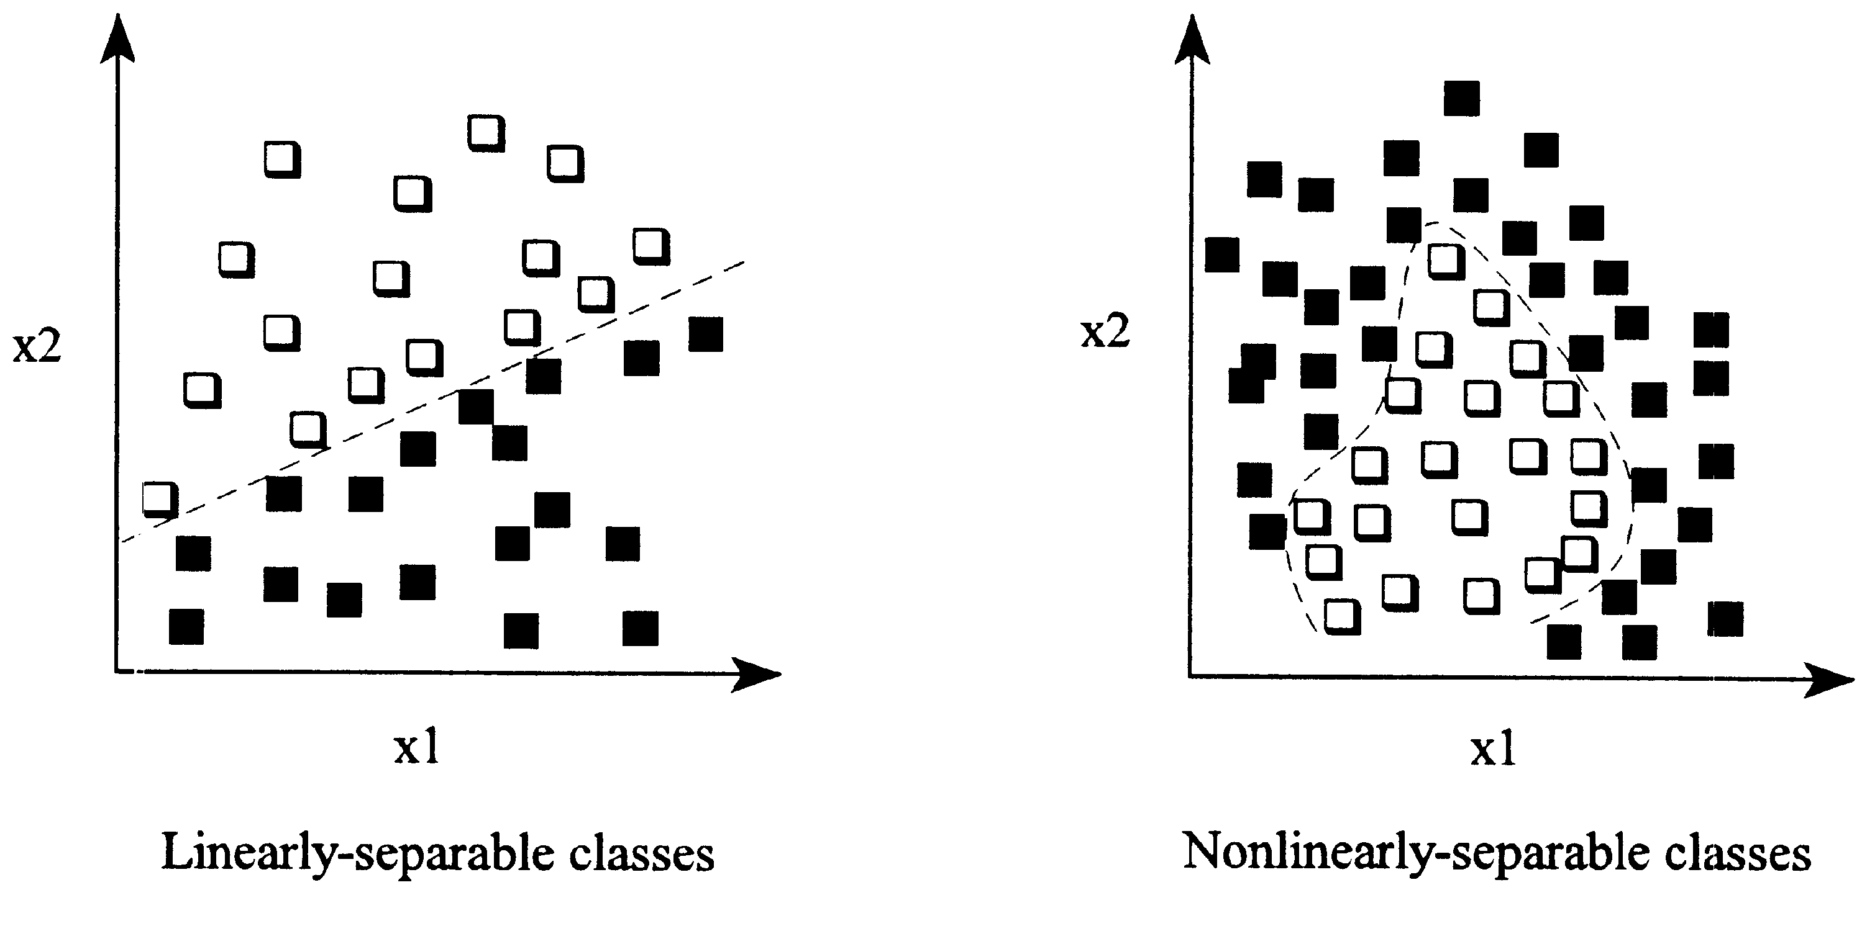
Artificial Neural Networks (ANNs)
Often used as non-linear classifier
Classifier: assigns each input into one category (class)
Non-linear: relations between inputs and outputs are not linear
Basheer, I. A., & Hajmeer, M. (2000).

Slide 11
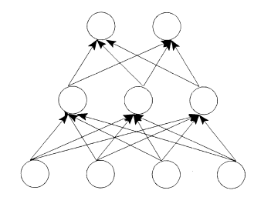


Examples of ANN applications
We can use ANNs for recognizing handwritten letters:
$$a$$

Slide 12
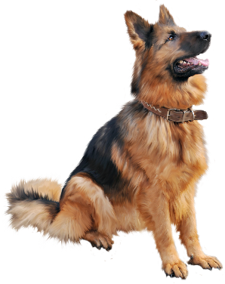
Examples of ANN applications
We can use ANNs for recognizing content of images:
dog

Slide 13
Examples of ANN applications
We can use ANNs as language models:
I have seen it on him, and could _____ to it.
(a) write
(b) migrate
(c) climb
(d) swear
(e) contribute
(d)

Slide 14
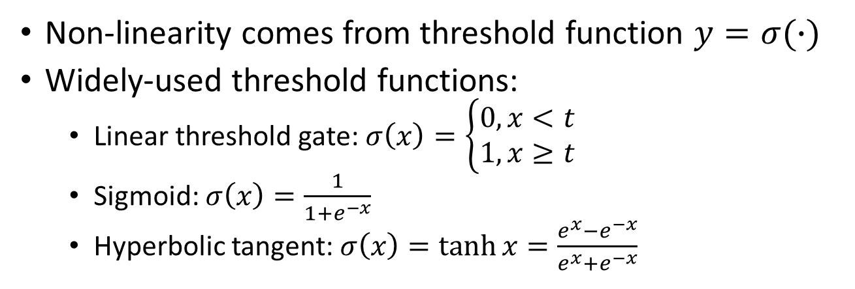
Artificial Neural Networks (ANNs)
Non-linearity comes from threshold function $y=σ(∙)$
Widely-used threshold functions:
Linear threshold gate: $σ\left(x\right)=\left\{\begin{aligned}0, x<t \\ 1, x≥t\end{aligned}\right.$
Sigmoid: $σ\left(x\right)=\frac{1}{1+e^{−x}}$
Hyperbolic tangent: $σ\left(x\right)=\tanh{x}=\frac{e^{x}−e^{−x}}{e^{x}+e^{−x}}$
Basheer, I. A., & Hajmeer, M. (2000).

Slide 15
Artificial Neural Networks (ANNs)
When we have the inputs, how do we use ANN to get output?
Convert the input into a vector and feed it to the input layer
Basheer, I. A., & Hajmeer, M. (2000).

Slide 16
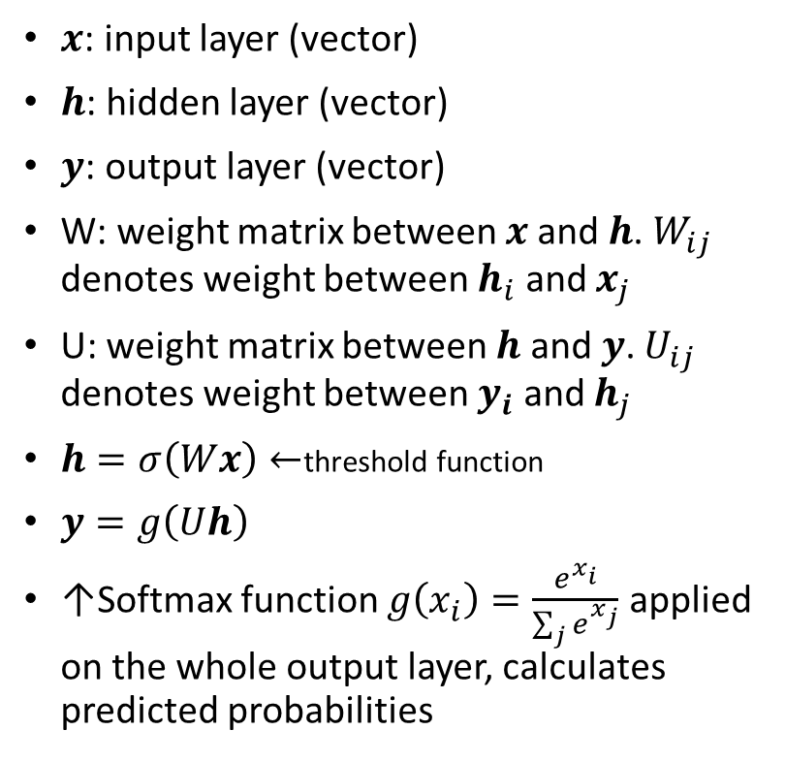
Feedforward propagation
$x$: input layer (vector)
$h$: hidden layer (vector)
$y$: output layer (vector)
W: weight matrix between $x$and $h$. $W_{ij}$ denotes weight between $h_{i}$ and $x_{j}$
U: weight matrix between $h$ and $y$. $U_{ij}$ denotes weight between $y_{i}$ and $h_{j}$
$h=σ\left(Wx\right)←$threshold function
$y=g\left(Uh\right)$
↑Softmax function $g\left(x_{i}\right)=\frac{e^{x_{i}}}{\sum_{j}{e^{x_{j}}}}$ applied on the whole output layer, calculates predicted probabilities
Feedforward propagation
W
U
h
y
x

Slide 17
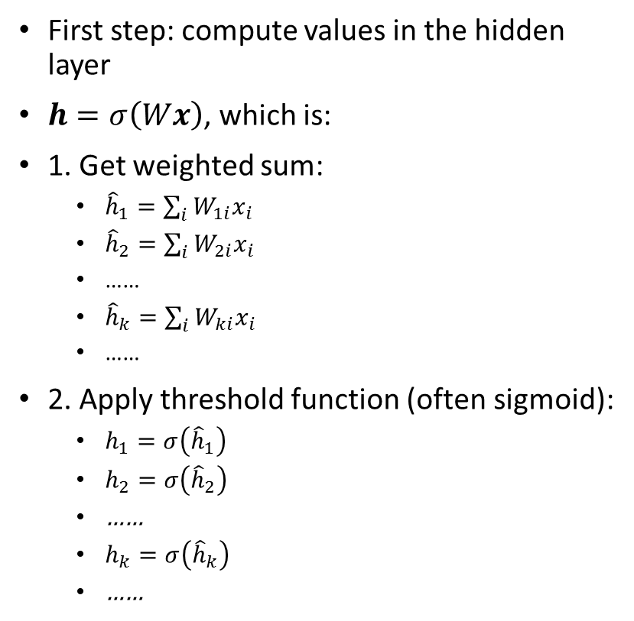
Feedforward propagation
First step: compute values in the hidden layer
$h=σ\left(Wx\right)$, which is:
1. Get weighted sum:
${\hat{h}}_{1}=\sum_{i}{W_{1i}x_{i}}$
${\hat{h}}_{2}=\sum_{i}{W_{2i}x_{i}}$
……
${\hat{h}}_{k}=\sum_{i}{W_{ki}x_{i}}$
……
2. Apply threshold function (often sigmoid):
$h_{1}=σ\left({\hat{h}}_{1}\right)$
$h_{2}=σ\left({\hat{h}}_{2}\right)$
……
$h_{k}=σ\left({\hat{h}}_{k}\right)$
……
Feedforward propagation
W
U
h
y
x

Slide 18
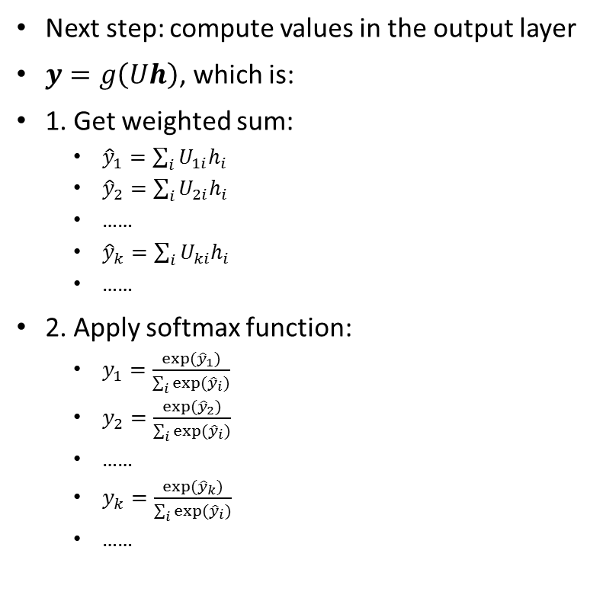
Feedforward propagation
Next step: compute values in the output layer
$y=g\left(Uh\right)$, which is:
1. Get weighted sum:
${\hat{y}}_{1}=\sum_{i}{U_{1i}h_{i}}$
${\hat{y}}_{2}=\sum_{i}{U_{2i}h_{i}}$
……
${\hat{y}}_{k}=\sum_{i}{U_{ki}h_{i}}$
……
2. Apply softmax function:
$y_{1}=\frac{exp⁡({\hat{y}}_{1})}{\sum_{i}{exp⁡({\hat{y}}_{i})}}$
$y_{2}=\frac{exp⁡({\hat{y}}_{2})}{\sum_{i}{exp⁡({\hat{y}}_{i})}}$
……
$y_{k}=\frac{exp⁡({\hat{y}}_{k})}{\sum_{i}{exp⁡({\hat{y}}_{i})}}$
……
Feedforward propagation
W
U
h
y
x

Slide 19


Example: single handwritten digit
Feedforward propagation (hidden layer size = 20)
reshape
W
U
$$h=σ(Wx)$$
$$y=softmax(Uh)$$
28x28 image
y
h
10x1 vector
20x1 vector
x
784x1 vector

Slide 20
Example: single handwritten digit
Output
Probability of this digit to be 0
0.018
0.002
0.003
0.124
0.000
0.832
0.002
0.001
0.016
0.003
0
0
0
0
0
1
0
0
0
0
Probability of this digit to be 5
Probability of this digit to be 9
10x1 output vector
desired output vector

Slide 21
Training neural networks
Why do neural networks have the ability to do classification: specific values of weights in weight matrices
To build a classifier, weights need to be trained (just like modifying strength of synapses)
How to train: use plenty pairs of input-output datasets, adjust the weights so that for each input, the network gives desired output (or very close to desired output)
Training algorithm: Stochastic Gradient Descent (SGD)

Slide 22
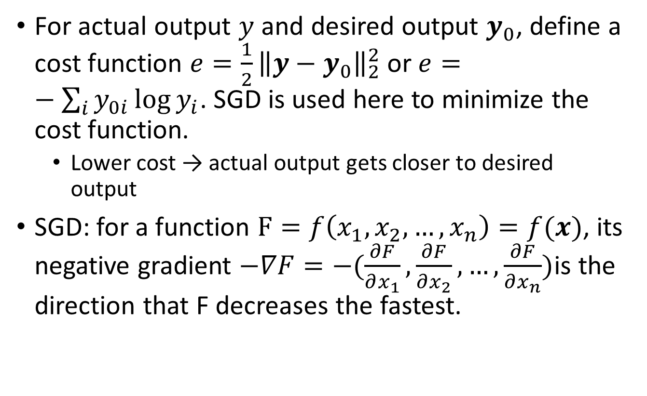
Stochastic Gradient Descent
For actual output $y$ and desired output $y_{0}$, define a cost function $e=\frac{1}{2}{\left\|y−y_{0}\right\|}_{2}^{2}$ or $e=−\sum_{i}{y_{0i}\log{y_{i}}}$. SGD is used here to minimize the cost function.
Lower cost → actual output gets closer to desired output
SGD: for a function $F=f\left(x_{1},x_{2},…,x_{n}\right)=f(x)$, its negative gradient $−∇F=−(\frac{∂F}{∂x_{1}},\frac{∂F}{∂x_{2}},…,\frac{∂F}{∂x_{n}})$is the direction that F decreases the fastest.

Slide 23


Stochastic Gradient Descent
Example of 1D function $F=f(x)$
Direction of gradient
Current point
Gradient descent

Slide 24
Stochastic Gradient Descent
Example of 1D function $F=f(x)$
Direction of gradient
Current point
Gradient descent

Slide 25
Stochastic Gradient Descent
Example of 1D function $F=f(x)$
Direction of gradient
Current point
Gradient descent

Slide 26
Stochastic Gradient Descent
Example of 1D function $F=f(x)$
Current point (local minimum)

Slide 27


Stochastic Gradient Descent
Example of 2D function $z=f(x,y)$
Direction of gradient
Current point
Gradient descent

Slide 28
Stochastic Gradient Descent
Example of 2D function $z=f(x,y)$
Direction of gradient
Current point
Gradient descent

Slide 29
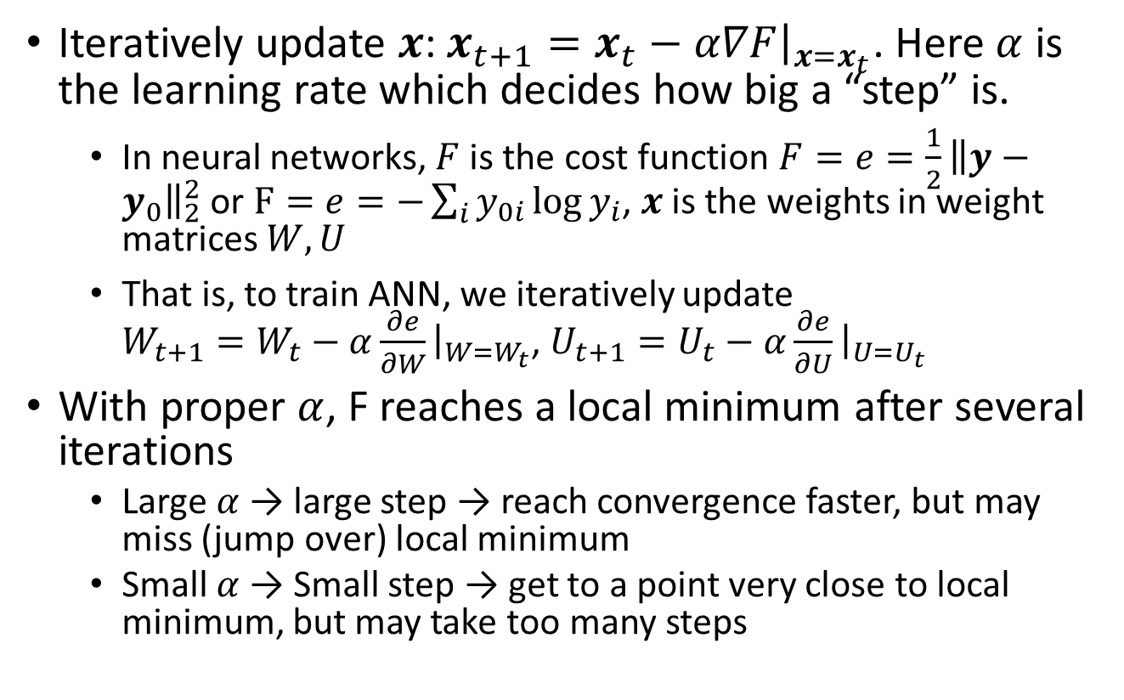
Stochastic Gradient Descent
Iteratively update $x$: $x_{t+1}=x_{t}−α∇F{\left.​\right|}_{x=x_{t}}$. Here $α$ is the learning rate which decides how big a “step” is.
In neural networks, $F$ is the cost function $F=e={\frac{1}{2}\left\|y−y_{0}\right\|}_{2}^{2}$ or $F=e=−\sum_{i}{y_{0i}\log{y_{i}}}$, $x$ is the weights in weight matrices $W, U$
That is, to train ANN, we iteratively update $W_{t+1}=W_{t}−α\frac{∂e}{∂W}{\left.​\right|}_{W=W_{t}}$, $U_{t+1}=U_{t}−α\frac{∂e}{∂U}{\left.​\right|}_{U=U_{t}}$
With proper $α$, F reaches a local minimum after several iterations
Large $α$ → large step → reach convergence faster, but may miss (jump over) local minimum
Small $α$ → Small step → get to a point very close to local minimum, but may take too many steps

Slide 30
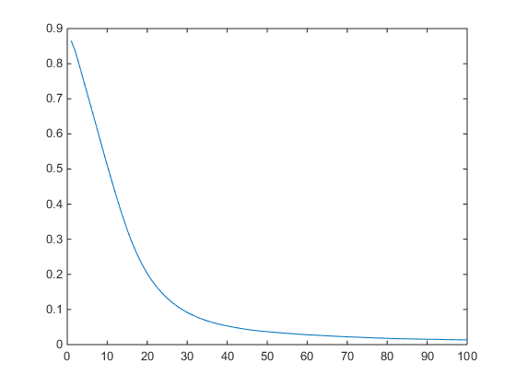

Effect of learning rate
$α$=0.001
MSE
0.02
Iteration

Slide 31
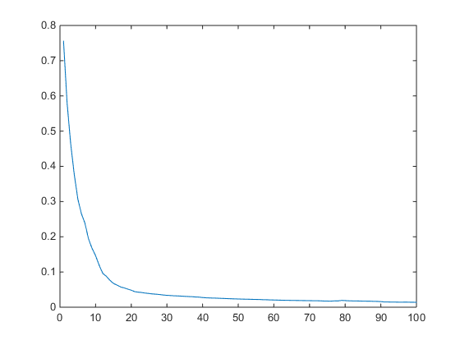

Effect of learning rate
$α$=0.01
MSE
0.02
Iteration

Slide 32
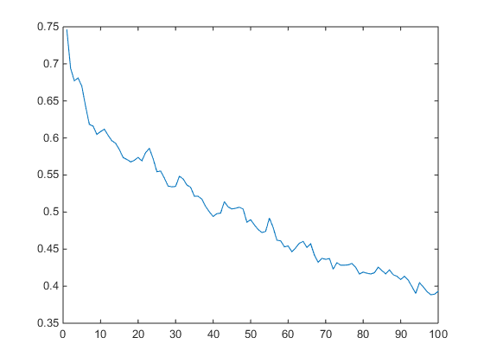

Effect of learning rate
$α$=0.1
MSE
0.39
Iteration

Slide 33


Training neural networks
At the very beginning, weights are randomly initialized
For each training sample, first get its output by feedforward propagation
W
U
$$h=σ(Wx)$$
$$y=softmax(Uh)$$
h
y
x

Slide 34


Training neural networks
Calculate error at output layer: $y_{e}=y−y_{0}$ ($y_{0}$: desired output. Use $e=−\sum_{i}{y_{0i}\log{y_{i}}}$ here. Note we need to consider about softmax function when calculating gradient)
W
U
h
y_{e}
$$y_{e}=y−y_{0}$$
x

Slide 35
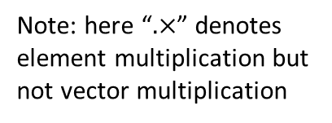


Training neural networks
Back-propagate error to hidden layer: $h_{e}=U^{T}y_{e}$
Unfortunately, not correct. We need to consider about threshold function: $h_{e}≔U^{T}y_{e}.×σ^{′}(Wx)$.
For sigmoid, it has $σ^{′}\left(x\right)=σ(x)(1−σ(x))$, so $h_{e}=U^{T}y_{e}.×h.×(1−h)$.
W
U
$$h_{e}=U^{T}y_{e}.×h.×(1−h)$$
h_{e}
y_{e}
Note: here “$.×$” denotes element multiplication but not vector multiplication
x

Slide 36

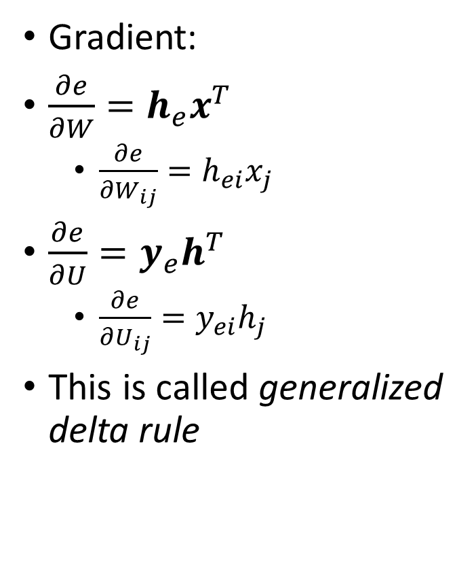

Training neural networks
Gradient:
$\frac{∂e}{∂W}=h_{e}x^{T}$
$\frac{∂e}{∂W_{ij}}=h_{ei}x_{j}$
$\frac{∂e}{∂U}=y_{e}h^{T}$
$\frac{∂e}{∂U_{ij}}=y_{ei}h_{j}$
This is called generalized delta rule
W
U
h_{e}
y_{e}
$$\frac{∂e}{∂W}$$
x
$$\frac{∂e}{∂U}$$
W
U
h
y
x

Slide 37
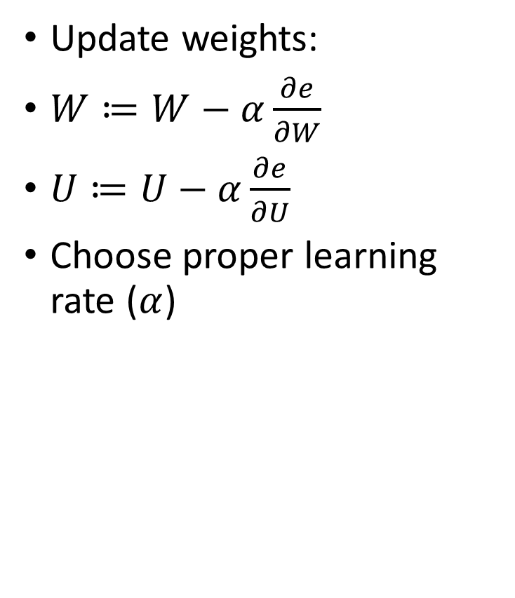
Training neural networks
Update weights:
$W≔W−α\frac{∂e}{∂W}$
$U≔U−α\frac{∂e}{∂U}$
Choose proper learning rate ($α$)
W
U
h_{e}
y_{e}
$$\frac{∂e}{∂W}$$
x
$$\frac{∂e}{∂U}$$
W
U
h
y
x

Slide 38
Training neural networks
Train with every input-output pair in the training dataset with steps above, for many iterations until convergence (loss function reaches the local minimum).
Training dataset: the larger the better (but may take longer time)
Number of iterations: often depends on learning rate and training dataset

Slide 39
Number of hidden layer elements
Number of hidden layer elements are manually decided. Large hidden layer may enhance performance
HOWEVER, large hidden layer may also cause over-fitting

Slide 40
Over-fitting
Example of over-fitting
Actual classification (with noise on data points)
Over-fitting

Slide 41
Over-fitting
Symptom of over-fitting: errors on training data samples are very small, but when test with another dataset, the classifying accuracy is low
Choose proper hidden layer size to avoid over-fitting

Slide 42
References
Basheer, I. A., & Hajmeer, M. (2000). Artificial neural networks: fundamentals, computing, design, and application. Journal of microbiological methods, 43(1), 3-31.
Neural Computing, A Technology Handbook for Professional II/PLUS and NeuralWorks Explorer, NeuralWare Inc., Pittsburgh(1996).

