Slide 1
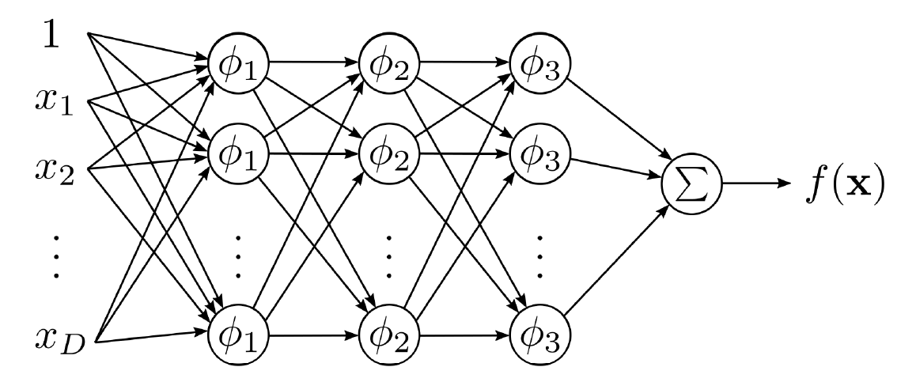
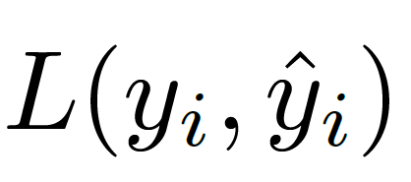
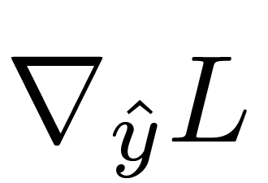
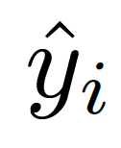
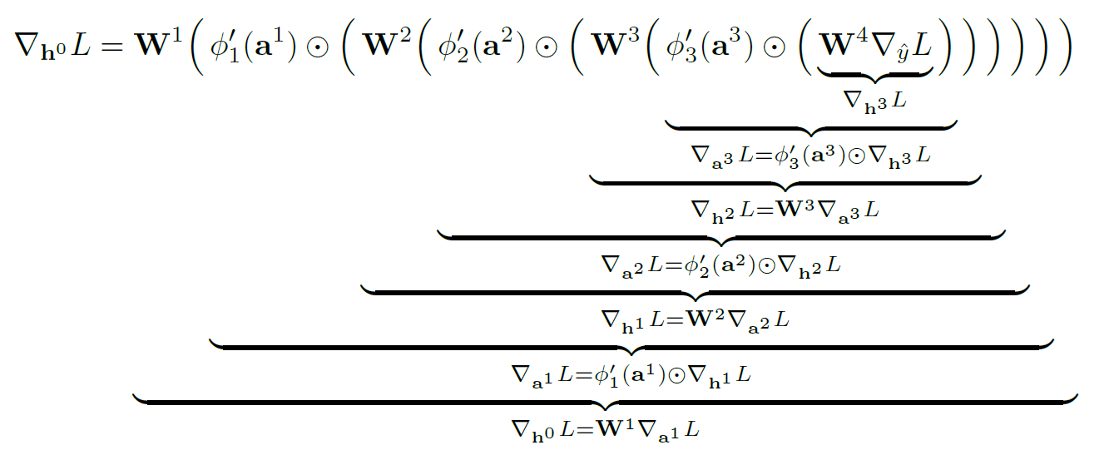
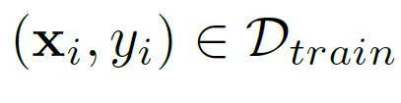

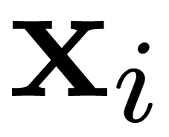
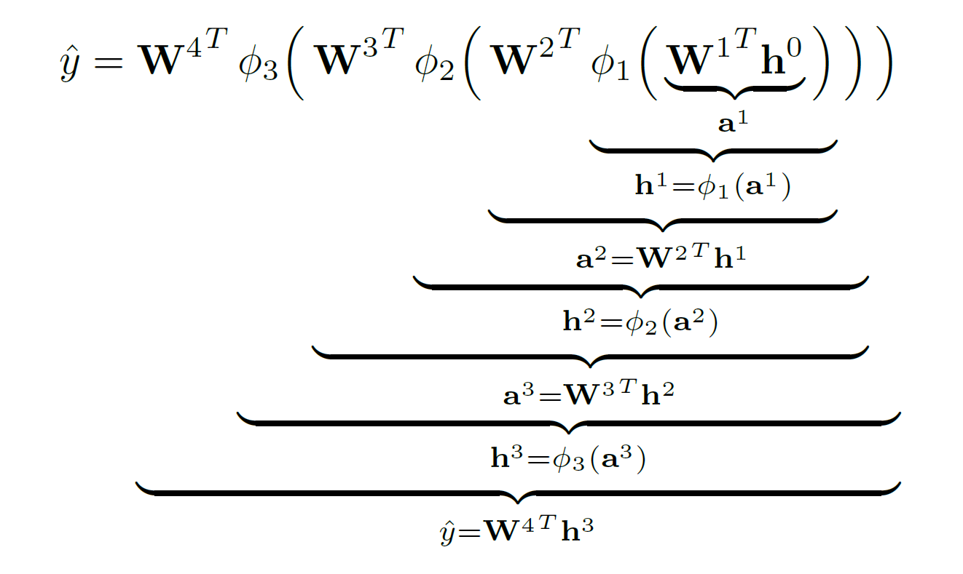
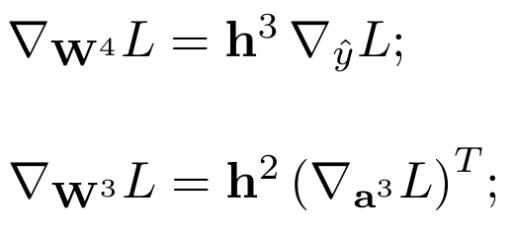
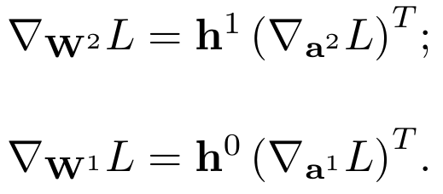
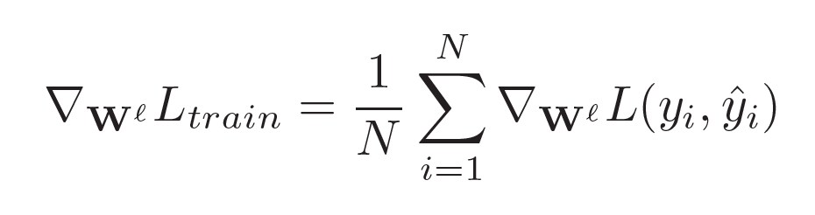

Step 4 Compute loss function and its gradient
Step 5 Back propagate the error (encoded in the loss)
Step 0 Repeat Steps 1 – 6 for all
Step 1 Stack the input features
Step 2 Feed the inputs forward using the current parameters {W¹, W², W³, W⁴}
Step 6 Compute gradient of the loss w.r.t. network parameters {W¹, W², W³, W⁴}
Step 7 Update network parameters {W¹, W², W³, W⁴}
Step 3 Bookkeep both the activations {a¹, a², a³, a⁴} and the layer outputs {h¹, h², h³, h⁴}
Step 8 Go to Step 0 until reach some stop criteria

