Slide 1
Coursera Capstone Project
New York City Crime Analysis

Slide 2
Introduction
This report is for commercial companies as well as State law enforcement on ways to reduce crime, provide internet accesses as well solve potential crimes. Suggestions provided in this study will provide recommendations on where to emplace wifi Camera systems that provide a free 5G Wifi service in New York City.
Crime in select New York City neighborhoods has increased overtime despite efforts to Police the areas. What I would to illustrate is that there is a direct correlation to locations that offer free Wifi and reduced crime rates. While deciding the location to offer free wifi service there are several factors to consider. Below is the data required to explain the problem and recommendations on where to place more cameras.
My business does not require a physical location to establish a company headquarters since we are providing a service. The service that I am providing has two(2) target audiences; law enforcement, and people looking for free data. Additionally, I will have ad services targeted to those individuals using the free WiFi.

Slide 3
Data
1.) Locational data for all Wi-Fi access points in New York City. I will use this data to show that areas in New York City that have clusters of WiFi have lower crime rates. I will then use areas without WiFi to use as locations to install WiFi 5G cameras
2.) Crime statistics for New York City. This data will be used to show where crime is higher than surrounding areas.
3.) New York City Neighborhood Names from JSON
4.) Locations of Police Stations in New York City from Foursquare.

Slide 4
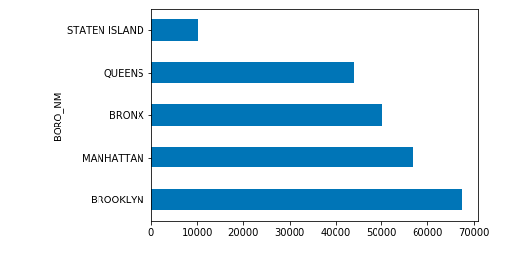
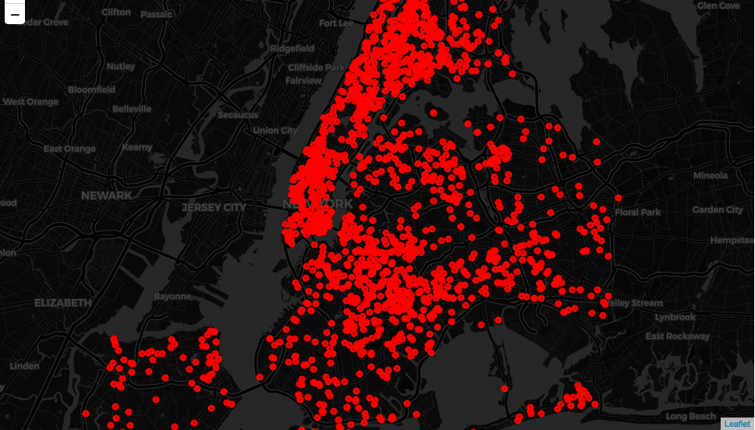
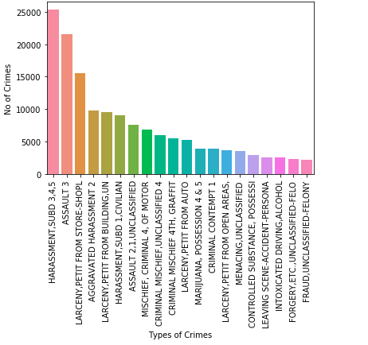
Data
Wi-Fi Locations
New York 1545
Brooklyn 564
Queens 370
Bronx 294
Staten Island 73
Flushing 9
Long Island City 7
Jamaica 5
Corona 3
Bayside 3
Crime Types and Locations
Locations of Crime in NYC

Slide 5
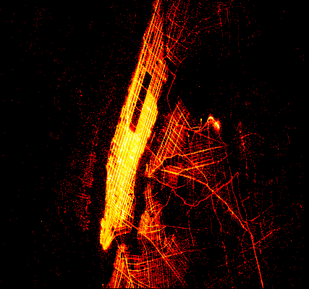
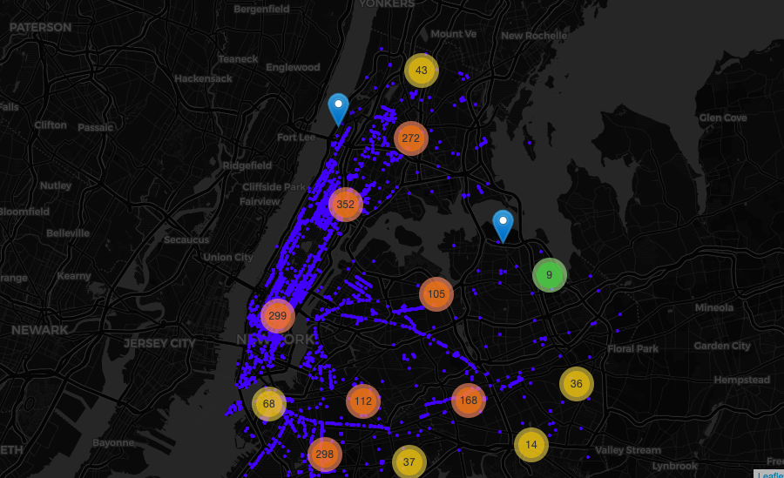
Methodology

Slide 6
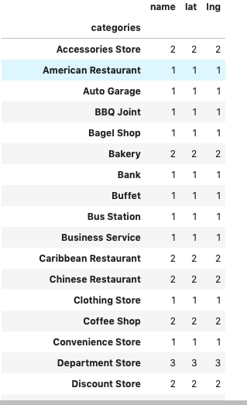
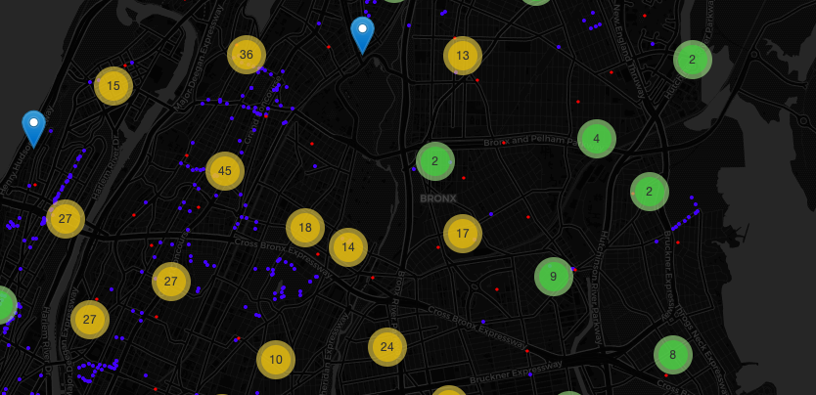
Analysis
No reported Police Station
Crime in the Bronx
Minimal Wi-Fi Available for Free

Slide 7
Conclusion
Purpose of this project was to identify areas in New York that have a high crime rate. In doing so, we found that areas within the Bronx were higher than surrounding areas. Additionally, I wanted to see the availability of free wifi in these areas to see if this service was already being provided. Lastly, I wanted to query the Foursquare data to determine if there police stations or government buildings in this location. Analysis of the Bronx identified
Final decission on optimal restaurant location will be made by stakeholders based on specific characteristics of neighborhoods and locations in every recommended zone, taking into consideration additional factors like attractiveness of each location (proximity to park or water), levels of noise / proximity to major roads, real estate availability, prices, social and economic dynamics of every neighborhood etc.

