Slide 1
First: questions from Lab 1

Slide 2
Numerical vs categorical data
Several people are still confused how to use
categorical data in
continuous classifiers
Cat | Class
A | +
A | +
B | +
B | -
C | -
No way to separate using a hyperplane
Have to convert categories to integers/floats
…

Slide 3
Numerical vs categorical data
Several people are still confused how to use
categorical data in
continuous classifiers
Label encoding
Cat | Class
A | +
A | +
B | -
B | -
C | +
Cat | Class | Label
A | + | 1
A | + | 1
B | - | 2
B | - | 2
C | + | 3

Slide 4
Numerical vs categorical data
BUT can result in difficult to separate values…
Several people are still confused how to use
categorical data in
continuous classifiers
Label encoding
Cat | Class
A | +
A | +
B | -
B | -
C | +
Cat | Class | Label
A | + | 1
A | + | 1
B | - | 2
B | - | 2
C | + | 3

Slide 5
Numerical vs categorical data
Several people are still confused how to use
categorical data in
continuous classifiers
Target encoding, sort according to positive class probability
Cat | Class
A | +
A | +
B | -
B | -
C | +
Cat | Class | Label
A | + | 1
A | + | 1
B | - | 3
B | - | 3
C | + | 2

Slide 6
Numerical vs categorical data
Cheating if the test set is used!
Several people are still confused how to use
categorical data in
continuous classifiers
Target encoding, sort according to positive class probability
Cat | Class
A | +
A | +
B | -
B | -
C | +
Cat | Class | Label
A | + | 1
A | + | 1
B | - | 3
B | - | 3
C | + | 2

Slide 7
Numerical vs categorical data
Several people are still confused how to use
categorical data in
continuous classifiers
One-hot encoding, every value is a new column
Cat | Class
A | +
A | +
B | +
B | -
C | -
Cat | Class | A | B | C
A | + | 1 | 0 | 0
A | + | 1 | 0 | 0
B | + | 0 | 1 | 0
B | - | 0 | 1 | 0
C | - | 0 | 0 | 1

Slide 8
Numerical vs categorical data
Q: What to do with unseen values in the test set?
Several people are still confused how to use
categorical data in
continuous classifiers
One-hot encoding, every value is a new column
Cat | Class
A | +
A | +
B | +
B | -
C | -
Cat | Class | A | B | C
A | + | 1 | 0 | 0
A | + | 1 | 0 | 0
B | + | 0 | 1 | 0
B | - | 0 | 1 | 0
C | - | 0 | 0 | 1

Slide 9
Numerical vs categorical data
Q: What to do with unseen values in the test set?
Several people are still confused how to use
categorical data in
continuous classifiers
One-hot encoding, every value is a new column
Cat | Class
A | +
A | +
B | +
B | -
C | -
Cat | Class | A | B | Other
A | + | 1 | 0 | 0
A | + | 1 | 0 | 0
B | + | 0 | 1 | 0
B | - | 0 | 1 | 0
C | - | 0 | 0 | 1

Slide 10
Numerical vs categorical data
Another downside is the
blow-up in dimensionality…
It is essentially a unary encoding of categorical membership
Several people are still confused how to use
categorical data in
continuous classifiers
One-hot encoding, every value is a new column
Cat | Class
A | +
A | +
B | +
B | -
C | -
Cat | Class | A | B | Other
A | + | 1 | 0 | 0
A | + | 1 | 0 | 0
B | + | 0 | 1 | 0
B | - | 0 | 1 | 0
C | - | 0 | 0 | 1

Slide 11
Numerical vs categorical data
A binary encoding is also possible..
Several people are still confused how to use
categorical data in
continuous classifiers
One-hot encoding, every value is a new column
Cat | Class
A | +
A | +
B | +
B | -
C | -
Cat | Class | bit1 | bit2
A | + | 1 | 0
A | + | 1 | 0
B | + | 0 | 1
B | - | 0 | 1
C | - | 1 | 1

Slide 12
Most important consideration
Which encoding to use depends on the classifier!
Consider one-hot encoding, the distance between rows with different values becomes 2.
In label encoding, the distance seems a bit arbitrary
Perhaps less arbitrary in target encoding…
But in label/target encoding, it is possible to separate row subgroups using a single feature
Advice:
try and see what makes sense, and is computationally feasible
avoid using encondings as black-boxes!

Slide 13
Rank Swapping
Rank values of each attribute in ascending order
For each attribute A and row R
Randomly select another row R’ from [R-p,R+p]
Swap the values of A for R and R’
The p ensures that swapped values are somewhat close
Requires numerical or ordinal data

Slide 14
Rank Swapping
Rank values of each attribute in ascending order
For each attribute A and row R
Randomly select another row R’ from [R-p,R+p]
Swap the values of A for R and R’
The p ensures that swapped values are somewhat close
Requires numerical or ordinal data
V1 | V2 | V3 | V4 | Class
1 | 1 | 0.4 | 0 | -
3 | 2 | 0.8 | 0 | -
5 | 3 | 1.4 | 1 | +
2 | 4 | 1.0 | 1 | +
4 | 5 | 0.6 | 1 | -

Slide 15
Rank Swapping
Rank values of each attribute in ascending order
For each attribute A and row R
Randomly select another row R’ from [R-p,R+p]
Swap the values of A for R and R’
The p ensures that swapped values are somewhat close
Requires numerical or ordinal data
V1
1
2
3
4
5
V1 | V2 | V3 | V4 | Class
1 | 1 | 0.4 | 0 | -
3 | 2 | 0.8 | 0 | -
5 | 3 | 1.4 | 1 | +
2 | 4 | 1.0 | 1 | +
4 | 5 | 0.6 | 1 | -

Slide 16
Rank Swapping
Rank values of each attribute in ascending order
For each attribute A and row R
Randomly select another row R’ from [R-p,R+p]
Swap the values of A for R and R’
The p ensures that swapped values are somewhat close
Requires numerical or ordinal data
V1
1
2
3
4
5
V1 | V2 | V3 | V4 | Class
2 | 1 | 0.4 | 0 | -
3 | 2 | 0.8 | 0 | -
5 | 3 | 1.4 | 1 | +
2 | 4 | 1.0 | 1 | +
4 | 5 | 0.6 | 1 | -

Slide 17
Rank Swapping
Rank values of each attribute in ascending order
For each attribute A and row R
Randomly select another row R’ from [R-p,R+p]
Swap the values of A for R and R’
The p ensures that swapped values are somewhat close
Requires numerical or ordinal data
V1
1
2
3
4
5
V1 | V2 | V3 | V4 | Class
2 | 1 | 0.4 | 0 | -
3 | 2 | 0.8 | 0 | -
5 | 3 | 1.4 | 1 | +
3 | 4 | 1.0 | 1 | +
4 | 5 | 0.6 | 1 | -

Slide 18
Rank Swapping
Rank values of each attribute in ascending order
For each attribute A and row R
Randomly select another row R’ from [R-p,R+p]
Swap the values of A for R and R’
The p ensures that swapped values are somewhat close
Requires numerical or ordinal data
V1
1
2
3
4
5
V1 | V2 | V3 | V4 | Class
2 | 1 | 0.4 | 0 | -
2 | 2 | 0.8 | 0 | -
5 | 3 | 1.4 | 1 | +
3 | 4 | 1.0 | 1 | +
4 | 5 | 0.6 | 1 | -

Slide 19
Rank Swapping
Rank values of each attribute in ascending order
For each attribute A and row R
Randomly select another row R’ from [R-p,R+p]
Swap the values of A for R and R’
The p ensures that swapped values are somewhat close
Requires numerical or ordinal data
V1
1
2
3
4
5
V1 | V2 | V3 | V4 | Class
2 | 1 | 0.4 | 0 | -
2 | 2 | 0.8 | 0 | -
5 | 3 | 1.4 | 1 | +
3 | 4 | 1.0 | 1 | +
3 | 5 | 0.6 | 1 | -

Slide 20
Rank Swapping
Rank values of each attribute in ascending order
For each attribute A and row R
Randomly select another row R’ from [R-p,R+p]
Swap the values of A for R and R’
The p ensures that swapped values are somewhat close
Requires numerical or ordinal data
V1
1
2
3
4
5
V1 | V2 | V3 | V4 | Class
2 | 1 | 0.4 | 0 | -
2 | 2 | 0.8 | 0 | -
4 | 3 | 1.4 | 1 | +
3 | 4 | 1.0 | 1 | +
3 | 5 | 0.6 | 1 | -

Slide 21
Rank Swapping
Compare to original data:
High values are still high, low values are still low
Correlations remain in the data
Data are more anonymous
(knowing V1 does not help to identify the row)
Q: Also swap the class, what about categorical atrtibutes?
V1
1
3
5
2
4
V1 | V2 | V3 | V4 | Class
2 | 1 | 0.4 | 0 | -
2 | 2 | 0.8 | 0 | -
4 | 3 | 1.4 | 1 | +
3 | 4 | 1.0 | 1 | +
3 | 5 | 0.6 | 1 | -

Slide 22
Rank Swapping
Compare to original data:
High values are still high, low values are still low
Correlations remain in the data
Data are more anonymous
(knowing V1 does not help to identify the row)
Q: Also swap the class, what about categorical attributes?
A: do what makes sense!
V1
1
3
5
2
4
V1 | V2 | V3 | V4 | Class
2 | 1 | 0.4 | 0 | -
2 | 2 | 0.8 | 0 | -
4 | 3 | 1.4 | 1 | +
3 | 4 | 1.0 | 1 | +
3 | 5 | 0.6 | 1 | -

Slide 23
Schedule
week | topic | lab | deadline
1 – 21 April | Intro & Fraud | Fraud data | Team up
2 – 28 April | Imbalanced Data & Privacy
5 May | Liberation Day
3 – 12 May | Anomaly Detection | Anomaly data | Fraud
4 – 19 May | Sequential Data Mining
5 – 26 May | Stream Mining | Network traffic | Anomaly
6 – 2 June | Software Data
7 – 9 June | Adversarial Machine Learning | Malware data | Network
25 June |  |  | Malware
We are available on Mattermost every Thursday afternoon for Q&A
and regularly check for updates
https://mattermost.ewi.tudelft.nl/cs4035-19-20/channels/town-square

Slide 24
Delivery Lab 1
Upload Lab 1 on both Brighspace and the Peer system
You will get to review two reports from other groups this Thursday/Friday (depending on uploads)
Please review before Tuesday using rubric
You can provide optional feedback about the reviews
We use the rubric for grading, starting Wednesday next week

Slide 25
Anomaly detection

Slide 26
Today
Types of anomalies and detection methods
Classification
Nearest Neighbor
Clustering
Statistical
Spectral
Examples how to detect anomalies in:
sequences
multivariate sequences
Evaluating anomaly detection
Deep learning for anomaly detection

Slide 27
Point Anomalies
An individual data instance is anomalous w.r.t. the data
Y
N₁
o₁
O₃
o₂
N₂
X

Slide 28
Point Anomalies
Q: Is O₁ an anomaly?
An individual data instance is anomalous w.r.t. the data
Y
N₁
o₁
O₃
o₂
N₂
X

Slide 29
Point Anomalies
Q: Is O₂ an anomaly?
An individual data instance is anomalous w.r.t. the data
Y
N₁
o₁
O₃
o₂
N₂
X

Slide 30
Point Anomalies
Q: Are O₃ anomalies?
An individual data instance is anomalous w.r.t. the data
Y
N₁
o₁
O₃
o₂
N₂
X

Slide 31
Point Anomalies
Q: Which outliers are anomalies?
A: it depends
An individual data instance is anomalous w.r.t. the data
Y
N₁
o₁
O₃
o₂
N₂
X

Slide 32
Contextual Anomalies
An individual data instance is anomalous within a context
Requires a notion of context
Also referred to as conditional anomalies*
Anomaly
Normal
* Xiuyao Song, Mingxi Wu, Christopher Jermaine, Sanjay Ranka, Conditional Anomaly Detection, IEEE Transactions on Data and Knowledge Engineering, 2006.
Notes:
Replace figure?

Slide 33
Collective Anomalies
A collection of related data instances is anomalous
Requires a relationship among data instances
Sequential Data
Spatial Data
Graph Data
The individual instances within a collective anomaly are not anomalous by themselves
Anomalous Subsequence

Slide 34
Anomalies in time series
Q: How to detect?

Slide 35


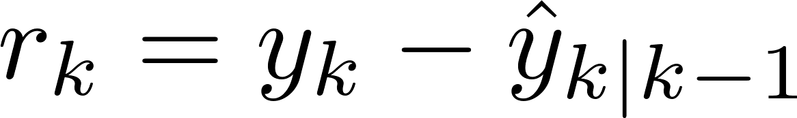
Compute the residual
Use training data to learn a model:
Use past test data to make a one-step prediction:
Compute the residual:
Evaluate the residual error through statistical test (depends on noise assumptions)
Or simply using a decision threshold, typical:
2 or 3 times the standard error
or simply sort on residual error and return largest ones
Works with almost every time series model

Slide 36
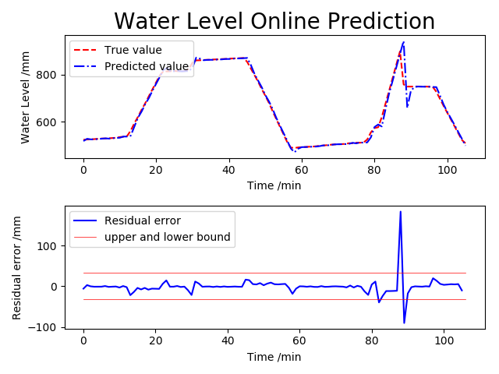
An example (in SCADA)

Slide 37
Anomalies in time series
Q: How to detect?

Slide 38
Possibilities
Use sliding windows:
translate to standard point anomaly detection, or
compute distances using sequence alignment
Learn a sequential model (e.g. n-gram), and
compute the probability of observing a sequence
if below a threshold, raise an alarm
…

Slide 39
Today
Types of anomalies and detection methods
Classification
Nearest Neighbor
Clustering
Statistical
Spectral
Examples how to detect anomalies in:
sequences
multivariate sequences
Evaluating anomaly detection
Deep learning for anomaly detection

Slide 40
Anomaly detection, non-sequential
A mess of possible methods:
Clustering
(One-class) Classification
Nearest Neighbors
Statistical
Spectral
...
Key ingredient: assumption of what is an anomaly

Slide 41
Taxonomy*
Anomaly Detection
Point Anomaly Detection
Classification Based
Nearest Neighbor Based
Clustering Based
Statistical
Others
Rule Based
Neural Networks Based
SVM Based
Density Based
Distance Based
Parametric
Non-parametric
Information Theory Based
Spectral Decomposition Based
Visualization Based
Contextual Anomaly Detection
Collective Anomaly Detection
Online Anomaly Detection
Distributed Anomaly Detection
* Outlier Detection – A Survey, Varun Chandola, Arindam Banerjee, and Vipin Kumar

Slide 42
Taxonomy*
Anomaly Detection
Point Anomaly Detection
Classification Based
Nearest Neighbor Based
Clustering Based
Statistical
Others
Rule Based
Neural Networks Based
SVM Based
Density Based
Distance Based
Parametric
Non-parametric
Information Theory Based
Spectral Decomposition Based
Visualization Based
Contextual Anomaly Detection
Collective Anomaly Detection
Online Anomaly Detection
Distributed Anomaly Detection
* Outlier Detection – A Survey, Varun Chandola, Arindam Banerjee, and Vipin Kumar

Slide 43
Where to put the decision boundary?
y
+
+
+
+
+
+
+
+
+
+
x

Slide 44
Where to put the decision boundary?
+
-
for instance
y
+
+
+
+
+
+
+
+
+
+
x

Slide 45
Where to put the decision boundary?
+
-
for instance
y
+
+
+
+
+
+
+
+
+
+
x

Slide 46
Where to put the decision boundary?
+
-
for instance
y
+
+
+
+
+
+
+
+
+
+
x

Slide 47
Classification based methods: OSVM
Supervised → fraud detection exercise
Only positive data:
separate positive data from remaining input space
Assumptions:
Further away from origin is anomalous (one-class SVM)
Close to the origin is anomalous (different one-class SVM)
Close to origin is also anomalous (improved one-class SVM)
Further from centroid is anomalous (non-linear one-class SVM)
…
Key ingredient:
Maximize negative/outlier space
Minimize positive/normal space

Slide 48
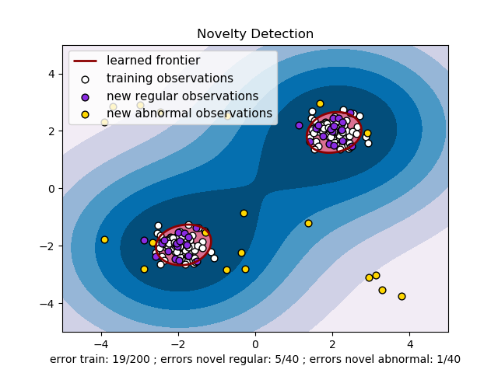
RBF one-class SVM

Slide 49
Different ways to use classification?
y
+
+
+
+
+
+
+
+
+
+
x

Slide 50
Other methods
Add synthetic anomalous records
i.e. uniformly over a hypersphere or hypercube
Learn a classifier from the data
Predict X using Y, predict Y using X
(or more general predict X using everything but X, …)
Label as anomalous when sufficient predictions are off
Of course many studies use ensembles….
Use models in innovative ways
e.g. Isolation Forests

Slide 51
Isolation Forest
Repeat N times:
Randomly pick a feature f
Split the f uniformly at randomly between [min,max]
Continue until all leafs contain singletons
The path length to reach a leaf is the isolation score
Average this length over all trees to get the anomaly score
Intuition:
isolating anomalies is easier because only a few conditions are needed to separate those cases from the normal observations

Slide 52
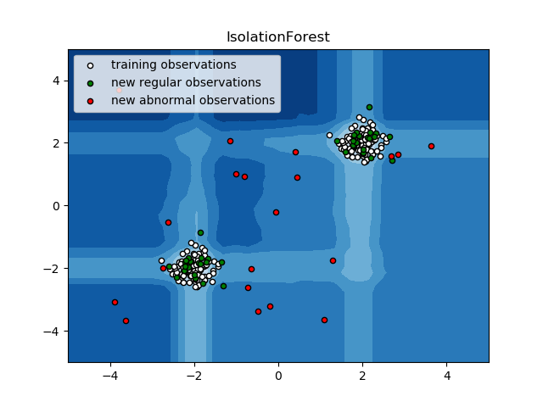
Isolation Forest

Slide 53
Classification Based Techniques
Advantage
Can be used in unsupervised setting
Models can be (easily) understood
Computationally inexpensive when testing
Drawback
Make assumptions about data distribution
Where is the origin? Is it normal or anomalous?
Intuitively less appealing

Slide 54
Taxonomy
Anomaly Detection
Point Anomaly Detection
Classification Based
Nearest Neighbor Based
Clustering Based
Statistical
Others
Rule Based
Neural Networks Based
SVM Based
Density Based
Distance Based
Parametric
Non-parametric
Information Theory Based
Spectral Decomposition Based
Visualization Based
Contextual Anomaly Detection
Collective Anomaly Detection
Online Anomaly Detection
Distributed Anomaly Detection

Slide 55
Nearest Neighbor Based Techniques
Key assumption:
normal points have close neighbors while anomalies are located far from other points
Two-step approach
Compute neighborhood for each data record
Analyze the neighborhood to determine whether data record is anomaly or not

Slide 56
How to use neighbors?
?
?
y
+
+
?
?
?
+
+
+
+
?
?
+
+
+
+
x

Slide 57
How to use neighbors? Distance
?
?
y
+
+
?
?
?
+
+
+
+
?
?
+
+
+
+
x
Anomaly if distance from other points is above threshold

Slide 58
How to use neighbors? Compare Distances
?
?
y
+
+
?
?
?
+
+
+
+
?
?
+
+
+
+
x
Anomaly if distance to nearest neighbor n compared to
distance from n to nearest neighbor is above threshold

Slide 59
How to use neighbors? Compare densities
?
?
y
+
+
?
?
?
+
+
+
+
?
?
+
+
+
+
x
Anomaly if density is substantially lower then neighbor’s density,
or average density

Slide 60
How to use neighbors? Compare densities
1
2
?
y
+
+
2
+
+
+
+
+
+
+
3
+
x
Similar to density estimation using e.g., Parzen windows

Slide 61
Two key approaches
Distance-based:
A point is anomalous when it is far from other points
Density-based:
A point is anomalous when it is in a low density region

Slide 62
Distance based Outlier Detection
Nearest Neighbor (NN) approach*,**
For each data point d compute the distance to the k-th nearest neighbor dk
Sort all data points according to the distance to dk
Outliers are points that have the largest distance dk and therefore are located in the more sparse neighborhoods
Usually data points that have top n% distance dk are identified as outliers
n – user parameter
Not suitable for datasets that have modes with varying density
Knorr, Ng,Algorithms for Mining Distance-Based Outliers in Large Datasets, VLDB98
** S. Ramaswamy, R. Rastogi, S. Kyuseok: Efficient Algorithms for Mining Outliers from Large Data Sets, ACM SIGMOD Conf. On Management of Data, 2000.

Slide 63
Density based Outlier Detection Local Outlier Factor (LOF)*
The local outlier factor is based on a concept of a local density
locality is given by k nearest neighbors
distance to k neighbors is used to estimate the density
Points that have a substantially lower density than their neighbors are considered to be anomalies
The local density is estimated by the typical distance at which a point can be "reached" from its neighbors.
The definition of "reachability distance" used in LOF is an additional measure to produce more stable results within clusters
See next slides for further details
* - Breunig, et al, LOF: Identifying Density-Based Local Outliers, KDD 2000.

Slide 64
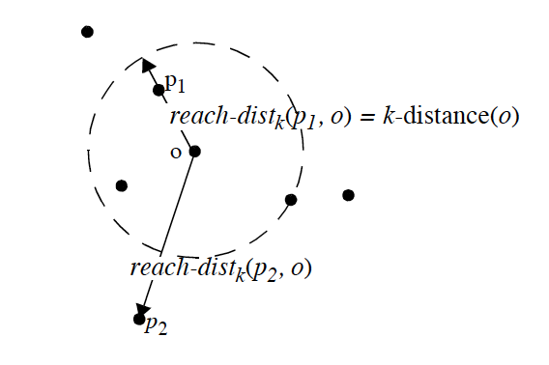
Density based Outlier Detection Local Outlier Factor (LOF)*
For each data point q compute the distance to the k-th nearest neighbor (k-distance(q) )
Compute reachability distance (reach-dist) for each data example q with respect to data example p as:
reach-dist(q, p) = max{k-distance(p), d(q,p)}
* - Breunig, et al, LOF: Identifying Density-Based Local Outliers, KDD 2000.

Slide 65
Density based Outlier Detection Local Outlier Factor (LOF)*
For each data point q compute the distance to the k-th nearest neighbor (k-distance(q) )
Compute reachability distance (reach-dist) for each data example q with respect to data example p as:
reach-dist(q, p) = max{k-distance(p), d(q,p)}
k-distance(p) serves as a lower bound
* - Breunig, et al, LOF: Identifying Density-Based Local Outliers, KDD 2000.

Slide 66
Density based Outlier Detection Local Outlier Factor (LOF)*
Compute local reachability density (lrd) of data example q as inverse of the average reachability distance based on the MinPts (k) nearest neighbors of data example q
lrd(q) =
* - Breunig, et al, LOF: Identifying Density-Based Local Outliers, KDD 2000.

Slide 67
Density based Outlier Detection Local Outlier Factor (LOF)*
Compute local reachability density (lrd) of data example q as inverse of the average reachability distance based on the MinPts (k) nearest neighbors of data example q
lrd(q) =
lrd(q) = low → large avg. reach_dist
lrd(q) = high → small avg. reach_dist
* - Breunig, et al, LOF: Identifying Density-Based Local Outliers, KDD 2000.

Slide 68
Density based Outlier Detection Local Outlier Factor (LOF)*
Compute local reachability density (lrd) of data example q as inverse of the average reachability distance based on the MinPts (k) nearest neighbors of data example q
lrd(q) =
Compute LOF(q) as ratio of average local reachability density of q’s k-nearest neighbors and local reachability density of the data record q
LOF(q) =
* - Breunig, et al, LOF: Identifying Density-Based Local Outliers, KDD 2000.

Slide 69
Density based Outlier Detection Local Outlier Factor (LOF)*
LOF(q) < 1 → lrd(p) < lrd(q)
q has smaller avg. reach dist →
higher density → inlier
LOF(q) > 1 → lrd(p) > lrd(q)
q has larger avg. reach dist →
lower density → outlier
Compute local reachability density (lrd) of data example q as inverse of the average reachability distance based on the MinPts (k) nearest neighbors of data example q
lrd(q) =
Compute LOF(q) as ratio of average local reachability density of q’s k-nearest neighbors and local reachability density of the data record q
LOF(q) =
* - Breunig, et al, LOF: Identifying Density-Based Local Outliers, KDD 2000.

Slide 70
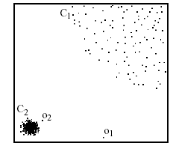
Advantages of Density based Techniques
Local Outlier Factor (LOF) approach
Example:
Distance from p₃ to nearest neighbor
In the NN approach, p₂ is not considered as outlier, while the LOF approach find both p₁ and p₂ as outliers
NN approach may consider p₃ as outlier, but LOF approach does not
p₃
×
Distance from p₂ to nearest neighbor
p₂
×
p₁
×

Slide 71
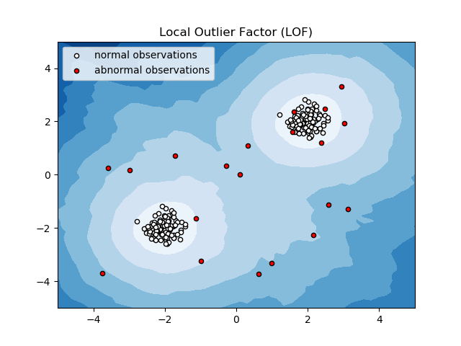
Local Outlier Factor

Slide 72
Nearest Neighbor Based Techniques
Advantage
Can be used in unsupervised setting
Do not make any assumptions about data distribution
Intuitively appealing, uses distances
Drawbacks
Computationally expensive (when testing)
Requires distances, may be unintuitive
In high dimensional spaces, data is sparse and the concept of similarity may not be meaningful anymore:
Due to the sparseness, distances between any two data records may become quite similar
=> Each data record may be considered as potential outlier!

Slide 73
Taxonomy
Anomaly Detection
Point Anomaly Detection
Classification Based
Nearest Neighbor Based
Clustering Based
Statistical
Others
Rule Based
Neural Networks Based
SVM Based
Density Based
Distance Based
Parametric
Non-parametric
Information Theory Based
Spectral Decomposition Based
Visualization Based
Contextual Anomaly Detection
Collective Anomaly Detection
Online Anomaly Detection
Distributed Anomaly Detection

Slide 74
How to use clusters?
y
+
?
+
+
+
+
+
+
+
+
+
x

Slide 75
Clustering Based Techniques
Key assumption:
normal data records belong to large and dense clusters
anomalies do not belong to any cluster or form very small clusters
Local density using clustering:
Local anomalies are distant from other points within the same cluster

Slide 76
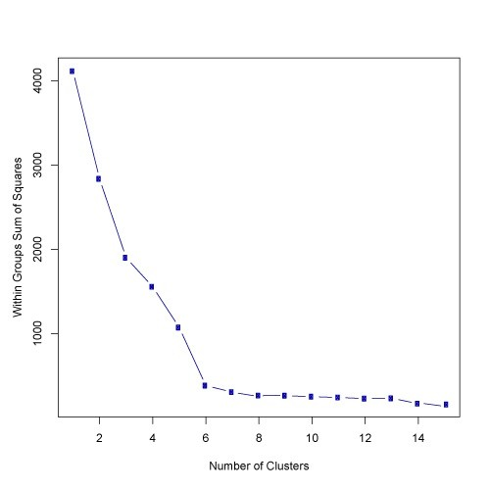
Deciding the number of clusters: ELBOW
what is the optimal k?

Slide 77
Clustering Based Techniques
Advantages:
No need to be supervised
Easily adaptable to on-line / incremental mode suitable for anomaly detection from temporal data
Drawbacks
Computationally expensive
Using indexing structures (k-d tree, R* tree) may alleviate this problem
If normal points do not create any clusters, the techniques may fail
In high dimensional spaces, data is sparse and distances between any two data records may become quite similar.
Clustering algorithms may not give any meaningful clusters

Slide 78
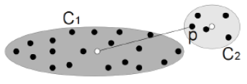
Cluster-based Local Outlier Factor (CBLOF)
Determine CBLOF for each point using the cluster size and cluster distance:
if point is in a small cluster, CBLOF is the product of the cluster size and its distance to the closest larger cluster
if point is in a large cluster CBLOF is the product of the cluster size and the distance between the point and its own cluster

Slide 79
Cluster-based Local Outlier Factor (CBLOF)
CBLOF large → small cluster or far from closest large cluster center → outlier
CBLOF small → large cluster, not at edge of cluster → inlier
Determine CBLOF for each point using the cluster size and cluster distance:
if point is in a small cluster, CBLOF is the product of the cluster size and its distance to the closest larger cluster
if point is in a large cluster CBLOF is the product of the cluster size and the distance between the point and its own cluster

Slide 80
Taxonomy
Anomaly Detection
Point Anomaly Detection
Classification Based
Nearest Neighbor Based
Clustering Based
Statistical
Others
Rule Based
Neural Networks Based
SVM Based
Density Based
Distance Based
Parametric
Non-parametric
Information Theory Based
Spectral Decomposition Based
Visualization Based
Contextual Anomaly Detection
Collective Anomaly Detection
Online Anomaly Detection
Distributed Anomaly Detection

Slide 81
Statistics Based Techniques
Data points are modeled using stochastic distribution
points are determined to be outliers depending on their relationship with this model
Advantage
Utilize existing statistical modeling techniques to model various type of distributions
Challenges
With high dimensions, difficult to estimate distributions
Parametric assumptions often do not hold for real data sets

Slide 82
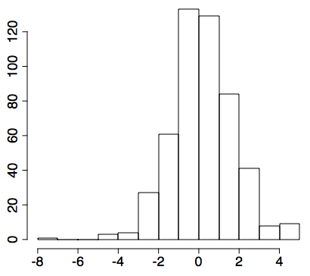
Hypothesis testing
H₀ : μ = 0
H₀ : μ = 0
null hypothesis
H₁ : μ > 0
alternative hypothesis
Test statistic (t-student):
Reject H₀ if
for desired false negative rate α

Slide 83
Types of Statistical Techniques
Parametric Techniques
Assume that the normal (and possibly anomalous) data is generated from an underlying parametric distribution
Learn the parameters from the normal sample
Determine the likelihood of a test instance to be generated from this distribution to detect anomalies
Non-parametric Techniques
Do not assume any knowledge of parameters
Use non-parametric techniques to learn a distribution
e.g. parzen window estimation

Slide 84
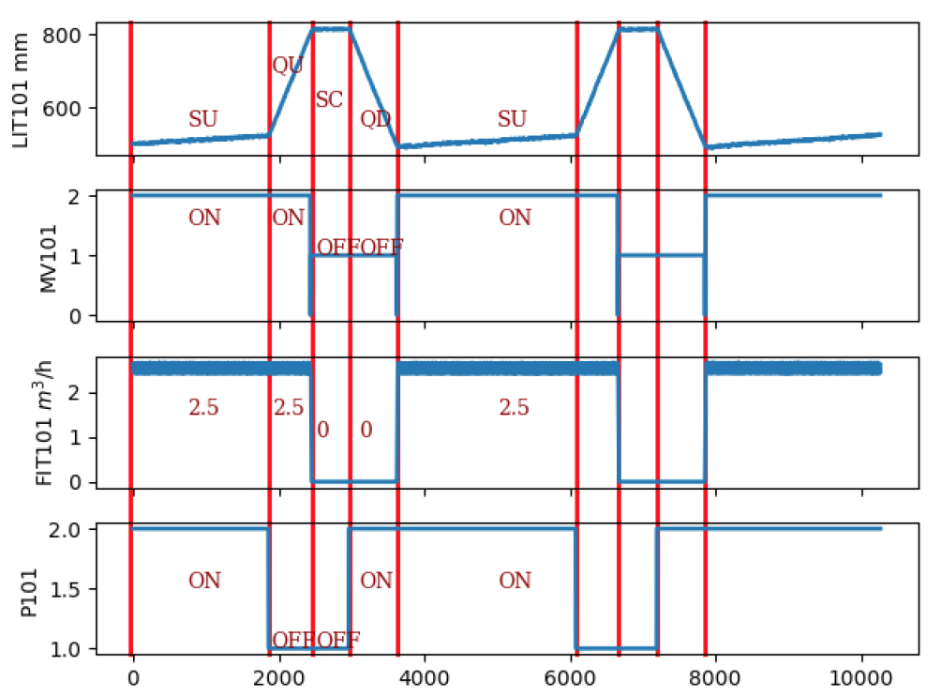
An example on SCADA signals

Slide 85
An example on SCADA signals
How to use the data distribution for anomaly detection?

Slide 86
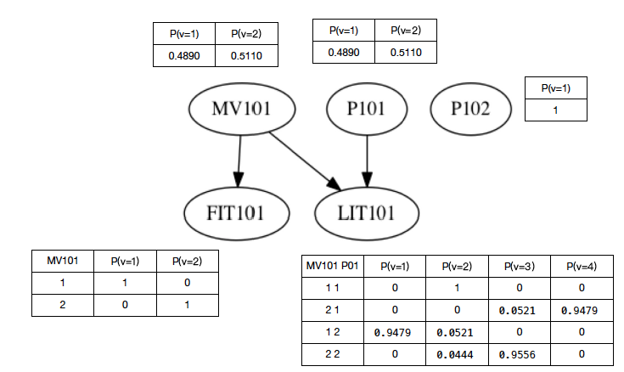
Learn a Bayesian Network distribution
Model conditional (in)dependencies between attributes

Slide 87
Learn a Bayesian Network distribution
Model conditional (in)dependencies between attributes
When an event occurs with small probability, it is labelled as anomaly

Slide 88
Taxonomy
Anomaly Detection
Point Anomaly Detection
Classification Based
Nearest Neighbor Based
Clustering Based
Statistical
Others
Rule Based
Neural Networks Based
SVM Based
Density Based
Distance Based
Parametric
Non-parametric
Information Theory Based
Spectral Decomposition Based
Visualization Based
Contextual Anomaly Detection
Collective Anomaly Detection
Online Anomaly Detection
Distributed Anomaly Detection

Slide 89
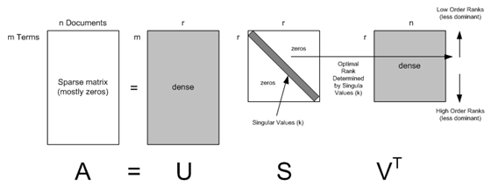
Spectral Techniques
Analysis based on Eigen decomposition of data
PCA (Principal Component Analysis)
Orthogonal transformation to reduce dimension
Most data patterns are captured by the several principal vectors

Slide 90
Spectral Techniques
Analysis based on Eigen decomposition of data
PCA (Principal Component Analysis)
Orthogonal transformation to reduce dimension
Most (linear) data patterns are captured by several principal vectors
How to use this for
anomaly detection?

Slide 91
Spectral Techniques
Key Idea
Find combination of attributes that capture bulk of variability
Reduced set of attributes can explain normal data well
But do not necessarily explain the outliers
Several methods use Principal Component Analysis
Top few principal components capture variability in normal data
Smallest principal component should have constant values
Outliers have variability in the smallest component

Slide 92



PCA (Principal Component Analysis)
Deriving principal vectors
Deriving the principal vector which captures the maximum variance
Find next component

Slide 93
Example: Network traffic
Data matrix
Perform PCA on matrix Y
anomalies
….
Y=
100 30 42 212 1729 13
….
Low-dimensional data
Eigenvectors
(components)
….
Yv=
y_{t}^{T}v₁ y_{t}^{T}v₂
v₁ v₂ …
….

Slide 94
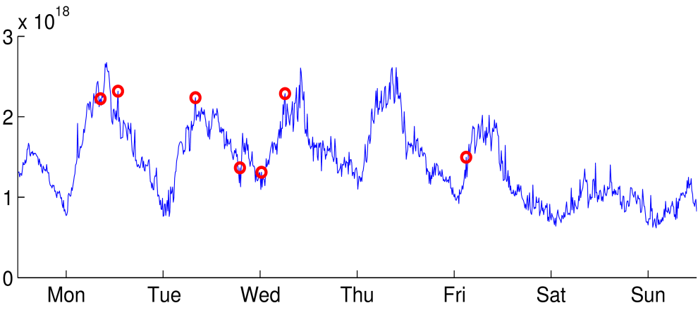
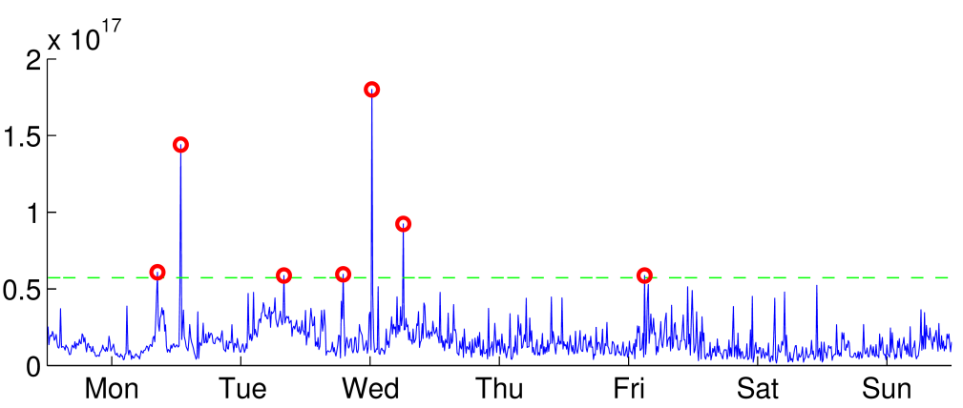

Example: Network traffic
Total traffic volume over time
threshold
Projection to residual subspace

Slide 95
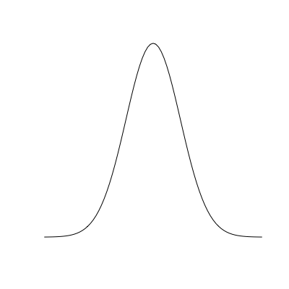
Using Robust PCA*
Variability analysis based on robust PCA
Compute the principal components of the dataset
For each test point, compute its projection on these components
If yi denotes the ith component, then the following has a chi-squared distribution
An observation is outlier if for a given significance level (statistical test)
Have been applied to intrusion detection, outliers in space-craft components, etc.
alarm
Notes:
Explain in more detail!

Slide 96
Spectral Techniques
Remember to first normalize your data, if your PCA method does not do it for you
Advantage
Useful for multi-variate signals
Computationally efficient (use graphic cards!)
Disadvantage
Based on the assumption that anomalies and normal instances are distinguishable in the reduced space
Does not take context into account
PCA is sensitive to outliers…

Slide 97
Today
Types of anomalies and detection methods
Classification → define what is anomalous
Nearest Neighbor → use distance/density
Clustering → elbow method, clusters are normal
Statistical → small probability is anomalous
Spectral → valid combinations/correlations are normal
Examples how to detect anomalies in:
Sequences, more sequential models next week
Multivariate sequences, PCA is surprisingly powerful, use correlations!
Evaluating anomaly detection
Deep learning for anomaly detection

Slide 98
Anomaly detection is hard to evaluate
Often little/no information on positives
Rely on quality of clustering, no clear quality measure exists
Good distances are often hard to find
Anomalies are usually time periods instead of points
An attack starts and stops
Is every detection within that period a true positive?
Unclear how to count positives
Many alarms are raised in a few seconds, is this a single positive?
Should we group them over time or per host/group?

Slide 99
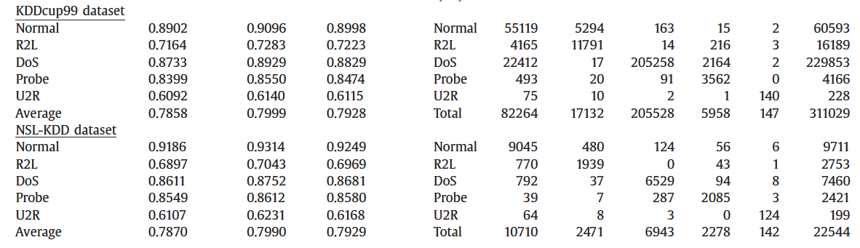
Evaluation example
Results from network anomaly detection paper (using LOF)
Is this good or bad? It is useful?

Slide 100
Evaluation example
Results from network anomaly detection paper (using LOF)
Is this good or bad? It is useful?
How many hosts should be investigated?
Are they easy to investigate?
How quick is the detection?

Slide 101
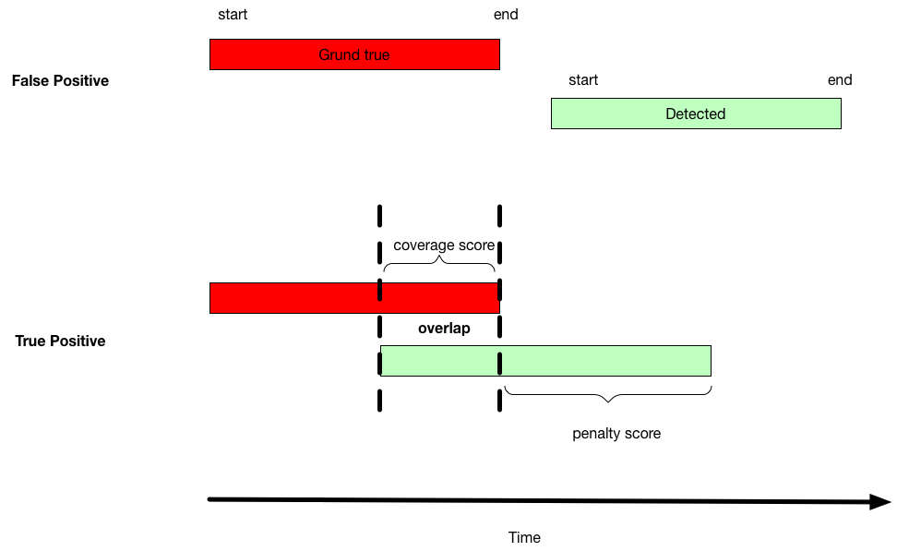
Evaluation in SCADA systems
Time series discord (unusual motif) [1]
More meaningful than isolated points
[1] Senin P, Lin J, Wang X, Oates T, Gandhi S, Boedihardjo AP, Chen C, Frankenstein S. Time series anomaly discovery with grammar-based compression. In EDBT 2015 Mar 23 (pp. 481-492).

Slide 102
An attempt in BATADAL

Slide 103
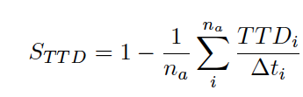


An attempt in BATADAL
TTD = time till detection
Δti = duration of attack
point-based values
gamma is parameter set by organizers

Slide 104
Take-away message
Evaluating anomaly detection is hard
You should evaluate it in a way that makes sense
Is host-detection important, or packet-based?
Is time untill detection relevant?
Is detecting a single attack a single positive?
…

Slide 105
Today
Types of anomalies and detection methods
Detecting anomalies in:
sequences
multivariate data sets
multivariate sequences
Evaluating anomaly detection
Deep learning for anomaly detection

Slide 106

Neural Network
y
^
activation
input
NN
x
output
weights
bias

Slide 107
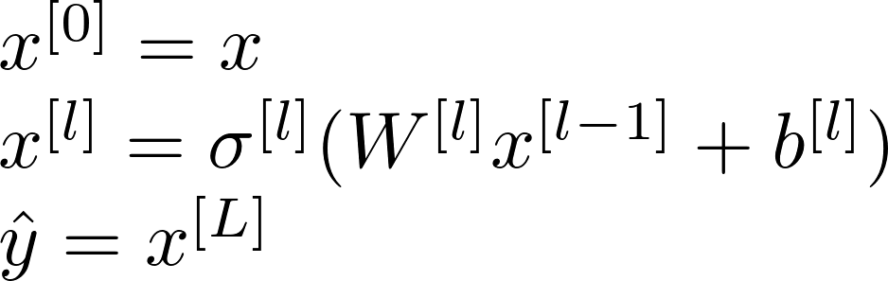
Deep Neural Network (DNN)
x
NN₁
NN₂
NN_{L}
y
...
^
stack L fully connected layers

Slide 108
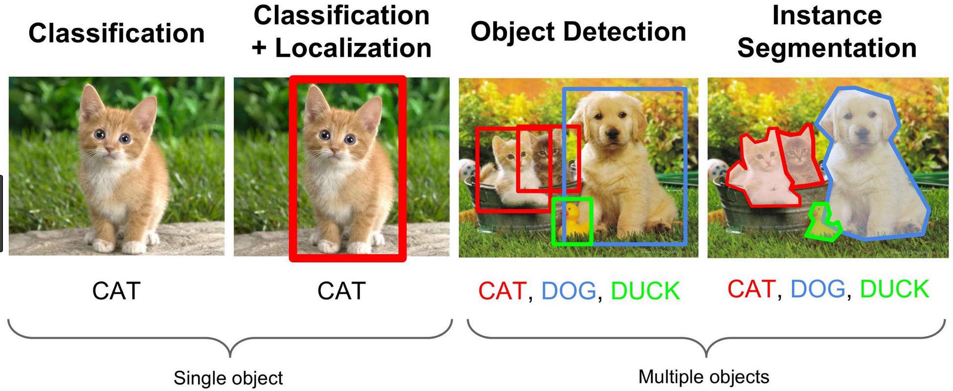
DNNs give great SOTA results!
NNs are great with fixed and continuous input

Slide 109
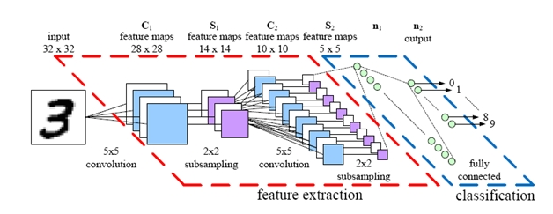
What makes DNNs tick
Deep learning success is based on automated feature extraction based on locality and memory
Image credit: https://www.kaggle.com/cdeotte/how-to-choose-cnn-architecture-mnist

Slide 110
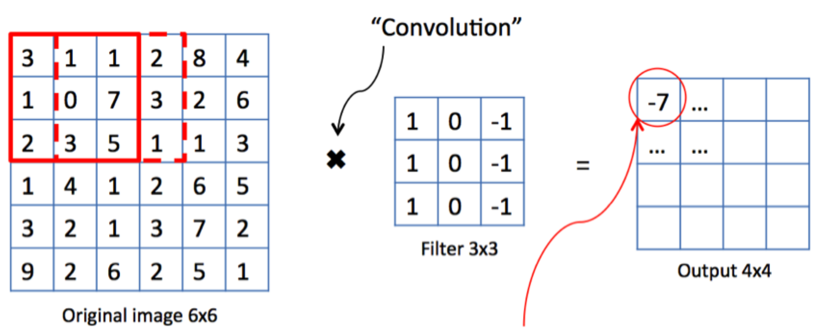
Locality
convolutions can exploit locality and dependencies
Further reading on CNNs http://cs231n.github.io/convolutional-networks/

Slide 111
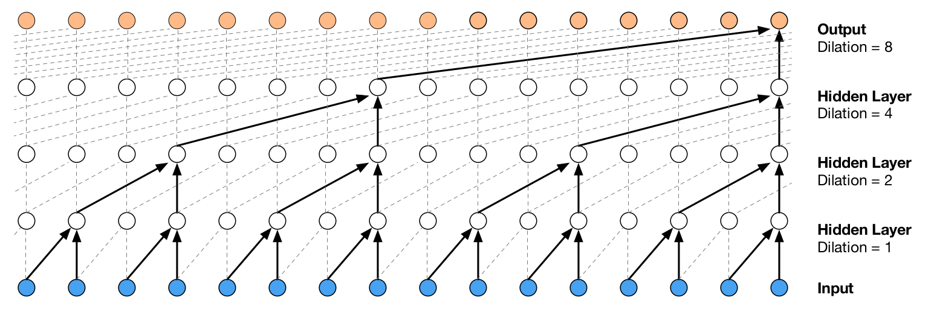
Example: WaveNet
Oord, A. van den, Dieleman, S., Zen, H., Simonyan, K., Vinyals, O., Graves, A., … Kavukcuoglu, K. (2016). WaveNet: A Generative Model for Raw Audio. arXiv:1609.03499 [Cs].
Code: https://github.com/vincentherrmann/pytorch-wavenet

Slide 112
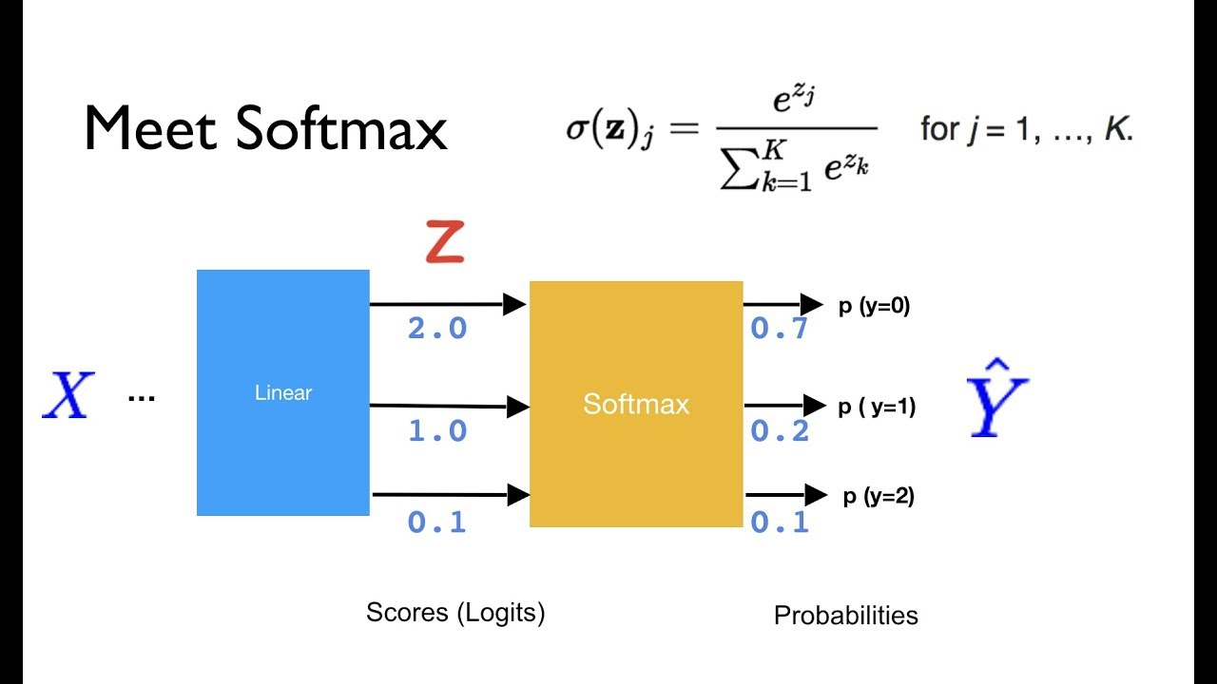
Anomalies using softmax
Example: Use softmax to learn distribution
Further reading: https://arxiv.org/pdf/1610.02136.pdf

Slide 113
Autoencoder
x
Input
encode
Encoder
Code
N dimensional
M < N dimensional

Slide 114
Autoencoder
Input
encode
Encoder
Code
decode
Decoder
Reconstructed
Input
N dimensional
M < N dimensional
N dimensional
minimize difference between x and Decoder(Encoder(x))
the code encode(x) captures the important aspects of x

Slide 115
Autoencoder
x
x’
Input
encode
Encoder
Code
decode
Decoder
Reconstructed
Input
Compare
Reconstruction loss |x - x’|

Slide 116
Autoencoder for anomaly detection
Small reconstruction loss: |x -x’| < t
Normal sample x
Input
encode
Encoder
Code
decode
Decoder
Reconstructed
Input
Compare reconstruction loss
Anomalous sample y
| y - y’| > t
Anomaly if loss larger than a given threshold t
Implementations:
https://towardsdatascience.com/extreme-rare-event-classification-using-autoencoders-in-keras-a565b386f098
https://towardsdatascience.com/lstm-autoencoder-for-extreme-rare-event-classification-in-keras-ce209a224cfb
Further reading on autoencoder types: https://medium.com/datadriveninvestor/deep-learning-different-types-of-autoencoders-41d4fa5f7570

Slide 117
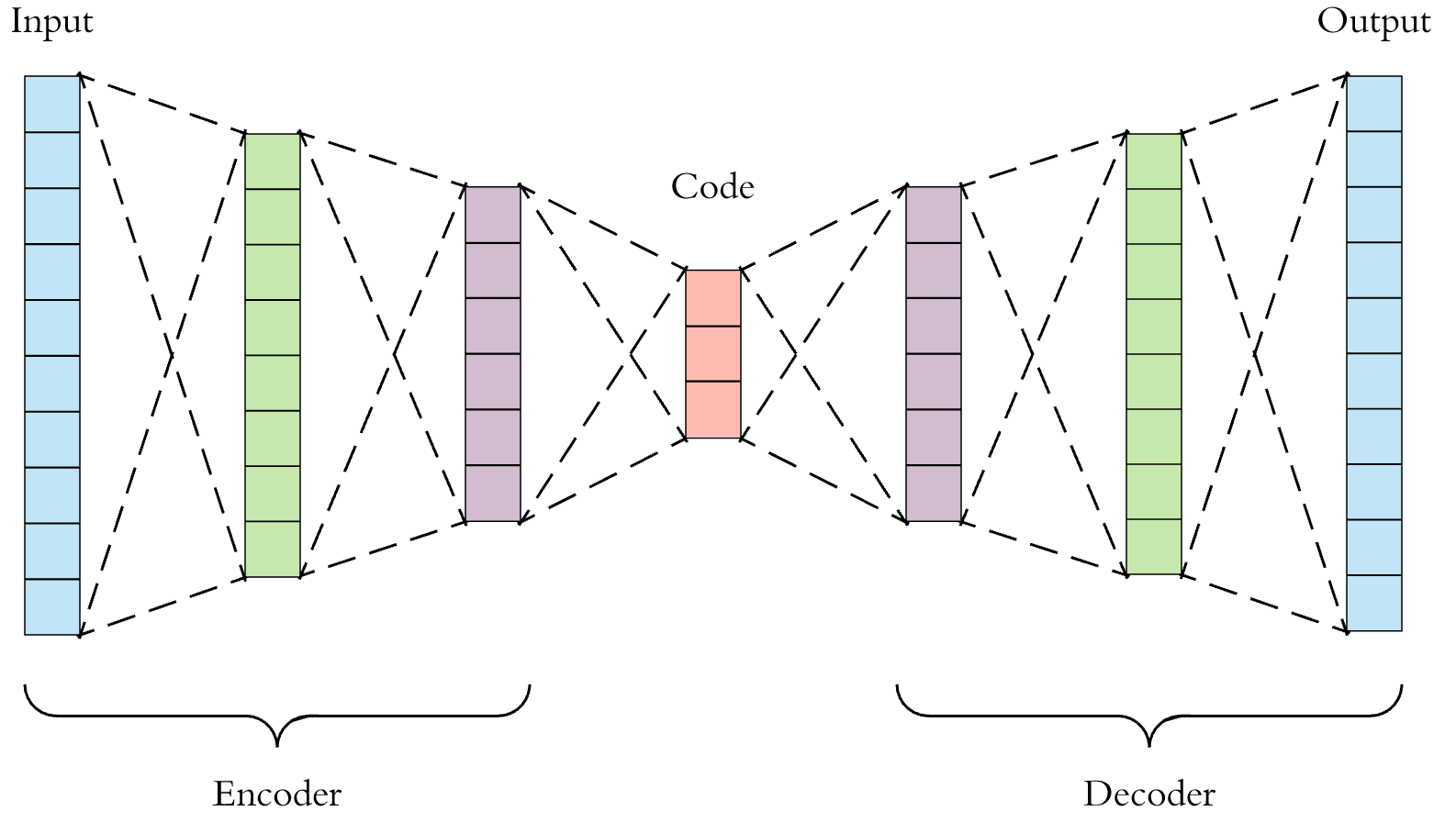
Compare to PCA
Find a low dimensional representation of normal data
Abnormal data will map to abnormal code
Reconstruction from that code will be bad
The model model has only learned to map back to normal data

