Slide 1
Data streams

Slide 2
Determining model orders (eg ARMA)
Let’s think for a second, do we know a method to choose between different kinds of models?

Slide 3
Determining model orders (eg ARMA)
Let’s think for a second, do we know a method to choose between different kinds of models?
Say we have:
A regression tree
A neural net
A linear regressor
An ARMA model
...
Which one is best for our data?

Slide 4
Determining model orders (eg ARMA)
Let’s think for a second, do we know a method to choose between different kinds of models?
Say we have:
A regression tree
A neural net
A linear regressor
An ARMA model
...
Which one is best for our data?
Determine using (eg) cross-validation!

Slide 5
Determining model orders (eg ARMA)
Let’s think for a second, do we know a method to choose between different kinds of models?
Say we have:
An ARMA(1,1) model
An ARMA(1,2) model
An ARMA(2,1) model
An ARMA(1,3) model
...
Which one is best for our data?
Determine using (eg) cross-validation!
... Or model selection...

Slide 6
Cross-validation and model selection
Cross-validation is a type of model selection
It is a great tool, but there are problems, for example:
It is expensive
It only uses part of the data for learning
It assumes the average performance is a good indicator
...
Is it possible to use the entire data?
Yes, sometimes...

Slide 7
Model selection and the AIC
Trade-off between model quality (variance) and model size (bias)
Akaike Information Criterion (AIC)
2*num_parameters – 2*log(likelihood)
Larger models result in more parameters, higher AIC
Better models result in higher likelihood, lower AIC
Goal:
Find a small good model, one with smallest AIC

Slide 8
Example: AIC for ARMA
First maximize likelihood (fit model), then:
AIC = − 2log(L) + 2(p+q)
Pick a p and q that minimize the AIC
Works for any kind of model, but make sure:
Likelihood is computed in the same way, on the same data
Comparing differenced and undifferenced data does not work!
Do not compare different model classes (different parameters)
...

Slide 9
N-gram table on windows
 | Ngram 1 | Ngram 2 | Ngram 3 | …
Window 1 | f(1,1) | f(1,2) | f(1,3)
Window 2 | f(2,1) | f(2,2) | f(2,3)
Window 3 | f(3,1) | f(3,2) | f(3,3)
…
With f(x,y) the frequency of Ngram y in Window x
So make larger windows, count the ngrams in those models,
construct these rows, these are profiles
Apply any ML method to match/cluster/classify these profiles

Slide 10
Data streams

Slide 11
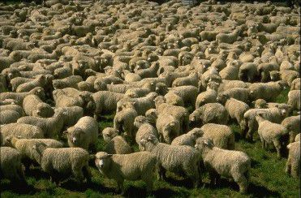
Counting
Suppose we have stream of items, and we want to count how many items are in the stream
First method:
Set counter to 0, whenever we see an item, increase the counter
If asked for count, return the counter

Slide 12
Counting
Suppose we have stream of items, and we want to count how many items are in the stream
First method:
Set counter to 0, whenever we see an item, increase the counter
If asked for count, return the counter
Second method:
Set counter to 0, whenever we see an item, flip a coin:
If heads: increase the counter
If tails: do nothing
If asked for count, return the counter times two

Slide 13
Counting
Suppose we have stream of items, and we want to count how many items are in the stream
First method:
Set counter to 0, whenever we see an item, increase the counter
If asked for count, return the counter
Second method:
Set counter to 0, whenever we see an item, flip a coin:
If heads: increase the counter
If tails: do nothing
If asked for count, return the counter times two
Q: Why would this be useful?

Slide 14
Counting
Suppose we have stream of items, and we want to count how many items are in the stream
First method:
Set counter to 0, whenever we see an item, increase the counter
If asked for count, return the counter
Second method:
Set counter to 0, whenever we see an item, flip a coin:
If heads: increase the counter
If tails: do nothing
If asked for count, return the counter times two
Uses log(n) bits
Uses log(n-1) bits
Q: Why would this be useful?

Slide 15
Morris counting
On data streams, we have to reduce memory usage
Approximate counting uses several such counters, with different head/tail probabilities:
Set counter to 0
Update:
Draw random number x from [0, 1]
If (x <= 2^{-c}) c = c + 1
Query: return 2^{c} - 2
And it runs in loglog(n) memory ( E[c] = log(n) .... )

Slide 16
Data streaming
Continuous and rapid input of data
Limited memory to store the data (less than linear in the input size)
Limited time to process each element
Sequential access (no random access)
Algorithms have one (p=1) or very few passes (p={2,3}) over the data
slides from Graham Cormode, Claudia Hauff, and Jeff Ullmann
Notes:
http://www.ecmwf.int/
The European Centre for Medium-Range Weather Forecasts (ECMWF) is an independent intergovernmental organisation supported by 34 states.

Slide 17



Data stream models
Massively long input stream
Basic model:
Space complexity goal: s bits of random-access memory with
“holy grail”
“reality”
Notes:
Our central goal will be to process the input stream using a small amount of space s , i.e., to use s bits of random access working memory. Since m and n are to be thought of as “huge,” we want to make s much smaller than these;
specifically, we want s to be sublinear in both m and n .
The informal assertion "f(x) is little-o of g(x)" is formally written f(x) = o(g(x)), or in set notation f(x) ∈ o(g(x)). Intuitively, it means that g(x) grows much faster than f(x).
Holy grail: to store a constant number of items from the stream [log(n)] and a constant number of counters that count up to the length of the stream [log(m)]
Reality: poly log is log(x)^c

Slide 18
Sampling
slides from Claudia Hauff

Slide 19
Sampling
Sampling: selection of a subset of items from a large data set
Goal: sample retains the properties of the whole data set
Important for drawing the right conclusions from the data
Notes:
A fundamental problem in data management is to draw and maintain a sample of a large data set,
for approximate query answering, selectivity estimation, and query planning

Slide 20
Sampling from a Data Stream
Fundamental problem: sample m items uniformly from stream
Useful: approximate costly computation on small sample
Challenge: don’t know how long stream is
So when/how often to sample?
Two solutions, apply to different situations:
Reservoir sampling (dates from 1980s?)
Min-wise sampling (dates from 1990s?)

Slide 21
Reservoir Sampling
Sample first m items
Choose to sample the i’th item (i>m) with probability pi = m/i
If sampled, randomly replace a previously sampled item
Optimization: when i gets large, compute which item will be sampled next, skip over intervening items

Slide 22

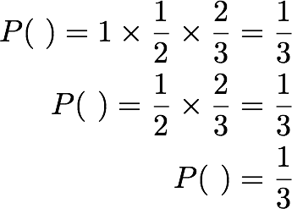
Reservoir sampling, example
Toy example with k=1
m=1
keep it
m=2
replace with probability 1/2
m=3
replace / with probability 1/3
keep / with probability 2/3
Notes:
WITHOUT STREAMING: N=10,000 pick 100 elements at random; generate 100 random integers between 0 and N-1 (no duplicates), retrieve elements at those indices.
Lets look at a toy example with three stream elements.
More generally, reservoir sampling is appropriate when you don't know the size of the set beforehand.
At m=1 [stream length 1] we only see one element, we keep it.
At m=2 we have to decide whether to replace the blue element - we do this with probability 1/2.
At m=3 we replace the picked element with probability 1/3 and keep it with probability 2/3.
If we follow these simple rules, we can compute the probability of each element - blue, green and yellow - at m=3. For blue, at m=1 we have a probability 1 of being picked, at m=2 it is 1x0.5 and at m=3 this probability is 1x0.5x0.66=0.33; thus

Slide 23
Reservoir Sampling - Analysis
Analyze simple case: sample size m = 1
Probability i’th item is the sample from stream length n:
Prob. i is sampled on arrival × prob. i survives to end
1 i i+1 n-2 n-1
× × … ×
i i+1 i+2 n-1 n
= 1/n
Case for m > 1 is similar, easy to show uniform probability

Slide 24
Reservoir Sampling via Order Sampling
a.k.a. bottom-k sample, min-hashing, min-wise sampling, …
Uniform sampling of stream into reservoir of size k
Each arrival n: generate one-time random value rn ∈ U[0,1]
rn also known as hash, rank, tag…
Store k items with the smallest random tags
0.391
0.908
0.291
0.555
0.619
0.273
Each item has same chance of least tag, so uniform
Fast to implement via priority queue
Can run on multiple input streams separately, then merge

Slide 25
Frequency counter algorithms
“Counter-based algorithms track a subset of items from the inputs, and monitor counts associated with these items.
For each new arrival, the algorithms decide whether to store this item or not, and if so, what counts to associate with it.”
Finding Frequent Items in Data Streams by Graham Cormode & Marios Hadjieleftheriou.
Notes:
Finding Frequent Items in Data Streams by Graham Cormode & Marios Hadjieleftheriou.

Slide 26
Examples
Packets on the Internet
Frequent items:
most popular destinations
most heavy bandwidth users
Queries submitted to a search engine
Frequent items:
most popular queries
Notes:
(EC2: elastic compute cloud, S3: simple storage service)

Slide 27



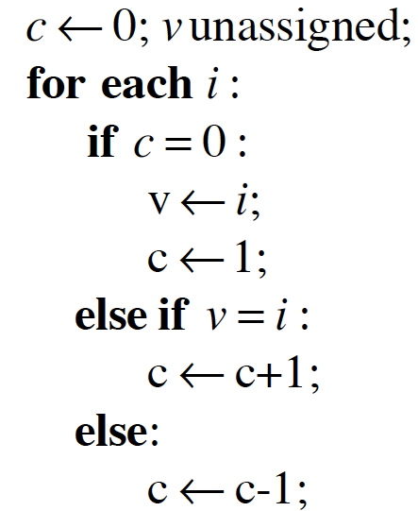
MAJORITY algorithm
Task: Given a list of elements - is there an absolute majority (an element occurring times)?
no absolute majority
blue wins
Notes:
The problem of frequent items dates back at
least to a problem first studied by Moore in 1980. It was published
as a ‘problem’ in the Journal of Algorithms in the June 1981 issue,
as follows
[J.Alg 2, P208-209] Suppose we have a list of n numbers,
representing the “votes” of n processors on the
result of some computation. We wish to decide if there
is a majority vote and what the vote is.

Slide 28

MAJORITY algorithm
Task: Given a list of elements - is there an absolute majority (an element occurring times)?
In this stream, the last item is kept.
A second pass is needed to verify if the stored item is indeed the absolute majority item (count every occurrence of b).

Slide 29

MAJORITY algorithm
Task: Given a list of elements - is there an absolute majority (an element occurring times)?
Correctness based on pairing argument:
Every non-majority element can be paired with a majority one
After the pairing, there will still be majority elements left

Slide 30


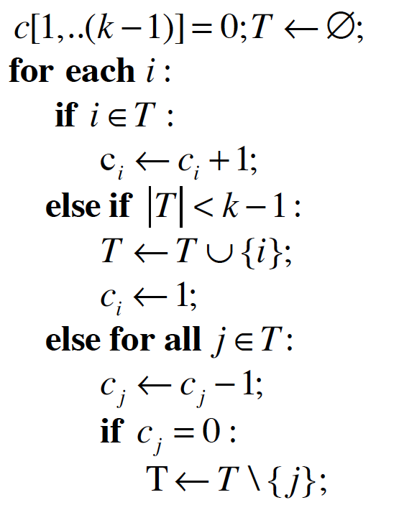
FREQUENT algorithm (Misra-Gries)
Task: Find all elements in a sequence whose frequency exceeds fraction of the total count (i.e. frequency )
(k-1) counter-
value pairs
Notes:
The FREQUENT problem is one of the most heavily studied problems in data stream mining, dating back to the 1980s. FREQUENT is a generalisation of MAJORITY

Slide 31

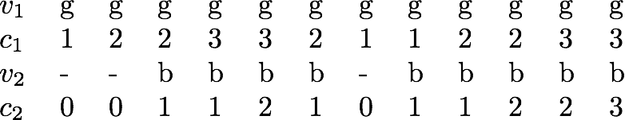
FREQUENT algorithm (Misra-Gries)
Blue and green have been estimated to each occur 3 times.

Slide 32
FREQUENT algorithm (Misra-Gries)
Green is estimated to have occurred once.

Slide 33
FREQUENT algorithm (Misra-Gries)
Streaming algorithms are approximations (estimates) of the correct answers!

Slide 34

FREQUENT algorithm (Misra-Gries)
space complexity
Implementation: associative array using a balanced binary search tree
Each key has a max. value of n, each counter has a max. value of m
At most (k-1) key/counter pairs in memory at any time

Slide 35



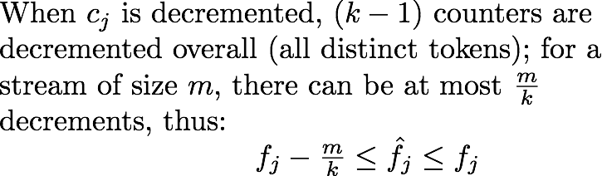

FREQUENT algorithm (Misra-Gries)
answer quality of frequency estimates
Notes:
use a grouping argument to show that any item occurring more than m/k times must be stored by the algorithm in the end.

Slide 36

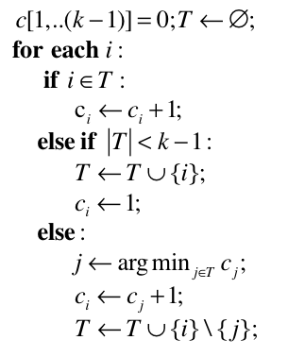

FREQUENT algorithm (Space Saving)
Task: Find all elements in a sequence whose frequency exceeds fraction of the total count (i.e. frequency )
Counters are not reset, the element with minimum count is simply replaced
Maximum overestimation can be tracked
Notes:
For each monitored element ei , we keep track of its maximum over-estimation, εi , resulting from the initialization of its counter when it was inserted into the
list. That is, when starting to monitor ei , set εi to the counter value that was evicted;
Frequent elements will reside in the counters of bigger values, and will not be
distorted by the ineffective hits of the infrequent elements, and thus, will never be replaced out of the monitored counters. Meanwhile, the numerous infrequent elements will be striving to reside in the smaller counters, whose
values grow slower than those of the larger counters.

Slide 37
FREQUENT algorithm (Space Saving)
Analysis
Smallest counter value min is at most m/k
Counters sum to m by induction
k counters, so average is m/k: smallest cannot be bigger
True count of an uncounted item is between 0 and min
Proof by induction, true initially, min cannot decrease
All counts are overestimates: count of any item is off by at most m/k
Any item x whose true count > m/k is stored
By contradiction: last time x was removed, with count ≤ min_{t}
x does not occur afterwards, so:
Count of x >m/k ≥ min ≥ min_{t} , and would not be removed
Notes:
For each monitored element ei , we keep track of its maximum over-estimation, εi , resulting from the initialization of its counter when it was inserted into the
list. That is, when starting to monitor ei , set εi to the counter value that was evicted;
Frequent elements will reside in the counters of bigger values, and will not be
distorted by the ineffective hits of the infrequent elements, and thus, will never be replaced out of the monitored counters. Meanwhile, the numerous infrequent elements will be striving to reside in the smaller counters, whose
values grow slower than those of the larger counters.

Slide 38
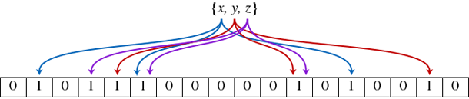
hashing
slides from Graham Cormode

Slide 39
Sketches
Not every problem can be solved with sampling
Example: counting how many distinct items in the stream
If a large fraction of items aren’t sampled, don’t know if they are all same or all different
Other techniques take advantage that the algorithm can “see” all the data even if it can’t “remember” it all
“Sketch”: essentially, a linear transform of the input
Model stream as defining a vector, sketch is result of multiplying stream vector by an (implicit) matrix
linear projection

Slide 40
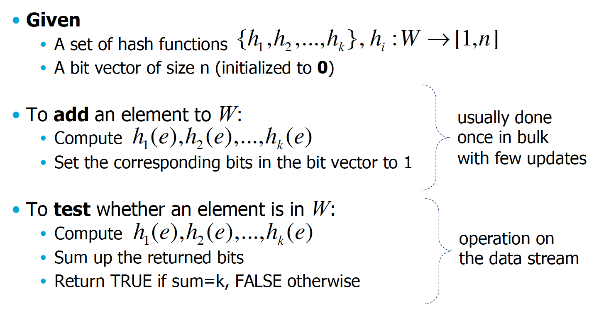
Bloom filter
Hash function maps each item in the universe to a random number
uniform over the range.
Usually done once in bulk with few updates.
Operation on the data stream.

Slide 41
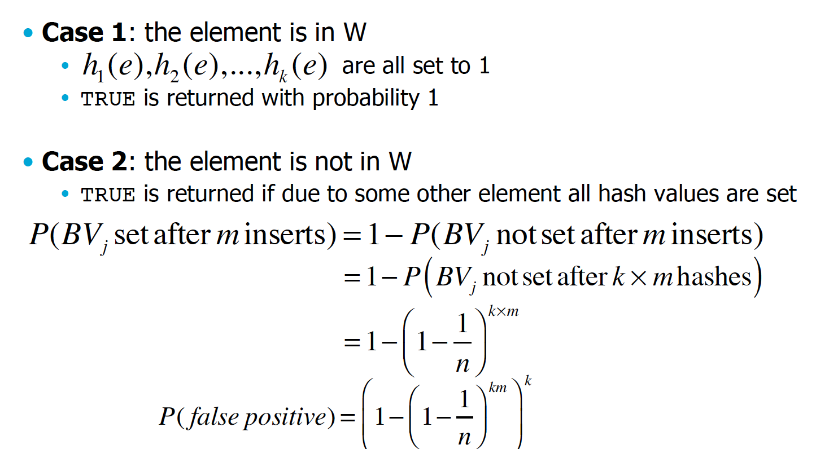
Bloom filter: element testing
Notes:
probability that bit j is set after m inserts
= 1 minus the prob. that bit j is not set
= 1 minus the prob. that bit j is not set after computing k*m hashes
= [1/n] is the probability of a random bit being set, 1-1/n is the prob of the bit not being set
P(false positive): all k bits have to be set to record a false positive

Slide 42
Count-Min Sketch
Simple sketch idea, can be used for as the basis of many different stream mining tasks
Join aggregates, range queries, moments, …
Creates a small summary as an array of w × d in size
Use d hash functions to map vector entries to [1..w]
W
Array: CM[i,j]
d

Slide 43
CM Sketch Structure
Assume a stream of length m
Modeled using a vector A[] of counts
Entries from A[] are mapped to one bucket per row
Counts merged in buckets are summed up
Estimate A[j] by taking min_{k} { CM[k,h_{k}(j)] }
+c
h₁(j)
<j, +c>
+c
d=log 1/δ
+c
h_{d}(j)
+c
w = 2/ε

Slide 44
CM Sketch Guarantees
CM sketch guarantees approximation error on point queries less than εm in space O(1/ε log 1/δ)
Probability of more error is less than 1-δ
How?
Counts are biased (overestimates) due to collisions
Use independence across rows to boost the confidence for the min{} estimate

Slide 45
CM Sketch Analysis
Estimate A’[j] = min_{k} { CM[k,h_{k}(j)] }

Slide 46
CM Sketch Analysis
Estimate A’[j] = min_{k} { CM[k,h_{k}(j)] }
Analysis: In k'th row, CM[k,h_{k}(j)] = A[j] + X_{k,j}

Slide 47
CM Sketch Analysis
Estimate A’[j] = min_{k} { CM[k,h_{k}(j)] }
Analysis: In k'th row, CM[k,h_{k}(j)] = A[j] + X_{k,j}
X_{k,j} = Σ A[i≠j] | h_{k}(i) = h_{k}(j)

Slide 48
CM Sketch Analysis
Estimate A’[j] = min_{k} { CM[k,h_{k}(j)] }
Analysis: In k'th row, CM[k,h_{k}(j)] = A[j] + X_{k,j}
X_{k,j} = Σ A[i≠j] | h_{k}(i) = h_{k}(j)
E[X_{k,j}] = Σ A[i≠j]*Pr[h_{k}(i)=h_{k}(j)] (recall 2/ε columns)
≤ (ε/2) * Σ A[i≠j] ≤ εm/2 (recall m = stream length)

Slide 49
CM Sketch Analysis
Estimate A’[j] = min_{k} { CM[k,h_{k}(j)] }
Analysis: In k'th row, CM[k,h_{k}(j)] = A[j] + X_{k,j}
X_{k,j} = Σ A[i≠j] | h_{k}(i) = h_{k}(j)
E[X_{k,j}] = Σ A[i≠j]*Pr[h_{k}(i)=h_{k}(j)] (recall 2/ε columns)
≤ (ε/2) * Σ A[i≠j] ≤ εm/2 (recall m = stream length)
Pr[X_{k,j} ≥ εm] = Pr[X_{k,j} ≥ 2E[X_{k,j}]] ≤ 1/2 by Markov inequality
P(X ≥ a)) ≤ E(x) / a

Slide 50
CM Sketch Analysis
Estimate A’[j] = min_{k} { CM[k,h_{k}(j)] }
Analysis: In k'th row, CM[k,h_{k}(j)] = A[j] + X_{k,j}
X_{k,j} = Σ A[i≠j] | h_{k}(i) = h_{k}(j)
E[X_{k,j}] = Σ A[i≠j]*Pr[h_{k}(i)=h_{k}(j)] (recall 2/ε columns)
≤ (ε/2) * Σ A[i≠j] ≤ εm/2 (recall m = stream length)
Pr[X_{k,j} ≥ εm] = Pr[X_{k,j} ≥ 2E[X_{k,j}]] ≤ 1/2 by Markov inequality
P(X ≥ a)) ≤ E(x) / a
Pr[A’[j]≥ A[j] + εm] = Pr[∀ k. X_{k,j}>εm] ≤1/2^{log 1/δ} = δ

Slide 51
CM Sketch Analysis
Estimate A’[j] = min_{k} { CM[k,h_{k}(j)] }
Analysis: In k'th row, CM[k,h_{k}(j)] = A[j] + X_{k,j}
X_{k,j} = Σ A[i≠j] | h_{k}(i) = h_{k}(j)
E[X_{k,j}] = Σ A[i≠j]*Pr[h_{k}(i)=h_{k}(j)] (recall 2/ε columns)
≤ (ε/2) * Σ A[i≠j] ≤ εm/2 (recall m = stream length)
Pr[X_{k,j} ≥ εm] = Pr[X_{k,j} ≥ 2E[X_{k,j}]] ≤ 1/2 by Markov inequality
P(X ≥ a)) ≤ E(x) / a
Pr[A’[j]≥ A[j] + εm] = Pr[∀ k. X_{k,j}>εm] ≤1/2^{log 1/δ} = δ
Final result: with certainty A[j] ≤ A’[j] and with probability at least 1-δ: A’[j]< A[j] + εm

Slide 52

FM-sketch (Flajolet-Martin)
Approach: hash data stream elements uniformly to N bit values, i.e.:
Task: Given a data stream of, estimate the number of distinct elements occurring in it (recall Morris counting)
Assumption: the larger the number of distinct elements in the stream, the more distinct the occurring hash values, and the more likely one with an unusual property appears
Notes:
(EC2: elastic compute cloud, S3: simple storage service)

Slide 53
FM-sketch
What is unusual?
Intuition:
Say I roll 6 dice, then the probability that I get 1,2,3,4,5,6 as roll is very small
But If I repeat this a million times, then the probability that this occurs at some point is very high
If I tell you that I rolled the dice X times, and I observed 1,2,3,4,5,6 once
You can use these probabilities to estimate X!

Slide 54
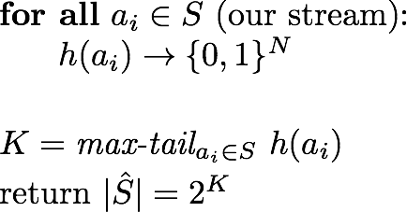
FM-sketch
One possibility of interpreting unusual is the hash tail: the number of 0’s a binary hash value ends in
100110101110
100110101100
100110000000
N must be long enough;
there must be more possible results of the hash function than elements in the stream
maximum hash tail seen so far

Slide 55
FM-sketch (Flajolet-Martin)
Intuitive justification
r 0’s occur
When there are m distinct elements in the stream
Notes:
2^10=1024
we start with 10,000 stream elements, thus m>>2^10

Slide 56
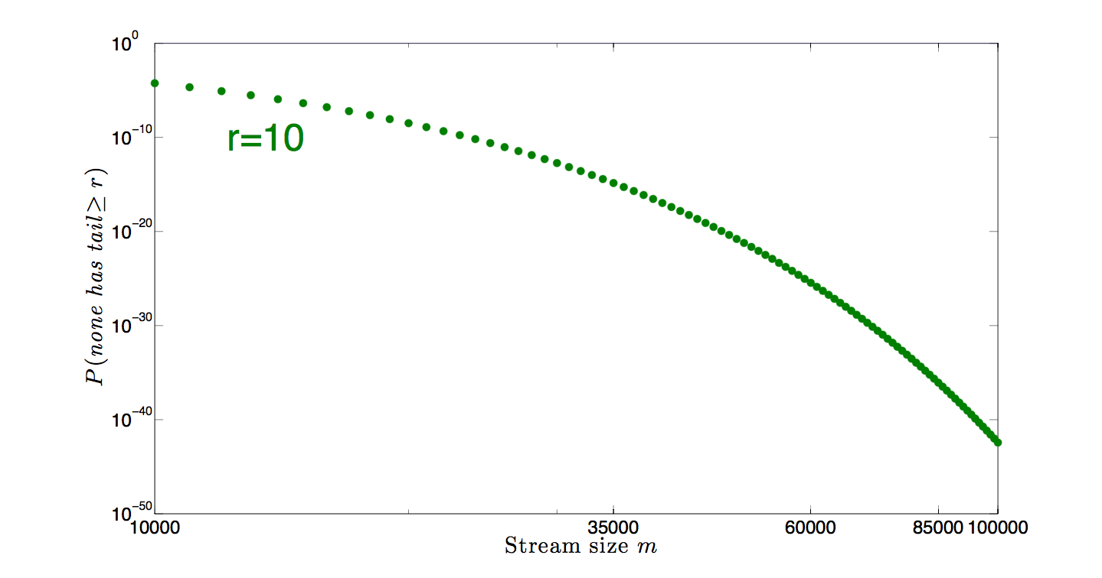
FM-sketch (Flajolet-Martin)
Intuitive justification
r 0’s occur
When there are m distinct elements in the stream
Notes:
2^10=1024
we start with 10,000 stream elements, thus m>>2^10

Slide 57
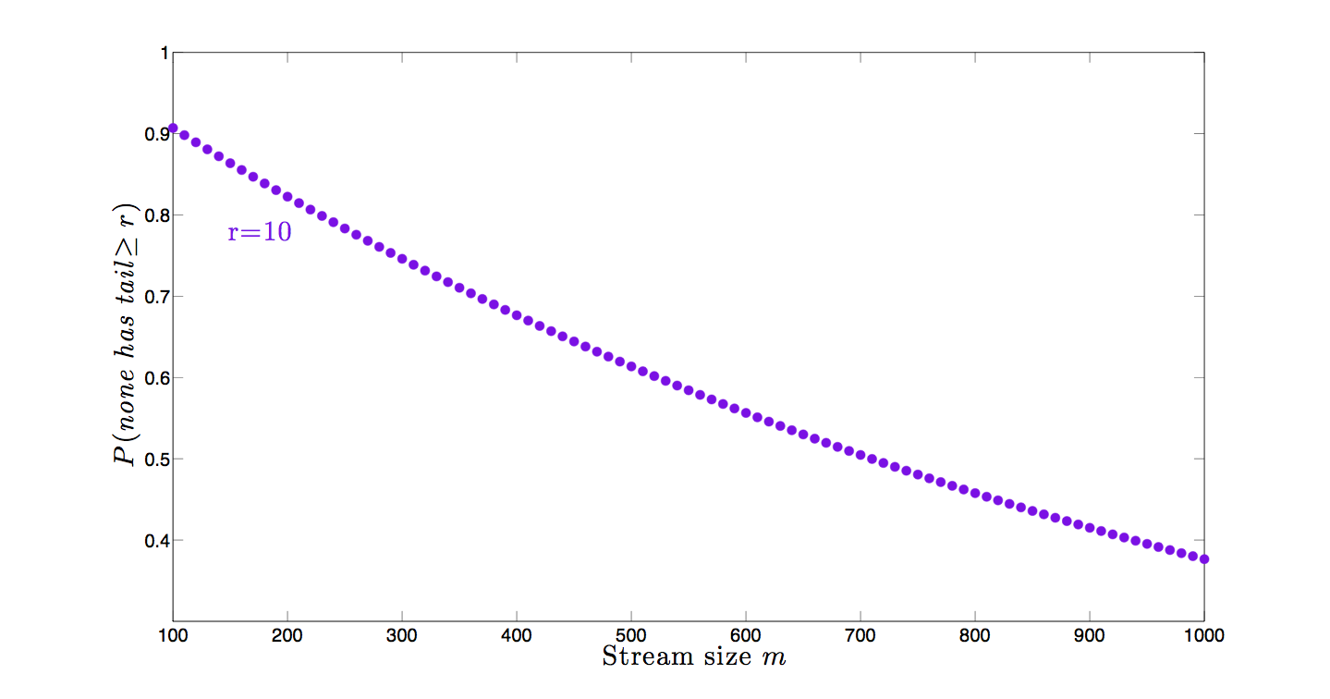
FM-sketch (Flajolet-Martin)
Intuitive justification
r 0’s occur
When there are m distinct elements in the stream
Notes:
2^10=1024
we start with 10,000 stream elements, thus m>>2^10

Slide 58
Locality sensitive hashing and sufficient statistics
slides from Jeff Ullmann

Slide 59
Hashing, recap
Approximate queries (questions on counts) over large data streams using very limited memory
Sampling:
Selectively storing elements, keeping certain properties intact (e.g. a uniform distribution, …)
Hashing:
Store multiple (counts of) hashes of incoming elements
Answer queries using stored hashes
Hashes may overlap, causing errors in query answers

Slide 60
Hash using Signatures
Key idea: “hash” each column C to a small signature Sig (C), such that:
Sig (C) is small enough that we can fit a signature in main memory for each column.
Sim (C1, C2) is the same as “similarity” of Sig (C1) and Sig (C2).
i.e., Sig() is locality sensitive!

Slide 61
Hash using Signatures
Key idea: “hash” each column C to a small signature Sig (C), such that:
Sig (C) is small enough that we can fit a signature in main memory for each column.
Sim (C1, C2) is the same as “similarity” of Sig (C1) and Sig (C2).
i.e., Sig() is locality sensitive!
Why would this be useful?

Slide 62
Jaccard Similarity of Sets
The Jaccard similarity of two sets is the size of their intersection divided by the size of their union.
Sim (C1, C2) = |C1∩C2|/|C1∪C2|.
3 in intersection.
8 in union.
Jaccard similarity
= 3/8

Slide 63
Four Types of Rows
Given columns C1 and C2, rows may be classified as:
C1 C2
a 1 1
b 1 0
c 0 1
d 0 0
Also, a = # rows of type a , etc.
Note Sim (C1, C2) = a /(a +b +c ).

Slide 64
Minhashing
Imagine the rows permuted randomly.
Define “hash” function h (C )
the row number of the first (in the permuted order) row in which column C has 1.
Use several (e.g., 100) independent hash functions to create a signature.

Slide 65
Minhashing Example
Input matrix
Signature matrix M
1
4
3
4
7
6
1
2
5
1
0
1
0
2
1
2
1
3
2
1
0
0
1
2
1
4
1
7
1
0
1
0
1
1
2
1
2
6
3
0
1
0
1
2
6
0
1
0
1
5
7
1
0
1
0
4
5
1
0
1
0

Slide 66
Minhashing Example
Input matrix
Signature matrix M
1
4
3
4
7
6
1
2
5
1
0
1
0
2
1
2
1
3
2
1
0
0
1
2
1
4
1
7
1
0
1
0
1
1
2
1
2
6
3
0
1
0
1
2
6
0
1
0
1
5
7
1
0
1
0
4
5
1
0
1
0
Q: Why would this be useful?

Slide 67
Surprising Property
The probability (over all permutations of the rows) that h (C1) = h (C2) is the same as Sim (C1, C2).
Both are a /(a +b +c )!
(a = number of a-type rows, etc.)
Why?

Slide 68
Surprising Property
The probability (over all permutations of the rows) that h (C1) = h (C2) is the same as Sim (C1, C2).
Both are a /(a + b + c )!
(a = number of a-type rows, etc.)
Why?
Look down the permuted columns C1 and C2 until we see a 1.
Every row has equal probability to be the first with a 1.
If it is a type-a row, then h (C1) = h (C2).
If it is a type-b or type-c row, then not.
Type d rows have no 1s

Slide 69
Min Hashing – Example
Input matrix
Signature matrix M
1
4
3
4
7
6
1
2
5
1
0
1
0
2
1
2
1
3
2
1
0
0
1
2
1
4
1
7
1
0
1
0
1
1
2
1
2
6
3
0
1
0
1
2
6
0
1
0
1
Similarities:
1-3 2-4 1-2 3-4
Col/Col 0.75 0.75 0 0
Sig/Sig 0.67 1.00 0 0
5
7
1
0
1
0
4
5
1
0
1
0

Slide 70
Implementation: Hashing!
Suppose 1 billion rows.
Hard to pick a random permutation from 1…billion.
A good approximation to permuting rows:
pick 100 (?) hash functions.
For each column c and each hash function hi , keep a “slot” M (i, c ).
Intent: M (i, c ) will become the smallest value of hi (r ) for which column c has 1 in row r.

Slide 71
Example
Sig1 Sig2
h(1) = 1 1 -
g(1) = 3 3 -
Row C1 C2
1 1 0
2 0 1
3 1 1
4 1 0
5 0 1
h(2) = 2 1 2
g(2) = 0 3 0
h(3) = 3 1 2
g(3) = 2 2 0
h(4) = 4 1 2
g(4) = 4 2 0
h(x) = x mod 5
g(x) = 2x+1 mod 5
h(5) = 0 1 0
g(5) = 1 2 0

Slide 72


Locality Sensitive Hashing
The basic idea behind LSH is to project the data into a low-dimensional binary space; that is, each data point is mapped to a b-bit vector, the hash key
Each hash function h must satisfy the
sensitive hashing property:
Where ∈ [0, 1] is the similarity function of interest
slides from Kristen Grauman

Slide 73
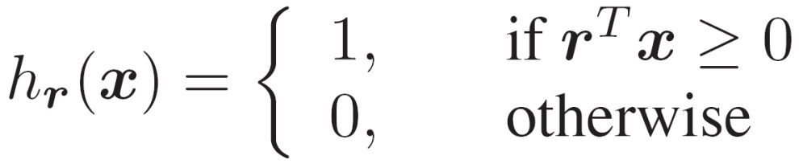



LSH functions for dot products
The hashing function of LSH to produce Hash Code
is a hyperplane separating the space
Notes:
73

Slide 74
Locality Sensitive Hashing
Take random projections of data
Quantize each projection with few bits
0
101
Feature vector
1
0
No learning involved
1
1
0

Slide 75
How to search from hash table?
A set of data points
N
h
r₁…r_{k}
Search the hash table
for a small set of images
Hash function
X_{i}
Hash table
110101
Q
h
r₁…r_{k}
Q
110111
111101
New query
results
Notes:
75
Dd definition

Slide 76
How to search from hash table?
A set of data points
N
h
r₁…r_{k}
Search the hash table
for a small set of images
Hash function
X_{i}
Without this final step,
it is a sketch
(don’t store but approximate the data)
Hash table
110101
Q
h
r₁…r_{k}
Q
110111
111101
New query
results
Notes:
76
Dd definition

Slide 77
Sketching, Hashing, Sampling Summary
Sampling, hashing, and sketching ideas are at the heart of many stream mining algorithms
Moments/join aggregates, histograms, wavelets, top-k, frequent items, other mining problems, …
A sample is a quite general representative of the data set; sketches tend to be specific to a particular purpose
FM sketch for count distinct, CM/AMS sketch for joins / moment estimation, LSH for distances, …
Sample implementations available on the web
http://www.cs.rutgers.edu/~muthu/massdal-code-index.html
http://www.mit.edu/~andoni/LSH
All provide approximations of true counts!

Slide 78
Sketching, Hashing, Sampling Summary
Sampling, hashing, and sketching ideas are at the heart of many stream mining algorithms
Moments/join aggregates, histograms, wavelets, top-k, frequent items, other mining problems, …
A sample is a quite general representative of the data set; sketches tend to be specific to a particular purpose
FM sketch for count distinct, CM/AMS sketch for joins / moment estimation, LSH for distances, …
Sample implementations available on the web
http://www.cs.rutgers.edu/~muthu/massdal-code-index.html
http://www.mit.edu/~andoni/LSH
All provide approximations of true counts!
Hashing is COOL!

Slide 79
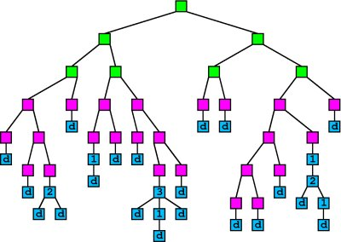
Learning from streams

Slide 80
General idea
Many ML algorithms are greedy and use data to estimate statistics
For every greedy step:
Wait till sufficient data is available
use sampling, hashing, sketching if possible
Compute statistics with high certainty
Perform greedy steps with high certainty

Slide 81
Sufficient statistics
“no other statistic that can be calculated from the same sample provides any additional information as to the value of the parameter”
For example, the sample mean is a sufficient statistics for the expected value of normally distributed data
For Decision Trees, we need e.g. GINI index:
G() = 2 * (n+ / n) * (n- / n)
i.e., estimates of n, n+, and n-

Slide 82
Data Mining As Search
Training Data
Training Data
Training Data
1.8
1.7
...
1.9
...
1.5
1.9
2.0

Slide 83
How Much Data is Enough?
Training Data
X1?
1.65
...
1.38
Xd?

Slide 84
How Much Data is Enough?
Sample of Data
Use statistical bounds
Normal distribution
Hoeffding bound
Applies to scores that are average over examples
Can select a winner if
Score1 > Score2 + ε
How to decide ε?
1.6 +/- ε
X1?
...
1.4 +/- ε
Xd?

Slide 85
Hoeffding Trees
In order to pick split attribute for a node looking at a few example may be sufficient
Given a stream of examples:
Use the first to pick the split at the root
Sort succeeding ones to the leaves
Pick best attribute there
Continue…
Leaves predict most common class

Slide 86
How Much Data?
Make sure best attribute is better than second
That is:
G is the estimated Gini
Using a statistical result: Hoeffding bound
Collect n data point untill:
Then, X1 is correct with probability 1-δ, distribution-free!
With R the range (log c, where c is the number of classes)

Slide 87
Hoeffding Tree Algorithm
Procedure HoeffdingTree(Stream, δ)
Let HT = Tree with single leaf (root)
Initialize sufficient statistics at root
For each example (X, y) in Stream
Sort (X, y) to leaf using HT
Update sufficient statistics at leaf
Compute G for each attribute
If G(best) – G(2nd best) > ε, then
Split leaf on best attribute
For each branch
Start new leaf, init sufficient statistics
Return HT

Slide 88
VFDT (Very Fast Decision Tree)
Memory management
Memory dominated by sufficient statistics
Deactivate less promising leaves/attributes when needed
Ties:
Wasteful to decide between identical attributes
Check for splits periodically
Postpone time-consuming tasks!
Pre-pruning (optional)
Consider not splitting as option
Only make splits that improve the value of G()
Initialize with model from traditional learner
Rescan old data when time available
avoid bad decisions due to observing examples once

Slide 89
Practical learning from streams
Prove that given infinite data, the result is the same as the batch-version with high probability
Define sufficient statistics
Estimate using sketches/hashes/samples
Store incoming data in buffer as long as possible
Use to re-estimate if time permits, clearly better estimates than proven…
Postpone expensive operations
Clearly not log(n), postpone exponentially to get log(n) time on average…
Pick most promising step when there is insufficient information to guarantee correctness…

Slide 90
Practical learning from streams
Prove that given infinite data, the result is the same as the batch-version with high probability
Define sufficient statistics
Estimate using sketches/hashes/samples
Store incoming data in buffer as long as possible
Use to re-estimate if time permits, clearly better estimates than proven…
Postpone expensive operations
Clearly not log(n), postpone exponentially to get log(n) time on average…
Pick most promising step when there is insufficient information to guarantee correctness…
Stream learning theory imposes constraints that can be avoided in practice!

