Slide 1
RESEARCH PROPOSAL
Invasive Mechanical Ventilation
Versus Non-Invasive Respiratory Support
on 28-Day Mortality in ICU Patients
with Malignant Cancer
AI declaration: KIMI and Claude were used in creating the slides. Codex is used for data analysis. And Claude was used to assist with assignment writing.
Critical Care Research
MIMIC-IV Analysis
Causal Inference

Slide 2
PRESENTATION OVERVIEW
Contents
01
Background & Clinical Dilemma
02
Study Objectives
The critical decision facing clinicians in cancer ICU settings
Research question, PICO framework, and primary outcomes
03
Methodology
04
Cohort Characteristics
MIMIC-IV data source, study population, and statistical methods
Baseline demographics and clinical features
05
Key Results
06
Discussion & Conclusions
ATT, ATE estimates, and sensitivity analysis
Clinical interpretation and implications
07
Limitations & Future Directions
Study constraints and next steps

Slide 3



CLINICAL CONTEXT
Clinical Background & Research Rationale
Why Cancer ICU Patients?
The Intubation Dilemma
Why Causal Inference?
Respiratory failure is the most frequent ICU admission reason
Sepsis & treatment-related complications also common
Clinical heterogeneity (cancer type, stage, treatment history) complicates decisions
Early intervention → improved outcomes
IMV carries serious risks: VAP, VILI, ICU-associated delirium
Non-invasive options (HFNC, NIV/BiPAP) increasingly favoured
RCTs are costly, ethically challenging, and lack generalizability in ICU
Causal inference + MIMIC-IV leverages real-world data at scale
Advanced propensity methods mimic randomisation
Biskup et al., 2017; Codru & Vecerzan, 2025
Lee et al., 2015; Azevedo et al., 2014

Slide 4
BACKGROUND
The Clinical Challenge
Cancer patients in ICU face a critical decision with uncertain optimal strategy
Invasive Mechanical Ventilation (IMV)
The Complex Trade-off
Approach: Endotracheal intubation or tracheostomy with mechanical ventilation
Avoiding IMV may reduce ventilation-related complications, but delayed intubation following unsuccessful non-invasive support may worsen outcomes. The optimal initial strategy remains uncertain.
Benefits: Definitive airway control, reliable oxygenation
Risks & Complications:
• Ventilator-associated pneumonia
Cancer ICU Population Complexity
• Ventilator-induced lung injury
• Sedation-related complications
Respiratory failure is a leading cause of ICU admission
Varying degrees of immunosuppression
Organ dysfunction and treatment-related complications
Non-Invasive Support (NIV/HFNC)
Clinically heterogeneous outcomes
Approach: High-flow nasal cannula or CPAP/BiPAP without intubation
Potential Benefits: Reduced intubation rates in select populations
Key Concern:
Delayed intubation following non-invasive failure may worsen outcomes
Which initial respiratory support strategy improves survival?

Slide 5
RESEARCH AIMS & FRAMEWORK
Objectives & PICO Framework
Primary Question:
Among adult malignant cancer patients admitted to the ICU requiring respiratory support, what is the causal effect of initial IMV compared with HFNC or NIV/BiPAP on 28-day all-cause mortality?
P
Population
I/C
Intervention & Comparator
C
Covariates
O
Outcomes
Adults ≥18 years
Confirmed malignant cancer (solid or haematological)
First ICU admission, index hospitalisation
Required respiratory support
(Reference) IMV via endotracheal intubation or tracheostomy within 24h
vs. HFNC (high-flow nasal cannula)
vs. NIV/BiPAP (non-invasive ventilation)
Demographics: age, sex, race
Cancer type & metastatic status
Severity scores: SOFA, SAPS-II
Vitals, labs (SpO₂, PaO₂, lactate, creatinine), vasopressors
Primary: 28-day all-cause mortality from ICU admission
Secondary: Hospital mortality (in-hospital death, index admission)
Retrospective Cohort · MIMIC-IV
Propensity Score Methods
Comparative Effectiveness

Slide 6
STUDY DESIGN
Study Objectives & Research Question
Primary Objective
Estimands
To estimate the causal effect of Non-invasive and HFNC as an initial respiratory support strategy on outcomes in adult cancer patients admitted to the ICU.
ATE
Average Treatment Effect
Population-level effect
Clinical Question:
Among adult malignant cancer patients admitted to the ICU who require respiratory support, what is the causal effect of initial invasive ventilation compared with initial non-invasive oxygen delivery methods on 28-day all-cause mortality?
ATT
Average Treatment Effect on Treated
Effect in treated patients
Primary Outcome
Secondary Outcome
Why 28-Day Mortality?
28-Day
In-Hospital
Commonly adopted in critical care research
Captures delayed deaths from acute illness
All-cause mortality from ICU admission
Mortality during hospitalization

Slide 7
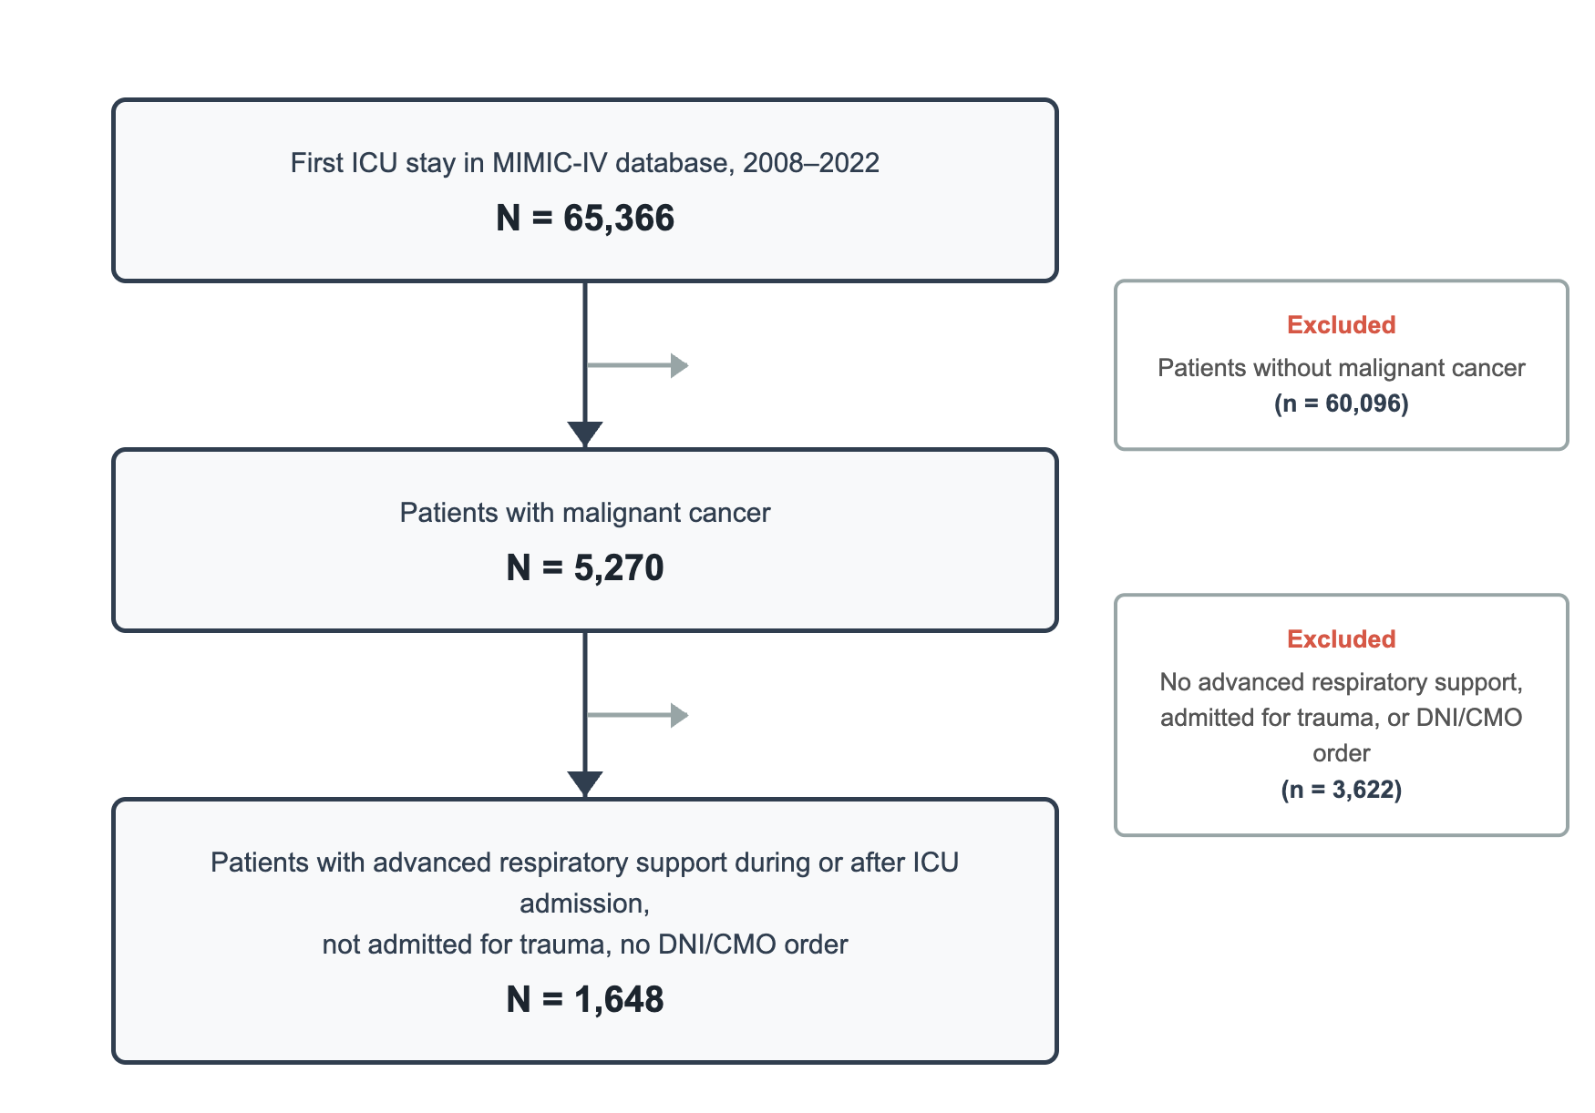
METHODOLOGY
Data Source & Study Population
MIMIC-IV v3.1 Database
Exclusion Criteria
Trauma-related admissions
65,000+
2008-2022
Mechanically ventilated before ICU admission
ICU Patients
Time Period
"Do Not Intubate" orders
A large, publicly available, de-identified electronic medical record dataset from Beth Israel Deaconess Medical Center providing high-resolution, time-stamped clinical information.
Comfort-measures-only orders
Inclusion Criteria
Final Analytic Cohort
1
Adult patients aged ≥18 years
1,648
2
Confirmed diagnosis of malignant cancer (solid or hematological) via ICD-9/10 codes
3
First ICU admission during index hospitalization
Patients
4
Received respiratory support within 24 hours of ICU admission
De-identified data • No additional IRB consent required

Slide 8
RESULTS
Cohort Characteristics: Baseline Differences
Substantial baseline differences confirm confounding by indication requiring causal adjustment
Key Clinical Characteristics
Cohort Overview
Variable | Non-Invasive (N=308) | IMV (N=1,340) | Difference
28-day mortality | 30.5% | 25.7% | Paradox!
SOFA Score (median) | 4 | 6 | Higher severity
SAPS-II (median) | 40 | 46 | Higher severity
GCS Score (median) | 15 | 15 | Similar
Vasopressor use | 8.8% | 45.5% | 5× higher
Age (median) | 70 | 68 | Similar
Medicare/Medicaid | 75.3% | 73.0% | Similar
1,648
Total Patients
IMV
81.3%
1,340 patients
Non-Invasive
18.7%
308 patients (70 later switched to IMV)
The Paradox
Demographics
Despite higher severity scores and more vasopressor use, unadjusted mortality was lower in the IMV group. This confirms confounding by indication that requires causal adjustment.
Groups were broadly similar in age, language (88.3% English), and insurance status (~73-75% Medicare/Medicaid), with slight differences in racial composition.

Slide 9
RESULTS · ATT
Average Treatment Effect on the Treated (Propensity Score Matching)
METHOD: 1:1 NEAREST-NEIGHBOUR PSM
DIRECTION OF EFFECT
ODDS RATIO (Non-Invasive over Invasive)
• Matched on log-odds of propensity score
• Caliper: 0.2 SD of log-odds PS
• Matching without replacement
• 18 covariates
• 95% CI via bootstrap (1,000 samples)
1.93
Among patients who actually received non-invasive ventilation, the odds of 28-day mortality were nearly 2× higher compared with the counterfactual of having received IMV instead.
95% CI [1.33, 2.82]
28-day mortality
CLINICAL INTERPRETATION
The ATT addresses a practical clinical question: for patients who were in fact intubated, what would their outcome have been if they had instead received non-invasive ventilation? The harmful direction suggests that delayed intubation following non-invasive failure may have contributed to worse outcomes in this subgroup.
This estimate is most relevant for guiding decisions in patients similar to those in the treated (non-invasive) group.
Notes:
If matched

Slide 10
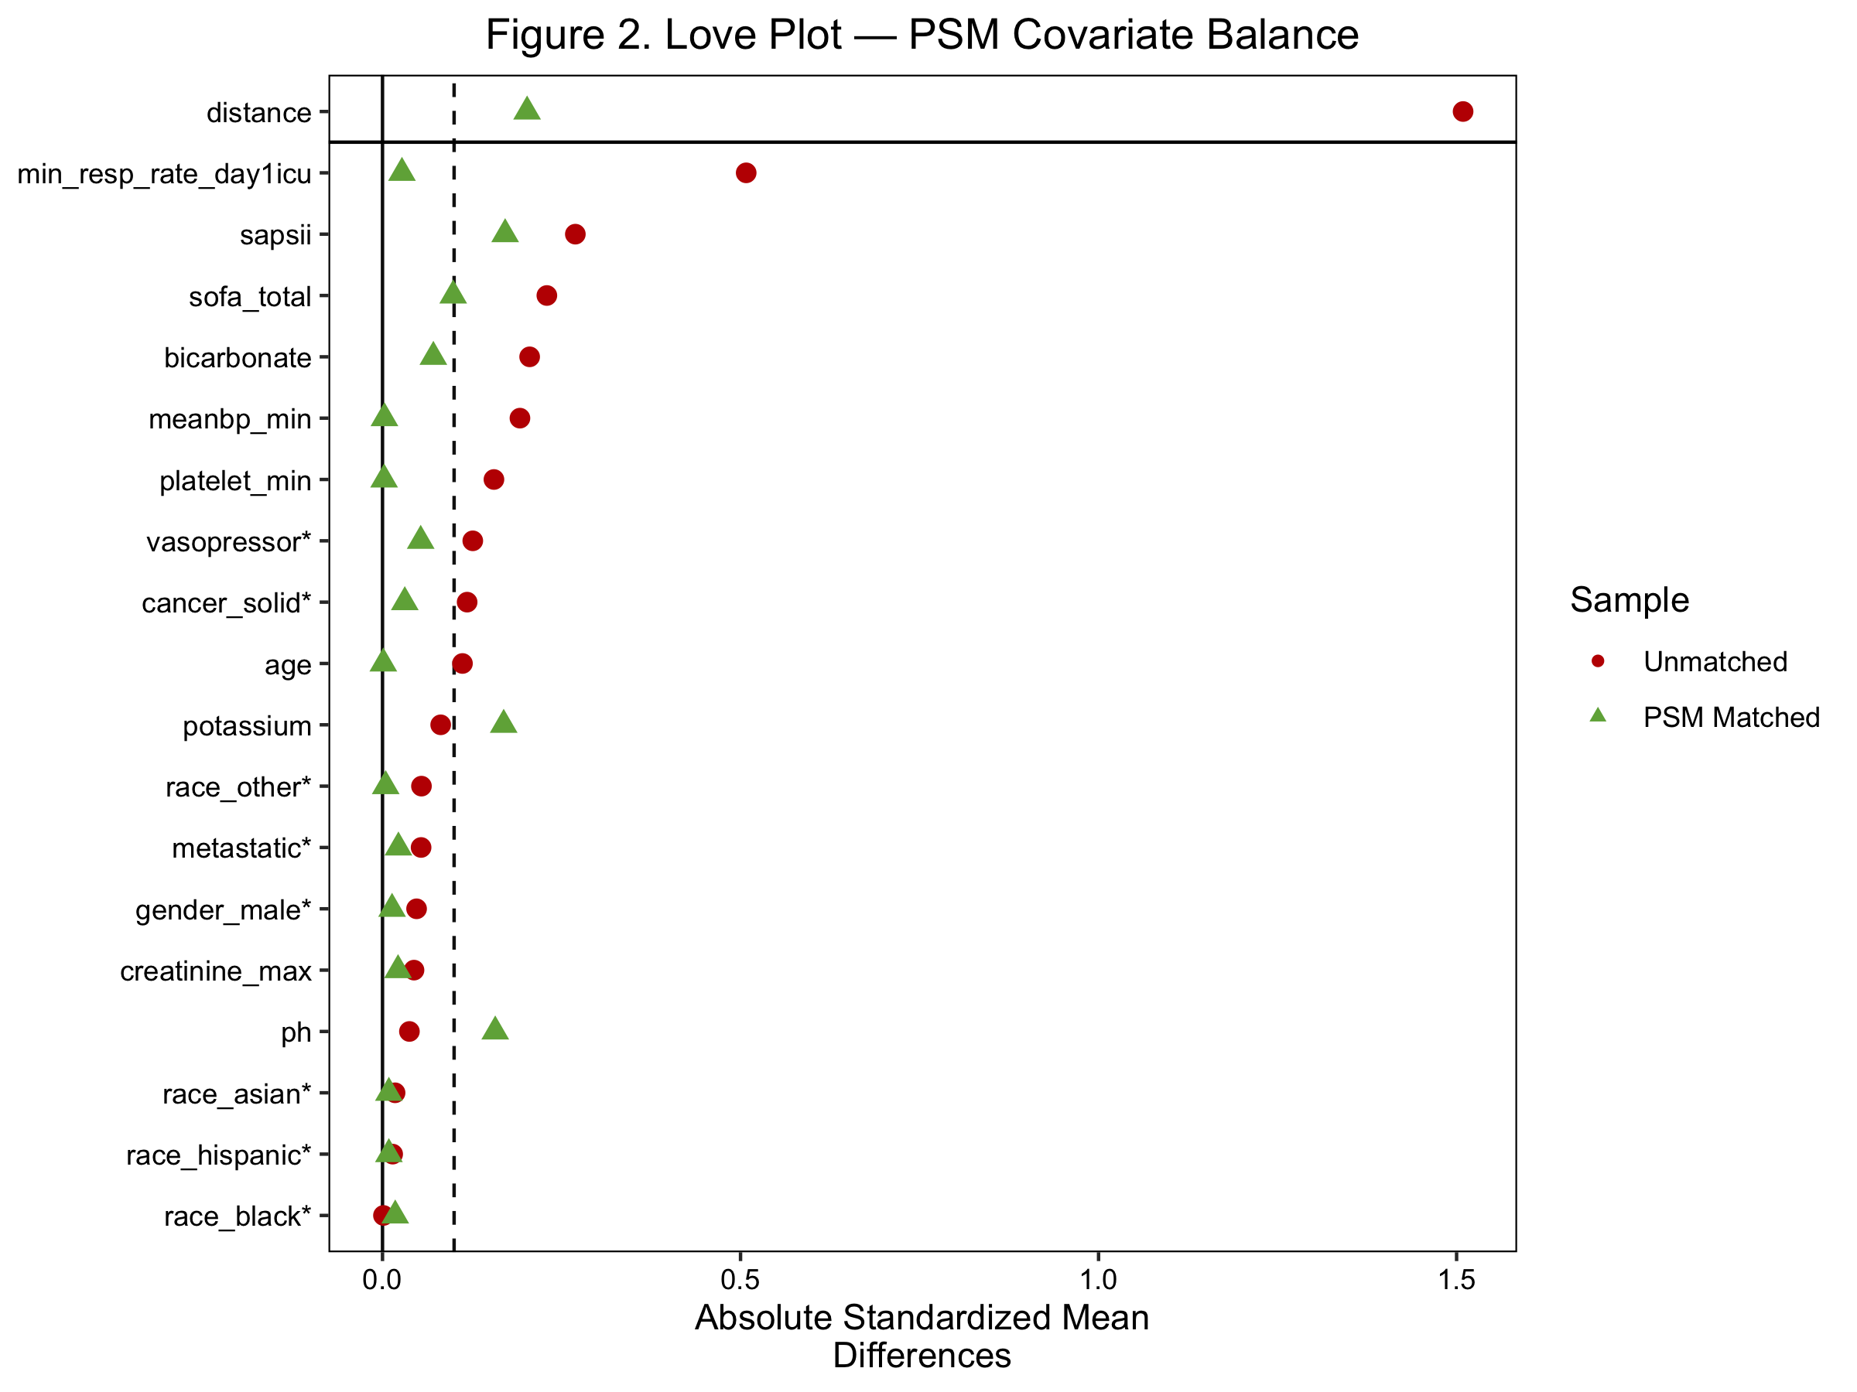

Slide 11
RESULTS · ATE
Average Treatment Effect at the Population Level (Doubly Robust IPW)
METHOD: DOUBLY ROBUST IPW
POPULATION-LEVEL VIEW
ODDS RATIO (Non-invasive vs Invasive)
• Combines PS weighting with outcome regression
• Consistent if either model is correct
• Overlap trimming: weights capped at 10
• Covariate balance: SMD < 0.10
• 95% CI via bootstrap (1,000 samples)
1.87
If the entire cohort received non-invasive ventilation vs IMV, the average odds of 28-day mortality would be approximately 87% higher on the NI strategy.
95% CI [1.40, 2.47]
28-day mortality
IMPORTANT CAVEAT
The ATE assumes both strategies are suitable for every patient — a condition not met in practice. Many patients who received IMV would not have been appropriate candidates for non-invasive support due to depressed consciousness, inability to protect the airway, haemodynamic instability, or severity of respiratory failure. The ATE should therefore be interpreted as a theoretical reference point rather than a directly actionable estimate.

Slide 12
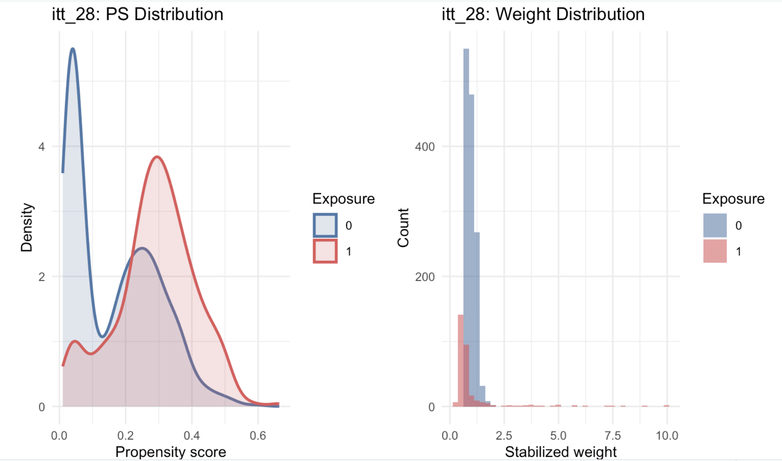

Slide 13
RESULTS · SENSITIVITY
Sensitivity Analysis: Robustness Across Specifications
The robustness of estimated treatment effects was assessed by varying (i) the mortality endpoint and (ii) the treatment group definition. Both ATT and ATE remained consistent across specifications.
OUTCOME DEFINITION: 28-DAY vs HOSPITAL MORTALITY
TREATMENT REGIME: ITT vs PER-PROTOCOL
Effect sizes were smaller for 28-day than hospital mortality
Per-protocol analysis produced a smaller effect size
ITT (include oxygen as treatment)
28-day mortality
Hospital mortality
ITT (primary)
Per-protocol
ITT (primary)
Include Non-compliant
Allow treatment switching
Include Non-compliant
Short-term Survival
Immediate Survival
NI vs IMV — observed mortality
Treatment group definition — effect magnitude
The choice of mortality endpoint influences effect magnitude, though direction is preserved.
Allowing treatment switching may introduce a protective component — interpret tentatively given limited power.
BOTTOM LINE: No statistically significant differences between alternative specifications — primary findings are robust to outcome and treatment group definitions.

Slide 14
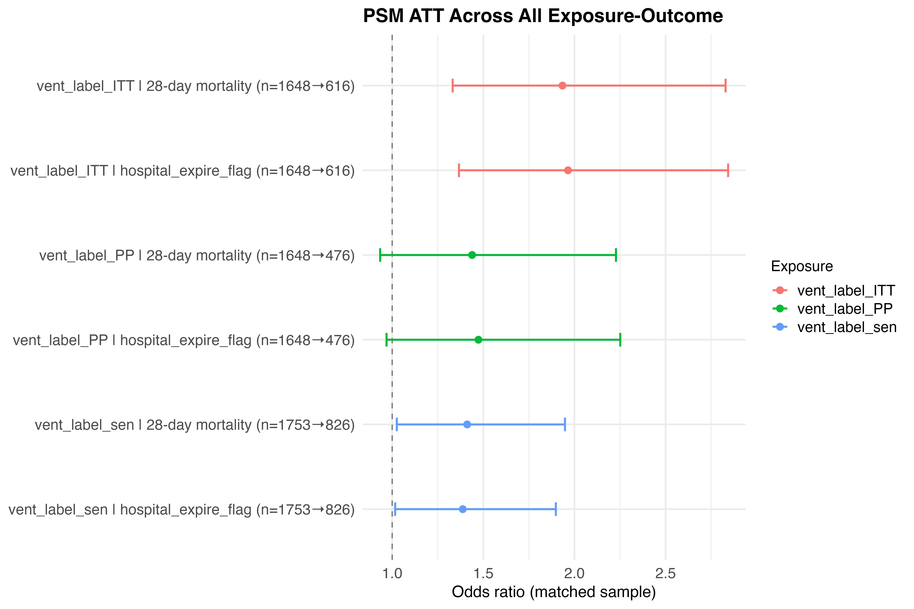

Slide 15
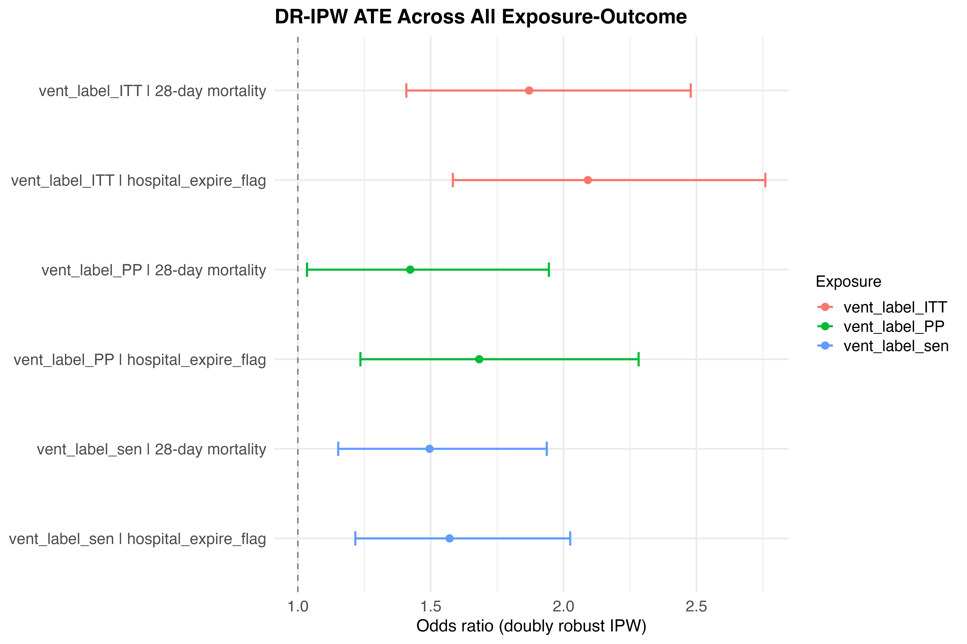

Slide 16
DISCUSSION
Interpretation & Clinical Implications
PRIMARY FINDING
Both ATT and ATE indicate that non-invasive ventilation was associated with worse outcomes than IMV in this cancer ICU population — consistent direction across methodologically distinct estimators strengthens the conclusion.
ATT — WHO IT APPLIES TO
ATE — HYPOTHETICAL VIEW
CLINICAL IMPLICATION
Speaks to patients actually managed non-invasively. Worse outcomes may reflect:
• Delayed intubation after NI failure
• Residual confounding not captured by measured covariates
Most relevant for clinical decisions in patients similar to the treated group.
Represents a hypothetical world where every patient receives NI vs IMV.
Assumes both strategies are appropriate for every patient — often violated in practice.
Best interpreted as a theoretical reference, not a directly actionable policy.
Non-invasive ventilation is not universally preferable in critically ill cancer patients.
Results emphasise the importance of careful patient selection for NI support.
Reporting multiple estimands offers complementary perspectives for clinical and policy decisions.

Slide 17
LIMITATIONS & FUTURE DIRECTIONS
Study Constraints and Next Steps
LIMITATIONS
FUTURE DIRECTIONS
1
Limited sample size
1
Federated analysis across institutions
Reduced statistical power and precision of effect estimates, particularly for sensitivity analyses.
Collaborate with other clinical databases to pool evidence while preserving data privacy — increases sample size and statistical power.
2
Pre-treatment information gaps
2
Enhanced confounder capture
Limited data on patient characteristics prior to treatment initiation restricted the extent to which baseline confounding could be fully addressed.
Incorporate richer pre-ICU clinical data and treatment trajectories to better address confounding by indication.
3
Residual confounding
3
Cancer subtype-specific analysis
Observational design: unmeasured factors influencing both treatment assignment and outcomes may remain despite propensity score adjustment.
After population-level characterisation, deep-dive into specific cancer subtypes to identify subgroups with differential treatment effects.

