Slide 1

Traffic Accident Database Design
Sicheng Zhang
Yihui Huang
Youyi Liu
Zhouyang Zhuang

Slide 2
Introduction
Our database collects the information about traffic accidents, it includes the basic information in the accident, such as time, location, driver and vehicle information, and the reason and result of the accident
The purpose of this database design is to track and report traffic accidents, to analyze the possible factors of accidents, and make adjustment with the road design, vehicle design or other element according to the report analysis.
The database will be used by traffic departments, related agencies and insurance companies.

Slide 3
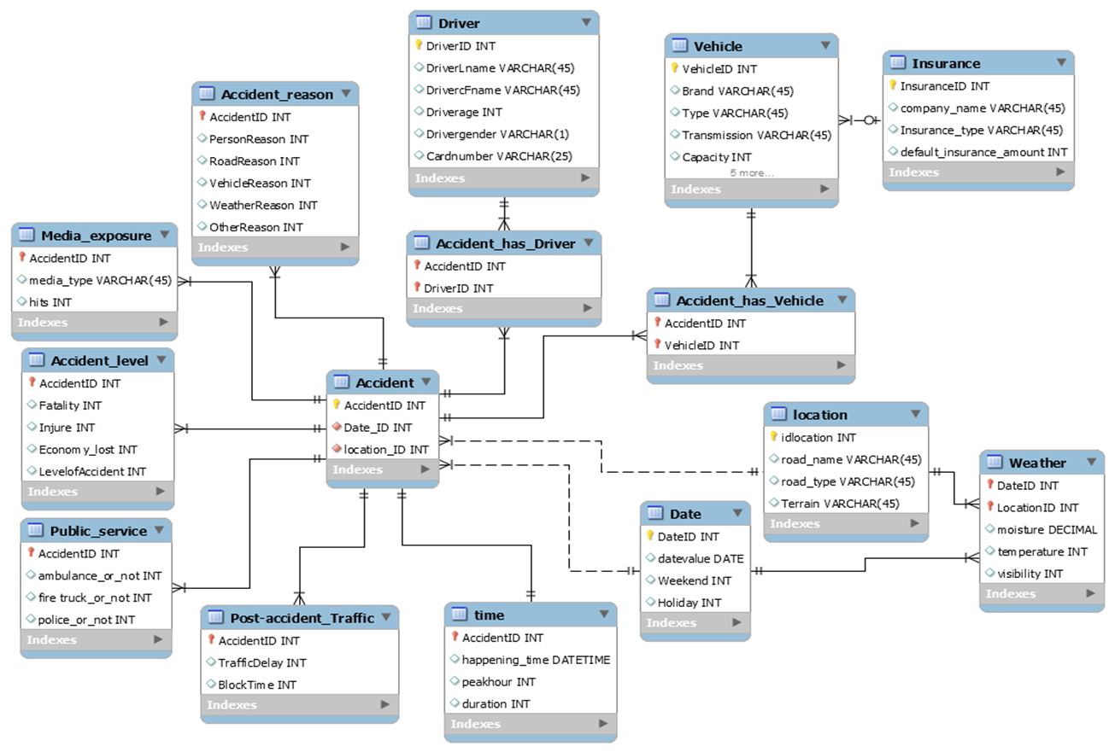
Entity Relationship Diagram

Slide 4
Primary Keys
AccidentID
Date_ID
Location_ID
DriverID
VehicleID
InsuranceID

Slide 5
Primary Foreign Keys
AccidentID (Accident_reason, Media_exposure, Accident_level, Public_ service, Post-accident_Traffic, time)
DateID + LocationID (Weather)
AccidentID + DriverID (Accident_has_Driver)
AccidentID + VehicleID (Accident_has_Vehicle)

Slide 6

Relationship Examples

Slide 7
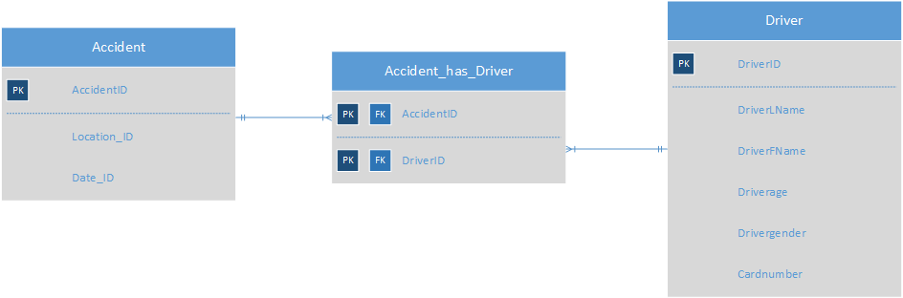
Accident - Accident_has_Driver - Driver

Slide 8
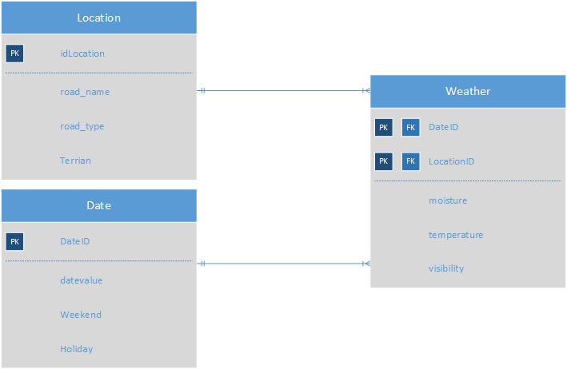
Location-Date-Weather

Slide 9



Create tables
CREATE TABLE Vehicle(
VehicleID INT IDENTITY PRIMARY KEY,
Brand VARCHAR(45),
[Type] VARCHAR(45),
Transmission VARCHAR(45),
Capacity INT CHECK(Capacity>0 and Capacity<100),
Mileage INT CHECK(Mileage>0),
Vehicle_age INT CHECK(Vehicle_age>0 and Vehicle_age<50),
InsuranceId INT FOREIGN KEY REFERENCES Insurance(InsuranceId),
Insurance_status int,
Insurance_amount INT CHECK(Insurance_amount>0)
);

Slide 10
Triggers & Functions
Triggers
updateAccidentLevel → Accident_Level
WK_HOLIDAY_datevalue → [date]
updateinsurance_status_amount → accident_has_vehicle
Functions
holiday_date
getDefaultInsuranceAmount
CK_peakhour

Slide 11
updateinsurance_status_amount → accident_has_vehicle
CREATE Trigger updateinsurance_status_amount
ON accident_has_vehicle
After INSERT,UPDATE
AS BEGIN
DECLARE @accidentamount INT
DECLARE @insurance_status INT
DECLARE @insuranceID INT
SET @accidentamount = (Select Count(ahv.AccidentID) FROM accident_has_vehicle ahv inner join inserted i on i.VehicleID = ahv.VehicleID)
SET @insuranceID = (SELECT InsuranceId FROM Vehicle WHERE VehicleID = (select i.vehicleid from inserted i))
if @accidentamount>=0
and @accidentamount < 2 SET @insurance_status = 0
else if @accidentamount >= 2
and @accidentamount <5 SET @insurance_status = 1
else if @accidentamount >=5
and @accidentamount <10 SET @insurance_status = 2
else SET @insurance_status = 3
UPDATE Vehicle
SET Insurance_status = @insurance_status
WHERE VehicleID = (select i.vehicleid from inserted i);
UPDATE Vehicle
SET Insurance_amount = @accidentamount * 500 + (@insurance_status*0.5 + 1)* dbo.getDefaultInsuranceAmount(@insuranceID)
WHERE VehicleID = (select i.vehicleid from inserted i)
END

Slide 12
holiday_date
create function holiday_date(@date_value date)
returns int
as
begin
declare @holiday int
declare @m int=DATEPART(mm, @date_value)
declare @d int=DATEPART(DD, @date_value)
declare @weekend int =DATEPART(DW,@date_value)
begin
-- New Years Day
IF (@M = 1 AND @D = 1 )
set @holiday=1;
-- Martin Luther King Day (3rd Monday of January)
Else IF (@M = 1 AND @D BETWEEN 15 AND 21 AND @weekend = 2) set @holiday=1;
-- Presidents Day (3rd Monday of February)
Else IF (@M = 2 AND @D BETWEEN 15 AND 21 AND @weekend = 2) set @holiday=1;
-- Memorial Day (Last Monday of May)
Else IF (@M = 5 AND @D BETWEEN 25 AND 31 AND @weekend = 2) set @holiday=1;
-- Independence Day
Else IF (@M = 7 AND @D = 4 ) set @holiday=1;
-- Labor Day (1st Monday of September)
ELSE IF (@M = 9 AND @D BETWEEN 1 AND 7 AND @weekend = 2)
set @holiday=1;
-- Columbus Day (2nd Monday of October)
ELSE IF (@M = 10 AND @D BETWEEN 8 AND 14 AND @weekend = 2)
set @holiday=1;
-- Veterans Day (October 11th)
ELSE IF (@M = 11 AND @D = 11 ) set @holiday=1;
-- Thanksgiving Day (4th Thursday of November)
ELSE IF (@M = 11 AND @D BETWEEN 22 AND 28 AND @weekend = 5)
set @holiday=1;;
-- Christmas Day (December 25th)
ELSE IF (@M = 12 AND @D = 25 ) set @holiday=1;
Else set @holiday=0;
end
return @holiday;
end
go

Slide 13

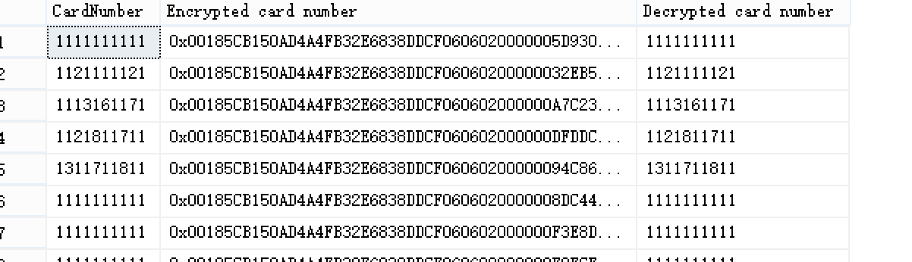
Encryption
USE [Traffic accidents]
--Encryption CardNumber for Driver
CREATE MASTER KEY ENCRYPTION BY PASSWORD = 'p@ssw0rd'
CREATE CERTIFICATE Insurance
WITH SUBJECT = 'Driver Credit Card Numbers';
GO
CREATE SYMMETRIC KEY CreditCards_Key11
WITH ALGORITHM = AES_256
ENCRYPTION BY CERTIFICATE Insurance;
GO
ALTER TABLE Driver
ADD CardNumber_Encrypted varbinary(128);
OPEN SYMMETRIC KEY CreditCards_Key11
DECRYPTION BY CERTIFICATE Insurance;
UPDATE [dbo].[Driver]
SET CardNumber_Encrypted = EncryptByKey(Key_GUID('CreditCards_Key11')
, CardNumber, 1, HashBytes('SHA1', CONVERT( varbinary
, DriverID)));

Slide 14
Insert data
insert Vehicle values ( 'BMW', 'Sedan', 'Auto', 4, 10000, 3, 1, null, null)
insert Location values('Huntington','Avenue','level')

Slide 15

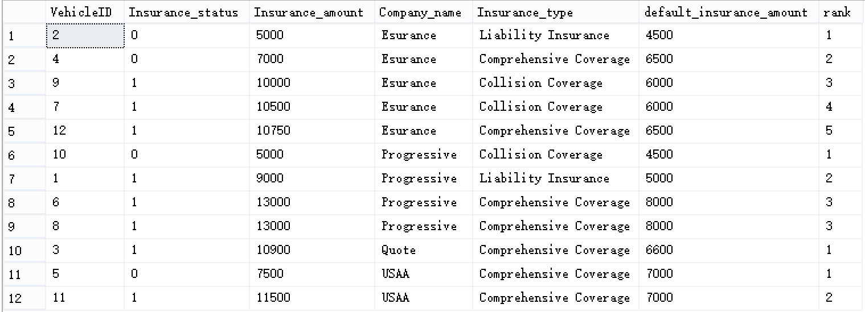
View for Insurance Company

Slide 16
View for Insurance Company
create view insurancereport as (select VehicleID, Insurance_status,Insurance_amount,Company_name,Insurance_type,default_insurance_amount,rank()over(partition by company_name order by isnull(insurance_amount,default_insurance_amount)) as rankfrom Vehicle vinner join Insurance ion v.InsuranceID = i.InsuranceID);select * from insurancereportdrop view insurancereport;

Slide 17
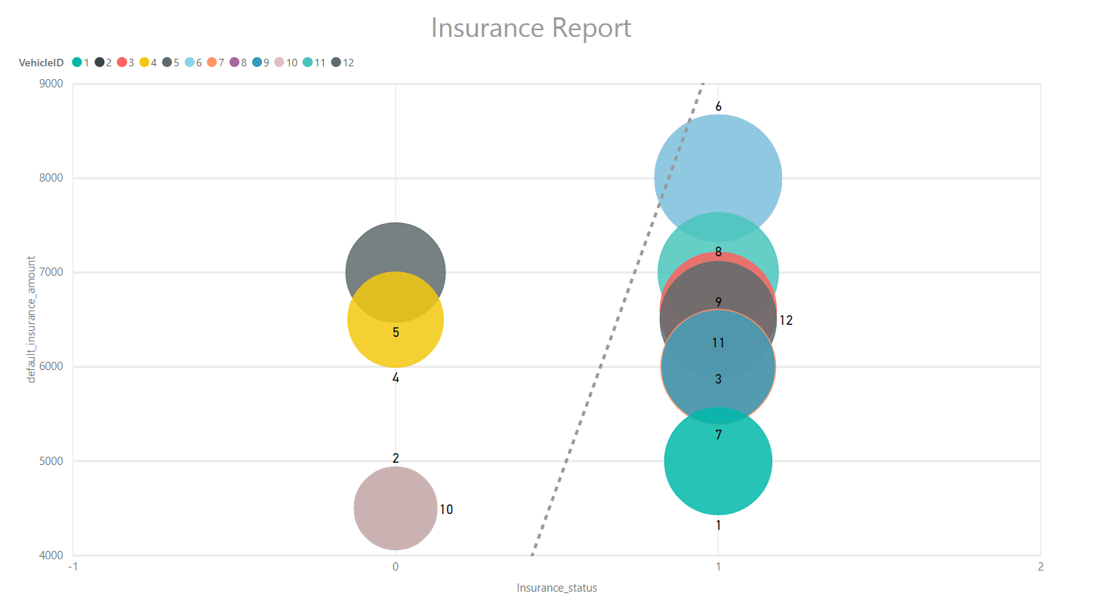
Report for Insurance Company

Slide 18

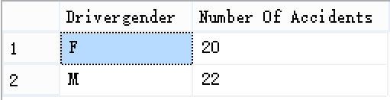


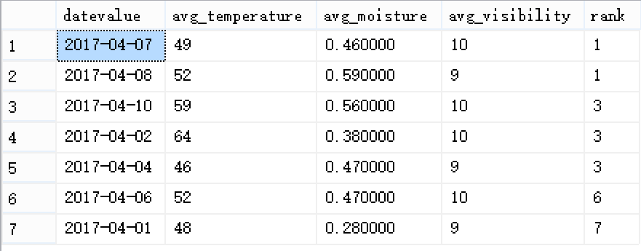

View for Transportation Department
Accident influence -Driver
Accident influence -Location
Accident influence -Weather

Slide 19
View for Transportation Department
Accident influence -Driver
create view transporationreport_humanasselect Drivergender,count(AccidentID) as [Number Of Accidents]from driver dinner join Accident_has_Driver adon ad.DriverID = d.DriverIDgroup by Drivergender
Accident influence -Weather
create view transporationreport_weatherasselect datevalue,avg(temperature) as avg_temperature,avg(moisture)as avg_moisture,avg(visibility)as avg_visibility,count(AccidentID) as total_accident,rank()over(order by count(AccidentID)desc) as rankfrom Accident ainner join weather won a.Date_ID = w.DateIDinner join Date don w.DateID=d.DateIDgroup by datevalue

Slide 20
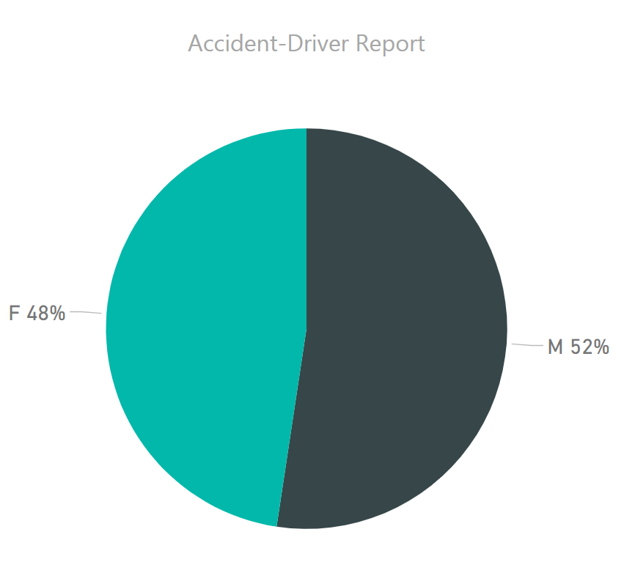
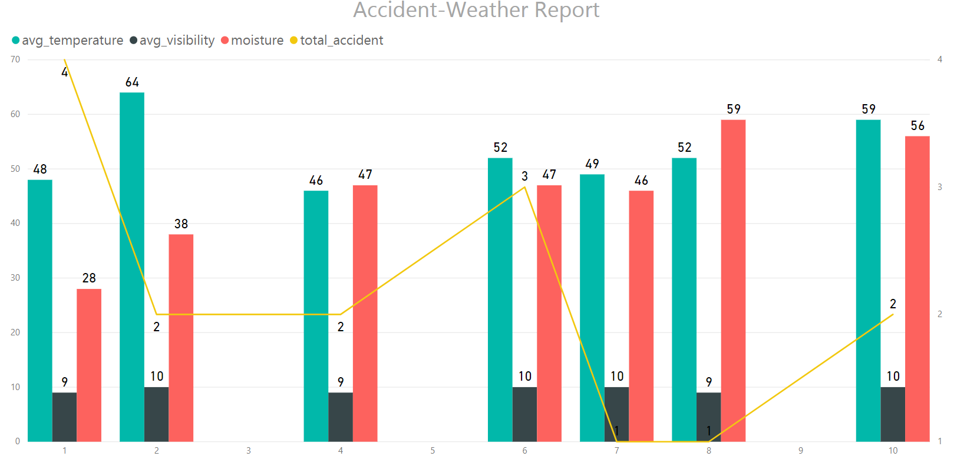
Report for Transportation Department

Slide 21
Future works

Slide 22
CREATE Trigger updateinsurance_status_amount
ON accident_has_vehicle
After INSERT,UPDATE
AS BEGIN
………
if @accidentamount>=0
and @accidentamount < 2 SET @insurance_status = 0
……….
else SET @insurance_status = 3
UPDATE Vehicle
SET Insurance_status = @insurance_status
WHERE VehicleID = (select i.vehicleid from inserted i);
UPDATE Vehicle
SET Insurance_amount = @accidentamount * 500 + (@insurance_status*0.5 + 1)*
dbo.getDefaultInsuranceAmount(@insuranceID)
WHERE VehicleID = (select i.vehicleid from inserted i)
END

Slide 23
Thank you for watching !

