Slide 1
week 1
Li Qilin

Slide 2
Overview
To predict where the person is looking at.
usability: track the eye movement
Two directions:
3-D gaze vector estimation is to predict the gaze vector
2-D gaze position estimation is to predict the horizontal and vertical coordinates on a 2-D screen

Slide 3
Challenges
Low sensor quality or unknown
Large variations in eye region appearance
illumination
ojects (glasses)

Slide 4
Datasets
Multi-view Gaze Dataset
without the need for person-specific calibration settings
The MPIIGaze Dataset & The MPIIFaceGaze Dataset
with calibration settings
Q1: requirements on hardware?

Slide 5
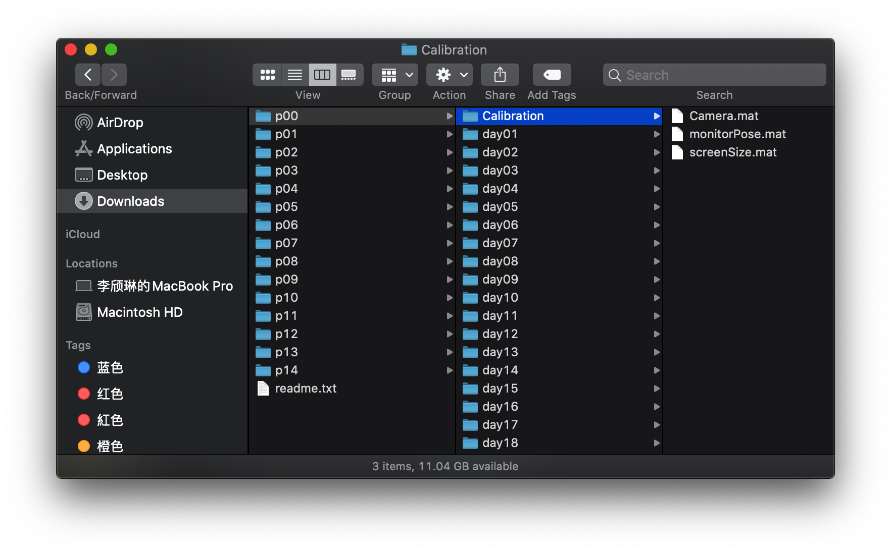

Slide 6
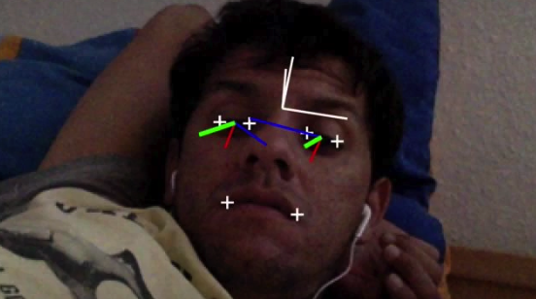
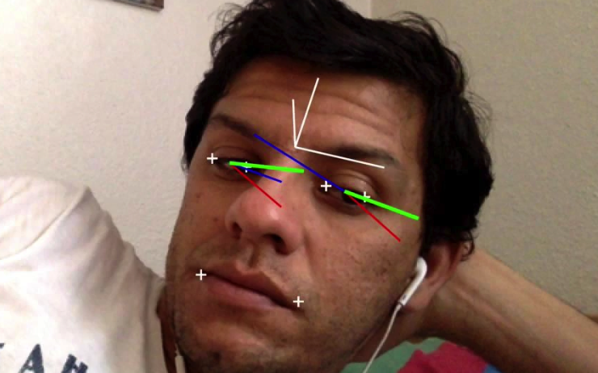
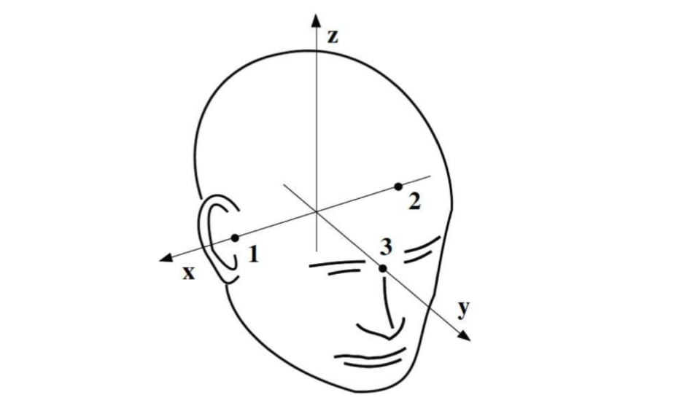
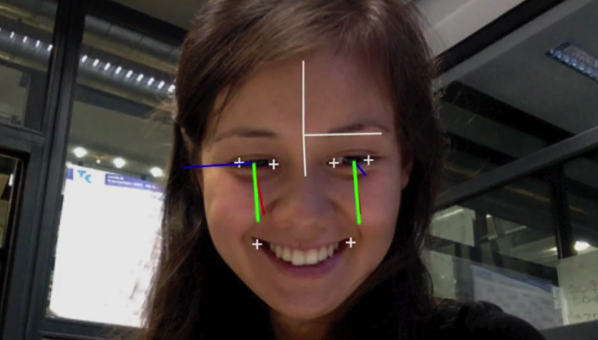

Slide 7
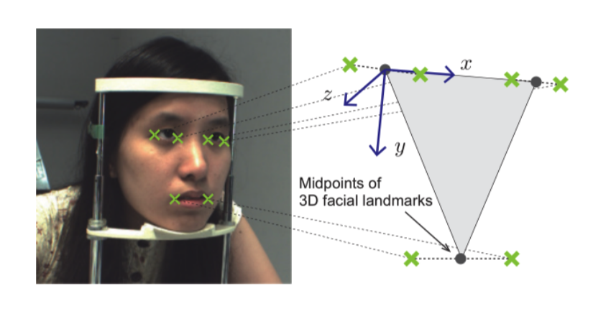
Methods
Model-based: use 3D eyeball models and estimate the gaze direction using geometric eye features.
Appearance-based: learn generic gaze estimators from large amounts of person, head pose-independent training data

Slide 8
Learning-by-Synthesis (UTokyo)
without modeling illumination changes or accounting for the varying material properties of the face
Random Forest (to make regression)

Slide 9
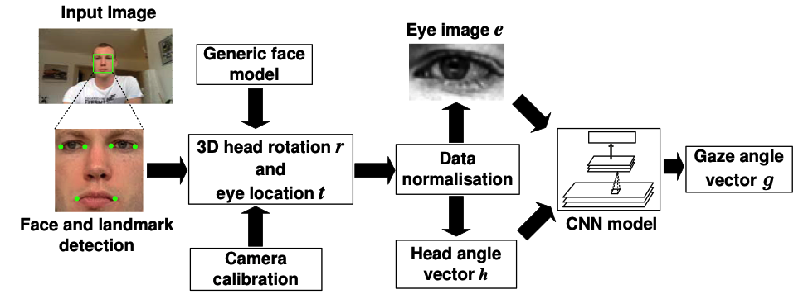
Appearance-Based Gaze Estimation in the Wild
Data pre-processing
Detect the user's face in the image
Fit a generic 3D facial shape model
Normalize
is to cope with the rotation and extension caused by the camera.
use NNs to fit a mapping between input and output

Slide 10
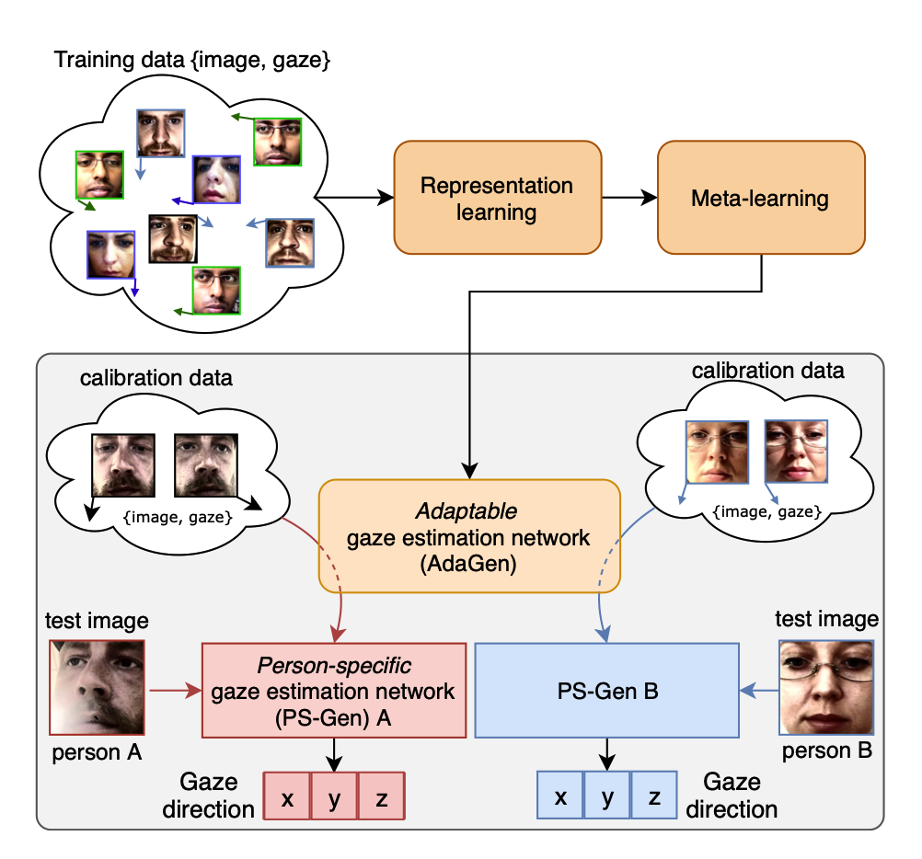
Few-Shot Adaptive Gaze Estimation
Meta learning
learn from few data
person-specific
Q2: what is person-specific?

Slide 11
to find a mapping between the given figure of eye and head position ( and calibration) and gaze vector.
render techniques
regression

