Slide 1
Appearance-Based Gaze Estimation in the Wild
Li Qilin

Slide 2
Previous datasets
Recorded under controlled labotary settings. (LIMITED)
limited head positions.

Slide 3
MPIIGaze dataset
15 participants, 213,659 pictures
outside of laboratory conditions, i.e during daliy routine
wilder range of recording location, time, illumination and eye appearance

Slide 4
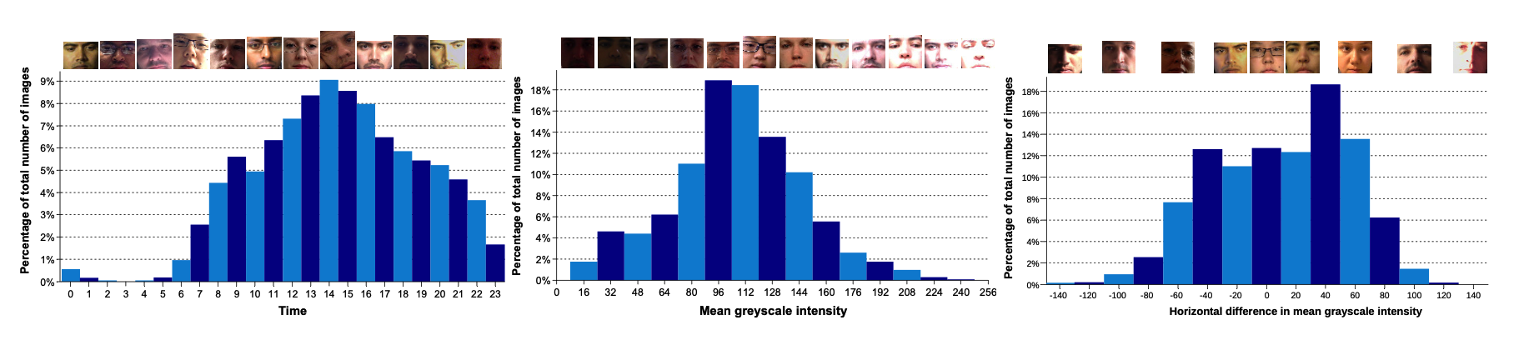
(Outside) variations in MPIIGaze

Slide 5
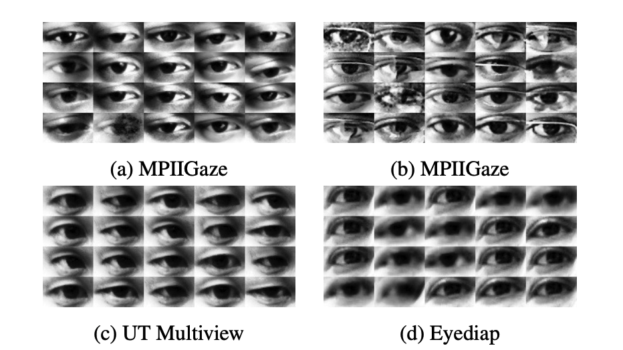
(Inside) variations in MPIIGaze

Slide 6
Collcetion process
use of laptop application to let volunteers to look at a fixed place, and take pictures of their eyes.
Suitable for laptop-captured application
more samples

Slide 7
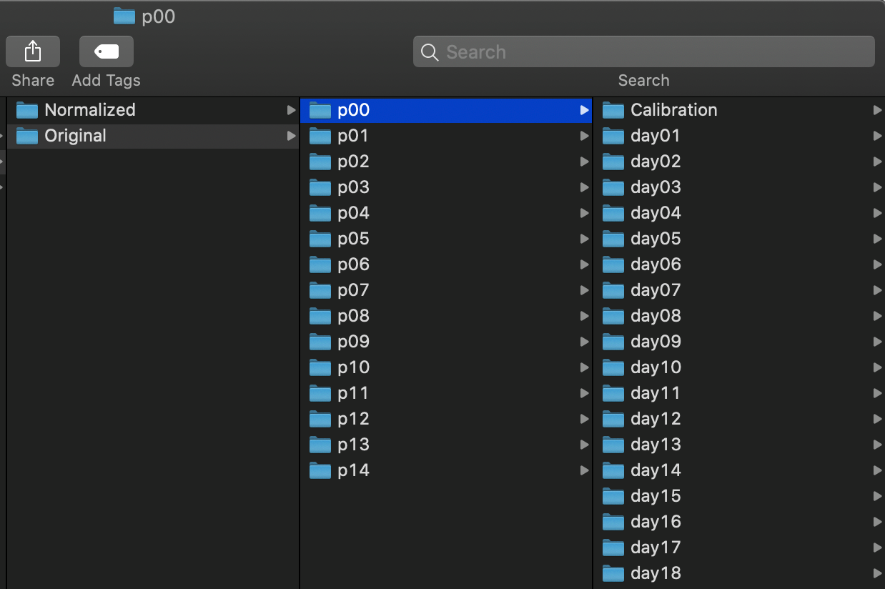
Dataset content

Slide 8
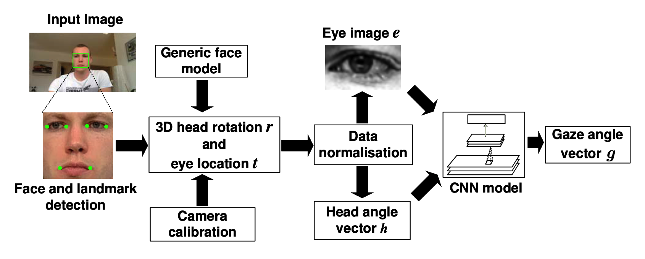
appearance-based gaze estimation using multimodal CNN

Slide 9
Calibration settings
Camera.mat: the intrinsic parameter of the laptop camera.
monitorPose.mat: the position of image plane in camera coordinate.
screenSize.mat: the laptop screen size.

Slide 10
Head Pose Estimation
Using Images of Planar Mirror Reflections
Camera can't directly point at the object
Parameters from Calibration settings

Slide 11
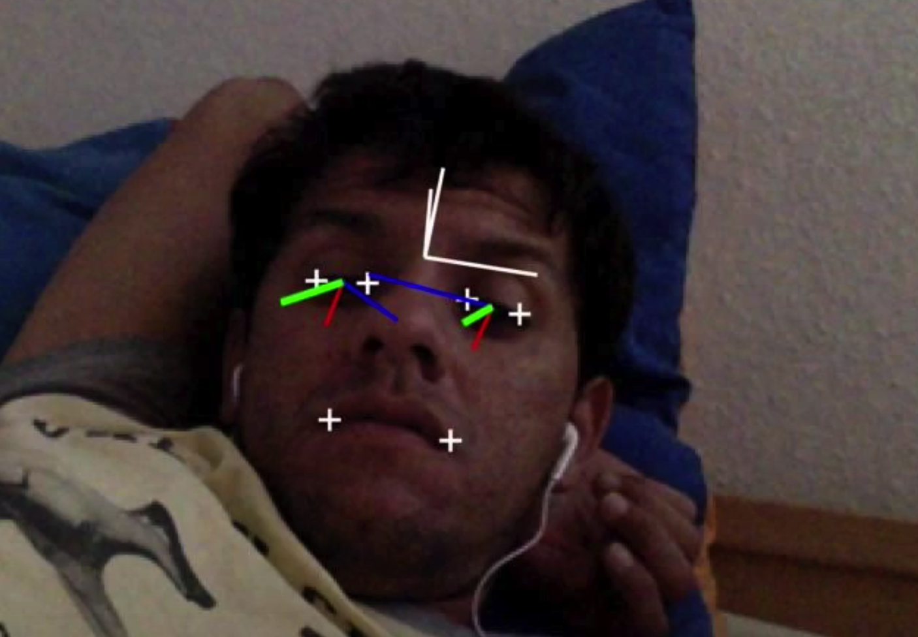

Slide 12
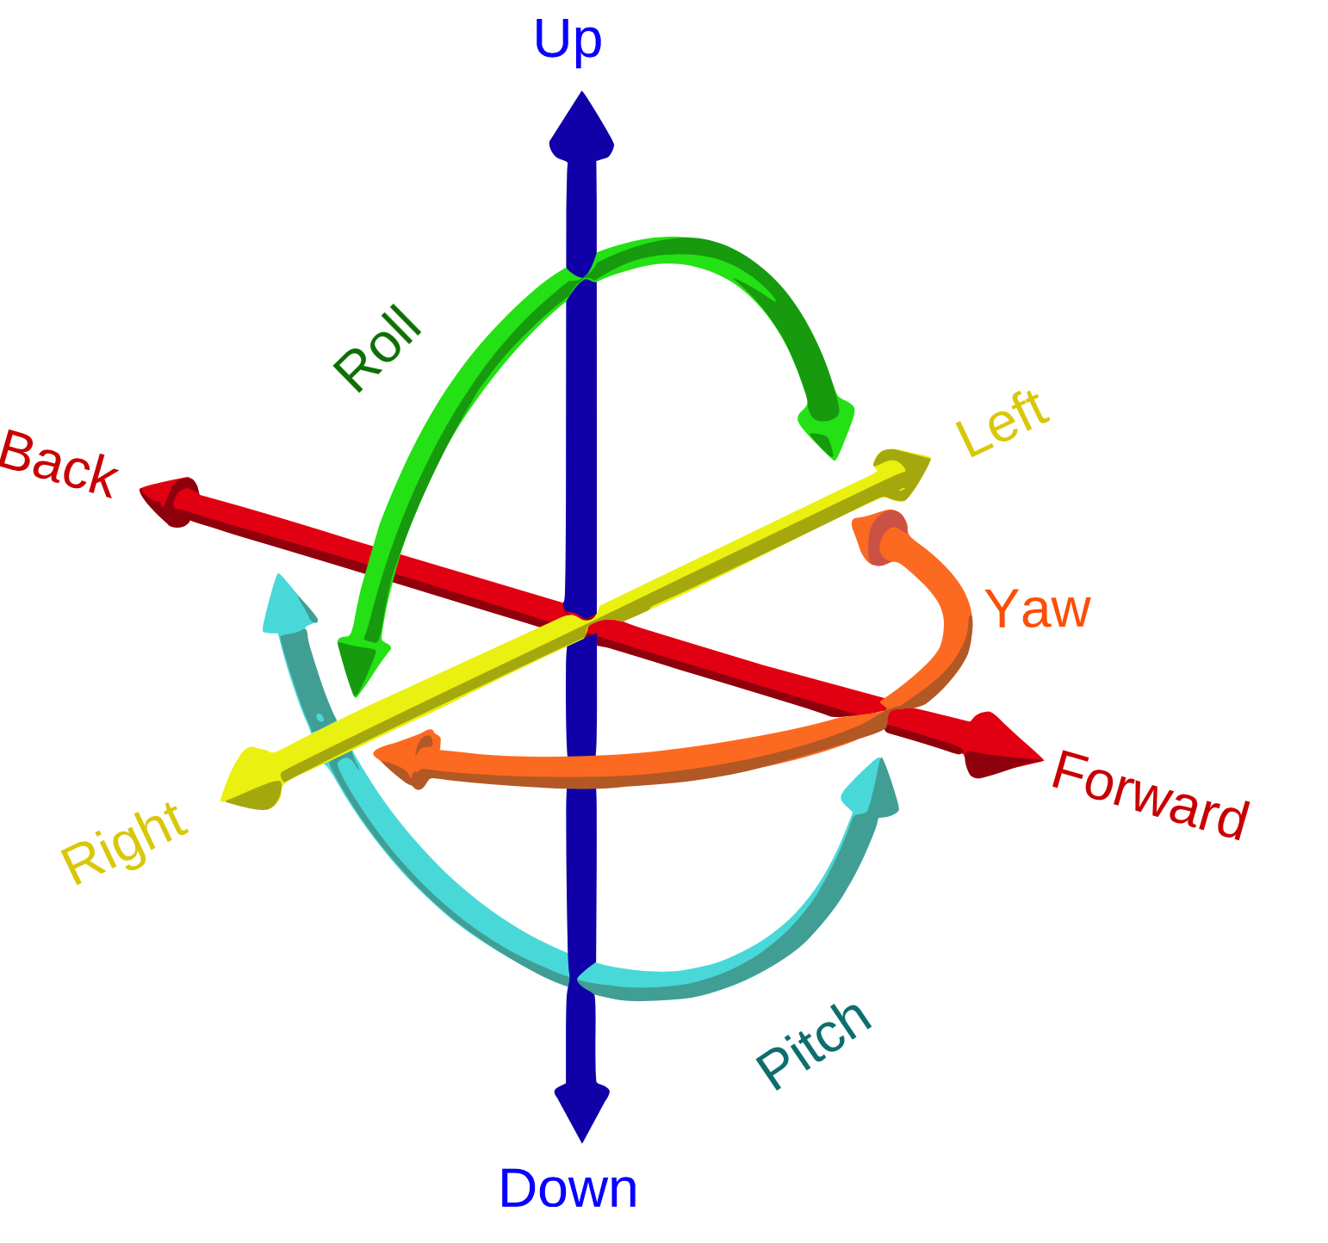
6DOF ( 6 degrees of freedom)

Slide 13
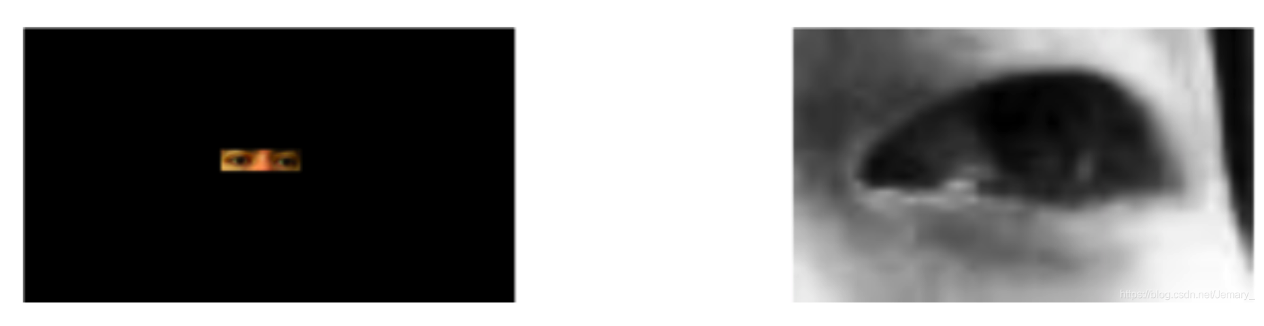
Normalisation
the difference between the left and right eyes is irrelevant in the person-independent training scenario.

Slide 14
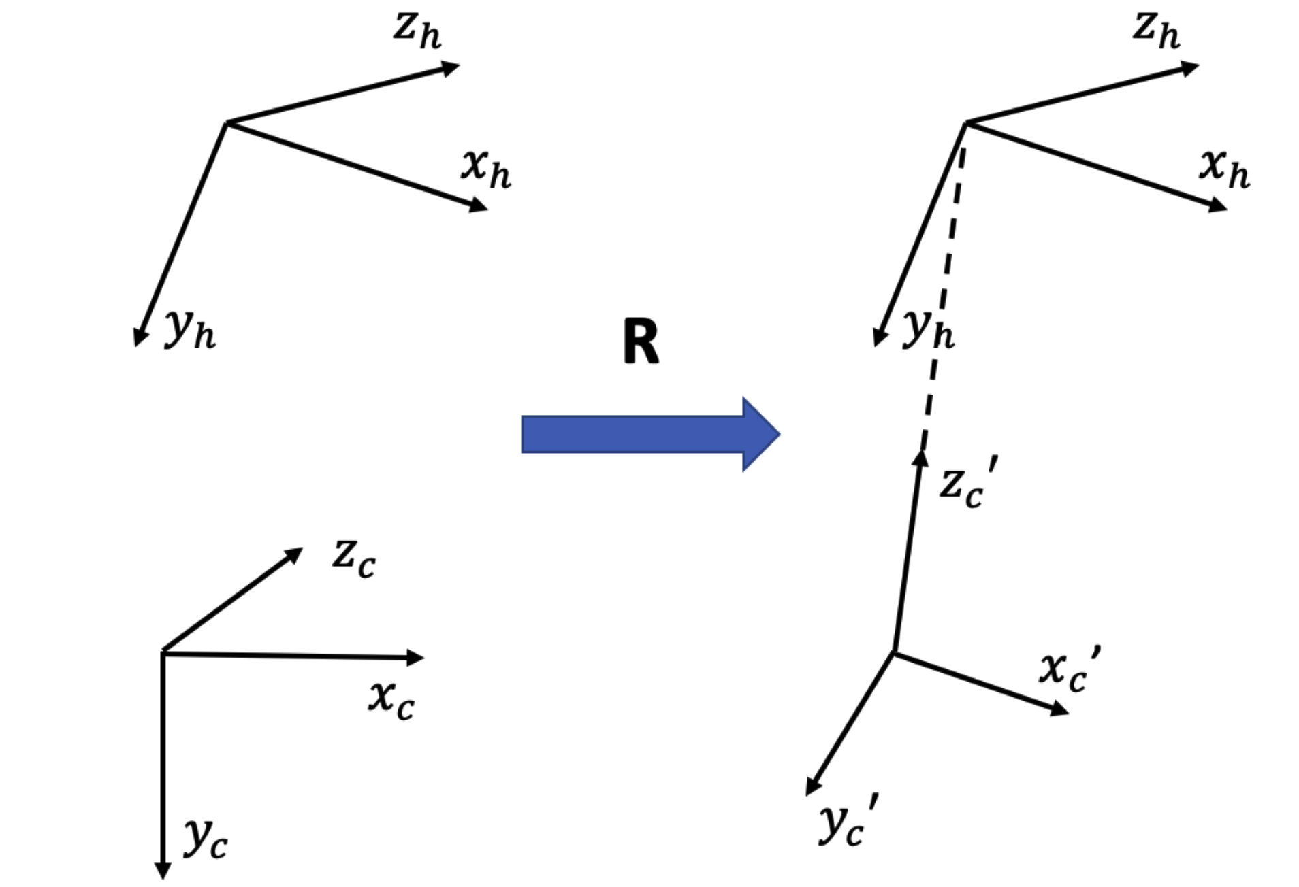
Normalisation
camera coordinate
head coodinate

Slide 15
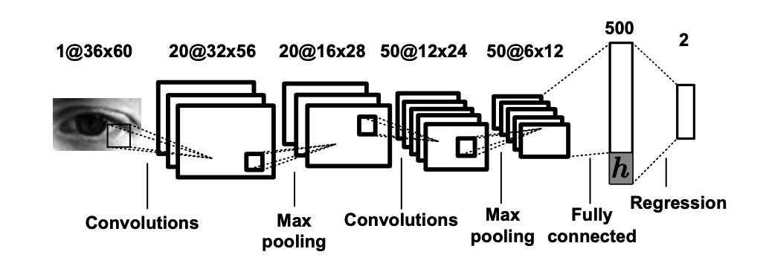
Multimodal CNN

Slide 16
How to start my own task?

