Slide 1
LSSD
April 24 2020

Slide 2
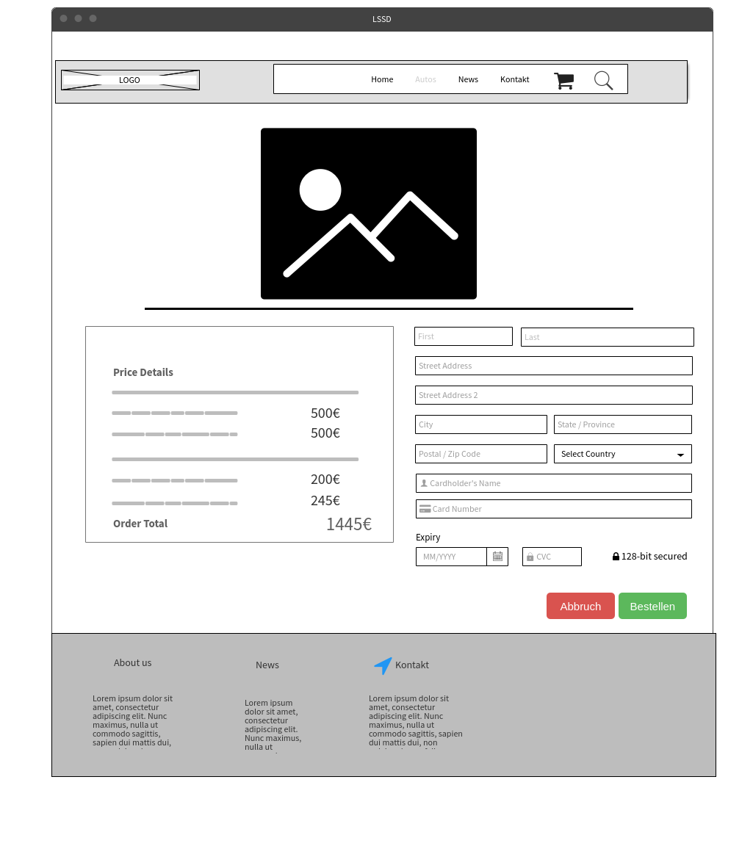

Slide 3
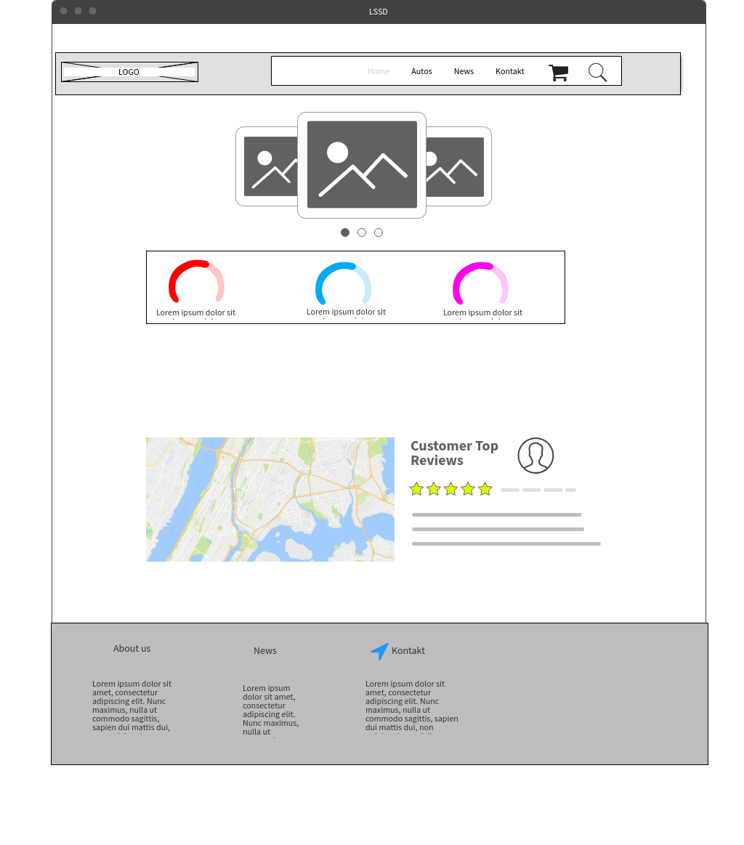

Slide 4
