Slide 1
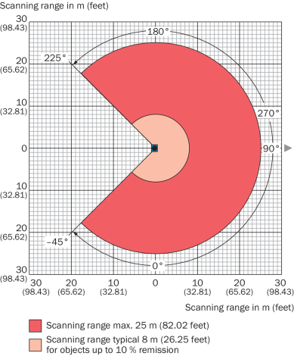
Y
Azimuth-Angle
X

