Slide 1
EL9333 – Lab 6
Cing-Yu (Frank) Chu

Slide 2
Objectives
Learn developing SDN traffic monitoring applications.
Gain real time traffic measurement experience.
Manage flows in real-time based on traffic measurement

Slide 3
Major Goals
Monitor traffic in a SDN network
go through the traffic monitoring example from RYU website: https://osrg.github.io/ryu-book/en/html/traffic_monitor.html
write a controller to monitor the traffic in a costumed topology in Mininet
Manage flows based on link load
controller manages the flows among hosts in the costumed topology so that load on each link is evenly distributed

Slide 4

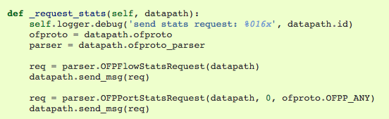
Traffic Monitoring
Idea: periodically pull port or flow counters on switches for statistics
Two type of counters: port and flow
every 10 secs

Slide 5
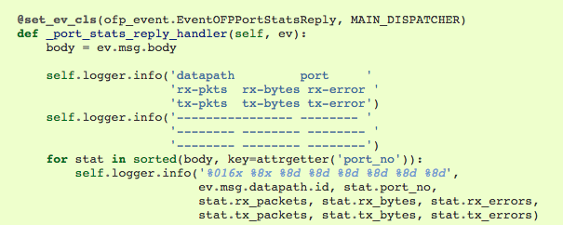
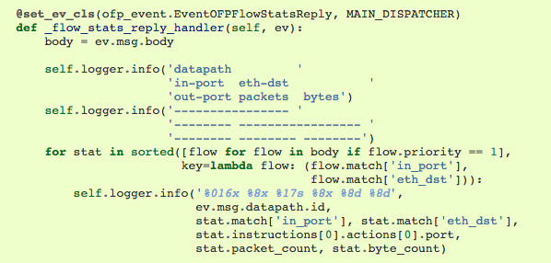
Traffic Monitoring
Port statistics : link load
Flow statistics

Slide 6
Lab 6 Topology
The following topology the required in lab 6
a costumed topology file is provided (on NYU Classes)
A costumed command is provided for use in Mininet prompt
mininet > runTraffic , this will generate udp traffic among hosts
S1
S2
1
3
1
3
2
2
2
3
2
3
2
3
S3
S4
S5
1
1
1
H1
H2
H3

Slide 7
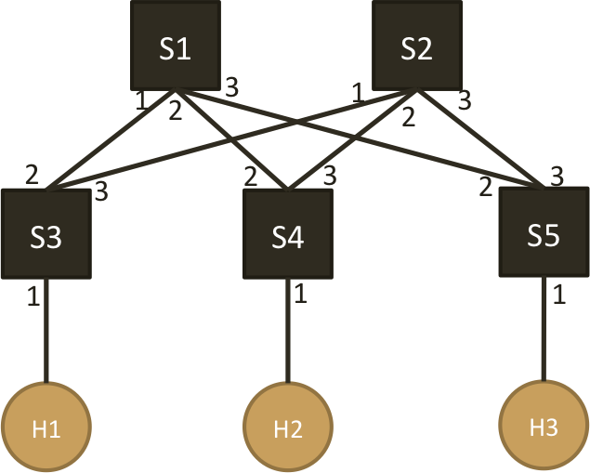
Lab 6 : Part 1
Write a controller that,
for new flows, always use the following paths
H1 ➔ H2: S3 – S1 – S4
H1 ➔ H3: S3 – S1 – S5
H3 ➔ H3: S4 – S1 – S5
monitor the traffic load on each link periodically
ex: every 5 or 10 secs
draw a time vs. link load figure for each link
traffic load
( x bps: bits/s )
time

Slide 8
Lab 6 : Part 2
Write a controller that,
monitors the traffic load on each link periodically
ex: every 5 or 10 secs
based on measured link load, manage the flows so that all links are as evenly loaded as possible
assign path to new flows based on current traffic load on each link
re-locate existing flow onto different paths
draw a time vs. link load figure for each link
so you can compare with part 1!

Slide 9
To run the tests
Run Mininet with costumed topology
sudo mn --custom lab6_topo.py --topo mytopo --mac --switch ovsk --controller remote
Launch your controller code with RYU Manager
ryu-manager -v your_controller.py
Start the traffic generation among hosts in Mininet prompt
mininet> runTraffic

Slide 10
Some hints
ARP is handled
ARP tables are hard-coded into hosts already
Links are bi-directional
when pulling port statistics, you have both TX/RX
background UDP traffic only goes from
H1 ➔ H2, H1 ➔ H3 and H2 ➔ H3 so you only need to show link load on one direction
Plotting
you can use python library (ex: matplotlib) to plot the figure within your controller code
or, you can output the result and use other softwares (ex: Excel)
Traffic measurement,
run your controller and do the measurement for 10 mins
traffic generation lasts 10 mins
all flows are udp, so your rules should specify (IP src, IP dst, src port, dst port, udp)
flows can join and leave the network at any time

