Slide 1


Slide 3


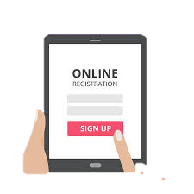




Open Account
Registers
for
Can generate
Account Statement
Customer
Login
Has
Can
Add
Account No.
User Id
Password
Transaction Password
Request
Beneficiary
-------------------------------------------------------------------------------------------------------------------------------
Can Initiate
Account No.
generated
Forgot ID
Beneficiary A/c No.
Forgot Password
Account No.
OTP
Payment
Accepts
User ID
OTP
NEFT
RTGS
IMPS
Set New Password
1
2

