Slide 1
Impact Analyzer
The Problem:
Code changes in microservice ecosystems often break consumers silently.
Manual tracking of code changes is slow and error‑prone
Consumers discover breaking changes only in integration or production
Communication between teams is inconsistent
Impact analysis across services is nearly impossible manually
Teams generally may phase the risk of missing out on alerting dependent teams because of incomplete cross functional knowledge
Our Solution :
• Monitors Repo changes whenever a PR is raised.
• Identifies impacted consumers via subscriptions and broadcasts.
• GenAI (Gemini) explains what changed and why it matters. These insights are shared over mail to the dependent teams explaining the impacted components, possible repurcusions, risk severity and suggestive measures.

Slide 2
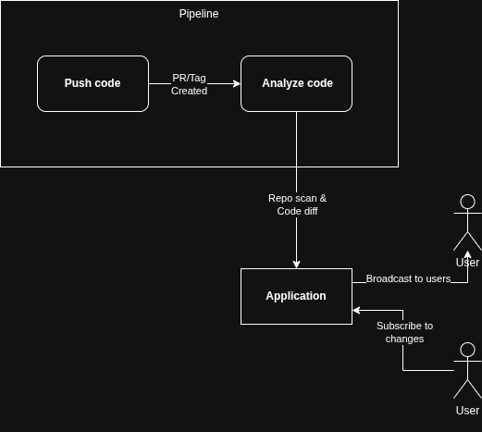
Architecture Overview
Flow
1. CI/CD triggers Java/Gradle Analyzer on each PR.
2. Analyzer parses Codebase and builds endpoint catalog and tracks git diff.
3. Git diff is used to detect structural behavioral changes
4. FastAPI backend stores metadata in SQLite.
5. React/Vite UI allows consumers to subscribe to APIs.
6. Gemini LLM generates high‑level impact insights
7. SMTP engine sends targeted email alerts

Slide 3
Approach:
• CI/CD‑native automated analysis
• Static + diff‑based code change detection
• Consumer‑centric subscription model
• GenAI‑enhanced impact summaries
Key Highlights:
• End‑to‑end working MVP
• Targeted email notifications
• Gemini‑powered insights
• Minimal manual overhead
Outcomes
• Fewer surprise breakages
• Better cross‑team communication
• Faster, safer releases
Future Scope:
• Extend to more frameworks, chat alerts, deeper impact graphs

