Slide 1
EdgeLite-MTAN
A Lightweight Multi-Task Attention Network for
Real-Time Outdoor Navigation Using Monocular RGB Images
Dr. S. A. Sajidha
Siddhartha Mallavolu
Puvvada V. N. S. N. Kedhar
Vellore Institute of Technology, Chennai

Slide 2

Introduction & Objectives
The Problem
Our Objectives
Outdoor navigation needs real-time multi-task perception
LiDAR/stereo/RGB-D sensors are expensive and power-hungry
Monocular RGB is cheap but lacks geometric info
Existing MTL methods use heavy backbones (32M-300M+)
Lightweight 3-task MTL (depth + seg + normals)
Full 19-class Cityscapes at 512x1024 resolution
Real-time inference (>30 FPS) on consumer GPU
81% parameter reduction vs original MTAN
6.2M
70.1%
84.9%
39.6
Parameters
mIoU
Depth δ₁
FPS

Slide 3

System Design: Architecture Overview
Module 1
Module 2
Module 3
MobileNetV3-Large
Shared Encoder
Task-Specific
Attention
Parallel Decoders
+ Skip Connections
4 feature taps: F4(24), F8(40),
F16(112), F32(160)
2.816M params
Channel-wise 1x1 bottleneck
160→80→160 + Sigmoid
0.078M params (3 tasks)
4-stage upsample: 256→128→64→32
Skip from F4, F8, F16
1.110M params each
RGB Input → Shared Encoder → Attention × 3 → Decoders × 3 → Depth | Seg | Normals

Slide 4
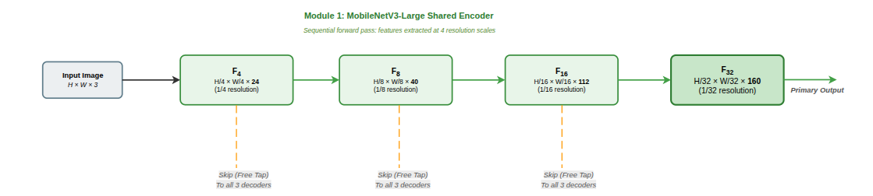
Architecture Diagrams
Module 1: Encoder

Slide 5
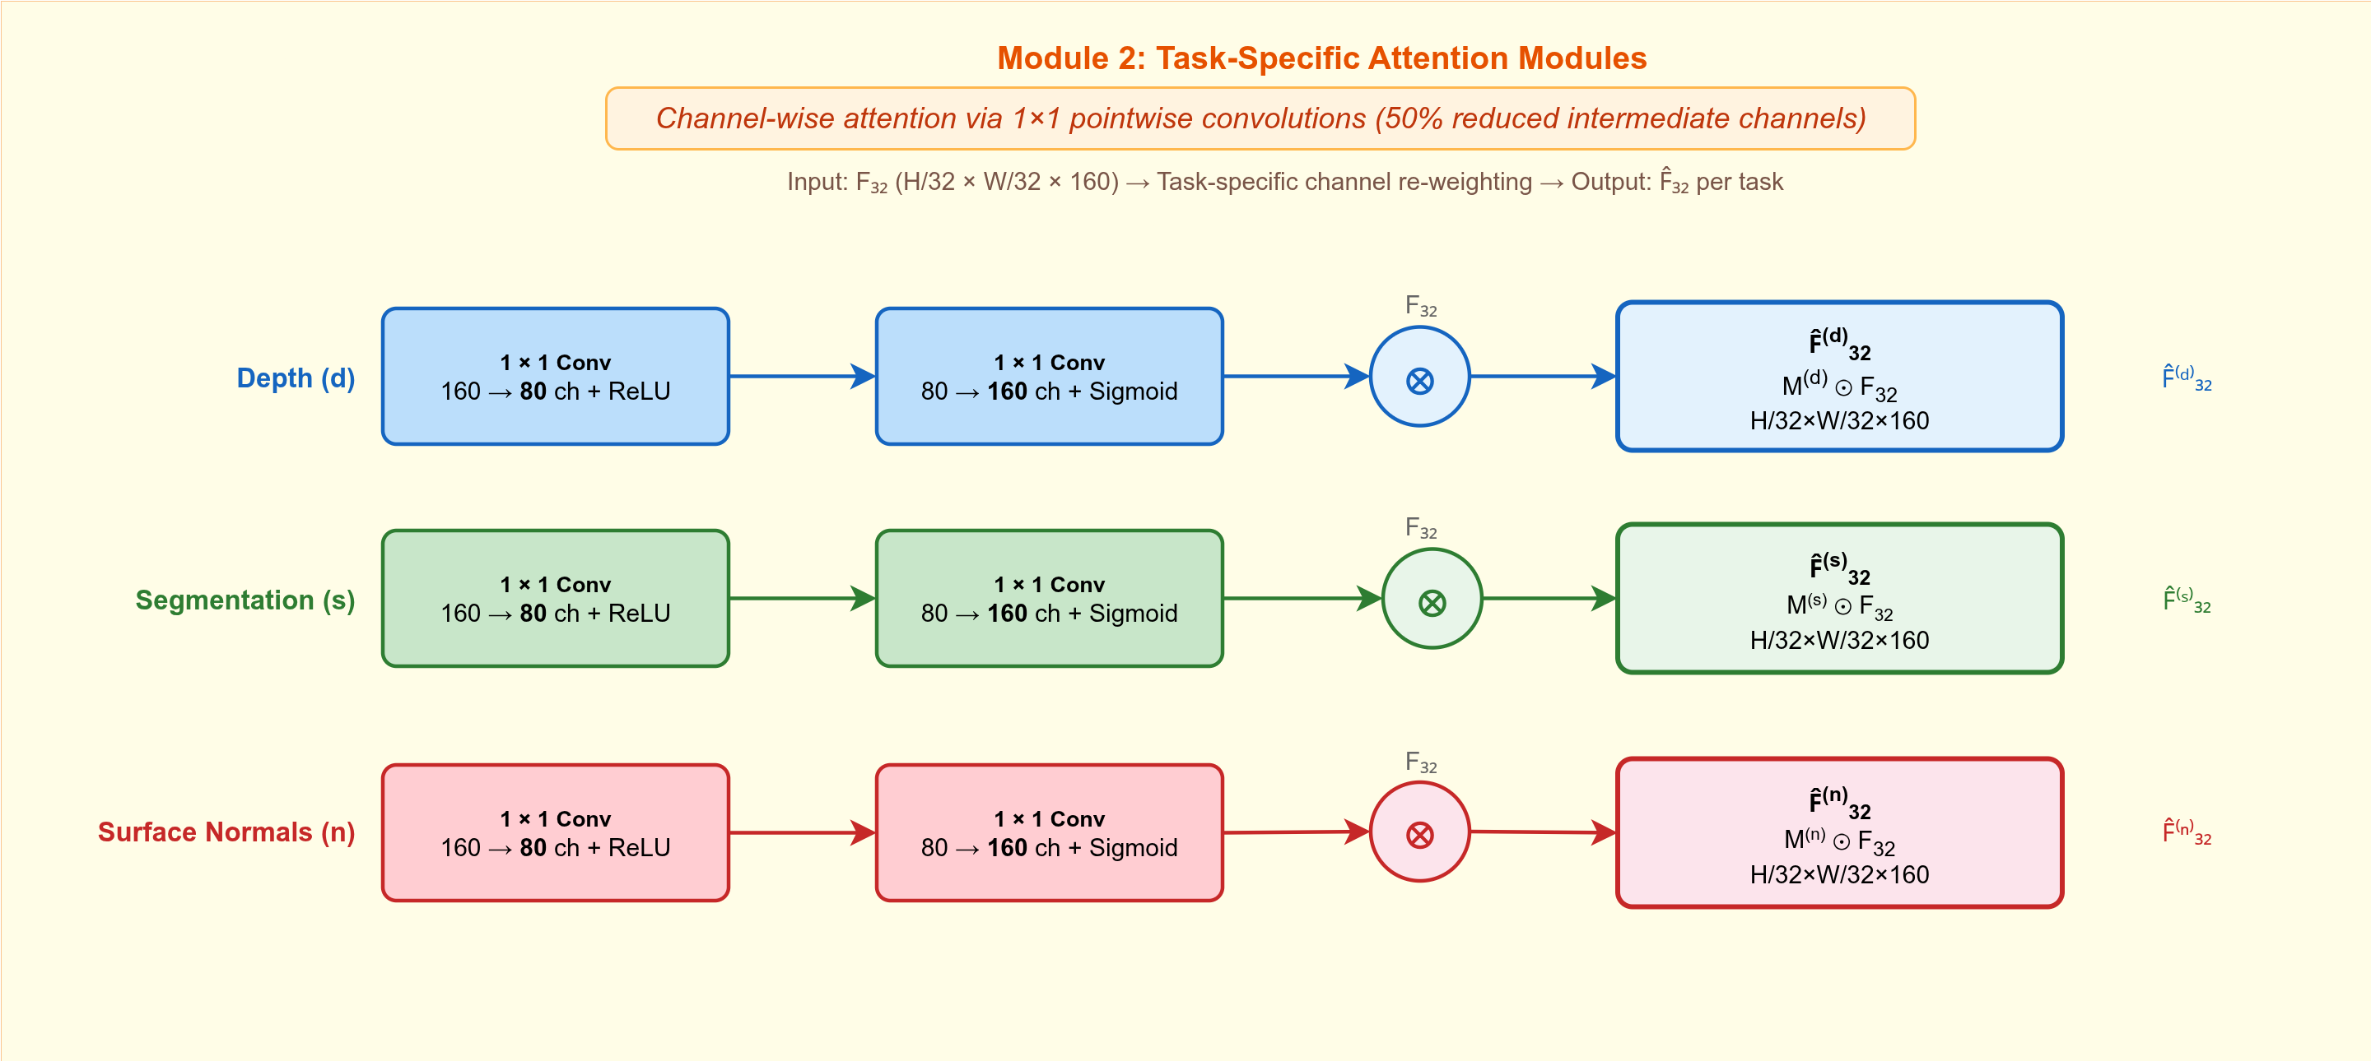
Architecture Diagrams
Module 2: Attention Module

Slide 6
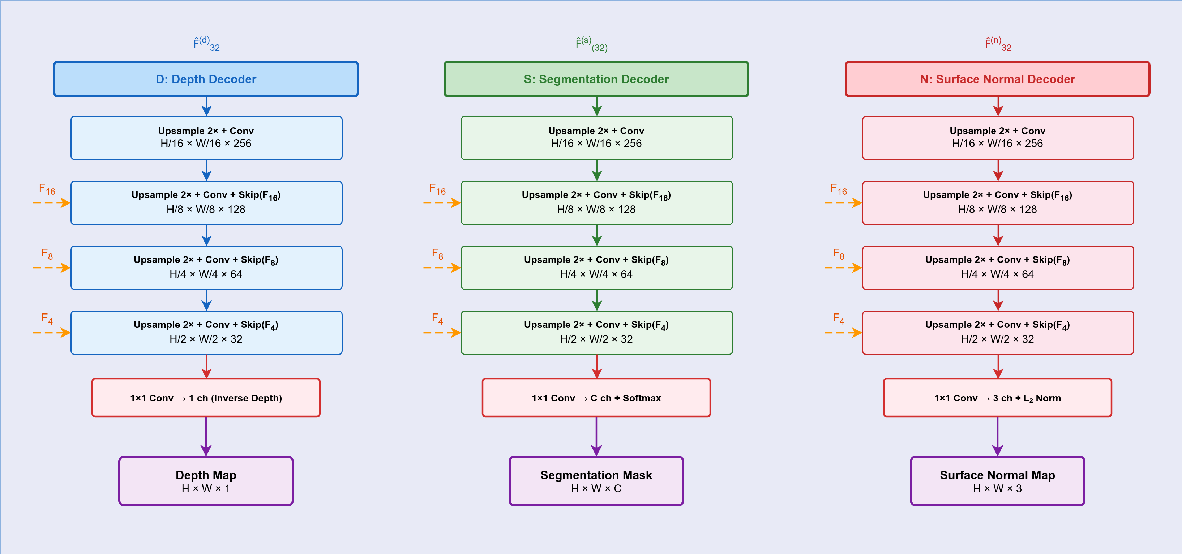
Architecture Diagrams
Module 3: Decoder

Slide 7

Implementation: Loss Functions
L_total = 1.0 × L_depth + 4.0 × L_seg + 0.5 × L_normal
Scale-Invariant Depth Loss
Handles 1-80m range without overweighting distant pixels
Log-space residuals with λ_si=0.5 for partial scale correction
DiceFocal Segmentation Loss
Handles extreme class imbalance (road 35% vs bicycle 0.3%)
0.5×Dice + 0.5×Focal(γ=2.0) with per-class alpha weights
Cosine Similarity Normal Loss
Normals are unit vectors; angular comparison is geometrically correct
Valid mask excludes sky + unreliable disparity regions
Fixed weights (not uncertainty-based) — pseudo-GT noise causes uncertainty weighting to suppress normal loss

Slide 8
Implementation: Surface Normal Generation
1
2
3
4
5
Stereo Disparity
Metric Depth
Back-project 3D
Cross-Product
Normal Maps
Cityscapes precomputed
disparity maps
z = b × fx / δ
Per-frame camera JSON
Using camera intrinsics
(fx, fy, cx, cy)
DSINE d2n_tblr utility
5×5 finite-difference kernel
3-channel float32
Camera coordinate frame
Why Geometric (not Neural)?
No domain gap — derived from physical stereo measurements, not a pretrained model
Fully deterministic and reproducible — no model weights or GPU inference needed
Avoids train-on-predictions circularity (DenseMTL used the same strategy)

Slide 9
Implementation: Training Configuration
Parameter | Value
Dataset | Cityscapes — 2975 train / 500 val
Resolution | 512 × 1024 (half native)
Optimizer | Adam, lr=1e-4, cosine annealing → 1e-6
Batch Size | 2 (4GB VRAM constraint)
Epochs | 80 (best checkpoint at epoch 72)
Augmentation | Random H-flip, color jitter
Encoder Init | ImageNet-pretrained MobileNetV3-Large
Hardware | NVIDIA GTX 1650 (4GB), ~48 hours

Slide 10
Implementation: Dataset & Resolution Choice
Depth GT
Segmentation GT
Normal GT
Stereo disparity → metric depth
z = b × fx / δ
Range: 1m to 80m+
Native Cityscapes fine annotations
19 evaluation classes
5000 finely annotated images
Geometric cross-product pipeline
From stereo-derived depth
DSINE d2n_tblr, k=5
Why 512 × 1024?
1024×2048 (native): Exceeds 4GB VRAM with 3 decoders at batch size 2
128×256 (MTAN): 16× fewer pixels, small classes unresolvable, limited to 7 classes
512×1024 (ours): Preserves 1:2 aspect ratio, all 19 classes visible, 39.6 FPS real-time

Slide 11

Results: Comparison with Existing Methods
Method | Type | Tasks | Params | mIoU% | δ₁ | N-MAE° | FPS
MTAN† | MTL | 2 | 32.4M | 51.9 | 0.776 | -- | --
DenseMTL | MTL | 4 | -- | -- | -- | -- | --
SegFormer-B0‡ | Single | 1 | 3.8M | 71.9 | -- | -- | 48
DeepLabv3+‡ | Single | 1 | 5.8M | 72.5 | -- | -- | --
Ours | MTL | 3 | 6.2M | 70.1 | 0.849 | 49.1 | 39.6
Key Takeaways
Within 1.8% mIoU of SegFormer-B0 while predicting 3 tasks (not just 1)
81% fewer parameters than MTAN, 16× more pixels, +1 additional task
First lightweight 3-task MTL on full 19-class Cityscapes at real-time speed

Slide 12
Results: Per-Class Segmentation IoU
mIoU = 70.1% | No class below 48% | DiceFocal loss prevents ignoring rare classes

Slide 13
Results: Ablation Study — MTL vs Single-Task
Variant | mIoU (%) | δ₁ | AbsRel | N-MAE (°)
Depth only | -- | 0.855 | 0.118 | --
Seg only | 66.8 | -- | -- | --
Normal only | -- | -- | -- | 48.6
Full (3 tasks) | 70.1 | 0.849 | 0.123 | 49.1
Key Findings
MTL improves segmentation by +3.3% mIoU over single-task (70.1% vs 66.8%)
Depth drops only 0.6% δ₁ — minimal negative transfer
Normal MAE increases only 0.5° — negligible degradation
Task-specific attention effectively prevents cross-task interference

Slide 14
Results: Surface Normal Per-Category Analysis
[Paste radar_sne_metrics.png here]
Roadway (25.1°) and Walkway (32.7°) — planar surfaces, reliable stereo GT
Building (70.0°) and Vegetation (70.4°) — complex geometry + noisy pseudo-GT
Bottleneck is pseudo-GT quality, not network capacity

Slide 15
Results: Inference Efficiency
39.6 FPS
25.2 ms
102 MB
6.2M
Inference Speed
Latency
GPU Memory
Parameters
> 30 FPS real-time
Per-frame
Peak consumption
81% less than MTAN
5.2× smaller than MTAN (32.4M params)
Order of magnitude smaller than InvPT (ViT-Large, >300M) and MTMamba (Swin-Large, 308MB)
Benchmarked on NVIDIA GTX 1650 (4GB VRAM) — consumer-grade hardware

Slide 16
Results: Qualitative Predictions
[Paste sample_0000.png — RGB | Depth | Seg | Normals]
[Paste sample_0002.png — RGB | Depth | Seg | Normals]
[Paste sample_0004.png — RGB | Depth | Seg | Normals]

Slide 17

Challenges & Solutions
No native surface normal GT for Cityscapes
Geometric pipeline: stereo disparity → depth → cross-product normals via DSINE utility
Noisy pseudo-GT suppressed by uncertainty weighting
Switched to fixed loss weights (λ_d=1.0, λ_s=4.0, λ_n=0.5) via grid search
mIoU metric bug (per-batch averaging deflated scores)
Fixed to global intersection/union accumulation — mIoU jumped from 51% to 70%
4GB VRAM constraint on GTX 1650
Batch size 2, 512×1024 resolution, MobileNetV3-Large (2.8M vs ResNet-50 25.6M)
Class imbalance (road 35% vs bicycle 0.3%)
DiceFocal loss: Dice for per-class balance + Focal for hard-example mining

Slide 18

Future Work
1
Cross-Dataset Evaluation
Validate on KITTI benchmark for generalization beyond Cityscapes
2
Neural Normal Refinement
Multi-view consistency or learned refinement to improve normals on complex surfaces
3
Edge Hardware Deployment
TensorRT/ONNX optimization on Jetson Nano/Xavier for real latency measurements
4
Additional Tasks
Extend to edge detection or optical flow to leverage shared encoder further

Slide 19

References
[1] Liu et al., "End-to-End Multi-Task Learning with Attention," CVPR 2019
[2] Vandenhende et al., "MTI-Net: Multi-Scale Task Interaction Networks," ECCV 2020
[3] Xu et al., "PAD-Net: Multi-Tasks Guided Prediction-and-Distillation," CVPR 2018
[4] Ye & Xu, "Inverted Pyramid Multi-Task Transformer," ECCV 2022
[5] Lin et al., "MTMamba: Mamba-Based Decoders for MTL," ECCV 2024
[6] Lopes et al., "Cross-Task Attention for Dense MTL," WACV 2023
[7] Xie et al., "SegFormer: Semantic Segmentation with Transformers," NeurIPS 2021
[8] Chen et al., "Encoder-Decoder with Atrous Separable Conv," ECCV 2018
[9] Howard et al., "Searching for MobileNetV3," ICCV 2019
[10] Ranftl et al., "Vision Transformers for Dense Prediction," ICCV 2021
[11] Bae & Davison, "Rethinking Inductive Biases for Surface Normal Est.," CVPR 2024
[12] Eigen et al., "Depth Map Prediction from a Single Image," NeurIPS 2014
Code: github.com/Sid-5137/edgelite-mtan

