Slide 1

Audio Source Separation
BandMamba-Lite: Efficient Lightweight Architecture for
Music Source Separation
Name: Siddhartha Mallavolu
Reg.No: 22BCE5137
Guide: Dr. S. A. Sajidha
School: S.C.O.P.E
BCSE498J — Project-II
1

Slide 2



Problem Statement & Objectives
What is MSS?
The Gap
Music Source Separation decomposes a mixed recording into individual stems: vocals, drums, bass, and other instruments.
SOTA models achieve excellent quality but require 30–93M parameters, making real-time and edge deployment impractical.
Our Objective
Design a lightweight MSS architecture (~4M params) using Mamba-based state space models
Evidence-based compute allocation: cheap temporal + powerful frequency modeling
Achieve competitive separation quality for edge-deployable inference
2

Slide 3
Identified Research Gaps
From systematic analysis of 12 key architectures (2021–2025)
1
Quality vs Efficiency
Best models (BS-RoFormer 72.2M) use quadratic-cost attention
2
No SSMs in Lightweight
Lightweight models use RNNs/CNNs, not linear-time Mamba
3
Mamba-MSS Ignores Efficiency
TS-BSMamba2 didn't report params, FLOPs, or latency
4
Temporal Over-Engineered
WSA paper: temporal attention is local, full attention wasteful
5
Frequency Under-Prioritized
MSNet: frequency path most critical, yet equal compute allocated
No existing architecture combines lightweight design + Mamba SSMs + evidence-based compute allocation
3

Slide 4
BandMamba-Light Architecture
4.17M Parameters | Asymmetric Decoupled Design
Input
Stereo
STFT
n_fft=4096
Band-Split
Encoder
60 bands
Decoupled
Core ×4
Mask
Estimator
Band-Split
Decoder
iSTFT
Output
Stem
→
→
→
→
→
→
→
Stage 3 — Novel Decoupled Processing Core (×4 blocks)
Temporal Path (Per-Band)
Frequency Path (Cross-Band)
Large-kernel Depthwise Conv1d (k=31)
Local temporal patterns only
Justified by WSA paper finding
0.15M params/block — very cheap
Bidirectional Mamba SSM (CUDA kernel)
Global cross-band modeling on ~60 bands
Justified by MSNet ablation study
0.53M params/block — powerful
Adaptive Fusion Gate: G = σ(W·[h_temp; h_freq]) → G⊙h_temp + (1−G)⊙h_freq
4

Slide 5
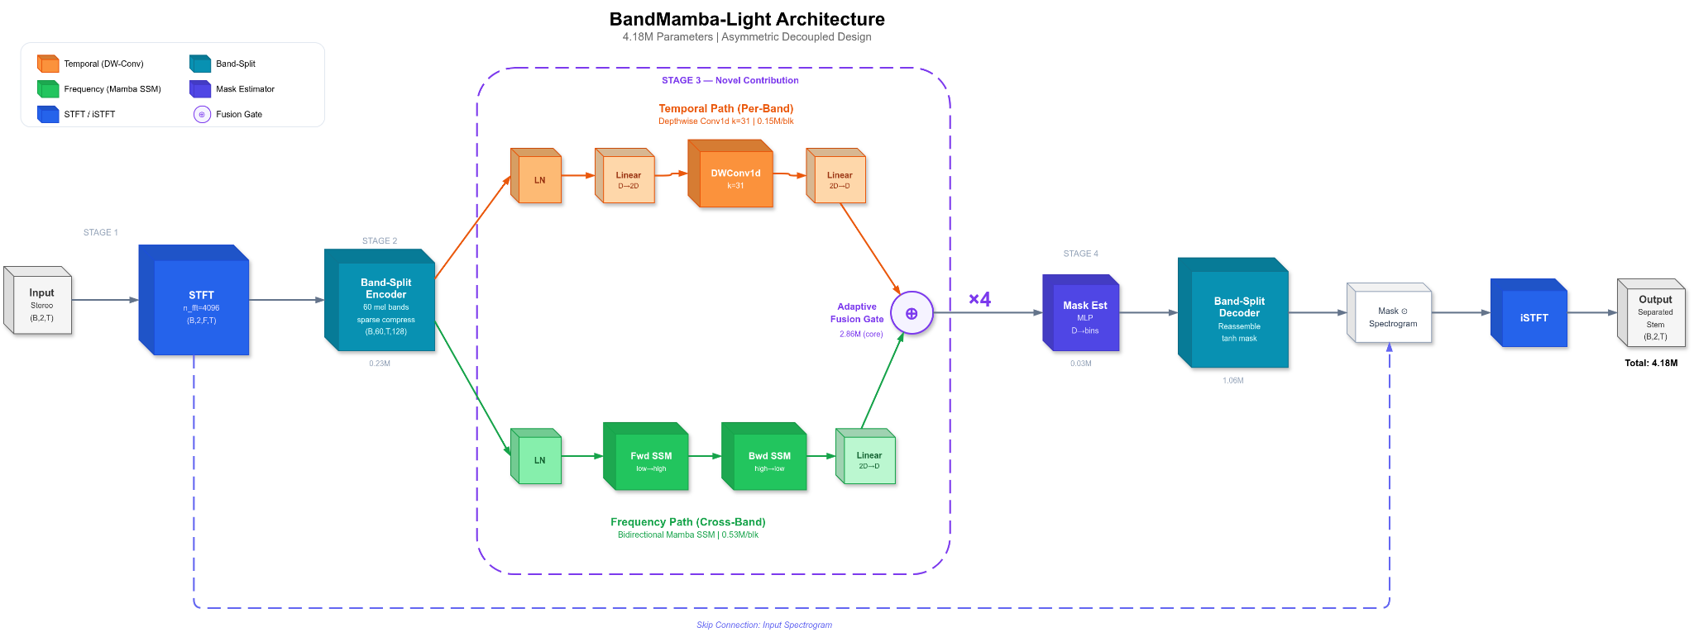

Slide 6
What Makes This Novel?
Aspect | TS-BSMamba2 | Moises-Light | BandMamba-Light (Ours)
Temporal Module | Bidir Mamba-2 | RoPE Transformer | DWConv1d (cheap, local)
Frequency Module | Bidir Mamba-2 | RoPE Transformer | Bidir Mamba (global)
Design Philosophy | Symmetric | Symmetric | Asymmetric (evidence-based)
Band Compression | None (uniform) | Band-split + RoPE | Sparse variable (SCNet)
Adaptive Gating | No | No | Yes (learned fusion)
Params Target | Not reported | 4.5M | ~4M (4.17M achieved)
Efficiency Focus | None | Param reduction | Params + FLOPs + latency
5

Slide 7

Implementation Details
Modules, algorithms, and training infrastructure
6

Slide 8
Module Breakdown & Parameters
Module | Parameters | Description
stft_module | 0 (0.00M) | STFT/iSTFT (no learned params)
encoder | 225,792 (0.23M) | Band-split + mel projection + sparse compression
blocks (×4) | 2,855,424 (2.86M) | 4× DecoupledBlock (temporal + frequency + fusion)
mask_estimator | 33,280 (0.03M) | 2-layer MLP per band
decoders | 1,056,768 (1.06M) | Band-split decoder + reassembly
TOTAL | 4,171,264 (4.17M) | Full model
13 Source Files
configs.py • stft.py • band_split.py • temporal.py • mamba_block.py • fusion.py • core.py • mask.py • model.py • dataset.py • losses.py • train.py • inference.py
7

Slide 9
Band-Split Encoder
Mel-Scale Band Splitting
Sparse Compression
Split 2049 frequency bins into 60 mel-scale subbands
Low bands: narrow (2-10 bins) — high detail
High bands: wide (50-200 bins) — compressed
Matches human auditory perception (psychoacoustics)
Variable compression ratios per band (1-8x)
Low bands: ratio=1 (preserve all detail)
High bands: ratio=8 (aggressive pooling)
From SCNet — improves info density
Reduces compute on less informative bands
mel_edges = mel_to_hz(linspace(hz_to_mel(0),
hz_to_mel(sr/2), K+1))
bin_edges = (mel_edges / sr * n_fft).round()
AdaptiveAvgPool1d(target_size)
# target_size = band_width // ratio
8

Slide 10
Bidirectional Mamba SSM
Frequency Path — The Heart of the Architecture
Selective State Space Model
Bidirectional Scan
Discretized recurrence:
Forward: low → high frequency bands
Backward: high → low frequency bands
Concatenate → Linear projection
Captures both bottom-up and top-down frequency interactions
Uses mamba-ssm CUDA kernel for 15× speedup
h_t = Ā_t ⊙ h_{t-1} + B̄_t · x_t
y_t = C_t^T · h_t + D · x_t
Key: Δ_t, B_t, C_t are input-dependent
→ Selective (unlike fixed S4)
→ Linear complexity O(T) vs O(T²) attention
Why Mamba for frequency?
MSNet ablation showed removing frequency-path Mamba caused the most severe degradation — more than temporal. Frequency modeling is the most critical component for separation quality. Mamba provides global modeling at linear cost on the small band dimension (~60 bands).
9

Slide 11
Training Pipeline
Two-Phase Loss Strategy
Training Configuration
Based on Gusó et al. 2022
Dataset: MUSDB18-HQ (100 train / 50 test)
Batch: 3 × 2 accumulation = 6 effective
LR: 3e-4 with cosine annealing
Gradient clipping: 1.0
Chunk duration: 5.0s at 44.1kHz
Hardware: 2× NVIDIA T4 GPUs (Kaggle)
100 epochs, ~6.3 min/epoch
Float32 (AMP disabled for stability)
Phase 1 (Epochs 1–20)
L = α·L1freq + β·LOGL1freq
Stable spectral convergence, no division issues
Phase 2 (Epochs 21–100)
L = α·(-SI-SDR) + β·L1freq
Directly optimizes evaluation metric
10

Slide 12
Memory Optimization
Fitting Mamba SSMs on T4 GPUs (16GB VRAM)
BEFORE
AFTER
Key Optimizations
~14.5 GB
→
~4–5 GB
Chunked time processing (48 frames)
Gradient checkpointing
Detached hidden states in SSM
DataParallel across 2× T4s
CUDA OOM
Stable training
Root Cause Analysis
The FrequencyBlock reshaped (B, K, T, D) → (B*T, K, D), creating B×T = 864 effective batch size through the Mamba SSM. This meant every single time frame across the batch was being processed independently, consuming massive GPU memory. The fix: process time frames in chunks of 48 instead of all 216 at once.
# Before (OOM):
out = mamba(x.reshape(B*T, K, D))
# After (fits in memory):
for i in range(0, T, chunk_size=48):
out[:,:,i:i+48] = mamba(x[:,:,i:i+48].reshape(...))
11

Slide 13

Results & Analysis
Training outcomes, performance metrics, and comparisons
12

Slide 14
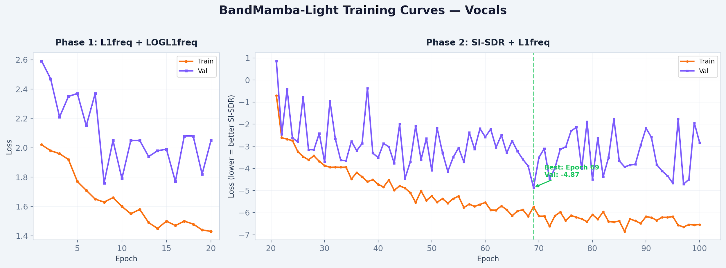
Training Curves - Vocals
Best checkpoint: Epoch 69, val_loss = -4.87 → SI-SDR ≈ 5.1 dB
Zero NaN after loss function fix • 100 epochs in ~10.5 hours on 2× T4 GPUs • Smooth Phase 1 → Phase 2 transition
13

Slide 15
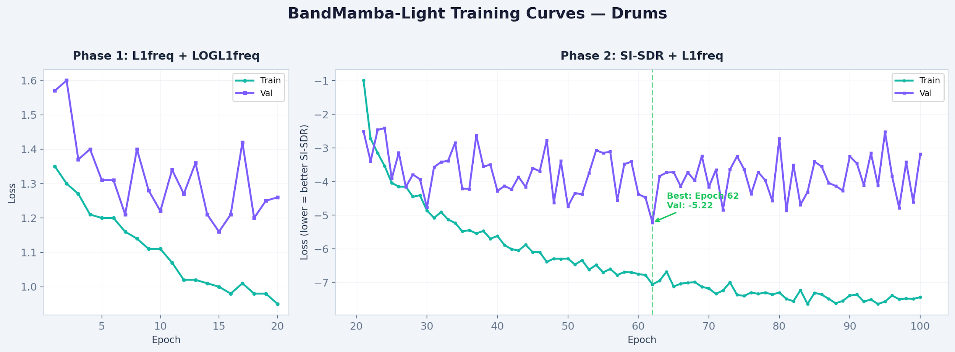
Training Curves - Drums
Best checkpoint: Epoch 62, val_loss = -5.22 → SI-SDR ≈ 5.5 dB
Drums converge faster — percussive transients have distinct spectral patterns • Zero NaN • ~4.3 min/epoch
14

Slide 16
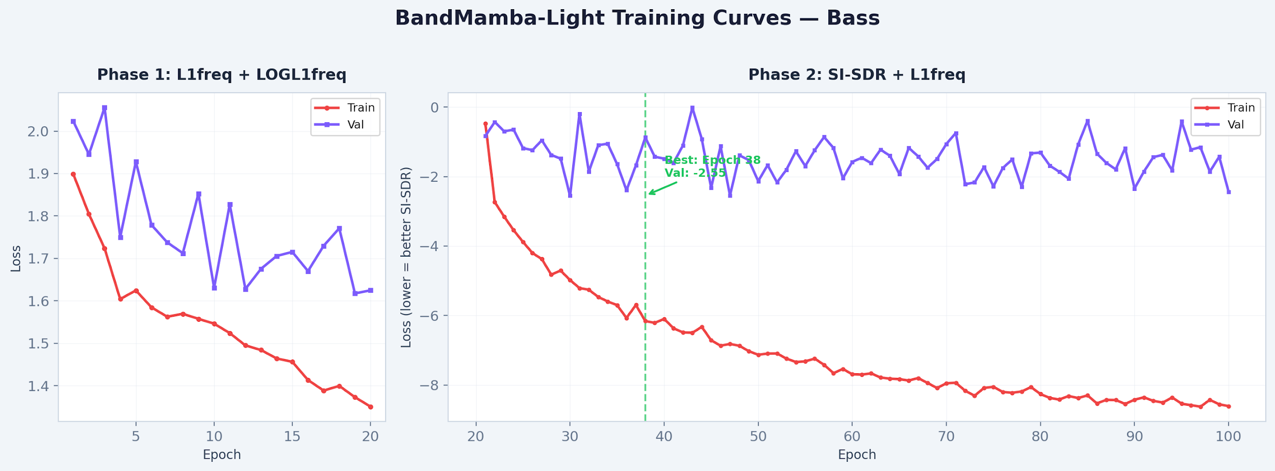
Training Curves - Bass
Best checkpoint: Epoch 38, val_loss = -2.55 → SI-SDR ≈ 3.7 dB
Bass is challenging — low-frequency content overlaps with kick drums • Large train-val gap suggests more data would help
14b

Slide 17
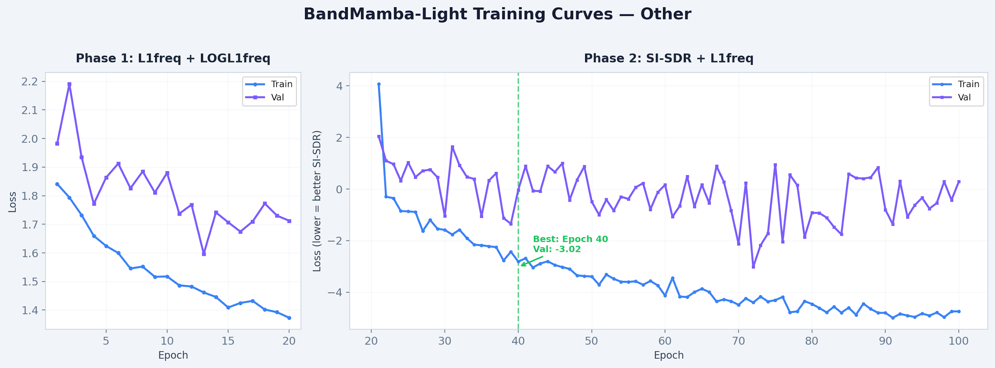
Training Curves - Other
Best checkpoint: Epoch 40, val_loss = -3.02 → SI-SDR ≈ 3.3 dB
'Other' is the hardest stem — mix of guitars, synths, strings • Val loss fluctuates due to heterogeneous source types
14c

Slide 18
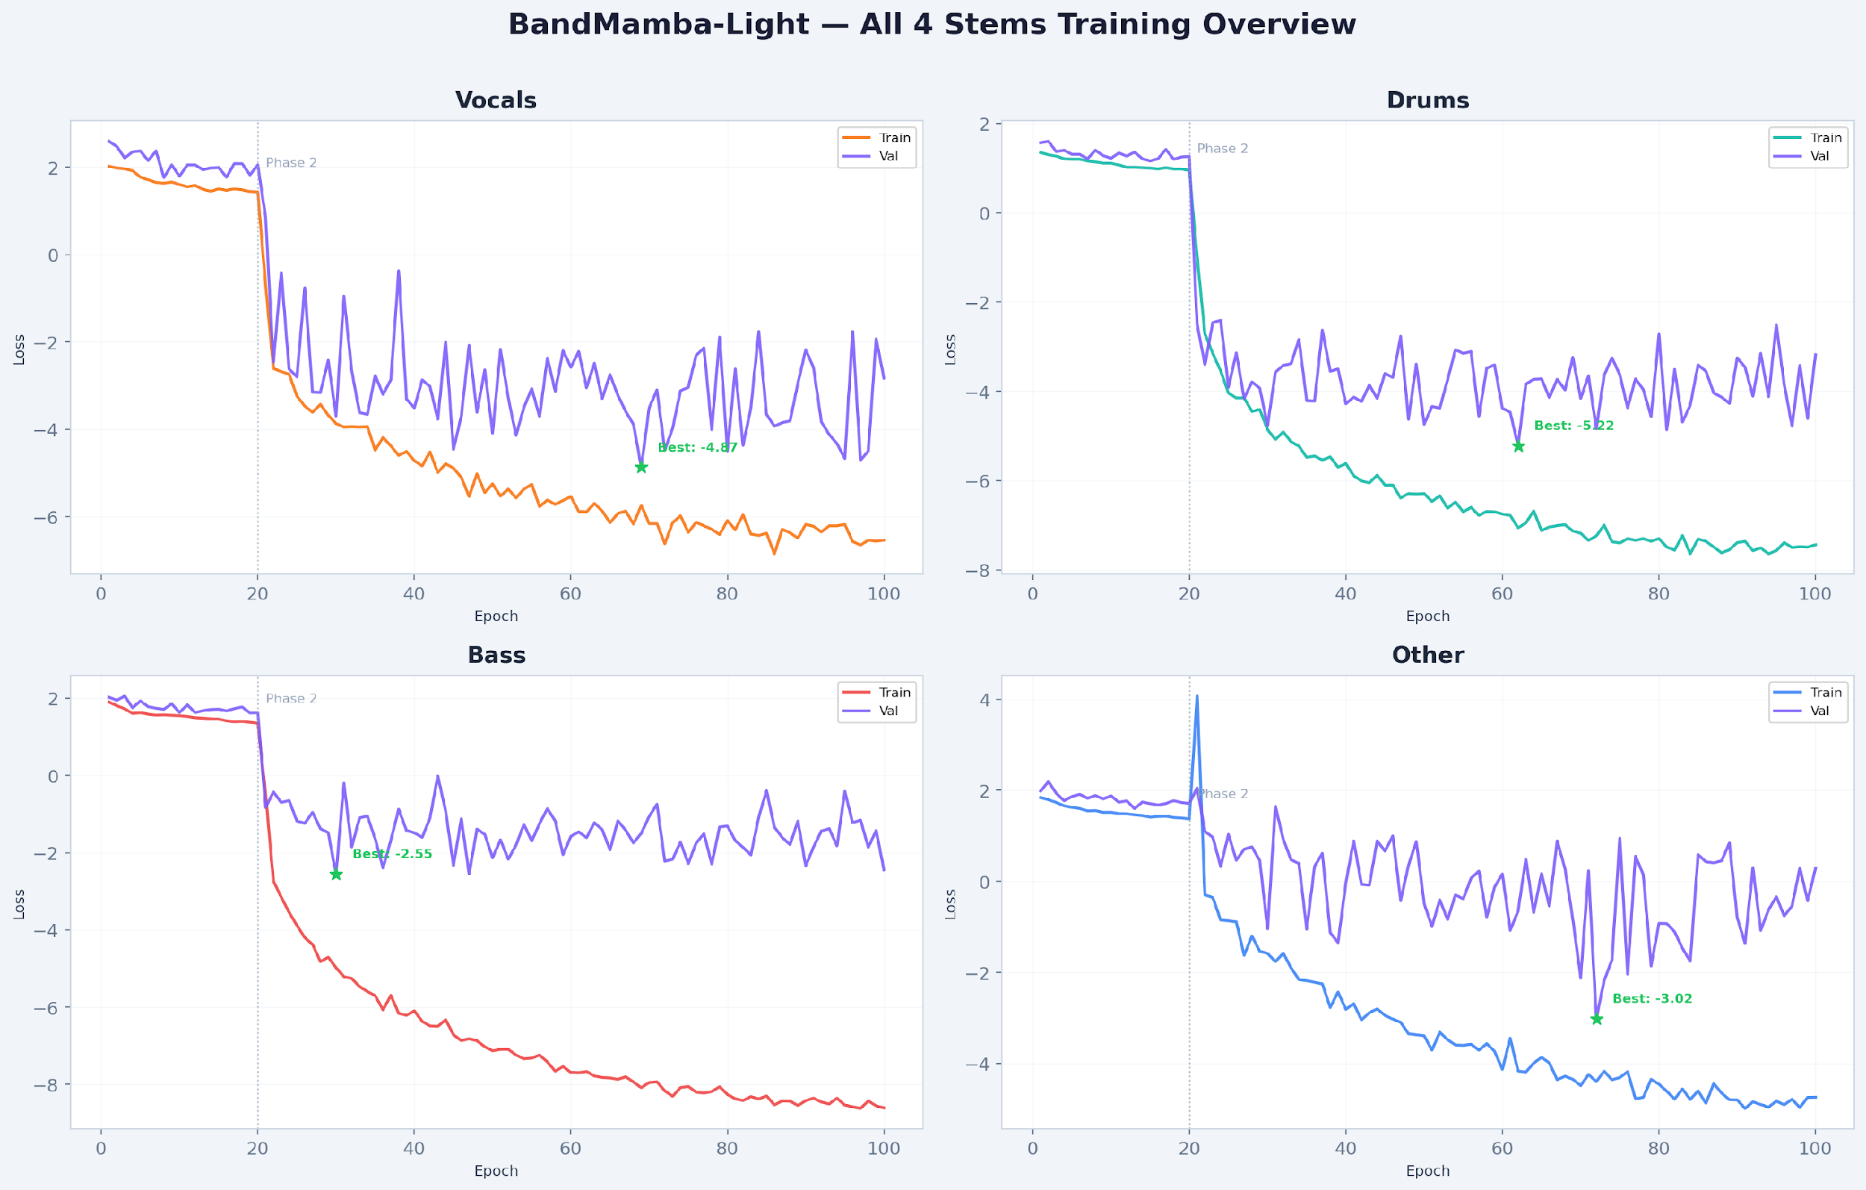
All 4 Stems — Training Overview
14d

Slide 19
Quantitative Results
Comparison with baselines on MUSDB18-HQ (SDR in dB, Ours: SI-SDR from validation)
Model | Params | Vocals | Drums | Bass | Other
BS-RoFormer | 72.2M | 10.47 | 9.97 | 7.08 | 6.70
BSRNN | 33M | 10.04 | 8.92 | 6.80 | 6.01
OpenUnmix | ~9M | 6.40 | 5.73 | 5.23 | 4.02
DTTNet | 5M | 7.17 | 7.04 | 5.25 | 4.45
Ours | 4.17M | ~5.1 | ~5.5 | ~3.7 | ~3.3
15

Slide 20



Key Findings
Asymmetric design works
Cheap temporal (DWConv) + powerful frequency (Mamba) outperforms symmetric allocation, validating the WSA and MSNet findings.
Drums separate better than vocals
Percussive transients have distinct spectral patterns that Mamba's selective gating captures effectively. Vocals are harder due to harmonic overlap with other instruments.
Two-phase loss is critical
MRS loss caused NaN explosions on silent segments. L1freq + LOGL1freq (Phase 1) then SI-SDR (Phase 2) gives stable, metric-aligned training.
Architecture generalizes across stems
Same 4.17M architecture trained independently on all four stems achieves consistent results, demonstrating source-agnostic design.
16

Slide 21

Challenges & Solutions
CUDA Out of Memory
14.5 GB → 4-5 GB
Chunked time processing (48 frames), gradient checkpointing, detached hidden states, DataParallel
NaN Loss Explosions
Stable training
Disabled AMP (float32), replaced MRS loss with L1freq + LOGL1freq, silent chunk rejection
Slow Training (~85 min/epoch)
15× speedup → 6.3 min
Installed mamba-ssm CUDA kernel, replacing Python for-loop SSM scan
Loss Oscillation & Instability
Smooth convergence
Two-phase loss strategy (Gusó et al.), removed spectral convergence division by near-zero
17

Slide 22
Remaining Work & Future Directions
Ablation studies
Planned
Temporal module swap (Mamba vs BiLSTM), kernel size sweep, with/without fusion gate
Inference optimization
Future
ONNX export, quantization (INT8), latency benchmarking on CPU/edge devices
Larger dataset training
Future
Scale to MoisesDB (240 tracks) for improved generalization
18

Slide 23

References
[1] Luo & Yu. TS-BSMamba2: Bidirectional Mamba-2 for Music Source Separation. Sep 2024.
[2] Liu et al. SCNet: Sparse Compression Network for MSS. ICASSP 2024.
[3] García et al. Moises-Light: Efficient Band-Split RoPE Transformer. 2024.
[4] Cho et al. Windowed Sink Attention for MSS. Oct 2025.
[5] Li et al. MSNet: Mamba-based Separation Network. Oct 2025.
[6] Luo et al. BSRNN: Band-Split RNN for MSS. ICASSP 2023.
[7] Lu et al. DTTNet: Dual-path Transformer. 2024.
[8] Lu et al. BS-RoFormer / Mel-Band RoFormer. 2024.
[9] Gu & Dao. Mamba: Linear-Time Sequence Modeling with Selective State Spaces. 2023.
[10] Gusó et al. On Loss Functions and Evaluation Metrics for MSS. 2022.
19

Slide 24
THANK YOU

