Slide 1

HADES
HACKATHON BUILD · AI SYSTEMS ENGINEERING
HADES
PROJECT
FROM AI ASSISTANT TO AI OPERATING SYSTEM
HUMAN
→
HADES
→
→
MODELS + TOOLS + SYSTEM
REAL RESULT
The user should manage the goal — not the intelligence required to achieve it.
01 / 13

Slide 2
HADES
01 / THE PROBLEM
THE AI PROBLEM IS NO LONGER CAPABILITY.
IT IS ORCHESTRATION.
TODAY'S AI STACK
THE HIDDEN TAX
●Context switching between tools
GEMINI
CLAUDE
●Repeating yourself to every model
Research
Coding
●Manually selecting the right AI
●Managing workflow and sequencing
●Context lost between sessions
●Decision fatigue from tool sprawl
CHATGPT
YOU
NOTION
Writing
Notes
Today's AI gives humans MORE capabilities.
Hades is designed to REMOVE the burden of
ZAPIER
CALENDAR
coordinating them.
Automation
GMAIL
Scheduling
Email
The human IS the orchestration layer.
02 / 13

Slide 3
HADES
02 / THE GAP
WHERE EXISTING AI SYSTEMS STOP
CAPABILITY | TRADITIONAL AI ASSISTANT | AI AGENT | HADES
Conversation | ✓ | ⚡ | ✓
Persistent Identity | × | × | ✓
Long-Term Memory | × | ⚡ | ⚡
Goal Understanding | ⚡ | ⚡ | ✓
Human Alignment Gate | × | × | ✓
Multi-Model Orchestration | × | ⚡ | ✓
Tool Orchestration | × | ✓ | ✓
Background Execution | × | ✓ | ✓
Output Validation | × | × | ✓
Human Goal Authority | × | × | ✓
Continuous Relationship | × | × | ⚡
RESEARCH / DESIGN GAP
Persistent understanding + mutual alignment + intelligence orchestration + verified execution
— No existing system combines all four. Hades targets this gap.
03 / 13

Slide 4


HADES
03 / AUTHORIZATION
HADES DOESN'T START WITH A TASK.
IT STARTS WITH UNDERSTANDING.
01 USER INTENT
INPUT
AFTER LOCK: Execution Brain takes control. User controls the goal, not the process.
↓
02 CONVERSATION
IMPLEMENTED ✓
↓
03 CLARIFICATION
IMPLEMENTED ✓
↓
04 PUSHBACK / ALIGN
IMPLEMENTED ✓
↓
05 MUTUAL UNDERSTANDING
IMPLEMENTED ✓
Conversation is the authorization layer between intent and action.
06 LOCKED MISSION
understanding_evaluator.py · mission.py → MissionStatus.AUTHORIZED_EXECUTION
04 / 13
↓
07 PLANNING
PARTIAL ⚡
↓
08–10 EXECUTE · REVIEW · DELIVER
IMPLEMENTED ✓

Slide 5
HADES
04 / SYSTEM DESIGN
ONE PARTNER.
MULTIPLE BRAINS. MANY CAPABILITIES.
USER
HUMAN IN CONTROL
Goal · Context · Decisions
PARTNER BRAIN
IMPLEMENTED ✓
Intent Classification | Mission Extraction | Conversational Alignment | Session Memory
LOCKED MISSION — MUTUAL UNDERSTANDING GATE
IMPLEMENTED ✓
EXECUTIVE BRAIN
Task Graph | Worker Delegation | Recovery / Retry
PARTIAL ⚡
Currently generates 1 task; dynamic decomposition is a future milestone
WORKERS
Terminal | Filesystem | Process Manager | Browser (partial)
PARTIAL ⚡
Model endpoints today; autonomous worker agents = future
MODEL PROVIDERS
IMPLEMENTED ✓
Gemini (Google) | Llama 3.3 (Groq) | OpenRouter | Ollama (Local)
REVIEW ENGINE
IMPLEMENTED ✓
Exit Code Validation | Artifact Check | Semantic Review
MEMORY
05 / 13
Session (in-memory) | Mission History (JSON)
PARTIAL ⚡
Vector / RAG memory = future milestone

Slide 6
HADES
05 / THE ABSTRACTION
HADES THINKS IN MISSIONS.
NOT PROMPTS. NOT SESSIONS. NOT TABS.
TRADITIONAL AI · PROMPT LOOP
MISSION STATE OBJECT
objective: “Build a project scaffold...”
→ Prompt →
→ Response →
desired_outcome: “Working directory with...”
USER
AI
USER
constraints: [“No external deps”, ...]
success_criteria: “Directory exists, tests pass”
CONTEXT: NONE
STATE: DISPOSABLE
status: BACKGROUND_WORK
mutual_understanding: true
MEMORY: ZERO
CONTINUITY: NONE
conversation_history: [14 messages]
mission_id: “m_8f3a...”
Every message starts from scratch.
output_artifacts: [“scaffold.zip”, ...]
src/models/mission.py
CONVERSATION
AUTHORIZED_EXECUTION
BACKGROUND_WORK
COMPLETED
→
→
→
MISSION ABSTRACTION — IMPLEMENTED
DYNAMIC MULTI-STEP PLANNING — FUTURE MILESTONE
06 / 13

Slide 7
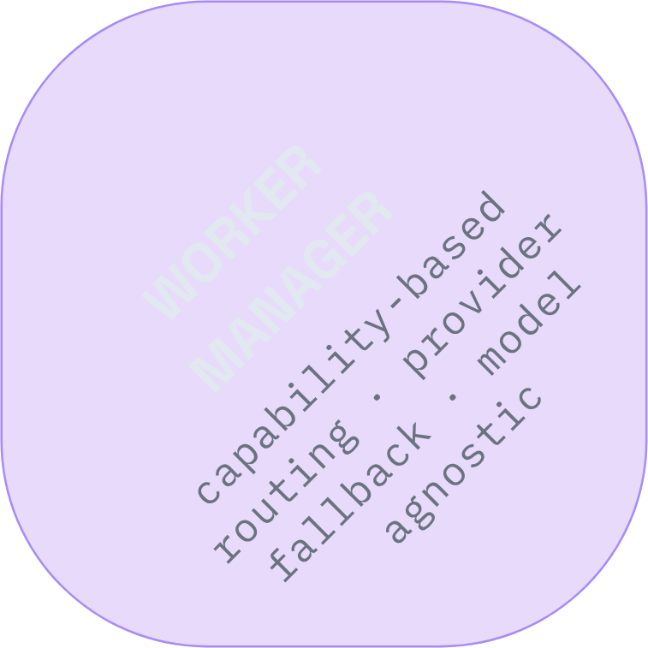
HADES
06 / INTELLIGENCE
HADES MANAGES AI.
THE USER DOESN'T.
GEMINI 2.5 FLASH
→ Conversational response
google · conversational, fast
GEMINI FLASH LATEST
→ Mission extraction
google · research, analysis
→ Command generation
LLAMA 3.3 70B
groq · fast, open-source
→ Review / validation
LOCAL OLLAMA
worker_manager.py
→ Future: specialized analysis
local · private, offline · partial
INVISIBLE TO USER
PROVIDER FALLBACK
REPLACEABLE
Users express goals. Hades selects the
right model internally.
If primary fails, WorkerManager tries
the next configured provider.
Any provider can be added or removed
from config.json.
CURRENT REALITY: Workers are model endpoints routed by LiteLLM. Autonomous specialized worker agents with independent loops — FUTURE MILESTONE.
07 / 13

Slide 8
HADES
07 / RELIABILITY
AI DOESN'T GET TO DECLARE ITSELF
SUCCESSFUL.
GENERATION ≠ COMPLETION
WORKER OUTPUT
↓
STAGE 1: EXIT CODE CHECK
exit_code == 0 ?
review_engine.py
↓ pass
WHY THIS MATTERS
LLMs generate plausible output, not
guaranteed correct output. The Review
Engine is the difference between an AI
assistant and a reliable AI system.
STAGE 2: ARTIFACT CHECK
Does output.txt exist?
File paths from criteria
↓ pass
STAGE 3: HEURISTIC CHECK
RETRY MECHANISM
Output matches expectations?
On RETRY: the failed output + error
message are fed back to the
ExecutionBrain as context. Max retries
enforced.
Sanity validation layer
↓ ambiguous
STAGE 4: SEMANTIC REVIEW
LLM validates output vs success_criteria
08 / 13
The worker delivers a result. The Review Engine determines if the MISSION was actually completed.
✓ PASS
↻ RETRY
DELIVER TO USER
RE-PROMPT LLM

Slide 9
HADES
08 / THE CONTROL SURFACE
THE INTERFACE IS A CONTROL SURFACE
FOR A LIVING MISSION.
IMPLEMENTED REQUEST / RESPONSE FLOW
VOICE INPUT ← Web Speech API
↓
REACT / VITE UI
IMPLEMENTED
↓
POST /api/chat
REAL-TIME EVENTS
BACKEND TTS
↓
Server-Sent Events stream
every background execution
step to the UI. User sees
Hades working, not just a
spinner.
Kokoro-ONNX generates local
speech synthesis. No cloud
TTS dependency.
FASTAPI BACKEND
IMPLEMENTED
↓
PARTNER BRAIN
IMPLEMENTED
VOICE INPUT
SESSION PERSISTENCE
↓
Browser
window.SpeechRecognition
today. Backend Whisper STT
is not yet implemented.
Session ID in localStorage.
Conversation survives page
refresh, not server
restart.
MISSION LOCK
IMPLEMENTED
frontend/src/services/HadesService.ts · main.py · voice_manager.py
↓
09 / 13
EXECUTION BRAIN
PARTIAL
↓
SSE /api/events
REAL-TIME

Slide 10
HADES
09 / PROOF
ONE SENTENCE → REAL COMPUTER ACTION
> “List all files in the current directory and save them to output.txt.”
01 · USER
02 · FRONTEND
03 · API
04 · PARTNER
Types or speaks the command
HadesService.sendMessage →
POST /api/chat
main.py looks up
SessionState by UUID
IntentClassifier →
SMALL_TASK
05 · PARTNER
06 · LOCK
07 · API
08 · EXEC
MissionExtractor populates
fields
UnderstandingEvaluator →
AUTHORIZED_EXECUTION
asyncio.create_task → HTTP
returns immediately
ExecutionBrain creates
1-task TaskGraph
09 · WORKER
10 · TOOL
11 · REVIEW
12 · MEMORY
Gemini generates: ls -la >
output.txt
TerminalSkill executes on
host
exit_code 0 ✓ · output.txt
exists ✓
Mission appended to
memory.json
13 · SSE
UI updates → Hades speaks
result
CONVERSATION
→
MISSION LOCK
→
→
→
ASYNC EXECUTION
VERIFICATION
DELIVERY
10 / 13

Slide 11



HADES
10 / MATURITY
THE PROTOTYPE IS REAL.
BUT IT IS NOT FINISHED.
IMPLEMENTED
PARTIAL / IN PROGRESS
NOT YET IMPLEMENTED
✓ Conversation Flow
✓ Intent Classification
✓ Mission Extraction
✓ Mission State Machine
✓ Mission Lock Gate
✓ WorkerManager + LiteLLM
✓ Multi-Provider Routing
✓ Terminal + Filesystem Skills
✓ Review Engine
✓ SSE event stream
✓ React/Vite Frontend
✓ Full E2E path
✓ Backend TTS
✓ Session persistence
⚡ Worker specialization
⚡ Task decomposition
⚡ Session memory
⚡ Mission memory
⚡ Voice input
⚡ Browser skill
⚡ Equal partnership guardrails
× Dynamic multi-step TaskGraph
× Autonomous specialized workers
× RAG / Vector memory
× Backend Whisper STT
× Docker / sandbox isolation
× Execution security hardening
× Deep Linux integration
× Structured observability
× Comprehensive test suite
× Production-grade automation
× Cross-session identity
Working prototype. Known gaps. Clear engineering path forward.
CORE LOOP: PROVEN
AI OS: IN PROGRESS
11 / 13

Slide 12
HADES
11 / NOVELTY
WHAT HADES ACTUALLY CONTRIBUTES
01 · MUTUAL UNDERSTANDING GATE
02 · MISSION-CENTRIC COMPUTING
03 · PARTNER + EXECUTIVE
DUALITY
Conversation is the authorization
layer. Execution is gated by
objective + desired outcome +
success criteria + mutual
understanding.
Prompts are disposable. Missions
are persistent units of work with
structured fields, state, and
outcome.
Partner Brain handles alignment.
Executive Brain handles execution.
Two isolated cognitive systems.
IMPLEMENTED · MISSION.PY
IMPLEMENTED
IMPLEMENTED · UNDERSTANDING_EVALUATOR.PY
04 · INVISIBLE ORCHESTRATION
05 · VERIFICATION-FIRST
EXECUTION
06 · MODEL-AGNOSTIC AI LAYER
Hades classifies capability,
selects a model, routes the
prompt, collects the result, and
validates it.
LiteLLM wraps multiple providers
behind one interface. Fallback is
automatic; config drives
extension.
Exit code → artifact → heuristic →
semantic review. Generation is not
success.
IMPLEMENTED
IMPLEMENTED · REVIEW_ENGINE.PY
IMPLEMENTED
The novelty is not another smarter model.
It is a system that organizes intelligence around human intent.
12 / 13

Slide 13



HADES
12 / THE PATH FORWARD
FROM WORKING PROTOTYPE
TO TRUE AI OPERATING SYSTEM
v0.1
v0.2
v1.0
TODAY · PROTOTYPE
NEXT · HARDENING
VISION · AI OS
✓ Partner Brain loop
✓ Mission Lock authorization
✓ Multi-provider routing
✓ Terminal + filesystem
✓ Review Engine
✓ Real-time SSE
✓ Backend TTS
✓ Complete E2E path
→ Dynamic TaskGraph
→ Multi-step execution
→ Docker sandbox
→ Whisper backend STT
→ Specialized workers
→ Vector / RAG memory
→ Security hardening
→ Structured logging
→ E2E test suite
◆ Cross-device identity
◆ Autonomous scheduling
◆ Background missions
◆ Plugin / skill ecosystem
◆ Distributed execution
◆ Local + cloud blend
◆ Long-term partnership
◆ Deep Linux integration
◆ Proactive goal suggestions
CORE LOOP: PROVEN
KNOWN ENGINEERING PROBLEMS
THE ACTUAL AI OS VISION
HUMAN SETS THE MISSION.
HADES ORCHESTRATES THE INTELLIGENCE.
13 / 13
Today Hades proves the loop. The next phase proves the system.
PROJECT HADES · AI OPERATING SYSTEM PROTOTYPE · 2025

