Slide 1
Predicting Network Behaviour
A new result for a Homophilic Price model
Sid Diamond
20/03/2026

Slide 2
Outline
This Presentation will contain
Motivation
Networks and Graphs
Citation Networks: Networks with Cumulative Attachment and Homophily
Derivation Outline
Finite-size consequences
Conclusion

Slide 3
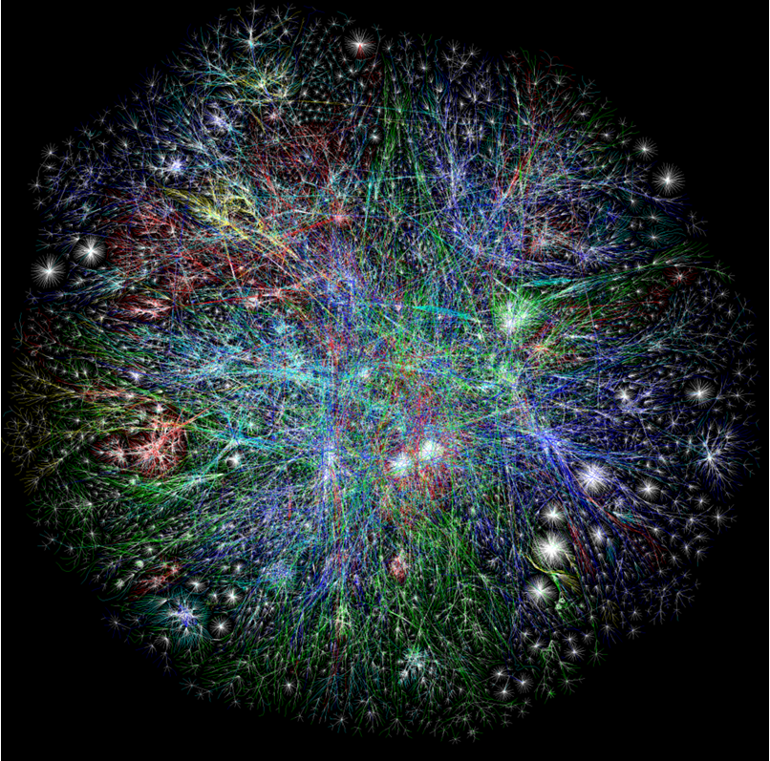
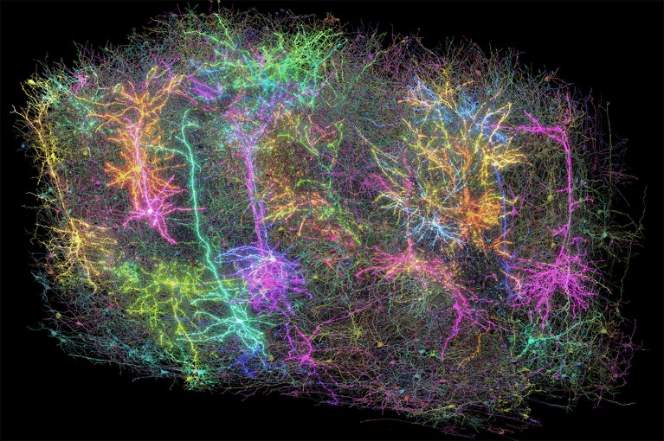
We exist in an interconnected world
Networks are everywhere
Asia Pacific Europe/Middle East/Central Asia/Africa North America
Latin American and Caribbean RFC1918 IP Addresses Unknown
Figure 1: Partial map of the Internet based on data from November 24rd 2003. Each line is drawn between two nodes, representing two IP addresses. Lines are colour-coded based on allocation of IP space.
Figure 2: A rendering of more than 1,000 brain cells out of those reconstructed from analysis of 1 cubic millimetre of mouse brain tissue.

Slide 4
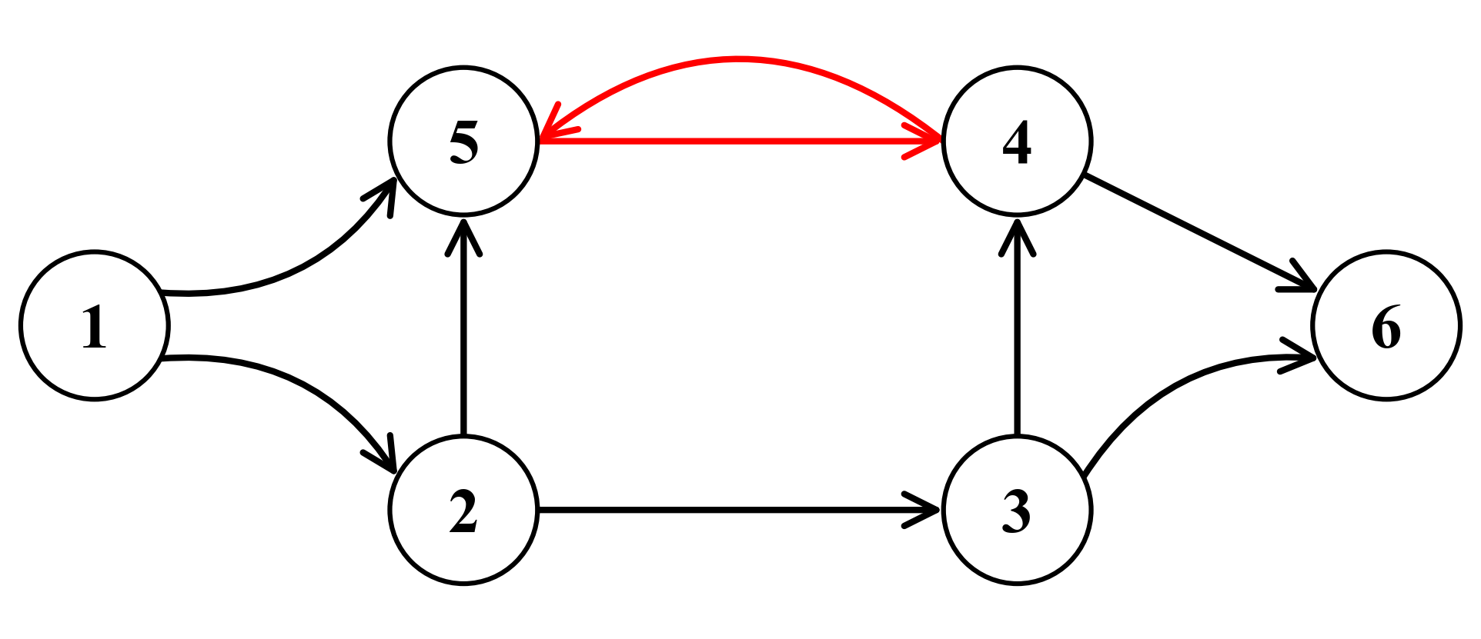
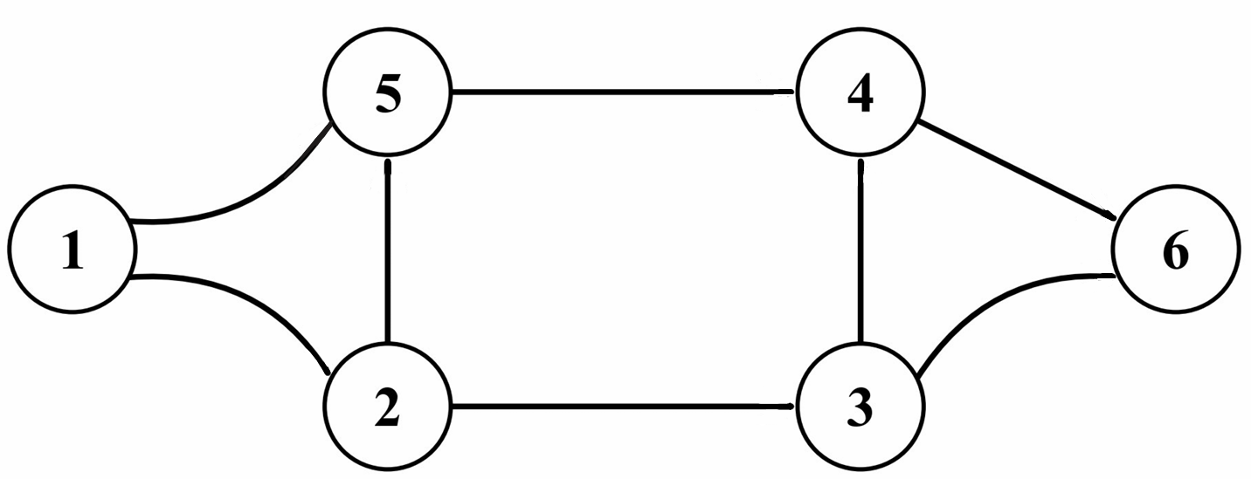
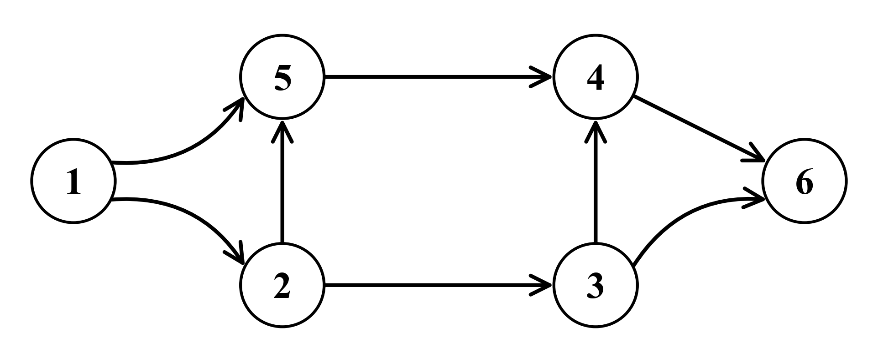
Graphs and DAGs
Cycle
The Language of Networks
Directed Edge
Directed Graph:
Graph:
Edge
Node
Figure 4: Diagram of six node directed graph with eight directed edges. The red edges indicate the presence of a cycle.
Directed Acyclic Graph:
Figure 3: Diagram of six node undirected graph with eight undirected edges.
Figure 5: Diagram of six node directed acyclic graph with eight directed edges.

Slide 5
Mathematical Models
Applying images to backgrounds
These networks can have different and often complex topologies.
Sharing properties that can be captured and compared using mathematical models analysing them as graphs.
Providing insight for useful questions; from:
(1) “What is the most important element in the network?”
to,
(2) “Given the characteristics of my network, how likely is it that one of its nodes forms the connections it does?”
Fig 6: An animation of the PageRank algorithm running on a small network of pages. The size of the nodes represents the perceived importance of the page, and arrows represent hyperlinks.
This Work

Slide 6
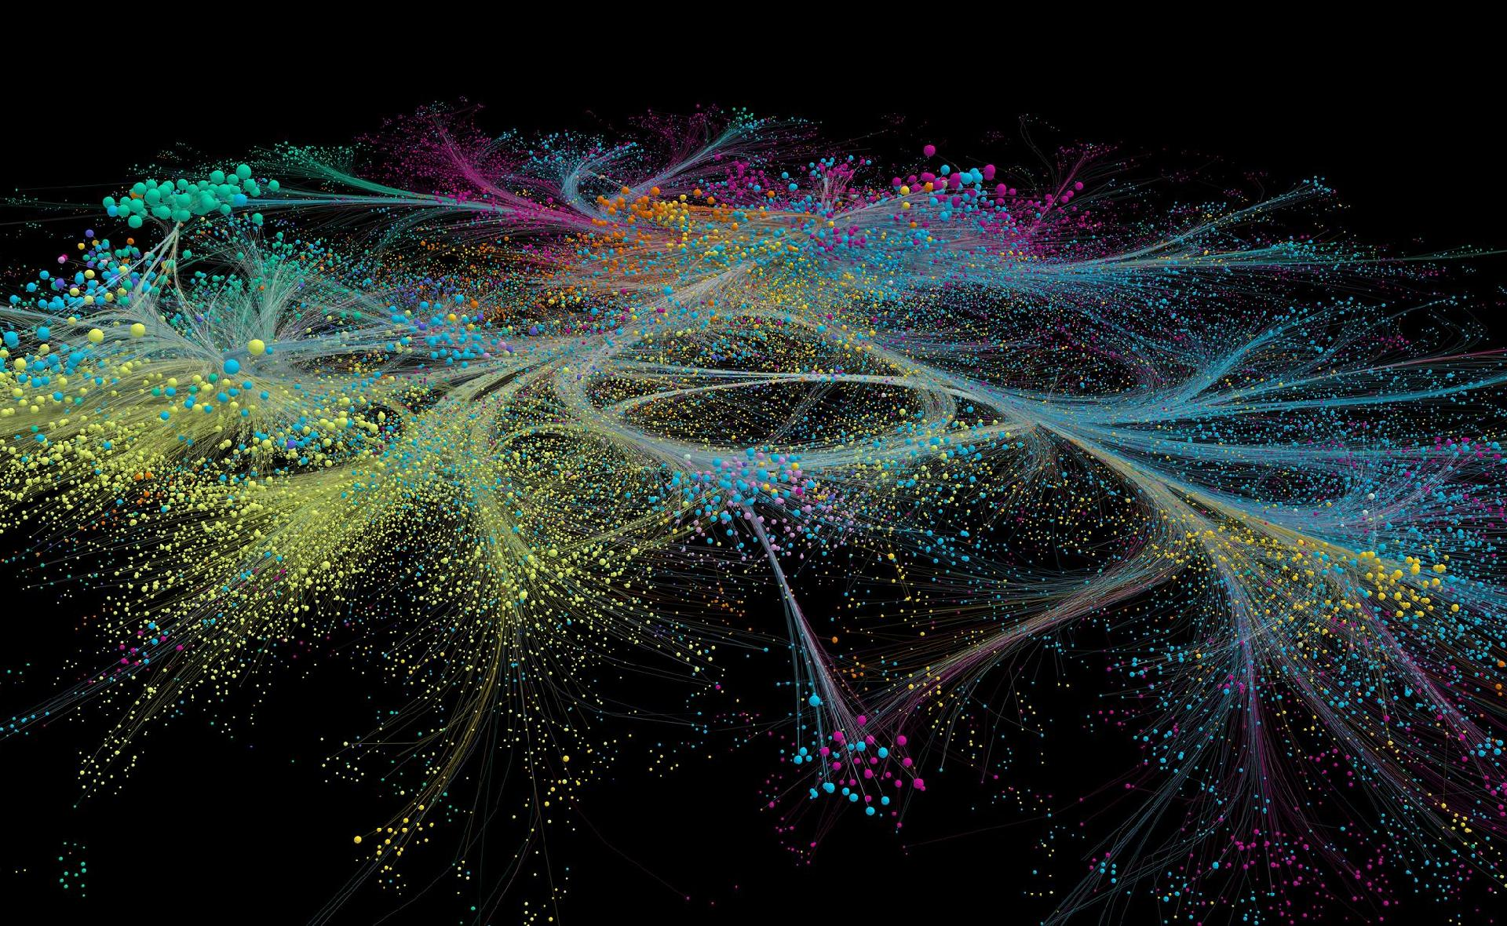

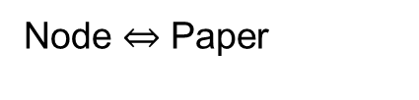

Citation Networks
Scientific publication document citations are everywhere
$$⇔$$
Figure 2: A rendering of more than 1,000 brain cells out of those reconstructed from analysis of 1 cubic millimetre of mouse brain tissue.
Figure 1: In 2019, the scientific journal Nature marked its 150th anniversary by commissioning a unique multimedia project created by Albert-László Barabási and his team. The project began as a data-driven analysis of the journal's history, mapping out the co-citation network connecting the 88,000 papers published since 1900. The resulting visualization highlighted the multidisciplinary scope of the journal and the co-citation of different disciplines.
Edge $⇔$ Citation
Node $⇔$ Paper

Slide 7
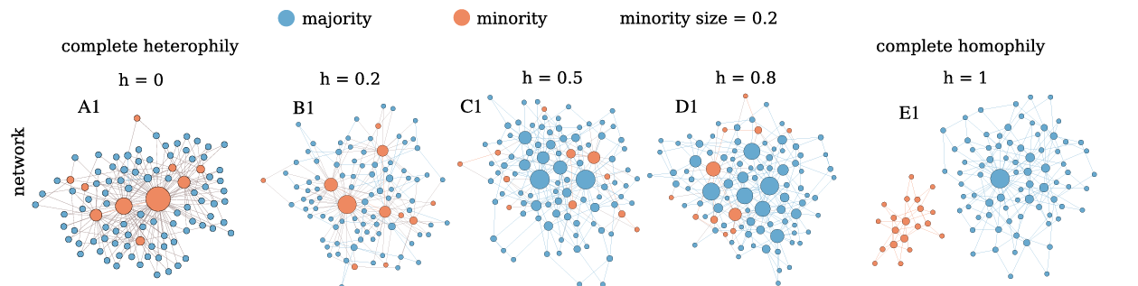
Selected Network Features
What are dominant behaviors do we wish to model?
(2) “Given the characteristics of my [citation] network, how likely is it that one of the [papers] has the number of [citations] it does?”
As physicists, we know that a mathematical model of a real-world system can only capture certain aspects of the system under study.
$⟹$ “What are the dominant behaviors of the system, and how can we describe these mathematically?”
(1) The Matthew effect:
(2) Homophily:
Figure 7: GIF of preferential attachment representing the Matthew effect.
Figure 8: Preferential attachment networks with various amounts of homophily.

Slide 8
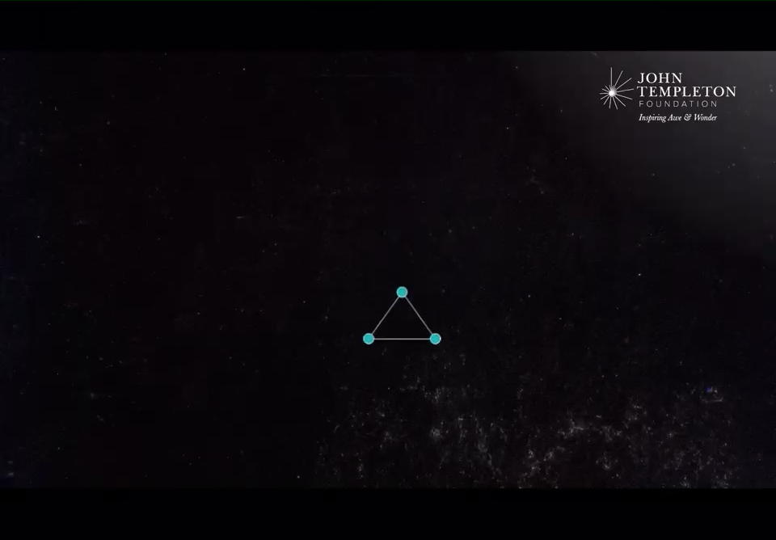


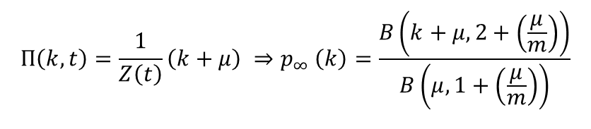
Cumulative Advantage
The Matthew effect, Price’s model and the Barabási–Albert Model
Matthew effect”: Verse from the Gospel of Matthew: “For everyone who has will be given more.”
1976: Price:
$$Π\left(k,t\right)=\frac{1}{Z\left(t\right)}\left(k+μ\right) ⇒p_{∞} \left(k\right)=\frac{B\left(k+μ, 2+\left(\frac{μ}{m}\right)\right)}{B\left(μ, 1+\left(\frac{μ}{m}\right)\right)}$$
$μ$= initial number of citations a paper has
$m$ = number of citations the newly added paper gives
1999: Barabási–Albert :
$$Π\left(k,t\right)=\frac{k}{Z(t)} ⇒\frac{2m^{2}}{k^{3}}$$
Figure 9: Video demonstrating preferential attachment representing the Matthew effect.

Slide 9
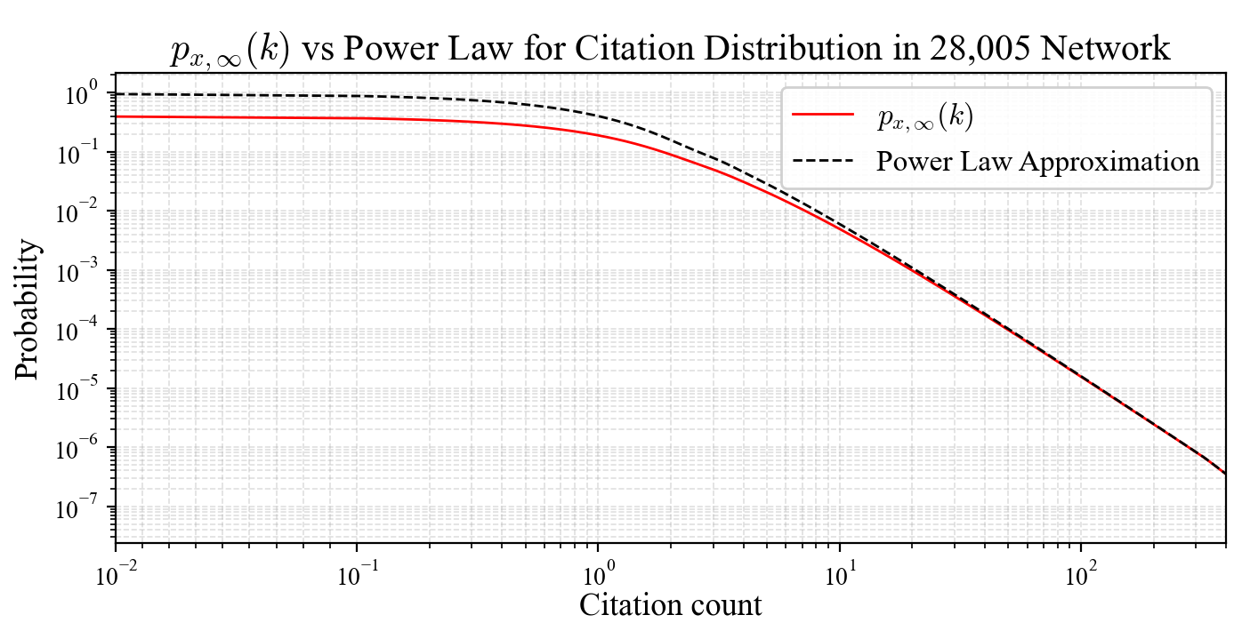

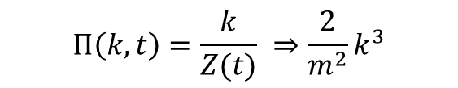
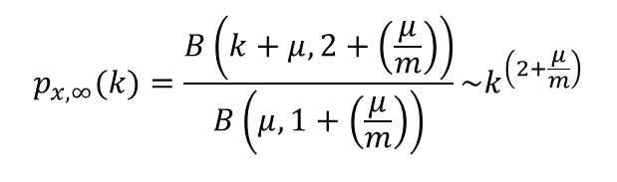
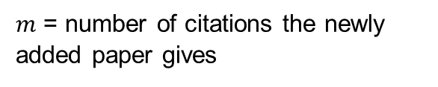
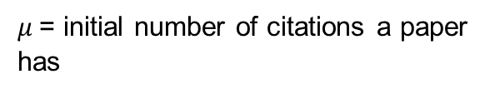
Cumulative Advantage
The Matthew effect, Price’s model and the Barabási–Albert Model
1976: Price:
$Π\left(k,t\right)=\frac{1}{Z\left(t\right)}\left(k+μ\right)$ $⟹$
$$p_{x,∞}(k)=\frac{B\left(k+μ, 2+\left(\frac{μ}{m}\right)\right)}{B\left(μ, 1+\left(\frac{μ}{m}\right)\right)}\sim k^{\left(2+\frac{μ}{m}\right)}$$
$m$ = number of citations the newly added paper gives
$μ$= initial number of citations a paper has
1999: Barabási–Albert :
$$Π\left(k,t\right)=\frac{k}{Z(t)} ⇒{\frac{2}{m^{2}}k}^{3}$$
Figure 11: Video demonstrating preferential attachment representing the$⇒p_{∞}$
Matthew effect

Slide 10



Homophily
Homophily: The idea that similarity breeds connection.
2001: McPherson et al. show that “homophily in race and ethnicity creates the strongest divides in our personal environments, with age, religion, education, occupation, and gender following in roughly that order”.
2018: Karimi et al. use Barabási-Albert model and incorporate homophily as follows:
$$Π_{x}\left(k,t\right)=\frac{kh_{x}}{Z\left(t\right)}$$
$h_{x} ∈\left[0,1\right]$. $h_{y}=1−h_{x}.$
$$⇒$$
Figure 12: Video demonstrating preferential attachment representing the Matthew effect

Slide 11
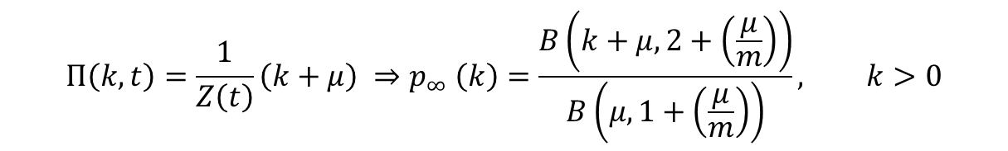
Motivating the result
Preferential attachment and the Homophily
If we want to be more accurately answer question (2) for a greater majority of the nodes in our network,
(2) “Given the characteristics of my network [Matthew effect and Homophily] how likely is it that one of its nodes forms the connections it does?”
Then we need to incorporate homophily not to the Barabási–Albert Model, but to the Price model:
So, if not:
But:
$$Π\left(k,t\right)=\frac{1}{Z\left(t\right)}\left(k+μ\right) ⇒p_{∞} \left(k\right)=\frac{B\left(k+μ, 2+\left(\frac{μ}{m}\right)\right)}{B\left(μ, 1+\left(\frac{μ}{m}\right)\right)}, k>0$$
$$Π_{x}\left(k,t;h_{x}\right)= ? ⇒p_{x,∞} \left(k;h_{x}\right)= ?$$

Slide 12
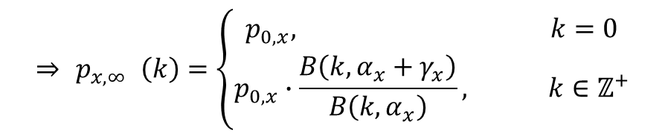


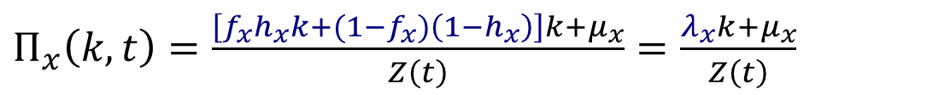


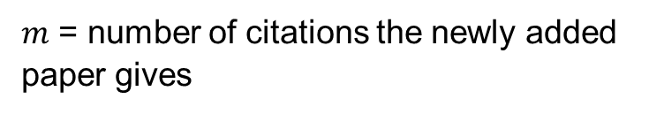


Key Result
Preferential attachment and the Homophily
$Π_{x}\left(k,t\right)=\frac{\left[f_{x}h_{x}k+(1−f_{x})\left(1−h_{x}\right)\right]k+μ_{x}}{Z\left(t\right)}=$ $\frac{λ_{x}k+μ_{x}}{Z\left(t\right)}$
$f_{x}=$fraction of nodes in network of type $x$
$μ_{x}$= initial number of citations a paper has
$${⇒ p}_{x,∞} \left(k\right)=\left\{\begin{aligned}p_{0,x}, k=0 \\ &p_{0,x}∙\frac{B\left(k, α_{x}+γ_{x}\right)}{B\left(k, α_{x}\right)}, k∈ℤ^{+}\end{aligned}\right.$$
$m$ = number of citations the newly added paper gives
$h_{x}=$homophily parameter for type $x$ node
Where,
$α_{x}=\frac{μ_{x}}{λ_{x}}$,
$$Z\left(t\right)= \left[λ_{x}\left\langle g_{x}\right\rangle +λ_{y}\left\langle g_{y}\right\rangle +μ_{x}f_{x}+μ_{y}f_{y}\right]t,$$
$γ_{x}=1+\left(\frac{μ_{x}}{γ_{x}}\right)\frac{Z(t)}{mt}$,
$$p_{0,x}=1+(μ_{x})\frac{Z(t)}{mt}$$
So, what are these terms?
$$\left\langle g_{x}\right\rangle +\left\langle g_{x}\right\rangle =m$$

Slide 13
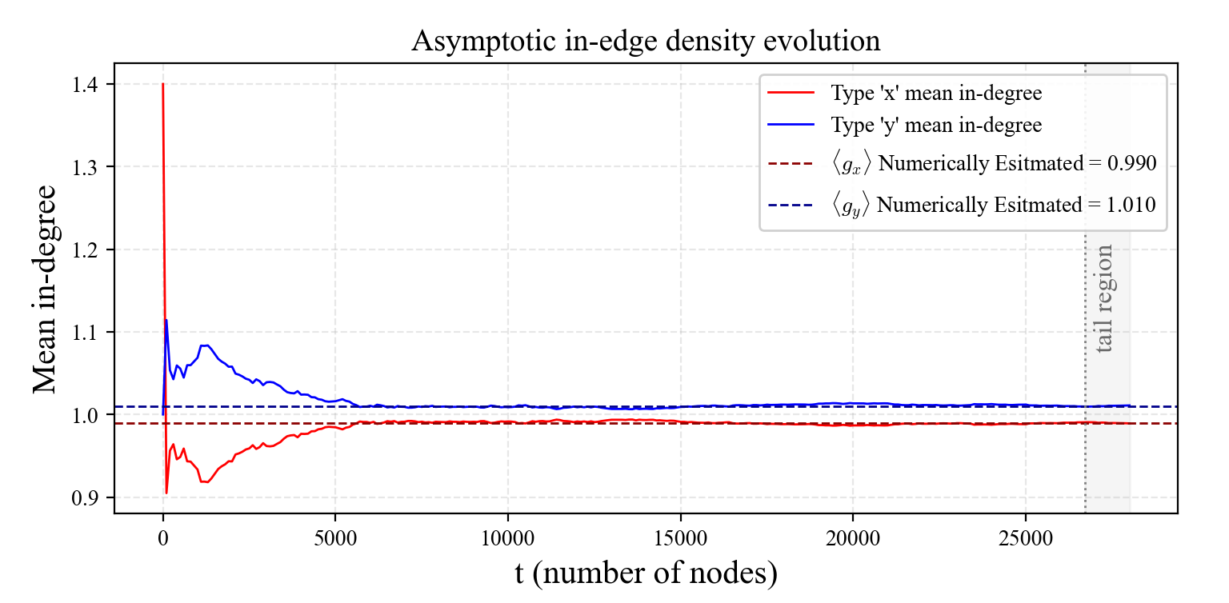

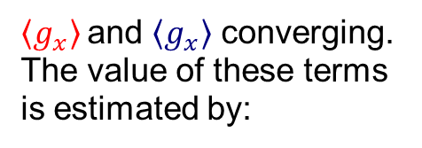
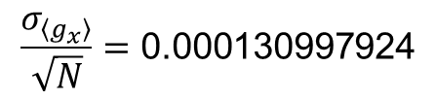

Asymptotic Values
Numerical Result Demonstrating term convergence
$\left\langle g_{x}\right\rangle$and $\left\langle g_{x}\right\rangle$ converging. The value of these terms is estimated by:
$\frac{σ_{\left\langle g_{y}\right\rangle }}{\sqrt{N}}=\text{0.000130997924}$
$$\frac{σ_{\left\langle g_{x}\right\rangle }}{\sqrt{N}}=\text{0.000130997924}$$
$$\left\langle g_{x}\right\rangle +\left\langle g_{x}\right\rangle =m$$
Figure 11: Mean in-degree for the type $x$ and $y$nodes sampled by taking the arithmetic mean in-degree every 100 nodes. The values of $\left\langle g_{x}\right\rangle$and $\left\langle g_{x}\right\rangle$ are taken as the arithmetic mean of this values for the last 5% of these values once the network has settled. In this case this was 14 points.

Slide 14
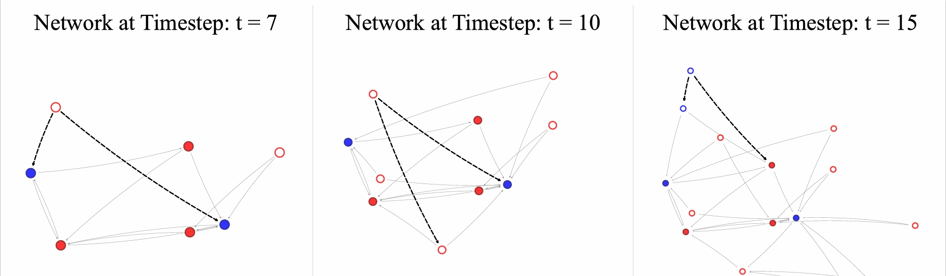
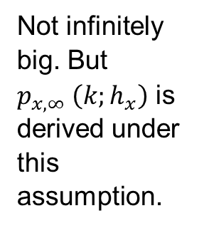
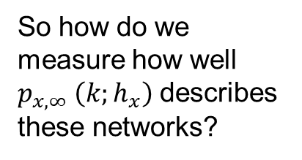
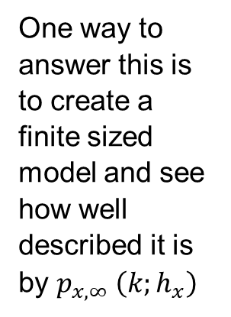
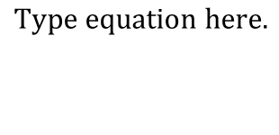
Our Network Model
Price’s model and the Homophily
One way to answer this is to create a finite sized model and see how well described it is by $p_{x,∞} \left(k;h_{x}\right)$
Not infinitely big. But $p_{x,∞} \left(k;h_{x}\right)$ is derived under this assumption.
Real networks are finite-sized this analysis is physically relevant.
So how do we measure how well $p_{x,∞} \left(k;h_{x}\right)$describes these networks?
Figure 12: Our Network simulation

Slide 15
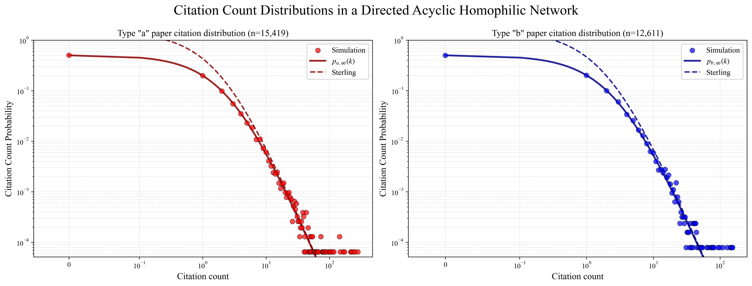
Finite Size Effects
Finite Size effects and statistical validation
Matthew effect” for this phenomenon [13], naming it after the verse from the Gospel of Matthew: “For everyone who has will be given more.

Slide 16
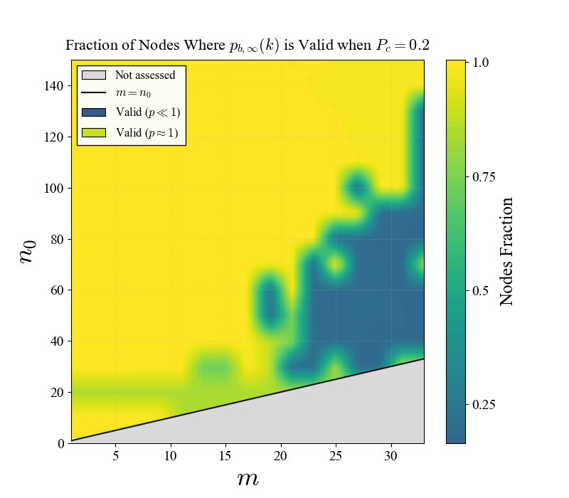
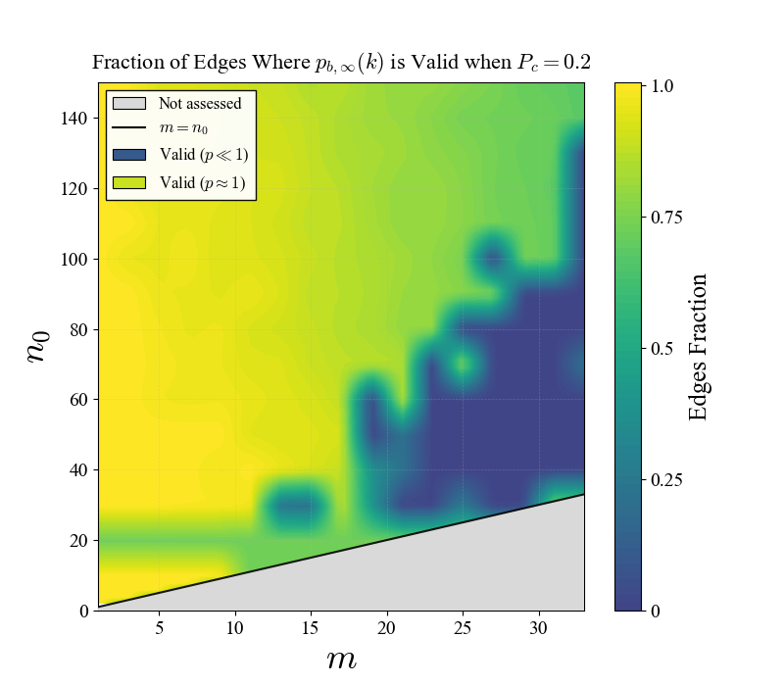
New Statistical Test
Creation of a new goodness of fit test to assess our derivation result

Slide 17
Thank you
Predicting Network Behaviour
20/03/2026

