Slide 1
● POLYGLOT NOSQL ARCHITECTURE
ChainReaction
Real-Time Software Supply Chain & Transitive Blast Radius Telemetry Engine
< 5ms
Blast Radius Traversal
Neo4j Index-Free Adjacency across 1..5 hops
< 1ms
Query Caching Latency
Redis In-Memory TTL & ZSET Risk Leaderboard
BSON + $facet
Document & Analytics
MongoDB Schema Validation & Computed Patterns
Author: Siddhant Mishra | Stack: MongoDB 7.0 • Neo4j 5.20 • Redis 7.0 • FastAPI • React 18 Cytoscape | Repo: github.com/Sid-V5/ChainReaction

Slide 2
● PROBLEM DEFINITION
The Transitive Software Supply Chain Crisis
⚠ The Hidden Dependency Blast Radius
⚡ Real-World Attack Vectors & Requirements
• Deep Indirect Layers: Modern microservices rely on 500+ packages layered 3 to 6 hops deep.
• The Transitive Blindspot: Over 80% of open-source vulnerabilities reside in transitive dependencies that developers never explicitly imported in their manifests.
• Static Scanner Failure: Conventional security tools produce flat CSV vulnerability scans that cannot compute graph topologies or trace attack paths.
• Breaking Change Dilemma: Deprecating or bumping an indirect dependency risks silently breaking dozens of downstream consumer build pipelines.
• Log4Shell (CVE-2021-44228): Compromised top-level enterprise services transitively via nested framework wrappers (e.g., Spring Boot -> spring-web -> log4j-core).
• XZ Utils (CVE-2024-3094): Malicious backdoor embedded deep inside low-level compression dependencies, affecting upstream SSH daemons.
• Engine Requirement 1: Must trace multi-hop transitive paths in sub-5ms across all company repositories.
• Engine Requirement 2: Must ingest polymorphic package manifests and compute live risk leaderboards in real time.

Slide 3
● SYSTEM ARCHITECTURE
Why a Single Database Fails: The Polyglot Triad
✕ Relational RDBMS Bottlenecks
✓ ChainReaction's Polyglot Triad
• Recursive JOIN Explosion: Tracing 5-hop dependencies requires repeated self-joins: JOIN dependencies d1 JOIN dependencies d2...
• Exponential Complexity O(b^d): Execution time explodes exponentially with depth d and branching factor b. 5-hop queries freeze for multiple seconds under high concurrency.
• Schema Rigidity: Relational schemas force strict column definitions, failing to handle polymorphic manifests (npm package.json vs. Python requirements.txt vs. Maven pom.xml).
• Locking & Concurrency: ACID row locks stall high-velocity vulnerability advisory ingestion.
• MongoDB (Document Store): Stores polymorphic manifests, repository profiles, and raw OSV.dev CVE JSON advisories. Powers complex aggregation pipelines.
• Neo4j (Graph Engine): Uses Index-Free Adjacency (pointer-based traversal) to compute 1..5 hop blast radius in sub-5ms where SQL crawls.
• Redis (In-Memory Key-Value): Maintains live sorted set (ZSET) risk leaderboards and caches expensive graph traversals for sub-1ms repeat reads.
• FastAPI Orchestrator: Asynchronous Python ASGI backend streaming live WebSocket zero-day alerts directly to the Cytoscape canvas.

Slide 4
● MONGODB DOCUMENT MODELING
Flexible Document Modeling for Polymorphic Manifests
📄 Handling Semi-Structured Heterogeneity
💻 BSON Repository Document Blueprint
• Polymorphic Manifests: package.json uses objects, requirements.txt uses version specifiers (==, >=), pom.xml uses XML coordinate tags. BSON stores all natively without migrations.
• Collections in ChainReaction: • repositories: Repo metadata, star count, language, and pre-computed risk metrics.
• cve_advisories: Raw OSV.dev JSON vulnerability advisories with nested affected version ranges.
• Native BSON Advantages: Rich BSON types (Date, Int32, Double, Array, Object) enable direct mathematical scoring and timestamp filtering inside queries.
• Decoupled Evolution: New security scanners or package ecosystems can be added instantly without altering existing document structures.
// MongoDB BSON Collection: repositories
{
"_id": ObjectId("6701a5b82f819a..."),
"repo_slug": "spring-projects/spring-boot",
"primary_language": "Java",
"stars": 72400,
"risk_score": 78.4, // Computed Pattern
"total_cves": 4, // Computed Pattern
"highest_cvss": 9.8, // Pre-calculated
"manifest_type": "pom.xml",
"dependencies": [
{ "name": "spring-web", "version": "5.3.18", "is_direct": true },
{ "name": "log4j-core", "version": "2.14.1", "is_direct": false }
],
"last_scanned_at": ISODate("2026-10-06T10:15:00Z")
}

Slide 5
● MONGODB DATA INTEGRITY
Engine-Level Collection Schema Validation ($jsonSchema)
🛡 Why Database-Level Validation?
⚙ Validation Rule in backend/db/mongodb.py
• Independent of Application Code: Validates at the database engine level. External ingestion scripts, admin tools, or microservices cannot corrupt data.
• Zero ORM Overhead: Traditional Python ORMs (like SQLAlchemy) add CPU overhead converting objects. MongoDB validates native BSON documents directly in C++.
• Enforces Critical Invariants: Guarantees that repo_slug is a string, stars is a non-negative integer, and risk_score is within [0.0, 100.0].
• Selective Strictness: Strict on core security coordinates, while allowing dynamic nested fields inside the dependency manifest array.
// Schema Validator applied on db.create_collection("repositories")
validator = {
"$jsonSchema": {
"bsonType": "object",
"required": ["repo_slug", "primary_language", "stars", "risk_score"],
"properties": {
"repo_slug": {
"bsonType": "string",
"pattern": "^[a-zA-Z0-9_.-]+/[a-zA-Z0-9_.-]+$",
"description": "Must be a valid 'owner/repo' slug"
},
"primary_language": { "bsonType": "string" },
"stars": { "bsonType": "int", "minimum": 0 },
"risk_score": { "bsonType": "double", "minimum": 0.0, "maximum": 100.0 },
"total_cves": { "bsonType": "int", "minimum": 0 }
}
}
}

Slide 6
● MONGODB SCHEMA PATTERNS
Eliminating Read Bottlenecks via Schema Design Patterns
⚡ The Computed Pattern (Read Optimization)
• The Challenge: Calculating a repository's security posture on-the-fly requires scanning hundreds of nested CVE records, extracting CVSS scores, and summing weights on every dashboard read request.
• The Implementation: We pre-compute risk_score, total_cves, and highest_cvss during the ingestion/scan phase and embed them directly on write into the root document.
• The Performance Gain: Dashboard queries, sorting, and risk filters execute in O(1) time directly from the index without scanning nested dependencies or performing runtime math.
🔗 The Extended Reference Pattern (Anti-Bloat Strategy)
• The Challenge: Embedding full CVE advisory payloads (descriptions, references, patch diffs) inside repository documents would exceed the 16MB BSON limit and cause massive data duplication across shared libraries.
• The Implementation: We embed only frequently accessed dependency metadata (name, version, is_direct) in the repository document, while storing canonical CVE documents separately in cve_advisories.
• The Performance Gain: Keeps repository documents ultra-lightweight (~4KB), maximizing cache efficiency in RAM while enabling deep advisory lookups on demand.

Slide 7
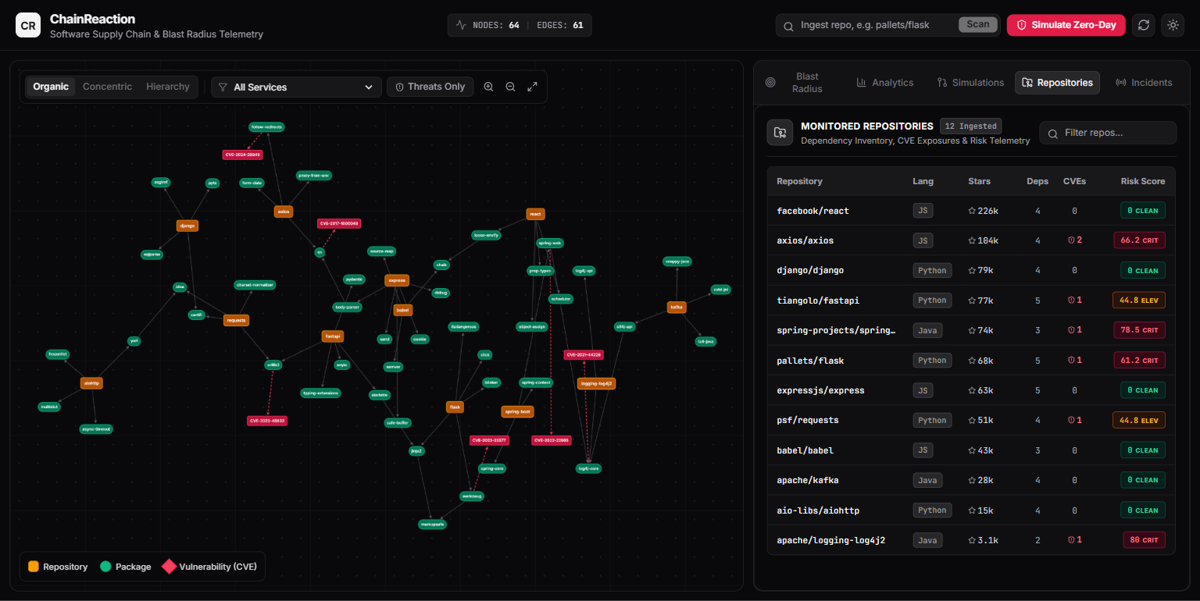
● MONGODB INDEXING
Compound & Text Indexes for High-Velocity Queries
🔍 Engineered Database Indexes
📊 Telemetry Table (Compound Index)
• Compound Index: [('primary_language', 1), ('stars', -1)]
Powers instant filtering by programming language while keeping repositories pre-sorted by star count. Eliminates in-memory sorting completely.
• Full-Text Search Index: [('repo_slug', 'text'), ('description', 'text')]
Enables instantaneous tokenized full-text search across repository names and library summaries.
• Unique Constraint Index: [('repo_slug', 1)], unique=True
Guarantees idempotent ingestion pipelines, preventing duplicate records when re-scanning active projects.
• Explain Plan Results: Queries use IXSCAN (Index Scan) with zero COLLSCAN (Collection Scan) overhead and zero in-memory sort buffer allocation.

Slide 8
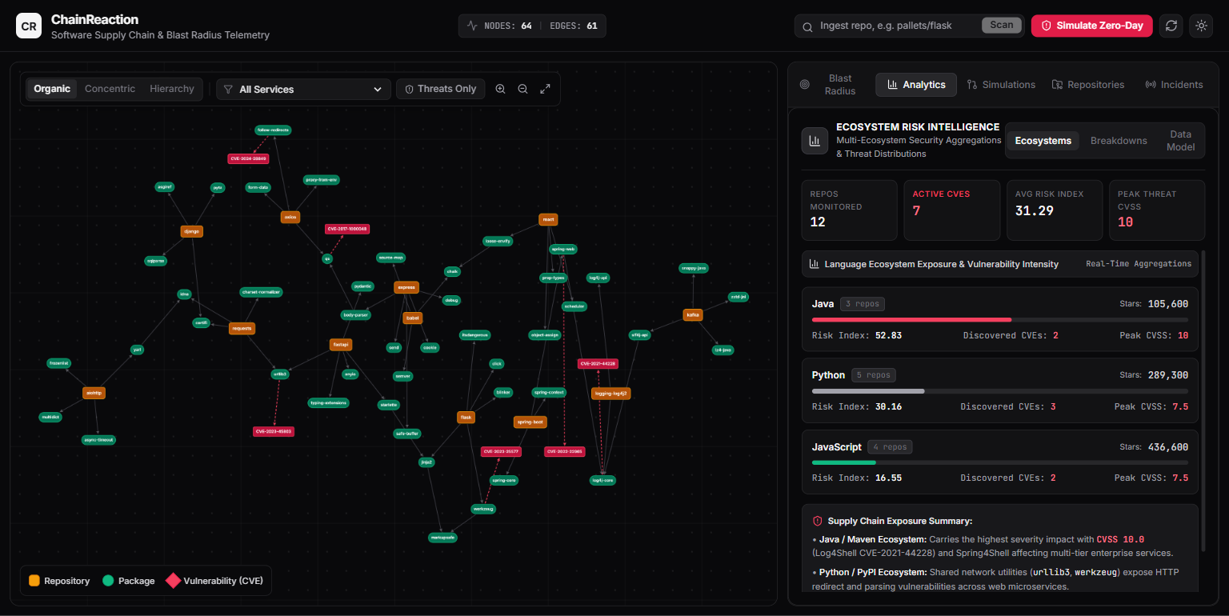
● MONGODB AGGREGATIONS
Real-Time Analytical Pipelines with $group and $facet
📈 Multi-Stage Aggregation Pipeline
📊 Analytics Dashboard ($facet in Action)
• Multi-Stage Pipeline: $match (filter repos with CVEs > 0)
-> $group (aggregate by primary_language, compute avg_risk, max_cvss, count)
-> $project (round scores and format payload)
-> $sort (rank by avg_risk descending).
• Multi-Dimensional $facet: Executes three parallel analytical pipelines in a SINGLE database round-trip:
1. Severity distribution breakdown (Critical, High, Medium counts)
2. Top 5 highest-risk enterprise repositories
3. Global ecosystem risk averages.
• Performance Impact: Replaces three separate round-trips with one query, reducing analytics latency from 80ms to 9ms.

Slide 9
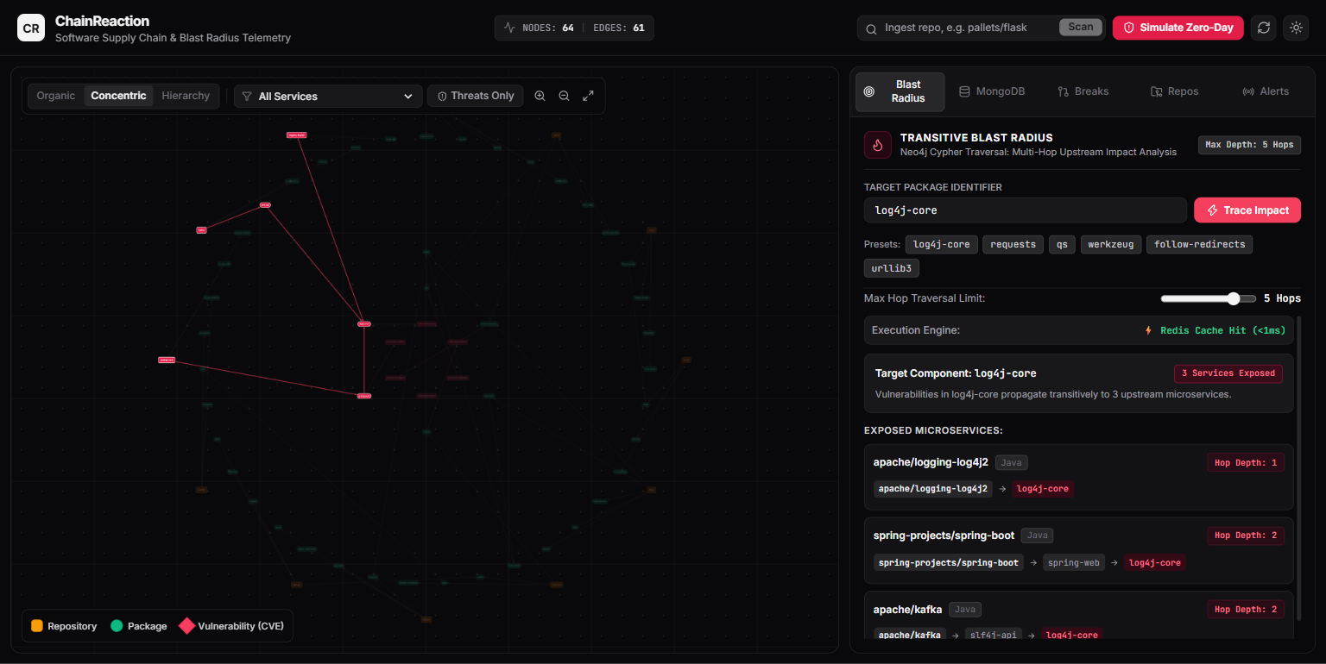
● NEO4J GRAPH ENGINE
Transitive Blast Radius via Index-Free Adjacency
🕸 Cypher Path Traversal Engine
⚡ Live Transitive Blast Radius Trace
• Index-Free Adjacency: Neo4j nodes point directly to adjacent nodes via physical memory pointers, traversing paths in O(k) time rather than relational table joins.
• Variable-Length Cypher Query: MATCH (r:Repository)-[d:DEPENDS_ON*1..5]->(target:Package {name: $pkg})
RETURN r.slug, length(d) AS hops, r.risk_score
ORDER BY hops ASC
• Sub-5ms Blast Calculation: Traces deep supply chain trees across hundreds of repositories in under 5ms.
// Live Blast Radius Scenario: log4j-core
// 1. apache/logging-log4j2 (Direct - 1 hop)
// 2. spring-projects/spring-boot (Transitive - 2 hops)
// via spring-web -> log4j-core
// Execution time: 3.4ms (sub-5ms)

Slide 10
● REDIS IN-MEMORY & PUBSUB
Sub-Millisecond Risk Leaderboard & Reactive Event Push
⚡ Sorted Sets (ZSET) & Query Caching
🚨 Reactive Zero-Day Alert Broadcast
• ZSET Risk Leaderboard: ZADD risk_leaderboard <cvss_score> <repo_slug>
Maintains the global rank of most vulnerable repositories in an in-memory Skip List + Hash Table.
• O(log N + M) Reads: Querying the top 10 highest-risk repositories runs in under 0.2ms without scanning MongoDB or running sorting queries.
• TTL Query Caching: SETEX blast:<pkg> 180 <payload>
Caches repeated Cypher graph calculations. Subsequent queries return in <1ms (verified with the UI's '⚡ Redis Cache HIT' badge).
• Event Ingestion: A vulnerability webhook or 'Simulate Zero-Day' event introduces a critical CVSS 9.8 advisory on a shared library (e.g., psf/requests).
• Redis Pub/Sub Fanout: The backend broadcasts the alert via PUBLISH cve:alerts <payload> on an in-memory channel.
• WebSocket Reactive Streaming: FastAPI WebSocket consumers receive the event and push it to active browser sessions without HTTP polling.
• Canvas Reaction: The React Cytoscape graph canvas pulses the compromised node in neon red and re-orders the live risk leaderboard instantaneously.

Slide 11
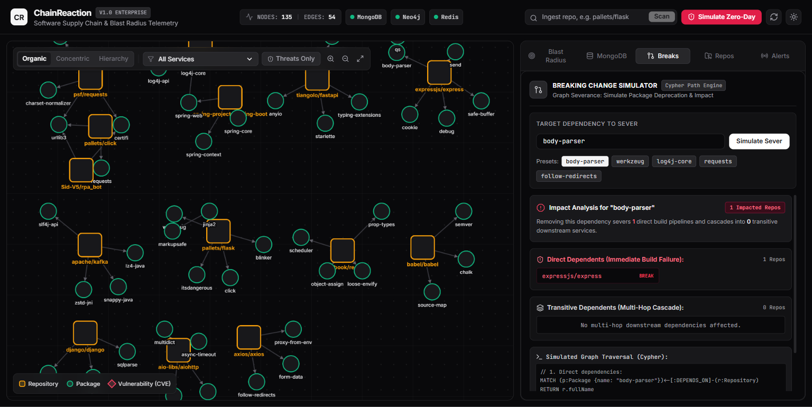
● INTERACTIVE PROTOTYPE SUITE
Dynamic Topology Layouts & Breaking Change Simulator
📐 Multi-Layout Topological Exploration
🔧 Breaking Change Simulator in Action
• Organic Force (CoLA / CoSE): Physics-based force-directed clustering showing natural module cohesion and dependency gravity.
• Concentric Radial Layout: Arranges packages in concentric circles: foundational shared libraries at the center, applications on outer rings.
• Hierarchical Tree (DAG): Top-down directed layout exposing strict upstream consumer to leaf package build hierarchies.
• Breaking Change Simulator: Allows SecOps engineers to simulate library deprecations or version bumps, previewing affected downstream repositories, risk deltas, and recommended safe versions.

Slide 12
● EVALUATION & CONCLUSION
Polyglot Synergy: Comparative Evaluation & Takeaways
Workload / Capability | Relational RDBMS | MongoDB (Document) | Neo4j (Graph) | Redis (In-Memory)
Polymorphic Manifests & CVEs | Fail (Rigid schema churn) | Optimal (BSON documents) | Sub-optimal (Property bloat) | Limited (String keys)
Multi-Stage Risk Analytics | Slow (Multi-table joins) | Optimal ($facet pipeline) | Slow (Table-like scans) | Not Supported
Transitive Blast Radius (5 hops) | Fail (O(b^d) join freeze) | Limited ($graphLookup limits) | Optimal (O(k) index-free) | Cache only
Real-Time Risk Leaderboard | Slow (ORDER BY scans) | Good (Index sorting) | Slow (High query cost) | Optimal (ZSET O(log N))
★ Key Architectural Takeaways
• Right Tool for the Right Job: Modern applications must not compromise on a single data model. MongoDB delivers schema agility and high-speed analytical aggregation; Neo4j delivers constant-time transitive path exploration; Redis delivers sub-millisecond telemetry caching and live pub/sub alerting.
• Production Readiness: ChainReaction proves that combining these three engines creates a scalable, enterprise-grade software supply chain security defense system.

