Slide 1
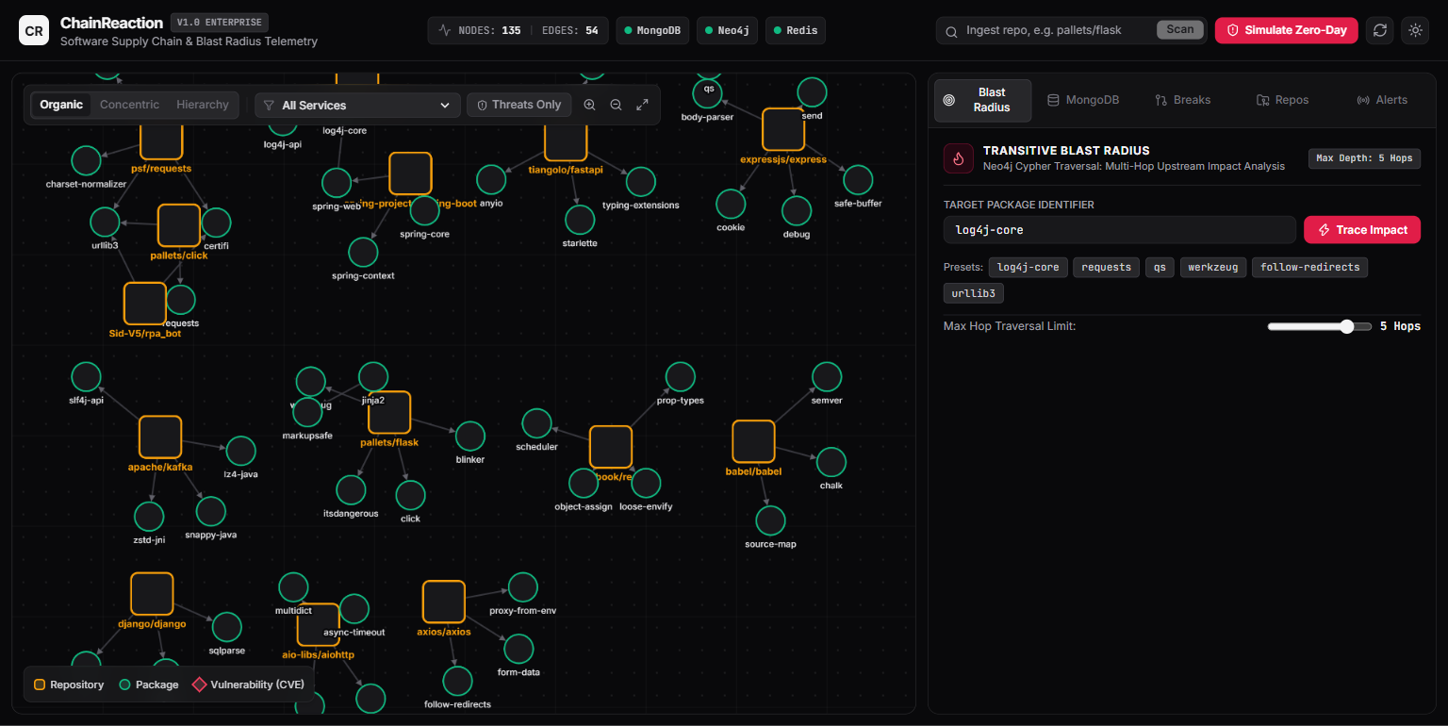
SOFTWARE SUPPLY CHAIN TELEMETRY
ChainReaction
Built around the workload
Real-Time Polyglot NoSQL Dependency & Transitive Blast Radius Engine
MongoDB · Neo4j · Redis
• MongoDB: Polymorphic manifests, schema validation & analytics
• Neo4j: Multi-hop graph traversal for transitive blast paths
• Redis: Sub-millisecond risk rank leaderboard & live alert ticker
FastAPI + React Cytoscape
Asynchronous ASGI API coordinating the three stores; pushes live WebSocket zero-day telemetry directly to the interactive canvas.
Siddhant Mishra | AIM3141 NoSQL Database | Manipal University Jaipur | github.com/Sid-V5/ChainReaction

Slide 2
THE FAILURE MODE
One buried package can expose every service above it
10.0
LOG4SHELL · CVSS CRITICAL
CVE-2021-44228
A simple logging utility became an all-hands zero-day emergency for thousands of engineering teams worldwide.
The Transitive Dependency Blindspot
Several layers down, the vulnerable package was completely invisible to developers. Modern applications pull 500+ direct and indirect dependencies. Nested dependency trees hide who actually depends on what.
The Blast Radius Reality
Blast radius stays unseen until someone traces it by hand. Conventional flat scanners dump disconnected CSV vulnerability lists without computing graph geometry or upstream impact paths.

Slide 3
POLYGLOT PERSISTENCE
No single database fits all three workloads
Workload | Engine | Why a single store stalls
Manifests, CVE advisories, aggregations | MongoDB | Flexible records fit documents naturally; repeated path expansion does not.
Multi-hop dependency traversal | Neo4j | Relationships are native; document joins add exponential traversal overhead.
Risk ranking, query cache, alert broadcast | Redis | Hot reads and broadcasts need a dedicated in-memory sub-millisecond path.
FastAPI Orchestrates the Triad
One unified asynchronous API coordinates MongoDB document writes, synchronizes Neo4j graph relationships, and broadcasts Redis WebSocket events to the React Cytoscape frontend.

Slide 4
MONGODB · DOCUMENT MODEL
Polymorphic manifests fit BSON documents naturally
ILLUSTRATIVE REPOSITORY DOCUMENT
One Collection, Multiple Ecosystem Shapes
package.json, requirements.txt, and pom.xml have fundamentally different manifest structures. BSON stores all ecosystems in one collection without migrations or rigid column conversions.
// MongoDB BSON Collection: repositories
{
repo: "apache/logging-log4j2",
primary_language: "Java",
dependencies: [
{ name: "log4j-core", version: "2.14.1", is_direct: true }
],
cves: [
{
id: "CVE-2021-44228",
severity: "CRITICAL",
cvss: 10.0,
affected_packages: ["log4j-core"]
}
],
last_scanned: ISODate("2026-10-06T10:15:00Z")
}
Dependencies & Advisories Stay Nested
The repository document carries an embedded dependencies array alongside active CVEs with severity, CVSS scores, and affected packages in a single atomic record.

Slide 5
MONGODB · WRITE CONTRACT
The database enforces structure, not the ORM
Every client meets the same contract.
Required fields, BSON type checks, a language enum, and CVSS bounds are enforced inside the database engine.
COLLECTION-LEVEL VALIDATOR · EXCERPT
db.createCollection("repositories", {
validator: { $jsonSchema: {
bsonType: "object",
required: ["repo", "primary_language"],
properties: {
repo: { bsonType: "string" },
primary_language: { enum: ["Java", "JavaScript", "Python"] },
cves: {
bsonType: "array",
items: {
bsonType: "object",
properties: {
cvss: { bsonType: "number", minimum: 0, maximum: 10 }
}
}
}
}
}}
})
✓ Valid Write
Accepted directly by the collection validator without application-level overhead.
✕ Invalid Write
Rejected immediately at the engine, preventing corrupt records from external scripts or services.

Slide 6
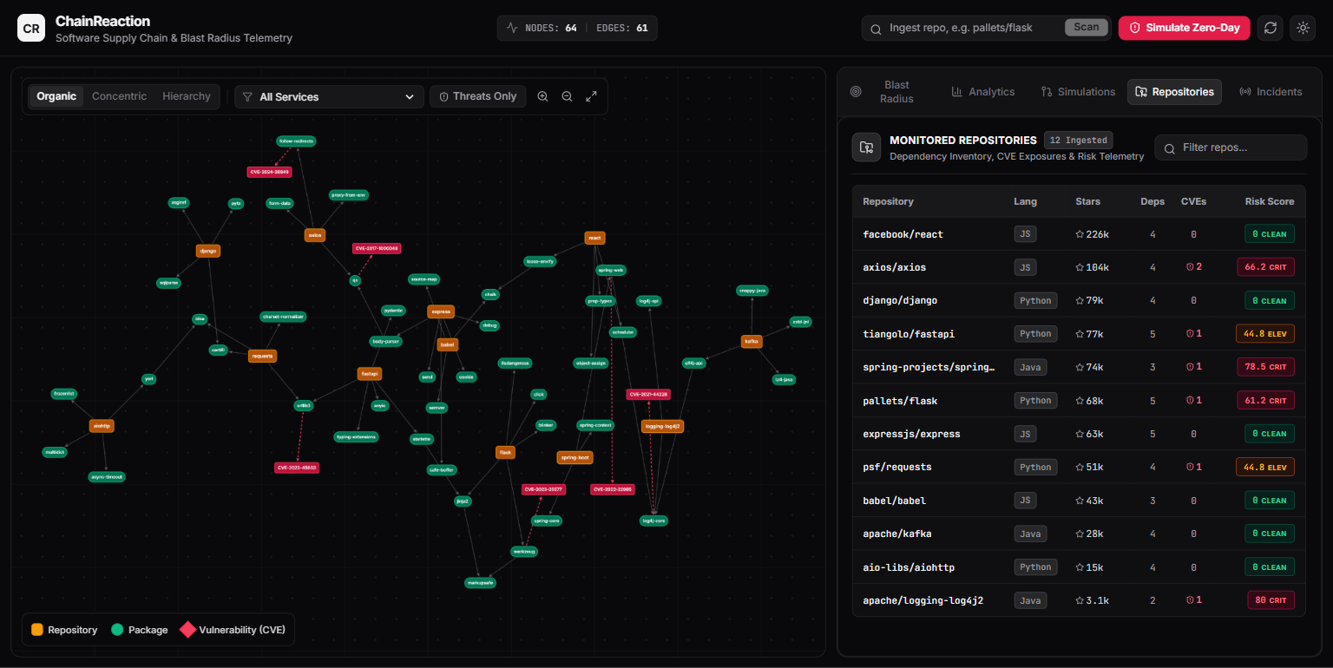
MONGODB · COMPUTED + EXTENDED REFERENCE
Pre-compute risk on write, so reads stay cheap
Store risk_score on each repository; render CLEAN / ELEV / CRIT badges without recomputing risk on reads.
Prototype repo | Score | Badge
apache/logging-log4j2 | 80.0 | CRIT
spring-projects/spring-boot | 78.5 | CRIT
pallets/flask | 61.2 | CRIT
psf/requests | 44.8 | ELEV
Copy the hot fields, retain the link
Embed frequently queried CVE id, severity, and score directly in the repository manifest for instant table rendering; link to full advisories in canonical collections.
Zero-Join Manifest Retrieval
The monitored repository view renders stars, languages, and severity badges from a single collection fetch—eliminating costly multi-table SQL joins.

Slide 7
MONGODB · ACCESS PATH
Compound indexes match the way analysts filter
01 · Equality
Filter on primary_language.
02 · Ordered scan
Read stars descending.
03 · No blocking sort
The compound index supplies the order.
INDEX DEFINITION & EXPLAIN PLAN
db.repositories.createIndex({
primary_language: 1, stars: -1
})
db.repositories.createIndex({ repo: "text" })
db.repositories.find({
primary_language: "Java"
}).sort({ stars: -1 }).explain("executionStats")
// Winning-plan stage: IXSCAN
// No blocking SORT for this query

Slide 8
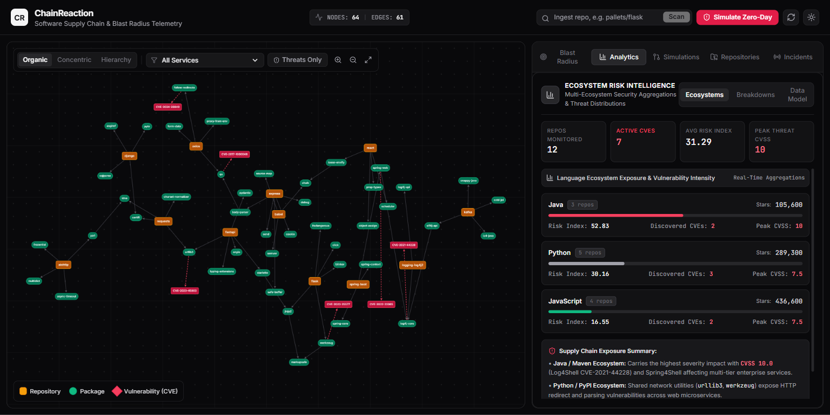
MONGODB · LIVE ANALYTICS
Aggregation pipelines turn telemetry into live analytics
$match → $group → $project derives per-language risk index, CVE counts and peak CVSS. $facet runs parallel pipelines over one shared input scan.
$FACET PIPELINE · EXCERPT
db.repositories.aggregate([
{ $match: { risk_score: { $exists: true } } },
{ $facet: {
byLanguage: [
{ $group: {
_id: "$primary_language",
risk_index: { $avg: "$risk_score" }
}},
{ $project: { _id: 0, language: "$_id", risk_index: 1 } }
],
peak: [
{ $unwind: "$cves" },
{ $group: { _id: null, peak_cvss: { $max: "$cves.cvss" } } }
]
}}
])
12 repos · 7 active CVEs
Java risk index: 52.83 | Peak CVSS: 10.0 (Log4Shell)
All computed dynamically via single-pass aggregation pipeline.

Slide 9
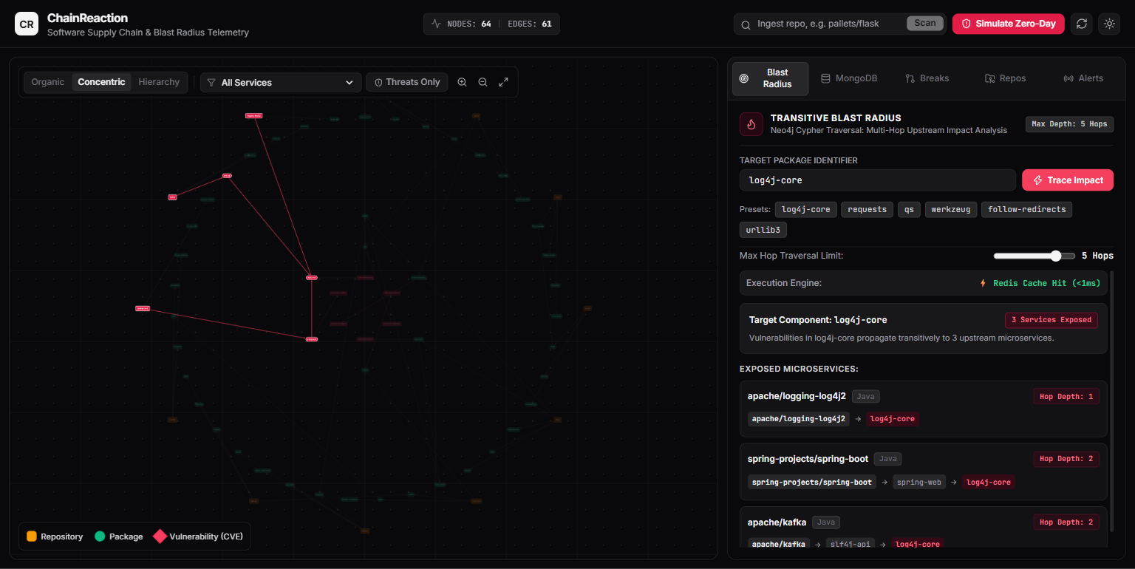
NEO4J · DEPENDENCY TRAVERSAL
Neo4j traces 1..5 hop blast radius where joins stall
Index-Free Adjacency
Each hop follows relationship pointers directly in memory, not relational join tables. Sub-5ms traversal across deep microservice dependency graphs.
CYPHER BLAST RADIUS QUERY
MATCH (p:Package)<-[:DEPENDS_ON*1..5]-(r:Repository)
WHERE p.name = "log4j-core"
RETURN DISTINCT r.slug, length(path) AS depth
3 Services Exposed
The log4j-core trace reached hop depths 1 and 2 in sub-5ms; repeat reads served as a Redis cache hit under 1ms.

Slide 10
REDIS · LOW-LATENCY DELIVERY
Redis makes risk ranking and alerts instant
ZSET
Risk Leaderboard
Repository risk scores are sorted on write for ranked reads in O(log N).
TTL CACHE
Repeated Traces
TTL-cached blast-radius queries return in under 1ms; expiry bounds cache lifetime.
PUB/SUB
Live CVE Ticker
New CVE zero-day alerts broadcast to WebSocket subscribers without database polling.
REDIS COMMAND
REDIS COMMAND
REDIS COMMAND
ZADD risk:repos 80.0 "apache/logging-log4j2"
ZREVRANGE risk:repos 0 4 WITHSCORES
SETEX trace:log4j-core 180 "{\"exposed\": 3}"
GET trace:log4j-core
PUBLISH cve:alerts "{\"cve\": \"CVE-2021-44228\"}"
SUBSCRIBE cve:alerts

Slide 11
CONCLUSION
Three engines, zero architectural compromises
What we built, what worked, and why a single database was never an option.
MONGODB · DOCUMENTS
Fits messy manifests
• Stored package.json, pom.xml, and requirements.txt in one BSON collection without schema migrations.
• Pre-computed risk scores on ingest so the repository view loads instantly without joins.
• Enforced CVSS bounds (0–10) and required fields in the database using $jsonSchema validation.
NEO4J · GRAPHS
Traces deep blast radius
• Traced 1 to 5 hops of dependencies in under 5ms using native Cypher graph traversal.
• Used index-free adjacency to avoid the slow, painful joins of relational databases.
• Instantly highlighted every upstream service exposed when a buried library breaks.
REDIS · IN-MEMORY
Keeps the UI real-time
• Sorted Sets (ZSET) gave us an instant, live risk leaderboard in O(log N) time.
• Cached repeat graph lookups with TTL for sub-1ms response times.
• Pub/Sub streamed live zero-day alerts straight to the browser without polling.
THE TAKEAWAY
Don't force one database to do every job. MongoDB handled the polymorphic documents, Neo4j traced the 5-hop relationships in under 5ms, and Redis kept the UI real-time. Pairing them made the system fast, simple, and resilient.

