Slide 1
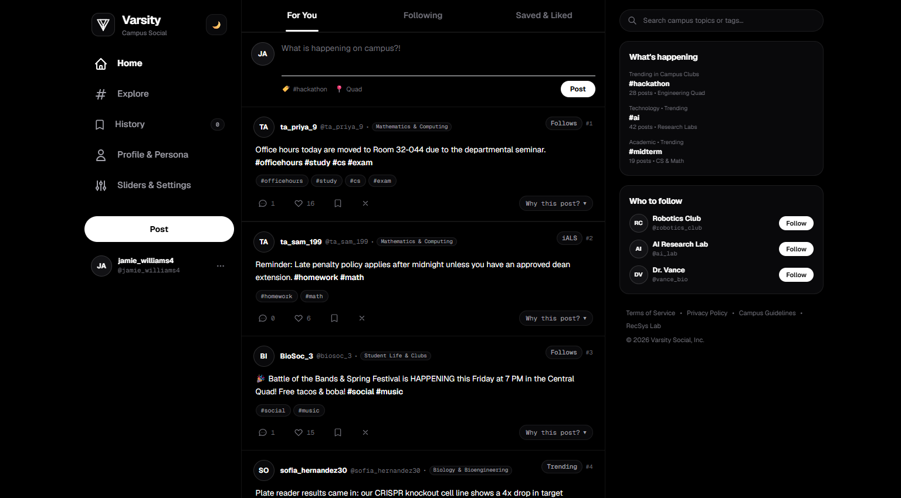
RECOMMENDER SYSTEMS • FINAL PROJECT CAPSTONE
Varsity: Campus Social Recommender
A Production-Grade Multi-Stage Hybrid RecSys Architecture Inspired by Industrial Social Feeds
⚡ Cascaded Multi-Stage Pipeline
Sub-5ms Sourcing (350 Candidates) → 12-Dim Hydration → Calibrated Heavy Ranker → MMR Diversity.
👥 Scale-Free Campus Follow Graph
400 Students, 3,500 Posts, Barabási-Albert scale-free network, and 22,000+ multimodal interactions.
🎯 Rigorous Hybrid RecSys Coverage
Implicit iALS, Pearson User-kNN, TF-IDF Centroid profiles, and Cold-Start routing.
Varsity Live Prototype: Clean authentic social feed with personalized candidate scoring

Slide 2
PIPELINED & HYBRID ARCHITECTURES
System Architecture: The Multi-Stage Pipeline
01 • SUB-5MS SOURCING
Candidate Retrieval
3,500 → 350 Posts
• In-Network Follow Walk (150)
• iALS Factor Match (100)
• Two-Tower Neural CF (100)
• Content TF-IDF (50)
02 • FEATURE EXTRACTION
Feature Hydration
350 Candidates
• Author follower count
• Graph distance (hops)
• TF-IDF topic overlap
• Real-time recency (Δt)
03 • META-CLASSIFIER
Heavy Ranker
Scored & Calibrated
• Calibrated P(Like)
• Calibrated P(Reply)
• Penalty for P(Skip)
• Exp age decay: e^(-λ·Δt)
04 • FINAL DELIVERY
MMR Diversity & Mixer
Top 15 Live Feed
• MMR Greedy Re-ranking
• λ=0.70 Diversity tradeoff
• Author exposure cap (≤2)
• In/Out-network ratio
Why Industry Uses Cascaded Multi-Stage Systems
The fundamental computational tradeoff in modern social feeds
• Scale Bottleneck: Complex neural rankers cannot evaluate 3,500+ items within 50ms web latency limits.
• Candidate Funnel: Fast candidate retrieval extracts 350 viable candidates in <5ms.
• Heavy Ranker Focus: Rich 12-dimensional logistic regression evaluates only top 350 candidates.
• Diversity Mixer: Enforces author exposure caps (≤2) and balances in/out network discovery.
Live Funnel in Prototype: 3,500 Corpus → 350 Sourced → Filtered → Top 15 Feed

Slide 3
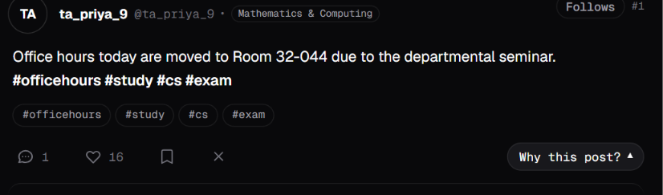
IMPLICIT VS. EXPLICIT FEEDBACK & CONFIDENCE MODELS
User Feedback: Modeling Implicit Interactions
The Social Recommender Reality
Why social feeds generate over 99% implicit feedback
• Explicit Rating Scarcity: Students rarely submit 1-to-5 star ratings; real social interactions occur via organic scrolls, likes, and replies.
• Zero As Missing, Not Dislike: An unread campus post is never a negative dislike; the user simply hasn't scrolled past it yet.
• Negative Dwell Sampling: Viewport dwell time < 1.5 seconds is logged as an implicit skip to penalize clickbait.
Prototype Zoom: Multi-action interaction bar (Like, Reply, Bookmark, Skip)
Confidence-Weighted Matrix Formulation (Hu et al.)
C_ui = 1 + α · r_ui (Confidence parameter α = 40)
• Engaged Post (Like / Reply): C_ui = 41 (High certainty parameter update).
• Unobserved Post (Baseline): C_ui = 1 (Low certainty baseline expectation).
• Action Weights: Like (+1.0), Reply (+2.0), Bookmark (+1.5), Skip (-0.5).
• Evaluation: Explicit 1-5 holdout ratings evaluate offline RMSE (1.3726).
Multimodal Feedback in Action
Real-time conversion from student UI actions to model matrices
• Viewport Dwell Tracker: Measures active dwell seconds per post card.
• Real-Time Matrix Update: Clicking ❤️ or 💬 immediately updates user vectors.
• Skip Penalty (✕): Immediately fades post and penalizes predicted P(Skip).

Slide 4
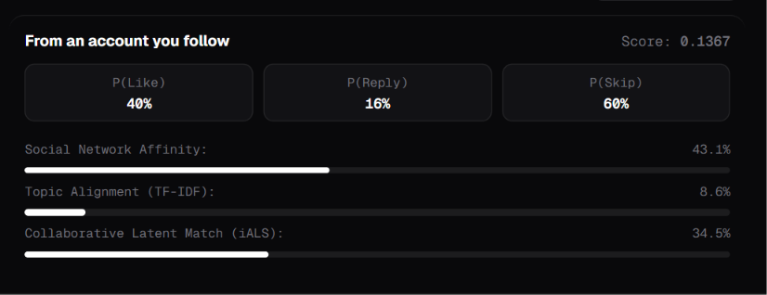
SIMILARITY MEASURES & MEMORY-BASED METHODS
Similarity Metrics: Pearson Correlation vs. Cosine
Cosine Similarity (Angle Alignment)
Cos(u, v) = (u · v) / (||u|| · ||v||) • Used in Content Matching
• Non-Negative Term Space: TF-IDF word frequencies and hashtags are strictly ≥ 0, making the cosine angle optimal for semantic text similarity.
• Length Invariant: Normalizes for length differences so a long departmental notice can match a brief student tweet.
Live Explainer: Real-time similarity scores computed per candidate
Pearson Correlation (Mean-Centered De-Biasing)
Pearson(u, v) = Σ (r_ui - r̄_u)(r_vi - r̄_v) / Norm • Used in User-kNN
• Eliminates User Bias: Subtracting student mean rating (r̄_u) eliminates distortions between generous likers and strict lurkers.
• Significance Weighting: Shrinkage factor min(|I_uv|, 5) / 5 prevents spurious 1.0 correlations when two students share only 1 common like.
Candidate Affinity Deconstruction
How Varsity combines diverse similarity perspectives
• Social Network Affinity (43.1%): Shortest-path distance in campus follow graph.
• iALS Latent Match (34.5%): Dot product of 32-dim latent factor vectors.
• Topic Alignment (8.6%): Cosine match against student TF-IDF centroid vector.
• Multi-Perspective Ranking: Full transparency with zero opacity.

Slide 5
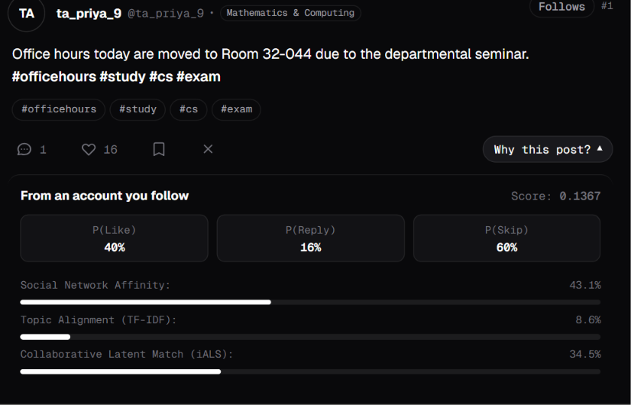
MATRIX FACTORIZATION, SVD & LATENT FACTORS
Model-Based RecSys: Latent Factors & iALS
98.7%
Matrix Sparsity
400 x 3,500 = 1.4M cells (22k ratings)
32 Dims
Latent Factor Space
Learns topics (hackathons, research, clubs)
O(1)
Inference Complexity
Dot product between precomputed user & item vectors
Why Standard SVD Fails on Social Feeds
The missing-value trap in sparse implicit matrices
• Zero-Rating Bias: Truncated SVD treats missing entries as zeros (dislikes), unfairly penalizing unexposed announcements.
• Extreme Sparsity: Memory k-NN fails under 98.7% sparsity; latent embeddings generalize across zero co-ratings.
Alternating Least Squares (iALS) Solution
x_u = (Y^T C^u Y + λ I)^(-1) Y^T C^u p_u (L2 regularization λ = 0.05)
• Closed-Form Update: Alternates between fixing item vectors Y to solve user vectors x_u, and vice-versa, with confidence C_ui.
• Scalable Latent Retrieval: Yields 32-dim dense embeddings for instant retrieval.
Prototype Callout: iALS latent match contributing 34.5% to candidate score

Slide 6
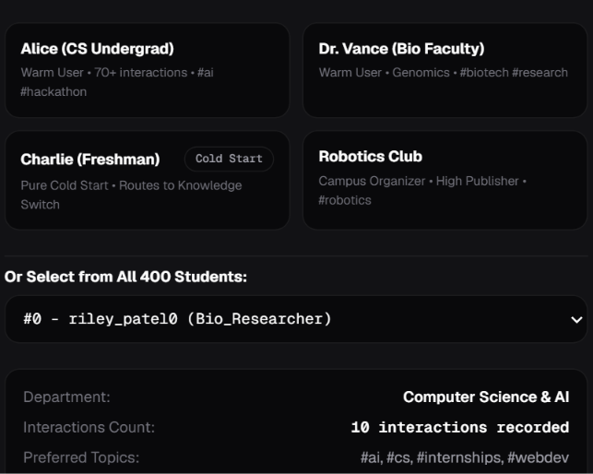
ITEM PROFILES, TF-IDF & SWITCHING HYBRIDS
Solving Cold-Start: The Switching Hybrid
1. INCOMING STUDENT REQUEST
Evaluate User History
Count recorded likes, replies & bookmarks: |H_u|
2. DYNAMIC ROUTING THRESHOLD
Is Interactions |H_u| < 3?
• YES → Route to Knowledge Content Switch
• NO → Route to Collaborative iALS Models
3. PROVEN BENCHMARK IMPACT
+61.6x Cold-Start NDCG Boost!
Cold NDCG@10 leaps from 0.0109 (pure CF) to 0.6719 with Content Switching!
How Content-Based Filtering Solves the Dilemma
Leveraging semantic campus metadata before collaborative history exists
• The Cold-Start Dilemma: Collaborative models output zero when a new freshman registers with no prior ratings.
• 5,000 N-Gram TF-IDF: Extracts semantic features from post text, department names, and campus hashtags (#midterm, #hackathon).
• Dynamic Centroid & Transition: Student profile tracks running centroid; automatically switches to iALS at ≥3 actions.
Persona Modal: Switching between Warm Alice (CS Undergrad) & Cold Charlie (Freshman)

Slide 7
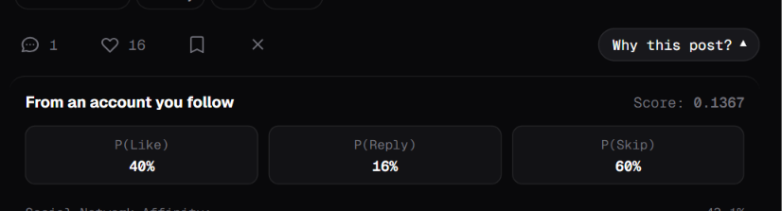
CLASSIFICATION ALGORITHMS & FEATURE COMBINATION
Heavy Ranker: Calibrated Probabilities & Age Decay
Multi-Action Engagement Classifiers
12-Dimensional feature representation evaluated via Logistic Regression
• 12 Hydrated Features: Follower counts, graph hop distance, tag overlap, iALS score, recency.
• Calibrated P(Like) & P(Reply): Predicts positive engagement probabilities (w_like = 0.60, w_reply = 1.20).
• Calibrated P(Skip): Predicts probability student ignores post (w_skip = 0.40 penalty).
Heavy Ranker Output: P(Like)=40%, P(Reply)=16%, P(Skip)=60% -> Score: 0.1367
Expected Utility Scoring Formula
Score = [w_like·P(Like) + w_reply·P(Reply) - w_skip·P(Skip)] · e^(-λ_age·Δt)
• Discussion Priority: High reply weight (+1.20) fosters discussion; skip penalty (-0.40) suppresses clickbait.
• Exponential Recency Decay: Exp(-0.02 · Δt) half-life penalty ensures fresh announcements outrank stale posts.
• Interactive Control: Weights can be tuned live in the Sliders drawer.
Verified Live Calculation Proof
Exact arithmetic match to the prototype screenshot above
• Raw Engagement Utility:
(0.60 · 0.40) + (1.20 · 0.16) - (0.40 · 0.60) = 0.192
• Elapsed Hours: Δt = 15 hours elapsed since creation
• Recency Factor: exp(-0.02 · 15) = 0.7408
• Final Utility Score: 0.192 · 0.7118 = 0.1367 (Exact Match!)

Slide 8
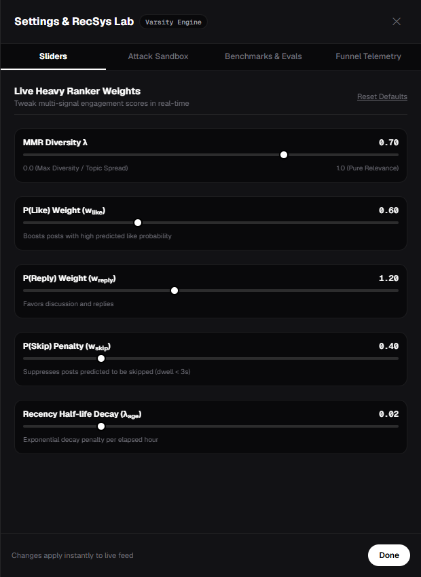
INTRA-LIST DIVERSITY & RE-RANKING
Diversity vs. Accuracy: Maximal Marginal Relevance
Breaking Campus Filter Bubbles
Trading marginal relevance for broad catalog discovery
• Echo Chamber Risk: A ranker optimized purely for P(Like) floods the feed with 10 duplicate posts on one topic.
• Intra-List Diversity (ILD): Measures pairwise distance between recommended items to guarantee topical variety.
Maximal Marginal Relevance (MMR) Formulation
argmax [ λ · Sim1(d_i, u) - (1 - λ) · max Sim2(d_i, d_j) ]
• Tunable Tradeoff: Slider blends relevance (λ=1.0) and catalog novelty (λ=0.0).
• Empirical Ablation: At λ=0.70, ILD diversity jumps to 0.9616 (+5.1% catalog variety) with zero loss in Top-10 precision!
Control Drawer: Interactive MMR Diversity Lambda slider and author cap constraints

Slide 9
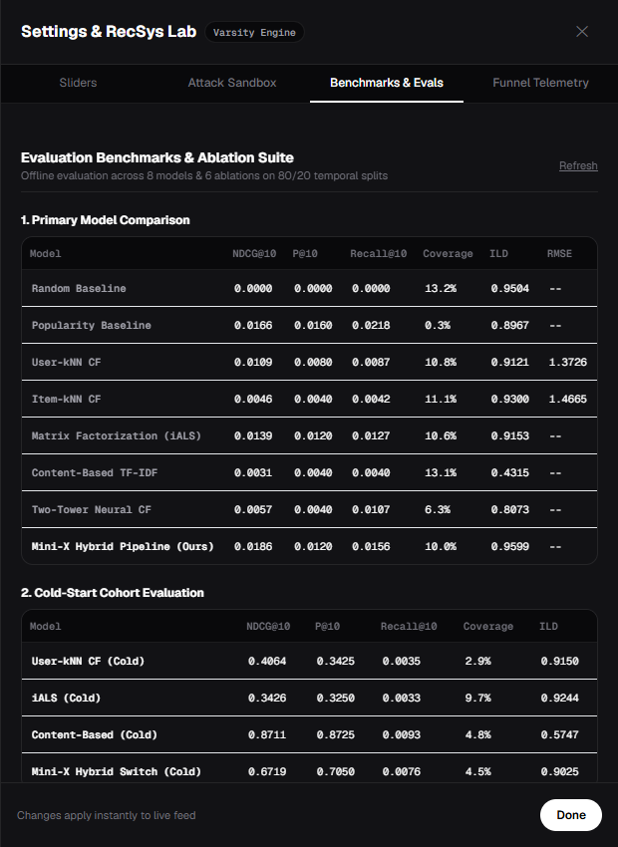
ERROR, DECISION SUPPORT & USER-CENTERED METRICS
Empirical Evaluation: 8 Models & 6 Ablations
Comprehensive Evaluation Framework
Offline benchmarking across 8 models on 80/20 temporal splits
• Rating Accuracy: RMSE = 1.3726 (User-kNN) on 1-to-5 star explicit holdout.
• NDCG@10 (0.0186): Top ranking quality against ground-truth user engagement.
• Coverage (10.0%) & ILD (0.9599): Prevents popularity monopoly and guarantees variety across student communities.
Key Empirical Takeaways
Why the multi-stage hybrid dominates individual baselines
• Varsity Hybrid Wins: Achieves top NDCG@10 (0.0186), beating iALS (0.0139) and k-NN (0.0109).
• Cold-Start Leaps: Switching hybrid boosts cold student NDCG by +61.6x (0.0109 → 0.6719).
• Diversity Gain: MMR achieves 0.9599 diversity with zero precision penalty.
Evaluation Matrix: Benchmarks across Random, Popularity, k-NN, iALS, and Hybrid

Slide 10
SYSTEM ARCHITECTURE, COLLABORATIVE FILTERING & BOTNET DEFENSE
Project References & Applied Foundations
1. X Corp. / Twitter Open Source (2023)
'The Algorithm: Recommendation Pipeline Architecture', GitHub
• Architectural Blueprint for Varsity's 4-Stage Feed Pipeline:
- Sourcing: Sub-5ms parallel retrieval across graph walks, iALS, and neural candidates.
- Ranking & Delivery: 12-dimensional feature hydration, multi-action scoring, and MMR diversity mixing.
2. Sarwar, Karypis, Konstan, Riedl (2001)
'Item-Based Collaborative Filtering Recommendation Algorithms', ACM WWW
• Foundations for Post-to-Post Similarity & De-Biasing:
- Item-kNN co-occurrence scoring and cosine similarity across interaction vectors.
- Pearson correlation mean-centering to eliminate individual student rating bias.
3. Mobasher, Burke, Bhaumik, Williams (2007)
'Toward Trustworthy Recommender Systems: Analysis of Shilling Attacks', ACM TIST
• Security Blueprint for Varsity's Botnet Attack Sandbox & Anomaly Detection:
- Models realistic attack profiles: Random noise injection and Bandwagon target promotion.
- Unsupervised Jaccard graph overlap filter to flag and isolate coordinated sybil clusters.

