Slide 1

Team Name: NidhiAI
Team Leader: Siddhant
Problem Statement:
India mandates Rs.38,000 Crores/year for Corporate Social Responsibility.
But 90% of this capital is captured by the top 50 well-resourced NGOs.
Grassroots organizations serving rural India are locked out because
they lack the legal teams and English fluency to navigate compliance
paperwork and write corporate-grade proposals.

Slide 2

Brief about the Idea:
NidhiAI is an AI-powered platform that gives grassroots NGOs
the same administrative firepower as large organizations.
1. Compliance Automation — NGOs upload their 12A/80G
certificates. Amazon Textract reads the scanned PDFs and a
Bedrock Agent validates legal standing in seconds.
2. Smart Grant Matching — We built a Knowledge Base of real
corporate CSR filings. Titan Embeddings match the NGO
profile to relevant funding opportunities semantically.
3. Instant Proposal Drafting — One click generates a formal
grant application tailored to the fund's criteria. The text
is livestreamed to the screen as the AI writes it.
4. CSR Legal Assistant — An integrated chatbot answers
questions about Section 135, Schedule VII, and FCRA
using a synced Knowledge Base of Indian CSR laws.

Slide 3
Why AI is required:
Government certificates (12A, 80G) are scanned PDFs with no API.
Amazon Textract + a Bedrock Agent is required to extract registration
numbers and expiry dates from these unstructured documents.
A keyword search cannot match "village water project" to a company's
"Schedule VII Rural Infrastructure" mandate. Semantic embeddings
(Titan Text Embeddings V2 + OpenSearch vector search) are needed.
Grassroots NGOs cannot afford Rs.50,000 per grant writer. The
Proposal Agent uses Claude via RAG to generate formal proposals.
How AWS services are used:
• Amazon Bedrock Agents — orchestrates 4 specialized sub-agents
using the Supervisor Pattern (compliance, grants, proposals, impact)
• Amazon Textract — OCR + document analysis on legal PDFs
• Amazon Bedrock Knowledge Bases — 3 KBs backed by OpenSearch
Serverless storing CSR laws, corporate CSR filings, and proposals
• AWS Lambda — 4 serverless functions for each agent action
• Amazon S3 / DynamoDB — document storage and state management

Slide 4
Features of the Prototype:
Core Platform:
• NGO profile management with sector and region tagging
• Drag-and-drop document upload with real-time progress bars
• Live compliance dashboard showing 12A / 80G / CSR-1 status
AI-Powered Agents (Amazon Bedrock Supervisor Pattern):
• Compliance Agent — validates legal documents via Textract
• Grant Scout Agent — semantic matching across 5+ corporate
CSR programs with relevance scores (e.g., 93% match)
• Proposal Agent — generates formal proposals via RAG, with
the text livestreamed to screen as the model writes
• Impact Agent — quarterly report generation with AI-computed
metrics from user-provided impact data
Additional Features:
• CSR Assistant chatbot backed by Indian CSR law Knowledge Base
• Agent Trace panel shows multi-agent orchestration in real-time
• Natural language command bar on the dashboard
• Dark/Light theme toggle • Responsive design

Slide 5
User Flow:
1. NGO leader signs up and creates a profile (name, sector, region)
2. Uploads legal documents (12A cert, 80G cert, CSR-1 form) via
drag-and-drop. Files are stored in S3.
3. The Supervisor Agent orchestrates the Compliance Agent, which
invokes Amazon Textract to read the PDFs. Results are validated
and stored, with compliance status shown on the dashboard.
4. The Grant Scout Agent uses Titan Embeddings to query the
Knowledge Base and returns the top matching CSR opportunities
ranked by relevance (e.g., Tata Steel 93%, Infosys 88%).
5. NGO clicks "Draft Proposal" on any matched grant. The Proposal
Agent generates a tailored grant application using RAG. The
output is livestreamed to the screen as the model writes.
6. For regulatory questions, the Supervisor queries the CSR laws
Knowledge Base directly and responds via the chatbot interface.
7. Impact Agent generates quarterly reports using user-supplied
data (beneficiaries served, funds utilized, programs completed).

Slide 6
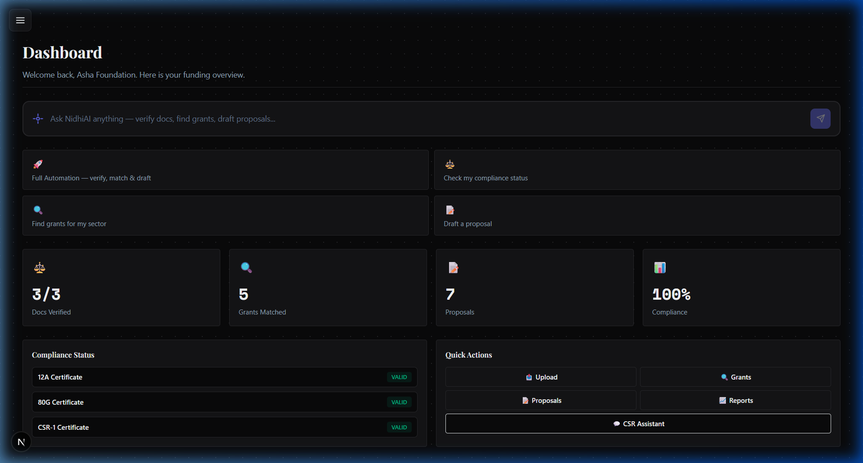
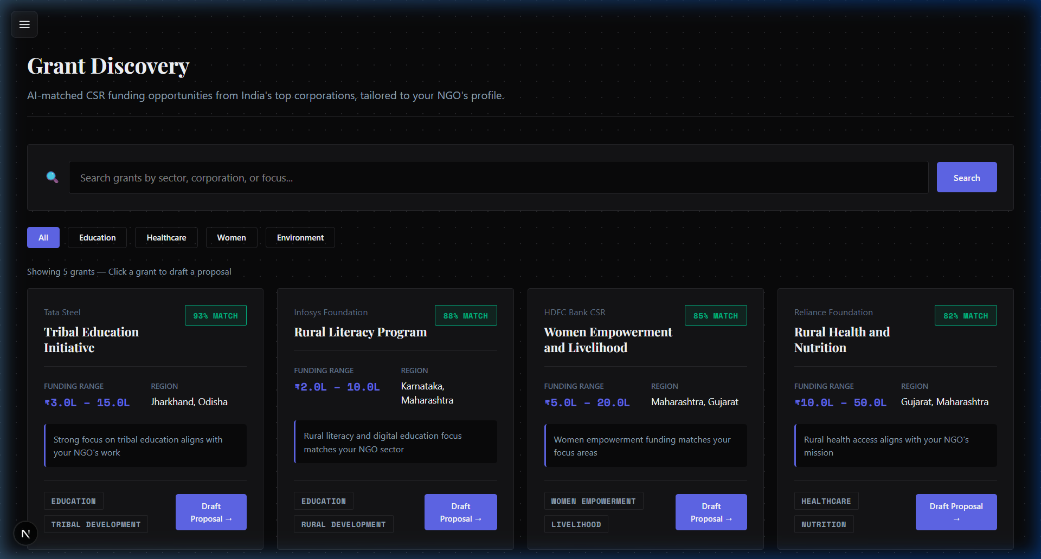
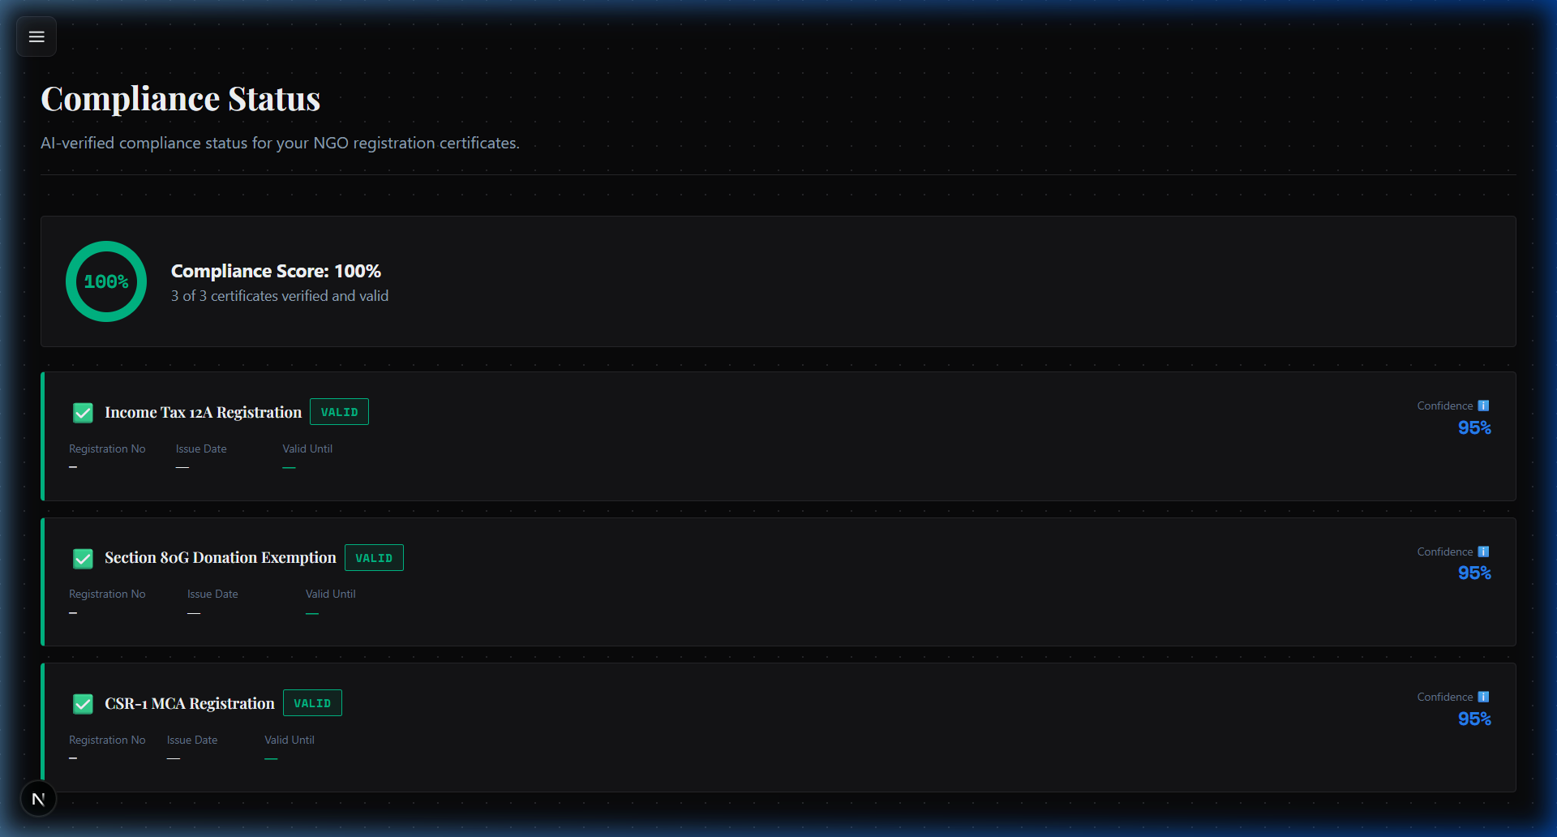
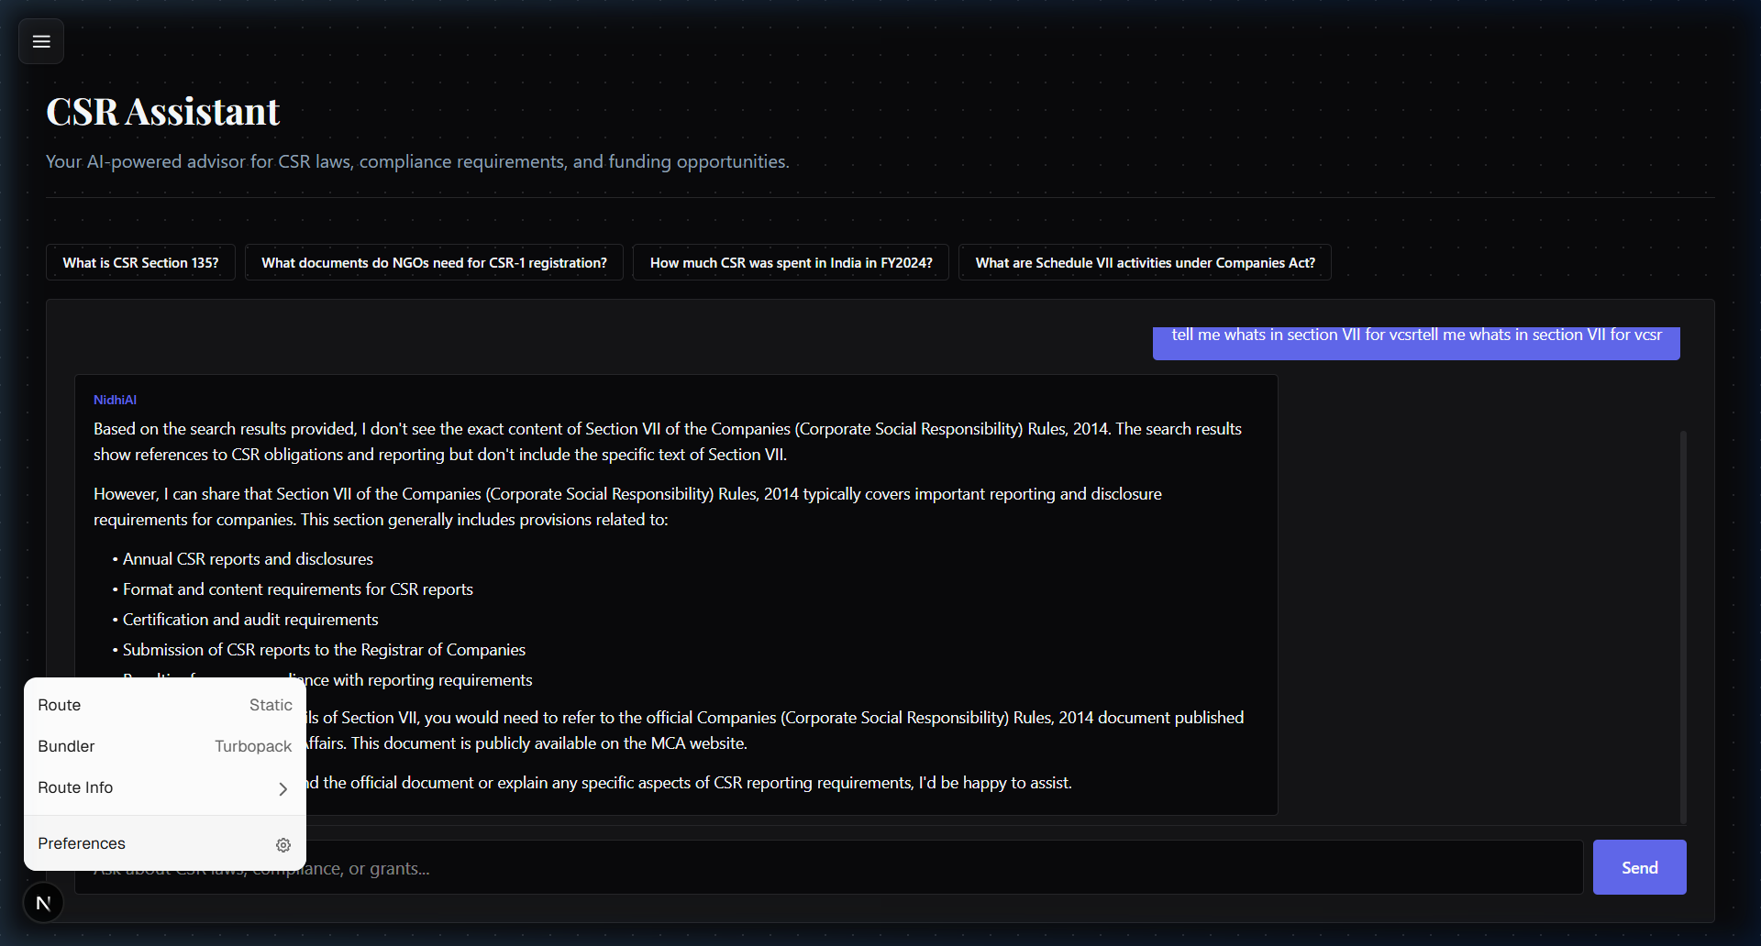
Screenshots from the working prototype:

Slide 7
Architecture:
[Next.js Frontend — Vercel]
|
[AWS API Gateway + Cognito]
|
[Gateway Lambda — route handler]
|
+--------------------+--------------------+
| |
[Amazon Bedrock Agents] [Direct API calls]
Supervisor Agent (S3 upload, DynamoDB)
|
+---------+---------+---------+
| | | |
Compliance Grant Proposal Impact
Agent Scout Agent Agent
| | |
Textract OpenSearch Claude/Nova
Serverless via Bedrock
(3 KBs)
Storage: Amazon S3 (5 buckets) + DynamoDB (4 tables)
All compute is serverless — zero always-on servers.

Slide 8
Technologies utilized:
AWS AI/ML:
• Amazon Bedrock Agents (Supervisor Pattern — 1 supervisor + 4 sub-agents)
• Amazon Bedrock Knowledge Bases (3 KBs backed by OpenSearch Serverless)
• Amazon Titan Text Embeddings V2 — vector embeddings for semantic search
• Foundation Models: Claude 3.5 Sonnet / Amazon Nova 2 Lite
• Amazon Textract — OCR and structured data extraction from PDFs
AWS Infrastructure:
• AWS Lambda — 4 functions (Python 3.12)
nidhiai-scan-documents, nidhiai-match-grants,
nidhiai-generate-pdf, nidhiai-generate-report
• Amazon API Gateway (REST API)
• Amazon DynamoDB — 4 tables (profiles, documents, compliance, proposals)
• Amazon S3 — 5 buckets (documents, generated PDFs, 3 KB data sources)
• Amazon Cognito — user authentication
Frontend:
• Next.js 16 (React 19, Server Components) + TailwindCSS
• Deployed on Vercel

Slide 9
Estimated implementation cost:
Prototype (current spend):
• Lambda / API Gateway / DynamoDB — AWS Free Tier
• Bedrock model inference — ~Rs.800/month at demo volume
• S3 storage — < Rs.50/month across all buckets
• Total prototype spend to date: < Rs.8,000
Unit Economics comparison:
• Cost per proposal — Traditional: Rs.50,000+ → NidhiAI: < Rs.10
• Time per proposal — Traditional: 2-4 weeks → NidhiAI: < 10 minutes
• Compliance check — Traditional: CA fees Rs.5,000+ → NidhiAI: automated
• Grant discovery — Traditional: manual search → NidhiAI: AI-matched
Production estimate (100 NGOs/month):
• AWS infra cost: ~Rs.17,000/month (~$204)
• Revenue at Rs.999/NGO/month: Rs.99,900/month
• Gross margin: ~83%
• Break-even: 18 paying NGOs
Serverless model means zero cost when idle.

Slide 10
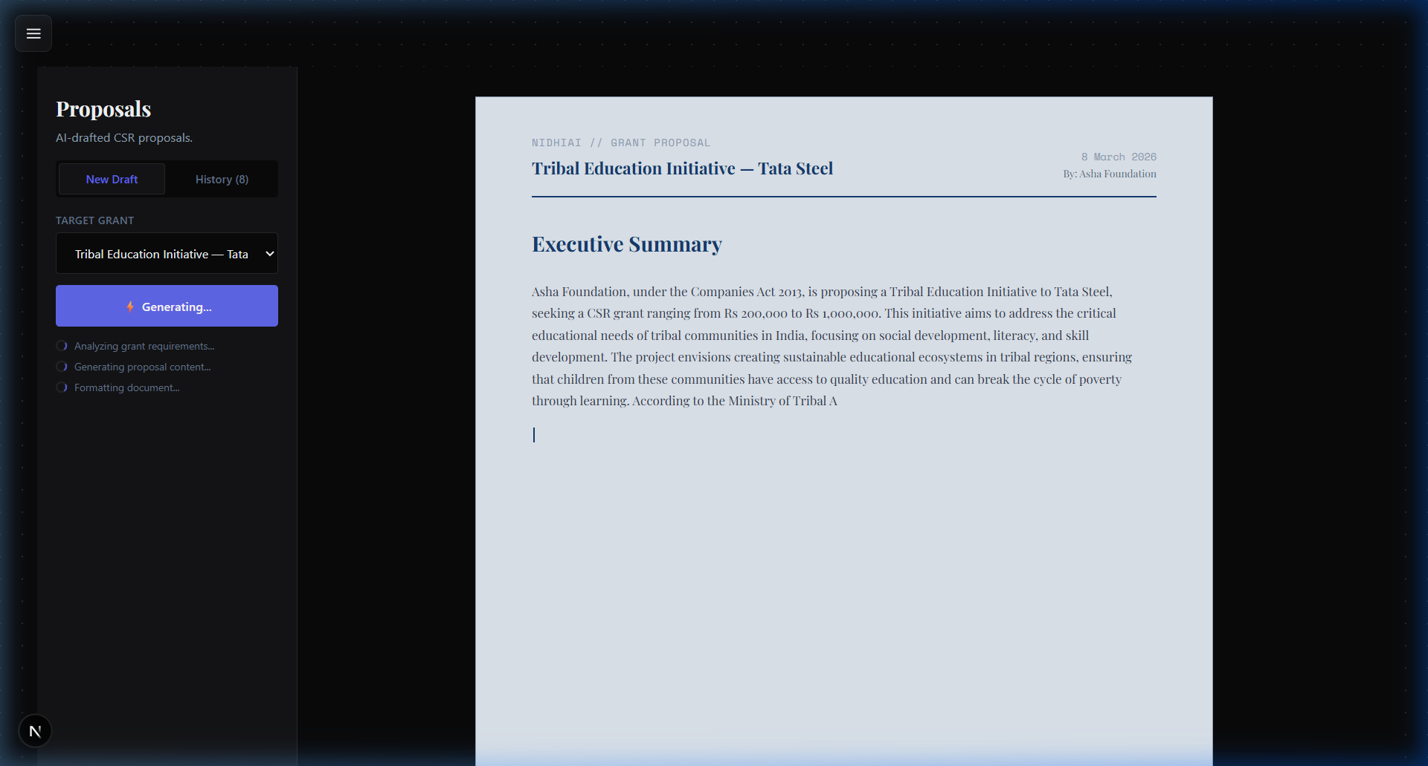
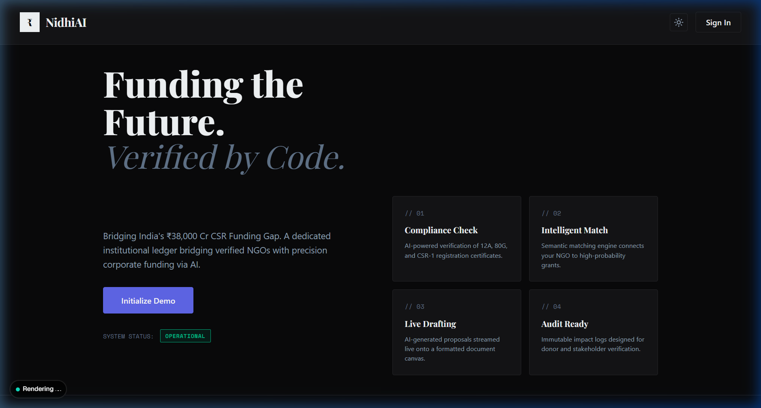
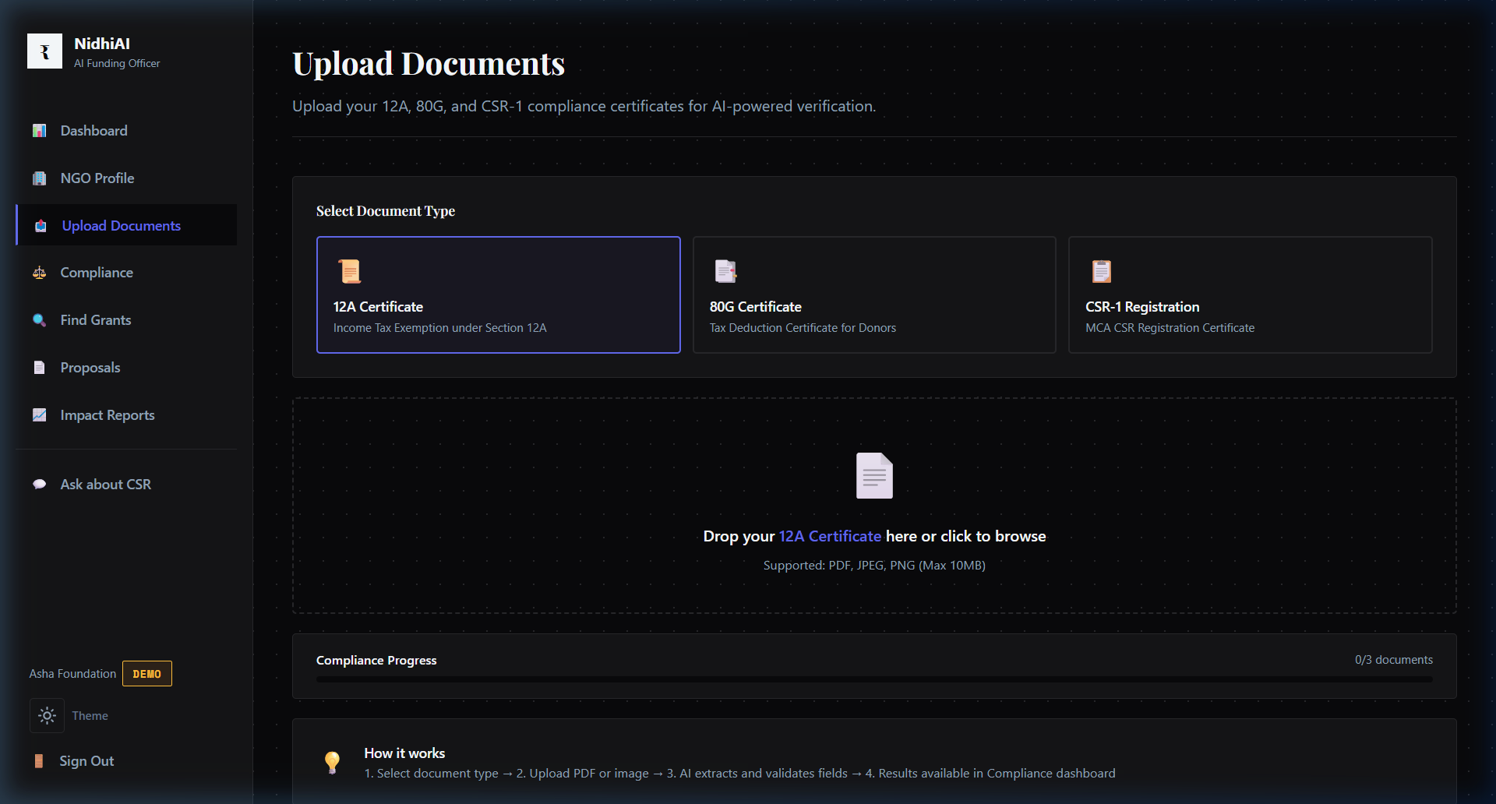
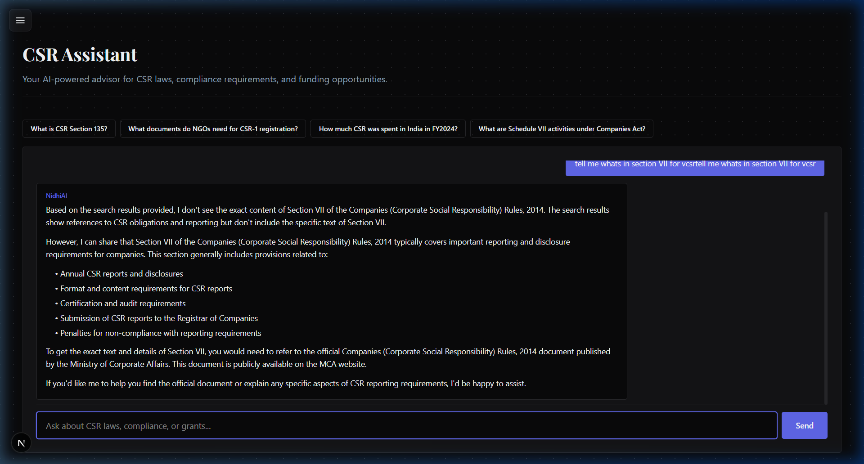
More prototype screenshots:

Slide 11
Prototype Performance:
Response Latency (measured on live AWS infrastructure, ap-south-1):
• Document upload to S3: ~1.2 seconds
• Compliance scan (Textract + Bedrock Agent): 4-6 seconds per document
• Grant matching (semantic search): 1.8 seconds
• Proposal generation (RAG + streaming): 15-20 seconds
— output is livestreamed to the user as the model writes,
so perceived wait time is much shorter
• CSR chatbot response: 2-4 seconds
Scalability:
• 100% serverless — automatically scales with demand
• No always-on servers, no capacity planning needed
• All AI models are managed by AWS (no self-hosted infra)
Reliability:
• Built entirely on AWS managed services
• Knowledge Bases synced with 18 documents, 0 ingestion failures
• All API responses include structured error handling

Slide 12
Future Development:
Near-term (3-6 months):
• Multilingual voice input via Amazon Transcribe — NGO founders
describe their work in Hindi, AI converts to English proposals
• Expand Grant KB from 5 corporations to 50+
• Automated compliance reminders (12A/80G renewal alerts)
• Mobile-first PWA for low-bandwidth rural areas
Medium-term (6-12 months):
• Direct submission to corporate CSR portals via API integrations
• Government scheme matching (PM-KISAN, MGNREGA tie-ins)
• WhatsApp bot for zero-tech-literacy users
Long-term vision:
• NidhiAI becomes the default administrative platform for NGOs
in India — handling compliance, funding, reporting, and filings
• If 10% of the Rs.38,000 Cr CSR pool reaches smaller NGOs
through NidhiAI, that is Rs.3,800 Crores unlocked for
communities that need it most

Slide 13
Prototype Assets:
GitHub Public Repository Link:
https://github.com/Sid-V5/NidhiAi
Demo Video Link (Max: 3 Minutes):
[Insert YouTube / Google Drive link here]

Slide 14


