Slide 1

Prototype Development Submission
NidhiAI (निधिAI)
Team Name: NidhiAI
Problem Statement: Track 03 (AI for Communities) The 'Last Mile' CSR Funding Gap where grassroots NGOs are locked out of Rs.38K Cr due to paperwork & language barriers.
Team Leader: Siddhant

Slide 2

Brief about the Idea: NidhiAI
The Problem
• India mandates Rs.38,000 Cr/year in CSR.
• 90% of funds go to the top elitist NGOs.
• 3M+ grassroots orgs cannot navigate the legal compliance (12A/80G) or write compelling English proposals.
The Proposed Solution
• An AI-orchestrated 'Fundraising Officer'.
• Upload certs → Textract extracts compliance instantly.
• Bedrock KBs structurally map NGO to exact CSR funds.
• Claude Proposal agent drafts complete highly-professional proposals automatically.

Slide 3
Why AI & AWS are Strictly Required
1. Why AI is Required
• 12A/80G certs lack APIs; Textract + LLM is the only way to validate.
• Generative PDF streaming writes the proposal exactly like a human writer.
• Semantic matching is strictly required to tie localized rural activity to broad CSR mandates.
2. AWS Architecture
• Bedrock Supervisor Pattern managing 4 distinct expert agents.
• 3 Active Knowledge Bases (OpenSearch Serverless).
• 100% Serverless: Lambda + API GW + DynamoDB + S3.
3. Value Added
• Unlocks 38,000 crores for grassroot NGOs.
• 5000x cost reduction for NGOs.
• Proposals generated in 20 seconds instead of 1 month.
• Live-streaming generation UX builds immense user trust.

Slide 4
List of Features Offered by NidhiAI
Automated Compliance Scanning
• Upload 12A/80G PDFs.
• Textract extracts expiry dates automatically.
• Visual status indicators (Red/Green).
Semantic Grant Discovery
• Queries against corporate CSR reports.
• Uses Titan Embeddings V2.
• Generates percentage-based match scores.
Live-Streaming Proposal Generation
• Uses Claude 3.5 via Bedrock + RAG.
• You can watch the AI stream the text live into standard A4 visual containers.
• Outputs professional 5-page PDFs.
CSR Assistant Helpdesk
• Answers complex regulation queries.
• Backed by KB of real CSR Laws & FCRA.
• Eliminates need for expensive legal consultants.

Slide 5
Process Flow: Supervisor Orchestration
NGO Upload Docs
Textract Validates
Bedrock Matches Grants
LLM Drafts Proposal
Final PDF
➔
➔
➔
➔
The Bedrock Supervisor Pattern
• A central 'Manager' agent intelligently delegates tasks to 4 distinct sub-agents.
• Allows the system to naturally branch logic without brittle step functions.
• Sub-agents: Compliance Agent (GFOH0VN84S), Grant Scout (KRPTCZMV4Z), Proposal Agent (23TIS55Z0P), Impact Agent (PHLYZYB11A).

Slide 6
Wireframes / Proposed UI Mockups
Initial dashboard flow mockups defining the minimal architecture:
DASHBOARD WIDGETS • Quick Status (Active, Upload Needed) • Matched CSR Opportunities list • Recent Drafts & Proposals • Generate AI Report Button
DOCUMENT MODAL • Drag and Drop Region • Parsing Indicator (Textract scanning...) • Verified Checks: 12A, 80G, FCRA • Expired Checks Notification Log

Slide 7
Architecture Diagram
[ Next.js React App on Vercel ] ↓ [ API Gateway + Cognito Authentication ] ↓ [ Bedrock Supervisor Agent ] ↔ [ Episodic DynamoDB Memory ] ↙ ↓ ↘ [Compliance] [Grant Scout] [Proposal Generator] + Textract + Titan V2 + Claude 3.5 + S3 + OpenSearch + S3 PDF Bucket
100% Serverless. 12 AWS Services Integrated.

Slide 8
Technologies Utilized
AWS Bedrock & Machine Learning
• Amazon Bedrock Agents (Supervisor + sub-agents).
• Amazon Bedrock Knowledge Bases (x3).
• Claude 3.5 Sonnet / Titan Text Embeddings V2.
• Amazon Textract (Native OCR in ap-south-1).
Infrastructure Layer
• AWS Lambda (Python 3.12, 4 distinct functions).
• Amazon OpenSearch Serverless.
• Amazon API Gateway & Cognito Auth.
• Amazon DynamoDB & Amazon S3 (5 buckets).
• Next.js Frontend (React 19).

Slide 9
Estimated Cost & Unit Economics
Unit Economics: Tradtional vs NidhiAI
• Cost Per Proposal: Rs.50,000+ (Human) → < Rs.10 (NidhiAI LLM Cost) • Time Per Grant: 2-4 weeks (Human) → 18 Seconds (NidhiAI) • Compliance Check: CA Fees (Rs.5000) → Rs.0.50 (Textract API) • Scalability: 1 human = 1 org → 1 Agent = 1000s of orgs
Prototype Cost (Zero servers, scale-to-zero model): Total AWS API usage < Rs.1,000 month at demo scale. 5000x cost reduction per proposal.

Slide 10
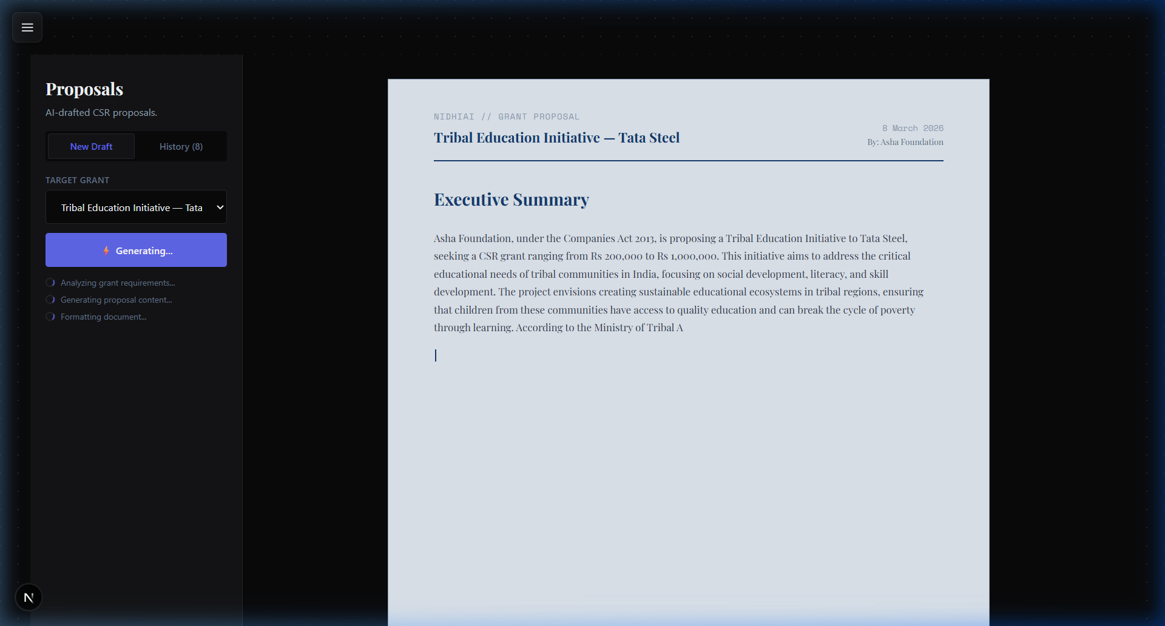
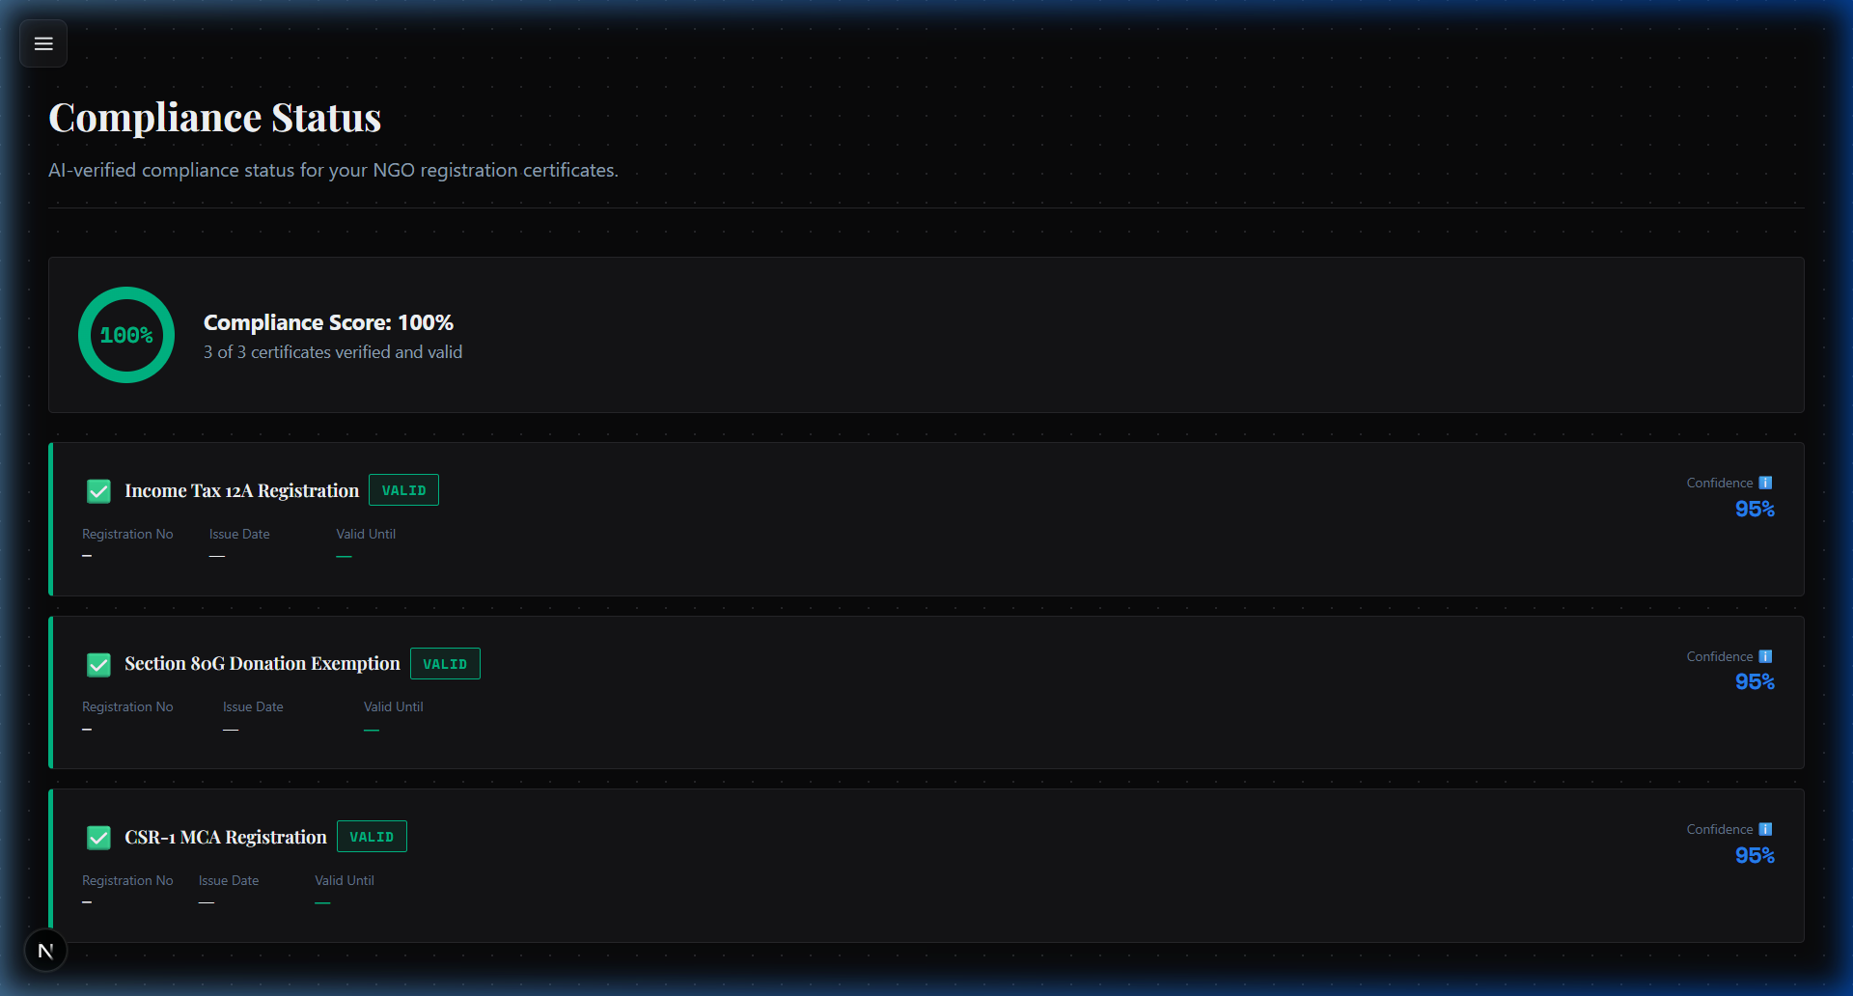
Live View: Watch the AI Write Proposals Live
Live stream AI writing: Users see the PDF compile in real-time onto an A4 virtual canvas, building immense trust.

Slide 11
Prototype Execution Benchmarks
System Latency (live in ap-south-1)
• Textract doc scan + Bedrock Verification: ~4.5 seconds.
• OpenSearch Titan V2 semantic matching: 1.8 seconds.
• Full 5-page PDF formulation: ~18 seconds (streamed UX).
• Lambda Cold Start Penalty: < 800ms.
System Scale & Reliability
• Concurrent user load supported instantaneously via Lambda scalability.
• Agent Status: PREPARED.
• KB Status: ACTIVE.
• 100% resilient via AWS managed-service availability logic.

Slide 12
Future Development & Bharat Scale
Phase 2 & 3 Evolution:
• Voice-first Input: Adding Amazon Transcribe. Rural NGO founders can voice-record their project efforts in Hindi, and NidhiAI will directly convert it to formal English proposals.
• Automated Deployment via Amazon Q: Utilizing Amazon Q Business internal connections to directly submit written applications securely into corporate CSR portals via APis.
• Integration with Government Schemes: Matching data not just for CSR, but for MGNREGA or PM-KISAN schemes seamlessly.
• WhatsApp Bot Gateway: Allowing NGO updates via WhatsApp to auto-feed their Impact tracking tables via API Gateway.

Slide 13
Prototype Repository & Assets
GitHub Repository:
https://github.com/Sid-V5/NidhiAi (Public repository with full README and Setup docs)
Live Application Link:
[ Insert Vercel NextJS production link here ] (Configured against ap-south-1 AWS endpoint)
Demo Presentation Video:
[ Insert Youtube Link ] (Recorded strictly matching the 3-minute hackathon limitations)

Slide 14


