Slide 1
NidhiAI
Prototype Development Submission
AI-Powered CSR Funding Access for Grassroots NGOs
Team Name: NidhiAI
Problem: The 'Last Mile' CSR Funding Gap Track 03 — AI for Communities, Access & Public Impact
Team Leader: Siddhant
Powered by AWS | AI for Bharat Hackathon 2026 | Track 03

Slide 2
Brief About the Idea
THE PROBLEM
THE SOLUTION
Section 135 of the Companies Act (2013) mandates qualifying
companies to spend 2% of avg net profits on CSR activities.
In FY 2024-25, 301 major companies spent Rs.17,742 Cr on CSR
(CSRBOX ICOR 2025 Report). Total CSR pool: ~Rs.38,000 Cr.
But the vast majority of these funds go to established,
well-connected NGOs with dedicated compliance teams.
3.7 million+ NGOs are registered on the DARPAN portal.
Most lack the resources for compliance paperwork (12A, 80G)
and cannot write formal English grant proposals.
NidhiAI automates the full CSR funding lifecycle for NGOs:
1. Upload documents — AI validates legal compliance
2. Discover grants — AI matches NGO to corporate CSR funds
3. Draft proposals — AI writes formal grant applications
4. Ask questions — chatbot answers CSR regulatory queries
Built on Amazon Bedrock Agents using the Supervisor Pattern.
4 specialized AI agents orchestrated as a coordinated team.
What takes 30 days manually now takes 10 minutes.
Rs.17,742 Cr CSR Spend FY24-25
3.7 Million+ Registered NGOs
Schedule VII 7 CSR Categories
Sources: CSRBOX ICOR 2025 Report | DARPAN Portal | Companies Act Section 135
Powered by AWS | AI for Bharat Hackathon 2026 | Track 03

Slide 3
Why AI + How AWS Services Are Used
Why AI is Required
How AWS Services Are Used
What Value AI Adds
Legal certificates (12A, 80G) are scanned PDFs with no standard API. Only OCR + an AI agent can extract registration numbers and dates. Keyword search can't map 'village water project' to 'Schedule VII Rural Infrastructure.' Semantic vector search is required. NGOs can't afford grant writers. An LLM generates formal proposals that match corporate requirements.
Amazon Bedrock Agents: Supervisor Pattern orchestrating 4 specialized sub-agents Amazon Textract: OCR on government certificates Bedrock Knowledge Bases (x3): CSR laws, corporate CSR filings, proposal templates — all on OpenSearch Serverless AWS Lambda (x4): Serverless compute for each action S3 + DynamoDB: Document storage and state
Without AI: Weeks of manual research Rs.50,000+ per grant writer CA fees for compliance With NidhiAI: Grants found in seconds Proposals drafted in 15 seconds Compliance checked instantly The AI layer converts a 30-day, Rs.50,000 process into a 10-min, near-zero-cost automated one.
Powered by AWS | AI for Bharat Hackathon 2026 | Track 03

Slide 4
Features of the Prototype
Compliance Scanner
AI Grant Discovery
Proposal Generator
Upload 12A, 80G, CSR-1 certificates. Textract reads them, Bedrock validates. Instant pass/fail with expiry dates.
Semantic search across corporate CSR filings. Returns ranked matches with relevance scores (e.g., 93%, 88%).
One-click formal proposal drafting. Output is livestreamed to screen as the model writes. PDF export.
Impact Reports
CSR Assistant Chatbot
Agent Trace Panel
Quarterly reports using user-provided data (beneficiaries, funds utilized). AI computes metrics and generates PDF.
Knowledge Base of Indian CSR laws. Answers questions about Section 135, Schedule VII, FCRA, 12A/80G.
See the multi-agent orchestration live — which agent was called, what data was retrieved, what happened.
Powered by AWS | AI for Bharat Hackathon 2026 | Track 03

Slide 5
Process Flow
NGO Leader Uploads Docs
Compliance Agent Scans
Grant Scout Finds Matches
Proposal Agent Drafts PDF
NGO Gets Ready Proposal
All orchestrated by SUPERVISOR AGENT (Bedrock Supervisor Pattern)
Step 1-2
Step 3
Step 4-5
Amazon Textract extracts fields from scanned 12A/80G certificates. Bedrock agent validates compliance.
Titan Embeddings V2 queries OpenSearch Serverless KB. Returns ranked matches by relevance to NGO profile.
Claude generates a formal proposal via RAG. Output is livestreamed to the user. PDF saved to S3 for download.
Powered by AWS | AI for Bharat Hackathon 2026 | Track 03

Slide 6
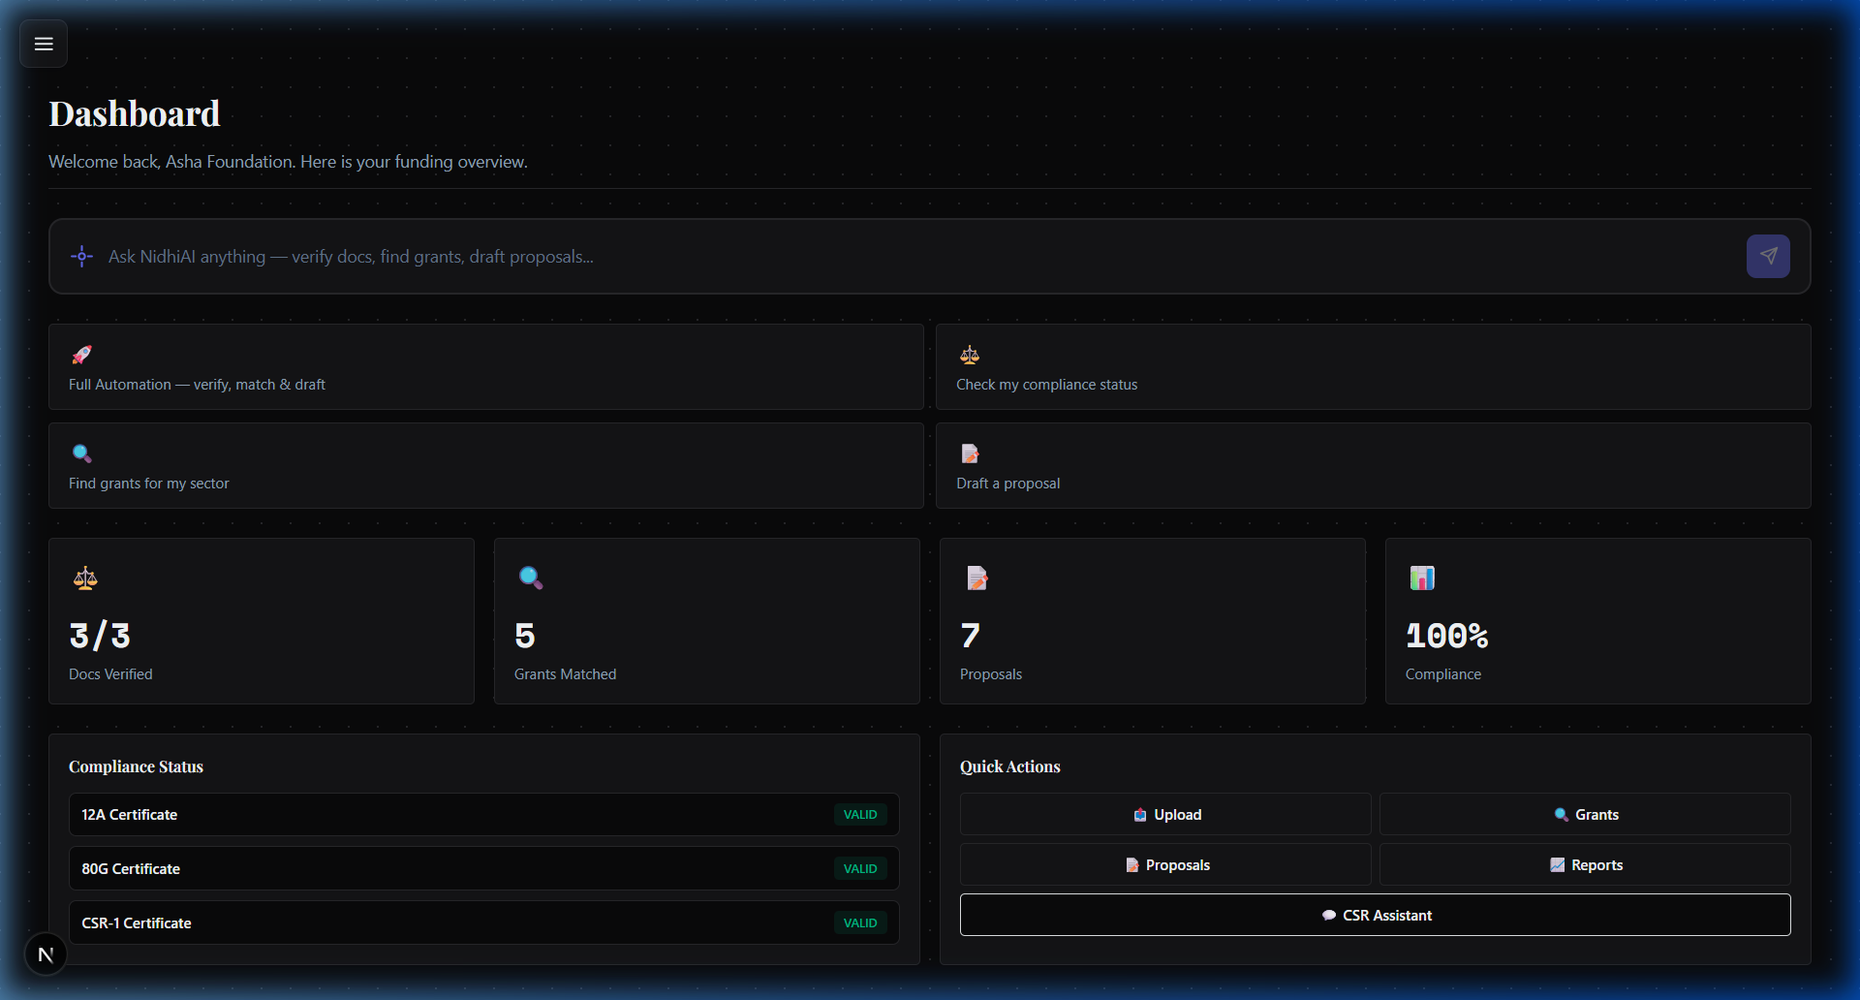
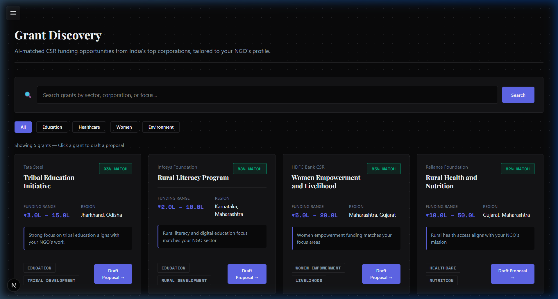
Screenshots of the Working Prototype
Dashboard — compliance status, grants, quick actions
Grant Discovery — AI-matched CSR opportunities
All screenshots from the live running prototype

Slide 7
Architecture Diagram
NGO User (Next.js Dashboard)
API Gateway + Cognito
Amazon Textract
KB: CSR Laws
Amazon Bedrock Supervisor Agent
KB: CSR Opportunities
KB: Proposals
Compliance Agent
Grant Scout Agent
Proposal Agent
Impact Agent
Lambda x4 (Python)
Amazon S3 (5 buckets)
DynamoDB (4 tables)
OpenSearch Serverless
Region: ap-south-1 (Mumbai) | 100% Serverless | 12 AWS Services
Powered by AWS | AI for Bharat Hackathon 2026 | Track 03

Slide 8
Technologies Utilized
AI & ML
Document Intelligence
Amazon Bedrock Agents (Supervisor Pattern)
Amazon Bedrock Knowledge Bases (x3)
Amazon Titan Text Embeddings V2
Foundation Models: Claude 3.5 Sonnet, Amazon Nova Lite
Amazon Textract (OCR + form extraction)
Reads 12A, 80G, CSR-1 govt certificates
Extracts registration numbers and expiry dates
Compute & Storage
Frontend & Auth
AWS Lambda — 4 functions (Python 3.12)
Amazon S3 — 5 buckets
Amazon OpenSearch Serverless (vector DB)
Amazon API Gateway + Amazon DynamoDB
Next.js 16 (React 19) + TailwindCSS
Amazon Cognito (user authentication)
Deployed on Vercel (CDN + Edge)
Powered by AWS | AI for Bharat Hackathon 2026 | Track 03

Slide 9
Estimated Implementation Cost
Unit Economics: NidhiAI vs Traditional
Prototype Spend Breakdown
Metric
Traditional
NidhiAI
Service
Monthly Cost
Cost per proposal
Rs.50,000+
< Rs.10
Lambda / API Gateway / DynamoDB
AWS Free Tier
Time per proposal
2-4 weeks
< 10 minutes
Bedrock model inference
~Rs.800
Grant discovery
Manual search
AI-matched
S3 storage (all buckets)
< Rs.50
Compliance check
CA fees Rs.5,000+
Automated (Textract)
OpenSearch Serverless
Min-capacity provisions
Scaling to 100 NGOs
50 grant writers
Same AI system
Total prototype spend to date
< Rs.8,000
5000x cost reduction per proposal Serverless = zero cost when idle
Production (100 NGOs)
~Rs.17,000/month
Powered by AWS | AI for Bharat Hackathon 2026 | Track 03

Slide 10
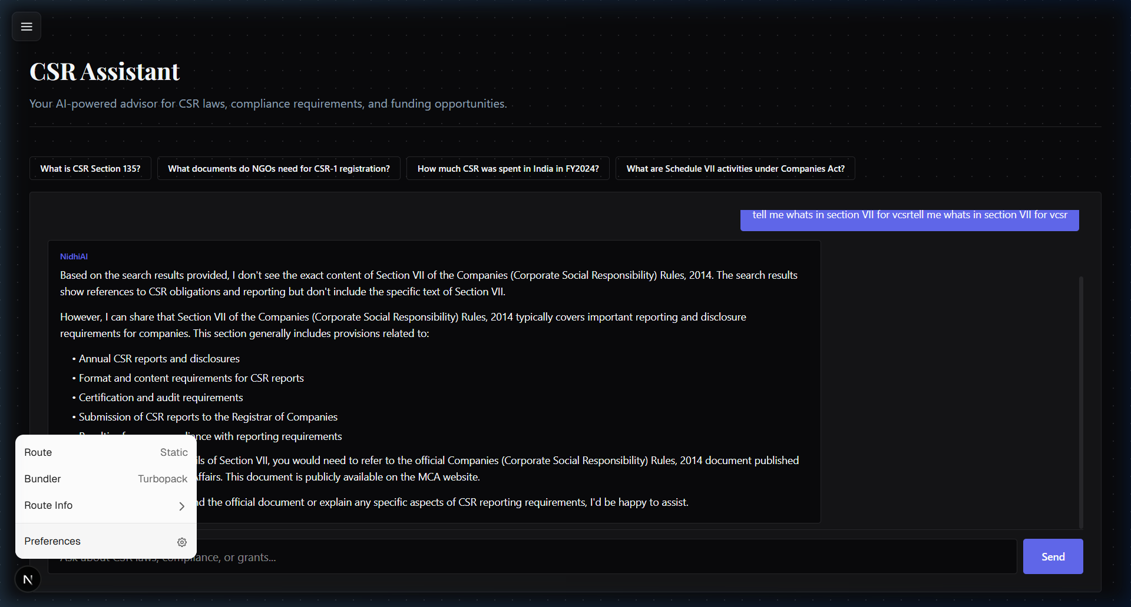
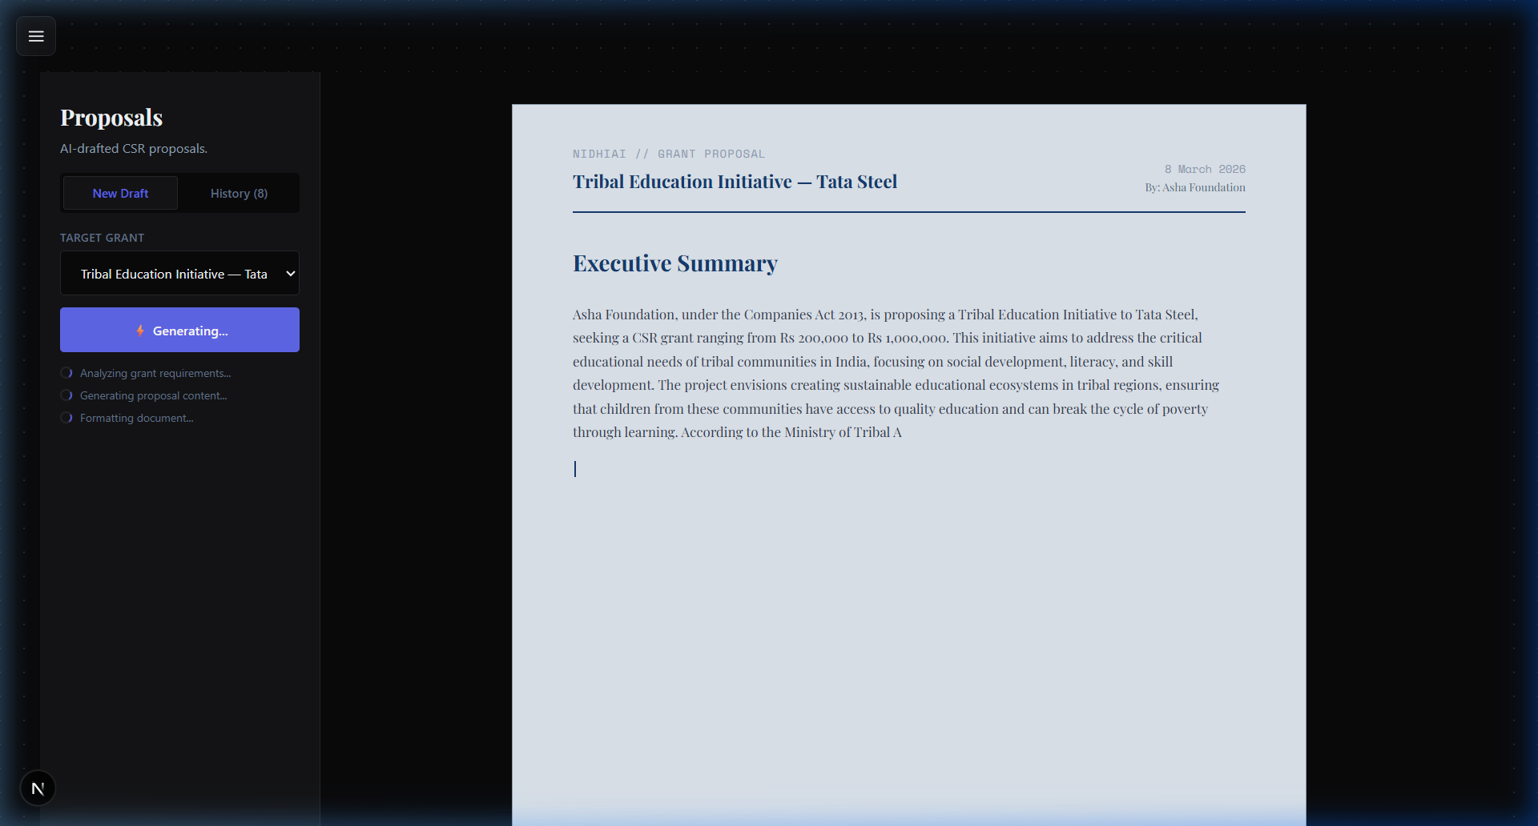
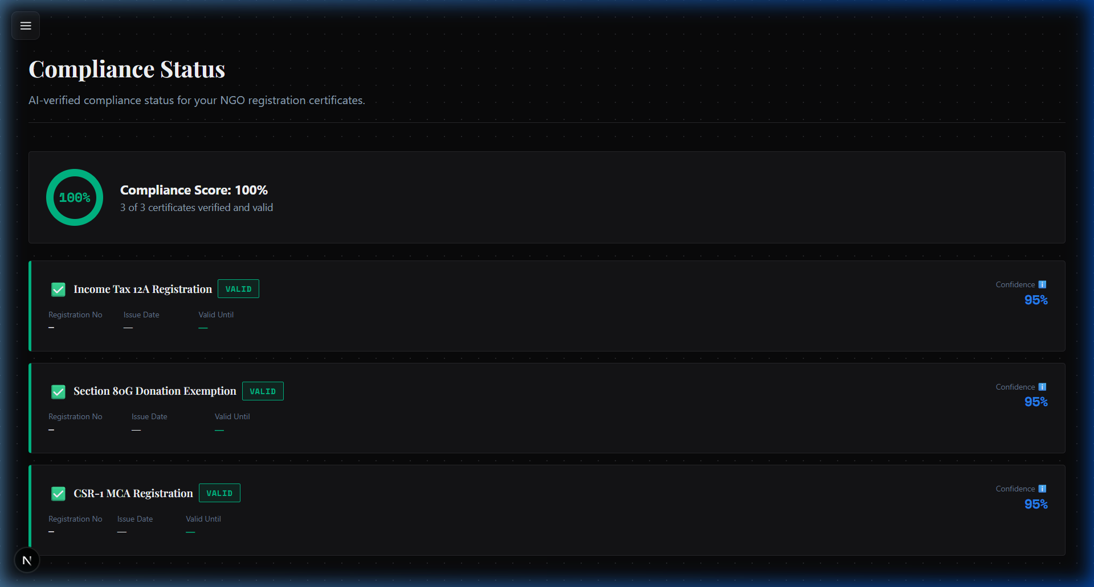
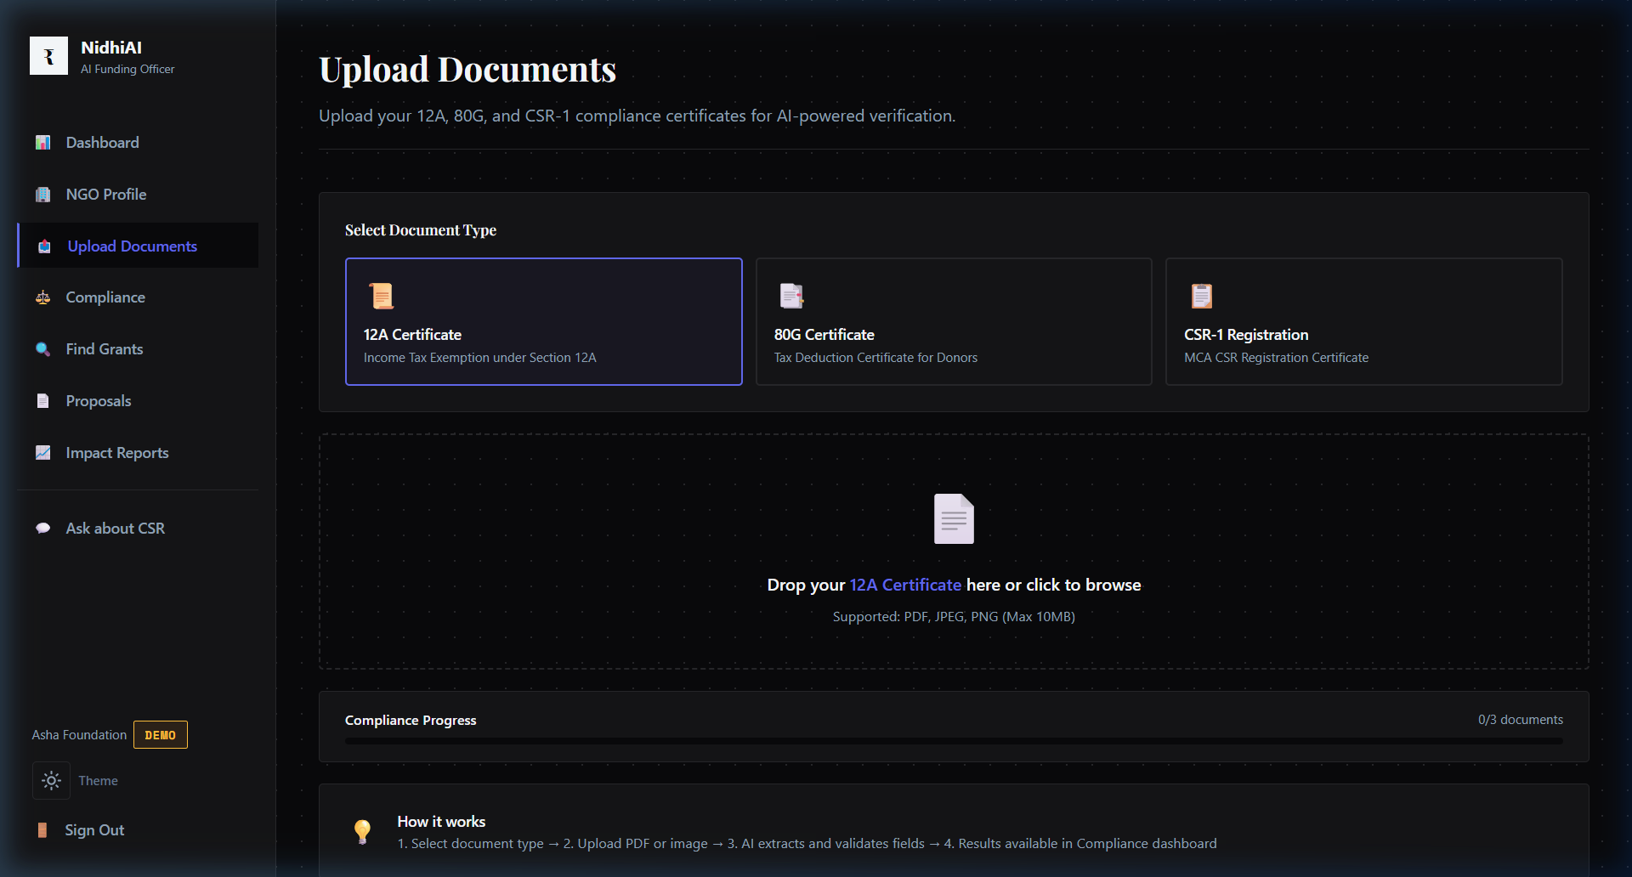
More Prototype Screenshots
CSR Assistant Chatbot — answers regulatory questions
Proposal Generator — livestreamed AI output
Live prototype — all features fully functional

Slide 11
Prototype Performance
Response Latency (ap-south-1)
How Streaming Works
Document upload to S3
~1.2 seconds
Proposal and report generation use server-side
streaming — the output appears on screen as
the model writes, so the user sees results
immediately rather than waiting 15-20 seconds.
The Agent Trace panel shows the Supervisor's
decision-making live: which sub-agent was
called, what Knowledge Base was queried,
and what data was returned.
Compliance scan (Textract + Agent)
4-6 seconds
Grant matching (semantic search)
1.8 seconds
Proposal generation (RAG + streaming)
15-20 seconds
CSR chatbot response
2-4 seconds
100% Serverless Auto-scales with demand
12 AWS Services All managed, no self-hosting
Real-time Streaming Live AI output to browser
Powered by AWS | AI for Bharat Hackathon 2026 | Track 03

Slide 12
Future Development
Near-Term (3-6 months)
Long-Term Vision
Multilingual voice input via Amazon Transcribe
— NGO founders narrate in Hindi, AI converts
to formal English proposals
Expand Grant Knowledge Base from 5 to 50+
corporate CSR programs
Automated 12A/80G renewal reminders
Mobile-first PWA for low-bandwidth rural areas
Direct submission to corporate CSR portals
Government scheme matching (PM-KISAN, MGNREGA)
WhatsApp bot for zero-tech-literacy users
NidhiAI as the default admin platform for
NGOs in India — compliance, funding, reporting
If even 1% of the Rs.17,742 Cr CSR pool reaches underserved NGOs through NidhiAI: Rs.177 Crores redirected to communities that actually need it.
Powered by AWS | AI for Bharat Hackathon 2026 | Track 03

Slide 13
Prototype Assets
GitHub Public Repository
https://github.com/Sid-V5/NidhiAi
Demo Video (Max 3 Minutes)
[Insert YouTube / Drive Link]
Working MVP Link
[Insert Vercel URL]
Powered by AWS | AI for Bharat Hackathon 2026 | Track 03

Slide 14
NidhiAI
Let's Fund the Changemakers of Bharat.
Team NidhiAI | Leader: Siddhant
Track 03: AI for Communities, Access & Public Impact
Amazon Bedrock • Amazon Textract • Amazon OpenSearch
AI for Bharat Hackathon 2026 | Thank You

