Slide 1












Concept Embedding Models
NeurIPS 2022
Mateo Espinosa Zarlenga*
University of Cambridge
me466@cam.ac.uk
Pietro Barbiero*
University of Cambridge
pb737@cam.ac.uk
Gabriele Ciravegna
Université Côte d’Azur
gabriele.ciravegna@inria.fr
Giuseppe Marra
KU Leuven
giuseppe.marra@kuleuven.be
Francesco Giannini
University of Siena
francesco.giannini@unisi.it
Michelangelo Diligenti
University of Siena
michelangelo.diligenti@unisi.it
Zohreh Shams
Babylon Health
University of Cambridge
zs315@cam.ac.uk
Frederic Precioso
Université Côte d’Azur
fprecioso@unice.fr
Stefano Melacci
University of Siena
mela@diism.unisi.it
Adrian Weller
University of Cambridge
Alan Turing Institute
aw665@cam.ac.uk
Pietro Lio
University of Cambridge
pl219@cam.ac.uk
Mateja Jamnik
University of Cambridge
mateja.jamnik@cl.cam.ac.uk
* Equal contribution and corresponding authors

Slide 2

Motivation
Explainable AI
—
open the black box

Slide 3
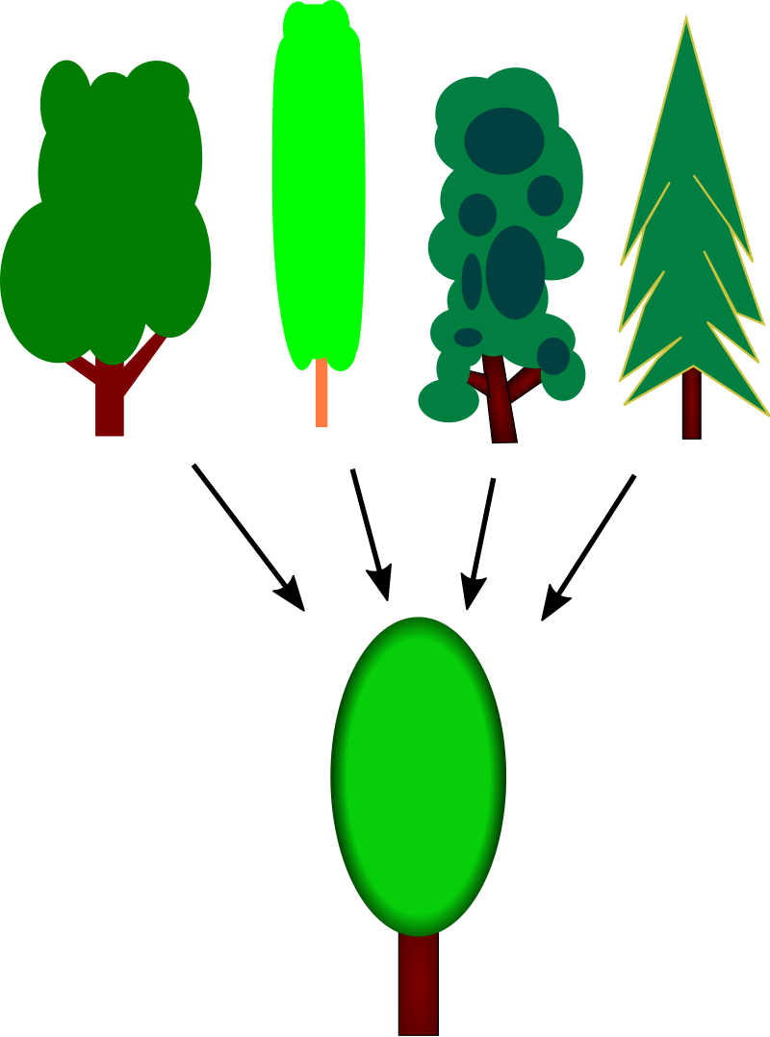
Motivation
Explainable AI
—
open the black box
Concepts Learning
—
Provide intuitive explanations using “high-level” units of information

Slide 4
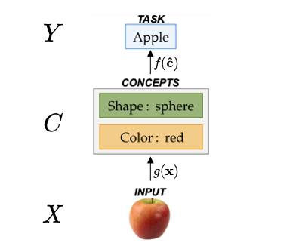
Motivation
Explainable AI
—
open the black box
Concepts Learning
—
Provide intuitive explanations using “high-level” units of information
Concept Bottlenecks
—
Explain predictions using learnt concepts & enable human interventions

Slide 5
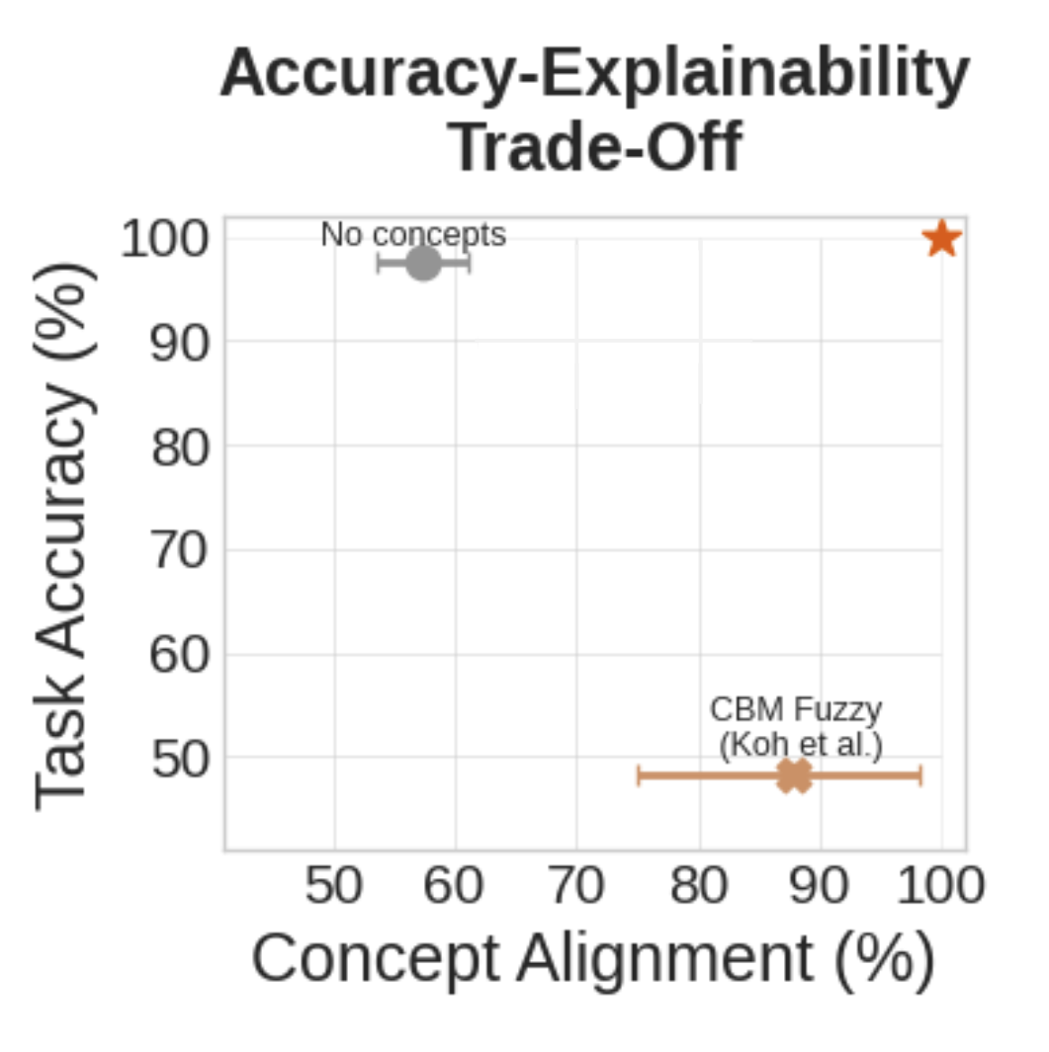
Why concept bottleneck models are not the solution
Poor Trade-offs
—
Struggle to compromise between accuracy and explainability
Notes:
Consider making it into text to avoid spending too much time in this slide (i.e., explaining each plot here)
Simple bullet points
If low-efficiency is not discussed later on, we should not discuss it. Or otherwise, let’s mention it somewhere.

Slide 6
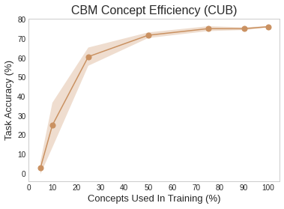
Why concept bottleneck models are not the solution
Poor Trade-offs
—
Struggle to compromise between accuracy and explainability
Low Concept Efficiency
—
CBMs do not scale in real-world conditions
Notes:
Consider making it into text to avoid spending too much time in this slide (i.e., explaining each plot here)
Simple bullet points
If low-efficiency is not discussed later on, we should not discuss it. Or otherwise, let’s mention it somewhere.

Slide 7
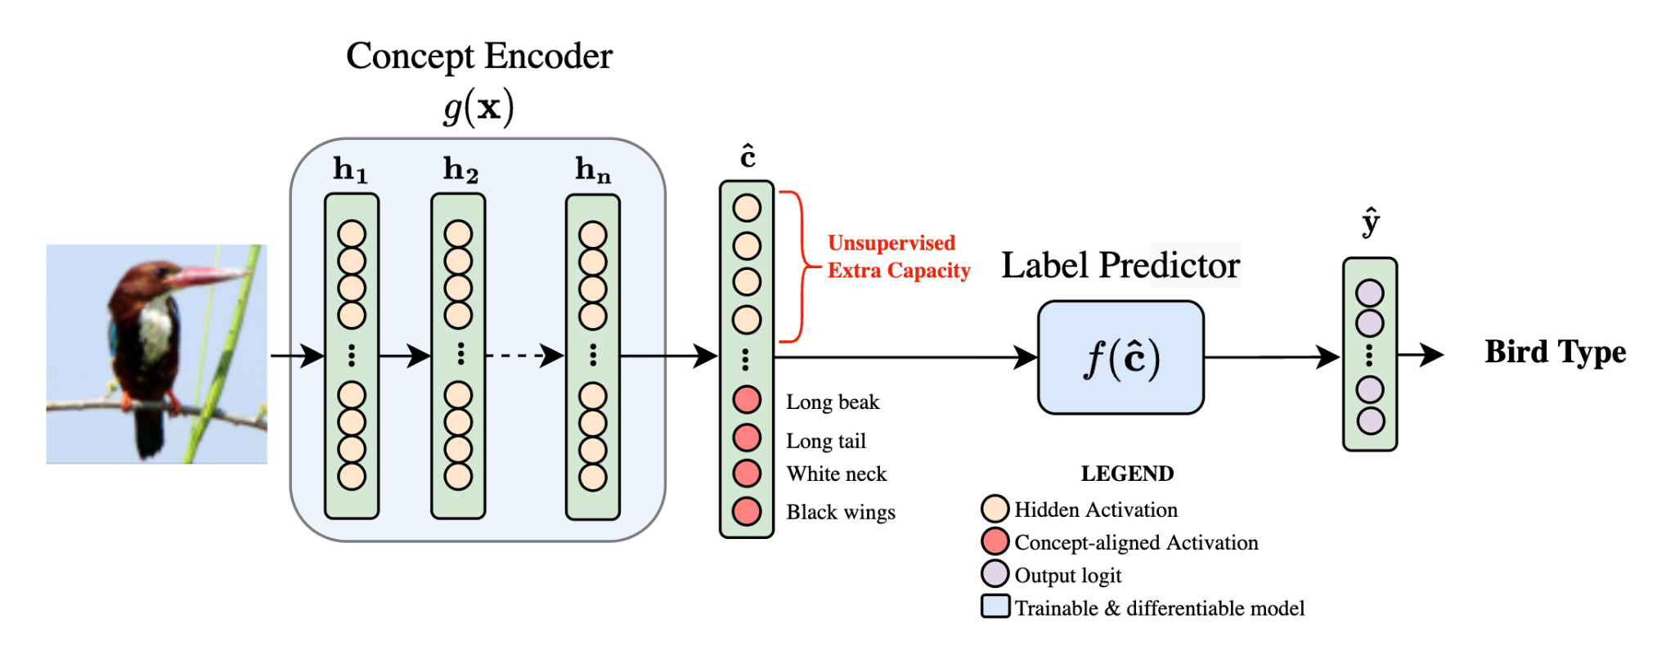
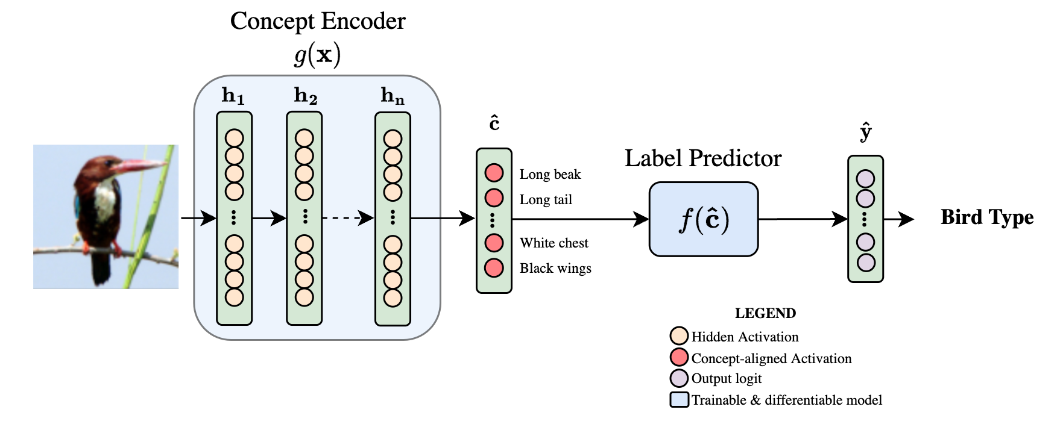
Extra capacity is NOT all you need
Why not simply add more activations to a CBM’s bottleneck?
CBM
Notes:
Concern: we will have to define the CAS here if we want to be able to discuss this
Suggestion: should we use the Cat/Dog architectures instead?

Slide 8
Extra capacity is NOT all you need
Why not simply add more activations to a CBM’s bottleneck?
Hybrid-CBM
Notes:
Concern: we will have to define the CAS here if we want to be able to discuss this
Suggestion: should we use the Cat/Dog architectures instead?

Slide 9
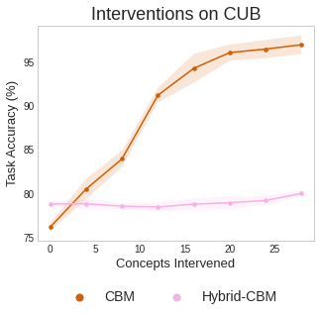
Extra capacity is NOT all you need
Why not simply add more activations to a CBM’s bottleneck?
intervention power is lost!
Hybrid-CBM
Notes:
Concern: we will have to define the CAS here if we want to be able to discuss this
Suggestion: should we use the Cat/Dog architectures instead?

Slide 10
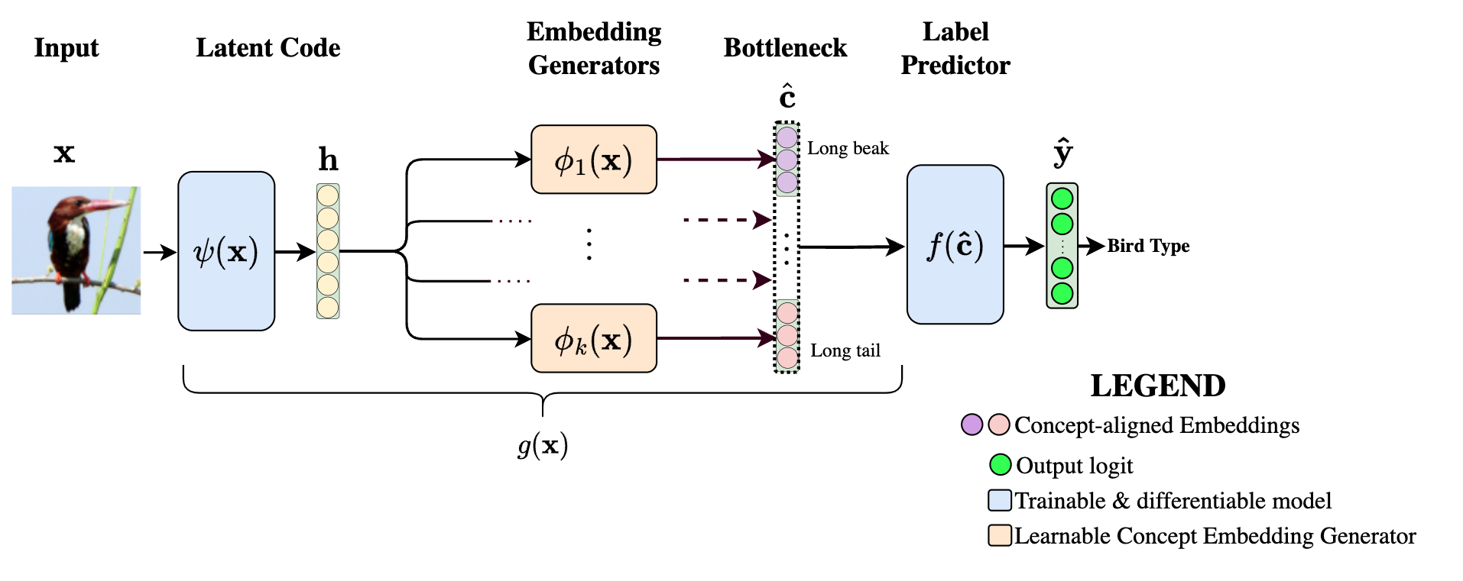
Solution: Concept Embedding Models
Notes:
In order to overcome the limitations of SOTA CBMs, we proposed CEMs. Our approach has 2 key novelties: (i) first we represent each concept with a fully supervised embedding and (ii) second we proposed an efficient algorithm to enable simple human interventions on concept embeddings.

Slide 11
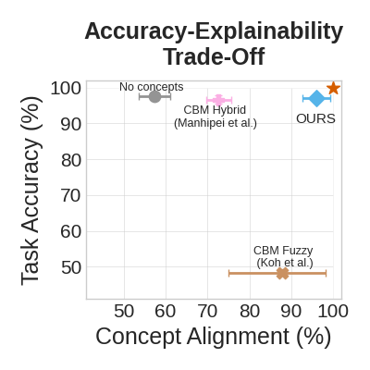
Key findings and significance
Beyond Trade-offs
—
CEMs overcome the current accuracy-explainability trade-off
Notes:
Our experiments demonstrate that (1) first, CEMs overcome the current A-X trade-off being as accurate as end-to-end models and as explainable as standard CBMs, (2) second CEMs scale to real-world conditions where complete concept supervisions are scarce, (3) third, CEMs support effective concept interventions as opposed to hybrid CBMs. In summary, our findings indicate that CEMs represent a significant step forward to address one of the hottest open problems in explainable AI such as the A-X trade-off.

Slide 12
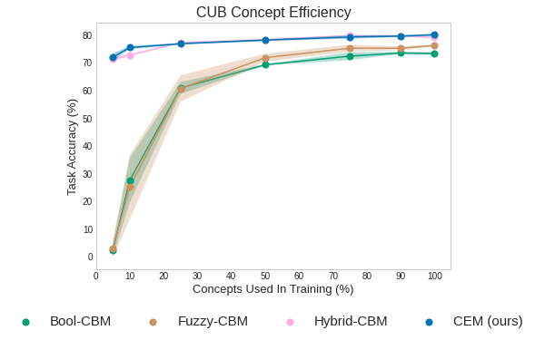
Key findings and significance
Beyond Trade-offs
—
CEMs overcome the current accuracy-explainability trade-off
High Concept Efficiency
—
CEMs scale to real-world conditions where concept supervisions are scarce
Notes:
Our experiments demonstrate that (1) first, CEMs overcome the current A-X trade-off being as accurate as end-to-end models and as explainable as standard CBMs, (2) second CEMs scale to real-world conditions where concept supervisions are scarce as opposed to standard CBMs, (3) third, CEMs support effective concept interventions as opposed to hybrid CBMs. In summary, our findings indicate that CEMs represent a significant step forward to address one of the hottest open problems in explainable AI such as the A-X trade-off.

Slide 13

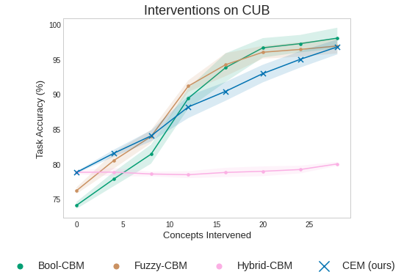
Key findings and significance
Beyond Trade-offs
—
CEMs overcome the current accuracy-explainability trade-off
High Concept Efficiency
—
CEMs scale to real-world conditions where concept supervisions are scarce
Effective interventions
—
CEMs are responsive to concept interventions
Notes:
Our experiments demonstrate that (1) first, CEMs overcome the current A-X trade-off being as accurate as end-to-end models and as explainable as standard CBMs, (2) second CEMs scale to real-world conditions where complete concept supervisions are scarce as opposed to standard CBMs, (3) third, CEMs support effective concept interventions as opposed to hybrid CBMs. In summary, our findings indicate that CEMs represent a significant step forward to address one of the hottest problems in concept-based explainable AI such as the A-X trade-off.

