Slide 1

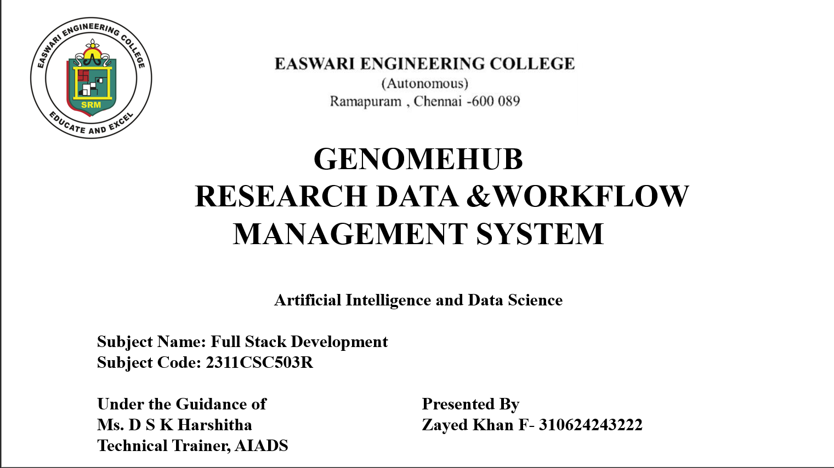
EASWARI ENGINEERING COLLEGE
(Autonomous)
Ramapuram, Chennai - 600 089
IOT DEVICE HEALTH AND SECURITY
MONITORING PLATFORM
Artificial Intelligence and Data Science
Subject Name: Full Stack Development
Subject Code: 2311CSC503R
Under the Guidance of
Ms. D S K Harshitha
Technical Trainer, AIADS
Presented By
Siddharth S - 310624243179
III Year, Section D, Batch 2024-2028

Slide 2
SCOPE OF THIS REVIEW
02
AGENDA
What will be covered in the first review
01
Project Overview
Problem, purpose and target users
02
Requirements
Functional and non-functional goals
03
Architecture
How the platform is organized
04
Use Cases
What operators and admins can do
05
Modules
Dashboard, devices, alerts, prediction, firmware
06
Technology Stack
React, Node, PostgreSQL, Redis and Docker
07
UI / Frontend
Screens and interaction design
08
Data / Backend
REST API, data flow and persistence
09
Status
What is built and working
10
Challenges & Next Steps
Considerations and remaining work
Review 1 | Full Stack Development

Slide 3
REQUIREMENTS
03
REQUIREMENTS
Functional capabilities of the current IoT Sentinel platform, plus quality goals
Functional Requirements
Non-Functional / Quality Goals
• Register devices and keep a central inventory with live status.
• Ingest heartbeats and telemetry from devices through a REST API.
• Detect offline devices through missed-heartbeat monitoring.
• Raise threshold alerts from configurable warning/critical rules.
• Predict anomalies before a limit is breached (predictive alerts).
• Track firmware versions and run controlled update rollouts.
• Log, triage and summarise security incidents.
• Sign in with admin and read-only viewer roles.
• Usability: one live dashboard with a mobile-friendly layout.
• Reliability: heartbeat TTLs and alerts that clear themselves.
• Security: JWT sign-in, hashed passwords and hashed device keys.
• Performance: Redis holds live state; PostgreSQL keeps history.
• Maintainability: typed (TypeScript) modular API and UI.
• Portability: one-command Docker Compose deployment.
• Extensibility: simulator and real devices share one ingest path.
Review 1 | Full Stack Development

Slide 4
ARCHITECTURE
04
SYSTEM ARCHITECTURE
Layered architecture of the IoT Sentinel platform
DEVICES / SIMULATOR
Telemetry • Heartbeat
EXPRESS REST API
Auth • Ingest • Rules
REDIS + POSTGRESQL
Live state • History
REACT UI
Dashboard
Supporting Services & Libraries
Anomaly predictor (TypeScript, logistic regression) • Heartbeat sweeper • Device simulator • JWT + bcrypt • Zod validation • Recharts • TanStack Query • Docker Compose
Note: there is no MQTT broker in this stack; real devices report over the REST API and the simulator uses the same ingest code path.
Review 1 | Full Stack Development

Slide 5
USE CASE
05
USE CASE MODEL
Main interactions supported by the current IoT Sentinel platform
Monitor Fleet
Live health + status
Review Alerts
Acknowledge / resolve
View Predictions
Forecast breaches
OPERATOR
Monitors the fleet
IOT SENTINEL
Alerts and predictions
Manage Firmware
Roll out updates
Triage Incidents
Log + resolve
Configure Rules
Edit thresholds
ADMIN
Manages devices and rules
Typical flow: sign in → open dashboard → inspect a device → review
alerts/predictions → acknowledge, update firmware or log an incident.
Review 1 | Full Stack Development

Slide 6
DATA MODEL
06
DATA MODEL
Main entities stored in PostgreSQL and Redis
Device
name • type • location
firmware • status
Telemetry
temp • cpu • memory
battery • signal
Alert
type • severity • metric
status • timestamps
Incident
category • severity
device • status
Firmware
release • version
update • progress
Rule & User
thresholds • roles
email • password hash
Relationships: a device produces telemetry; rules turn telemetry into alerts; incidents and firmware updates attach to devices; users acknowledge alerts.
Review 1 | Full Stack Development

Slide 7
MODULES
07
MODULE DESCRIPTION
What each module does in the platform
Dashboard
Fleet overview at a glance
Live device counts, active alerts, predicted risks, firmware gaps
and a simulator control panel
Devices
Inventory and activity
Register devices, view live readings and history, export CSV and
rotate one-time device keys
Alerts
Alerts and rules
Threshold, heartbeat and predictive alerts with configurable limits;
acknowledge or resolve
Prediction
Anomaly prediction
Forecasts which devices will breach a limit, with risk,
time-to-breach and a model card
Firmware
Firmware management
Compare installed and latest versions, flag missed security
releases and roll out updates
Security
Incidents and access
Incident triage, JWT sign-in, admin/viewer roles and accounts
Review 1 | Full Stack Development

Slide 8
TECHNOLOGY STACK
08
TECHNOLOGY STACK
Required stack plus supporting libraries; versions from the installed project
React
19.3.0
UI component library
TypeScript
7.0.2
Typed code in frontend + backend
Node.js
22.18.0
Server runtime for API and model
Express.js
5.2.1
REST API framework
PostgreSQL
16
Durable relational storage
Redis
7
Live state, heartbeats, caching
REST API
JSON / HTTP
Device ingest and dashboard data
Docker
29.7.2
Compose runs the full stack
Git / GitHub
2.45.1
Version control and delivery
Vite
8.3.2
Frontend build tooling
Recharts
3.10.1
Charts and forecast visuals
Zod
4.6.5
Request validation
Review 1 | Versions from the installed project dependencies

Slide 9
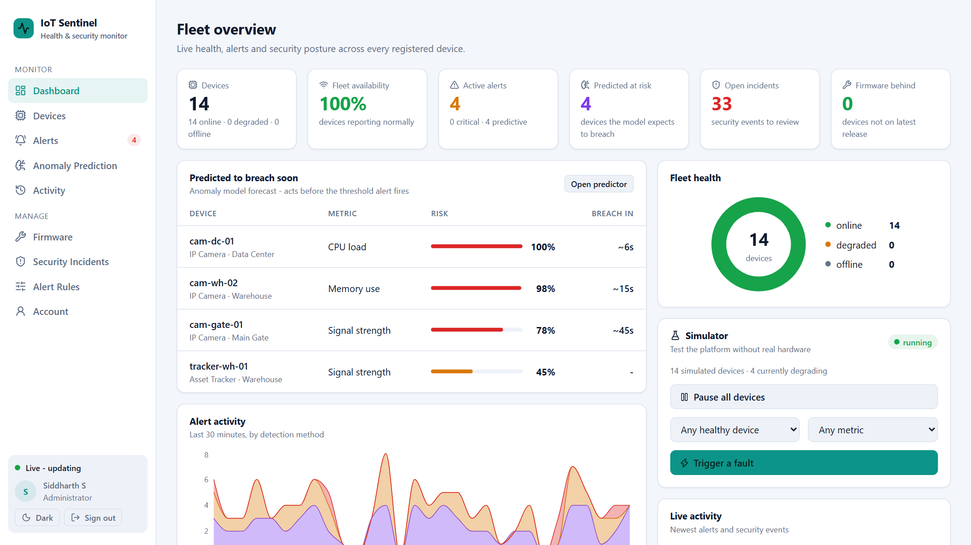
UI DESIGN
09
UI DESIGN / WIREFRAME EQUIVALENT
The running application itself acts as the UI prototype
Key UI Principles
• Persistent sidebar; bottom navigation on phones.
• Live data: values refresh every few seconds and flash on change.
• Summary cards put the key numbers first.
• Status and severity badges are easy to scan.
• Forecast charts show the limit, trend and confidence band.
• Dark and light themes; read-only mode for viewers.
Review 1 | Full Stack Development

Slide 10
FRONTEND
10
FRONTEND DEVELOPMENT
How the interface is organized
GLOBAL SHELL
Sidebar • sign-in • theme • account
PAGE MODULES
Dashboard • Devices • Alerts
Prediction • Activity
DATA VISUALS
Cards • charts • forecasts • timeline
ACTIONS
Register
update • rules
Frontend implementation points
• React 19 with TypeScript; Vite for development and builds.
• React Router for pages, protected by JWT sign-in.
• TanStack Query polls the REST API every few seconds for live data.
• Recharts draws telemetry, forecasts, alert timelines and fleet health.
• Plain CSS design system with dark/light themes and a mobile layout.
Review 1 | Full Stack Development

Slide 11
BACKEND
11
BACKEND / APPLICATION LOGIC
What the application does behind the UI
Responsibilities
Backend stack in use
• Authenticate users and enforce admin/viewer roles.
• Accept device heartbeats and telemetry through REST.
• Validate every request with Zod schemas.
• Evaluate alert rules and run the anomaly predictor.
• Detect missed heartbeats and mark devices offline.
• Manage firmware releases, updates and incidents.
• Serve live data to the dashboard (Redis-cached).
• Node.js 22 with Express.js 5 (TypeScript).
• PostgreSQL 16 through the pg driver.
• Redis 7 through ioredis: heartbeats, windows, cache.
• JWT (jsonwebtoken) and bcryptjs for authentication.
• Built-in simulator for 14 demo devices.
• Anomaly model written in TypeScript (no extra runtime).
Review 1 | Full Stack Development

Slide 12
DATABASE
12
DATABASE / DATA INTEGRATION
How a device reading moves from the API to persistent storage
1. DEVICE READING
POST /api/telemetry
2. VALIDATION
Key check + Zod
3. REDIS
Live state + window
4. POSTGRESQL
History + alerts
What is stored and where
PostgreSQL: devices, telemetry, alerts, rules, firmware releases and updates, incidents, users • Redis: heartbeat TTL keys, latest reading, rolling window for the predictor, dashboard cache, login rate limit
Telemetry older than 7 days is purged automatically; device keys are stored only as SHA-256 hashes.
Review 1 | Full Stack Development

Slide 13
API / DATA FLOW
13
API / DATA FLOW
Main request patterns of the REST API
TYPE
RESOURCE
PURPOSE
POST
/api/auth/login
Sign in and receive a JWT session token
POST
/api/telemetry
Device heartbeat and readings (x-api-key); triggers rules and prediction
GET
/api/devices
Inventory with status, firmware and latest readings
GET
/api/anomaly/predictions
Fleet risk ranking with time-to-breach estimates
PATCH
/api/alerts/:id
Acknowledge or resolve an alert (admin)
POST
/api/firmware/updates
Start a controlled firmware rollout (admin)
Representative endpoints. Everything except sign-in and device ingest needs a signed-in user; changes need an admin.
Review 1 | Full Stack Development

Slide 14
STATUS
14
CURRENT IMPLEMENTATION STATUS
Status of each part of the platform in the running build
WORKING
Frontend
10 screens: dashboard, devices, alerts, prediction, activity, firmware, incidents, rules, account
WORKING
REST API + Auth
Express endpoints with Zod validation, JWT sign-in and admin/viewer roles
WORKING
Data layer
PostgreSQL schema with seed data; Redis heartbeats, live state and caching
WORKING
Alerts
Threshold rules, missed-heartbeat detection and self-clearing alerts
WORKING
Anomaly prediction
Logistic-regression model (AUC 0.94) raises predictive alerts before breaches
SIMULATED
Device data
Readings and security events come from the built-in simulator, not real hardware yet
Model trained on synthetic data. Remaining: tests/CI, push updates, notifications, retraining on real telemetry.
Review 1 | Full Stack Development

Slide 15
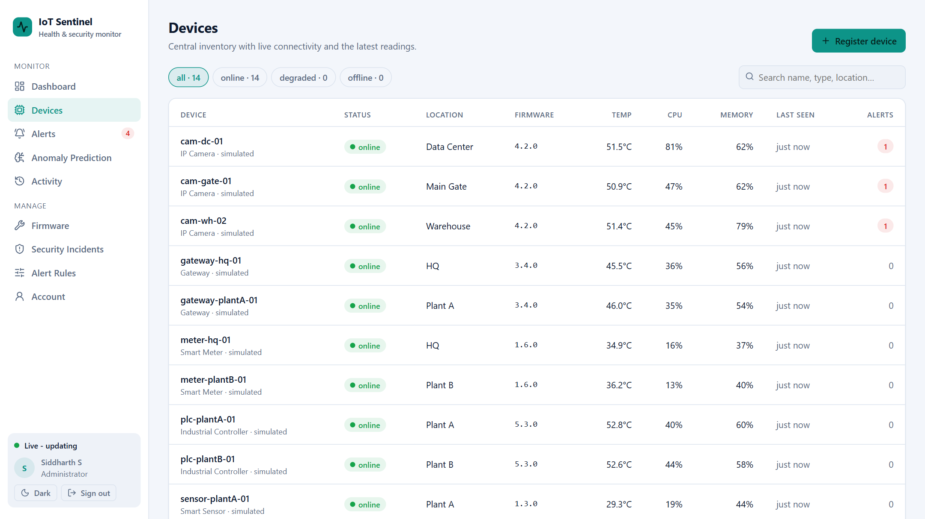
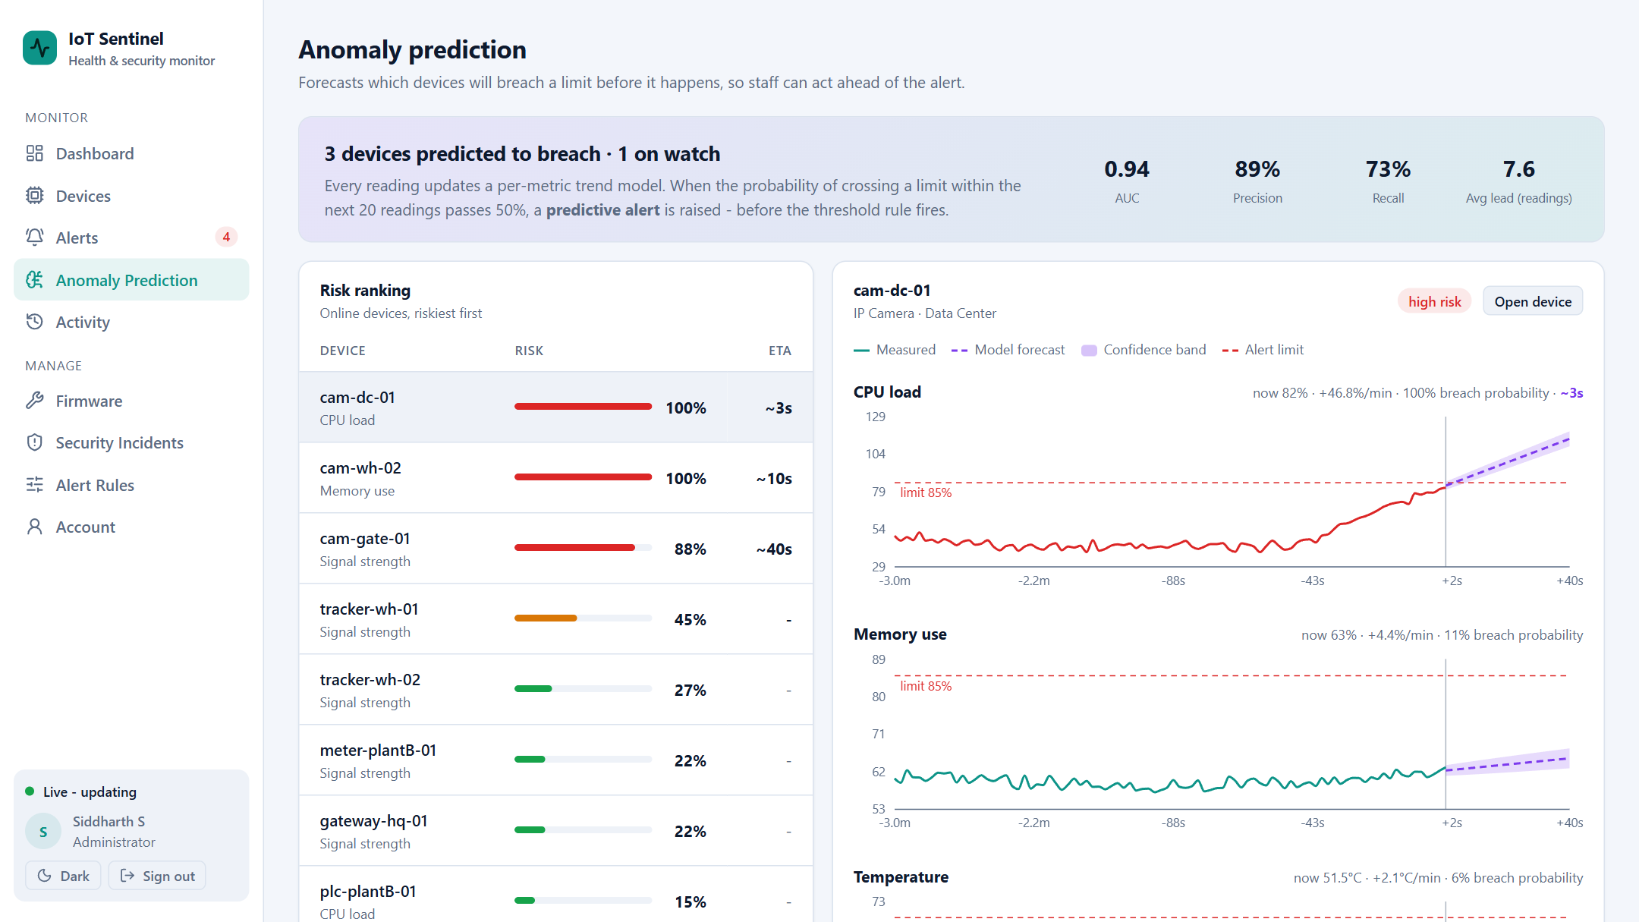
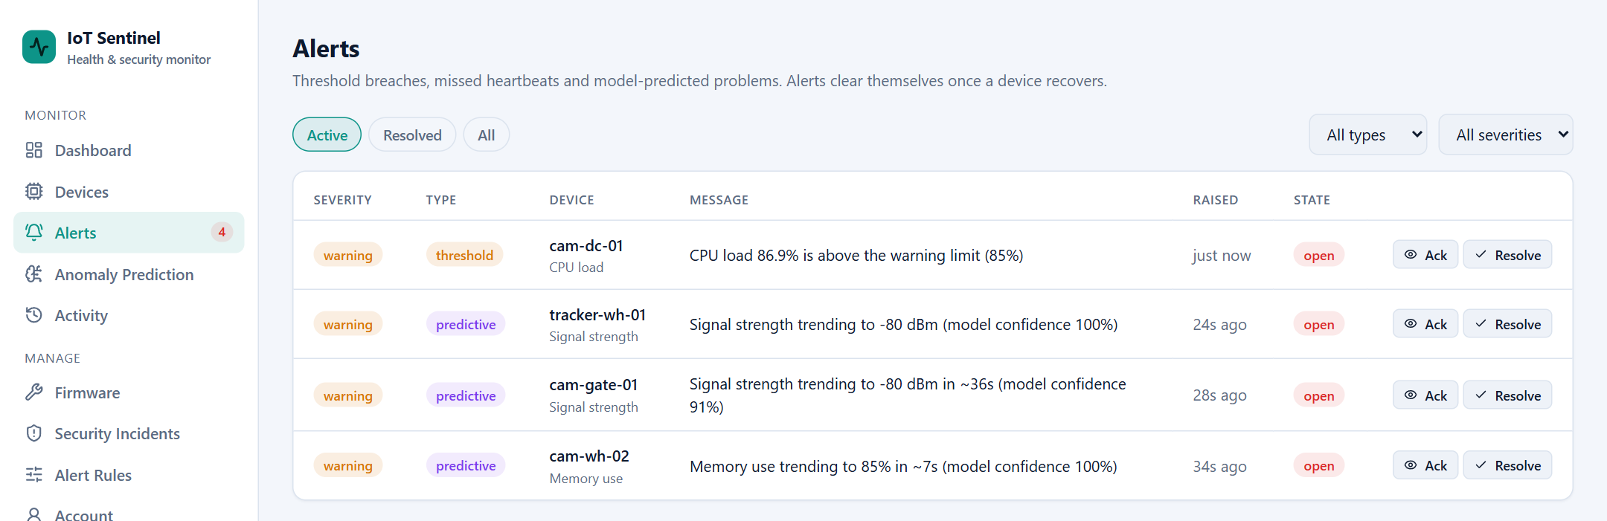
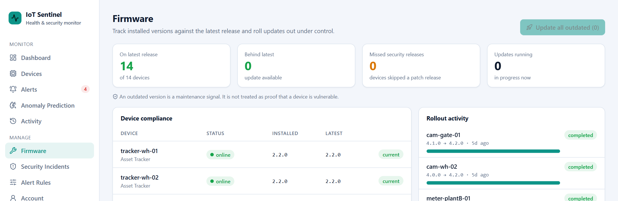
SCREENSHOTS
15
LIVE WEBSITE SCREENS
Current IoT Sentinel interface captured from the running project
Dashboard
Devices
Prediction
Alerts
Firmware
Review 1 | Full Stack Development

Slide 16
CHALLENGES
16
IMPLEMENTATION CONSIDERATIONS
Practical challenges to discuss in the first review
Real vs simulated data
Prediction quality
Readings are simulated today; real devices must send the same JSON to the REST ingest endpoint.
The model is trained on synthetic data and must be retrained on real telemetry before it is trusted.
Live updates
Alert noise
The dashboard polls every few seconds; WebSocket or SSE push would cut load and delay.
Predictive alerts need hysteresis and sanity checks so they do not flap or fire without cause.
Security hardening
Data growth
Keys are hashed and users have roles; HTTPS, rate limiting and secret management are still needed.
Telemetry arrives constantly, so retention (7 days) and averaged history queries keep the database fast.
Review 1 | Full Stack Development

Slide 17
NEXT STEPS
17
REMAINING WORK & PLAN
Planned work to move from a working core to a complete platform
01
Real-Time Push
Replace polling with WebSocket or SSE updates for an instant dashboard.
02
Notifications
Email and webhook alerts for critical and predictive events.
03
Model Retraining
Retrain the predictor on real telemetry; evaluate it per machine type.
04
User Management
Admin screen to promote viewers and manage accounts and ownership.
05
Testing & CI
Unit and integration tests with a GitHub Actions pipeline.
06
Hardening & Deploy
HTTPS, rate limiting, secret management and production deployment.
Review 1 | Full Stack Development

Slide 18
REFERENCES
18
REFERENCES & SOURCE BASIS
Sources used to prepare this first-review presentation
• Project proposal deck: IoT Device Health and Security Monitoring Platform (scope, objectives, architecture).
• Chatterjee & Ahmed (2022), IoT Anomaly Detection Methods and Applications: A Survey. doi.org/10.1016/j.iot.2022.100568
• Feng et al. (2023), Detecting Vulnerability on IoT Device Firmware: A Survey. doi.org/10.1109/JAS.2022.105860
• Asokan et al. (2018), ASSURED: Architecture for Secure Software Update of Realistic Embedded Devices. doi.org/10.1109/TCAD.2018.2858422
• Official documentation for React, TypeScript, Node.js, Express, PostgreSQL, Redis and Docker.
• UX ideas inspired by github.com/Merouanos/arduino-IoT (no code reused).
Important: the prediction model is trained on synthetic data and device readings come from a simulator; both are labelled as such throughout.
Review 1 | Full Stack Development

Slide 19


