Slide 1
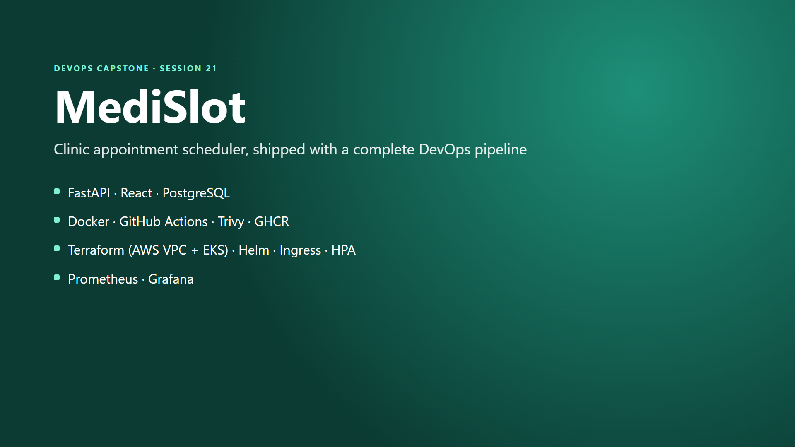
Notes:
Hi, I'm Siddhant Prasad, and this is MediSlot, a clinic appointment scheduler and my DevOps capstone. I'll walk through the app, then every layer that takes a commit to a running, monitored Kubernetes deployment.

Slide 2
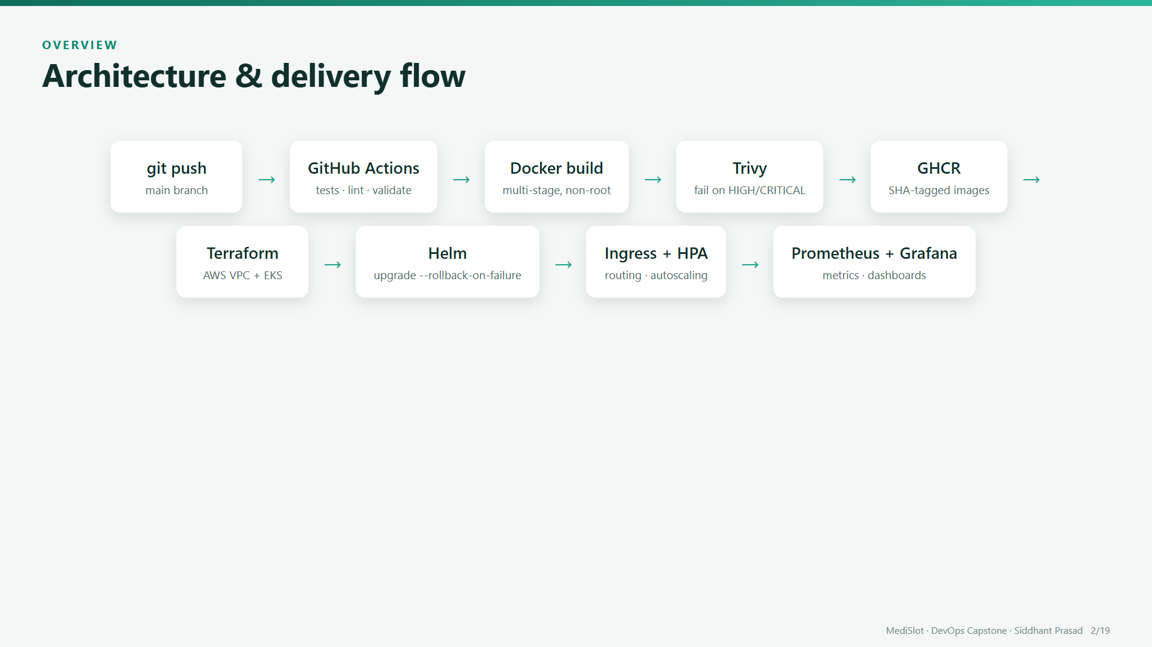
Notes:
A push to main triggers GitHub Actions. It runs the tests, builds two Docker images, scans them with Trivy, and pushes them to the GitHub Container Registry, tagged with the commit SHA. Terraform defines the AWS network and EKS cluster, and Helm deploys the app behind an Ingress, with autoscaling and Prometheus and Grafana monitoring.

Slide 3
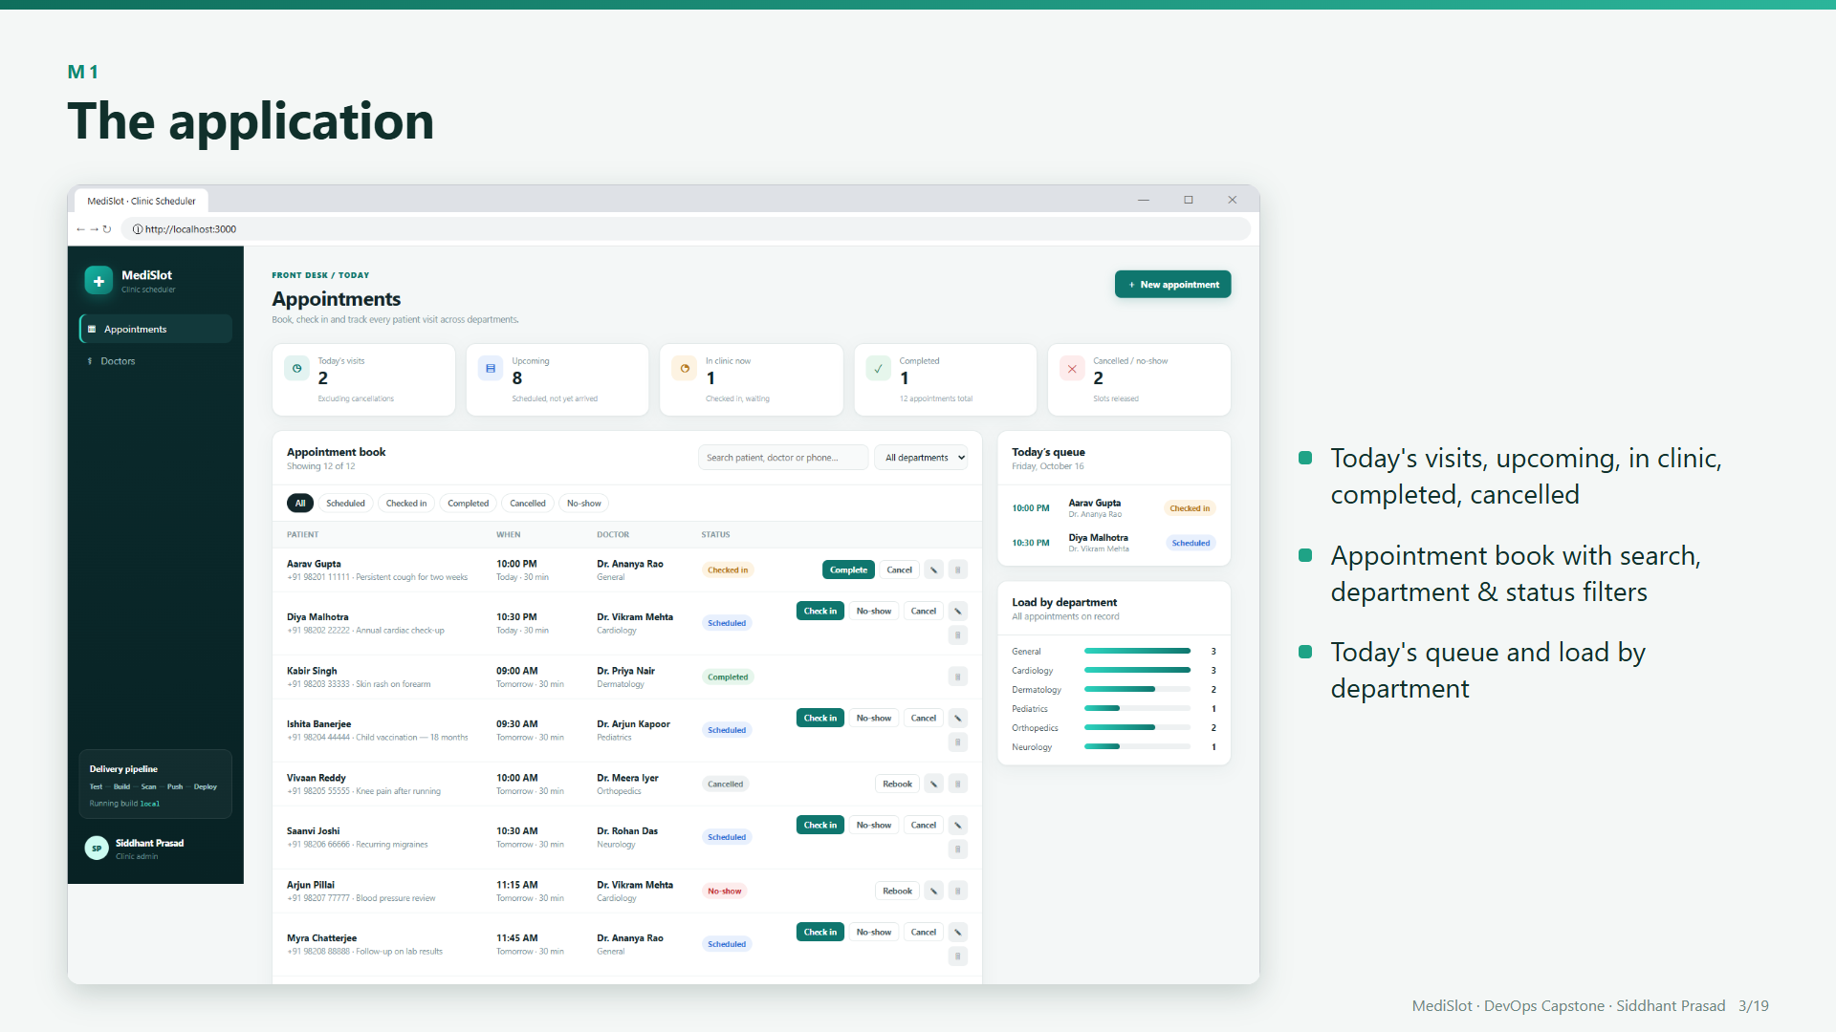
Notes:
This is the front-desk dashboard: today's visit counts at the top, the appointment book with search and filters, and today's queue and load per department. Every visit follows a strict lifecycle: scheduled, checked in, completed, or cancelled or no-show.

Slide 4
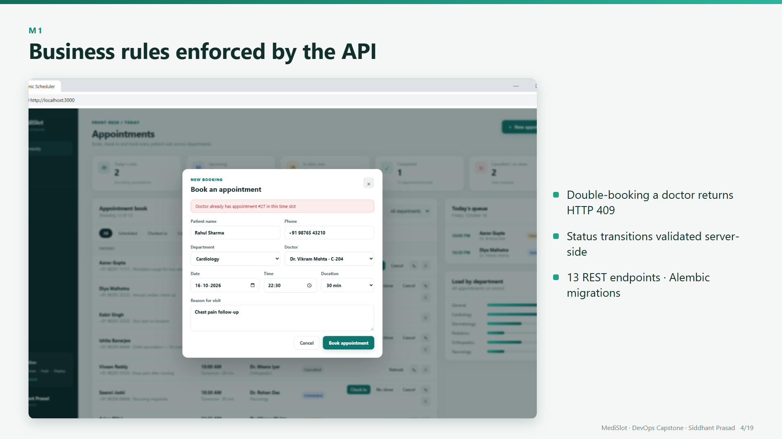
Notes:
The rules live in the backend. If I book Dr. Vikram Mehta at a time he's already taken, the API returns a 409 conflict and the form shows the clash. The FastAPI backend has thirteen REST endpoints, and Alembic migrations own the PostgreSQL schema.

Slide 5
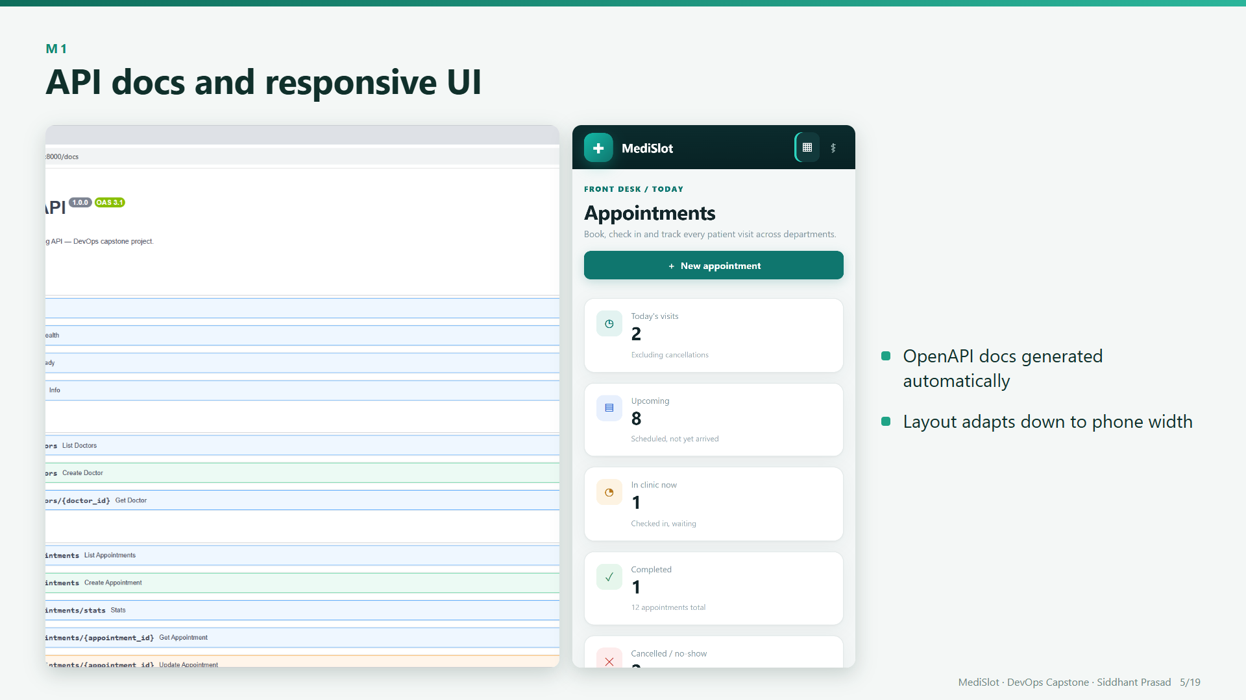
Notes:
FastAPI generates interactive API docs for every endpoint, and the React UI is responsive, so it also works on a phone.

Slide 6
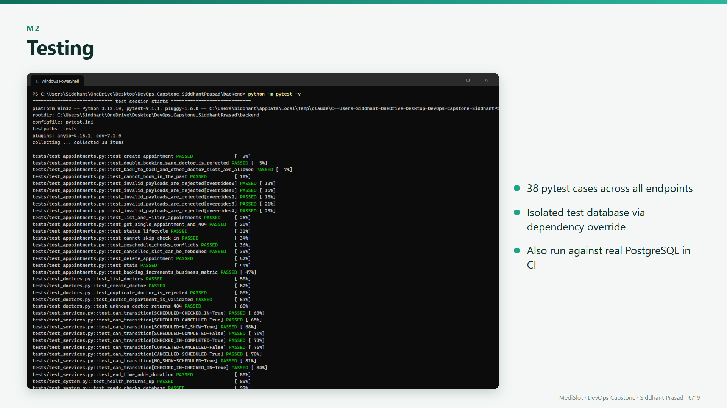
Notes:
Thirty-eight pytest cases cover every endpoint, the conflict rule and the status lifecycle. They use an isolated in-memory database, and CI runs them again against real PostgreSQL with migrations applied.

Slide 7
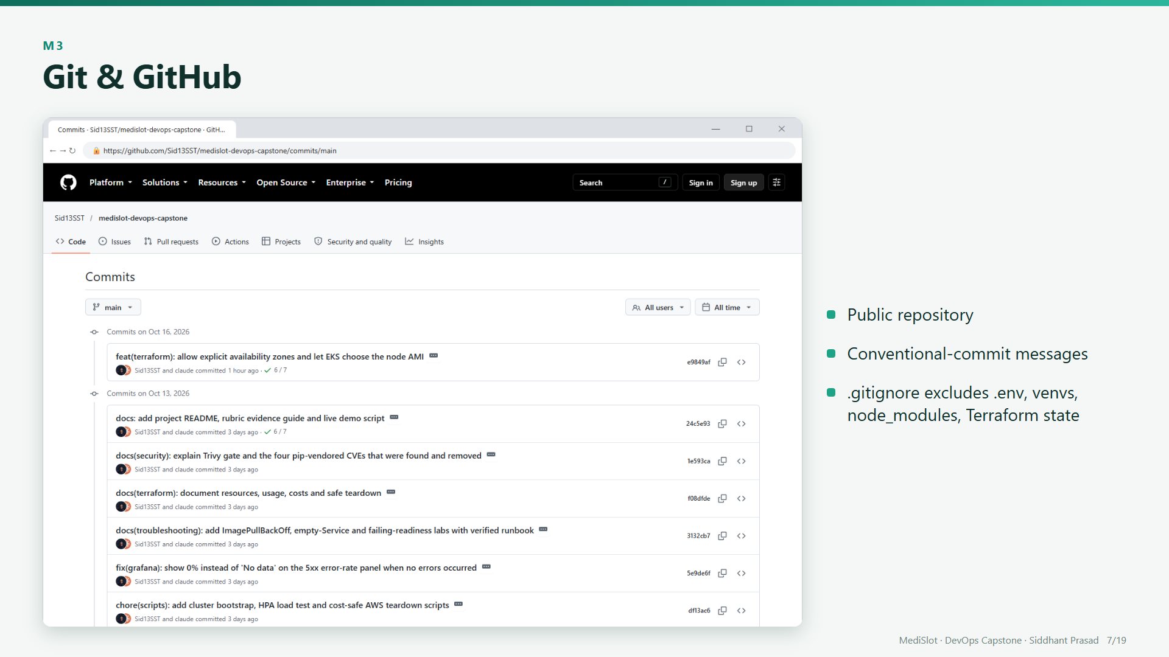
Notes:
The code is in a public GitHub repository with conventional commit messages. The gitignore keeps environment files, virtual environments and Terraform state out of Git, and no credentials were ever committed.

Slide 8
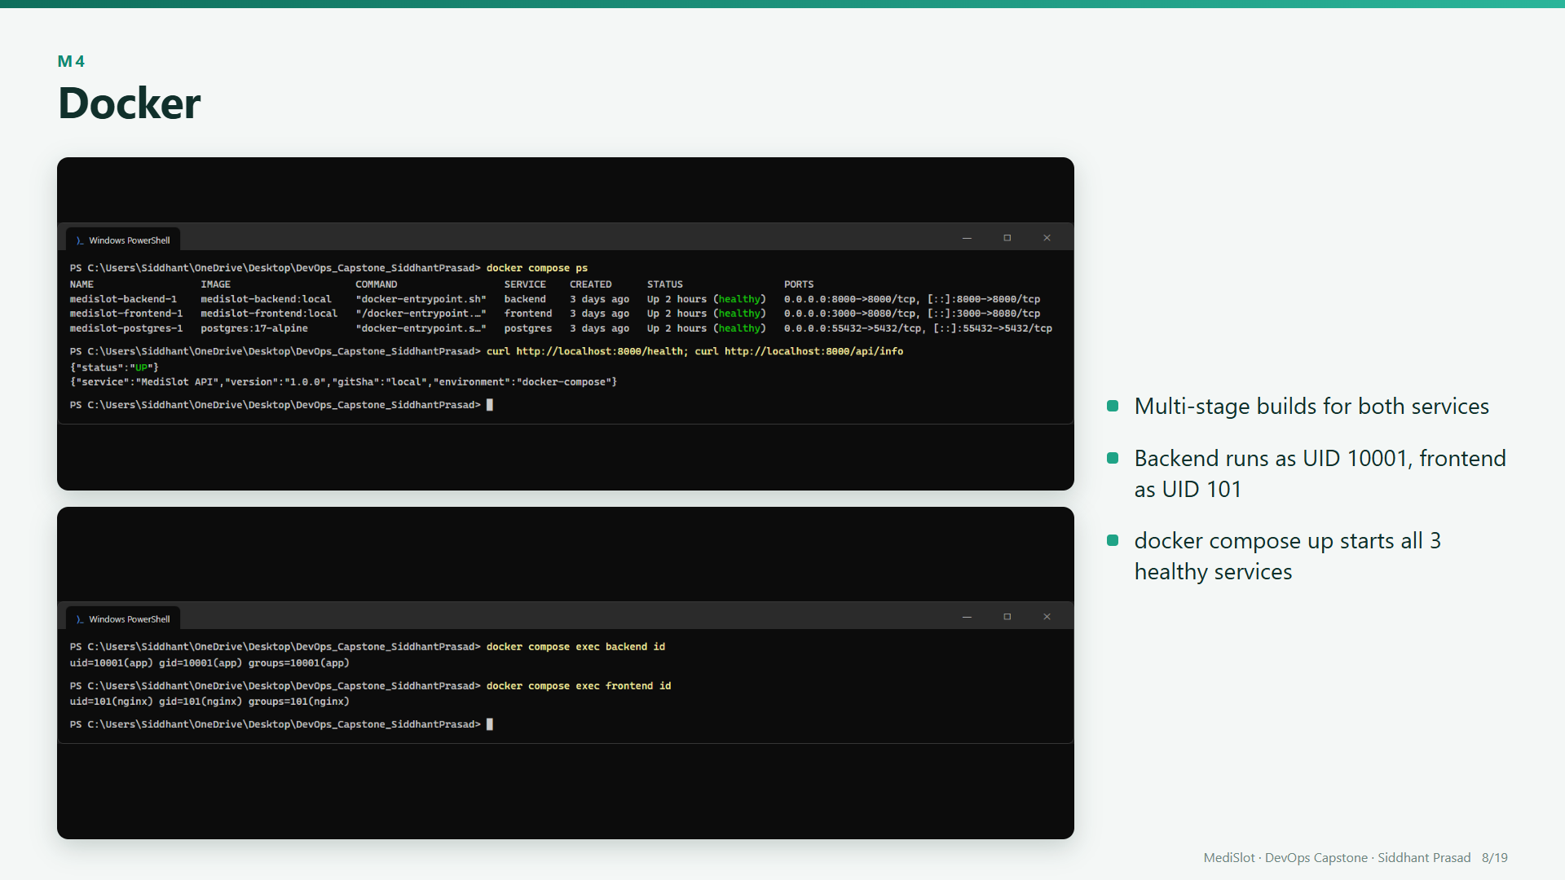
Notes:
Both services use multi-stage Docker builds, and neither runs as root: the backend runs as user ten thousand and one, the frontend as user one oh one. Docker Compose starts PostgreSQL, backend and frontend, each with a health check.

Slide 9
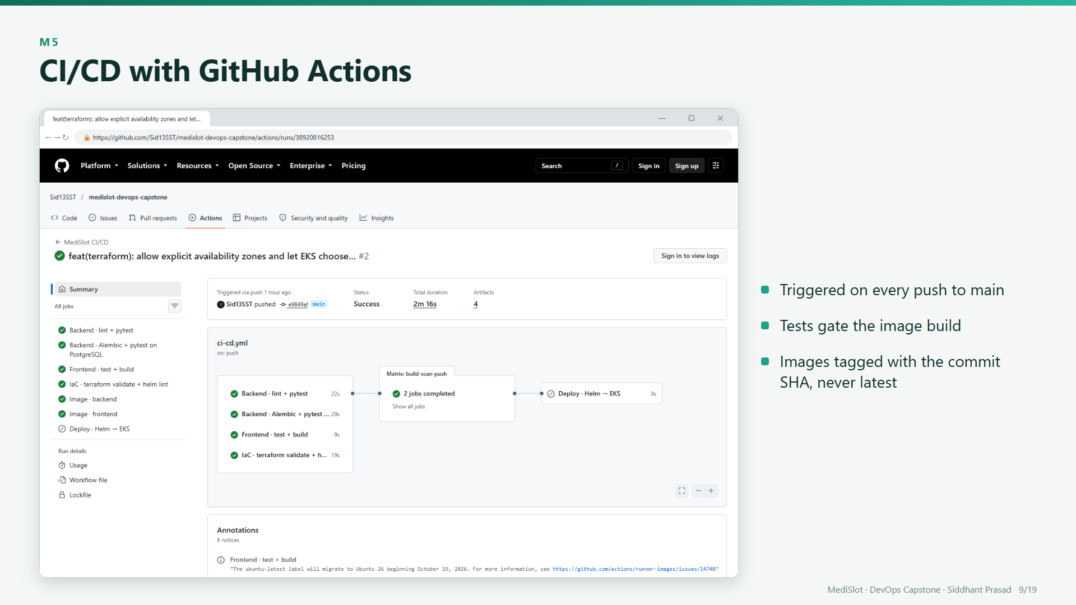
Notes:
On every push to main, four quality jobs run in parallel: backend tests, migrations on PostgreSQL, the frontend build, and Terraform and Helm validation. Images are built only if all of them pass.

Slide 10
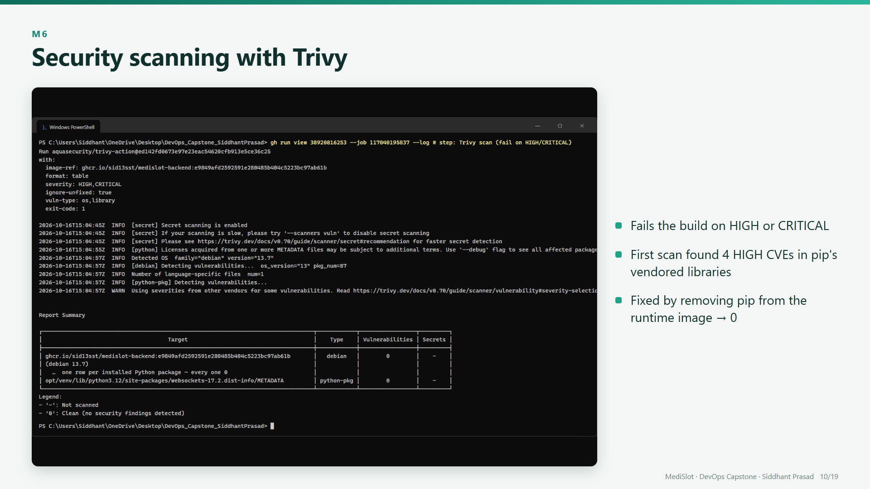
Notes:
Trivy scans each image and fails the build on high or critical vulnerabilities. My first scan failed with four high CVEs inside pip's vendored libraries. The runtime never needs pip, so I removed it, and the scan is now clean.

Slide 11
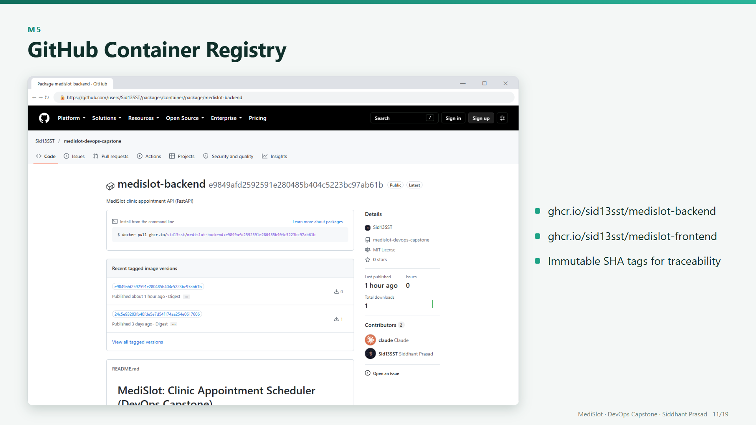
Notes:
Passing images are pushed to the GitHub Container Registry, tagged with the full commit SHA, so every running pod traces back to its exact commit.

Slide 12
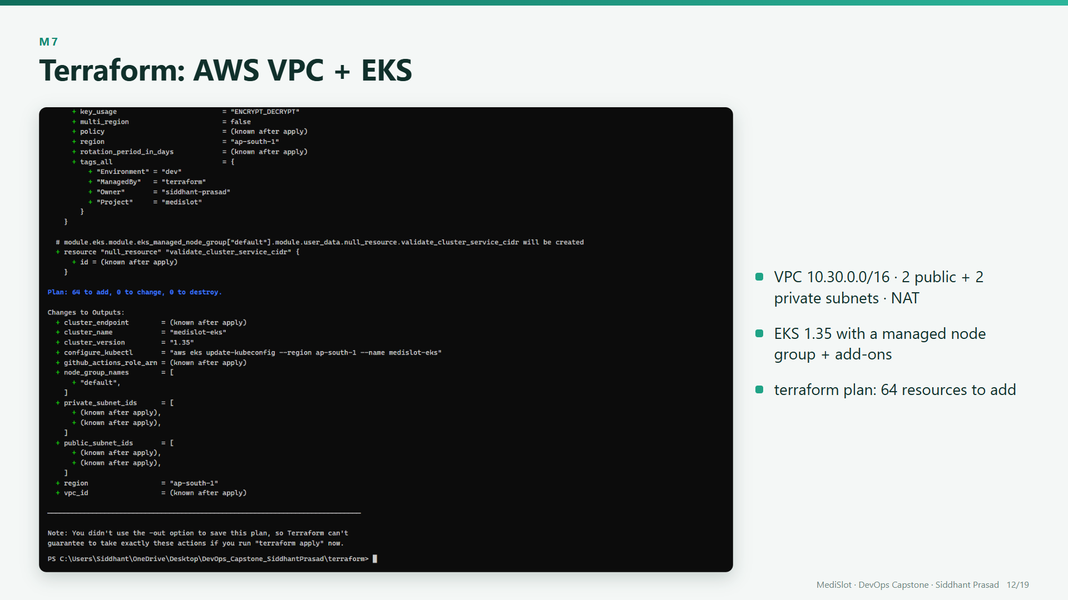
Notes:
Terraform defines a VPC with public and private subnets and a NAT gateway, an EKS cluster with a managed node group and add-ons, and a GitHub OIDC role, so no access keys are stored anywhere. Terraform plan shows sixty-four resources to add.

Slide 13
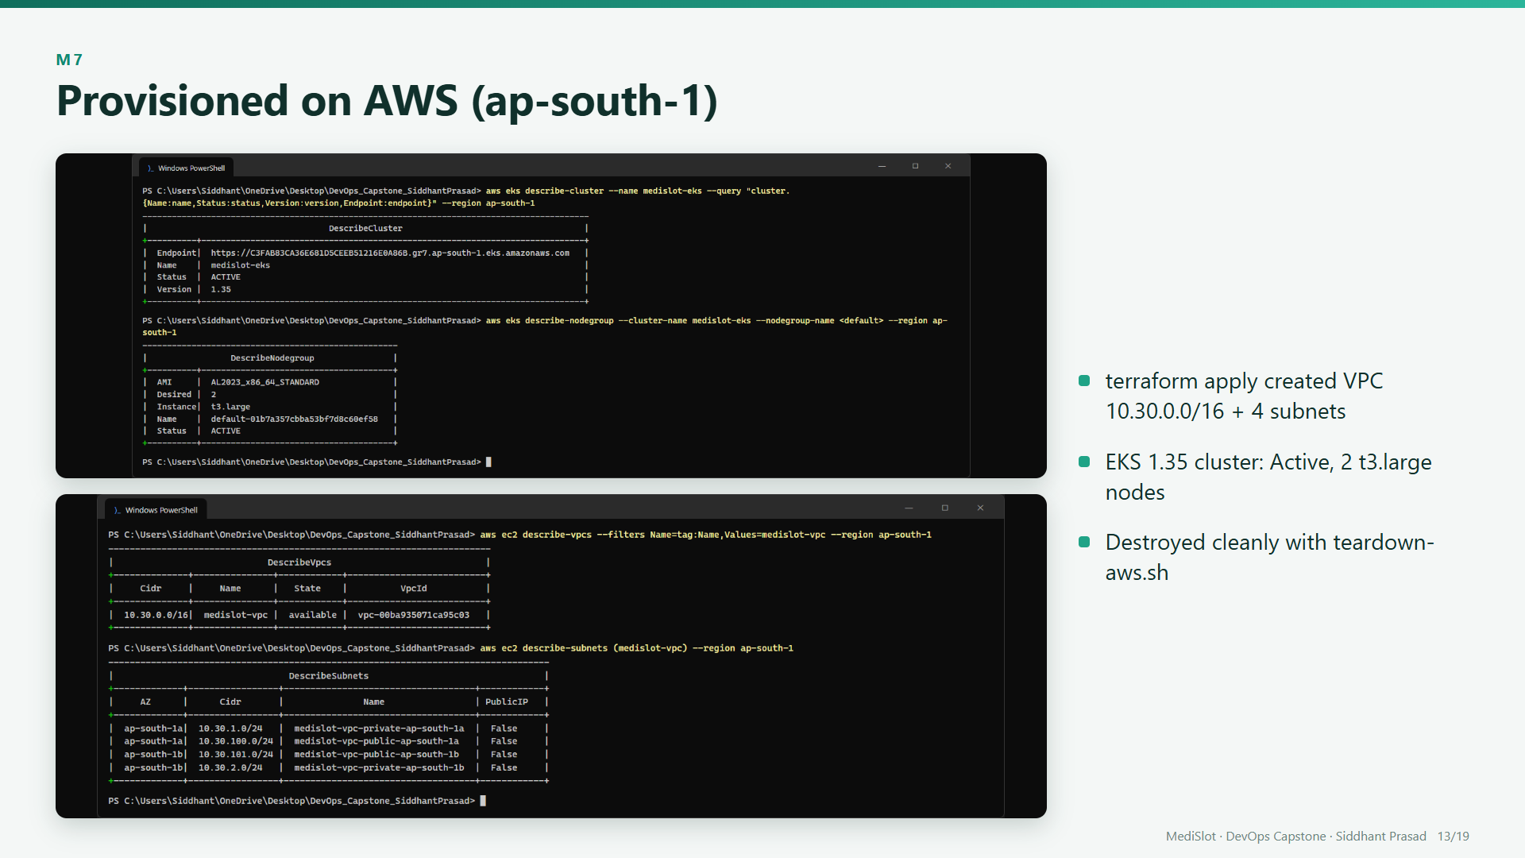
Notes:
Then terraform apply built it for real in the Mumbai region. Here is the EKS cluster, active, and the VPC with its four subnets. After the demo, the teardown script removed everything with terraform destroy, so nothing keeps billing.

Slide 14
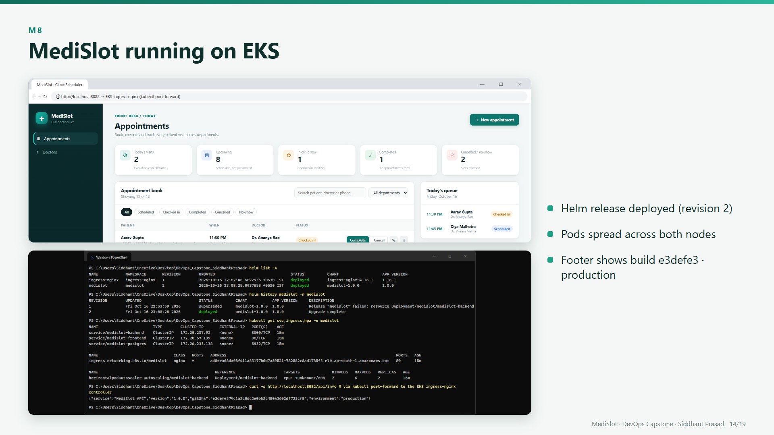
Notes:
And here is MediSlot running on that EKS cluster. Helm deployed it, the pods are spread across both worker nodes, and the footer shows the production build with the exact commit SHA. The new AWS account wasn't allowed to create load balancers yet, so I reached the Ingress controller through a port-forward.

Slide 15
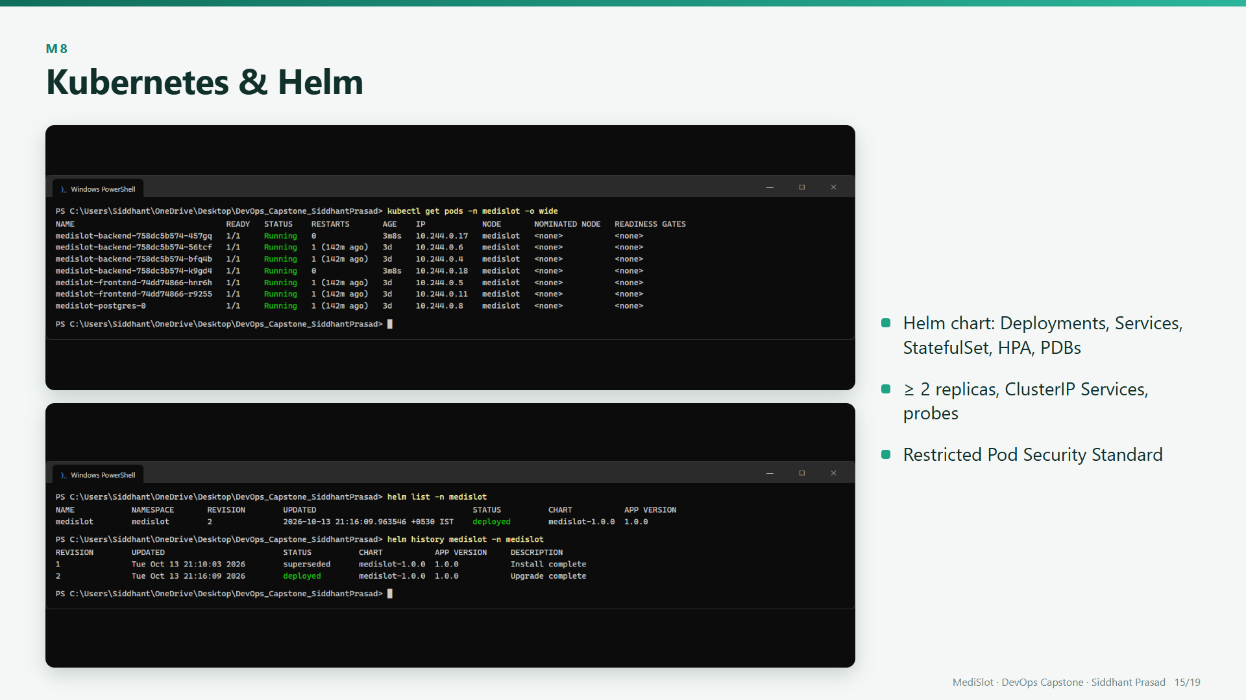
Notes:
One Helm chart deploys everything: frontend and backend with two replicas each, a PostgreSQL StatefulSet, ClusterIP services, an autoscaler and disruption budgets, under the restricted pod security standard.

Slide 16
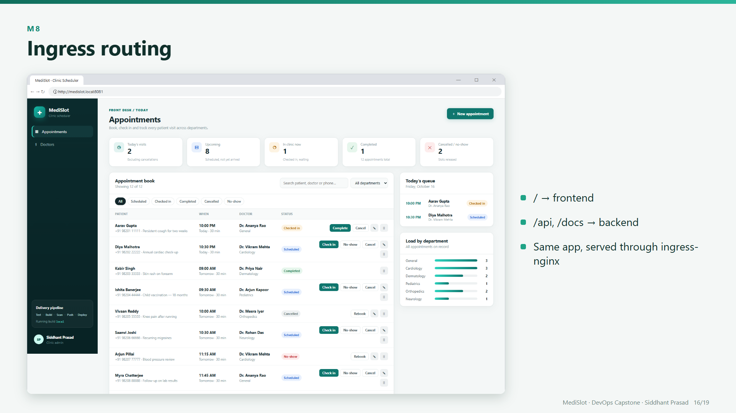
Notes:
An NGINX Ingress is the single entry point: slash goes to the frontend, and slash API and the docs go to the backend. Here's the app served through the Ingress hostname.

Slide 17
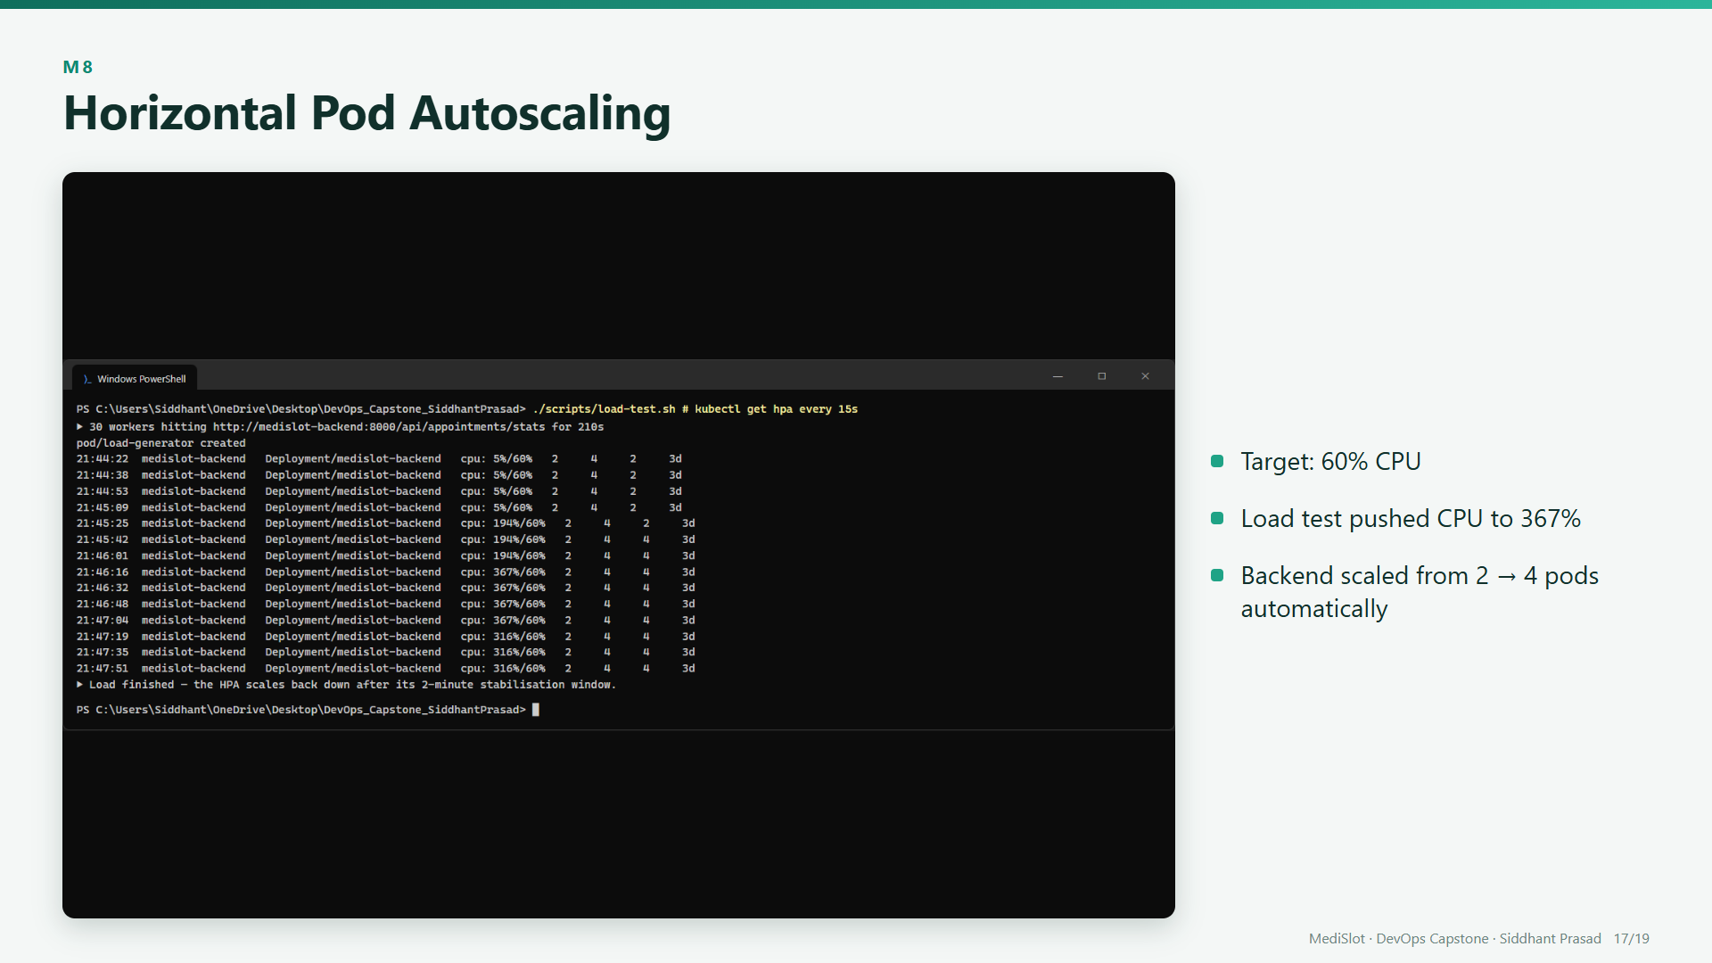
Notes:
Under a load test, CPU rose far past the sixty percent target, and the autoscaler scaled the backend from two pods to four, automatically.

Slide 18
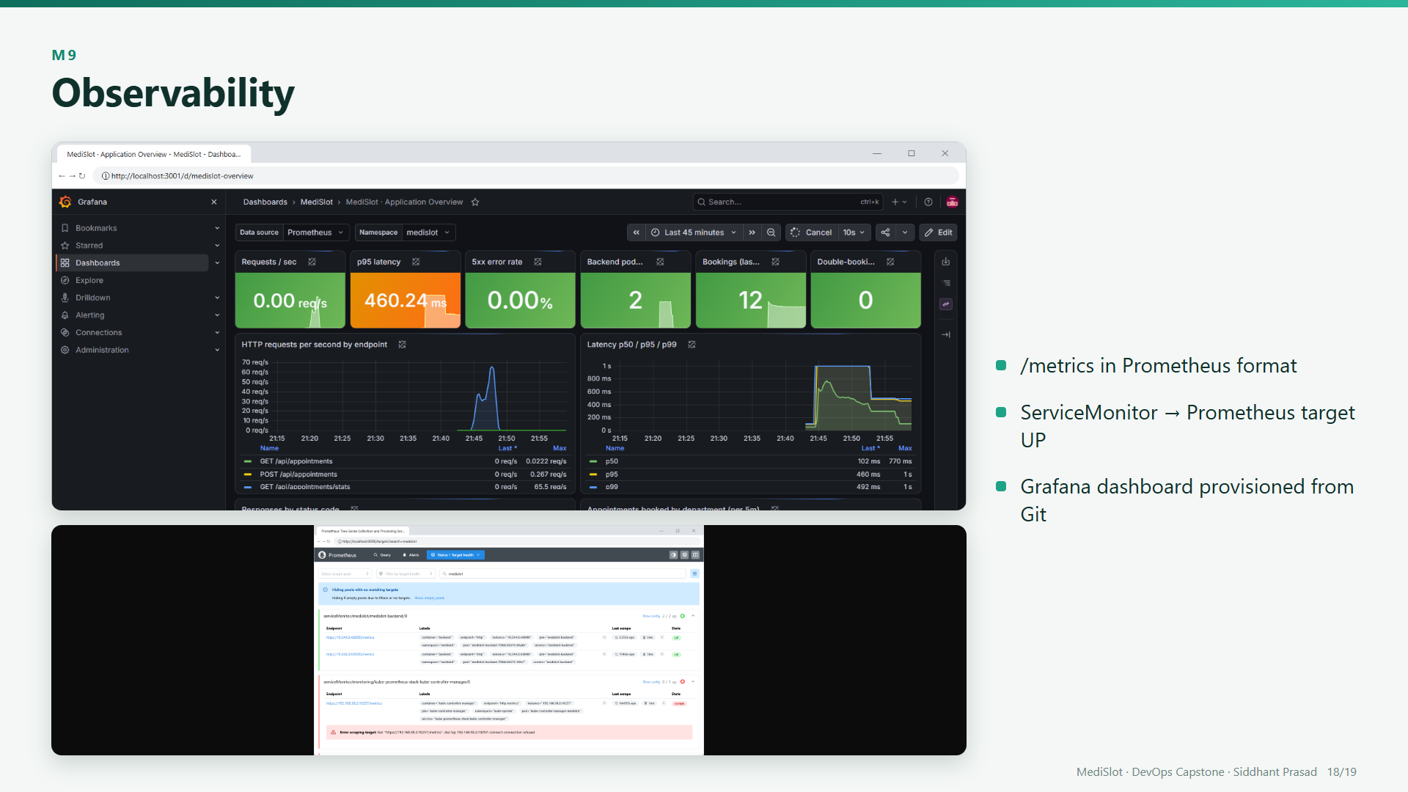
Notes:
The backend exposes Prometheus metrics, a ServiceMonitor makes Prometheus scrape it, and a Grafana dashboard from the Helm chart shows request rate, latency, status codes and bookings. You can see the load test spike.

Slide 19
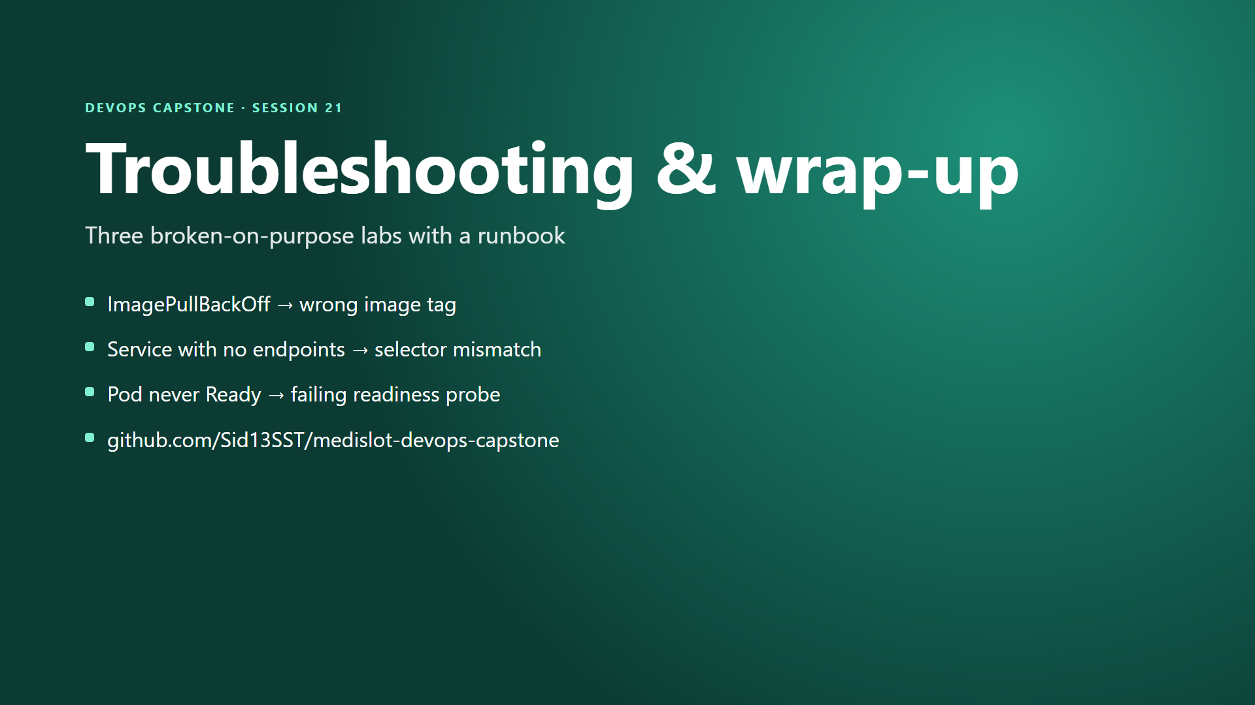
Notes:
Finally, three broken-on-purpose labs, an image pull failure, a service with no endpoints, and a pod that never becomes ready, each come with a runbook fix. That's MediSlot, from commit to a scaled, monitored deployment. Thanks for watching.

