Slide 1
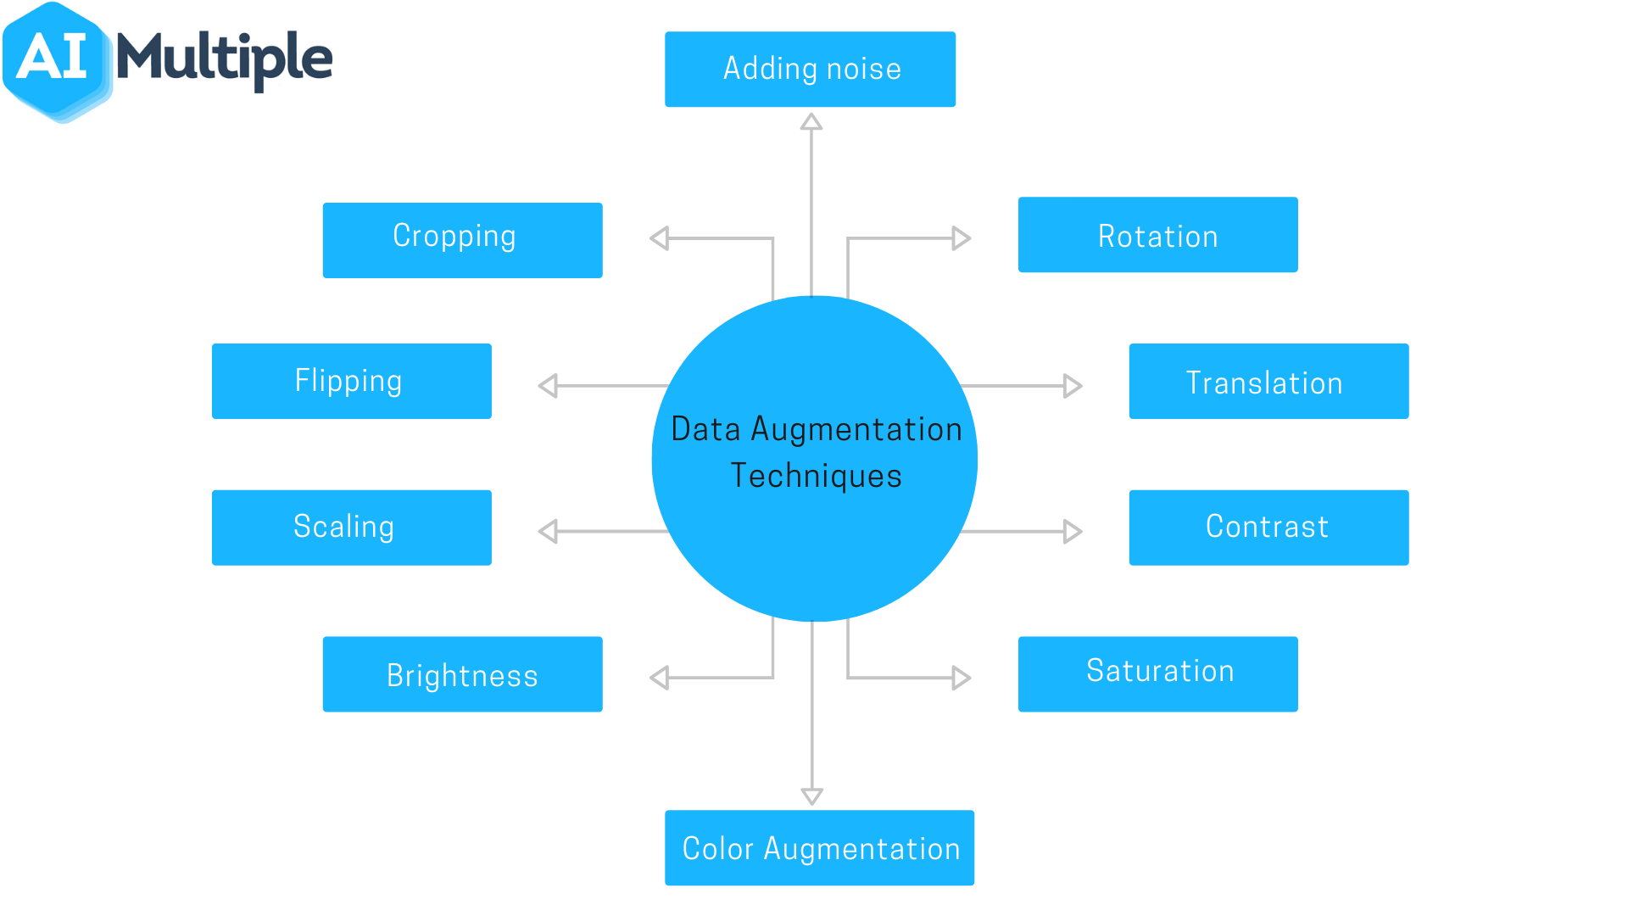
Data Augmentation Analysis
Group 13
Harsh Kumar - 19UCS185
Aditya Raj - 19UCS025
Yash Jain - 19UCS197
Siddharth Akar 19UCS215

Slide 2
Introduction - Data Augmentation
Data augmentation is a set of techniques to artificially increase the amount of data by generating new data points from existing data.
This includes making small changes to data or using deep learning models to generate new data points.
Data augmentation techniques may be a good tool against challenges which the artificial intelligence world faces.
Data augmentation is useful to improve performance and outcomes of machine learning models by forming new and different examples to train datasets.
Data augmentation by generating more training data helps in increasing the accuracy and lowering the variance of the model to help overcome overfitting.

Slide 3
Models and Dataset Used
Our model is a CNN model which classifies the digits from 0 to 9 and helps in digit recognition.
The Mnist dataset is an acronym that stands for the modified national institute of standards and technology dataset.
It is a dataset of 60,000 small square 28x28 pixel grayscale images of handwritten single digits between 0 and 9.
Svhn is a real world dataset where it contains images of Street view house numbers.
It is used to solve harder real world problems.

Slide 4
Types of Data Augmentation
Zooming: Zoom Augmentation will randomly zoom the image and adds new pixels for the image
Flipping: In flipping, the image is flipped horizontally or vertically.
Rotation: The image is rotated randomly in rotation.
Shear: It is another bounding box transformation, that can be done with the help of the transformation matrix
Shift: Shifting the pixels of the image horizontally or vertically resulting in new samples in the dataset.

Slide 5
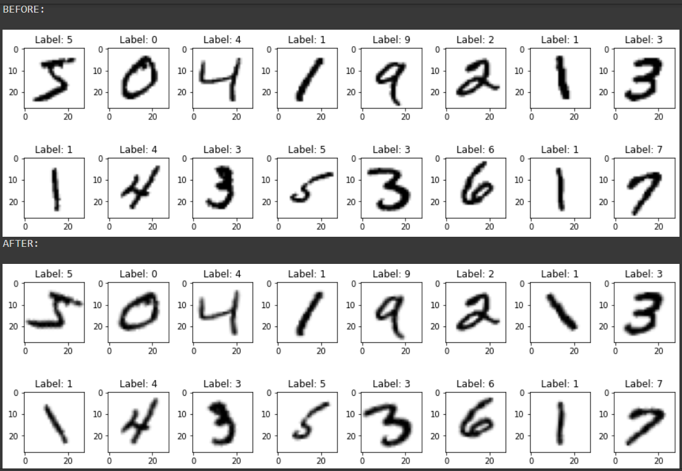
Rotation
Random Rotate is a useful augmentation in particular because it changes the angles that objects appear in your dataset during training
A source image is randomly rotated clockwise or counterclockwise by some number of degrees, changing the position of the object in frame.
Random rotation can improve your model without you having to collect and label more data.

Slide 6
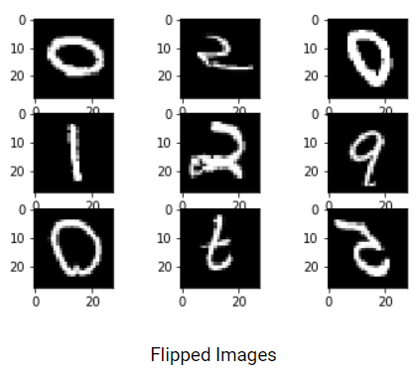
Flipping
We can also flip the images horizontally and vertically using the horizontal_flip and vertical_flip arguments respectively. These take boolean values as inputs.
Flipping rearranges the pixels while protecting the features of the image
Vertical flipping is not meaningful for some photos, but it can be useful in cosmology or for microscopic photos.

Slide 7
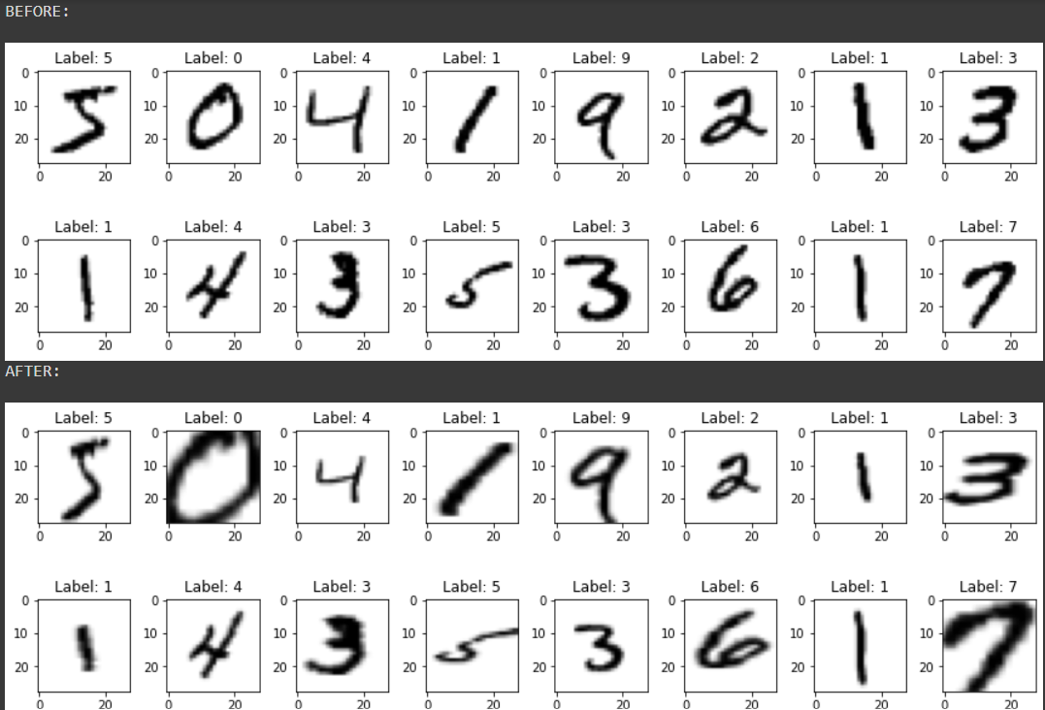
Zooming
Zoom Augmentation will randomly zoom the image and adds new pixels for the image
In the above example random zoom augmentation is performed on the input (upper image) image with the range of 0.5 to 1.0 % and returns the image (lower image) as result after zooming the entire pixels of an image.

Slide 8
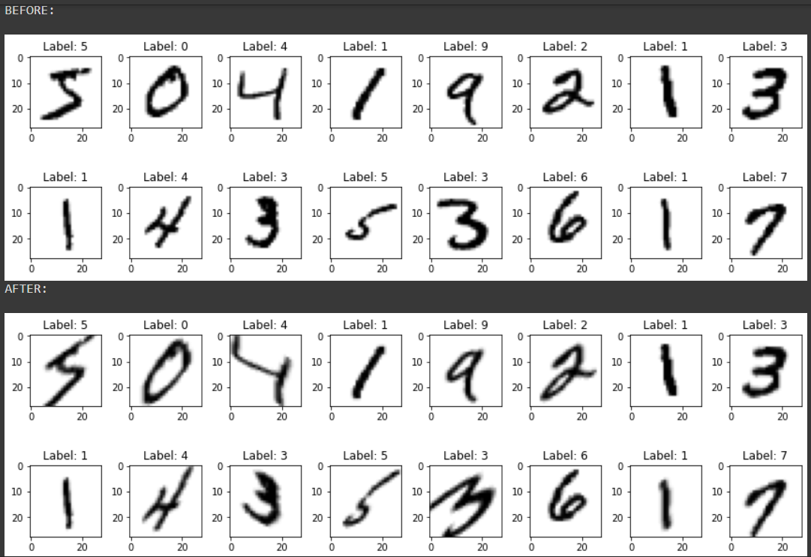
Shear
Image will be distorted along an axis, mostly to create or rectify the perception angles…
It's usually used to augment images so that computers can see how humans see things from different angles

Slide 9
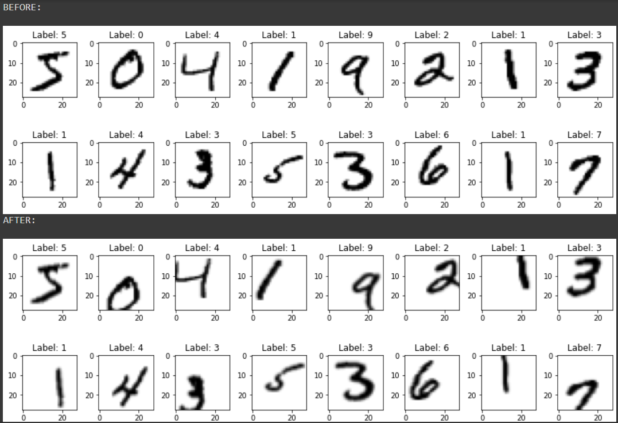
Shift
A shift to an image means moving all pixels of the image in one direction(horizontally or vertically)
Some of the pixels will be clipped and there will be a region where new pixel values will be specified.

Slide 10
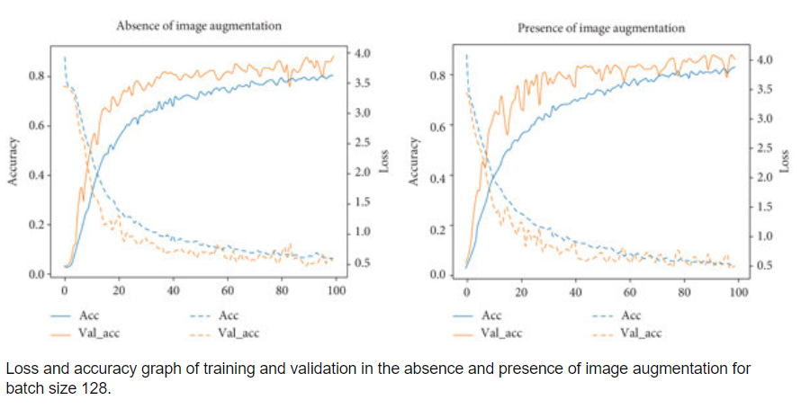
Result analysis- MNIST

Slide 11
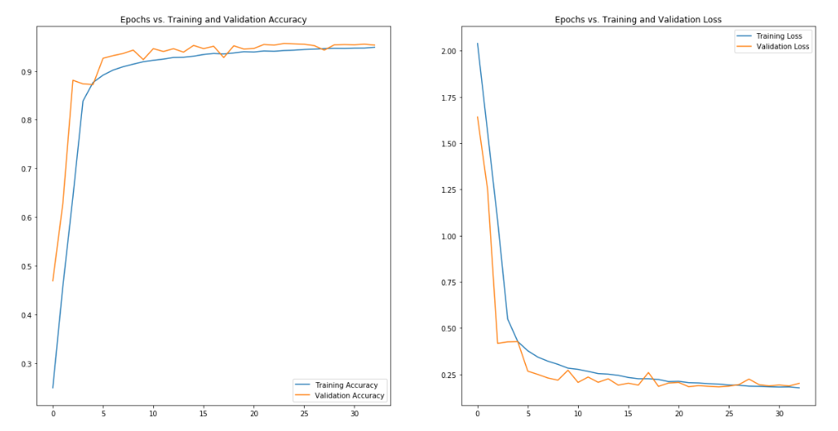
Result Analysis- SVHN

Slide 12
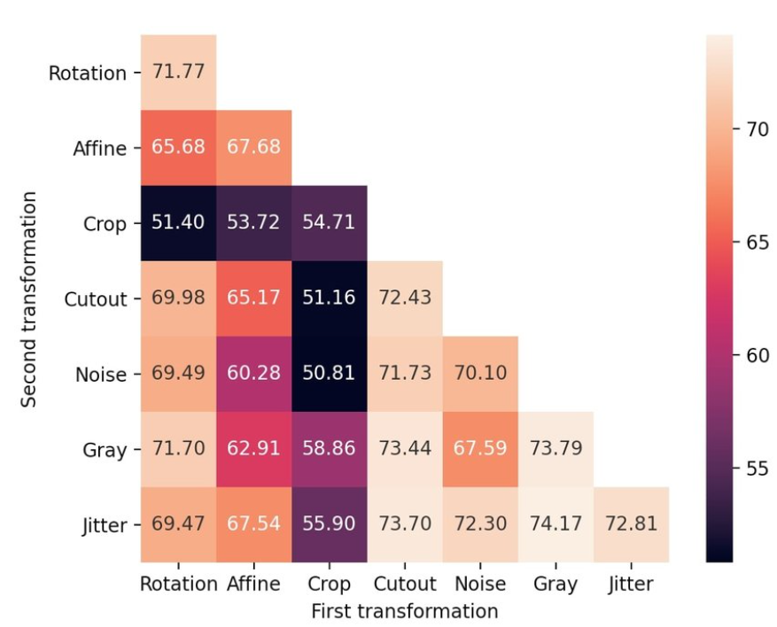
Confusion Matrix

Slide 13
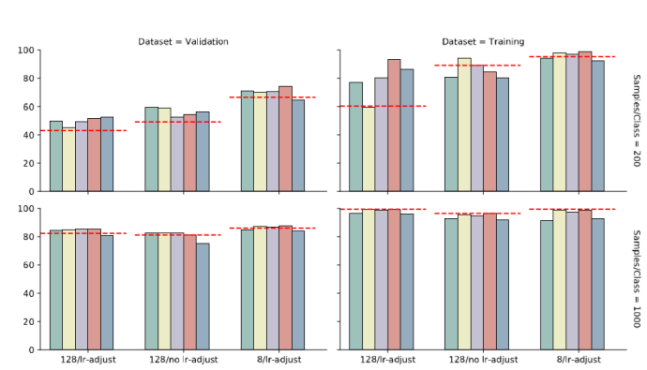

Slide 14
Thank You !

