Slide 1
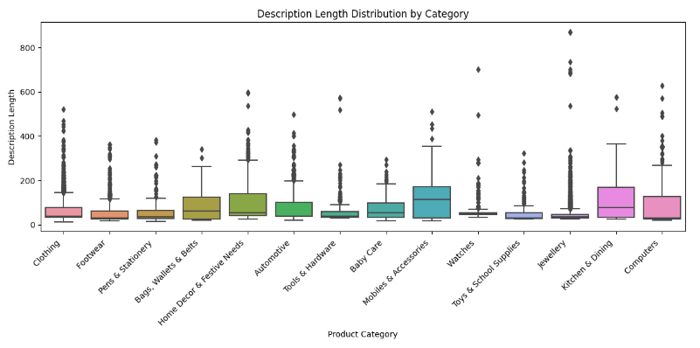
Description Length Distribution by Category
Product descriptions in the “Mobiles & Accessories” category are generally the longest, with “Kitchens & Dining” and “Computers” coming next.
Product descriptions in the “Clothing,” “Watches,” and “Footwear” categories are generally shorter.

Slide 2
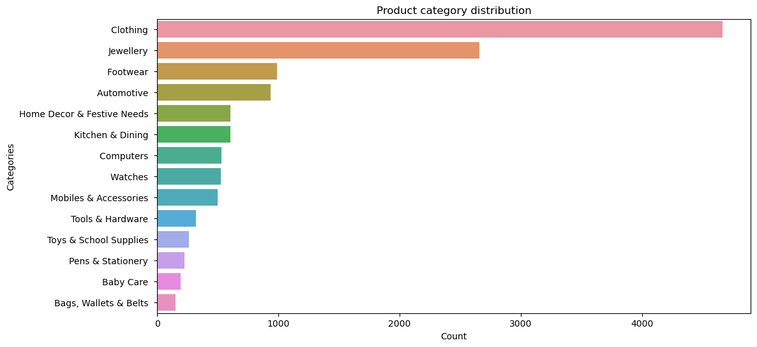
Product Category Distribution
The dataset reveals that “Clothing” categories are the most prevalent, followed by “Jewellery” and “Footwear.” This suggests a higher customer interest in these products, likely indicating a significant preference among female shoppers.

Slide 3
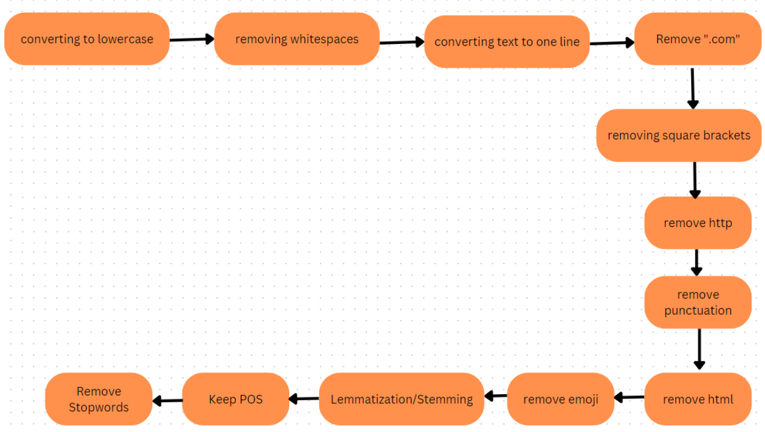
Text Normalization Flow

Slide 4
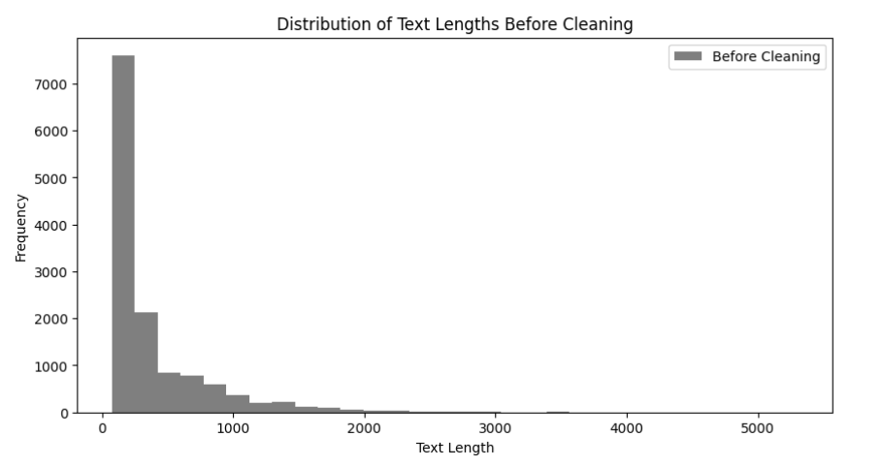
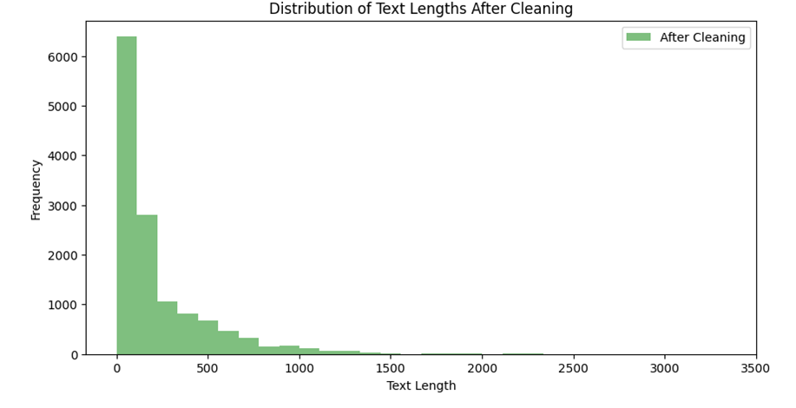
After Applying Normalization
Percentage reduction in text length after cleaning: 45.43%

Slide 5
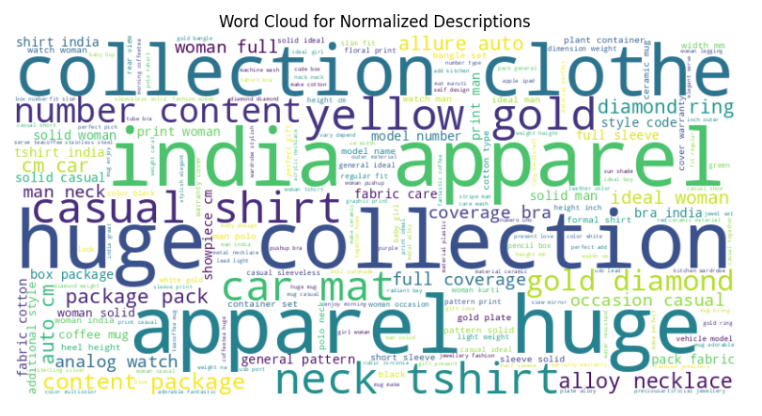
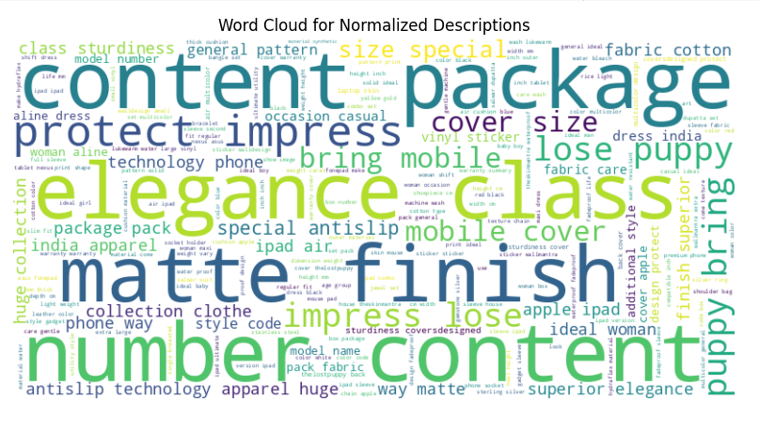
Word Distribution After Normalization
Training Data
Testing Data

Slide 6
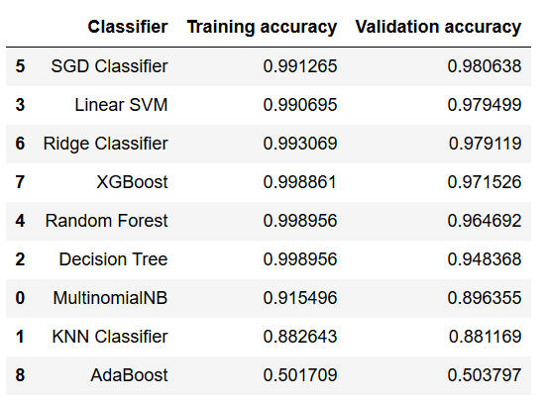
Applying Models on TF-IDF Vectorization
SGD Classifiers performed best of all

Slide 7
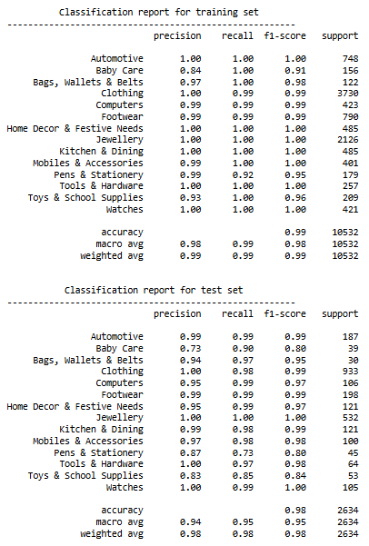
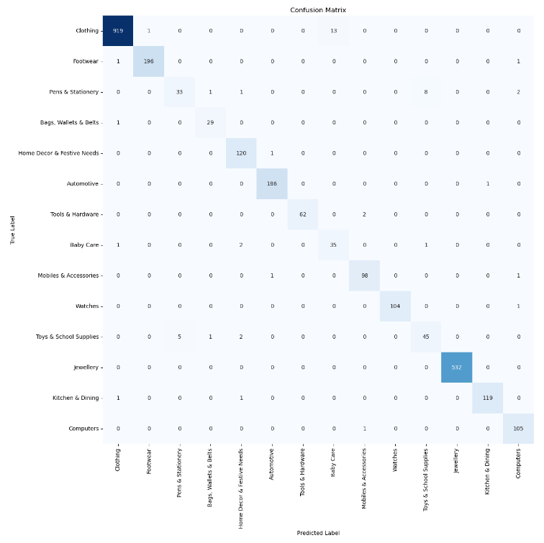
HyperParameter Tuning on Best Perfomed

Slide 8
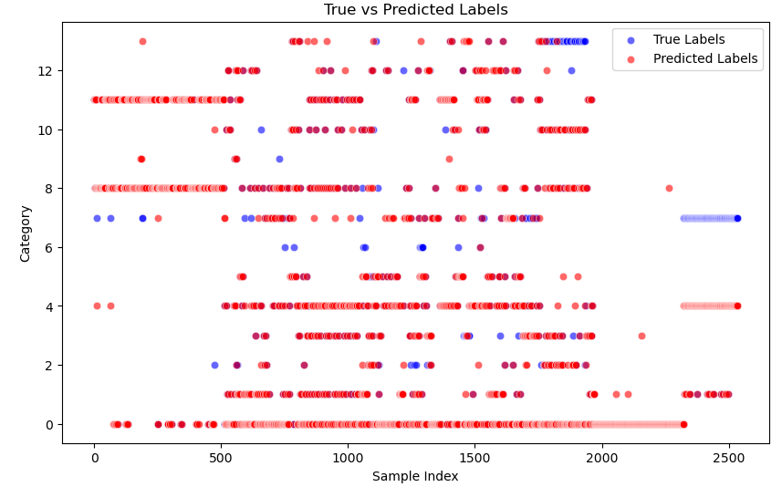
Prediction on Test Data
The model achieved a high accuracy of 83.46%, indicating strong performance in predicting the categories of the given samples

