Slide 1
MODEL CONTEXT PROTOCOL & GOOGLE A2A (WEEK 1)
VARUN DAGA (IN) (Manager, Advisory)
SIDDHARTH M(IN) (Intern, Advisory)

Slide 2
STRENGTHS AND CURRENT USE CASES OF LLMS
LLMs perform tasks like code writing, summarization, and question answering. They are accelerating innovation in customer service, documentation, and ideation
1
CAPABILITIES
2
Already in use for content creation, customer support, legal summarization, education, and code assistance.
ADOPTION
3
Exceptional language fluency, deep contextual understanding, zero-shot learning, and multi-modal input handling.
KEY STRENGTHS
4
Trained on vast amounts of general knowledge
TRAINING DATA

Slide 3
LIMITATIONS OF LLMS IN BUSINESS CONTEXTS
Prone to hallucination without reliable sources
Cannot inherently access structured systems
Lack of up-to-date or internal enterprise data.
No dynamic actions like calling APIs or interacting with tools
Limited in handling fine grained permissions and business logic
Not secure or context aware by default
LLMS must interact with trusted systems to be useful in enterprise workflows
Requires tools for retrieving real-time, structured, and secure data
Tool-augmentation is essential to combine LLM reasoning with real-world tools for effective automation
CURRENT LIMITATIONS
NEED FOR INTEGRATION

Slide 4
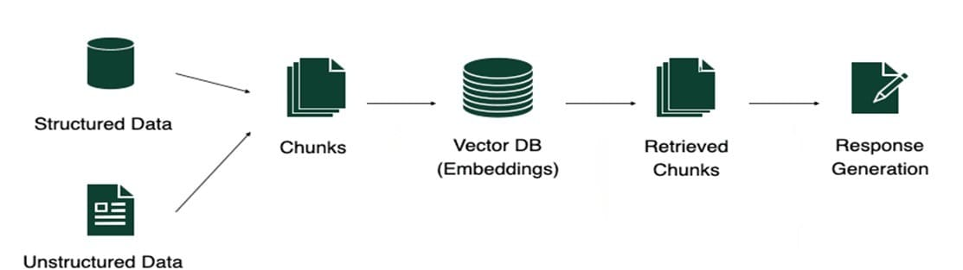
OVERCOMING LLM SHORTCOMINGS USING AUGMENTATION (RAG)
Ingest structured and unstructured data.
Split documents into manageable text chunks.
Text embedding model to convert chunks into vectors, stored in a Vector DB
Retrieve semantically relevant vectors from the Vector DB
Feed retrieved chunks into the LLM for a context aware response

Slide 5
CHALLENGES IN PROVIDING CONTEXT AND INTEGRATION
LACK OF STANDARDIZATION
LACK OF NATIVE TOOL AWARENESS
FRAGMENTED CONTEXT AND MEMORY
HIGH DEVELOPMENT OVERHEAD
Every API required custom integration logic.
No unified format for LLMs to call tools or interpret responses
Every integration was a one-off project.
Manual building of prompt templates and code integration.
LLMS lacked mechanisms to discover and understand available tools.
LLMS lacked the ability to autonomously choose actions.
Scattered tools outputs, user prompts and intermediate reasoning.
Stateless agents.

Slide 6
MODEL CONTEXT PROTOCOL
UNIVERSAL CONNECTOR FOR AI APPLICATIONS
ADDRESSING INTEGRATION CHALLENGES
ENHANCING AI CAPABILITIES
Standardises interfacing with external tools and data sources.
MCP provides structured, semantically rich business data for grounding LLMs
Eliminates custom integrations between AI models and different systems.
Aids quicker development
Enable automated and structured integration of context
Dynamic discovery and utilization of available tools and resources,

Slide 7
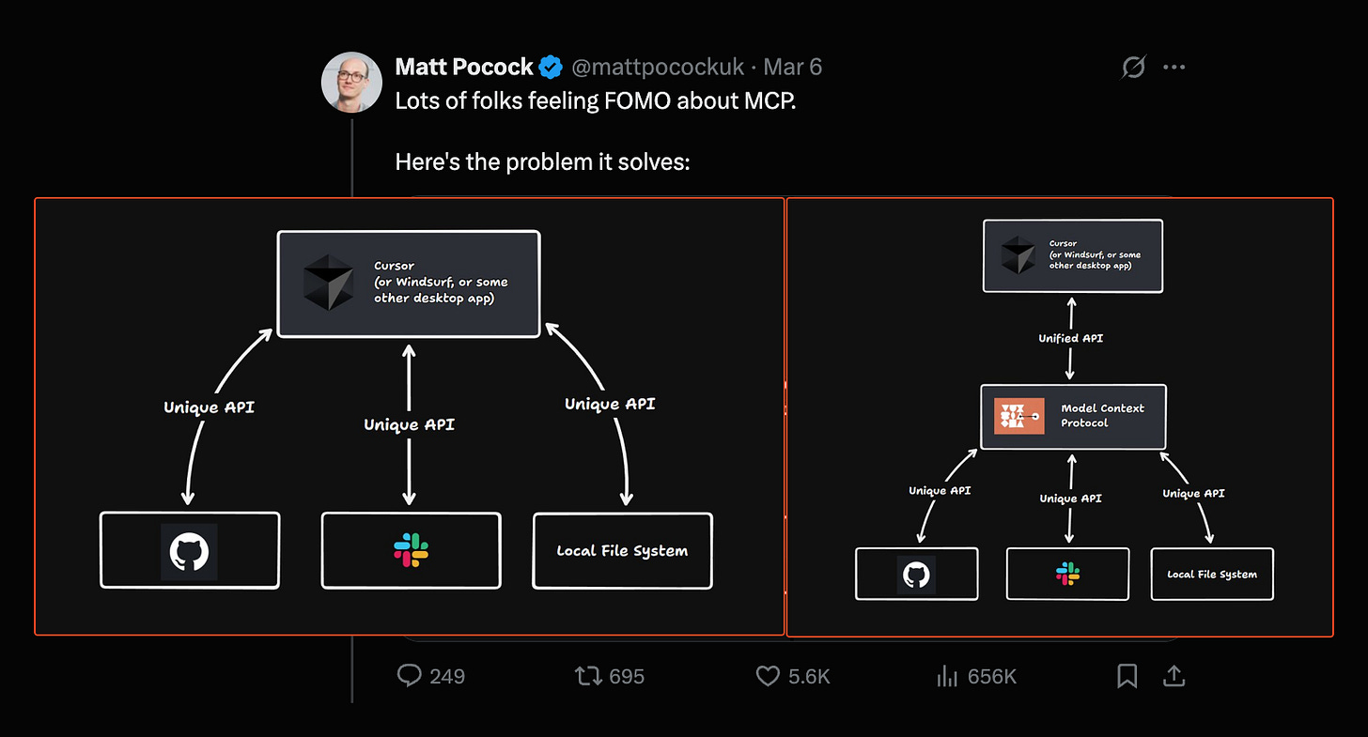
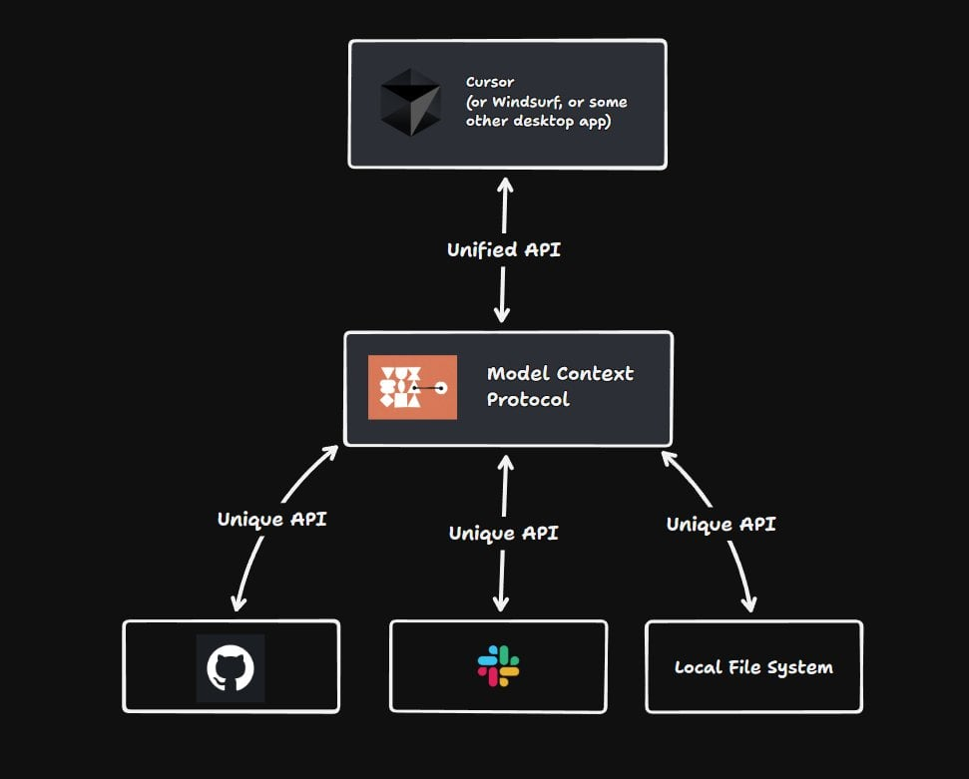
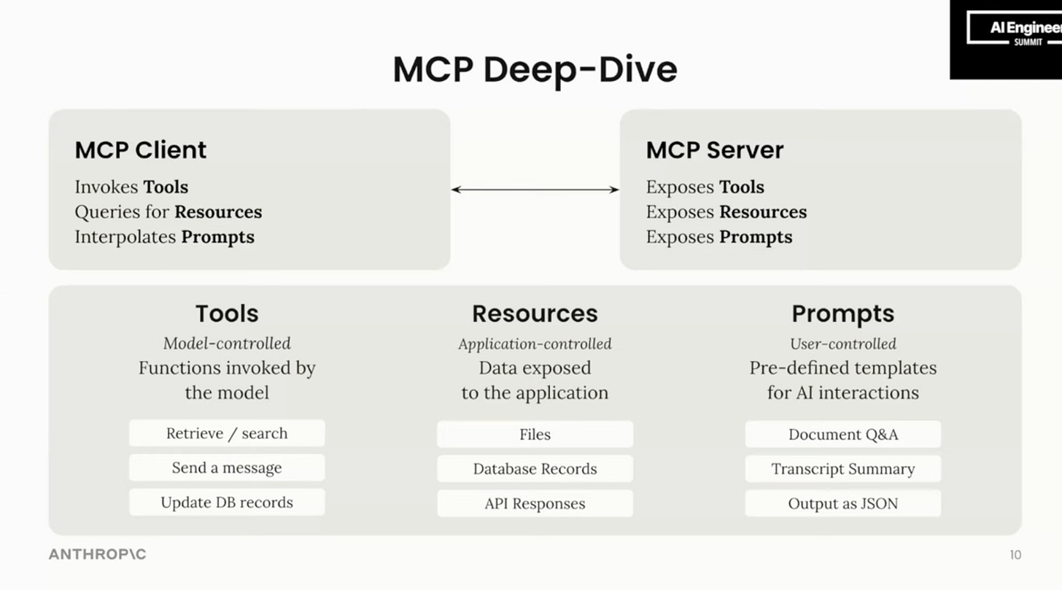
Standardized Tool Calling Protocol
Built in Tool Discovery & Handshake
Context Management and Memory Storage
Seamless LLM-Tool Orchestration
Multi-System Collaboration Support
Rapid Development and Scaling
CORE FEATURES OF MCP
Pre-MCP approach
Post-MCP approach
Components of MCP

Slide 8
CUSTOMER VALUE PROPOSITION
MCP connects siloed HR tools into a unified backend for easier employee management.
Finance teams can use MCP to centralize financial data ingestion, automate forecasting, and optimize cloud spend through AI agents.
MCP-powered chatbots can automate common support tasks by integrating with CRMs and other support platforms.
Hospitals can use MCP-powered systems to stream patient data into AI Agents that can autonomously schedule appointments and retrieve diagnostic data.
Connecting Disparate Systems and Resources
Enable Real-Time, Context-Aware AI Agents
Enterprises use MCP to centralize policy enforcement, automate audit logging across multiple systems.
MCP’s granular activity logs and version control make it easy to trace AI-generated outputs back to their data sources
Automate Compliance, Governance, and Audit
Accelerating Integration
And Support Agentic Workflows
Allows developers to build once and connect to many data sources
Businesses use MCP to build agentic frameworks where AI systems pull context from various enterprise systems and leveraging tools and APIs as needed.

Slide 9
AGENT-TO-AGENT PROTOCOL
MODULAR AGENT COLLABORATION
DECLARATIVE, SCALABLE ORCHESTRATION
ENHANCING AI CAPABILITIES
Enables multiple specialized agents to work together in a coordinated flow.
Each agents can focus on a specific task, creating a powerful multi-agent system.
Developers can use YAML-based configuration to define workflows, goals, tools, and agents.
Simplifies development
Scripted multi-agent workflow, where each agent can call tools independently for its own unique role.
Dynamic discovery and utilization of available tools and resources,

Slide 10
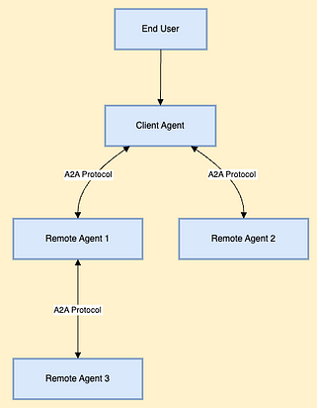
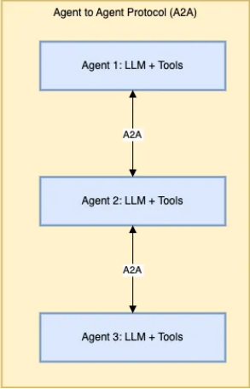
Modular Agent Pipelines
Agents, tools and goals are declared using YAML
Built-in state and memory management
Intelligent Tool routing
CORE FEATURES OF A2A
Interoperability of agents built with different technologies.
Multi-agent collaboration
The client and remote agents communicate through the A2A protocol.
Each remote agents comprises LLMs and their associated tools which are accessed through MCP.

Slide 11
BUSINESS VALUE PROPOSITION
Over 50 leading tech partners have adopted A2A allowing AI agents to exchange information across platforms.
A2A connects AI agents across different departments and cloud environments, breaking down traditional silos and enabling unified workflows.
AI agents where first-line support bots handle general inquiries and escalate specialized issues to expert agents.
Agents can also hand off cases across time zones to collaborate with human representatives as needed.
Vendor-Agnostic Workflows
Customer Service Automation
Organizations can build flexible, modular AI ecosystems where specialized agents can be added, upgraded, or replaced
This allows organizations to rapidly deploy new agents, with minimal integration costs.
Modular AI Infrastructure
Customer support, recommendation and delivery agents can coordinate to provide instant, personalized order fulfillment, and multilingual support.
Improved customer satisfaction and reduced operational costs.
Retail and E-Commerce

Slide 12
FUTURE SCOPE AND TRENDS
SEAMLESS INTEROPERABILITY
INTELLIGENT DECISION MAKING PIPELINES
DEMOCRATIZING AI INTEGRATION
UNIFIED AGENT ECOSYSTEMS
MCP and A2A are not competing, but complementary protocols.
MCP enables tool-level integration, while A2A enables multi-agent collaboration.
While MCP enables communication with tools, A2A can manage coordination and task distribution among agents.
Together, they form the backbone of modular, pluggable, AI systems.
A2A agents will be able to reason, plan, and negotiate across tools registered via MCP..
This enables the development of self-improving agent systems.
MCP and A2A driven systems can lowers the barrier to entry for integrating AI into enterprise workflows.
Sets the stage for non-technical teams to participate in the AI integration process.

Slide 13
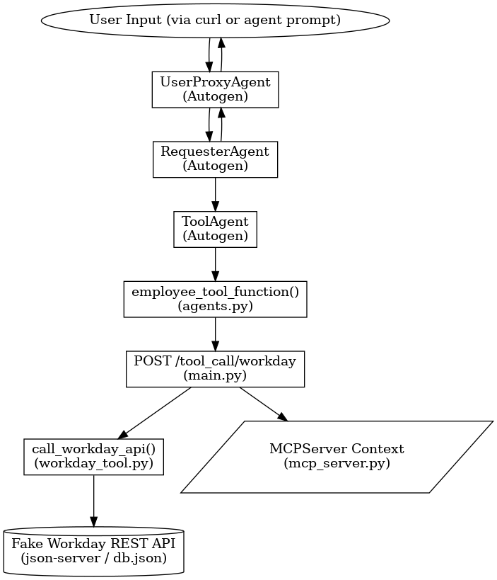
CONTROL FLOW FOR OUR MOCK MCP SERVER PROJECT

Slide 14
CHALLENGES WITH LARGE CONTEXTS AND STRUCTURED DATA
Truncating history causes knowledge loss.
Enterprises need explainable, memory-aware, structure-sensitive agents.
Structured data is hard to query without schema knowledge
LLMS have context window limits.
Dynamic Context Compression trims history based on relevance to current query
Semantic Navigation guides the LLM to explore unknown structures using intent
Enables natural-language-driven queries over long history and real APIs
CURRENT LIMITATIONS
PROPOSED SOLUTION

Slide 15
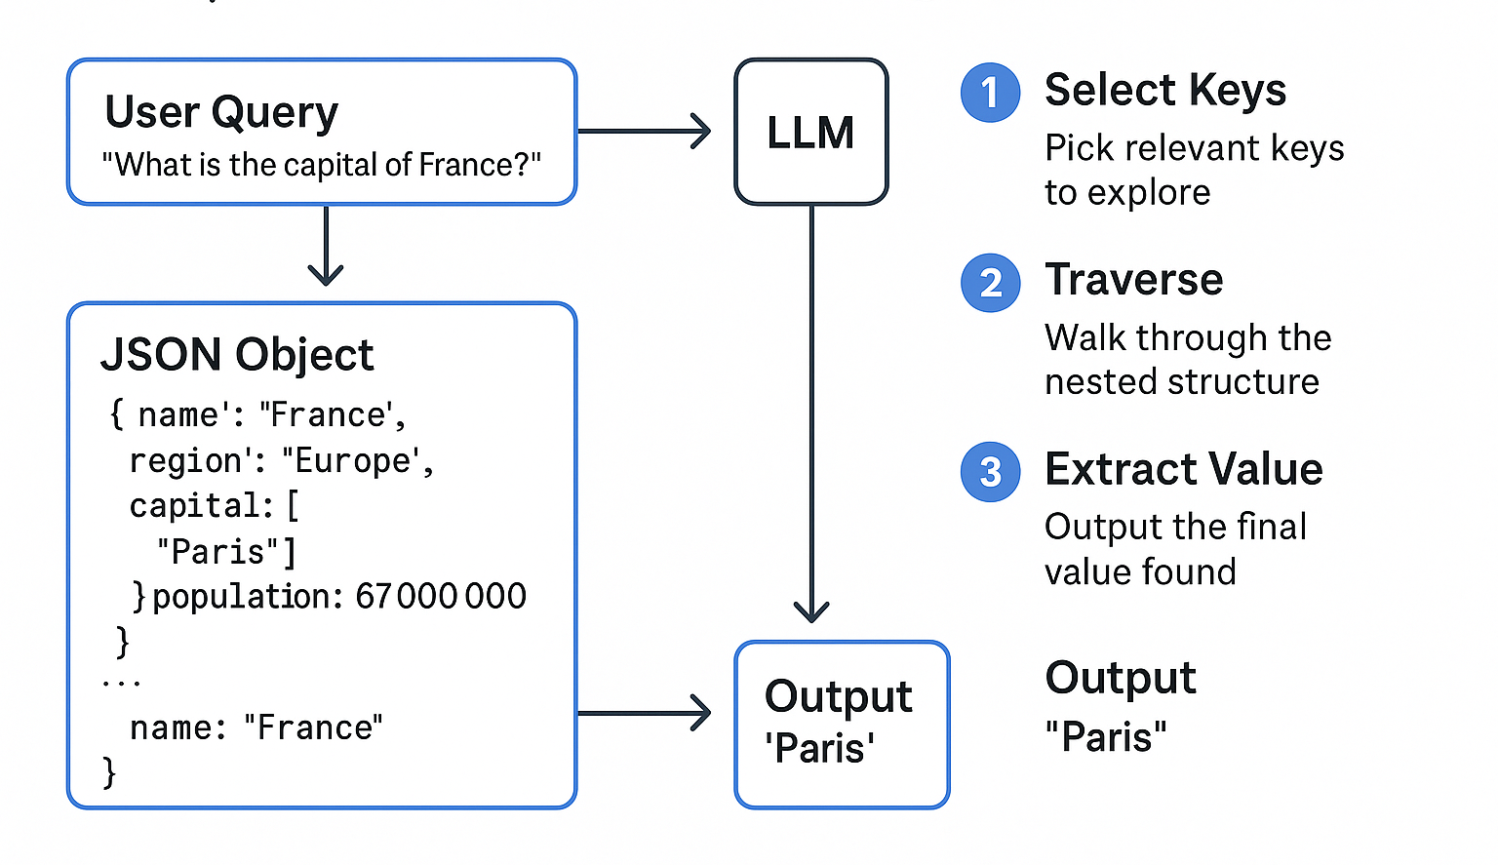
The user submits a query
The system provides current JSON keys + query context to the LLM
The LLM semantically selects the most relevant key
If the value is a dict/list, it recurses with a new sub-prompt
SEMANTIC NAVIGATION
Interoperability of agents built with different technologies.
Builds a reasoning pat, returning the final answer with justification

Slide 16
STRATEGIC IMPACT
NATURAL LANGUAGE INTERACTION
LLM AGNOSTIC
WORKS ACROSS INDUSTRIES
Works across industries, including finance, supply chain, HR, policy, compliance
Enables natural interaction with complex systems — no query language needed
Combines memory, reasoning, and explainability
Architecture-layer innovation — extensible to any LLM (e.g., GPT, Claude, LLaMA)
Ideal foundation for intelligent enterprise copilots and audit-ready agents

