Slide 1
Artificial Intelligence to Crack Passwords
By: Sidharth Bambah

Slide 2
outline
Password Cracking Then: hashCat
hashCat Techniques
Password Cracking Now: PassGAN
Deep Learning
Generative Adversarial Networks (GANs)
PassGan Techniques
Test of PassGan
Future of PassGan
How to Remain Safe
References

Slide 3

Password Cracking Then: hashCat
Self-proclaimed fastest password recovery tool
Required many years of manual coding to build attack methods
Created by Jens Steube

Slide 4
hashCat Techniques (I)
Algorithms accelerated through multiple GPUs
Choice of Algorithm
Brute force: Randomly try combinations
Extrapolating: Using previously leaked passwords.
Probability: Based on previous characters
Must be provided rules
Capitalization, special characters, word combinations

Slide 5
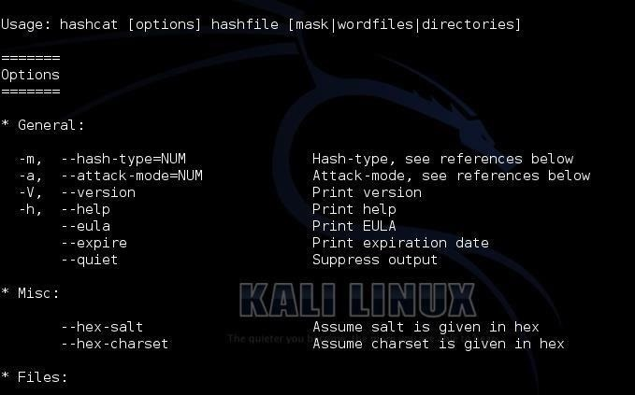
hashCat Techniques (II)

Slide 6
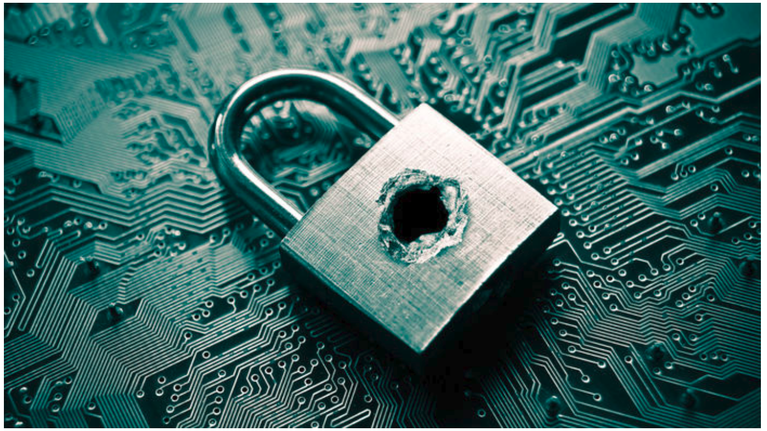
Password Cracking Now: PassGan
Developed by researchers at the Stevens Institute of Technology
Generates numerous password guesses
No manual analysis
Emulates how humans think

Slide 7
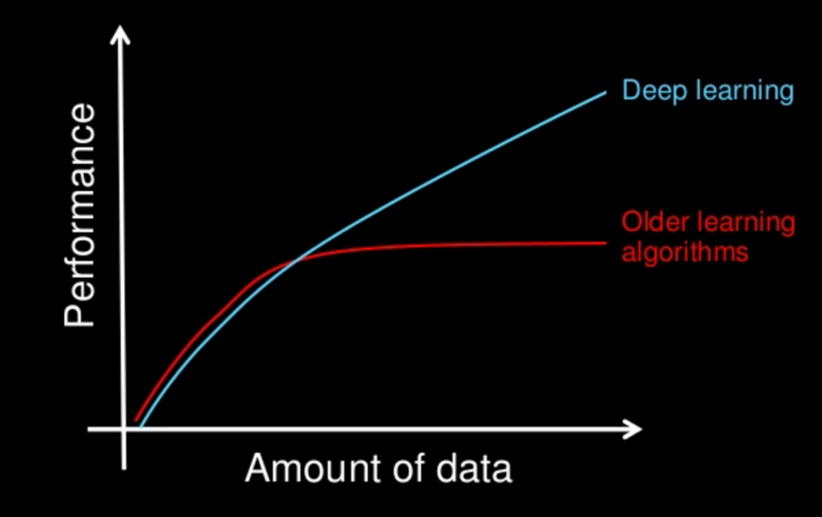
Deep Learning (I)
Learns in an unsupervised manner
Uses pattern analysis
Useful to analyze a large amount of data
Development of layers in neural networks

Slide 8
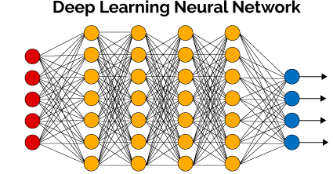
Deep Learning (II)
Neural networks based on brain’s use of layers of neurons
“learn” on training sets of data
Comes up with own rules of processing new data
Used in “a black box manner” ,Wojciech Samech, Fraunhofer Institute of Telecommunications in Berlin

Slide 9
Generative Adversarial Networks (GANs) (I)
Created through two contesting neural networks
Discriminative and Generative
Introduced by Ian Goodfellow
Create data similar to the data fed into them
Uses
Generate realistic images
Model patterns of motion in video
Construct 3D models of objects

Slide 10
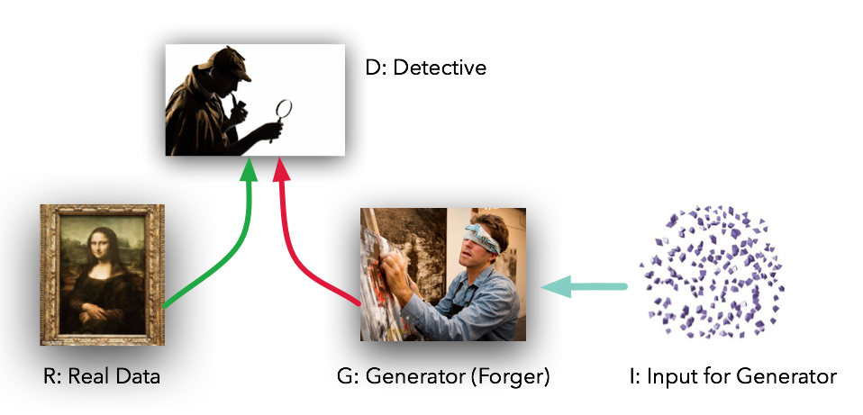
Generative Adversarial Networks (GANs) (II)

Slide 11
PassGan Techniques
Does not need any rules
Uses a generative adversarial network (GAN)
Takes in a set of passwords and generates numerous new, potential passwords
Compares to another set of password and creates its own “rules”

Slide 12
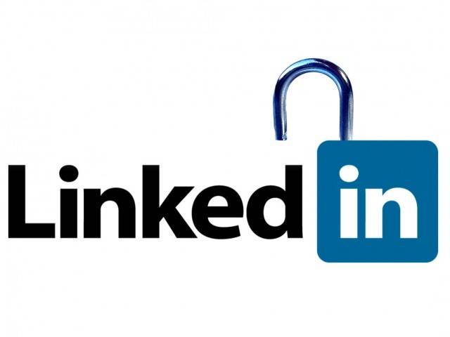
Test of PassGan
Given tens of millions of leaked passwords from RockYou
Generated hundreds of millions of new passwords
Compared generated passwords to leaked passwords from LinkedIn
Generated 12% matches to the leaked passwords

Slide 13

Future of PassGan
Can create passwords indefinitely
Will improve with more neural network layers and more leaked passwords
Giuseppe Ateniese compared it to AlphaGo
“will come up with rules that humans cannot think about”
Uses
Nefarious
Good: “generate decoy passwords to detect breaches”, Thomas Ristenpart, Cornell

Slide 14
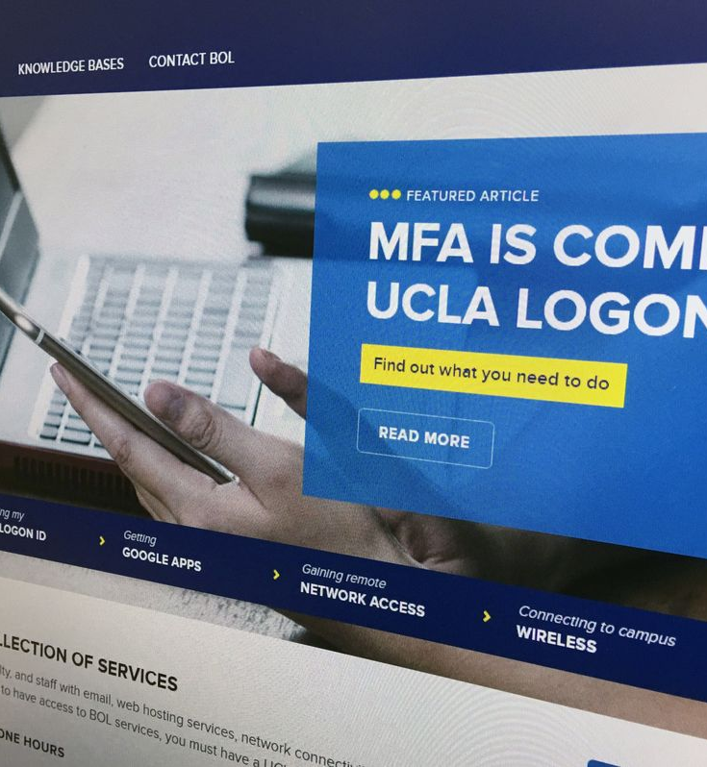
How to Remain Safe
Choose stronger passwords
8 characters or more
Combination of letters, numbers, and symbols
Use multi-factor authentication
Send a text to smartphone
Ping smart watch

Slide 15
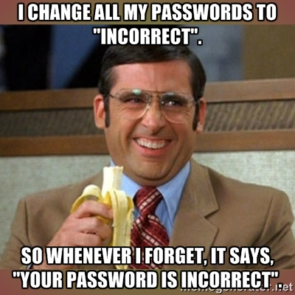
My Suggestion

Slide 16
References
Hutson, Matthew. “Artificial Intelligence Just Made Guessing Your Password a Whole Lot Easier.” ScienceMag, 15 Sept. 2017, www.sciencemag.org/news/2017/09/artificial-intelligence-just-made-guessing-your-password-whole-lot-easier
Hitaj, Briland, et al. “PassGAN: A Deep Learning Approach for Password Guessing.”Cornell Univsersity Library, 1 Sept. 2017, www.arxiv.org/abs/1709.00440
Snow, Jackie. “Brainlike Computers Are a Black Box. Scientists Are Finally Peering Inside.” ScienceMag, 26 July 2017, www.sciencemag.org/news/2017/03/brainlike-computers-are-black-box-scientists-are-finally-peering-inside

Slide 17
THANK YOU!!

