Slide 1
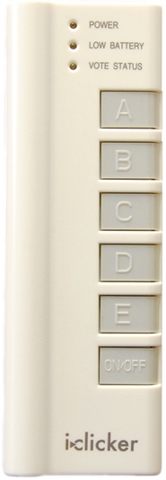
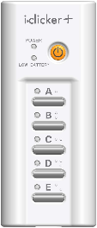

For iClicker remote users: | For iClicker REEF Polling Users:
Students in this class may use an iClicker remote. One can be purchased at the Cornell Store, or many online sites such as Kraftees, eBay or Craigslist. Any type of i>clicker remote will work: iClicker, iClicker+, or iClicker2 models. How to register your iClicker remote through Blackboard: Click the above link iClicker Student Registration Type in the iClicker Remote ID on the back of your clicker Click Submit NOTE: Registering your clicker for one Blackboard course will automatically register your clicker for ALL Blackboard courses each semester. Please do not register i>clickers at the iclicker.com site. | Students in this class may use a web-enabled device for iClicker REEF Polling: laptop computer, tablet, Apple iPad, and Smart phone are all devices that can be used Instructions: Students purchase a REEF Polling subscription - $14.99 per 6-months, or other options for longer subscriptions are available Purchase your subscription at: REEF Education or download the app from the Apple Store or Google Play Store on your smart phone. IMPORTANT NOTE: When filling out your information, the Student ID field MUST be your Cornell NetID (such as ewe2) and not your Cornell Student ID Add this course to your list by tapping/clicking the + in the upper-right and searching for the course or instructor name When in class, log in to app.reef-education.com or open your app and answer the questions as they are presented to you in class – multiple choice (A-E choices) or short-answer (up to 16 alpha-numeric characters) NOTE: Your app or web page access to iClicker REEF Polling is already registered to your name, so you do not need to register it in Blackboard.
If you cannot read the clicker remote ID: To find your i>clicker ID #: Please stop in to one of these locations with your clicker: - Carpenter Hall Reading Room (1st floor) between 9:00am – Noon, Monday – Friday - Uris Library Tower Room between 9:00am – Noon, Monday – Friday - the Academic Technology Center, 124 Computing & Communications Center building (on the Ag Quad, next to Bailey Hall), between 9:00am – 5:00pm, Monday – Friday and one of the staff can confirm your iClicker ID #. Once it has been confirmed, please write it on a small piece of paper and place it inside the battery compartment.
If you have any other issues with your iClicker remote or your REEF Polling app, please stop in to the Academic Technology Center, 123 Computing & Communications Center building (on the Ag Quad, near Bailey Hall), between 9:00am – 5:00pm, Monday – Friday.

