Slide 1
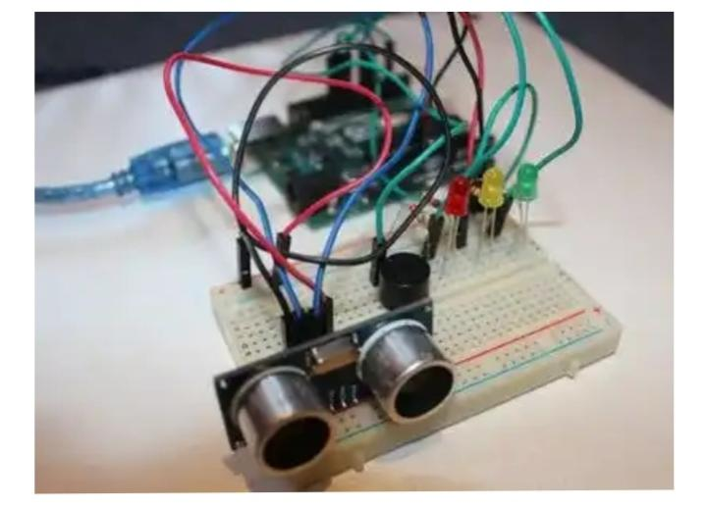
ULTRASONIC SECURITY SYSTEM

Slide 2
INTRODUCTION:
This is a simple alarm system made with help of buzzer, LED and an Ultrasonic sensor also known as Proximity/Distance Sensor (HC-SR04). One can stop the buzzer by pressing the button.

Slide 3
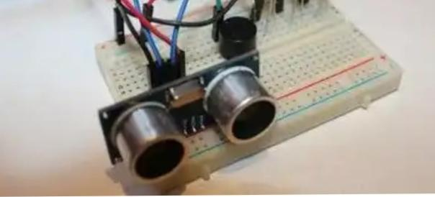
Ultrasonic movement detector:

Slide 4
Introduction to ultrasonic movement detector:
The circuit uses a matched pair of 40 kHz transducer elements to detect movement up to 1.5 feet away. The unit switches a LED for movement indication. Sensitivity is adjustable via control. Crystal locked circuit for maximum stability. The circuit uses PCB and 40khzs transducers One transducers use as transmitter and other as receivers. • A 9 to 12 volt DC supply to PC board. An alarm system circuit is also attached which is connected to buzzer (speaker).

