Slide 1
Recommendation system for food stalls aimed at students
Data Science Capstone Project
-Siddharth Jain

Slide 2
Brief Introduction
Mumbai, India is an extremely densely populated city (one of the most dense), with more than 18 million residents.
Obviously it is tough to start a business here due to high real estate costs. So, an entrepreneur aiming at a student centric market (13 - 20 year old demographic) should know the best places to set up shop.
A large population of Mumbai lies in this student demographic (more than 50 schools), and eating snack foods out is more popular and convenient than ever, hence we will find the best places in Mumbai to set up a food shop/ restaurant.

Slide 3
Target Audience
Entrepreneurs and small-scale businessmen/women interested in the food/ snacks industry, aiming at the student demographic

Slide 4
Required Data

Slide 5
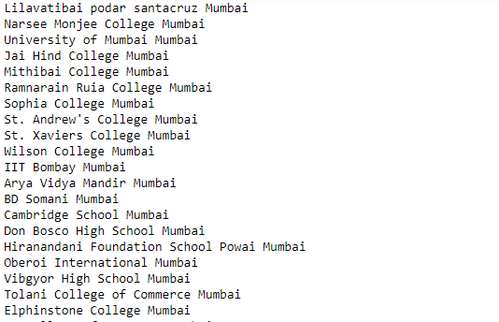
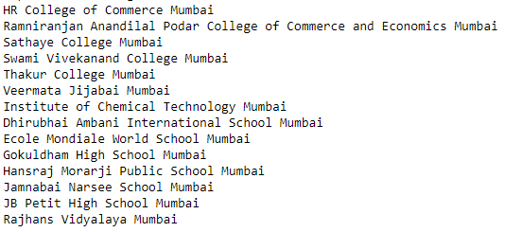
Data That Is Needed
We need a list of the most popular schools in Mumbai. Their latitude and longitude will be calculated using Geopy Nominatim (a Python Library).
This data can be found on Wikipedia, as well as the school websites.
For instance: https://en.wikipedia.org/wiki/List_of_educational_institutions_in_Mumbai
We choose these institutes:

Slide 6
Data That Is Needed
Then we can use the FourSquare API to find the number of eateries in a 1km radius around each school. The API will provide us with Postal Code, Neighborhood, Venue, Venue Summary and Venue Category.
Foursquare is a local search-and-discovery service mobile app which provides search results for its users (Wikipedia). It has more than 60 million users.
We can also use the FourSquare API to find all food related categories that we will filter.

Slide 7
Building The Project

Slide 8
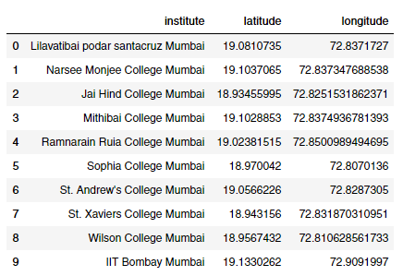
Institute Locations
Using the Nominatim Python Package

Slide 9
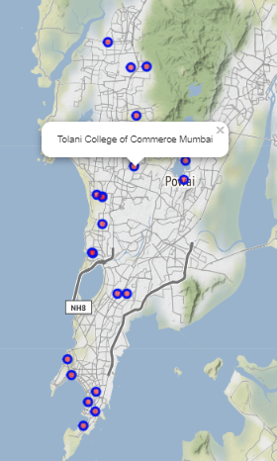
Plotting The Institutes on a map of Mumbai, India

Slide 10
Eatery Locations Near Institutes
More than 1050 eateries analysed.

Slide 11
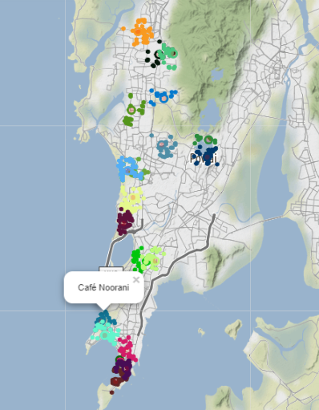
Plotting the Eateries
Each is color coded according to the educational institute nearest to it.

Slide 12
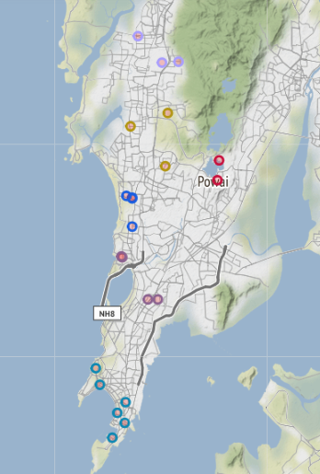
Clustering the Educational Institutes
Some of the eateries overlap. So instead of grouping locations based on colleges, we can use clustering to group colleges together based on distance from each other.
They are color coded to denote their groups.

Slide 13
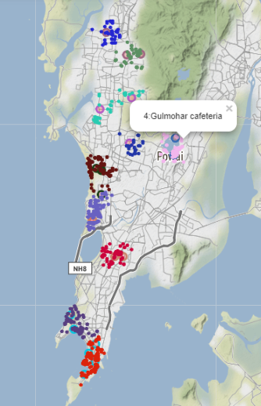
Finally clustering the Eateries
We do this to find the ones with least number of eateries in a radius.
Each eatery is labelled with the cluster it is a part of.

Slide 14
Analysis of Exploration

Slide 15
Analysis
From the maps, we can see that some clusters are much smaller than others. Let us look into the counts for each cluster.
We find that Cluster 1 has only 27 eateries around it.
This is near Tolani College (Dark Blue cluster).
It is a well reputed college in Mumbai and has a large student population.

Slide 16
Analysis
A good eatery aimed at students, or even at the general public would do well here due to sheer lack of competition in the vicinity.
Hence we find that the best place for a food shop aimed at students in the age range of 13 to 20 year old will be near Tolani College in Andheri East, Mumbai.

Slide 17
Analysis
We also find that 2 clusters have approximately 200 eateries near them.
These could be great localities to advertise an upcoming new fast food shop or restaurant.
The first cluster is near BD Somani College, Elphinstone College, Jai Hind College and Sophia College.
The second is near Mithibai College, Narsee Monjee College and Jamnabai Narsee School.

Slide 18
Thank you for your time.
The full project can be found on my github: https://github.com/SidJain1412/Coursera_Capstone
(with interactive maps)
Contact: sidjain1412.github.io

