Slide 1
Diabetes Risk Prediction using Deep Learning
Applied Machine Learning 2024
Alena Thomas | Ananya Kaushal | Om Ambaye | Siddhant Shah

Slide 2
Problem Statement

Slide 3
Introduction to the Problem
Diabetes is a serious chronic disease in which individuals lose the ability to effectively regulate levels of glucose in the blood, and can lead to reduced quality of life and life expectancy.
Complications like heart disease, vision loss, lower-limb amputation, and kidney disease are associated with chronically high levels of sugar remaining in the bloodstream for those with diabetes.
Early diagnosis can lead to lifestyle changes and more effective treatment, making predictive models for diabetes risk important tools for public and public health officials.

Slide 4
Context
CDC has indicated that as of 2018, 34.2 million Americans have diabetes and 88 million have prediabetes. Furthermore, the CDC estimates that 1 in 5 diabetics, and roughly 8 in 10 pre-diabetics are unaware of their risk.
Diabetes ranks as the seventh leading cause of death in America, emphasizing the need for effective management and treatment strategies.
Diabetes also places a massive burden on the economy, with diagnosed diabetes costs of roughly $327 billion dollars and total costs with undiagnosed diabetes and prediabetes approaching $400 billion dollars annually.

Slide 5
Dataset
Link: https://www.kaggle.com/datasets/alexteboul/diabetes-health-indicators-dataset
This is a clean dataset of 70,692 survey responses to the CDC's BRFSS 2015. It has an equal 50-50 split of respondents with no diabetes and with either prediabetes or diabetes. The target variable Diabetes_binary has 2 classes. 0 is for no diabetes, and 1 is for prediabetes or diabetes. This dataset has 21 feature variables and is balanced.
The Behavioral Risk Factor Surveillance System (BRFSS) is a health-related telephone survey that is collected annually by the CDC. Each year, the survey collects responses from over 400,000 Americans on health-related risk behaviors, chronic health conditions, and the use of preventative services.

Slide 6
Challenges
Variables such as lifestyle choices, underlying health conditions, and socioeconomic factors interact in complex ways that can obscure clear patterns.
Inaccurate or inconsistently recorded data can lead to misleading model conclusions.
Models developed on this dataset might not generalize well to other populations if the sample is not representative of the broader diabetic population.

Slide 7
Trade Offs
Model Complexity vs. Interpretability:
More complex models (like neural networks) might capture nuanced patterns in data but can be difficult to interpret. Simpler models (like decision trees) are easier to understand and interpret but might miss complex interactions or nonlinear relationships.
Coverage vs Depth of Data:
Including a wide range of variables gives a comprehensive view but can dilute focus and introduce noise. Concentrating on fewer, highly relevant variables can deepen understanding of key factors but might overlook important contributing factors.

Slide 8
Learning &
Models

Slide 9
Models
Model | Purpose | Advantage
Linear Regression | Establish a baseline for comparison. | Simple and interpretable, ideal for direct relationship analysis.
Decision Tree | Capture non-linear relationships and interactions. | Easy to understand, handles various data types, and illustrates decision paths.
Deep Neural Network | Model complex patterns in large datasets. | Powerful in detecting subtle interactions, suitable for comprehensive analytics.

Slide 10
Performance Comparison
Metrics | Linear Regression | Decision Tree | Neural Network
Accuracy | 0.7536 | 0.7240 | 0.7369
Precision | 0.7366 | 0.7011 | 0.6791
Recall | 0.7895 | 0.7808 | 0.8983
F1 Score | 0.7622 | 0.7388 | 0.7735
AUC ROC | 0.7536 | 0.7240 | 0.7369

Slide 11
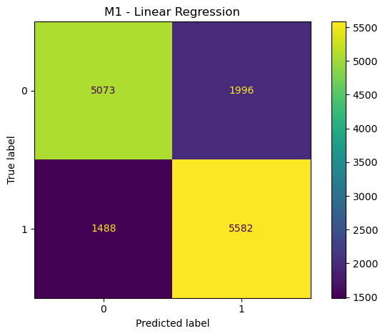
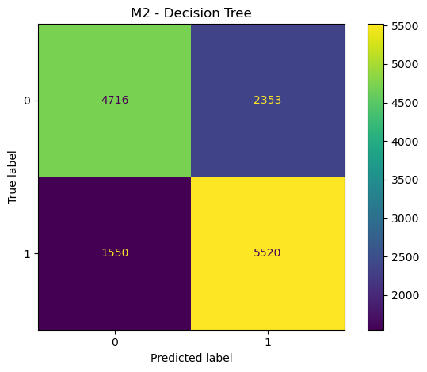
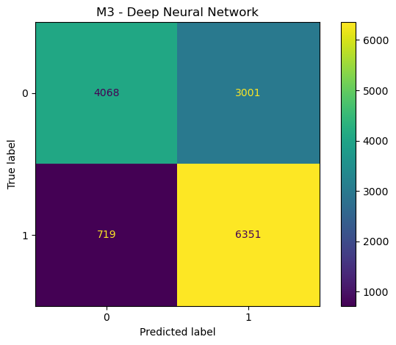
Confusion Matrices

Slide 12
Model Insights
It is clear that the Linear Regression model has better accuracy
(0.7536 vs 0.7240 and 0.7369)
However, the priority with this prediction is to decrease false negatives and increasing true positives, as we wish to identify the patients that are at-risk or are already suffering from diabetes.
Thus, we have to prioritise recall while maintaining a reasonable accuracy.
Hence, we suggest using the Neural Network Model which has the highest recall, by a significant margin.
(0.8983 vs 0.7895 and 0.7808)

Slide 13
Code
Walkthrough

Slide 14
Team Contributions

Slide 15
Team 404
Alena Maria Thomas | MDS202303
Implemented Deep Neural network
Ananya Kaushal | MDS202306
Created slides and compared various models’ performances
Om Hrishikesh Ambaye | MDS202338
Created slides and looked at the challenges and tradeoffs
Siddhant Shah | BMC202171
Implemented Linear Regression and Decision Tree Classifiers

Slide 16
Questions

