Slide 1
Secure Data hiding in images using steganography
CAPSTONE PROJECT
Student Name : Sidhant Vijh
College Name : University of Strathclyde

Slide 2
OUTLINE
Problem Statement
Technology used
Wow factor
End users
Result
Conclusion
Git-hub Link
Future scope

Slide 3
Problem Statement
Ensuring data confidentiality is crucial in digital communication. Traditional encryption is detectable, making it vulnerable. Steganography hides messages within images, ensuring secrecy. This project securely embeds and extracts hidden messages using Python.

Slide 4
Technology used
Programming Language: Python
Development Environment: Anaconda
Libraries Used:
OpenCV (for image processing)
OS (for file handling and execution)
Platform: Windows (compatible with other OS with minor modifications)

Slide 5
Wow factors
Invisible Encryption: Hides data within images without altering their appearance.
Undetectable by Hackers: Unlike traditional encryption, it doesn’t raise suspicion.
Quick & Lightweight: Fast processing with minimal resource usage.
No Extra Storage Needed: Embeds data without noticeably increasing file size.
Easy to Use & Modify: Simple Python implementation with OpenCV.

Slide 6
End users
Security Professionals: For embedding sensitive data securely within images for confidential communication.
Digital Forensics Experts: To detect hidden data in images during investigations.
Developers & Programmers: For integrating steganography into apps and tools for secure messaging.
Private Individuals: To share confidential information in a covert manner.
Businesses: For secure internal communication without raising suspicion of data transmission.

Slide 7
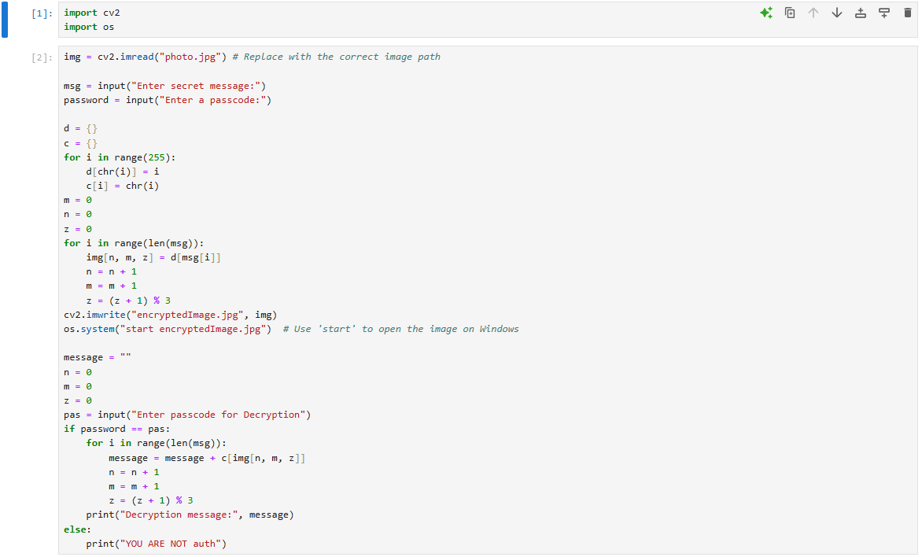

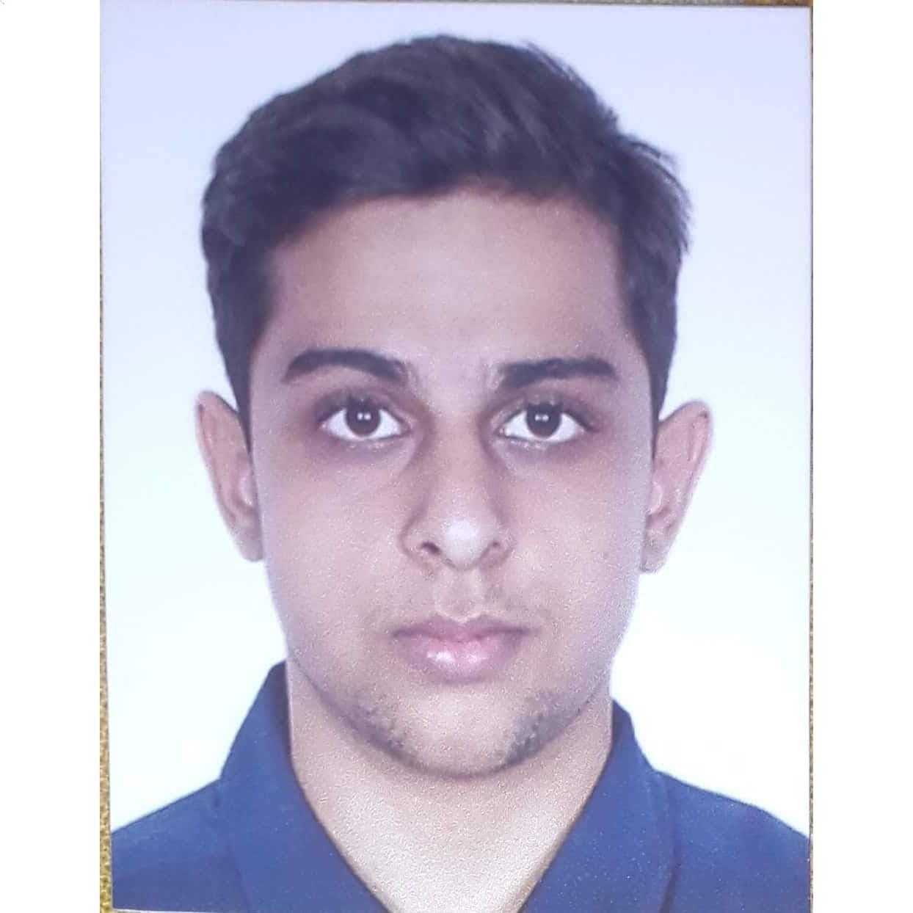
Results

Slide 8
Conclusion
This project successfully addresses the growing need for secure data transmission by using steganography to hide messages within images. Unlike traditional encryption, this method ensures the confidentiality of sensitive information without raising suspicion. The implementation is lightweight, fast, and simple, providing an effective solution for secure communication. By utilizing Python and OpenCV, we’ve created a tool that is both practical and adaptable for various use cases, ensuring data privacy in the digital age.

Slide 9
GitHub Link
https://github.com/SidVijh/Stegno_Edunet.git

Slide 10
Future scope
Stronger Encryption: Integrate advanced encryption for enhanced security.
Video Support: Extend to hide messages in videos.
Steganalysis Tools: Develop tools to detect hidden data.
Cross-Platform App: Create a user-friendly app for multiple devices.
Real-Time Messaging: Enable live, secure communication using steganography.

Slide 11
THANK YOU

