Slide 1


Music Genre Classification model using machine Learning
ArIES Project
Made by:
Pranjal Vanjale
Siddhant Gupta
Vidhi Gupta
Yashovardhan
Mentored by:
Aishwarya Rao Maratha
Shreshth Mehrotra

Slide 2
HOW WE CHOSE OUR MACHINE LEARNING ALGORITHM?
KNN
CNN
Vs
In KNN, output completely relies on nearest neighbors, which may or may not be good choice. Also it is sensitive to distance metrics.
We chose to use CNN as CNNs store much more information as parameters than other methods and CNNs build their own features from raw signal. These features make the use of CNN more appropriate.

Slide 3
Operations carried out
Get the dataset
Prepare the data
Train a model
GTZAN dataset consisting of 10genres x 100 audio files are loaded using librosa
Signal Processing Via MFCC Feature extraction and STFT
We will be using two models : CNN and Ensembler using CNN
Latency, Recommendation and Deployment
Improve Model
Evaluate the model
Compare accuracies , identify problems and test on Random data
Pruning , Quantization are carried out along with making a recommendation block
Cases of Overfitting, Underfitting, Accuracy , Generalisation are solved here

Slide 4
AUDIO PRE-PROCESSING
To start with we first load Audio files through librosa and get signal ( numpy array of amplitude +1 to -1) and sample rate ( sample rate is the number of samples per second that are taken of a waveform to create discrete digital signal)
Input Sound File
Fourier transform(FT)
Short Time Fourier transform(STFT)
Decompose complex periodic sound wave as a sum of sine waves oscillating at different frequencies.Fourier Transform converts Time Domain Dependency Waveform ( Amplitude vs Time ) into Frequency Domain Dependency ( Amplitude vs Frequency ).
computes several FFT at different time intervals.So it preserves time information STFT produces a spectogram(time +frequency+magnitude).
MFCC feature
The mel frequency cepstral coefficients of a signal are a small set of features (usually 10-20) which concisely describe the overall shape of spectral envelope.
Output MFCC

Slide 5
Our Primary Model Structure
Padding=same ( if needed)(P)
Flatten
Dense
1st Layer
Conv2D
Max Pooling
& Batch Normalisation
32 Channels of (3,3) Filters
(1,1) Stride
Probabilistic Layer (Softmax)
(3,3) Filters
(2,2) Stride
L2=0.01
ReLU
P
(130,13,1)
(128, 11, 32)
( 64, 6, 32)
Conv2D
Max Pooling
& Batch Normalisation
32 Channels of (3,3) Filters
(1,1) Stride
2nd Layer
(3,3) Filters
(2,2) Stride
(480)
(64)
(10)
L2=0.01
ReLU
P
(62, 4, 32)
(31, 2, 32)
Conv2D
Max Pooling
& Batch Normalisation
32 Channels of (3,3) Filters
(1,1) Stride
3rd Layer
(3,3) Filters
(2,2) Stride
+ Dropout
L2=0.01
ReLU
P
( 30, 1, 32)
(15, 1, 32)
Fully Connected Layer

Slide 6
Parameter Training
BN has 4 parameter in all 32 channels - Gamma,Beta, Moving Mean and Variance
The Primary Model Shown was Compiled by Training Params with Loss function = Sparse Categorical Cross entropy and Optimizer = Adam
Conv Layers
BN Layers
01
(Without BN , Dropout , L2)
Test Accuracy(TA) was able to reach 70%
While Validation Accuracy (VA) came out to be 96%
HENCE POINTING TO OVERFITTING
We Recovered from this by handling Overfitting
320 Params
128 Params
02
A total of 45,322 params were trained and 192 were left out
( Batch Normalization )
9248 Params
128 Params
Dense
Dense Softmax
03
We used Certain number of epochs and Used Early Stopping to increase efficiency
4128 Params
128 Params
30784
Params
650 Params

Slide 7
Problem that we were facing
We see that the model performs well on the training data but does not perform that well on the evaluation data. This is because the model is memorizing the data it has seen and is unable to generalize to unseen examples. Overfitting refers to an unwanted behavior of a machine learning algorithm used for predictive modeling.Overfitting happens due to several reasons, such as: The training data size is too small and does not contain enough data samples to accurately represent all possible input data values.
Overfitting

Slide 8
HOW WE TACKLED OVERFITTING?
We used L2 regularization technique to reduce our kernel values. It adds up sqaure of kernel values in the loss functions.
Weight Decay
Some techniques we used
this drops out some of the neurons by setting their activations to zero with a given probability,preventing it to rely on one feature
Dropout
If the performance on the validation dataset does not improve over a certain number of epochs, the training process is stopped
Early Stopping
This Normalizes the Activations in each Channel using its Mean and Variance in each mini batch. This can Regularize the Model.
Batch Normalization

Slide 9

Our Recovery
Test Accuracy
Validation Accuracy
96%
70%
Primary
Primary
77%
93%
Fixed Overfitting
Fixed overfitting
Used L2,BN,Dropout
Used L2,BN,Dropout
80%
94%
Ensembler
Ensembler
Used Voting Classifier and GridCVSearch
Used Voting Classifier and GridCVSearch

Slide 10
Ensembler-VotingClf (Voting)
01
02
03
04
Create Function
Model Instance
Parameter Grid
Voting Classifier Instance
For Generating Model by instruction for Primary Model
Create an instance of the CNN skeleton model
Define a Parameter Grid for Selecting different parameters to choose from
Create a VotingClf instance by inputting default values in
05
06
07
Grid CV Search
Fitting
Computational Time
Applying Cross Validation (any folds) as well as Searching Through the Grid
Fitting Data in the Model
Venus has a beautiful name, but it’s very hot

Slide 11
ENSEMBLE LEARNING?
Why ?
How?
What?
Ensemble learning is mainly used to increase accuracy and obtain a low bias low variance model. Disadvantage of using this is that it increases Computational complexity
There are primarily two ways in which we can have different models :
By having different algorithms for different models.
By having same algorithm for all models but trained on different datasets.
Ensemble learning model is a collection of small models.
In our model we have implemented Soft Voting Ensembling in which all the models are trained with same algorithm but different hyperparameters in 2 folds for Cross Validation
So in total we are training 2x24=48 base models.
Suppose there are 50 models and each model predicts something(0/1).Suppose 40 models predict 1 and 10 models predict 0 then the final output will be 1.
Similarly, in this case each model will predict a particular value. Then the final output will be average or maximum of all the predicted values.

Slide 12
Types of Ensembler
Voting
01
02
Stacking
Base models have different algorithms or same algorithm with different hyperparameters trained with same dataset.In voting all the base models have equal weightages.
In this case in addition to what is done in voting another model is trained by giving inputs (which are outputs of all models) to decide the weightages of these base models in providing the final output.
There are four different types of ensemble learning
03
Boosting
04
Bagging
In this case one model is
First trained on the dataset and
then the wrongly predicted data is passed
for training to the next model with same
algorithm and this is done for multiple
Number of times.So with each new model
iteration,the weights of the misclassified data in
the previous model are increased.This redistribution of weights helps the algorithm identify the parameters that it needs to focus on improving its performance.
Base models are trained with same algorithm but on different dataset. Special case of this is Random forest in which base model algorithm is decision tree.
In bagging, weak learners are trained in parallel.

Slide 13
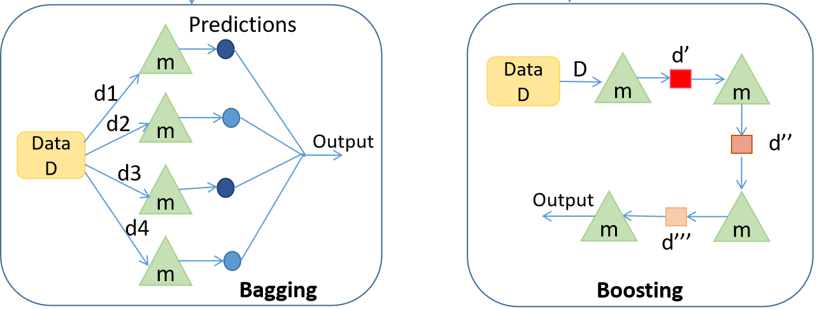
Bagging v/s Boosting v/s Voting
m1
Hard voting
Soft voting
Data
D
m2
Max
votes
Average
out
m3
Voting
m4

