Slide 1
Toward News Authenticity: Synthesizing Natural Language Processing and Human Expert Opinion to Evaluate News
By Shafaat Siddhi
ST:
Farah Binta Haque

Slide 2
Paper Title:
Toward News Authenticity: Synthesizing Natural Language Processing and Human Expert Opinion to Evaluate News

Slide 3
Introduction:
The paper addresses the challenges of fake news in the Bangla language, such as the lack of reliable datasets.
The complexity of the language and the socio-political influence on news media
The absence of a proper news evaluation process.

Slide 4
Methodology:
The paper suggests a decentralized platform that combines human expert opinion and machine classification using a novel synthesis procedure. The paper also uses incremental machine learning to keep the NLP model updated with new data using ethereum networks.

Slide 5
TESTED MODELS:
Hybrid Learning
SVM Classifier
Deep learning based detection
Data Striving
Bangla-Bert-Base
Bangla-BERT
mBERT

Slide 6
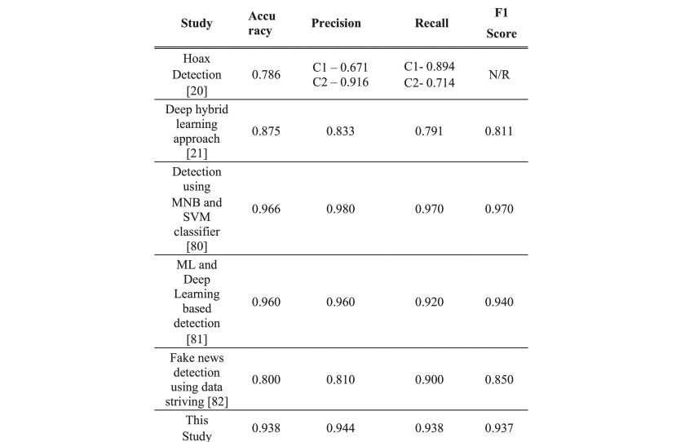
RESULTS:

Slide 7
LIMITATIONS:
Human expert evaluations are needed. Which is complex and time-consuming in terms of large-scale news authentication.
The blockchain network is a trade-off between reliability and computational cost because it is expensive in terms of execution and mining time.

Slide 8
CONCLUSION:
The NLP model was chosen by experimenting with three Bert-based models. The Bert-base-multilingual-cased model was chosen among three competing models with an initial training accuracy of 87.35% and testing accuracy of 88.63%. The Bangla-Bert-base scored nominally better training and testing accuracy.
The initial accuracies were improved to 93.75% training and 93.80% testing accuracy by incrementally training the model. This paper proposed news evaluation process using blockchain, smart contract and NLP shows great prospects in the pre-evaluation of news.

Slide 9
Thank you

