Slide 1
Exploring Natural Language Processing in Model-To-Model Transformations.
By Shafaat Siddhi
ST:
Farah Binta Haque

Slide 2
Paper Title:
Exploring Natural Language Processing in Model-To-Model Transformations.

Slide 3
Introduction:
This paper seeks to solve and improve the abbreviation/acronym
Conjunctive/disjunctive statements detection problem in Machine Learning based detection.
This model can be used in similar topics such as process mining, and conversational intelligence.

Slide 4
Methodology:
This paper is one of the first to apply deep learning-driven techniques to extract information from NLP models.
Parts of speech tagging.
Formal grammar-based extraction.
sequence tagging.

Slide 5
TESTED MODELS:
STANZA
SPACY
BERT
ALLEN NLP
ELECTRA

Slide 6
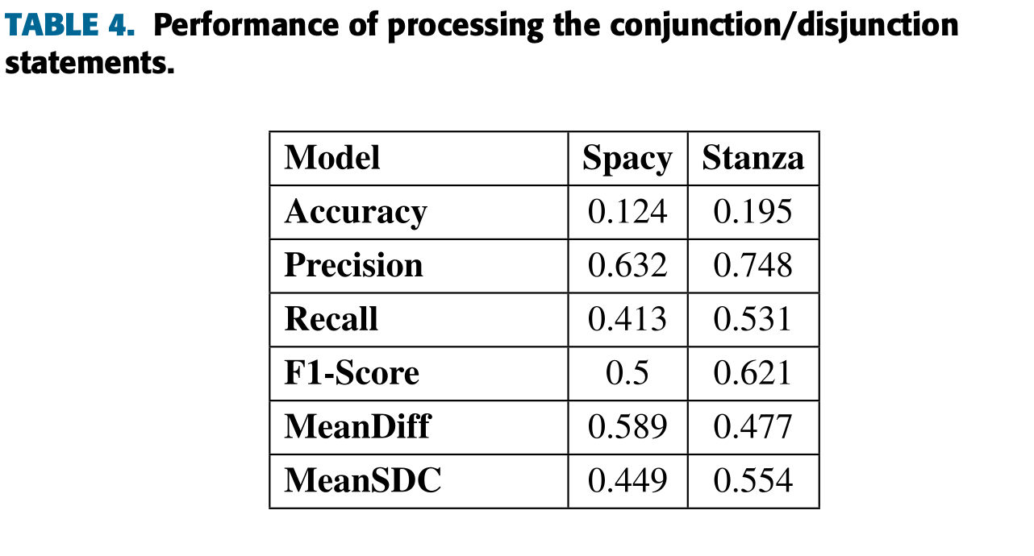
RESULTS:

Slide 7
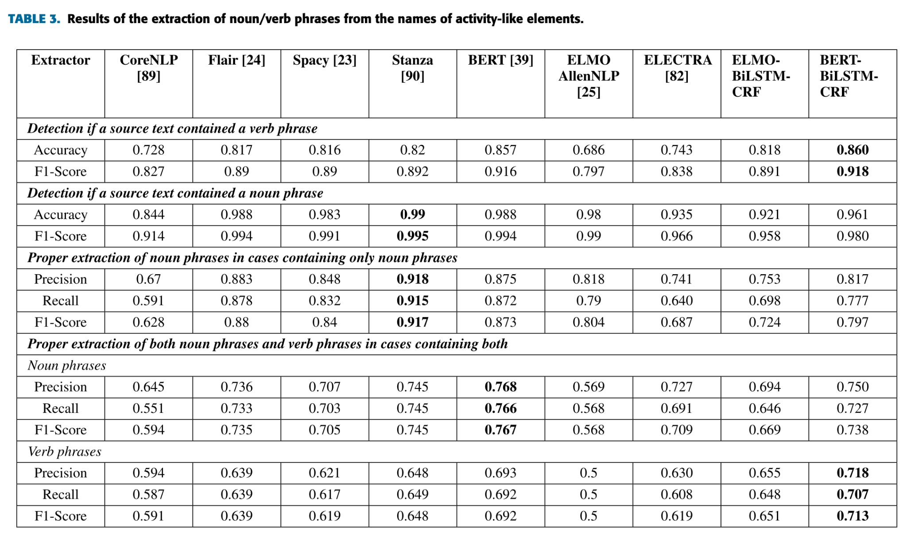
RESULTS:

Slide 8
LIMITATIONS:
Partial model-to-model transformation.
Not optimized for large-scale deployment.

Slide 9
CONCLUSION:
Stanza-based model outperformed all other models in abbreviation/acronym detections. However, BERT-BiLSTM- CRF outperformed all other models for the verb phrase detection task.
The paper provides valuable insights into the potential applications of NLP in improving the quality of model-to-model transformations and the use of deep learning techniques for NLP tasks. The paper offers valuable insights into the potential applications of natural language processing (NLP) in improving the quality of model-to-model transformations and the use of deep learning techniques for NLP tasks.

Slide 10
Thank you

