Slide 1
Cricket Player Analysis
An Analytical and Predictive Study on T20 Cricket Players
By – Sidak Preet Singh

Slide 2
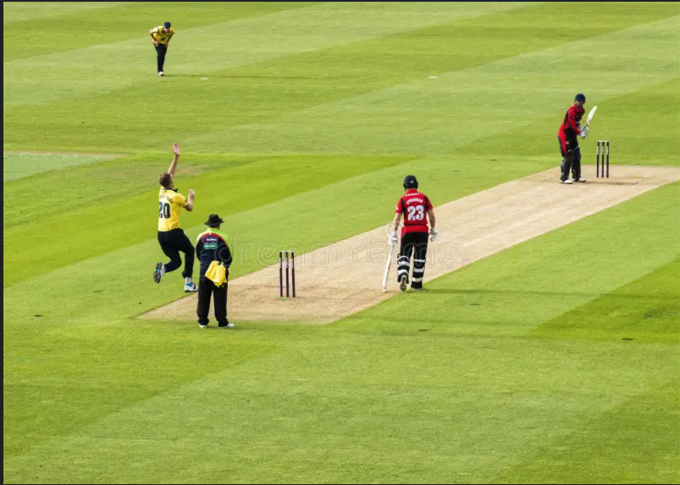
Introduction to Cricket
Structure: It is played between two teams of 11 players each. The main objective is to score more runs than the opposing team while taking turns to bat and bowl.
How the Game Works:
Batting: Players score runs by hitting the ball and running between the wickets or hitting boundaries (4 runs if the ball touches the ground and reaches the boundary, or 6 runs if it clears the boundary in the air).
Bowling: Bowlers try to dismiss batters using techniques like bowling them out, catching them, or running them out.
Why T20 Cricket for Analysis? T20 cricket is widely loved for its quick pace, explosive batting, tight bowling, and thrilling finishes. This makes it ideal for detailed analysis, focusing on key moments and high-impact performances.

Slide 3
Project Objective
Comprehensive and Well-Rounded Player Analysis: Design a tool that evaluates players by considering multiple performance factors such as strike rate, balls faced, boundaries scored, economy rate, and match contexts to measure their true impact on the game, rather than relying solely on runs scored.
Dynamic and Real-Time Functionality: Create a system that fetches and processes real-time data dynamically, eliminating the need for manual intervention.
User-Friendly and Seamless Integration: Ensure the tool is user-friendly and allows seamless analysis using real-time data from external sources.
Future Match Predictions: Incorporate predictive analytics using machine learning models to forecast player performance and impact in upcoming matches.
Interactive Visualization: Provide an interactive dashboard to analyze individual players, compare multiple players, and predict future performance in an engaging manner.

Slide 4
Literature Review
To design a dynamic impact calculation metric, I combined my cricketing knowledge with insights from key sources:
"The Art of Captaincy" by Mike Brearley
Highlights how middle-order batters (positions 3, 4) are valued for runs and stability,
while finishers (positions 5, 6) impact the game through strike rate and boundary hitting.
"Moneyball for Cricket" by Tim Wigmore & Freddie Wilde
Explains role-specific contributions, emphasizing metrics like strike rate for
finishers and economy rate for bowlers during death overs.
CricViz Article: "Cricket’s Hidden Game"
Discusses situational analysis, showing how top-order batters
rely on consistency, while bowlers’ impact varies with match phases.
Key Takeaway
These sources helped me design a framework assigning
role-based weights to metrics like runs, strike rate, and
economy rate, ensuring a nuanced player impact evaluation.

Slide 5
Project Workflow
Setting up and Calculating Impact Metrics
Gathering Real Time Data
Cleaning the Data
Visualising Analysis and Predictions
Analysing Player Performances
Predicting Player Performances

Slide 6
Gathering Real Time Data
In my project, player data was dynamically fetched using Python's Beautiful Soup library from ESPN Cricinfo. To ensure the dataset's relevance:
Filtering Criteria: Only players who have played 5+ matches in the last 5 years were included.
Dynamic Link Generation: I implemented a dynamic link mechanism in Python that automatically updates the URL to match the current date, ensuring the most up-to-date data is retrieved.
Workflow
Player Name Collection:
The code retrieves all player names and stores them in a list.
This ensures a comprehensive dataset of active players.
Player Search:
Each name is searched on ESPN Cricinfo to fetch player IDs and their profile URLs where detailed data is hosted.
Data Extraction:
Using the URLs, the code accesses player-specific pages to extract required data for:
All players (for a comprehensive analysis).
Specific players (based on user’s choice of specific player analysis).

Slide 7

Data Cleaning and Transformation
Handling Missing and Unwanted Data: Replaced non-performance indicators like "DNB", "TDNB", "-", and "NA" with NaN for consistency.
Standardizing Numeric Data: Converted columns such as Runs, Strike Rate (SR), Balls Faced (BF), 4s, and 6s to numeric types.
Removed asterisks (*) from not-out scores in the Runs column.
Date Formatting: Parsed and standardized Start Date into a proper datetime format for time-series analysis.
Dropping Redundant Columns:Removed columns where all values were NaN, reducing unnecessary data clutter.

Slide 8
Impact Metrics
Purpose: The impact metrics were created to evaluate a player's performance by looking at multiple factors, not just basic stats like runs or wickets.
Batting Impact: Calculated using runs, strike rate, batting position, and boundaries (fours and sixes).
Strike rate matters more for lower-order batters, while runs are more important for top-order batters.
Bowling Impact: Based on wickets, economy rate, and maidens.
Rewards bowlers for taking wickets, keeping runs low, and bowling maiden overs.
Maximum Impact:
Batting: The best performance is considered to be scoring 100 runs at a strike rate of 200.
Bowling: The best performance is taking 5 wickets with an economy rate of 3.
Normalization: Impact scores are adjusted to a scale of 0–100 for easy comparison and capped at 100.
These metrics use cricket knowledge and research to fairly measure how much players contribute based on their roles and match situations.

Slide 9
Machine Learning Predictions
Model Used: Applied ARIMA time series model for predicting players' future impact ratings.
Data Splitting: Divided data into 70% training and 30% testing using random sampling.
Training Process: Configured ARIMA model with flexible parameters to handle real-world data.
Prediction: Forecasted impact ratings for the next three matches of each player.
Evaluation: Assessed accuracy with metrics like MAE, RMSE, and MAPE after filtering extreme errors.
Filtered the players that has Atleast 30 records.

Slide 10
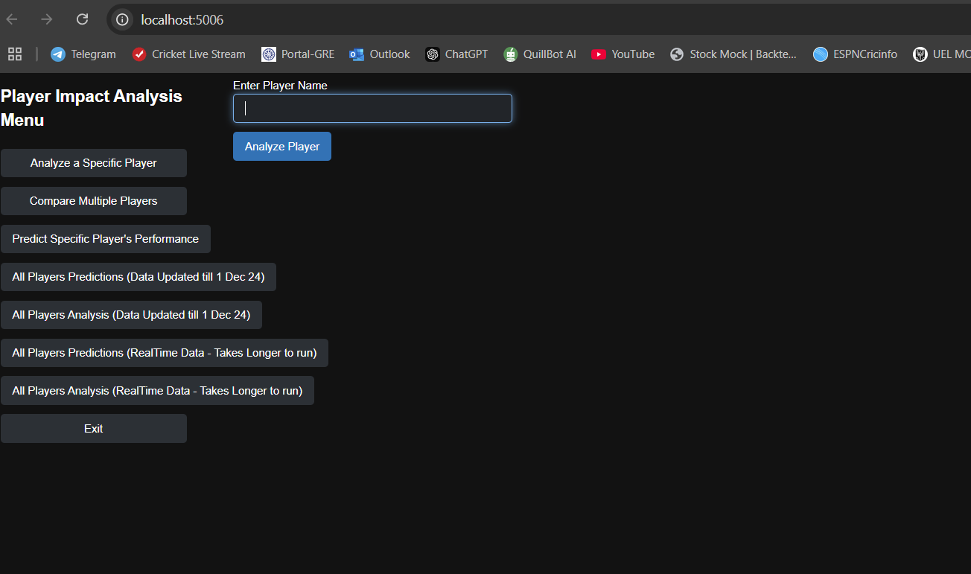
Panel Dashboard
Interactive Dashboard: Developed an intuitive and interactive dashboard using the Panel library, providing a seamless user experience for data exploration and analysis.
Data Visualizations: Integrated Plotly and Matplotlib to create dynamic and insightful visualizations, including graphs and charts for in-depth analysis.
Tabulator Integration: Added Tabulator visualizations for displaying tabular data interactively, enabling users to filter, sort, and explore datasets with ease.

Slide 11
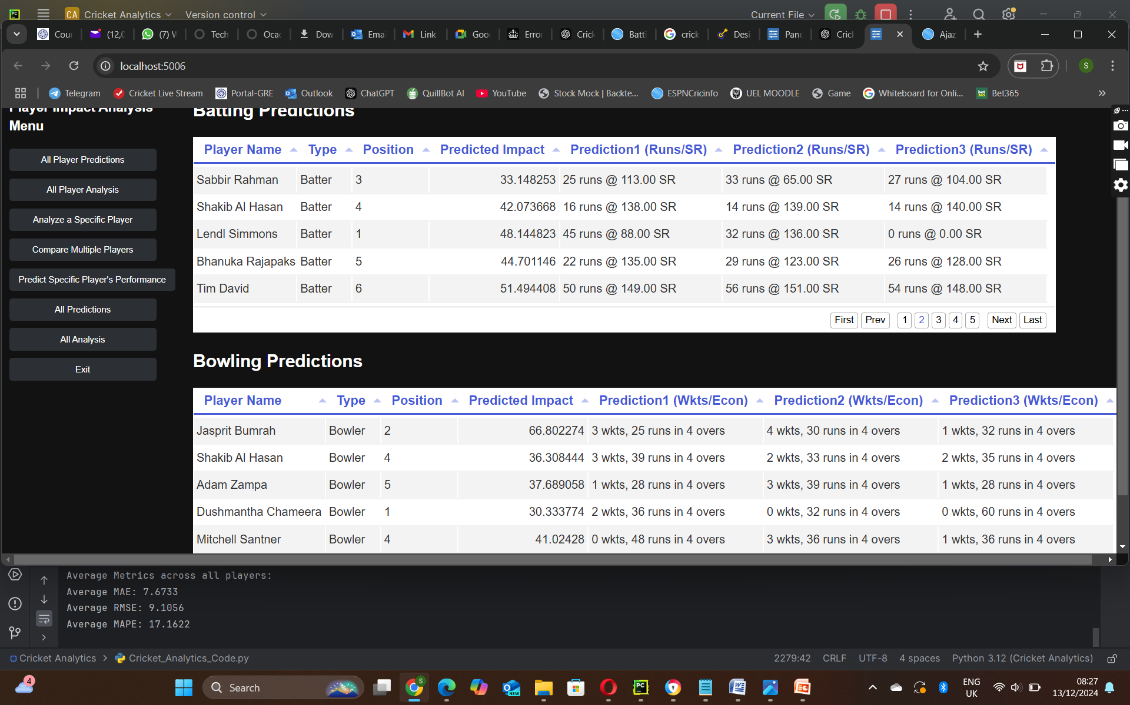
Prediction Highlights
Mean Absolute Error (MAE - 7.6733):
Represents the average error, showing predictions are close to actual values.
Acceptable Range: Lower values are better; for cricket impact metrics, errors under 10 are considered good.
Root Mean Squared Error (RMSE - 9.1056):
Highlights how well the model handles larger errors, ensuring robustness.
Acceptable Range: Lower values are ideal; for this context, staying below 12 is desirable.
Mean Absolute Percentage Error (MAPE - 17.1622):
Shows predictions are, on average, within 17.89% of actual values, providing relative accuracy.
Acceptable Range: Below 20% is considered acceptable; below 15% is excellent.

Slide 12
Player Analysis
Overall Analysis:
Comprehensive analysis of data for approximately 300 players.
Conducted category-wise analysis, including:
Bowlers, Batters, and All-rounders.
Performance breakdown by country.
Specific Player Analysis:
Focused on individual player insights with detailed breakdowns:
Recent Form Analysis: Tracks the player's performance trends in the latest matches.
Average Impact vs. Opposition: Evaluates performance consistency against various teams.
Venue-wise Performance: Assesses how players perform in different stadiums.
Highlighted Top 5 Best Performances for each player.
Player Comparison:
Enables comparison of performance metrics for 2 to 5 players.
Key comparative analyses include:
Recent Form Comparison: Displays recent match performances side-by-side.
Performance Against SENAI Countries: Insights on players’ records against specific nations.
Venue-wise Performance Comparison: Detailed analysis of how players fare in different venues.

Slide 13
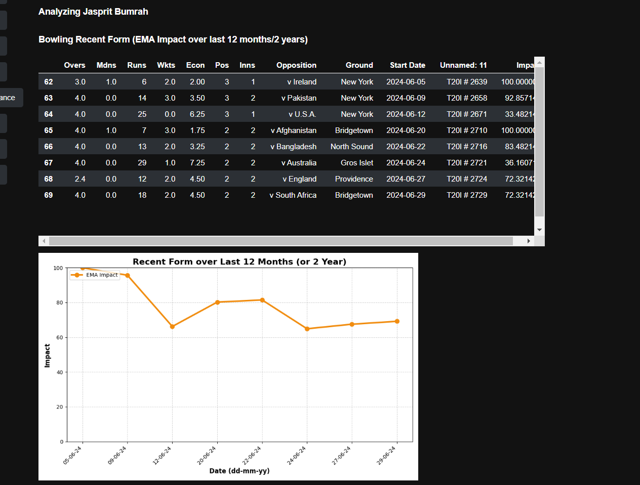
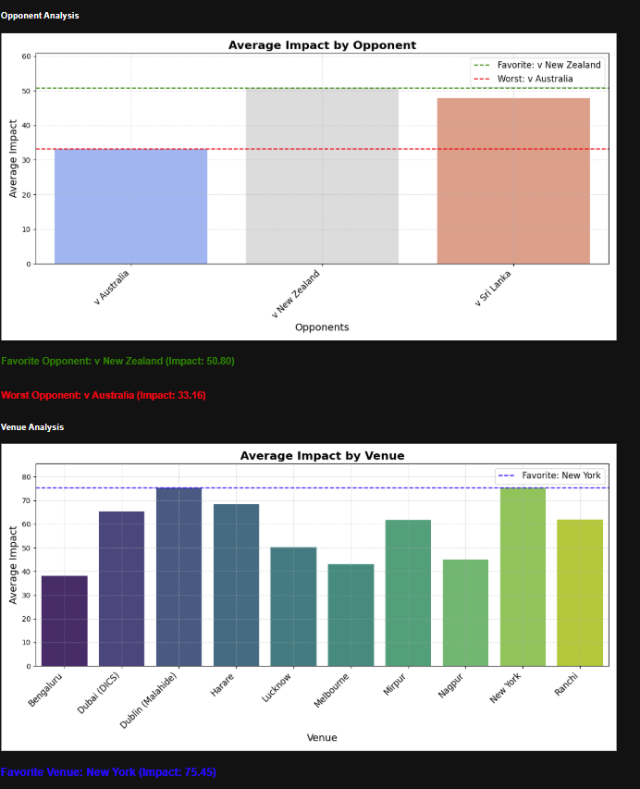
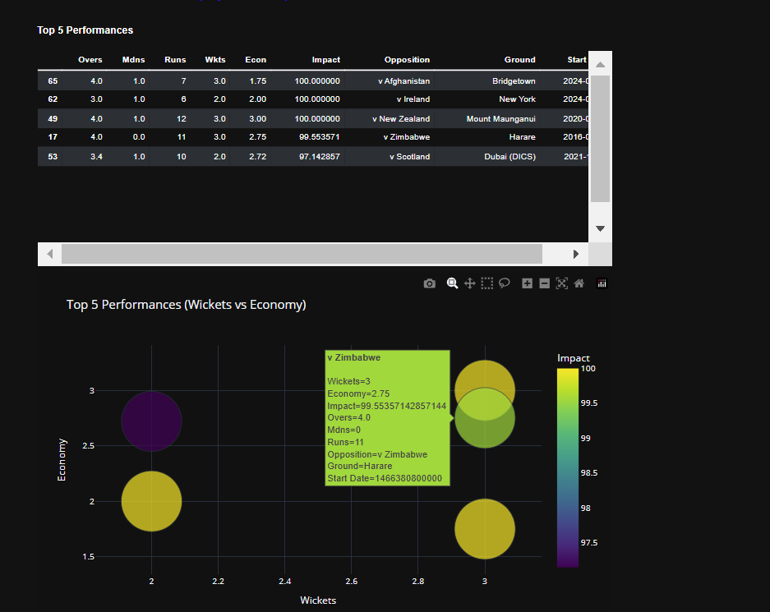
Specific Player Performance Output

Slide 14
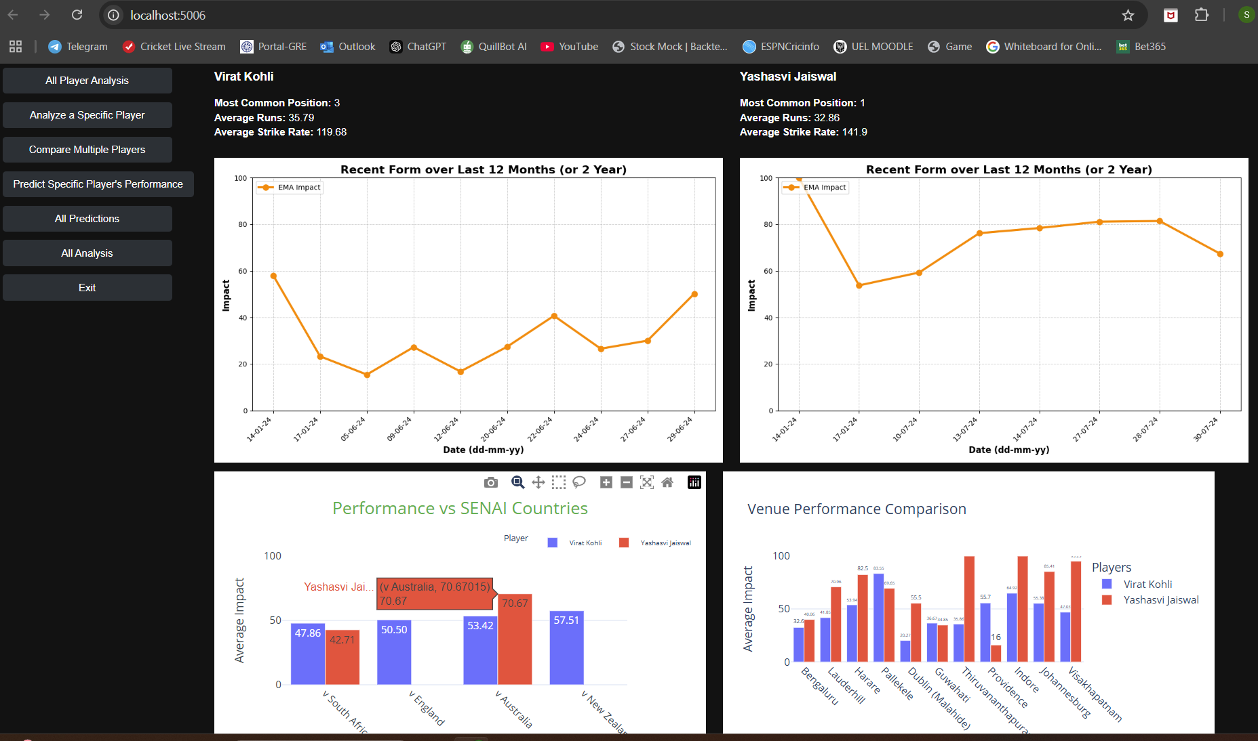
Compare Player Performances Output

Slide 15
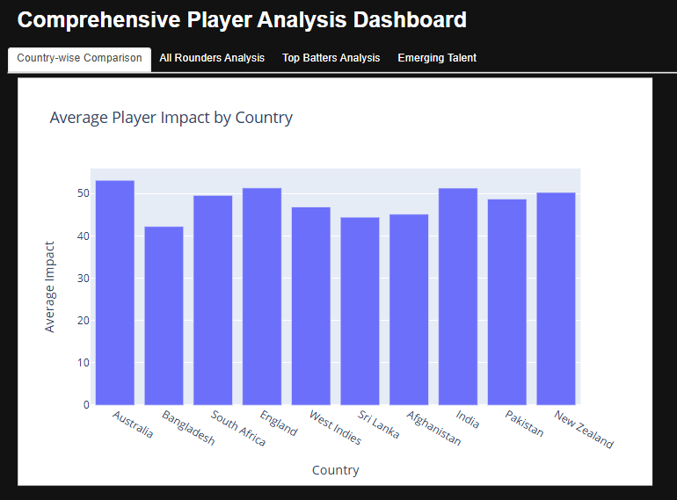
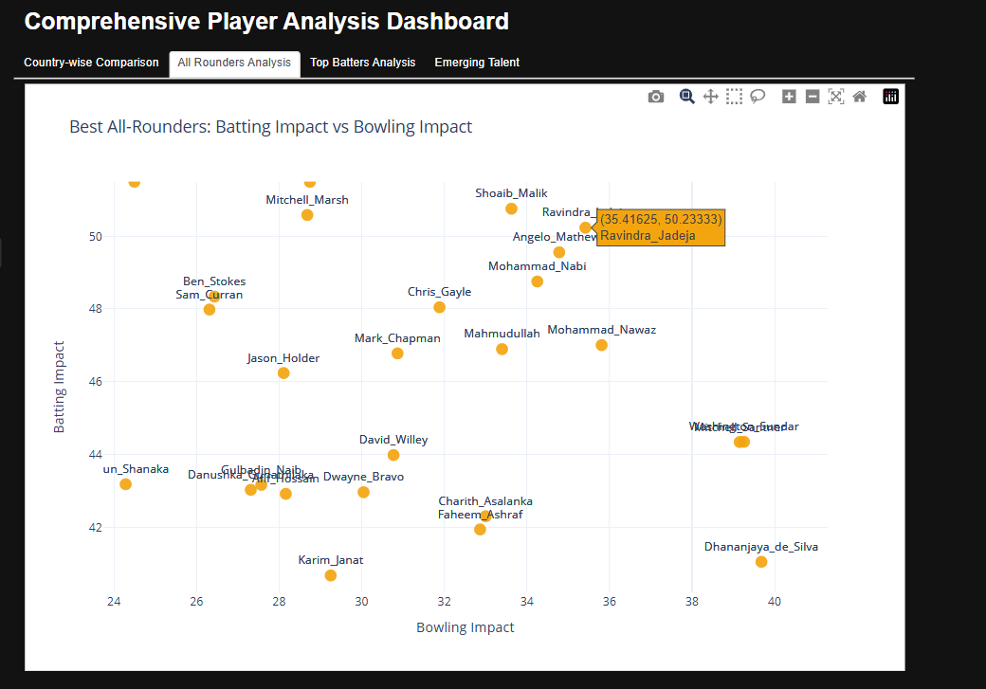
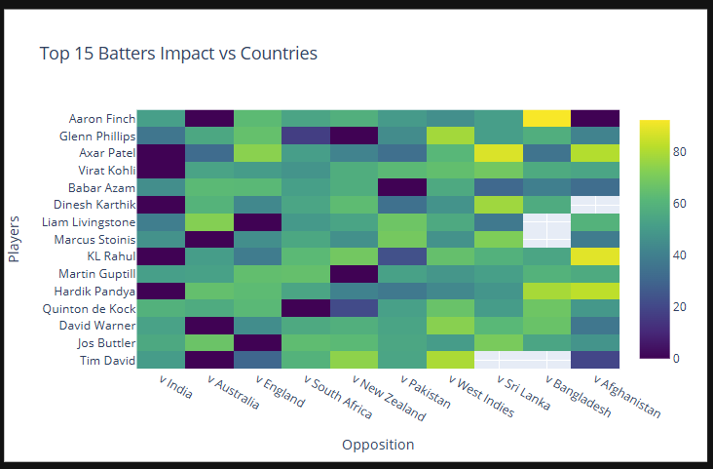
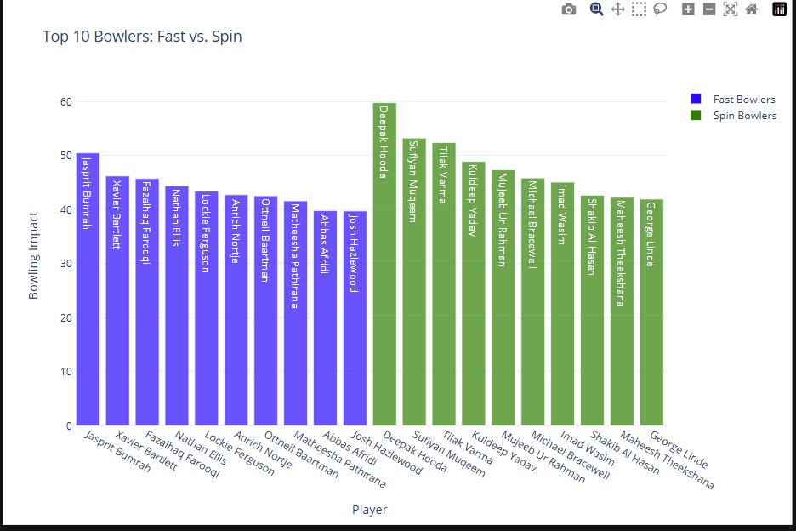
All Player Analysis Output

Slide 16
Future Scope
Expansion to Other Formats: Extend the analysis to include ODI and Test cricket formats, covering a broader spectrum of the game. Enhanced Analytical Features:
Incorporate additional insights like batter vs. bowler matchups, emerging talent analysis, and contextual performance metrics for a deeper understanding of player dynamics.User Customization:
Enable users to define their own impact metrics and weights, offering a more personalized analysis experience.
Global Accessibility: Develop a web-based platform or mobile application to make the tool widely accessible for cricket enthusiasts, analysts, and professionals.

Slide 17
Thank You

