Slide 1













StockPilot
Inventory management shipped through a full DevSecOps pipeline, from git push to a monitored, autoscaling EKS cluster
DevOps Final Capstone · Session 21 · SidantxDev · October 2026
Notes:
Hi, I'm presenting StockPilot, my DevOps capstone. It's an inventory management app, but the real subject is the delivery pipeline: every commit is tested, built into containers, security-scanned, pushed to GHCR, deployed to AWS EKS through Argo CD, and monitored with Prometheus and Grafana. The icons along the bottom are the tools in the order a change travels through them.

Slide 2
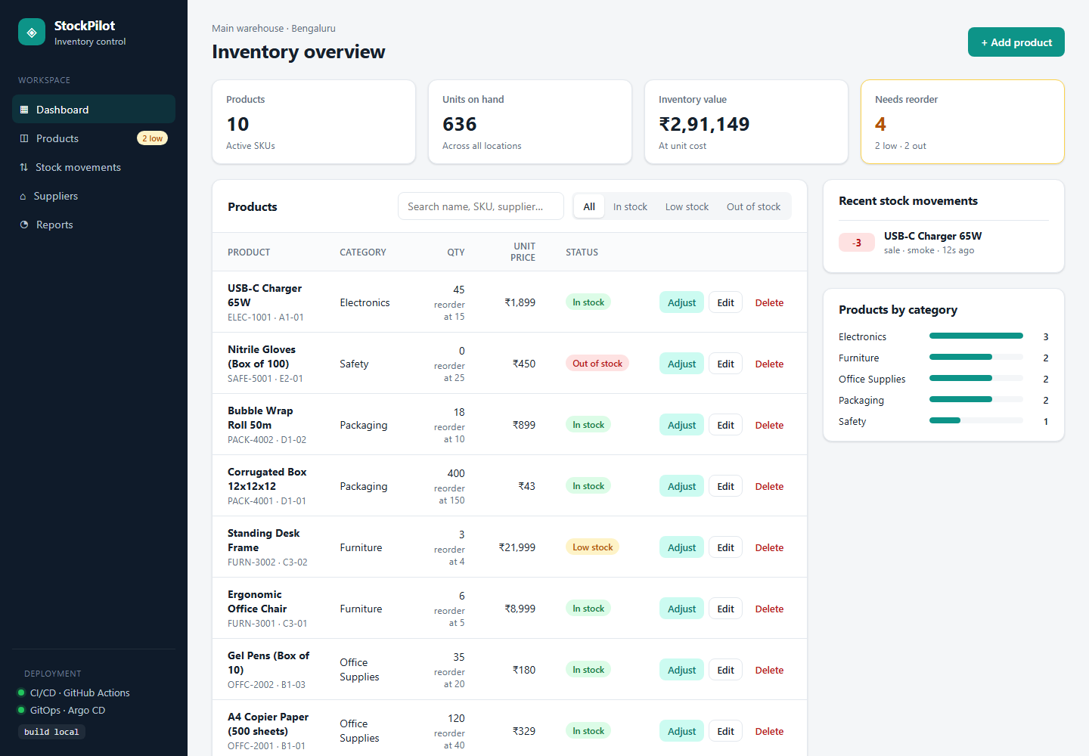



What I built: a warehouse inventory dashboard
The problem
Small warehouses track stock in spreadsheets, so reorders get missed and nobody knows why a count changed.
The app
Products with SKUs, live stock levels, low/out-of-stock alerts and an audit trail of every stock movement.
The DevOps goal
Every commit is tested, scanned, deployed by GitOps to EKS and observable in Grafana, with no manual steps.
Live UI: KPI cards, searchable product table, status badges, stock-movement feed
Notes:
The domain is warehouse inventory. You can add products, adjust stock with a reason like restock or sale, and every adjustment is recorded so you can see why a number changed. Items below their reorder level are flagged. The screenshot is the real app running in Docker Compose.

Slide 3

Tech stack, layer by layer
Frontend
Backend
Data
React 19 + Vite 8, served by unprivileged Nginx
Python 3.12, FastAPI, Pydantic v2, Uvicorn
PostgreSQL 17, SQLAlchemy 2, Alembic migrations
Quality
Containers
CI/CD + security
pytest (19 tests), flake8, in-memory SQLite test DB
Multi-stage Dockerfiles, non-root, Docker Compose
GitHub Actions, Trivy gate, GHCR with SHA tags
Infrastructure
Platform
Observability
Terraform: AWS VPC, NAT, EKS, managed nodes
Kubernetes, Helm, Argo CD, Traefik ingress, HPA
Prometheus, ServiceMonitor, alerts, Grafana
Notes:
Here's the stack by layer. Application: React, FastAPI and PostgreSQL with Alembic migrations. Engineering: pytest and Docker. Delivery: GitHub Actions with a Trivy security gate pushing to GitHub Container Registry. Platform: Terraform builds the AWS network and EKS, Helm packages the app, Argo CD deploys it, and Prometheus and Grafana watch it.

Slide 4
Architecture: from git push to running pods
Developer
git push to main
AWS ap-south-1 · VPC 10.20.0.0/16 · built by Terraform
EKS cluster · 2 × t3.medium in private subnets
Argo CD
pulls Git
Traefik Ingress
AWS NLB · / and /api
Helm release
stockpilot namespace
Argo CD
auto-sync · self-heal
GitHub repository
source + Helm values
GitHub Actions
pytest · npm build · docker build
Trivy gate · push · bump tag
Frontend × 2
React + Nginx
Backend × 2–6
FastAPI · HPA on CPU
Prometheus
scrapes /metrics
image
pull
metrics-server
feeds the HPA
PostgreSQL
StatefulSet · EBS gp3
Grafana
StockPilot dashboard
GHCR
stockpilot-*:<git-sha>
Notes:
On the left is the delivery path. A push to main triggers GitHub Actions, which tests, builds, scans and pushes images to GHCR tagged with the commit SHA, then commits that tag back into the Helm values. Everything on the right is AWS infrastructure created by Terraform: a VPC and an EKS cluster. Argo CD pulls the chart from Git and keeps the cluster in sync. User traffic enters through an AWS Network Load Balancer into Traefik, which routes slash to the frontend and slash-api to the backend. The backend talks to PostgreSQL on an EBS volume. Prometheus scrapes the backend, Grafana visualizes it, and metrics-server feeds the autoscaler.

Slide 5
Application layer: REST API, database and tests
Method | Path | Purpose
GET | /health · /ready | Liveness · readiness (DB check)
GET | /metrics | Prometheus metrics
GET | /api/products | List, search, filter by status
GET | /api/products/stats | Inventory KPIs
GET | /api/products/{id} | One product
POST | /api/products | Create (409 on duplicate SKU)
PUT | /api/products/{id} | Update product
DELETE | /api/products/{id} | Delete product + history
POST | /api/products/{id}/adjust | Record stock movement
GET | /api/movements | Recent movements feed
12
HTTP endpoints, including full CRUD
2
tables via 2 Alembic migrations (schema + seed)
19
pytest cases on an isolated SQLite DB
Notes:
The backend is FastAPI with full CRUD on products plus a stock-adjust endpoint that refuses to take stock below zero. Health is a cheap liveness check; ready actually queries the database, so Kubernetes only sends traffic to pods that can reach Postgres. Two Alembic migrations create the products and stock_movements tables and seed demo data. The 19 pytest cases override the database dependency with an in-memory SQLite database, so tests never touch production data.

Slide 6

CI/CD: every push to main runs the whole chain
1 Test
2 Build
3 Scan
4 Push
5 Deploy
flake8 lint
pytest -v (19)
npm ci + vite build
Docker Buildx
multi-stage images
GHA layer cache
Trivy report → summary
Trivy gate: fail on
HIGH / CRITICAL
Login to GHCR
push :<git-sha>
never :latest
sed tag into values.yaml
commit [skip ci]
Argo CD syncs
Traceability: image tag = full commit SHA, e.g. ghcr.io/sidantxdev/stockpilot-backend:3f9c2e1…, also shown in the UI sidebar.
Safety: pull requests build and scan but never push. Jobs get least-privilege GITHUB_TOKEN scopes. The Trivy action is pinned by commit SHA.
No cluster credentials in CI: the pipeline only changes Git; Argo CD performs the deployment.
Notes:
This is the GitHub Actions workflow. Stage one is the quality gate: lint, 19 pytest cases and the React build. If any test fails, nothing else runs. Stage two builds both images. Stage three is the security gate: Trivy fails the pipeline on any fixable high or critical CVE, so a vulnerable image is never pushed. Stage four pushes to GHCR tagged with the commit SHA, never latest. Stage five is GitOps: the pipeline writes the new tag into the Helm values file and commits it, and Argo CD rolls it out. CI never holds cluster credentials.

Slide 7
DevSecOps: the Trivy gate caught real CVEs
4 → 0
HIGH CVEs found on the first scan, then fixed
What the scan found
urllib3 CVE-2026-97687 (TLS bypass via HTTPS proxy), CVE-2026-97689, msgpack and setuptools were flagged HIGH.
None were app dependencies: they were vendored inside pip, which the venv carried into the runtime image.
Fix: uninstall pip/setuptools after installing requirements. The rescan passed.
Remaining Debian CVEs (e.g. libacl1 CVE-2026-54369) have no fix yet, so they are reported but not blocking.
0
fixable HIGH / CRITICAL in either image today
Defense in depth
0
vulnerabilities of any severity in the Alpine frontend
non-root uid 10001 / 101
read-only root FS
drop ALL capabilities
Pod Security: restricted
no secrets in Git
IRSA, not node IAM
Notes:
Trivy scans the OS packages and every Python package in the image. My first pipeline run failed the gate with four high CVEs, including a urllib3 TLS interception bug. They weren't my dependencies: pip vendors those libraries, and pip had been copied into the runtime image. Removing pip from the runtime fixed it, and the rescan was clean. Some Debian base packages still have high CVEs with no fix published. The gate ignores unfixed issues, and the Dockerfile upgrades packages on every build so fixes arrive automatically. Scanning is one layer, so the containers also run non-root with read-only filesystems under the restricted Pod Security standard.

Slide 8
Infrastructure as Code: Terraform builds VPC + EKS
VPC 10.20.0.0/16 · ap-south-1
Terraform files
ap-south-1a
ap-south-1b
main.tf: VPC, EKS, node group, add-ons
variables.tf / outputs.tf: inputs, kubectl command
IRSA role for the EBS CSI driver (Postgres volume)
terraform.tfvars.example: no credentials committed
Public subnet 10.20.0.0/24
NAT Gateway · NLB node
tag kubernetes.io/role/elb
Public subnet 10.20.1.0/24
NLB node
tag kubernetes.io/role/elb
terraform init → plan → apply
aws eks update-kubeconfig
terraform destroy
Private subnet 10.20.10.0/24
EKS worker node
t3.medium · AL2023
Private subnet 10.20.11.0/24
EKS worker node
t3.medium · AL2023
≈ $0.30 / hour
EKS + 2 nodes + NAT + NLB. Destroyed the same day.
Notes:
Terraform creates all the AWS infrastructure from code using the community VPC and EKS modules. Two availability zones, each with a public subnet for the load balancer and NAT gateway and a private subnet for the worker nodes. The EKS cluster runs Kubernetes 1.34 with a managed node group of two t3.medium instances that can grow to four, plus the EBS CSI add-on so Postgres gets a persistent volume. No credentials are in the repo; Terraform uses my AWS CLI login. It costs about thirty cents an hour, so I destroy it right after the demo.

Slide 9
Kubernetes + Helm: one chart, autoscaling backend
Deployment
backend · 2–6 pods
Deployment
frontend · 2 pods
StatefulSet
PostgreSQL + PVC
Service ×3
ClusterIP
Ingress
/ → FE · /api → BE
HPA
CPU 60% target
PDB
minAvailable 1
ServiceMonitor
Prometheus scrape
PrometheusRule
3 alerts
ConfigMap
Grafana dashboard
Secret + ConfigMap
DB settings
helm test
API smoke pod
Probes: startup + liveness /health, readiness /ready. The init container waits for Postgres.
Notes:
The whole app is one Helm chart: two Deployments with at least two replicas each, a Postgres StatefulSet with a persistent volume, ClusterIP Services, an Ingress that routes slash to the frontend and slash-api to the backend, an HPA, a disruption budget and the monitoring objects. The chart on the right is a real load test I ran. Six in-cluster workers pushed backend CPU far above the 60 percent target, and within about forty seconds the HPA scaled the backend from two to four pods, the maximum for that environment.

Slide 10


GitOps with Argo CD: Git is the source of truth
1
2
3
4
5
git push
CI green
tag commit
Argo CD
rollout
code change to main
tests + Trivy + GHCR
values.yaml → :<sha>
detects drift (60 s poll)
zero-downtime update
Why GitOps
Application spec
CI never holds cluster credentials
git revert = rollback
every change is reviewed in Git
auto-sync with prune + self-heal
values.yaml + values-eks.yaml
manual kubectl edits are reverted
Notes:
The deployment model is GitOps. The pipeline's last step commits the new image SHA into the Helm values file. Argo CD watches that file, sees the cluster no longer matches Git, and runs a rolling update. Because sync uses prune and self-heal, a manual kubectl change gets reverted, and rolling back is just a git revert. CI never needs credentials for the cluster.

Slide 11
Observability: Prometheus scrapes, Grafana explains
What the dashboard answers
Is traffic arriving? Request rate by endpoint
Is it failing? 4xx / 5xx rate
Is it slow? p50 / p95 latency
Is the business moving? Stock movements by reason, units in / out
Is it scaling? Pod CPU, HPA current vs desired
FastAPI /metrics
ServiceMonitor
Prometheus
Grafana
14 / 14
19
3
Prometheus targets UP
Grafana panels
alert rules
Verified on a local kind cluster with the same charts and values as EKS.
Alerts: BackendDown · HighErrorRate > 5% · SlowRequests p95 > 500 ms
Notes:
The backend exposes Prometheus metrics: request counts and latency histograms per endpoint, plus two business counters for stock movements. The Helm chart ships a ServiceMonitor, so Prometheus finds every backend pod automatically, and a dashboard ConfigMap that Grafana loads by itself. I disabled the control-plane scrape jobs EKS doesn't expose, so the Targets page shows all targets up. Three alert rules cover the backend being down, a high error rate and slow requests.

Slide 12



Key learnings
Gates before artifacts
SHA tags + GitOps
Liveness ≠ readiness
Tests and Trivy run before the push, so a bad image never reaches the registry.
Every pod traces to a commit; rollback is a git revert.
/health keeps busy pods alive; /ready keeps DB-less pods out of the load balancer.
Least privilege
K8s creates cloud resources
Measure the business too
Non-root, read-only FS, restricted PSS, scoped tokens, IRSA, no keys in Git.
NLBs and EBS volumes live outside Terraform state, so tear-down order matters.
Latency says it's healthy; stock movements say it's being used.
github.com/SidantxDev/stockpilot-devops-capstone · Thank you
Notes:
Six takeaways. Put quality and security gates before anything is published. Immutable SHA tags plus GitOps make deployments traceable and reversible. Liveness and readiness answer different questions. Least privilege applies at every layer. Kubernetes creates AWS resources Terraform doesn't track, so tear-down order matters. And observability should include business metrics. Next I'll walk through all of this live.

