Slide 1
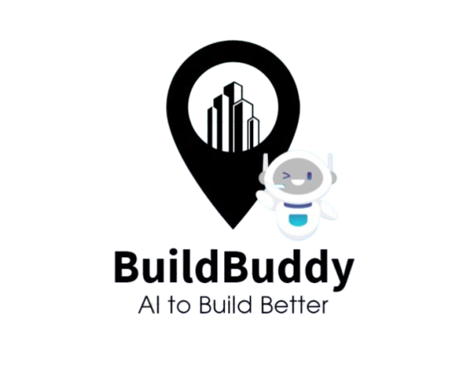
Call for Code
Team: CauseCoders
Siddhesh Prabhu
Stuti Wali
Somesh Lad
Shubham Garud
Apoorva Sahu

Slide 2
Outline
Problem Statement
Challenges
Real World Scenarios
Solution
Features
Advantages
Working
Output
References

Slide 3
Problem statement
In India and globally, equitable access to land for construction poses significant challenges, leading to disparities in housing quality, safety, and overall living conditions. The lack of access to suitable land affects marginalized communities disproportionately, resulting in inadequate housing solutions and perpetuating cycles of poverty. Addressing these issues is essential to ensure safe and sustainable living environments for all, while promoting social equity and community resilience.

Slide 4
challenges
Regulatory Barriers: Complex zoning laws and building regulations can impede access to land and necessary permits, particularly for low-income individuals and marginalized groups.
Financial Constraints: Limited access to financing options for land purchase and construction materials can hinder the ability of low-income families to build safe homes.
Environmental Concerns: Natural disasters and climate change disproportionately impact vulnerable communities, making it challenging to secure safe and stable housing.
Infrastructure Deficiencies: Lack of basic infrastructure—such as roads, water supply, and sanitation—can make certain lands undesirable for development, exacerbating inequities.​
Safe Housing : Marginalized groups often face significant barriers to accessing safe housing due to inequitable land distribution and exclusionary policies. Limited access to essential infrastructure and services further exacerbates the challenge, leaving vulnerable populations in substandard and unsafe living conditions.​

Slide 5
Real world scenarios
The Bandra-Worli Sea Link, Mumbai: During construction, inadequate geological surveys and environmental assessments led to unforeseen soil erosion and structural challenges. Portions of the project experienced delays and cost overruns due to the need for retrofitting and additional engineering solutions to stabilize the structure, ultimately increasing project costs and timeframes.
Chennai’s Flooding Issues: Rapid urban development and construction in low-lying areas occurred without proper environmental assessments. The 2015 floods highlighted the consequences, as inadequate drainage and poor soil management exacerbated flooding, causing widespread damage to homes and infrastructure.
Urban Slums in Mumbai, India: In cities like Mumbai, millions reside in informal settlements without legal land. Evictions and redevelopment projects often displace residents without providing adequate alternative housing.
Indigenous Land Rights in Canada: Indigenous communities face challenges accessing land due to historical injustices and ongoing legal battles for land rights, affecting their ability to build and maintain safe housing.
Post-Disaster Reconstruction in Haiti: Following the 2010 earthquake, many Haitians struggled to access land for rebuilding, facing bureaucratic obstacles and a lack of financial resources, leading to substandard living conditions.

Slide 6
Solution
In response to the pressing challenges of equitable access to land for construction, we have developed an innovative solution leveraging IBM’s Watsonx and its suite of AI services. This cutting-edge application utilizes predictive modeling to generate a comprehensive score-based output for various critical parameters that must be considered prior to building construction. By integrating advanced AI capabilities, our solution not only streamlines the decision-making process but also ensures that essential factors are meticulously evaluated.

Slide 7
Features
Our application assesses multiple parameters—such as land security, infrastructure availability, environmental risks, and financial viability—assigning a score to each. This quantifiable approach helps users identify areas of concern and prioritize their actions.
The solution includes dynamic graphs and visual representations of the output scores across all parameters. These visuals enhance comprehension and facilitate communication among stakeholders, making it easier to identify trends and patterns.
For each parameter assessed, the application provides clear and insightful explanations. Users can understand the significance of each score, enabling informed decisions based on data-driven insights.
Designed with accessibility in mind, the application offers an intuitive interface that allows users—from policymakers to community members—to navigate and interpret the data effortlessly.
Predictive Scoring
Visual Analytics
Detailed Explanations
User-Friendly Interface

Slide 8
Advantages of solution
Time and Cost Efficiency: Automating the assessment process reduces the time and resources spent on manual evaluations, allowing stakeholders to focus on implementation and impact.
Risk Mitigation: By identifying potential risks early in the planning phase, the application helps to prevent costly mistakes and promotes the construction of safer, more resilient buildings.
Collaboration and Transparency: The visual outputs foster collaboration among various stakeholders, encouraging a transparent approach to land use planning and community engagement.
Enhanced Decision-Making: By providing a robust scoring system and detailed analysis, our application empowers users to make informed, strategic decisions regarding land development and construction.
Promotes Equitable Access: The solution prioritizes inclusivity by addressing the specific needs of marginalized communities, ensuring that their voices and concerns are integrated into the construction planning process.
Data-Driven Insights: Leveraging AI capabilities, users gain access to sophisticated analytics that reveal hidden insights, ultimately driving better outcomes for land use and housing initiatives.

Slide 9
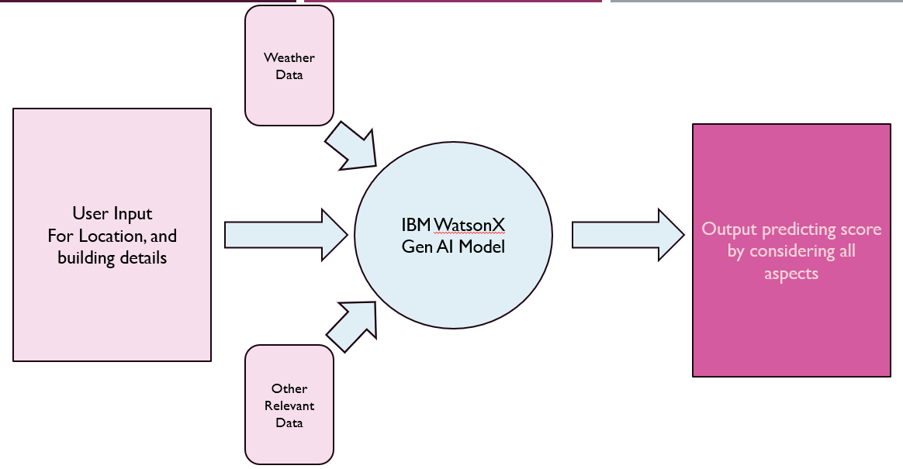
Application working

Slide 10
Weather Data from API
Input
Output
Explanation
Avg. Score
Graph
Llama model
Granite Model
Location
Integrate all data
Building type
Other
Other Relevant Data APIs

Slide 11
Future Scope
Dynamic Updates: Integrate real-time data feeds to update scores based on changes in regulations, environmental conditions, or urban development.
1
Automatically evaluate compliance with local zoning laws and building codes, reducing the administrative burden on developers.
3
Generate necessary documentation for regulatory submissions, streamlining the approval process.
4
Incorporate GIS (Geographic Information Systems) to provide visual representations of data, allowing users to interactively explore potential sites.
5
After construction, track performance of buildings in terms of sustainability and structural integrity, feeding data back into the predictive models for continuous improvement.
6
Will allow users to run different scenarios (e.g., changing zoning laws or climate conditions) to understand potential impacts on construction viability.
2

Slide 12
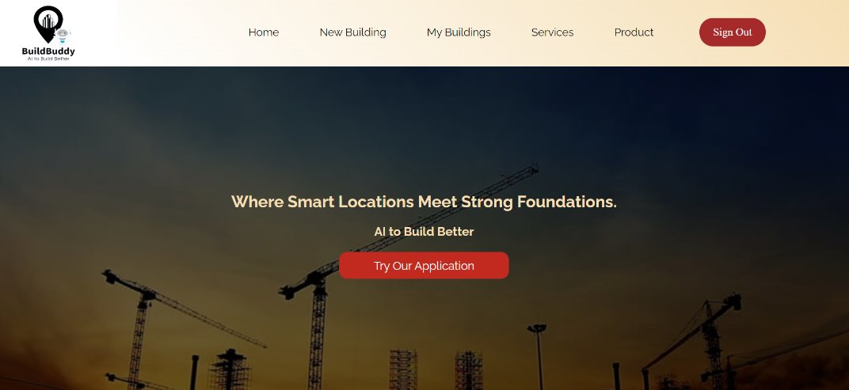
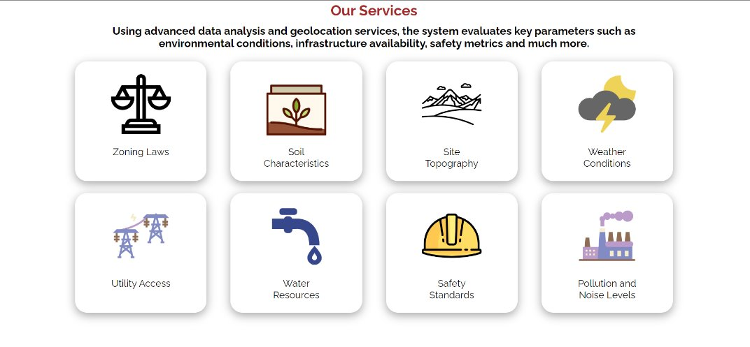
Working application
Homepage​
Services​

Slide 13
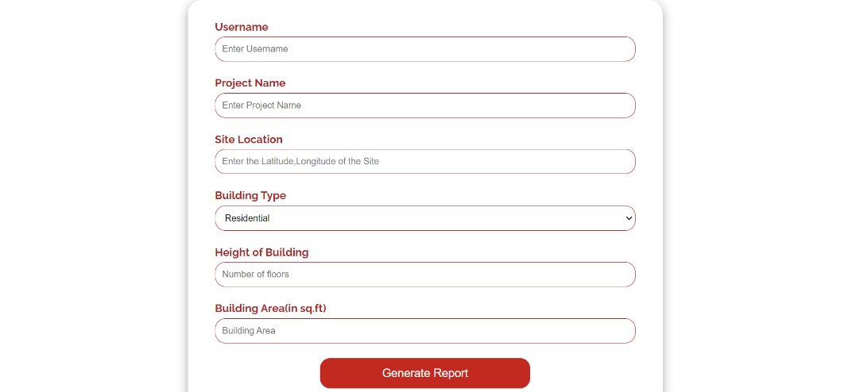
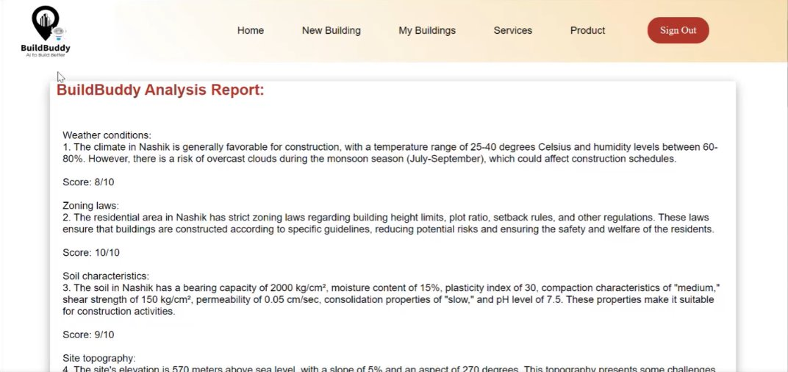
Working application
Form
Output

Slide 14
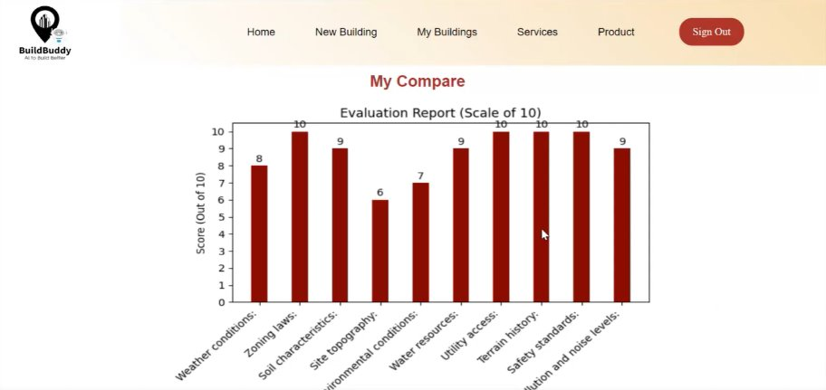
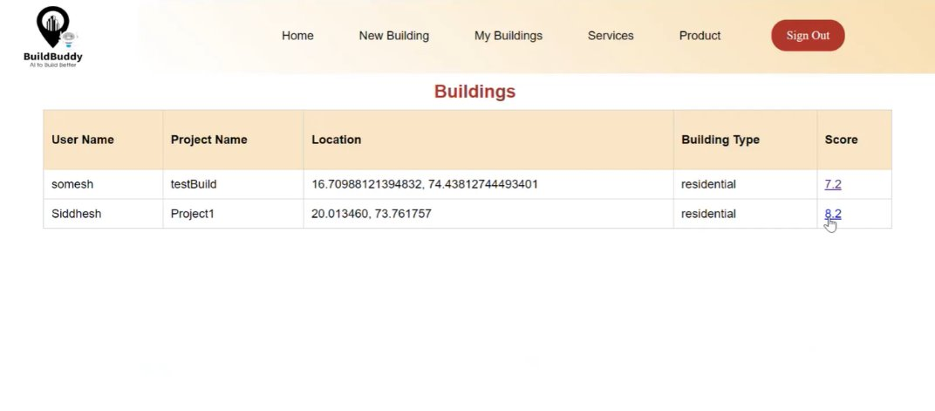
Working application
Graph
My Buildings

Slide 15
Thank you… build buddy

