Slide 1
ESE - 505
Control of system Project
Motor Speed control

Slide 2
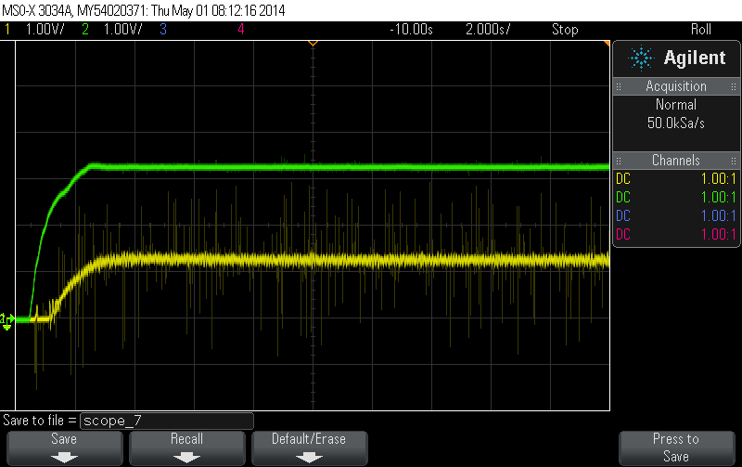
No Feedback
Initially we run the motor without any feedback we find the motor is unstable.

Slide 3
System Response without any feedback

Slide 4
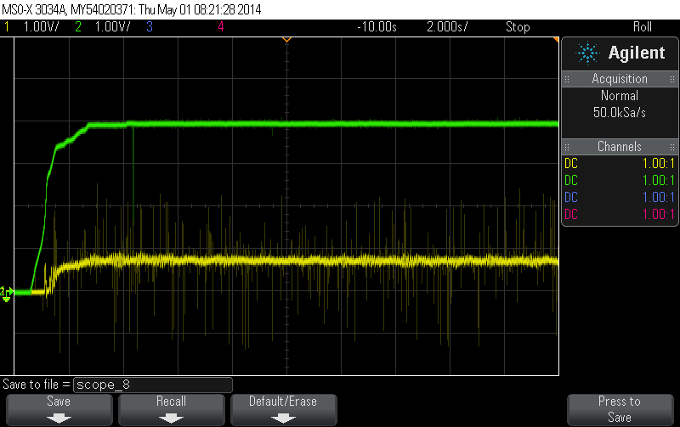
Feedback Path
We now add a feedback path in the system

Slide 5
System Response with feedback

Slide 6
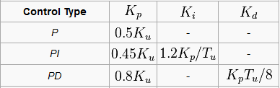
Ziegler Nicholas Tuning

Slide 7
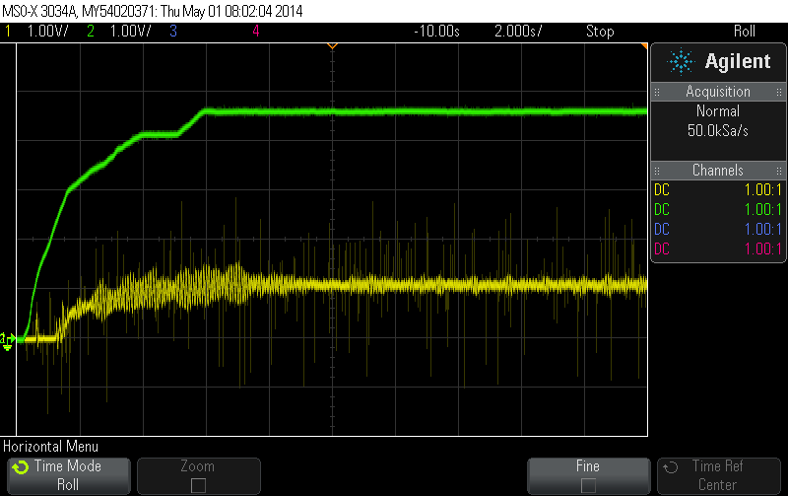
Proportionality constant(Kp)
We use Ziegler Nicholas, We select Ku=1.2 and Tu=0.1 and increased Kp from zero until we reach Ku till we get a better system response .
We got the Stable response at Kp=1

Slide 8
System Response with Proportionality Constant (Kp)

Slide 9
Observations
As we observed we have the residual steady-state error and the response is not that great hence we add derivative and integral.

Slide 10
PD Controller
Now we add a derivative term in the control along with proportionality in order to add some damping. We tune as per Ziegler Nicholas, we get the values as
Kp=1
Kd=0.012

Slide 11
System Response of the PD Controller

Slide 12
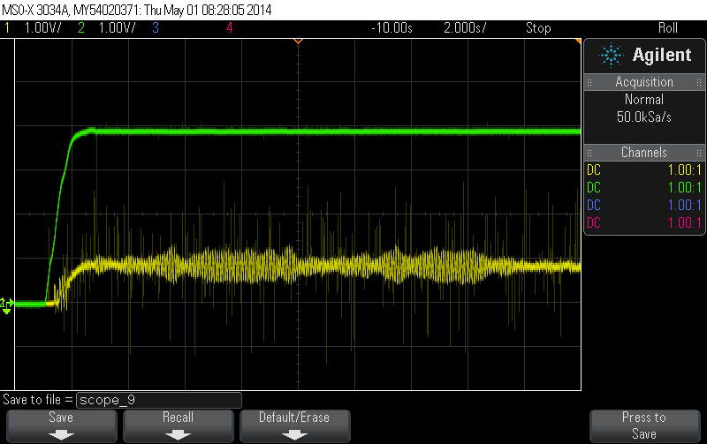
As we observe by adding the derivative the system has become more unstable and highly damped therefore we cannot used the PD Controller

Slide 13
PI Controller
Now we add a integral term in the control along with proportionality in order to eliminate the residual steady-state error. We tune as per Ziegler Nicholas, we get the values as
Kp=1.2
Ki=1

Slide 14
System Response of the PI Controller

Slide 15
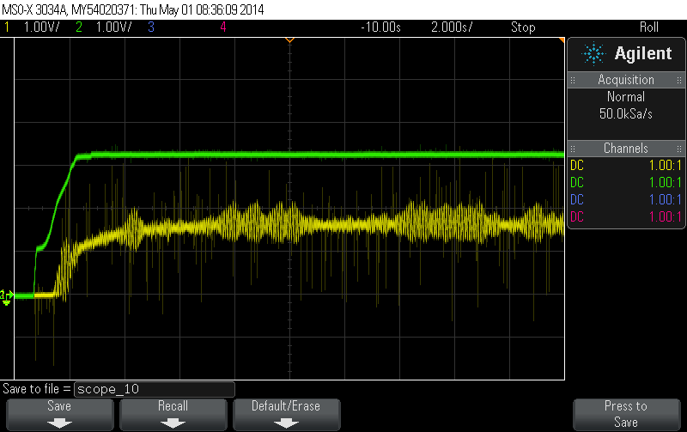
As we add integral feedback into the controller the system becomes highly unstable due to the accumulation of the error over the period of time.

Slide 16

PID Controller
As seen earlier PI and PD Controller doesn’t gives a much stable response, hence we use a PID Controller.
We use all three terms proportionality , derivative and integral

Slide 17
As per Ziegler Nicholas tuning we have selected the values of Ki, Kp, Kd and further tuned it to get better results as
Kp=1.2
Kd=0.001
Ki=1

Slide 18
PID Controller

Slide 19
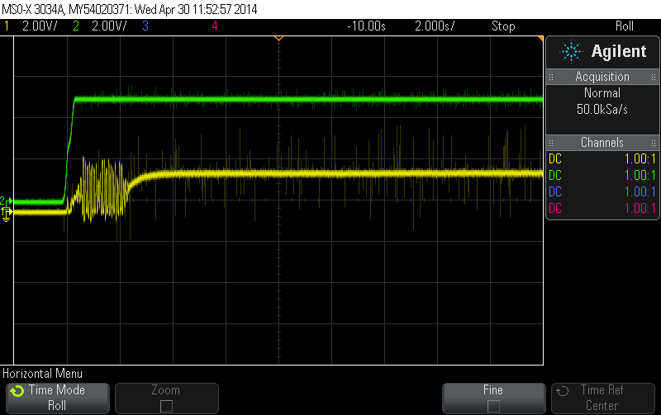
After implementing the PID Controller we observe that the system is quite stable and as compared to previous implementations of the controllers.

Slide 20
Clutch Gear
We now use a disturbance torque on the motor. Due to which the system is not able to reach 100% RPM.
This Cause Problems when we have Integral Feedback in the system.
We solve this problem using integral windup

Slide 21
System Response of PID with Disturbance

Slide 22
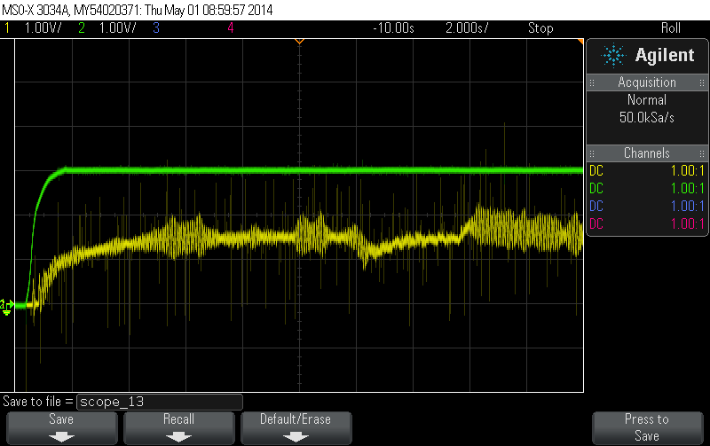
As we observe when the disturbance is applied to the system, it is not able to recover from it and the motor speed decreases and stabilizes only when the torque is released

Slide 23
Integrator Windup
It’s a condition in a PID feedback controller where a large change in set point occurs and the integral terms accumulates a significant error during the rise thus resulting in a overshoot.
We solve this problem by preventing the integral term from accumulating above or below pre-determined bounds.

Slide 24
PID with Integrator Windup

Slide 25
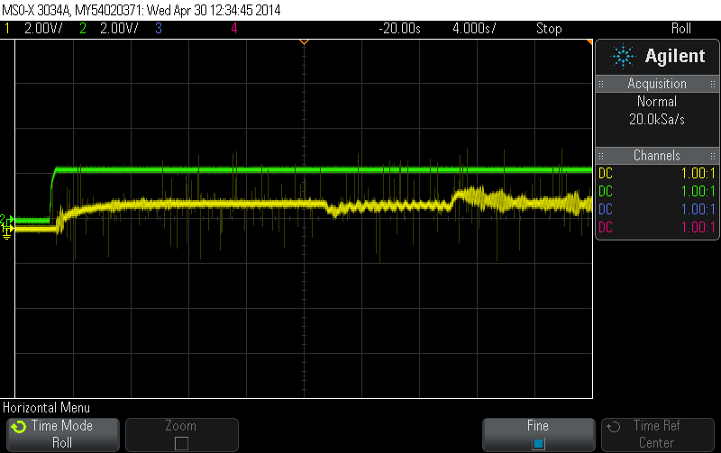
We observe from the plot when we apply disturbance torque using clutch gear the speed of motor is decreased initially but later it gains speed as more current is provided to the motor to overcome the disturbance
When the gear is released the speed of motor overshoots and then stabilizes very soon

Slide 26
Feed Forward Control
In a feed-forward system, the control variable adjustment is dependent on error. Instead it is based on knowledge about the process in the form of a mathematical model of the process and knowledge about or measurements of the process disturbances.
We implemented this by using a feed forward gain(K_{ff) into the forward path.}

Slide 27
Feed Forward

Slide 28
Advantages of forward feedback
Increased Stability of system
Better System Response
Control Accuracy is increased
It optimizes the performance further when coupled with feedback control

Slide 29
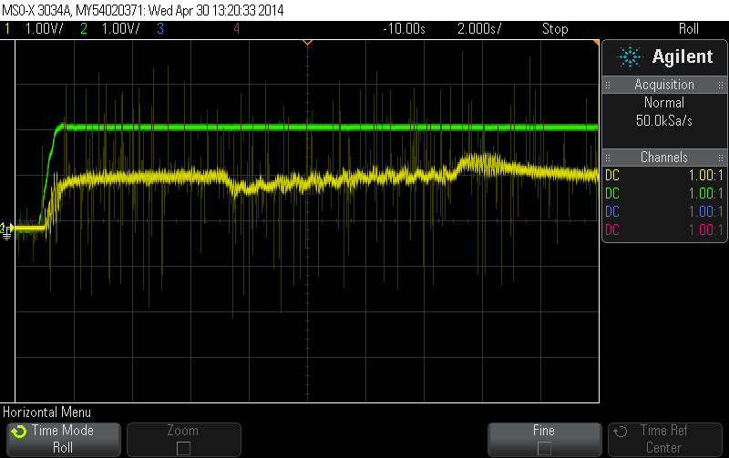
As we see the No of ripples in the response of the system is decreased and the system becomes much stable and also overcomes the disturbance by clutch gear.

Slide 30
Frequency Response
Frequency response is the quantitative measure of the output spectrum of a system or device in response to a stimulus,
It is used to characterize the dynamics of the system. It is a measure of magnitude and phase of the output as a function of frequency
We have provided sinusoidal input to the arduino at various frequencies and observed the response

Slide 31
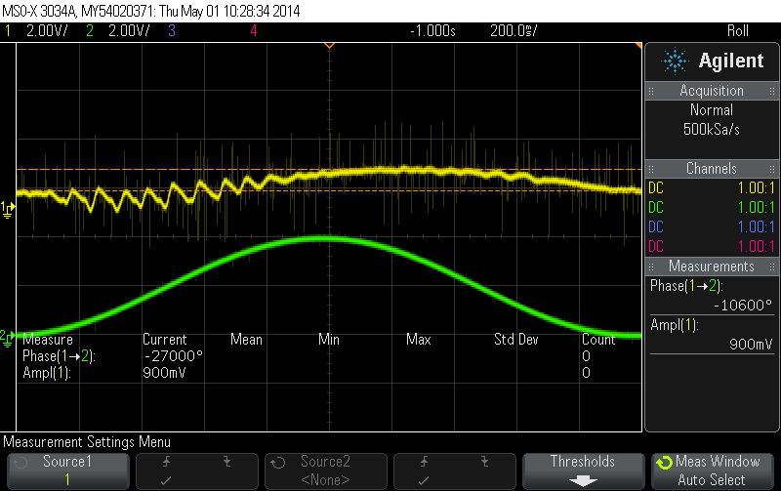
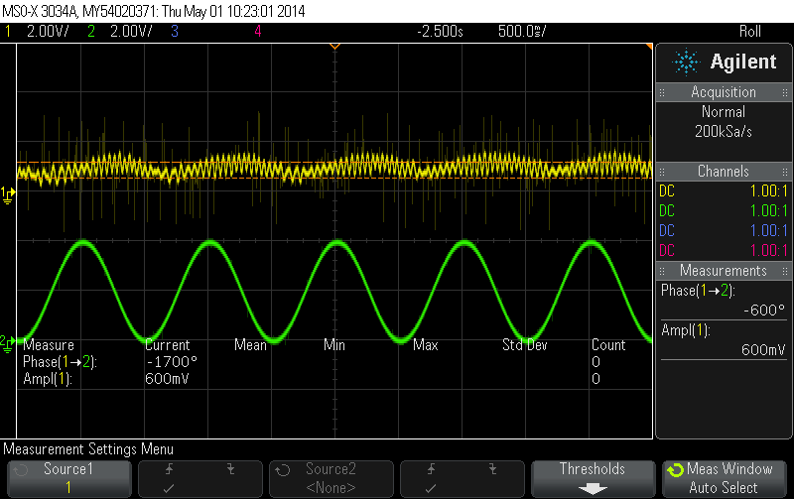
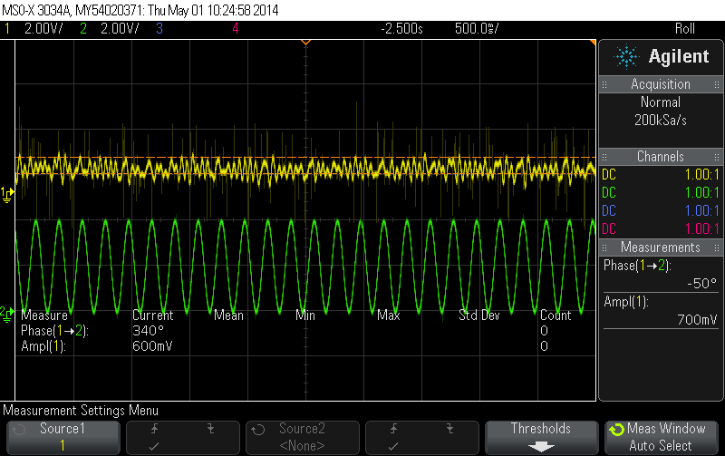
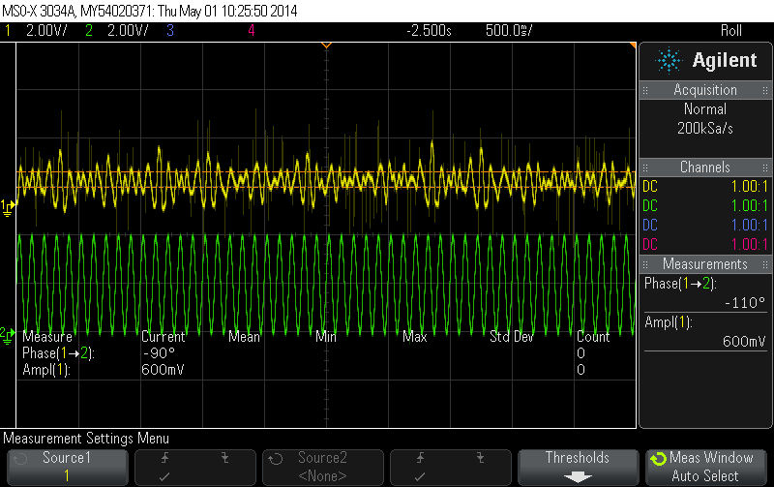
Frequency Reponses
F= 0.5 Hz
F= 1 Hz
F=5 Hz
F=10 Hz

Slide 32
Frequency Reponses
F = 20 Hz
F= 50 Hz

Slide 33
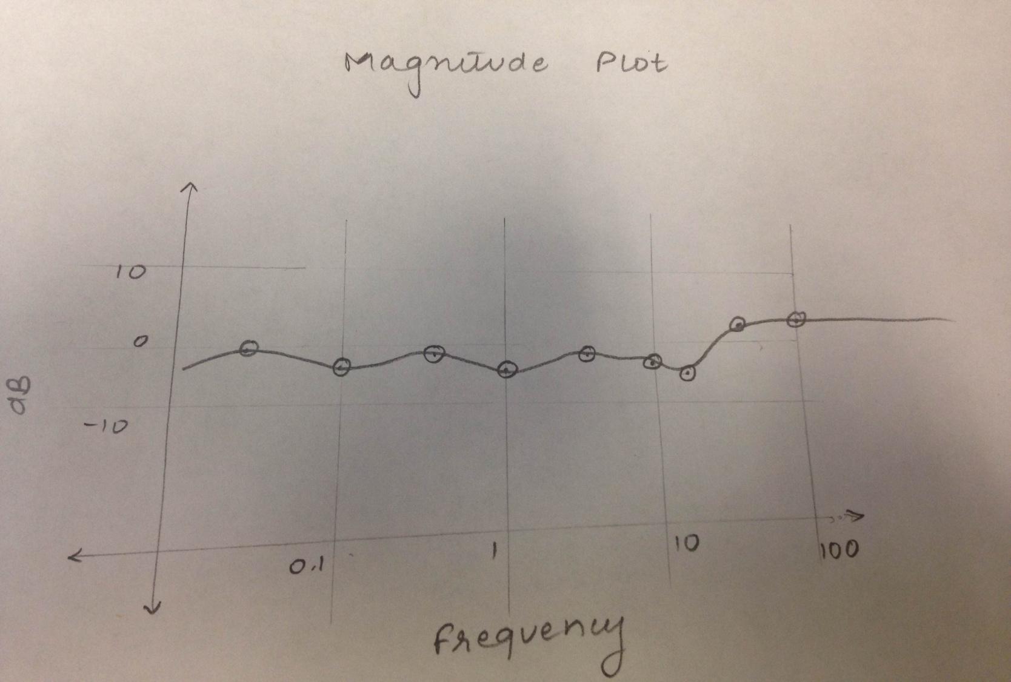
Rough Estimation of Bode plot

Slide 34
Spring Shaft
Presently the long shaft connected to the motor has higher rotational moment of inertia
On replacing it with the spring shaft, damping would be introduced into the system resulting in a lag.
A lightly damped mode is observed and to overcome that we could reduce the damping by decreasing Kd

Slide 35


