Slide 1
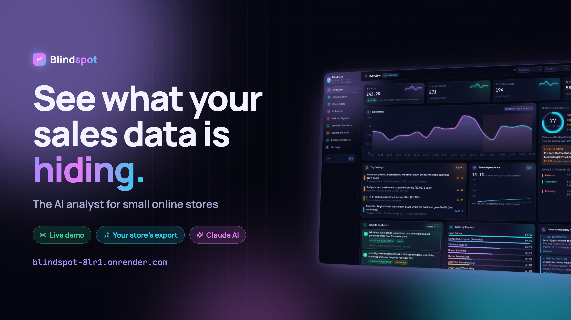
Notes:
Hi, this is Blindspot: an AI analyst for small online stores. It shows you what your sales data is hiding. The live demo is at blindspot-8lr1.onrender.com.

Slide 2
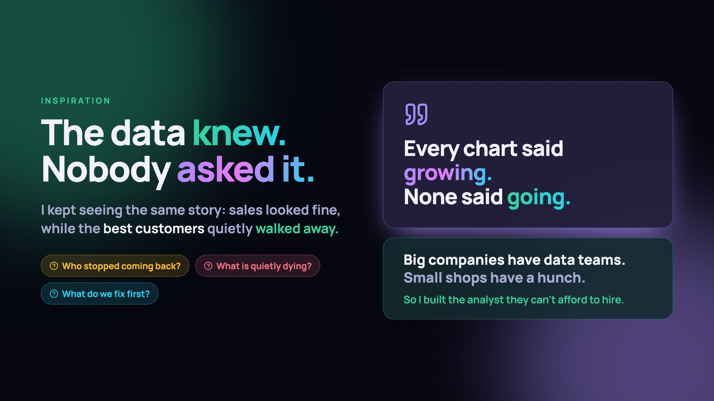
Notes:
Here's what inspired it. I kept seeing the same story: sales looked fine while the best customers quietly walked away. The data knew. Nobody asked it. Every chart said growing; none said going. Big companies have data teams. Small shops have a hunch. So I built the analyst they can't afford to hire.

Slide 3
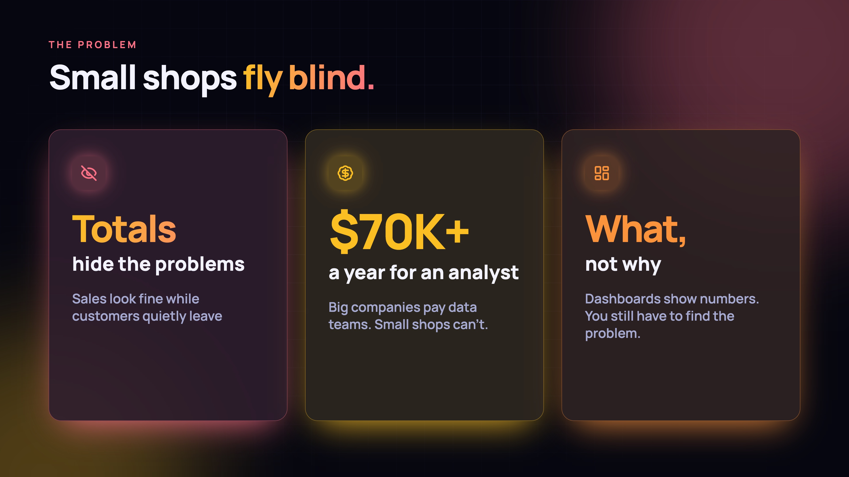
Notes:
The problem: small shops fly blind. Totals hide problems, a data analyst costs $70K+ a year, and dashboards show what happened but not why.

Slide 4
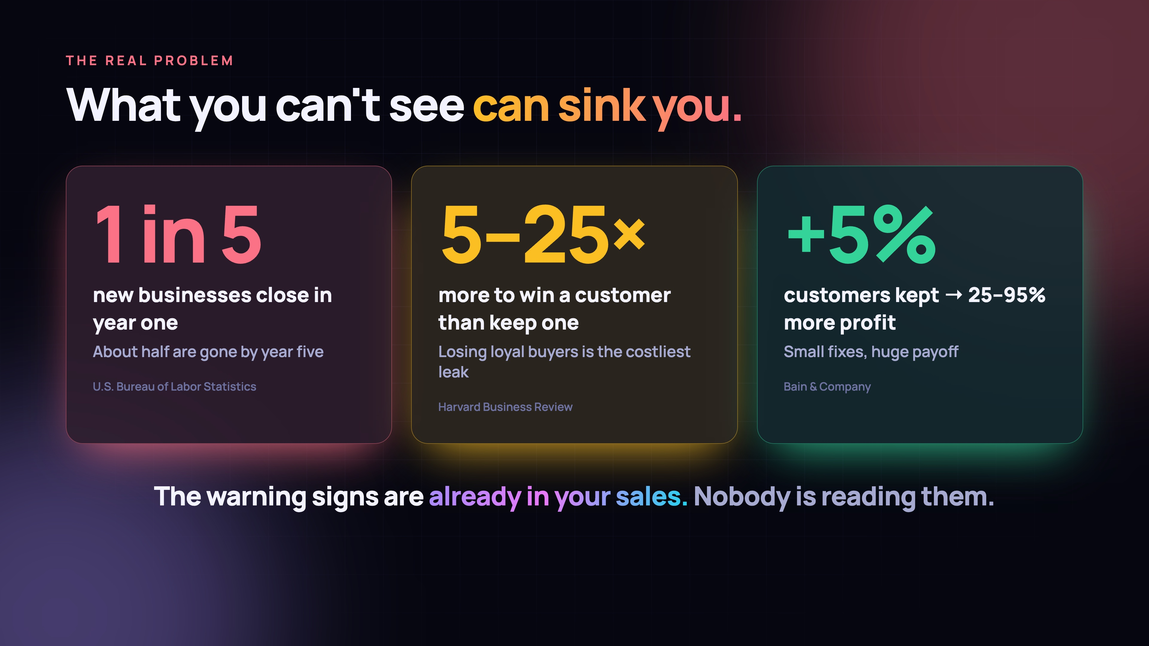
Notes:
And it matters. About 1 in 5 new businesses close in their first year, and about half by year five. Winning a new customer costs 5 to 25 times more than keeping one, and keeping just 5% more customers can raise profit by 25 to 95%. The warning signs are already in the sales data. Nobody is reading them.

Slide 5
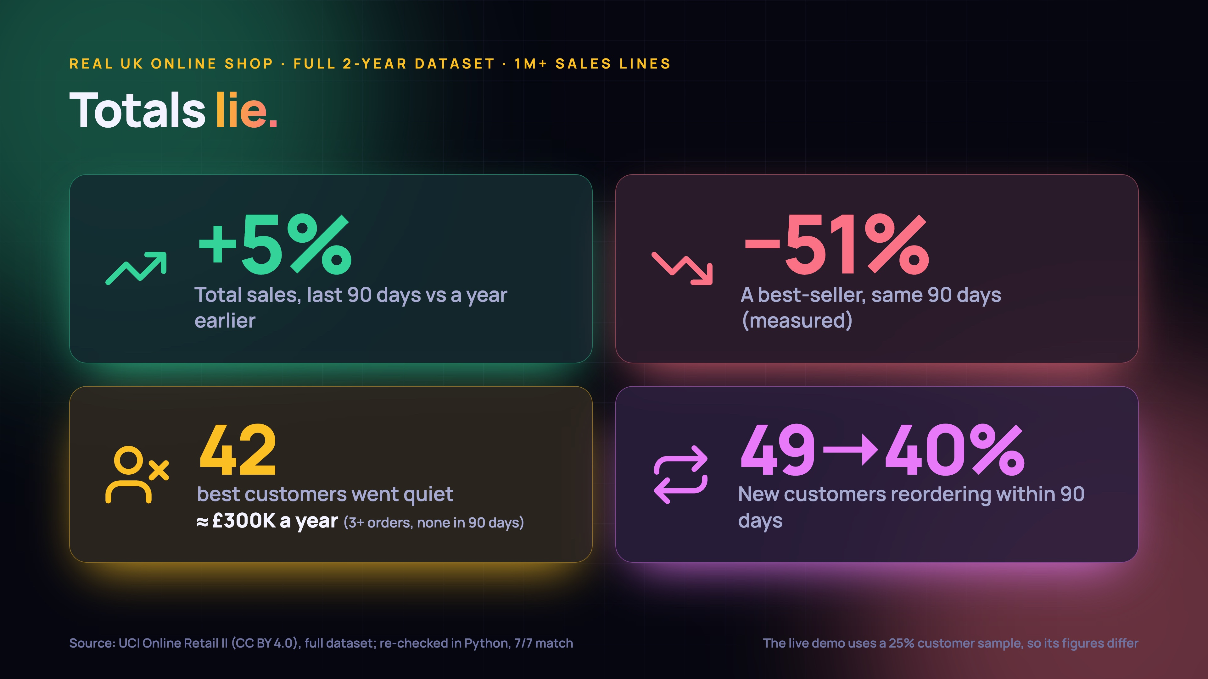
Notes:
Here's proof totals lie. In a real UK online shop, sales were up 5%, but its best-selling product was down 51%, 42 of its best customers quietly stopped buying (about £300K a year), and fewer new customers came back. Blindspot found all of this.

Slide 6
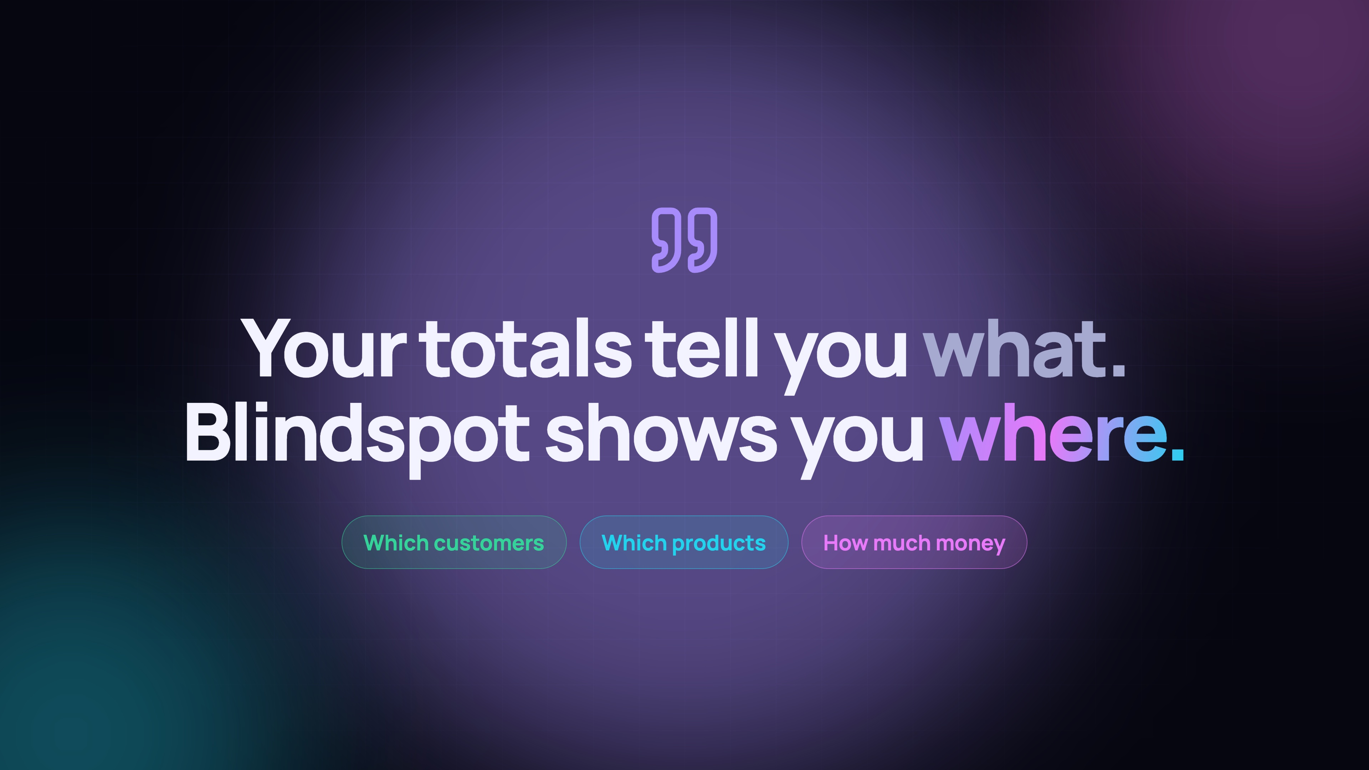
Notes:
Your totals tell you what happened. Blindspot shows you where: which customers, which products, and how much money.

Slide 7
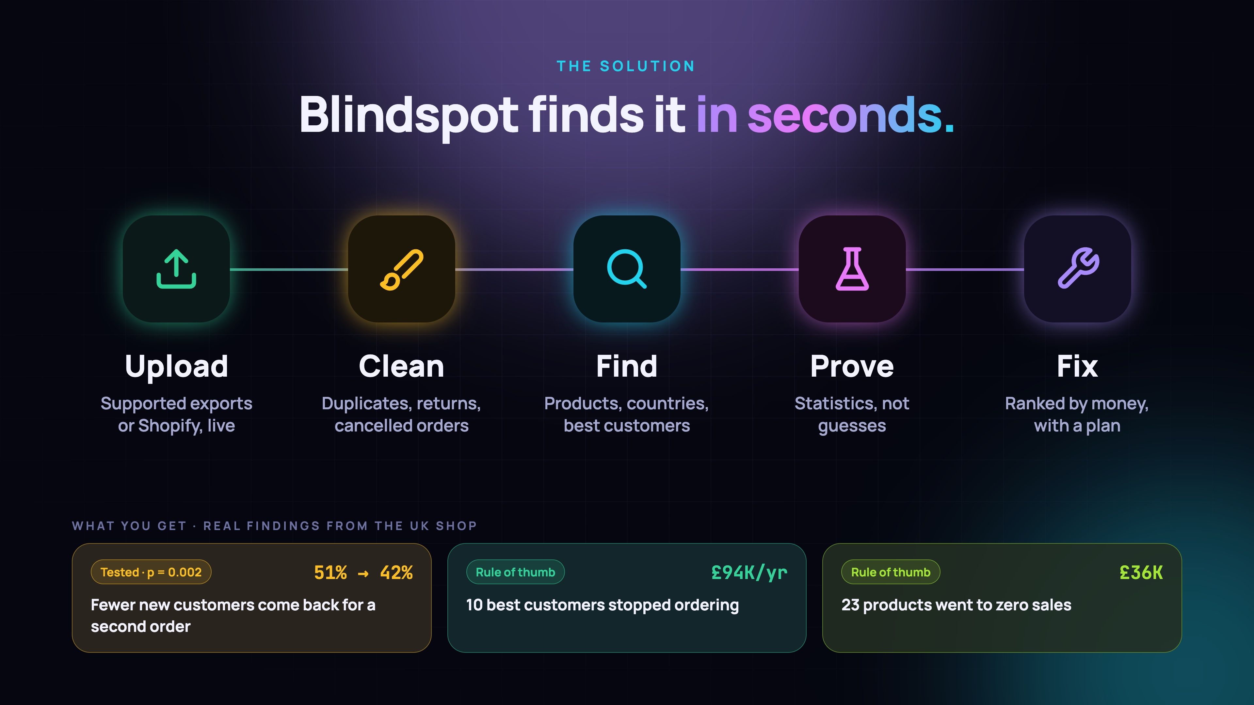
Notes:
Blindspot does it in seconds: upload your data, it cleans it, finds the problems, proves them with statistics, and tells you what to fix first, ranked by money.

Slide 8
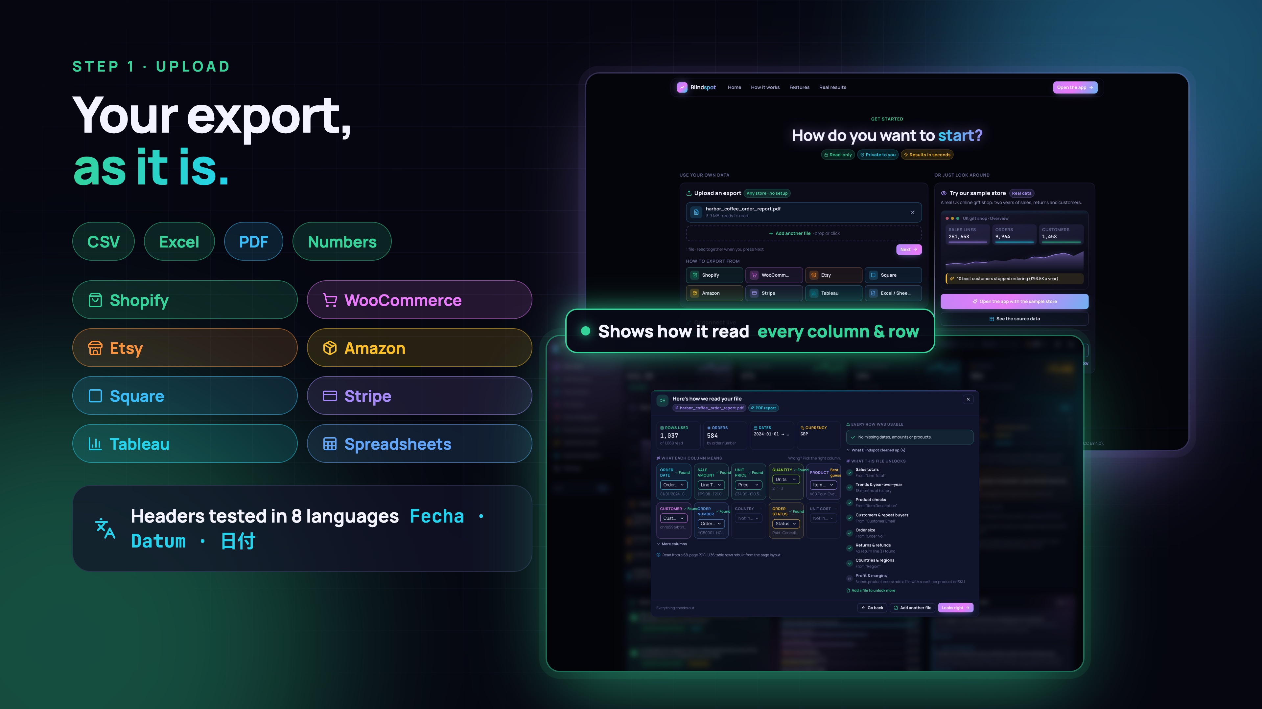
Notes:
Step one: your export, as it is. CSV, Excel or PDF, from Shopify, Etsy, Amazon, Square, WooCommerce, Stripe or Tableau, with headers in eight tested languages; PDFs need readable text. And it shows exactly how it read every column and every row, with line numbers.

Slide 9
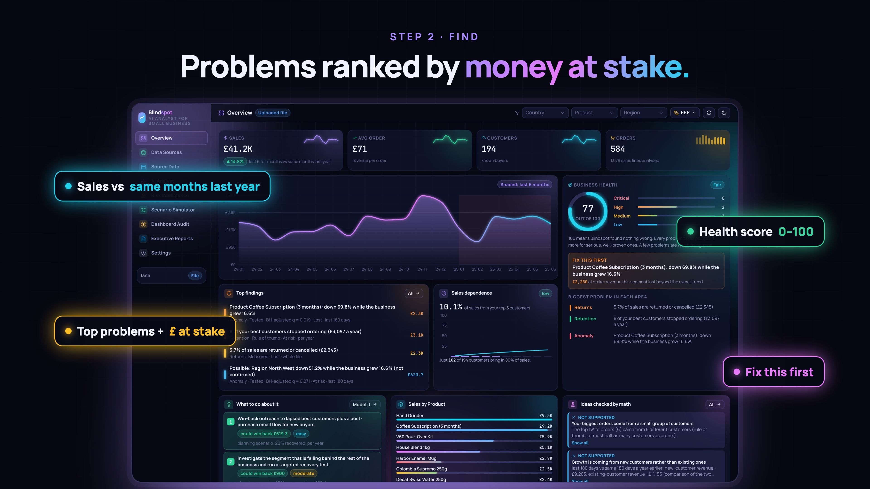
Notes:
Step two: the dashboard. Every problem is ranked by the money at stake, with a 0 to 100 health score, a comparison with the same months last year, and a clear 'fix this first'.

Slide 10
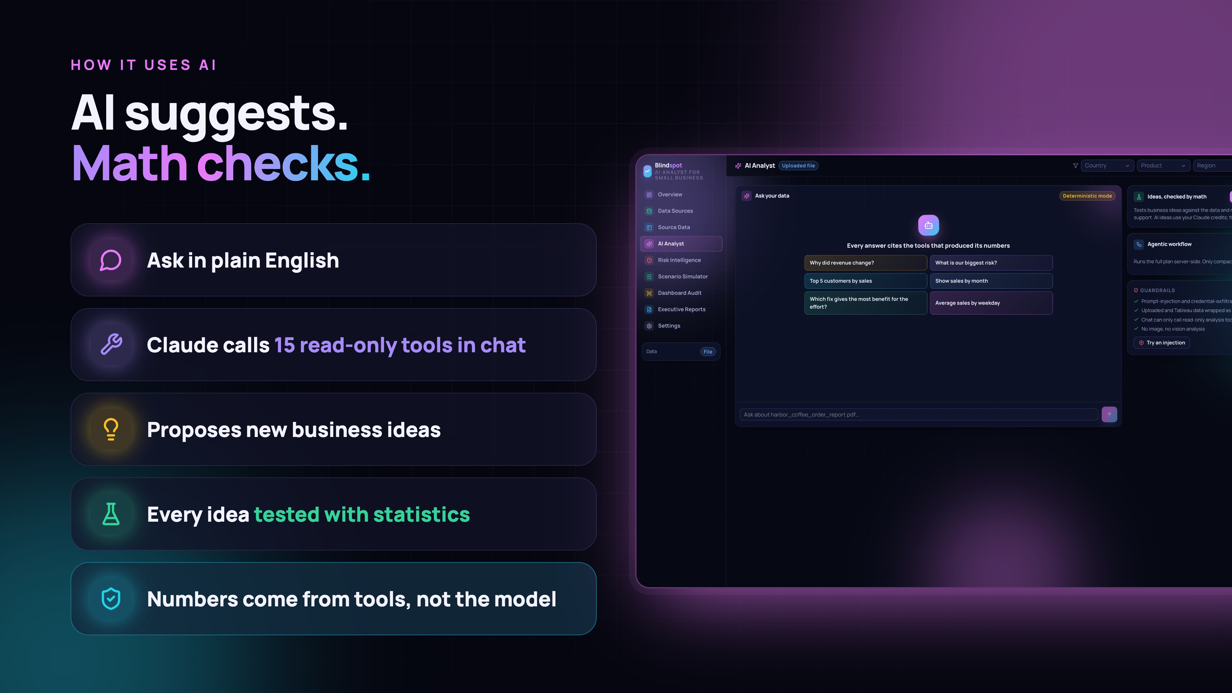
Notes:
How it uses AI: AI suggests, math checks. You ask in plain English, Claude picks from 15 read-only analysis tools (34 typed tools across the app and MCP), and it proposes new ideas, but every idea is tested with statistics before you see it. The numbers come from the tools, and every answer shows the tool results behind it.

Slide 11
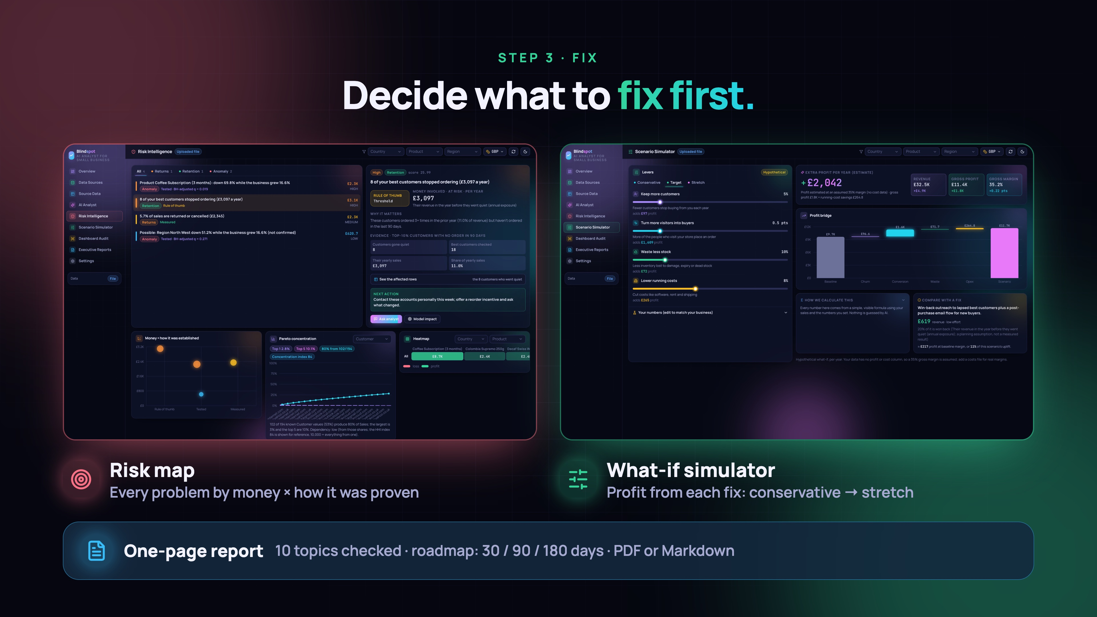
Notes:
Step three: decide what to fix. A risk map by money and confidence, a what-if simulator for profit, and a one-page report with a 30, 90 and 180-day roadmap.

Slide 12
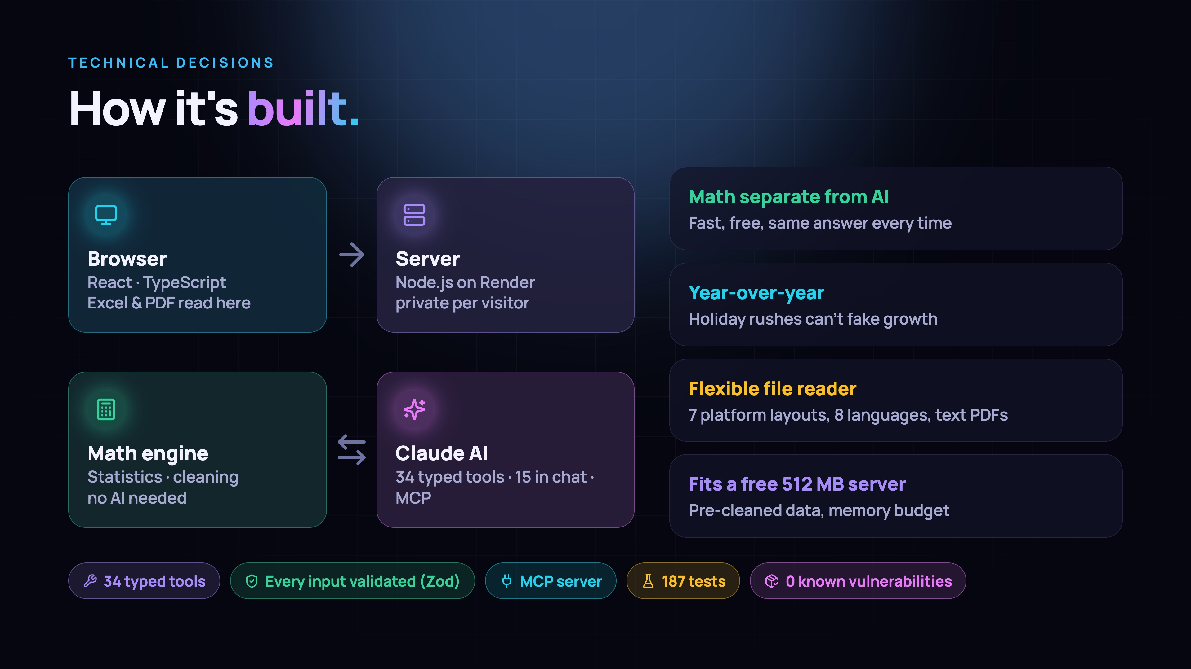
Notes:
How it's built: a React and TypeScript front end, a Node server on Render, my own math engine kept separate from the AI so results are fast, free and repeatable, and Claude with 34 typed tools, also available over MCP.

Slide 13
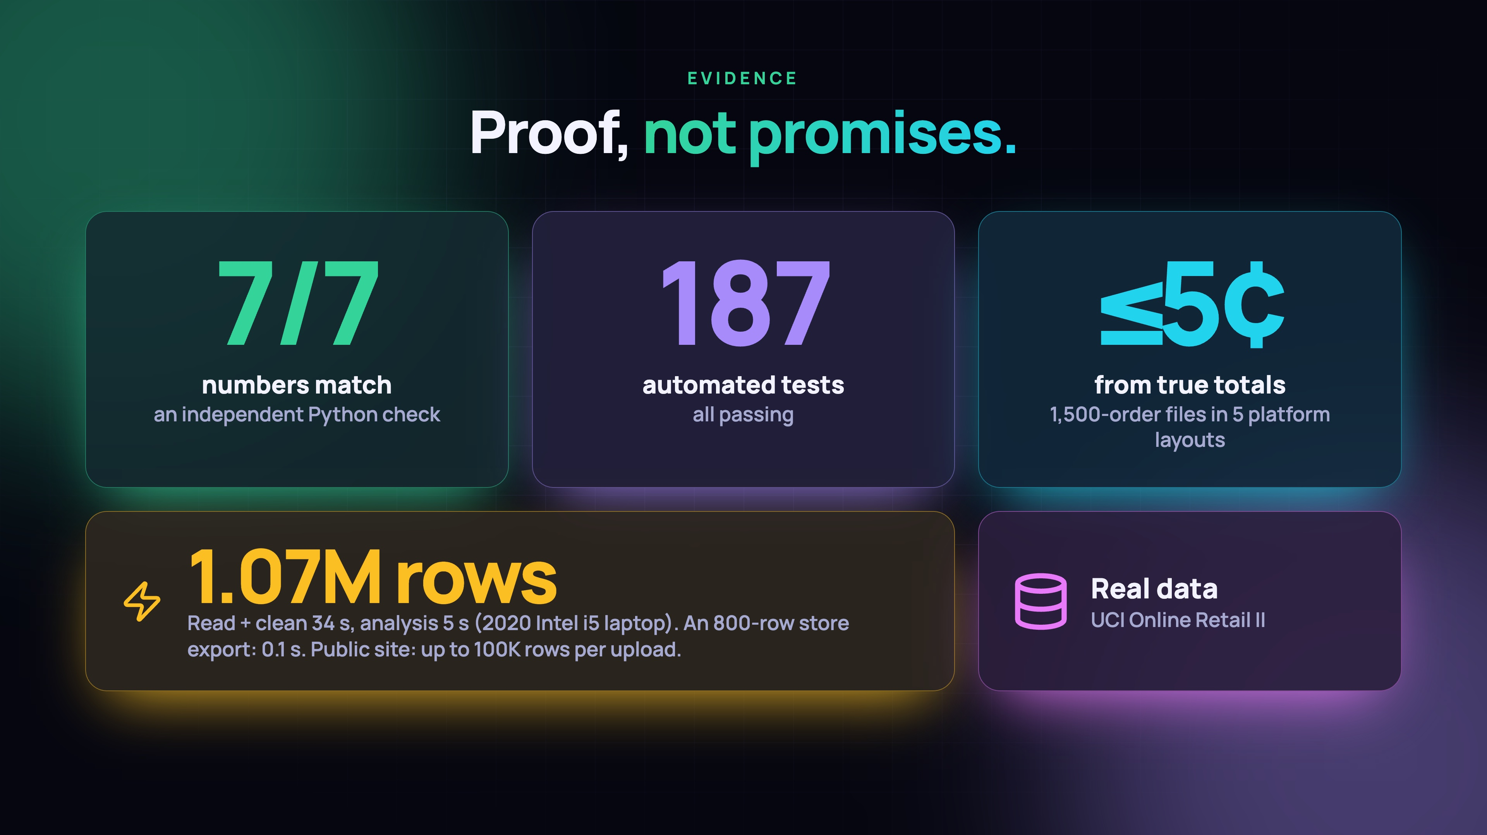
Notes:
Proof, not promises: 7 of 7 headline numbers match an independent Python check, 187 automated tests pass, test files from 5 platforms come out within 5 cents of the true totals, and the full 1.07-million-row dataset reads in 34 seconds and analyses in 5 on a 2020 laptop; the public site takes up to 100,000 rows per upload.

Slide 14
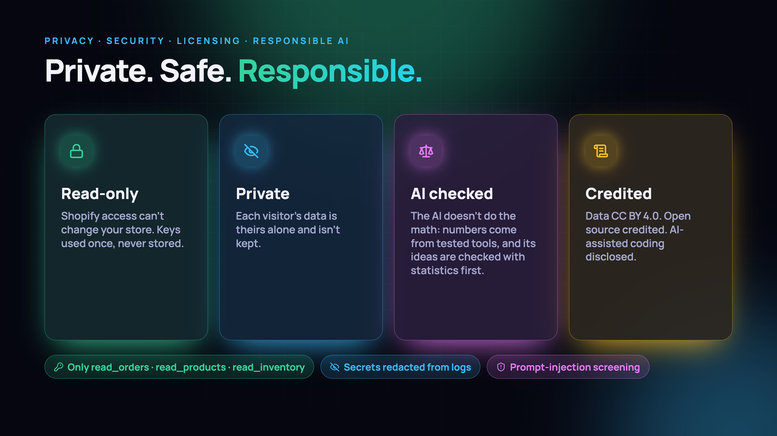
Notes:
It's private, safe and responsible: read-only Shopify access, keys never stored, each visitor's data private, the AI never calculates numbers, and the data license and open-source tools are credited.

Slide 15
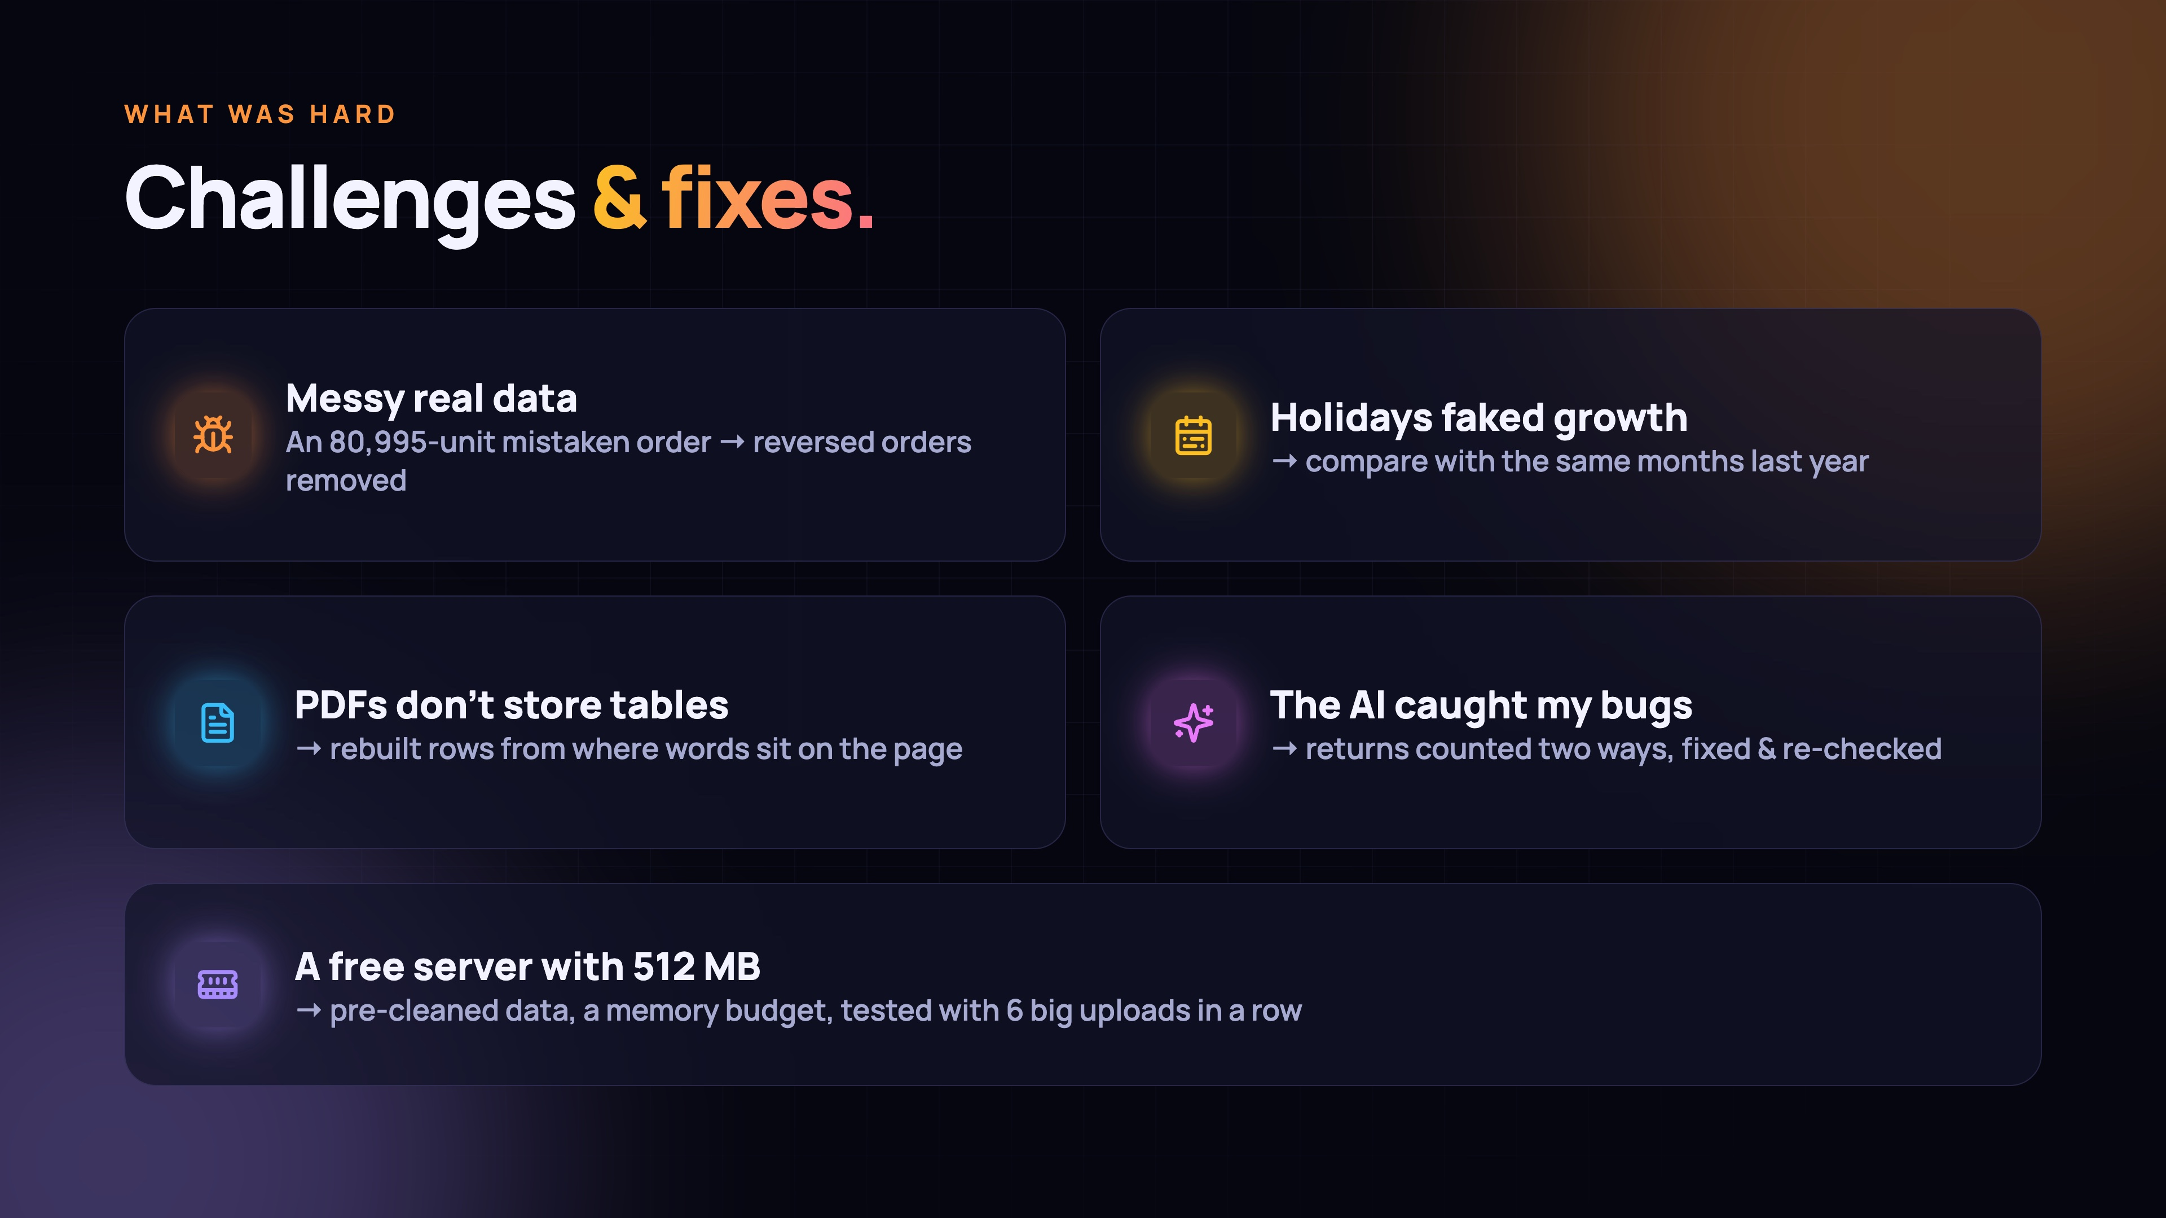
Notes:
Challenges: messy real data, including an 80,995-unit mistaken order; holidays that faked growth; PDFs that don't store tables; and a tiny free server. The AI even caught bugs in my own math.

Slide 16
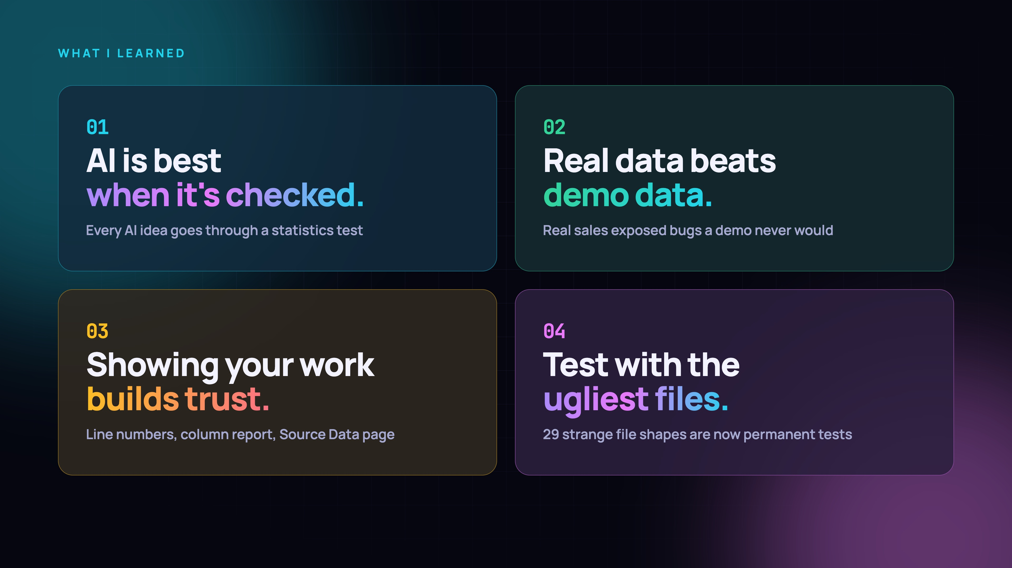
Notes:
What I learned: AI is best when it's checked, real data beats demo data, showing your work builds trust, and you should test with the ugliest files you can find.

Slide 17
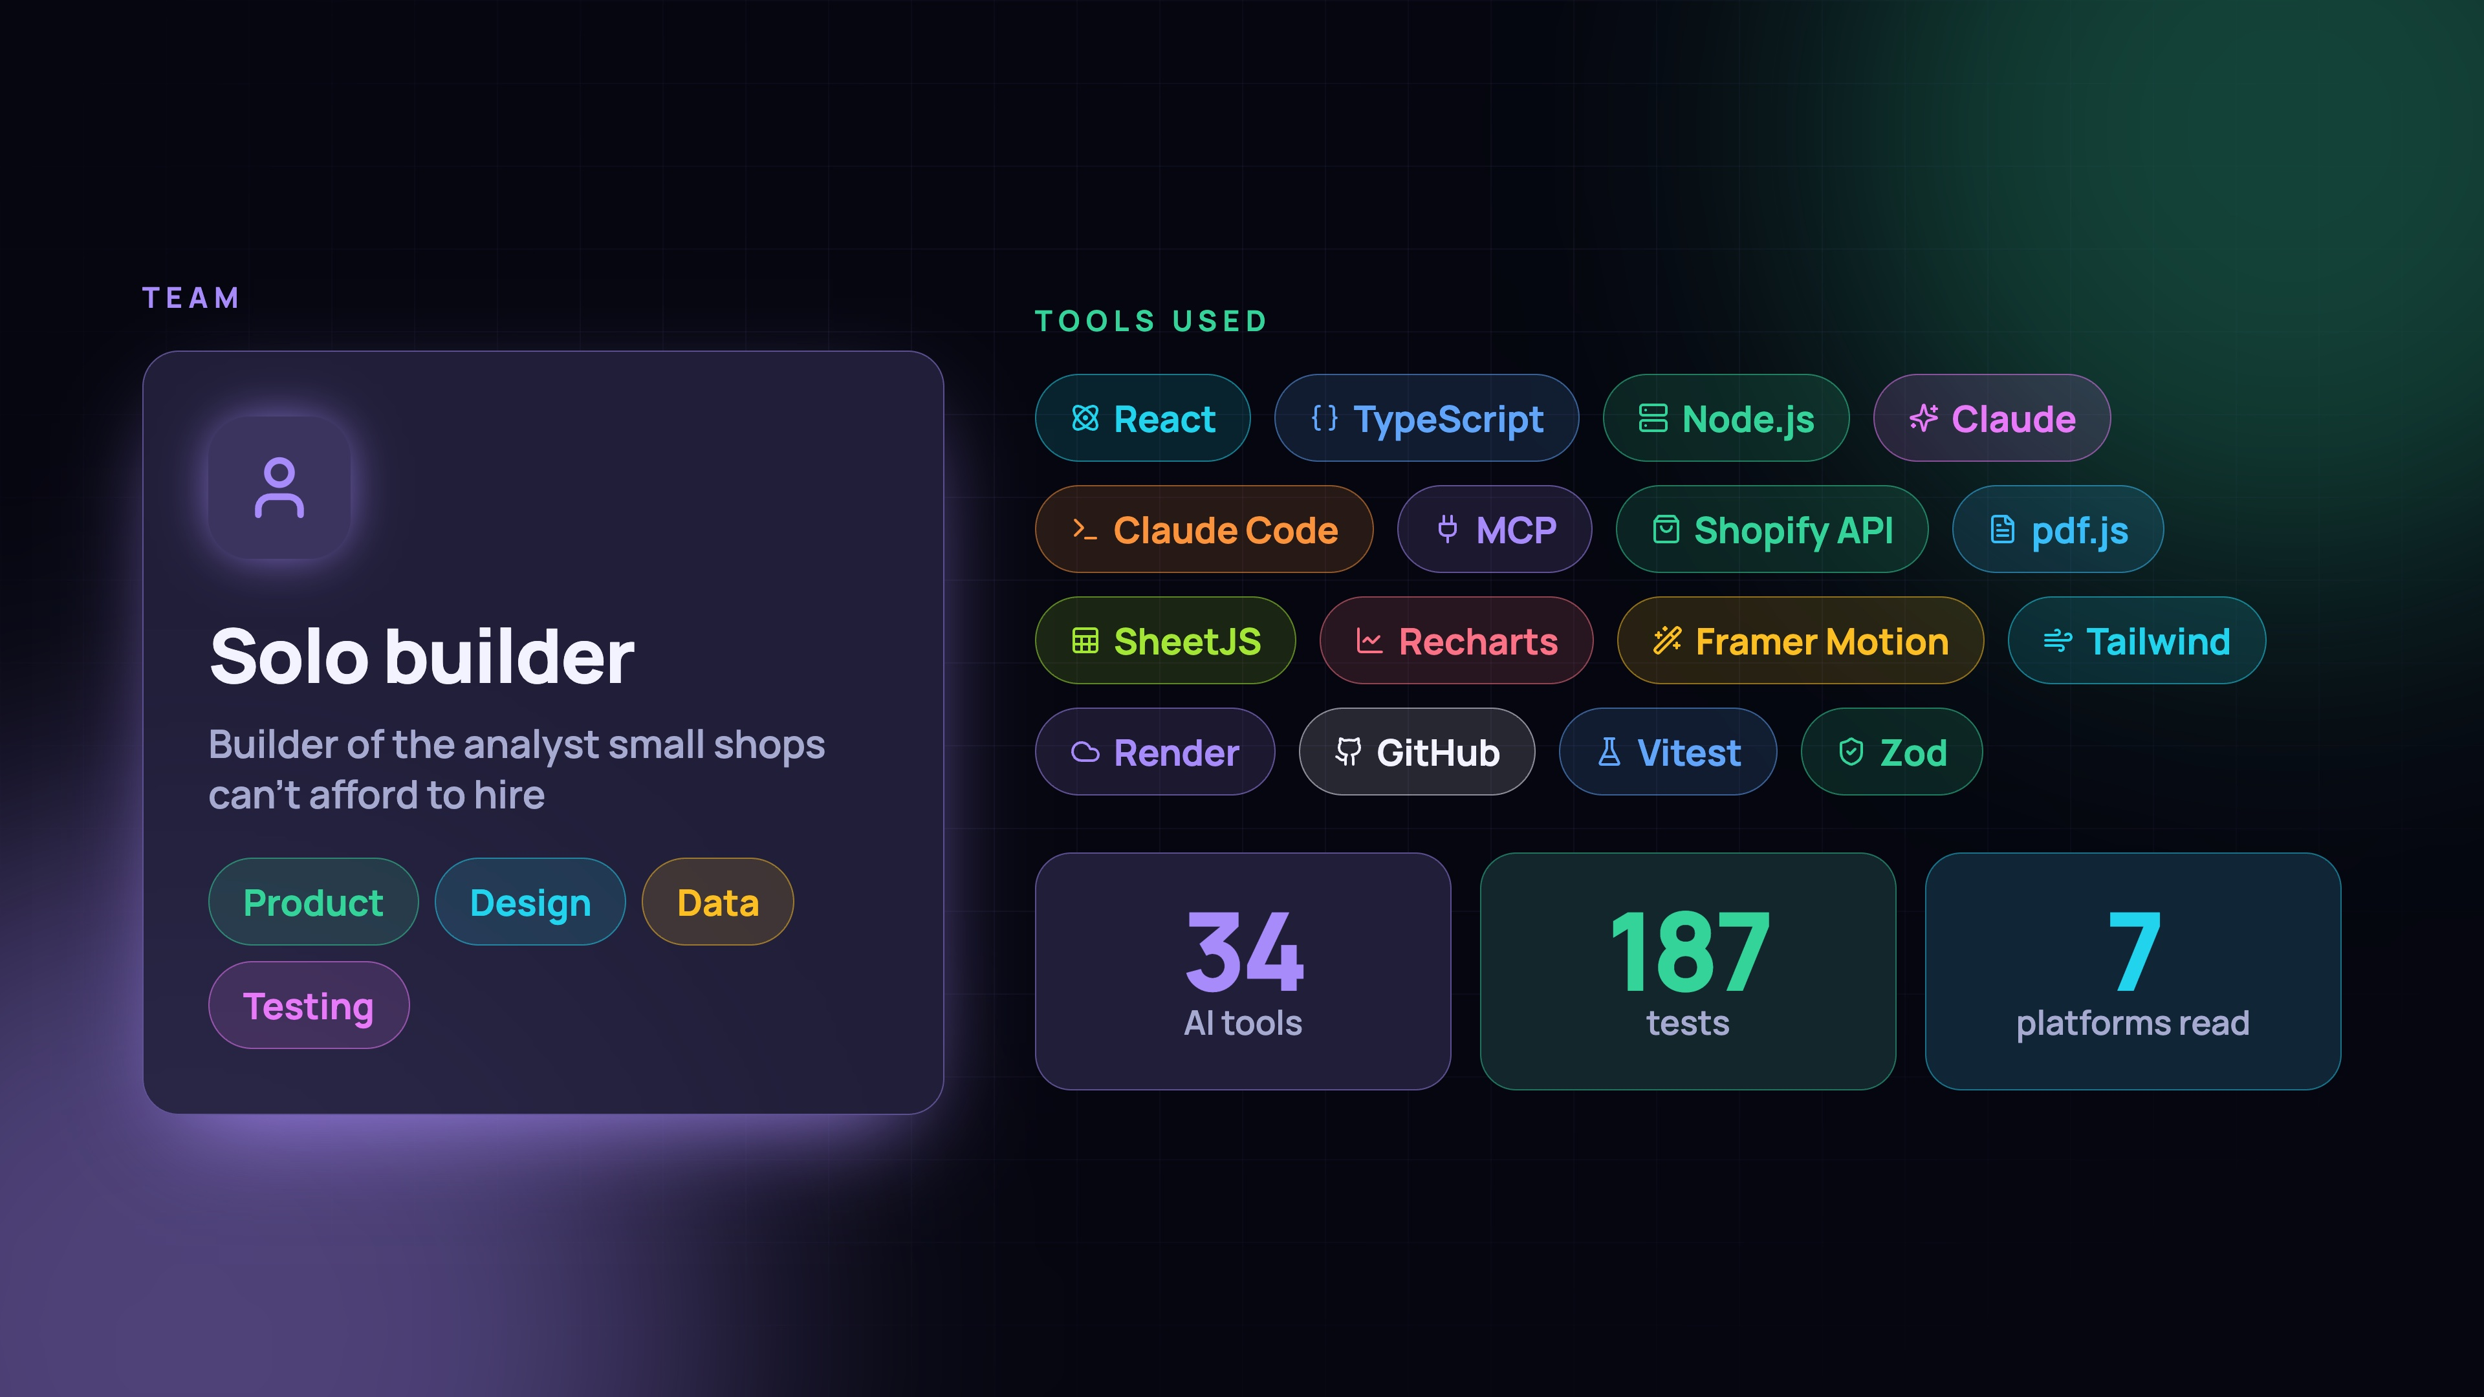
Notes:
I built this solo: the analyst a small shop can't afford to hire. Here are the tools I used: React, TypeScript, Node, Claude, the Shopify API and more.

Slide 18
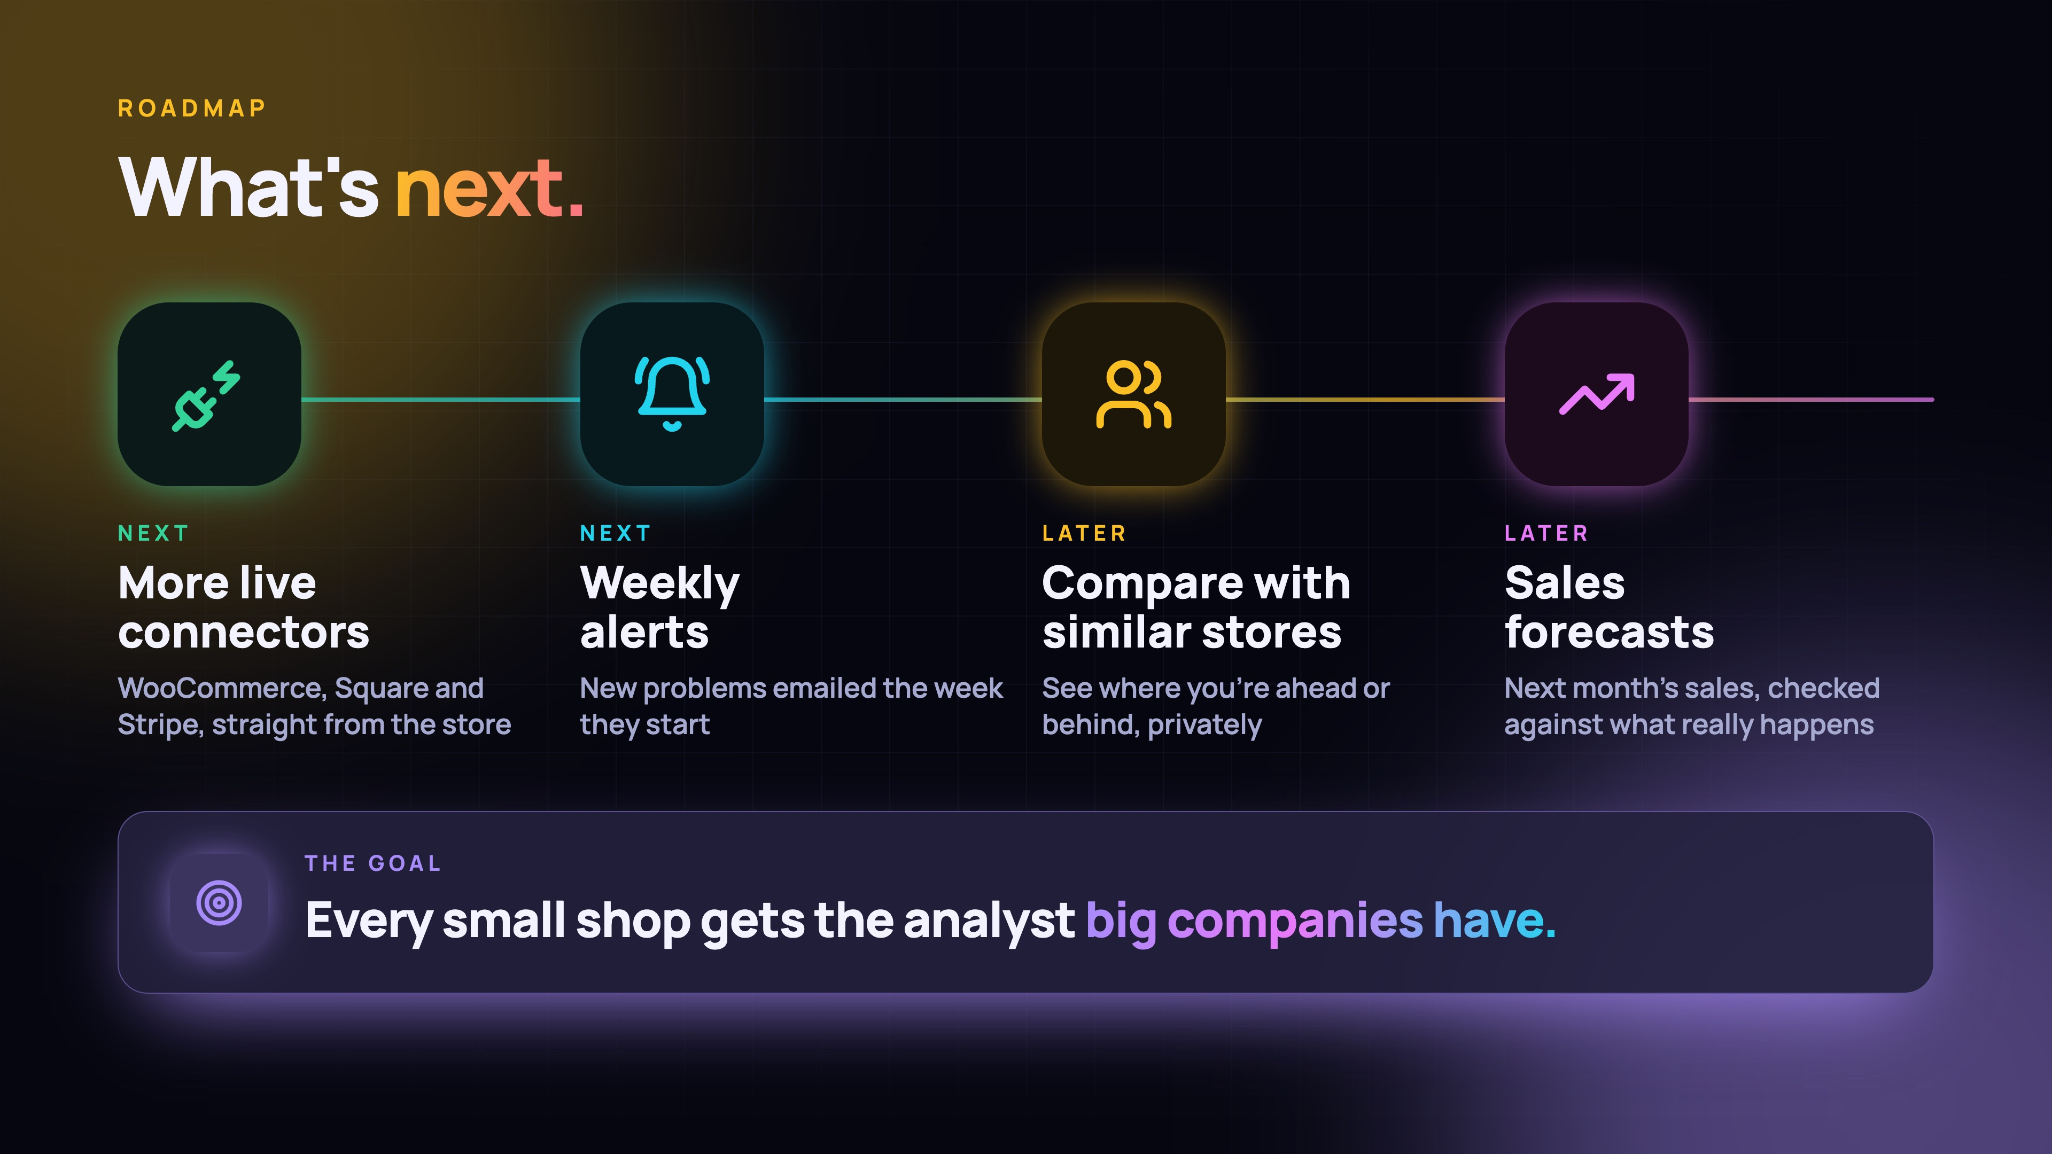
Notes:
What's next: more live connectors for WooCommerce, Square and Stripe, weekly alerts that email you new problems, then comparing your store with similar shops and sales forecasts.

Slide 19
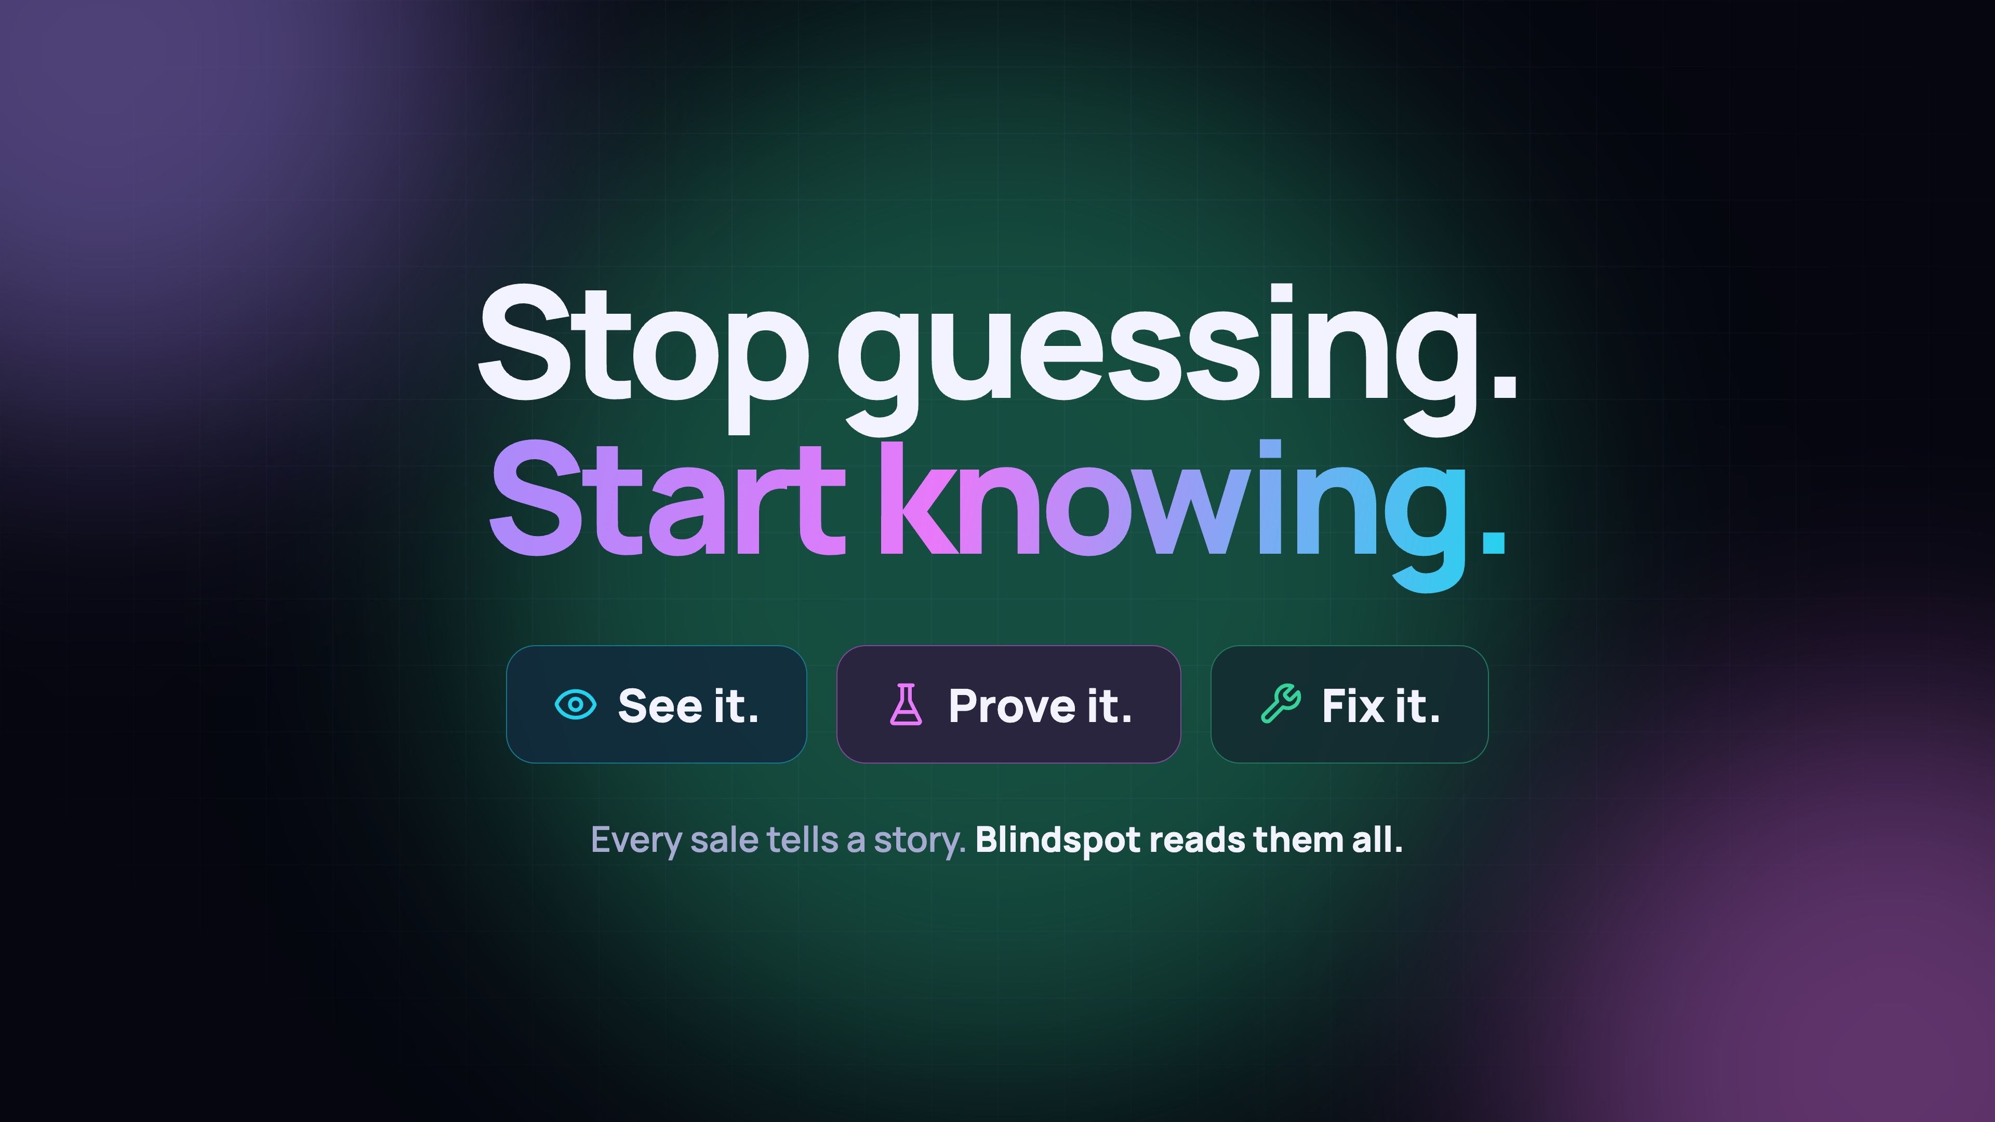
Notes:
Stop guessing. Start knowing. See it, prove it, fix it. Every sale tells a story, and Blindspot reads them all.

Slide 20
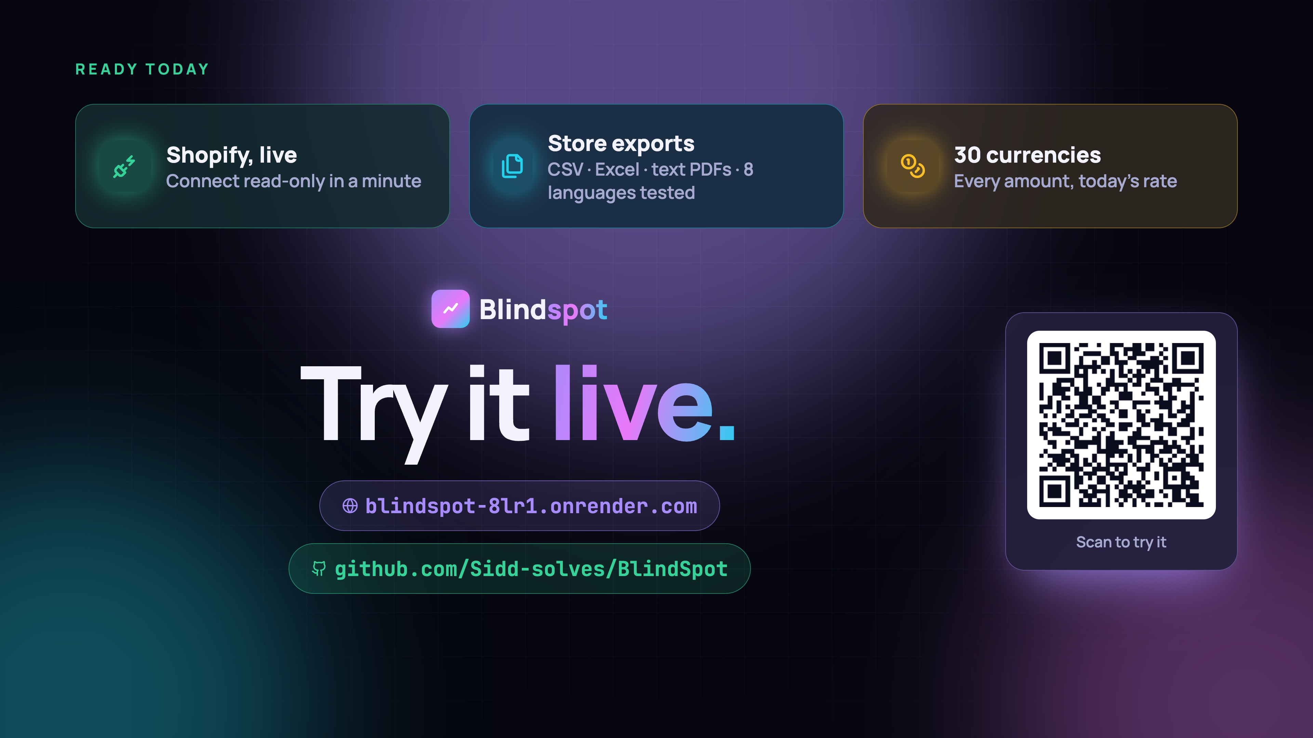
Notes:
It's ready today: connect Shopify live, upload CSV, Excel or text PDFs, and see every amount in 30 currencies. Try it live: scan the code or go to blindspot-8lr1.onrender.com. Thank you!

