Slide 1



Data Structures and Algorithms in Finance Management
Discover the key concepts of DSA in finance management, and learn how they can help you make better decisions and optimize your business.

Slide 2
Why DSA is Important in Finance Management
Efficiency:
DSA helps automate financial analysis and reduce human error, saving time and money.
Accuracy:
DSA algorithms can analyze data more accurately than humans for more objective decision-making.
Scalability:
DSA can handle large, complex datasets and adjust to changing business needs.

Slide 3
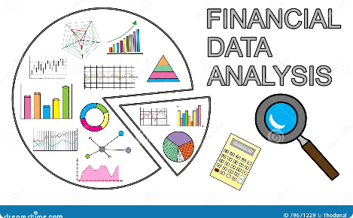



Applications of DSA in Finance Management
Financial Analysis
Expense Management
DSA algorithms can predict market trends, identify patterns in customer data, and optimize investment portfolios.
DSA algorithms can automate data input and flag fraudulent activity.
Loan Management
Automated Trading
DSA algorithms can predict risk and creditworthiness, and optimize loan portfolios.
DSA algorithms can analyze market trends and execute trades faster and more accurately than human traders.

Slide 4

Challenges in Implementing DSA in Finance Management
Data Quality
Security
Compliance
DSA relies on high-quality data, which can be difficult to access and verify in the finance industry.
DSA algorithms can be vulnerable to hacking and other security breaches without proper encryption and authentication procedures in place.
DSA algorithms must comply with industry regulations and ethical standards to avoid legal and reputational risks.

Slide 5




Examples of DSA in Finance Management
Algorithmic Trading
Payment Processing
DSA algorithms are used to analyze market trends and make trades faster and more accurately than human traders.
DSA algorithms can automate payment processing with greater accuracy and reduce fraud.
Loan Approval
Budgeting and Planning
DSA algorithms can analyze vast amounts of data to calculate creditworthiness and approve loans more quickly and accurately.
DSA algorithms can help users plan and optimize financial goals and budgets.

Slide 6
Best Practices for Using DSA in Finance Management
1
Focus on Quality Data
2
Set Clear Goals and Metrics
Choose high-quality data sources, validate data, and use data cleansing tools.
Define what you want to achieve and measure progress continuously.
3
Start Small and Iterate
4
Ensure Compliance and Security
Start with a small pilot project, analyze results, and adjust course as needed.
Follow ethical and legal standards, use secure encryption algorithms, and implement access control mechanisms.

Slide 7
Conclusion and Key Takeaways
DSA can help automate financial analysis and decision-making in finance management.
Data quality, security, and compliance can present challenges to implementing DSA.
Best practices for implementing DSA include focusing on quality data, setting clear goals and metrics, starting small and iterating, and ensuring compliance and security.

