Slide 1

News Insight:
A comprehensive News Application
Yash Baviskar | 22107031
Akshata Khandekar | 22107034
Mohini Deore | 22107065
Project Guide
Prof. Sarla Mary

Slide 2
Outline
Introduction
Literature Survey of the existing systems
Limitations of the existing systems
Problem statement
System Design
Technologies and methodologies
Implementation
Conclusion
References

Slide 3
Introduction
In today's fast-paced digital age, staying informed is essential.
Python-based news application designed for users consume and get news content in a
single application
Integrating advanced technologies to deliver real-time updates, personalized experiences, and insightful infographics to users.

Slide 4
Motivations
Lack of comprehensive features and user- centric news application based on tkinter and python
Lack of methodologies to fetch real-time news data in a efficient and cost effective way
Addressing the shortcomings observed in existing Python news applications

Slide 5
Objectives
To provide flexible and feature-rich based news consumption platform using tkinter GUI
To enable real-time news updates for users by web scraping
technology using beautifulsoup library
To reduce reliance on third-party APIs

Slide 6
Literature Survey of the existing system
Sr No. | Title | Author | Year | Outcomes | Methodology | Result
1 | [1] Web Scraping or Web Crawling: State of Art, Techniques, Approaches and Application | Moaiad Ahmad Khder, Department of Computer Science, College of Arts and Science, Applied Science University, Bahrain | 2021 | Web scraping, essential for Business Intelligence, requires code reuse and maintenance due to potential site changes; its applications are vast, but ethical considerations, legal implications, and plagiarism risks highlight the need for | Web scraping employs three main approaches: Regular expressions for pattern-based string matching, Beautiful Soup for easy XML and HTML parsing, and Lxml for fast and feature-rich XML/HTML processing, with their benefits and drawbacks | One of the best languages for implementin g it in would be Python, due to its fast learning curve and powerful syntax.

Slide 7
Sr No. | Title | Author | Year | Outcomes | Methodology | Result
2 | [2] A Review on Web Scrapping and its Applicatio ns | Vidhi Singrodia Amity University, Newtown, Kolkata Anirban Mitra Amity University, Newtown, Kolkata Subrata Paul Research Scholar, MAKAUT, Kalyani, NADIA | 2019 | To provide a comprehensive overview of web scraping techniques and methodologies used for data extraction from the web. | Analyzed real-world case studies and examples of web scraping implementations across different industries to understand the practical implications and effectiveness of various techniques. | Identification of Identified and classified common web scraping techniques, including HTML parsing, DOM traversal, XPath querying, and API-based extraction.

Slide 8
Sr No. | Title | Author | Year | Outcomes | Methodology | Result
3 | [2] Design and Implement ation of Domestic News Collection System Based on Python | Haixia Lv, College of Computer Science and Technology | 2021 | Emphasis on simplicity and efficiency allows users to quickly access relevant news content. Focuses on key information while disregarding unnecessary details for streamlined user experience. | Implemented Related Technologies for the application : Scrapy framework. Django Framework Data Analysis and Processing Technology | This system, as a comprehe nsive informati on, analysis and retrieval tool, will facilitate people's lives to a certain extentT

Slide 9
Limitations of existing systems
Heavy Reliance on Third Party APIs
Lack of Flexibility
Dependency on update intervals
Lack of backend Database in Most News Application
Applications do not provide comprehensive features for User centric experience

Slide 10
Problem statement
Current Python news applications exhibit limitations, such as heavy reliance on third-party APIs leading to inflexibility, potential subscription fees, and dependence on update intervals.
Lack of free-to-use Tkinter Based User Friendly Application with comprehensive features

Slide 11
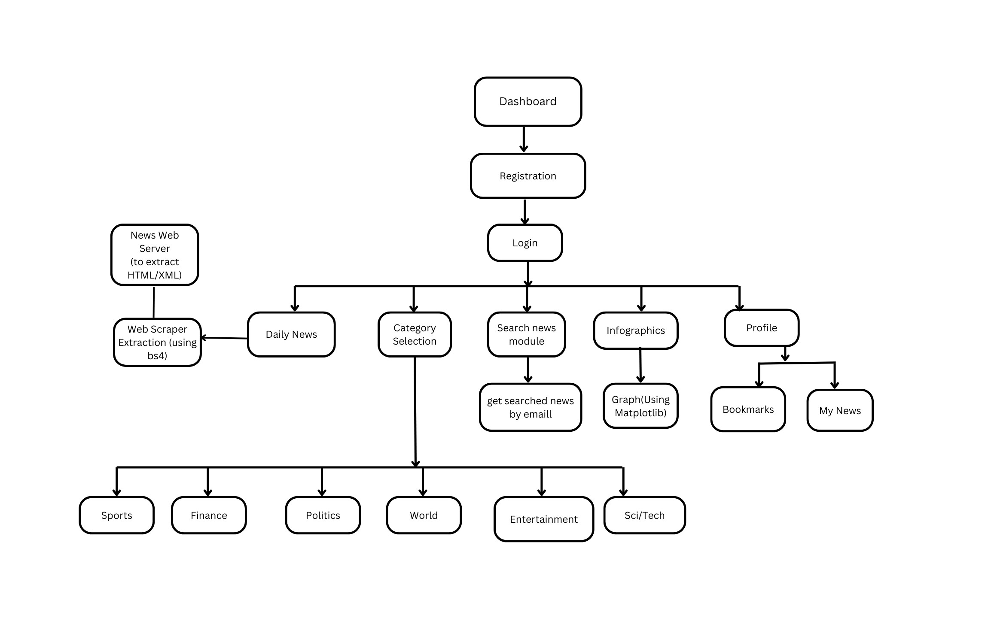

Slide 12
Technologies and methodologies
Frontend Technology :
Tkinter : Base of GUI Application
Customkinter : For Additional Features and enhanced customization and Design
Webview : Cross-platform to embed web content into application Backend technology :
Bs4 (Beautiful Soup) : Parsing HTML / XML for web scraping purposes
Requests Library : to make HTTP requests for retrieval of web page
Matplotlib : For Visualization of Data
SQL : structured storage for user details and relevant news information

Slide 13
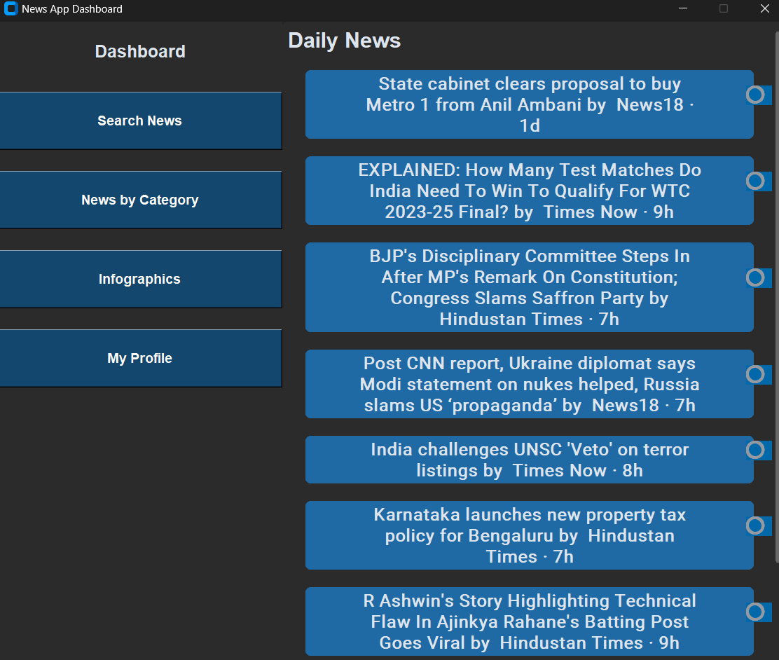
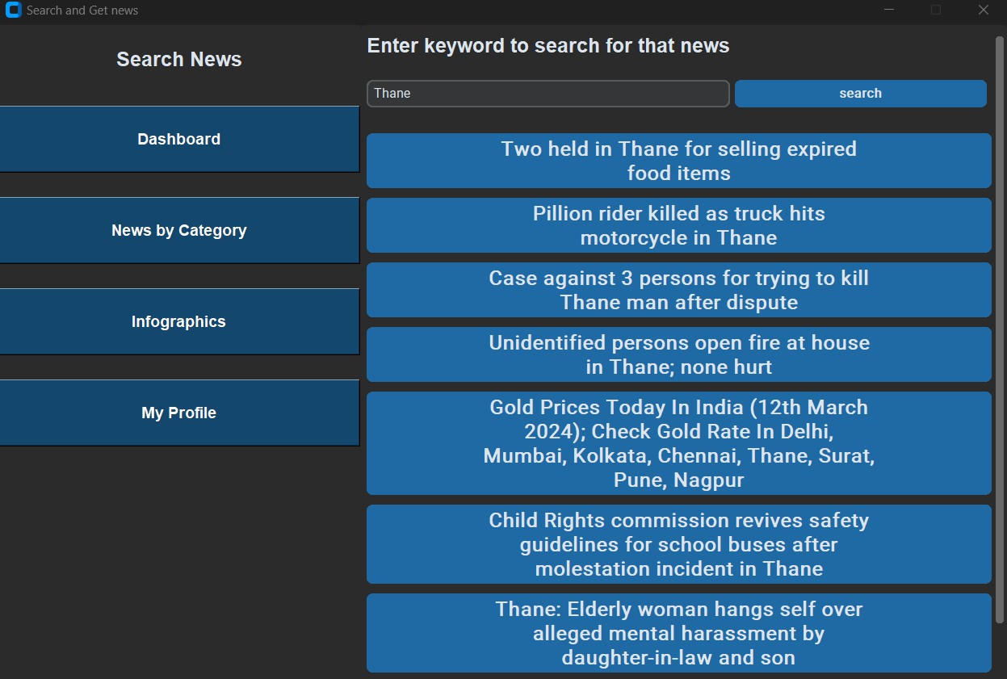
Implementation

Slide 14
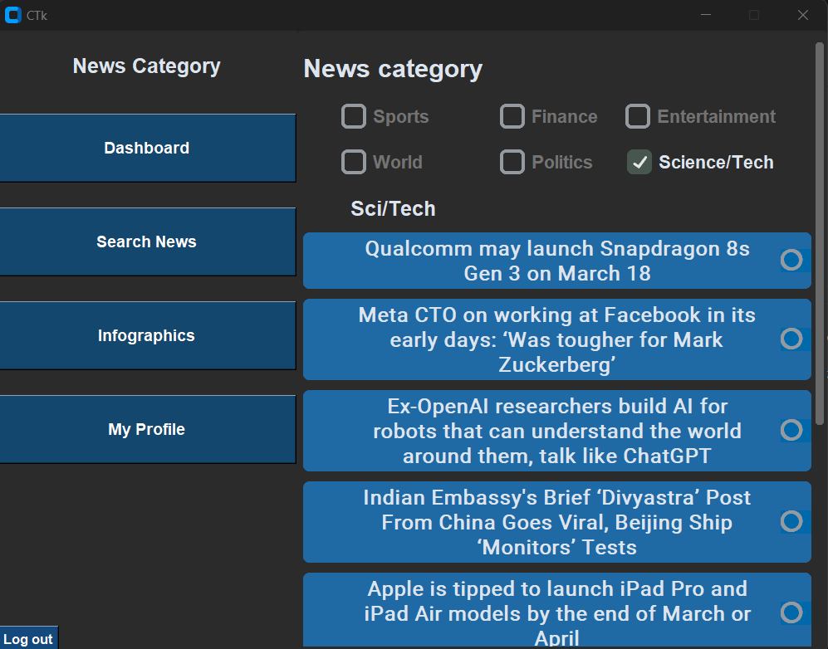
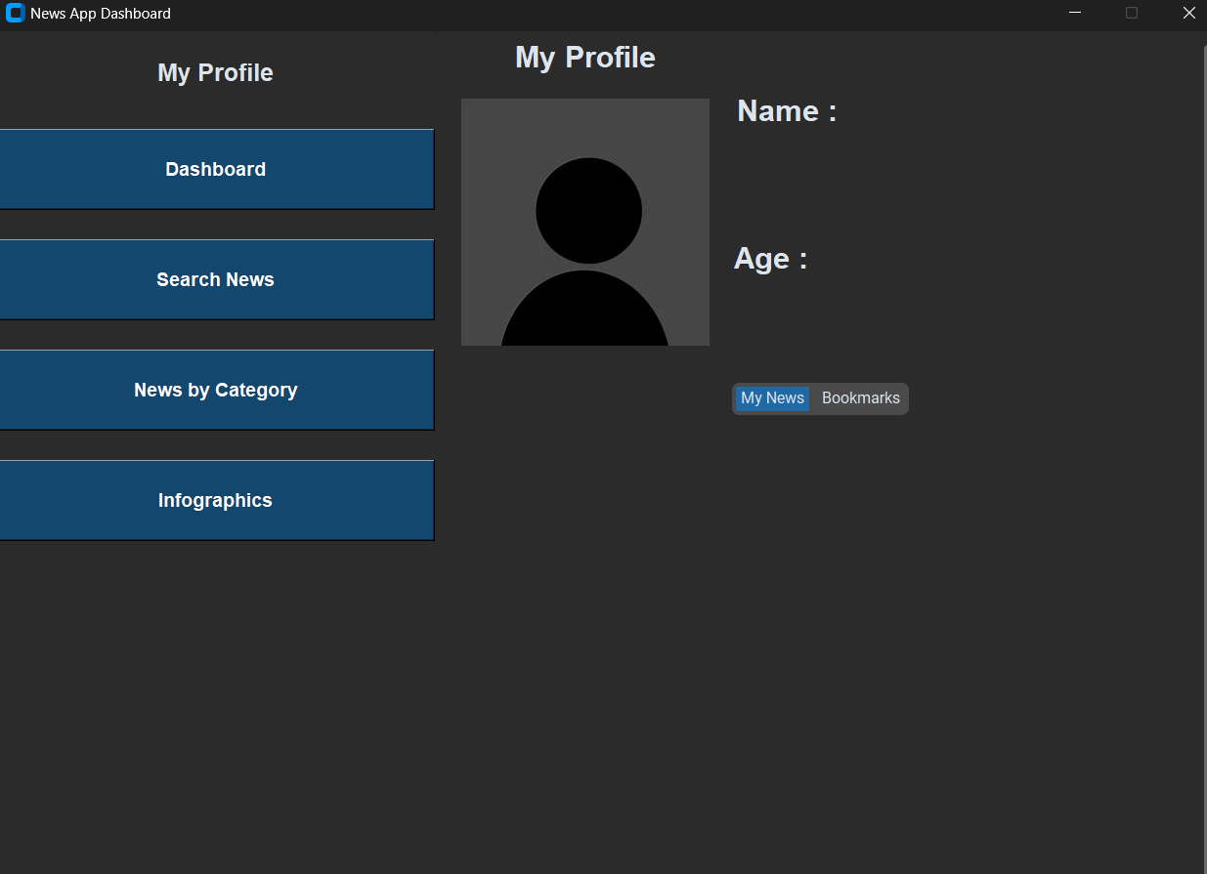
Implementation

Slide 15
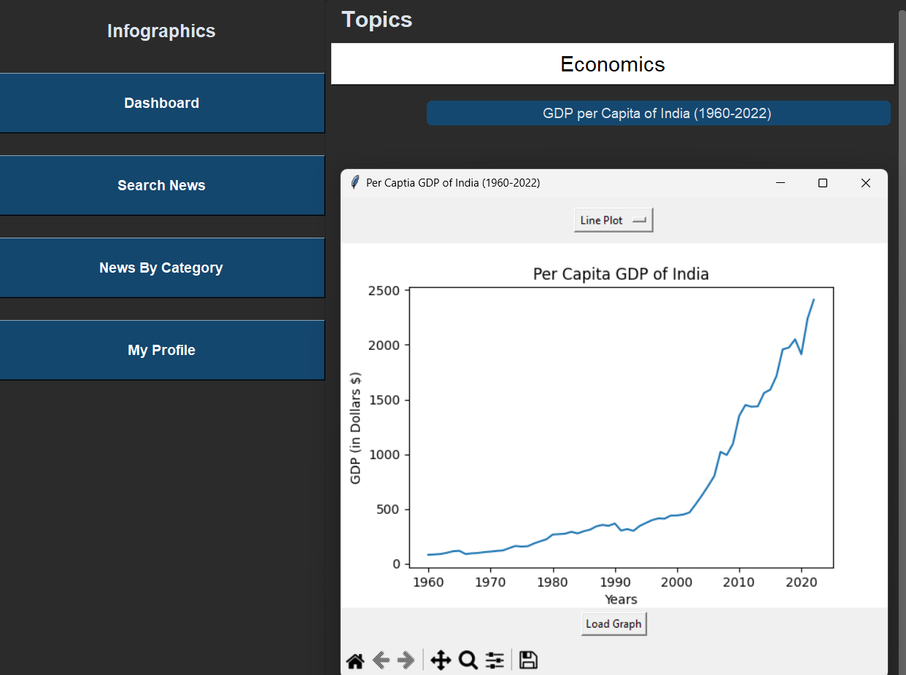

Slide 16
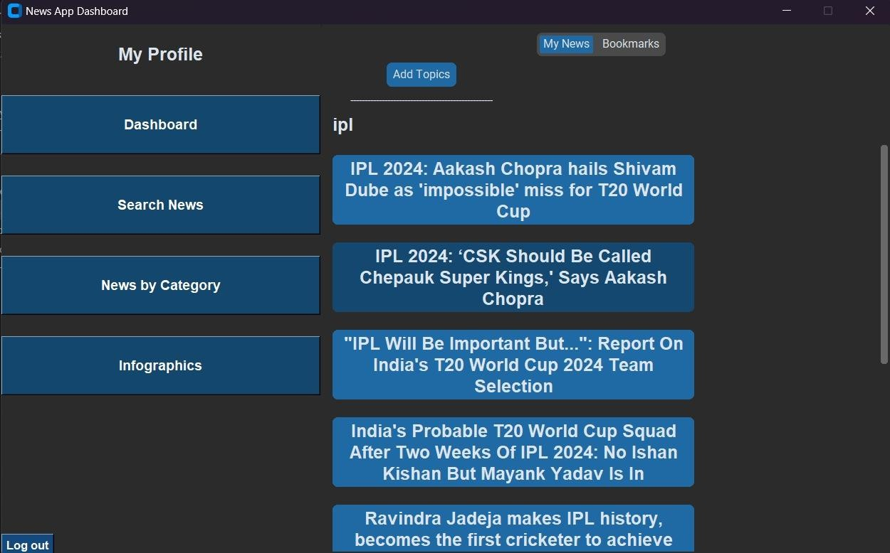

Slide 17
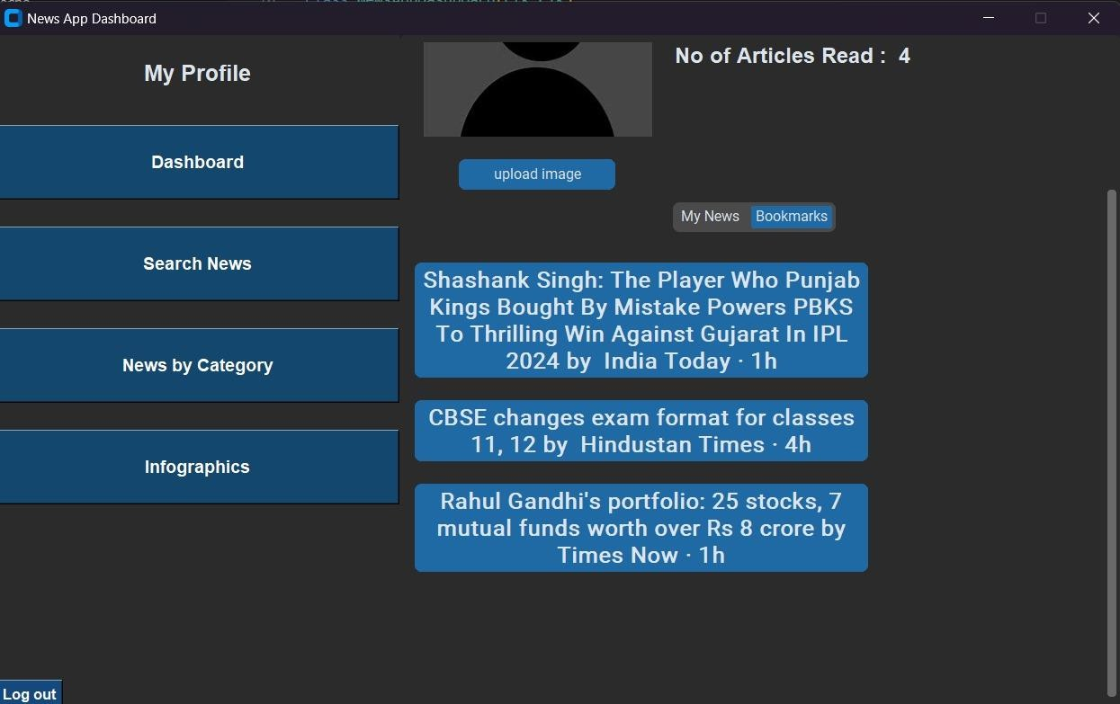

Slide 18
Conclusion
Hence Deployment and Implementation of 50 percent of Python Based News Application with successful real-time fetching of news and providing seamless user experience
Successfully achieved less reliance of third party apis and developed free-to-use news application
Successfully integrated matplotlib with tkinter to provide visual representation of news

Slide 19
References
[1] Haixia Lv, “Design and Implementation of Domestic News Collection System Based on Python”, Shandong University of Finance and Economics, 2021
[2] Vidhi Singrodia Amity University, Newtown, Kolkata ,” A Review on Web Scrapping and its Applications” , International Conference on Computer Communication and Informatics. (ICCCI) ,2019
[3] Moaiad Ahmad Khder, “Web Scraping or Web Crawling: State of Art, Techniques, Approaches and Application”, Int. J. Advance Soft Compu. Appl, Vol. 13, No. 3,Applied Science University, Bahrain

Slide 20
Thank You...!!

