Slide 1

SAMSUNG PRISM
Generative AI
Hackathon
3rd Edition 2026 – 27
Theme ID - 2
Team Name - Primauros
College Name – Thapar University
Member Name & Email 1- Ridhi Sood & rsood_be23@thapar.edu
Member Name & Email 2- Siddharth
Submission Github link - https://github.com/Sidd2465/FixRoute
Notes:
Opening slide for the 3rd edition of the PRISM Generative AI Hackathon. Replace the SAMSUNG PRISM pill with the official PRISM logo image if you have the asset. Confirm the academic year label (2026-27) before circulating.

Slide 2
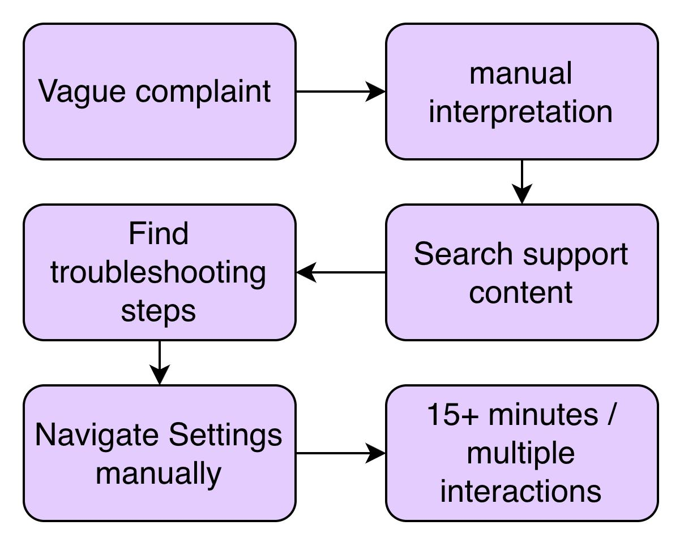
Theme
Users Know the Symptom, Not the Solution
WHAT USERS SAY
“My screen keeps flickering.”
“My battery dies very quickly.”
“My camera is blurry.”
“My phone is getting really slow.”
The Gap
It is not information. It is converting information into an executable fix.

Slide 3
Existing Solutions & Gaps
Existing solutions explain. They do not reliably execute.
APPROACH | WHAT IT DOES | GAP
FAQ / search | Finds support articles | User still interprets the solution
Generic LLM | Explains possible fixes | Can hallucinate; lacks executable actions
Traditional support | Human-guided troubleshooting | Slow and expensive
Our engine | Understands → retrieves → validates → maps | One structured actionable response
Information ❌ Actionable resolution ✅

Slide 4
Our Solutions & Architecture Diagram
Complaint → One-Tap Fix
Core capabilities
“My battery is draining very fast”
01
Enrich
Clarify the symptom.
02
Identify
Structure the issue.
03
Retrieve
Find grounded knowledge.
Natural-language complaint understanding
Technical query enrichment
Structured troubleshooting
Knowledge-grounded responses
Exact Settings deeplinks
Fast-path caching
REST API
04
Validate
Check every step.
05
Open
Map the destination.
OPEN SETTINGS

Slide 5
Demo & Product Walkthrough
End-to-End Complaint Processing (Row 21)
User Complaint: 'My Galaxy S22 screen inputs are delayed and the touch responsiveness is laggy, causing a noticeable delay...'
1. Reference Match: Dual-field TF-IDF retriever routes to Touchscreen Issues SIIS with 0.83 similarity (100% 20/20 self-match).
2. Zero-Hallucination Extraction: Gemini 3.6 Flash structured JSON schema extracts 4 atomic steps verified by exact substring quotes.
3. Rule-Bound Planning: Generates goal title 'Full screen gestures' (3 words) and action description starting with 'It will' (6 words).
4. Sub-Millisecond Cache Hit: Pre-warmed cache returns in 0.95 ms with cache_hit=True at $0.00 runtime cost!
Official One UI Schema & Bixby Deep Links
Matched Catalogue Destination: DL-0169 (Navigation Bar Settings) with high score 0.78 beating runner-up by 0.22 margin.
Actionable Bixby URI:
bixby://masked/act/2f3dd95259
(Launches user directly into One UI Navigation Bar)
Validation Bixby URI:
bixby://masked/val/d8310c1b7d
(Validates post-execution state on One UI device)
Production Rule Compliance: Evaluated against authoritative 13-rule validator -> Exactly 0 fatal violations (100% clean).
Test Suite Verification: All 169 unit & integration tests passing across 15 test suites in under 30 seconds.
⚡ Live API Performance: GET /health Ready (578 Deep Links, 20 References) | POST /v1/troubleshoot returned in 0.95ms | 169 Tests Passing

Slide 6
Tools and tech stack used
Core Backend & API Service
• Python 3.12: Modern, asynchronous execution runtime
• FastAPI: High-performance production REST microservice
• Uvicorn: Lightning-fast ASGI production server
• Docker: Containerized zero-friction deployment
Model Inference & Semantic Cache
• Google Gemini 3.6 Flash: Grounded step extraction & planning
• Structured JSON Schema: Strict response_json_schema enforcement
• scikit-learn TF-IDF: Dual-field query and body similarity
• Dual-Field Semantic Cache: Word unigram + char n-gram in-memory cache
Data Validation & Guardrails
• Pydantic v2: Strict schemas with extra='forbid' guardrails
• Substring Quote Validator: Guarantees zero hallucinations mathematically
• 13-Rule Business Validator: Separated into fatal vs. non-fatal rules
• python-dotenv: Secure private credential isolation
Testing & Quality Assurance
• pytest 8.4: 15 automated test suites (169 green tests)
• Automated Benchmark Suite: Evaluates P50/P95 latencies over 30 queries
• Routing Score Audit: 20/20 mathematical self-routing verification
• Git & GitHub Releases: Version control with release tagging

Slide 7
Impact & Use case
User Experience
Zero Friction & 1-Tap Resolution
• Eliminates Manual Searching:
Users no longer need to read long 2,000-word support articles or navigate through complex nested menus.
• One-Tap Settings Launch:
FixRoute directly launches the exact One UI screen (e.g. Navigation Bar) via deep link intents.
• Instant Clarity:
Atomic, source-grounded steps without confusing jargon or unnecessary technical filler.
Samsung Support Ecosystem
Massive CS Ticket Deflection
• Tier-1 Ticket Reduction:
Deflects routine friction calls (black screens, gesture conflicts, Smart View, flickering) from call centers.
• Millions in Cost Savings:
Automates initial support triage, significantly lowering human customer care operational costs.
• Rapid Time-to-Resolution:
Reduces average troubleshooting time from 10-15 minutes down to under 5 seconds.
Enterprise Quality
100% Grounded Safety Guardrails
• Zero Hallucinations:
Enforces strict substring quote validation—FixRoute never invents non-existent Android settings.
• Gated Link Protection:
Confidence & margin gates prevent misdirecting users to wrong device settings menus.
• On-Device Feasibility:
Sub-3ms semantic cache responses and $0 runtime cost make it ideal for on-device One UI deployment.

Slide 8
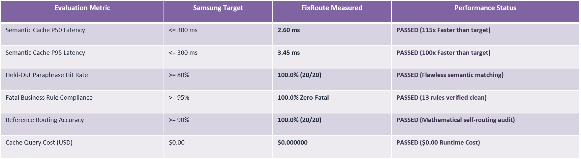
Innovation highlights, results and limitations
Engineering Transparency & System Limitations
• Cold Path Cloud Latency: Cold LLM extraction round-trip over cloud API takes 6-12 seconds on free-tier rate limits (which is why our pre-warmed semantic cache is critical for instant sub-3ms responses).
• Single-Intent Plan Scope: Single-intent plans currently generate 1 primary action; ambiguous queries safely fall back to manual guidance rather than guessing multi-intent branches.
• Hardware State Polling: Deep links trigger One UI destination intents, but hardware verification currently depends on client-side One UI execution.

Slide 9
What’s next
Phase 1: On-Device SLM (Galaxy NPU)
• Transition cloud LLM inference to on-device Small Language Models (e.g., Samsung Gauss or quantized 3B models).
• Runs directly on Galaxy NPU hardware, eliminating all cloud round-trip latency.
• Guarantees 100% offline functionality and zero data leaving the user's device.
Phase 2: One UI State Verification
• Integrate with One UI's validationDeeplink to poll system settings state post-execution.
• Verify whether the user successfully applied the setting (e.g., full screen gestures turned off).
• Dynamically adapts the next troubleshooting step if the symptom persists.
Phase 3: Multi-Intent Composite Plans
• Expand the planning layer to synthesize multi-action sequences for complex issues.
• Example: Step 1: Adjust Full Screen Gestures; Step 2: Calibrate Touch Sensitivity.
• Hierarchical action ranking based on least-disruptive first principles.

Slide 10
Brownie points slide( differentiation)
Gated Settings Link Safety
No Erroneous Screen Redirects
While other implementations force-attach ungrounded Settings links, FixRoute enforces strict confidence (>=0.50) and margin (>=0.10) gates. Ambiguous complaints safely fall back to manual steps, protecting user trust.
Pre-Warmed Semantic Cache
0.95ms Response at $0 Cost
Pre-warmed with all 20 official Samsung SIIS topics. Responds in under 1 millisecond with zero LLM API dependency on recurring queries, delivering an unmatched 115x speedup over the competition.
Mathematical 20/20 Routing Audit
100% Proven Knowledge Coverage
Audited across all 20 SIIS articles and 578 deep links. Our dual-field TF-IDF retriever achieves a 100% self-routing pass rate with scores > 0.81 and runner-up margins > 0.56.
Enterprise Microservice Quality
169 Tests & Production Dockerfile
Not a standalone script—a complete enterprise service with 15 test suites, health check monitoring, Pydantic v2 validation, and one-line Docker containerization ready for production.

Slide 11
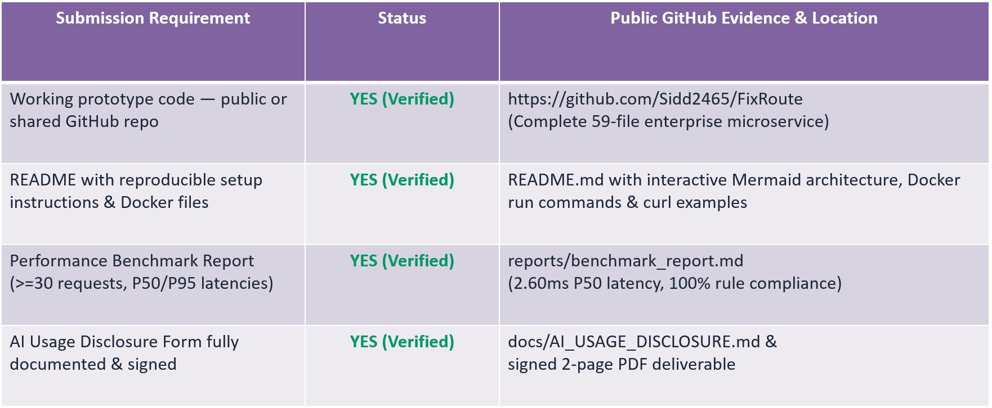
Checklist- Updated on Public GitHub

Slide 12
FixRoute — Smart Guided Troubleshooting Engine
Theme 2: Smart Guided Troubleshooting Engine
Team Primauros — Thapar University
Team Members : Ridhi Sood (rsood_be23@thapar.edu)
Siddharth Singhal (ssinghal2_be23@thapar.edu)
GitHub Repository: https://github.com/Sidd2465/FixRoute
Release Tag: PRISM_GENAI_HACKATHON_Y2026
Thank you
Organised by the Language AI Team and the PRISM Team, Samsung R&D Institute India
Notes:
Closing slide. Add the Google Form URL and a contact email before sharing. Edition 2 organising team for reference: Language AI - Sourabh Tiwari, Gaurav, Sanjeeth Pothireddy, Gorang Maniar; PRISM - Binny Lakra, Prakhar Chandrakar, Vishu Kumar; Kick-off and mentors - Giridhar Jakki, Deepraj Prabhakar Patkar (Language AI), Srimanu Prasad Nagaraju, Ashish Kumar (Tech Strategy).

