Slide 1
Vision-Based Multi-Class Object Tracking using Dashcam videos
Siddhant Jinturkar (BT23ECE066), Akash Chincholkar (BT23ECE085)
Supervisor - Dr. Vishal Satpute

Slide 2
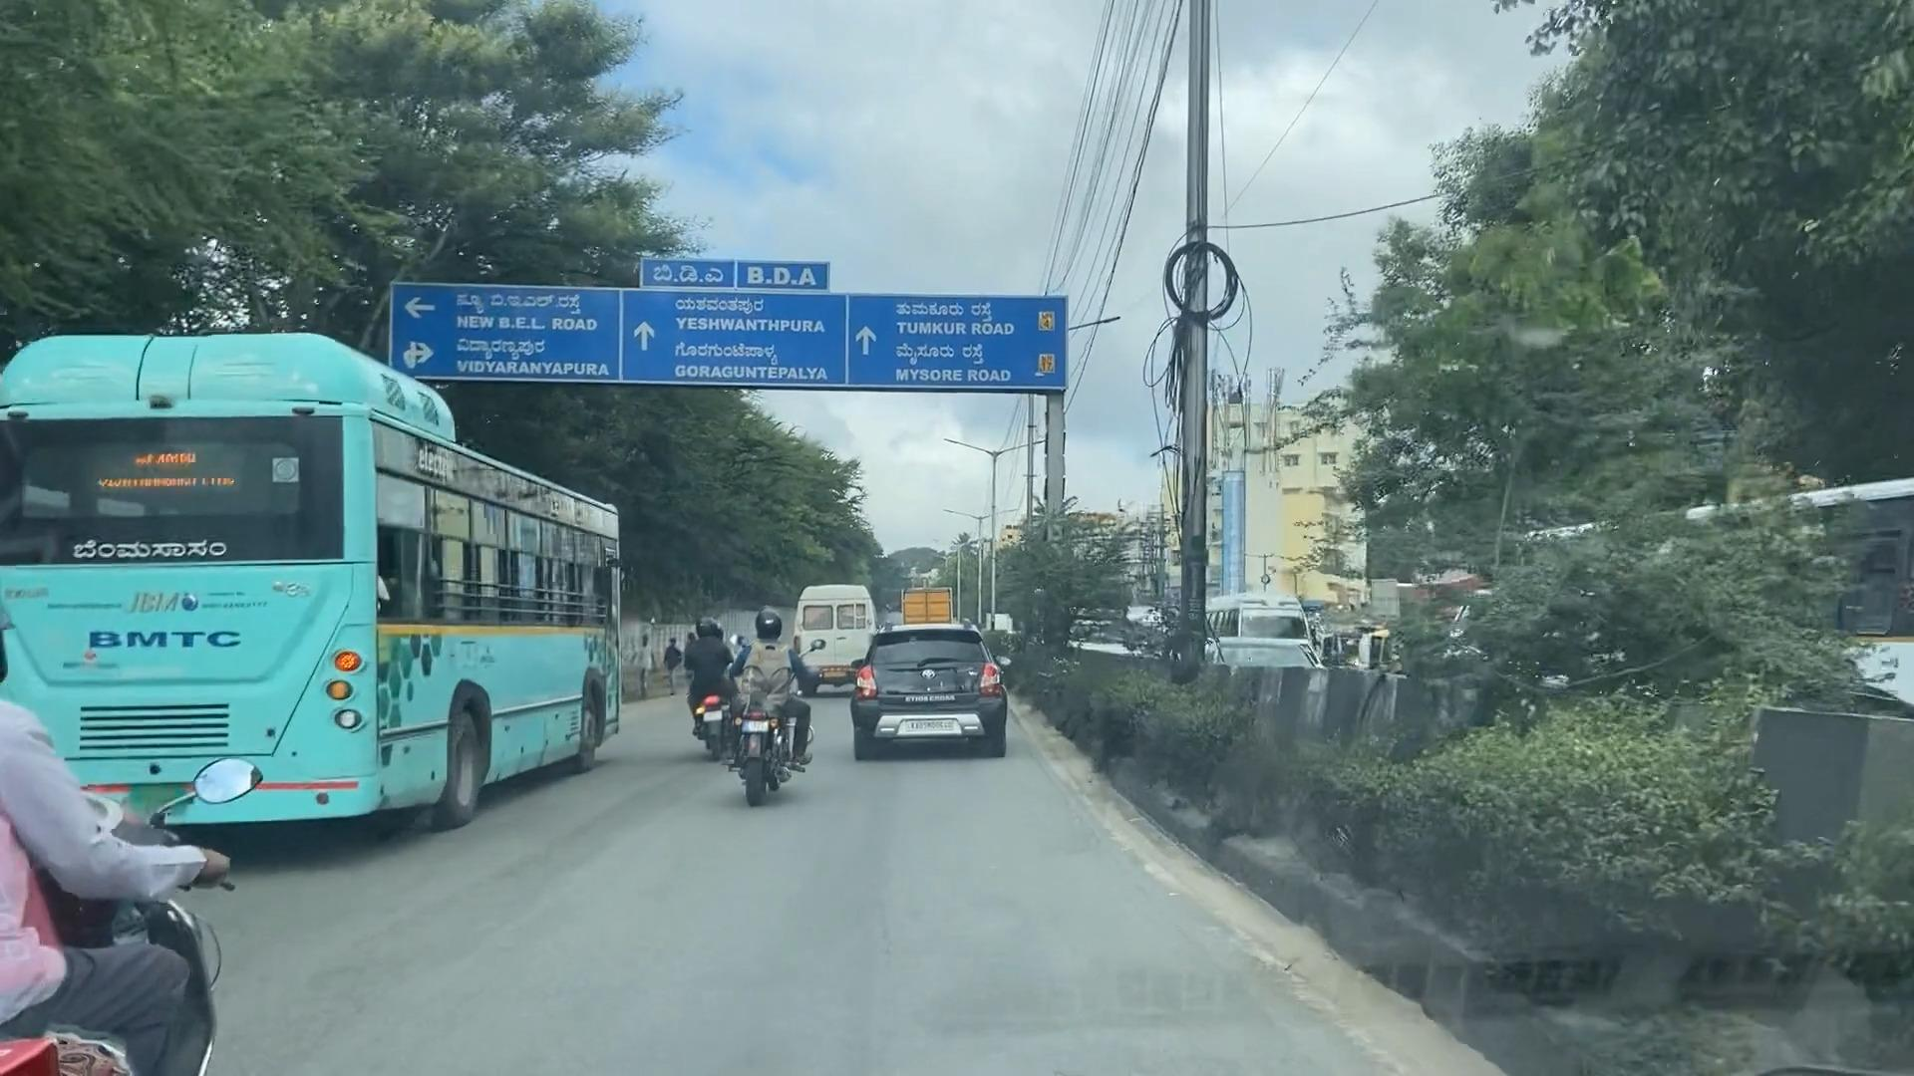
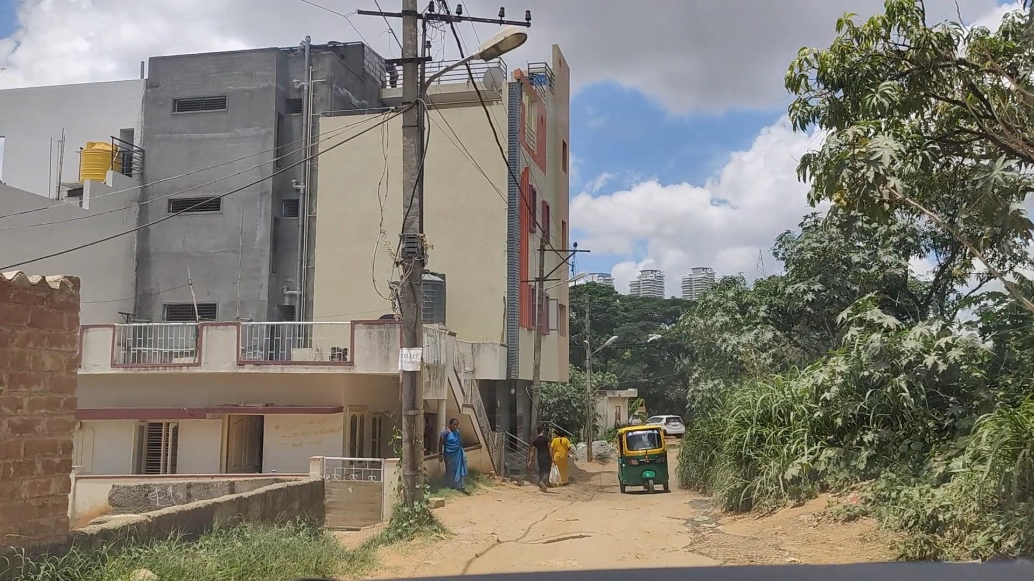
Problem Statement
High Cost Burden: Traditional ADAS platforms depend on expensive hardware sensors such as LiDAR and radar.
Lack of Persistence: Vision-only solutions perform isolated, frame-by-frame detection without maintaining target identities across consecutive frames.
Alert Instability: Fragmented detection leads to repeated, flickering driver warnings for the same obstacle.
Core Challenge: Develop a low-cost, real-time vision-only ADAS with object tracking tailored to chaotic Indian road conditions (narrow lanes, mixed traffic, animals, potholes) without extra hardware sensors.
Different Indian scenarios considered for training

Slide 3
Novelty
Indian Traffic-Aware Tracker: Optimized to handle unstructured lanes, dense occlusions, and non-standard trajectories in Indian traffic conditions.
Multi-Class Road Entity Coverage: Extends tracking beyond standard cars to 6 distinct road classes, including two-wheelers, auto-rickshaws, and pedestrians.
Collision Alert System: Trajectory-based velocity prediction with contextual priority logic for real-time collision warnings.
Unified Multi-Task Pipeline: Integrates detection, multi-class tracking, and alert generation into a single end-to-end architecture.
Indian Road Scenario Analysis: Comprehensive failure-mode analysis on RAD dataset tailored to edge dashcam hardware constraints.

Slide 4
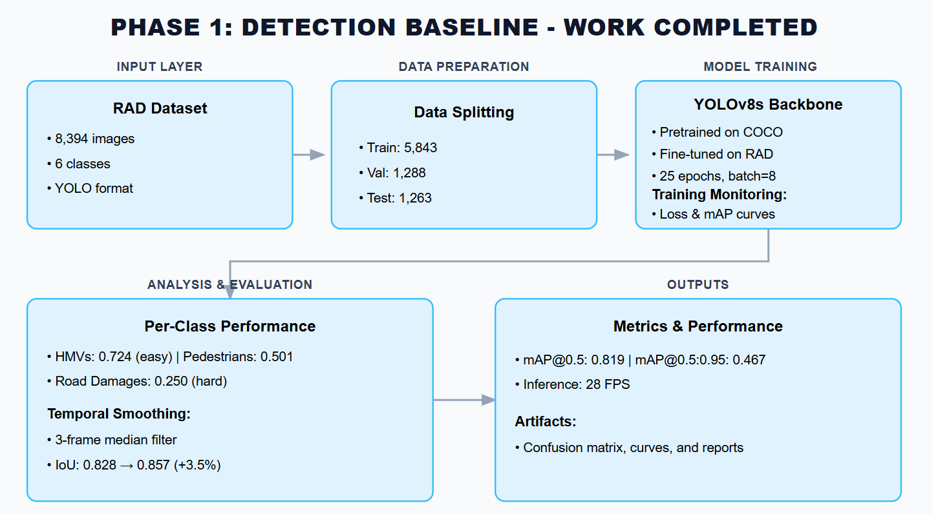
Work Done Until Now

Slide 5
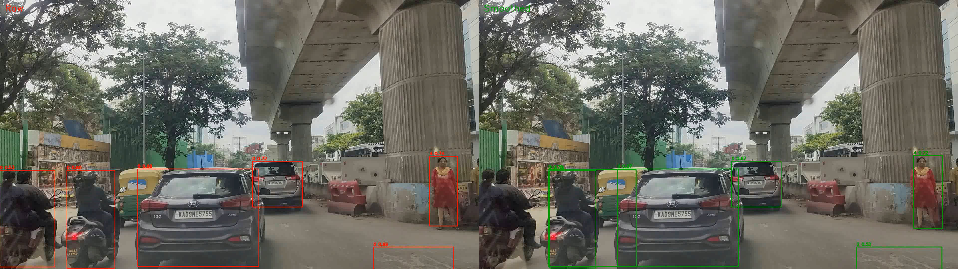
Results
Metric | Value
mAP@0.5 | 0.819
mAP@0.5:0.95 | 0.467
Inference Speed | 35.4 ms/frame
FPS (Frames Per Second) | 28.3 FPS
Model Size | 26.1 MB
Metric Improvement | Without smoothing | With smoothing
Frame-to-frame IoU | 0.828 | 0.857 (+3.5%)
Confidence Std Dev | 0.0644 | 0.0583 (-10%)
Class Consistency | 99.52% | 99.98% (+0.46%)
3-frame median temporal smoothing improves bounding box stability across consecutive video frames, reducing alert jitter and improving tracking persistence for Phase 2.

Slide 6
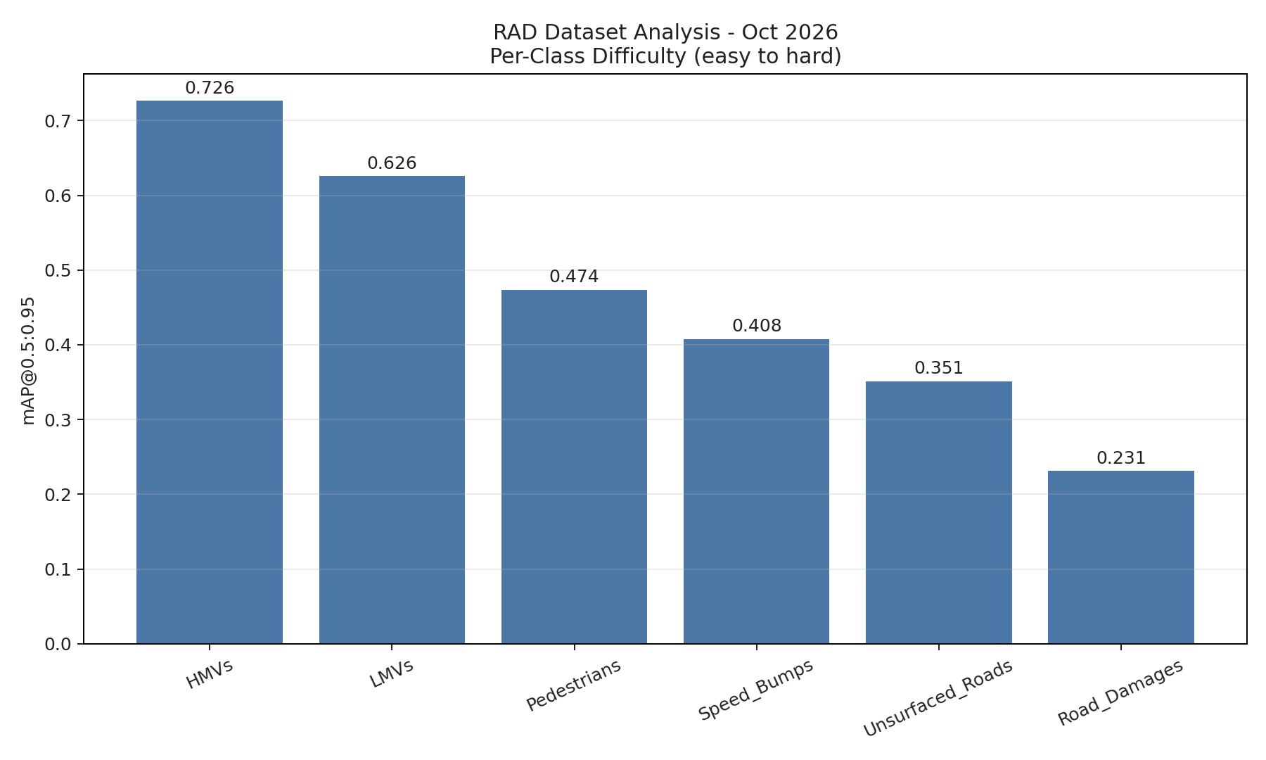
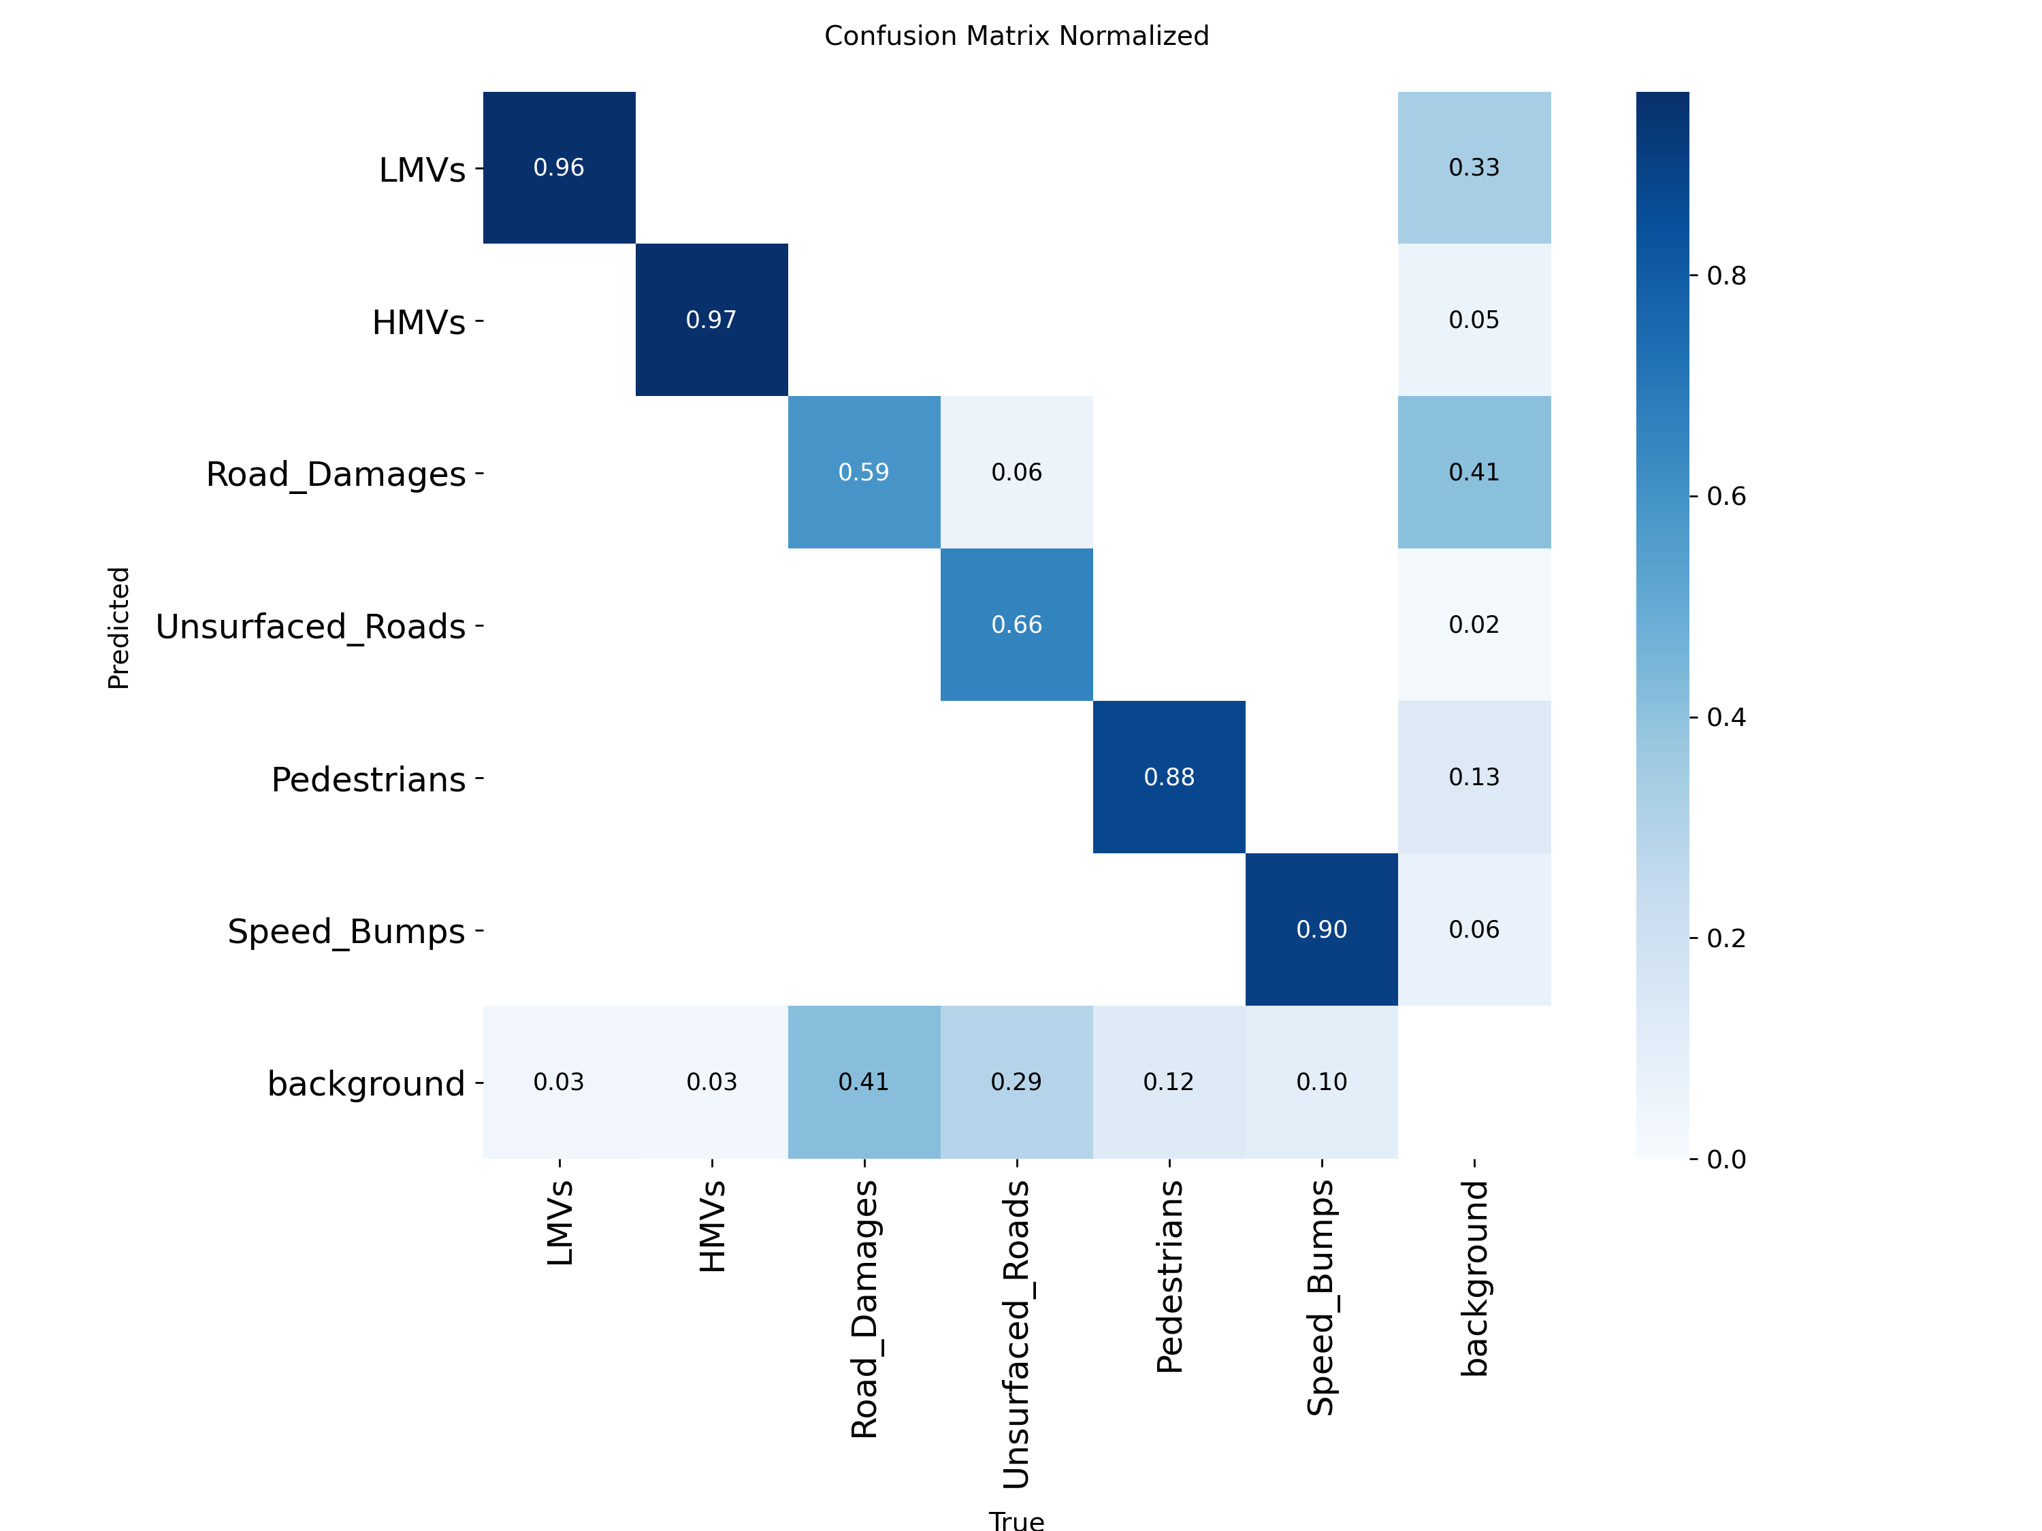
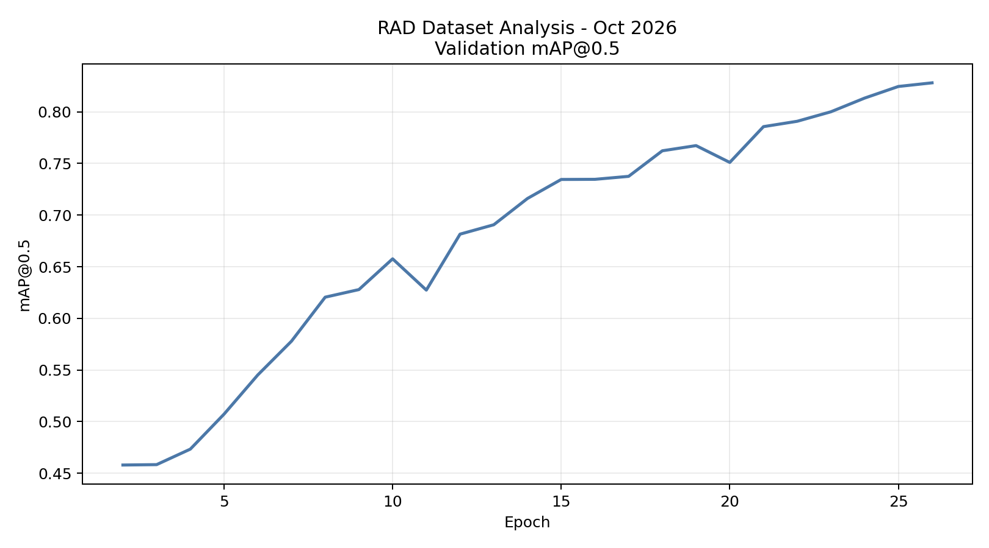
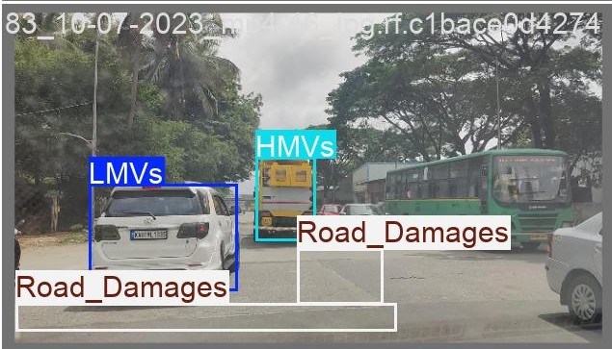
Results
Large objects (HMVs: 0.726 mAP) are detected reliably. Small/textured objects (Road Damages: 0.231, Speed Bumps: 0.408) are challenging.

Slide 7
Status of paper
Title of the paper:
Vision-Based Fog and Road Damage Detection for Intelligent Road Risk Assessment
Authors:1) Siddhant Jinturkar (BT23ECE066)
2) Akash Chincholkar (BT23ECE085)
Conference Name: Paradigm shift in Computer vision, Embedded systems, Machine learning, Signal processing (PCEMS), 2026
Conference Organizers: VNIT Nagpur and IEEE
Conference venue: VNIT Nagpur, Maharashtra (440010)
Conference edition: 5th International Conference
Conference Dates: 30-31st October, 2026
Status: Accepted

Slide 8
Works to be done with Timeline
Phase | Duration | Key Tasks | Deliverables
Phase 2: Object Tracking | October 2026 | • Implement ByteTrack • Implement DeepSORT • Evaluate on RAD videos • MOTA/MOTP benchmarking | • Tracker comparison table • Best tracker selected • Video tracking demo • Tracking metrics report
Phase 3: Hard Class Improvement | November – December 2026 | • Identify weak classes (potholes, bumps) • Enhanced data augmentation • Retrain detector • Per-class evaluation | • Improved mAP for hard objects • Class-wise metrics table • Augmentation techniques doc • Before/after comparison
Phase 4: Real-time Optimization | January 2027 | • Inference speed optimization • Model quantization • Edge device compatibility • Latency benchmarks | • Speed vs accuracy tradeoff • Deployment guide • Performance report • Optimization techniques

