Slide 1
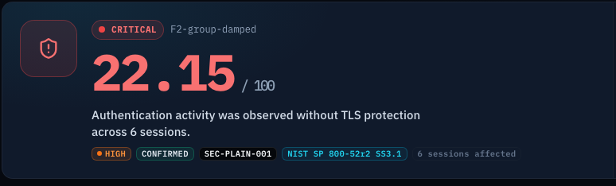
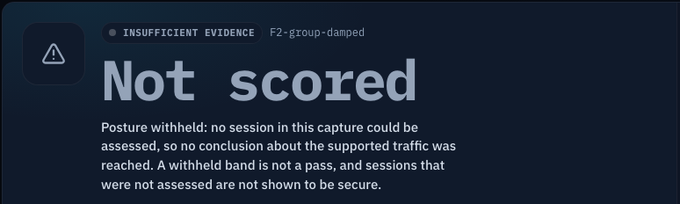
SEVA INNOVATION CHALLENGE 2026 • MAHARASHTRA ZONE • DRAFT
NyaySaakshya
Prototype screens (synthetic lab captures)
Evidence-first triage for email-traffic captures. It tells cyber-cell investigators what a capture does, and does not, prove.
Scored: every finding cites its evidence
Applicant / team: [APPLICANT NAME REQUIRED]
Application type: [INDIVIDUAL OR TEAM: REQUIRED]
Sector (as in portal): [SECTOR REQUIRED]
Contact: [EMAIL / MOBILE REQUIRED]
Stage: Working Prototype | Status: draft for applicant review
Withheld: no score when the capture cannot support one
DRAFT: orange [CAPITAL] text is missing applicant information and must be replaced before submission.
Notes:
Title and applicant snapshot. Placeholders in orange must be filled exactly as entered in the online application. Positioning sentence: NyaySaakshya turns supported email-traffic captures into evidence-linked forensic findings and reproducible reports, while explicitly identifying what the evidence cannot establish. Maturity: Working Prototype (see claim audit). Screens are synthetic lab captures from the working prototype; the applicant must approve them. No live demo URL is configured for this product.

Slide 2
2
The Problem
What real challenge in society, government service or industry are you solving?
What is the problem?
Who is affected, and where?
Investigators often hold a network capture that is cut short or encrypted. Reading more into it than it shows can produce a conclusion the evidence cannot support, and weaken a cyber-fraud case.
Cyber-cell and forensic investigators, and the supervisors who must defend a finding.
Proposed first users: a Maharashtra cyber cell or forensic lab. No partner has agreed yet.
17.82 lakh
cyber-fraud complaints handled through the national CFCFRMS (PIB, Oct 2025)
Evidence
Current gaps
Why it matters
Over 17.82 lakh cyber-fraud complaints handled through the national CFCFRMS (PIB, 7 Oct 2025; period not stated).
Wireshark decrypts TLS only if keys are supplied (Wireshark docs).
SMTP security "favors failing open" (Durumeric et al., IMC 2015).
Packet tools show packets; the analyst decides what is safe to conclude. For cut-off or encrypted captures that judgement is manual and hard to repeat or check.
Each case may rest on digital evidence that must be read carefully and defended. How many involve email is not published, so we make no claim about it.
Seva Innovation Challenge 2026 | Slide 2 of 6
Notes:
Statistic: PIB backgrounder 'Curbing Cyber Frauds in Digital India', 7 Oct 2025: through CFCFRMS financial institutions saved more than Rs 5,489 crore in over 17.82 lakh complaints (period not stated). Maharashtra press figures were excluded because the primary record could not be opened. Wireshark TLS wiki: decryption needs supplied secrets. Durumeric et al., ACM IMC 2015 abstract: SMTP policies favour failing open. The email share of fraud is unknown.

Slide 3
3
Our Solution & Innovation
What have you built or designed, how does it work, and what is new about it?
Our solution in brief
What makes it new?
NyaySaakshya reads a saved capture of email traffic and labels every fact: observed, inferred, unknown, ambiguous, incomplete or not observable. Each finding points to its packets. If the capture cannot support a score, it gives none.
 | Packet tools alone | NyaySaakshya
What you get | Packets, fields, logs | Cited findings with an evidence state
Cut-off or encrypted | Analyst decides | Marked incomplete or not observable
Repeatable? | Depends on the analyst | Same capture + software, same ID
Role | General analysis | Narrow: evidence-bounded triage
How it works
1
2
3
Input
›
Process
›
Output
Investigator uploads a saved email-traffic capture
SHA-256 fingerprint; sessions rebuilt; standards-based rules judge only what is visible
Cited findings, a score or "not scored", and a report
Complements packet tools; no speed or cost comparison is made.
Key USP
Every finding says how sure the evidence allows us to be, and which packets it rests on. When a capture is not enough, it says so instead of guessing.
Seva Innovation Challenge 2026 | Slide 3 of 6
Notes:
Workflow: Capture > Analysis > Evidence-linked findings > Posture assessment > Report. Six evidence states are defined in src/nyaysaakshya/evidence/states.py and produced by reproducible captures. Frame provenance: 13,822 cited frames, 0 stream mismatches. Score withheld when unsupported (scored=false, value=null). Same capture and software give the same assessment ID (98/98 controlled captures). Comparison column for packet tools is from their documentation (Wireshark TLS wiki; Zeek smtp.log shows a tls true/false field in the documented example); we did not benchmark them. No claim of being first or only.

Slide 4
4
Feasibility & Implementation
How ready is the solution, and what will it take to implement it on the ground?
Current stage: Working Prototype
✓
Idea
Proof of Concept
Working Prototype
Field Pilot
Ready to Deploy
Technology
Estimated cost
Timeline
Partners
Built and running: Python and TShark read the capture; React console; FastAPI service; SQLite storage.
1,521 automated tests; 98 controlled captures; no GPU needed.
Not yet built: login and roles, audit log, encrypted storage, backups, a database-concurrency fix.
Local synthetic demo: no extra cost.
Hosted prototype: free tiers wipe stored data when idle; Vercel Hobby is $0 for personal use only.
On-premise pilot: not priced. Needs vendor quotes for a server and encrypted storage, plus security engineering.
Estimates only, not quotations.
3 months: close the security gaps; tests pass.
6 months: technical pilot on synthetic or consented captures; collect baselines.
12 months: supervised single-unit pilot, only if a department agrees.
Proposed, not committed.
None yet. Seeking one cyber cell or forensic lab for a supervised pilot. No department has agreed.
[MENTOR / PARTNER: add only if confirmed]
Seva Innovation Challenge 2026 | Slide 4 of 6
Notes:
Stage: Working Prototype. Evidence: 1,521 tests collected and passing at baseline c0f77b9 (VALIDATION.md, DEPLOYMENT.md). Blockers are documented in DEPLOYMENT.md sections 6 and 17: no authentication or audit trail, SQLite shared-connection defect (TECH-DEBT #10), analysis time limit not enforced, no TLS or encryption at rest, no retention or backup. Costs: Vercel pricing page (Hobby $0 non-commercial); Render docs (free instances spin down and wipe files). Render paid prices and on-premise costs were not verified, so no totals are stated. Milestones are proposed, not commitments.

Slide 5
5
Impact & Scalability
What change will your solution create, and how can it grow beyond the first location?
1 pilot (target)
To be measured
Not claimed
Beneficiaries reached
Saving in cost / time
Jobs or livelihoods
Target: one supervised cyber-cell pilot in year one. None reached yet; no partner yet.
Pilot to compare time to a first assessment and to a finished report with current practice. No baseline yet.
No evidence of job creation, so none is claimed.
Social impact
Sustainability
Scale-up plan
Helps investigators avoid unsupported conclusions, supporting fairer and stronger cyber-fraud cases.
Links to SDG 16 (institutions that combat crime, target 16.a).
Social impact is not yet measured.
No revenue model is decided. The stack is open source; licences are to be confirmed.
Option to discuss with a partner: department budget or grant.
[SUSTAINABILITY MODEL: applicant to confirm]
Demo, then close the security gaps, then one supervised cyber-cell pilot, then further units.
Each unit would run locally so evidence stays in the unit; central administration only.
Proposed; nothing is deployed.
Pilot measures: time to first assessment, time to report, share of findings with usable provenance, correct handling of unresolved evidence, reproducibility, supervisor confidence.
Seva Innovation Challenge 2026 | Slide 5 of 6
Notes:
No beneficiary, saving or jobs figure is claimed: there is no measured baseline. Targets and measurement methods are from SUBMISSION_EVIDENCE.md section 9. SDG 16 wording (target 16.a: strengthen national institutions to prevent violence and combat terrorism and crime) from the UN SDG 16 page. Technical validation (not social impact): 98 controlled captures, deterministic 98/98, 13,822 cited frames with 0 mismatches.

Slide 6
6
Team/Individual & Support Required
Who is behind the idea, and what help do you need from the Challenge?
Photo
[NAME 1 REQUIRED]
Photo
[NAME 2 REQUIRED]
Support we are seeking
[ROLE]
[ROLE]
[QUALIFICATION]
[QUALIFICATION]
✓
Mentorship & technical guidance (security)
✓
Pilot with a government department
✓
Funding / grant support (secure deployment)
Photo
[NAME 3 REQUIRED]
Photo
[NAME 4 REQUIRED]
[ROLE]
[ROLE]
Incubation & workspace
[QUALIFICATION]
[QUALIFICATION]
✓
Testing, certification or IP support
With security mentorship and one supervised pilot, we can move from a tested prototype to a measured trial of whether NyaySaakshya helps investigators avoid unsupported conclusions.
[MENTOR / FACULTY GUIDE: name, designation, or delete this line]
Thank you | [CONTACT EMAIL / MOBILE REQUIRED]
Seva Innovation Challenge 2026 | Slide 6 of 6
Notes:
Team details, mentor and contact information must come from the applicant; none is invented. Support ticked (orange): mentorship and technical guidance, a supervised pilot introduction (no department has agreed), funding for secure deployment and testing, and testing/IP guidance. Incubation and workspace left unticked; the applicant may change it. Delete unused team cards before submission.

